Slide 1
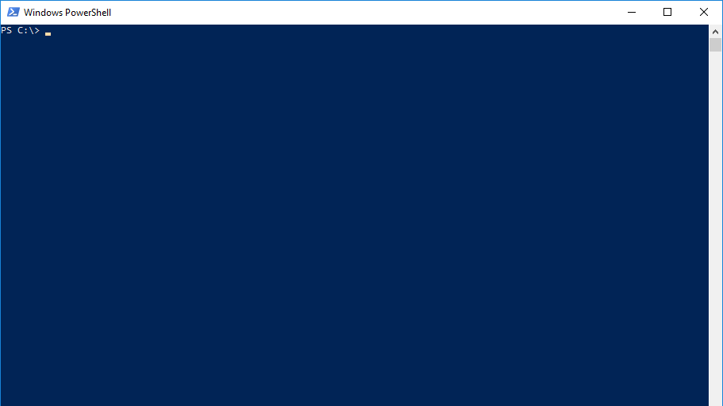
Datastructures JSON / HTML / XML
By Christoph Ruf

Slide 2
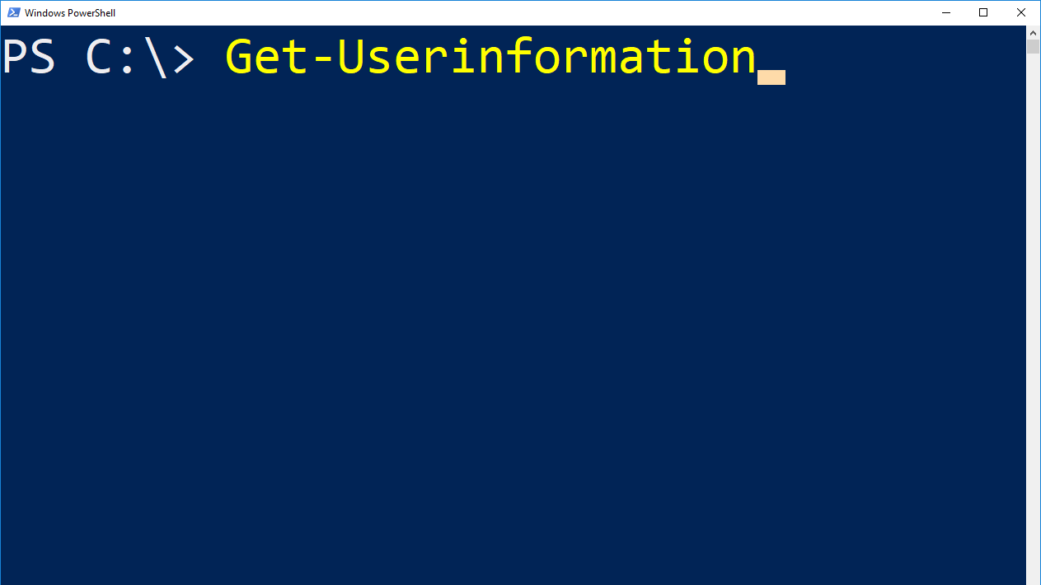
Name: Christoph Ruf
Job: SCCM Specialist, System- and Taskautomation, Client Management, Client Security
Employer: Hirschvogel Holding GmbH

Slide 3
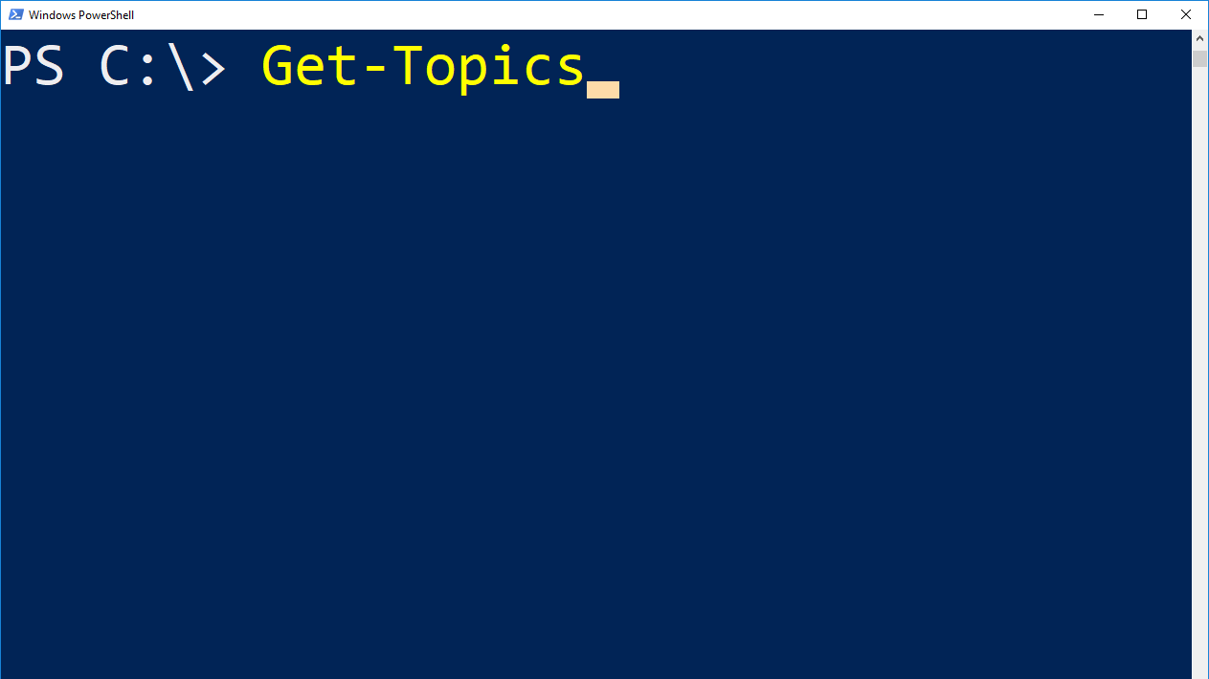
XML
HTML
JSON

Slide 4
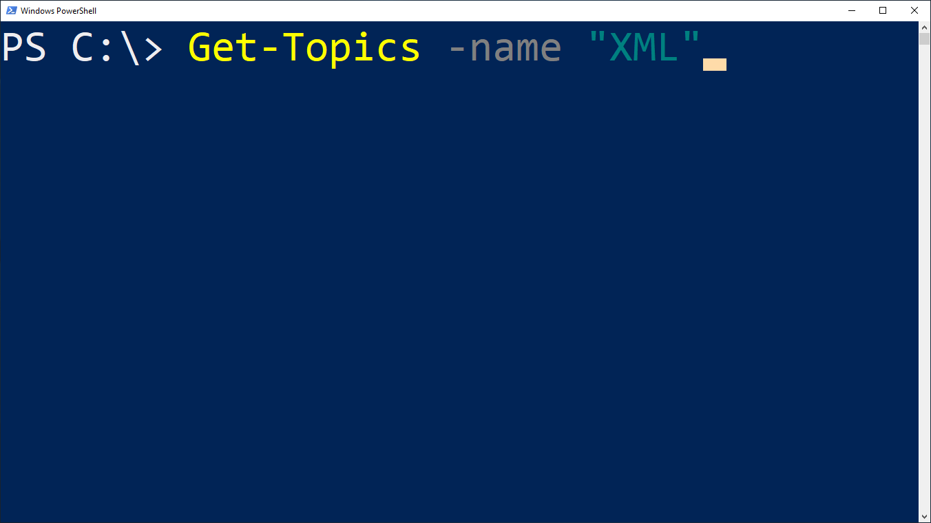
XML –eq Extensible Markup Language
Like HTML
<?xml version="1.0" encoding="UTF-8"?>
<doc xmlns="http://de.wikipedia.org/wiki/XML_Schema#Beispiel">
<head>
<title>This is the titel</title>
</head>
<body>This is the Text.</body>
</doc>

Slide 5
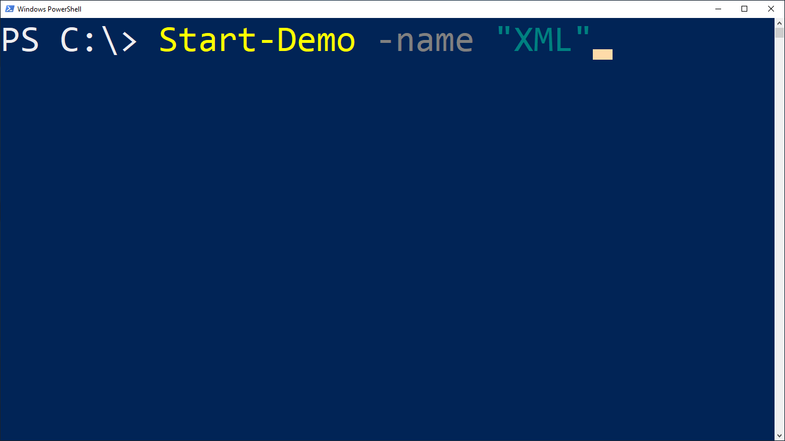
Starting Demo….
………
…….
….
Goto Demo XML

Slide 6

Automatically created HTML Files with Powershell
ConvertTo-Html

Slide 7
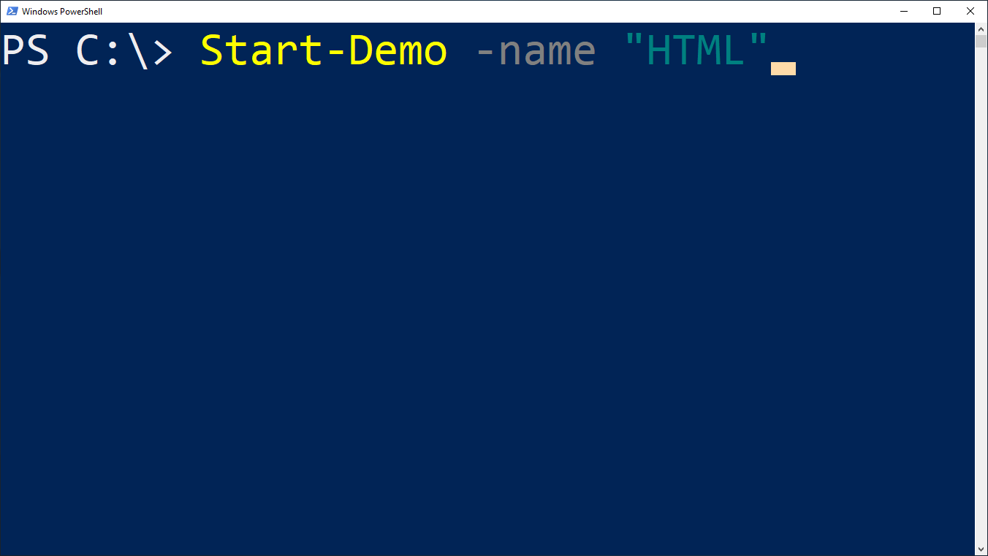
Starting Demo….
………
…….
….
Goto Demo HTML

Slide 8
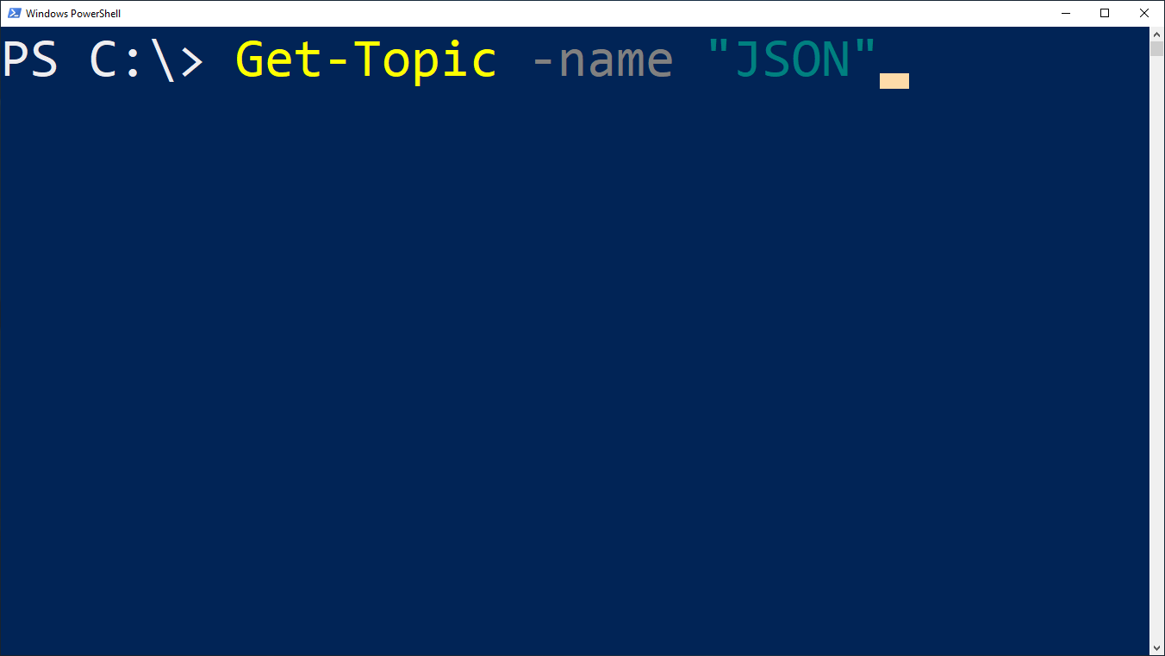
JSON –eq JavaScript Object Notation
{
"name": "Christoph Ruf",
"age": 30,
"skills": [
"SCCM",
"C#",
"Powershell"
]
}

Slide 9

Starting Demo….
………
…….
….
Goto Demo JSON

Slide 10
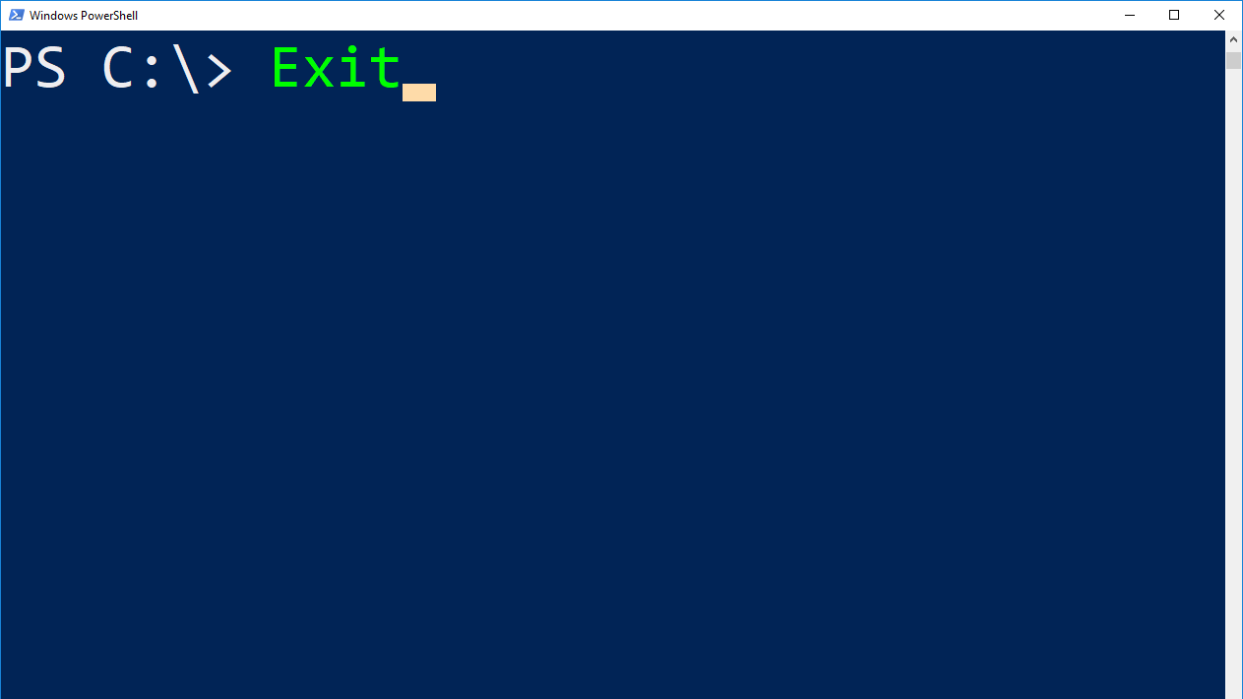
$Questions = Get-Questions -all
If (($Questions).count –gt 0) { $Questions }
Else { Write-Host "Thank you for listening"; Exit; }

