Slide 1
Mind Flow
Automated Educational Concept Mapping
Jaakko Rajala
Samith Binda Pantho
COMP.CS.530-2025-2026-2
Tampere University
23 March 2026
▣ AI Assessment
● Semantic Matching
▲ Fast Feedback

Slide 2

Problem & Solution
⚠
Problem
Manual mind flow evaluation is slow, subjective, and hard to scale.
⏱
Why it matters
Students wait too long for feedback while instructors face heavy grading load.
✓
Solution
The system extracts core concepts and evaluates mind maps using semantic matching and hybrid scoring.

Slide 3

Demo
⬆
Upload
A document is added and processed in the backend.
🧩
Build
Users create nodes with drag-and-drop and automatic layout.
★
Evaluate
The platform returns matched topics, score, and feedback.

Slide 4

Technical Implementation
⚙
Stack
React
TypeScript
Vite
ReactFlow
Zustand
ELK
FastAPI
PostgreSQL + pgvector
Ollama
Unsloth.

Slide 5
Challenges & Solution
⚠
Long Context Errors
Retrieval-Augmented Generation (RAG) implemented for fetching only relevant information, not the entire document.
Topic Ambiguity
Implemented semantic matching using Sentence-Transformers and cosine similarity.
⚠
⚠
Colab Timeouts
Implemented checkpoint saving system to resume training across sessions.

Slide 6

Impact & Future Scope
?
Who benefits?
Students get fast feedback and teachers get scalable assessment.
↗
?
Applications?
Integrate with digital education systems (e.g.: PLUSSA).
↗

Slide 7
Impact & Future Scope
?
Next steps?
Better semantic search
Graph-aware evaluation
Continuous learning
↗

Slide 8
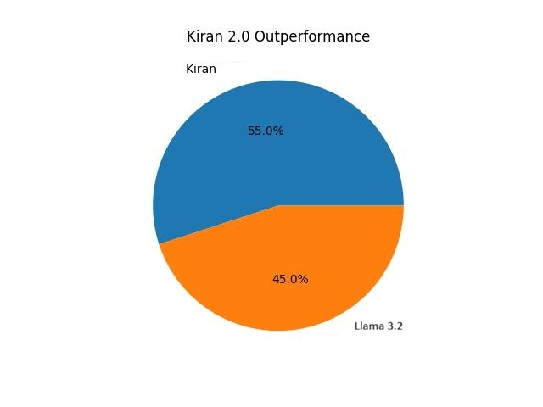
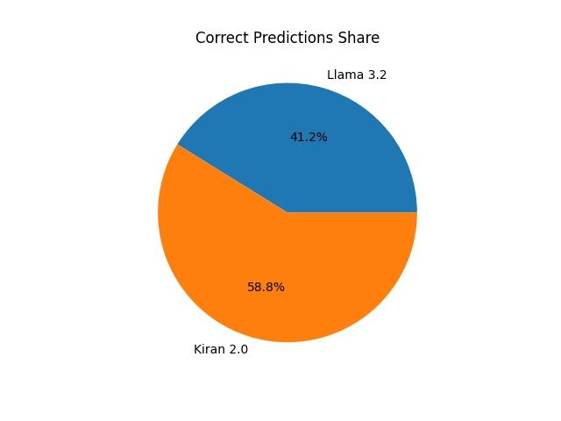
Conclusion
◆
Takeaway
The project makes mind map assessment more objective and efficient.
◎
Why it matters
It combines RAG, fine-tuning, and hybrid scoring into one practical platform and outperforms Llama3.2.

Slide 9

Q&A
?
Q&A
Open for questions.

