Slide 1
AMD ShadowFX
Alex Kharlamov

Slide 2
Table of contents
ShadowFX Techniques
ShadowFX Options
Integration guide

Slide 3
ShadowFX Techniques
Trivia AND algorithms description

Slide 4
ShadowFX Techniques
ShadowFX implements highly optimized GCN shadow filtering
  A full screen pass that returns a deferred shadow mask
Currently ShadowFX supports the following filtering kernels:
  Uniform Smooth Shadows (http://developer.amd.com/wordpress/media/2012/10/Isidoro-ShadowMapping.pdf)
  Contact Hardening Shadows (http://amd-dev.wpengine.netdna-cdn.com/wordpress/media/2012/10/TakingAdvantageofDirect3D10.pps)
  Shader permutations for different filter sizes: 7x7, 9x9, 11x11, 13x13, 15x15
ShadowFX sample can also serve as a sandbox for shadow filtering technique development and comparison

Slide 5


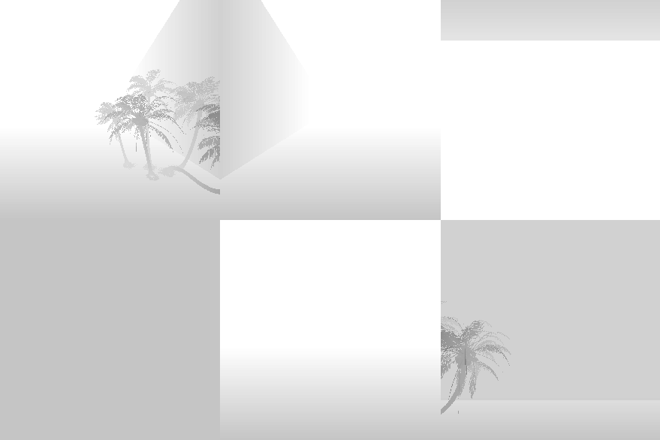
ShadowFX Techniques
ShadowFX implements a deferred shadow mask filtering
Full screen pass
Viewer Depth
Shadow Map[s]

Slide 6
ShadowFX OPTIONS

Slide 7
ShadowFX Options
Shader Permutations
Can process up to 6 shadow maps per full screen pass
Shadow maps can be arranged in
  Texture Atlas
    No UV clamping is done to avoid filtering across different atlas regions
  Texture Array
Supports different shadow casting types:
  Union – a set of shadow casters which contribute to the same deferred shadow mask
    Filtering shader will process all active lights (and potentially execute filtering up to 6 times)
    Filtered results are blended with a MIN function
  Cascade – a set of shadow maps that form different LOD levels of a cascaded shadow map
    Filtering shader will early out after it finds the nearest cascade that contains the filtered point
  Cube – a set of shadow maps that form different faces of a cube shadow map
    Filtering shader will calculate the exact shadow map face and only execute filtering once

Slide 8
ShadowFX Options
The world space position of a shadow’ed pixel can be used for light transformation directly or:
  Displaced by a normal fetched form Gbuffer
  Displaced by a normal calculated from depth buffer
Shadow filtering texture fetch instructions:
  Gather4
    AMD preferred option that results in better performance
  PCF
Application can setup up stencil buffer and stencil test
  Stencil reduces full screen pass to only execute in areas that overlap with shadow caster volume
Most of the options are orthogonal to each other
  A high number of shader permutations

Slide 9
ShadowFX Technique
Integration guide

Slide 10
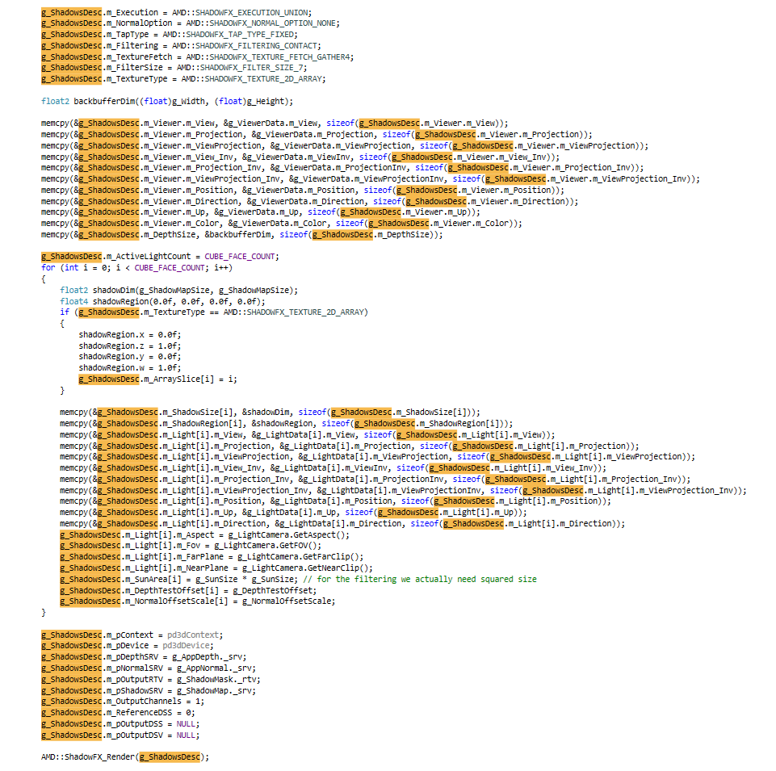

Integration
Minimum amount of code for initial integration
Declare, initialize
Setup viewer and light cameras, d3d11 resources
Release

Slide 11
Disclaimer & Attribution
The information presented in this document is for informational purposes only and may contain technical inaccuracies, omissions and typographical errors.
The information contained herein is subject to change and may be rendered inaccurate for many reasons, including but not limited to product and roadmap changes, component and motherboard version changes, new model and/or product releases, product differences between differing manufacturers, software changes, BIOS flashes, firmware upgrades, or the like. AMD assumes no obligation to update or otherwise correct or revise this information. However, AMD reserves the right to revise this information and to make changes from time to time to the content hereof without obligation of AMD to notify any person of such revisions or changes.
AMD MAKES NO REPRESENTATIONS OR WARRANTIES WITH RESPECT TO THE CONTENTS HEREOF AND ASSUMES NO RESPONSIBILITY FOR ANY INACCURACIES, ERRORS OR OMISSIONS THAT MAY APPEAR IN THIS INFORMATION.
AMD SPECIFICALLY DISCLAIMS ANY IMPLIED WARRANTIES OF MERCHANTABILITY OR FITNESS FOR ANY PARTICULAR PURPOSE. IN NO EVENT WILL AMD BE LIABLE TO ANY PERSON FOR ANY DIRECT, INDIRECT, SPECIAL OR OTHER CONSEQUENTIAL DAMAGES ARISING FROM THE USE OF ANY INFORMATION CONTAINED HEREIN, EVEN IF AMD IS EXPRESSLY ADVISED OF THE POSSIBILITY OF SUCH DAMAGES.
ATTRIBUTION
© 2013 Advanced Micro Devices, Inc. All rights reserved. AMD, the AMD Arrow logo and combinations thereof are trademarks of Advanced Micro Devices, Inc. in the United States and/or other jurisdictions. Other names are for informational purposes only and may be trademarks of their respective owners.

