Slide 1
Depth Bounds Test 11
May 2013
Bill Bilodeau
Developer Relations Engineer, AMD

Slide 2
Depth Bounds Test Overview
Hardware feature that allows applications to specify a depth range for rendering
  Pixels that are outside this range are not rendered
The depth bounds test uses the depth buffer depth, not the fragment depth
For techniques like deferred lighting, performance can be gained with depth bounds test
  Performance gains are from not executing the lighting shader for pixels outside the range of the light

Slide 3
How Depth Bounds Test Works
Assume the blue objects are rendered first
  Their depth values are stored in the depth buffer
x
z
Depth Bounds

Slide 4
How Depth Bounds Test Works
Red and green objects are drawn later
  With depth bounds test enabled
x
z
Depth Bounds

Slide 5
How Depth Bounds Test Works
Only the green object is visible, since locations where the depth buffer value is outside the depth bounds are culled
x
z
Depth Bounds

Slide 6
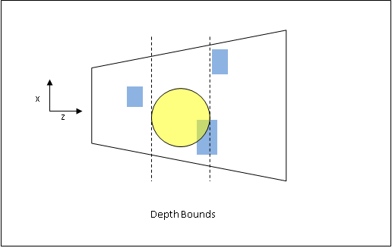
Depth Bound Test with Deferred Rendering
Used during the shading pass to avoid executing the shader for pixels outside the depth range of the light

Slide 7
Render Passes
G-Buffer Pass
  Render all of the geometry into the g-buffer
Shading Pass
  Enable the depth bounds test with range equal to the diameter of the light
  Use the depth buffer values from the G-Buffer pass
  Render each light as a quad
      width and height of the quad = screen space diameter of light range
  Disable the depth bounds test

Slide 8
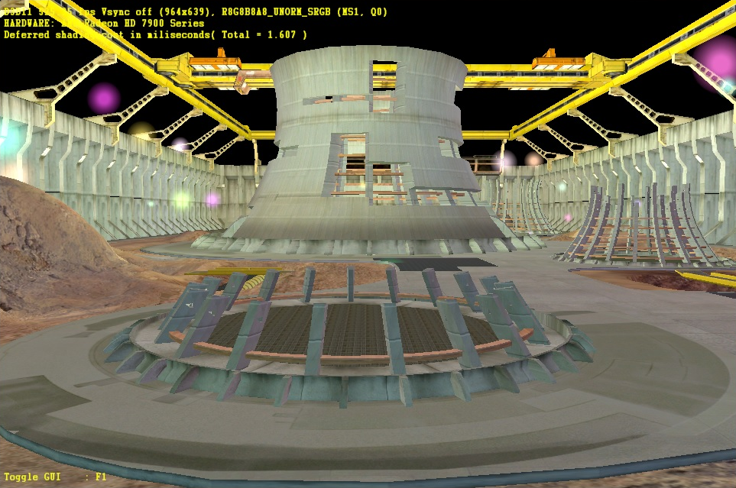
Results
50 randomly placed point lights with DBT enabled

Slide 9
Performance Comparison
Depth Bounds Test enabled vs Depth Bounds Test disabled
Radeon HD7970 @ 2560x1600

Slide 10
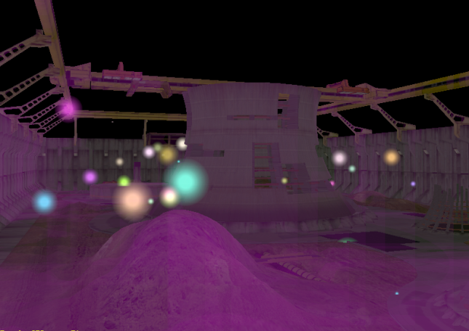
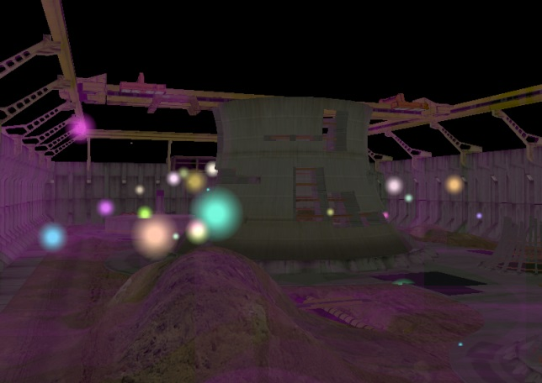
Discarded Pixels
Visual representation of pixels that needed to be “discard()-ed” in the pixel shader (magenta colored pixels) because they were outside the range of the light
  DBT is faster because fewer pixel shader instructions are executed
Depth Bounds Test Disabled
Depth Bounds Test Enabled

Slide 11
Questions ?
Email: bill.bilodeau@amd.com

