Slide 1
Super Sample Anti-Aliasing
(SSAA)
Gareth Thomas
Developer Relations Engineer, AMD

Slide 2
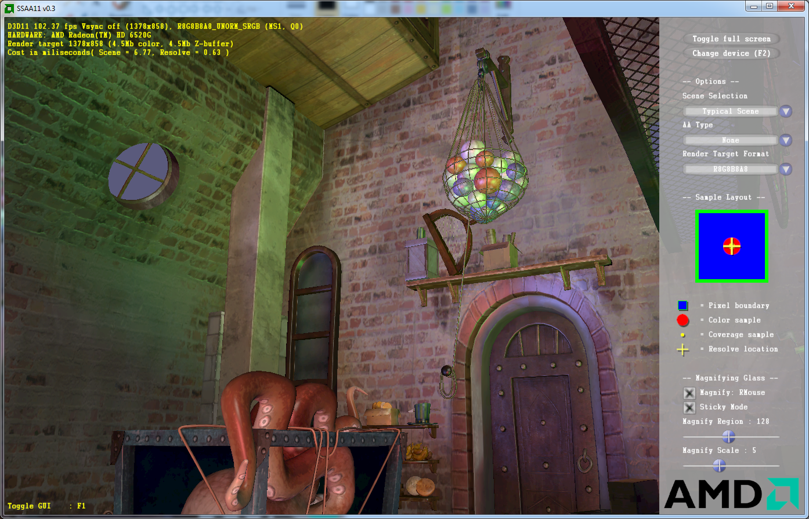
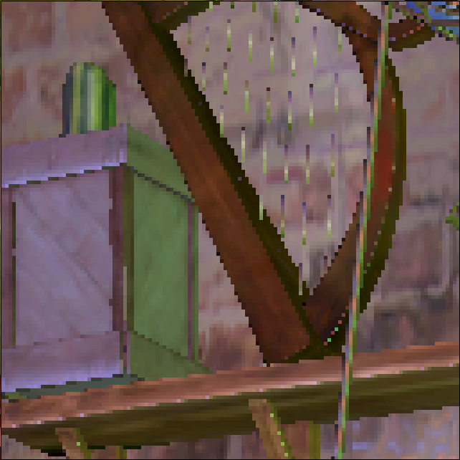
SSAA11 Demo
Choose your scene
Render target format
Timing information
Antialiasing mode
VRAM usage
Visualization
Magnifying Glass

Slide 3
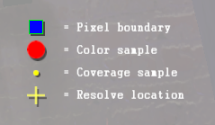
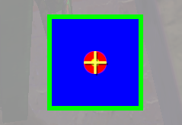
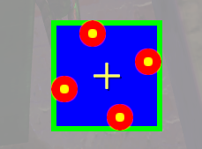
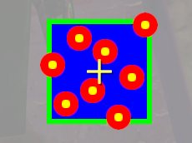
Multisample Anti-Aliasing
Render to nxm times larger surface
Multiple samples per pixel
Resolved to one pixel using ResolveSubresource()
Depth test executed per sample
Pixel shader runs ONCE!
Raster test on rotated grid pattern
No AA
4x MSAA
8x MSAA

Slide 4
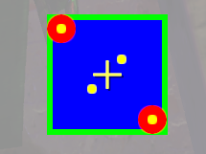
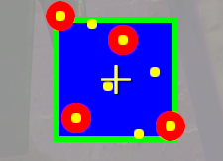
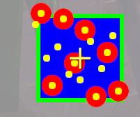
Enhanced Quality Anti-Aliasing
Color/Depth/Stencil performed just like MSAA
Depth tests performed on additional coverage samples
Samples index into list of color samples
No extra memory overhead
Much faster than equivalent MSAA level
Available on Northern Islands architecture onwards
Check VendorId and CheckMultisampleQualityLevels()
2f4x EQAA
4f8x EQAA
8f16x EQAA

Slide 5
Supersample Anti-Aliasing
Render to nxm times larger surface
For 4xSSAA: 2x2 block of samples
Resolved to one pixel using full screen quad and simple pixel shader
Depth test executed per sample
Pixel shader executed per sample

Slide 6
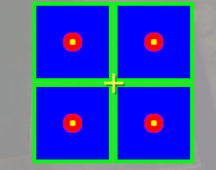
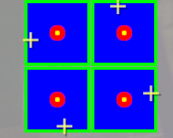
Implementation Options
4xSSAA
  2x2 block of samples
  One bilinear read to resolve
4xSSAA Rotated Grid Resolve
  2x2 block of samples
  Four bilinear reads in rotated grid pattern
4x SSAA
4x SSAA with rotated grid resolve

Slide 7
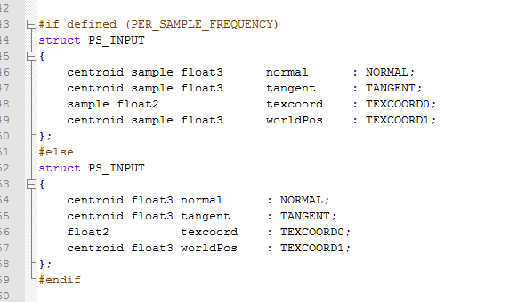
Implementation Options (continued…)
4xSSAA sample frequency
  4 samples per pixel (using MSAA buffer)
  Use sample modifier in HLSL to run pixel shader at sample frequency
  Standard MSAA resolve using ResolveSubresource()

Slide 8
Sample Frequency SSAA Considerations
Rendering at 4xSSAA textures looks sharper than 4xSSAA sample frequency, why?
The hardware evaluates quad derivatives per 2x2 pixel block
So at 4xSSAA SF the mip lods are calculated to be same values as 4xMSAA
Bias mip lod to -1 for 4xSSAA SF and -1.5 for 8x
Use D3D11_SAMPLER_DESC::MipLODBias

Slide 9

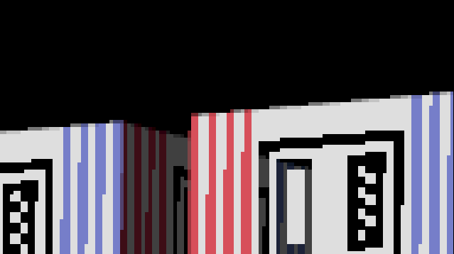
Image Quality
No MSAA
4x MSAA
Polygon edge AA
No shader AA
No alpha testing AA

Slide 10
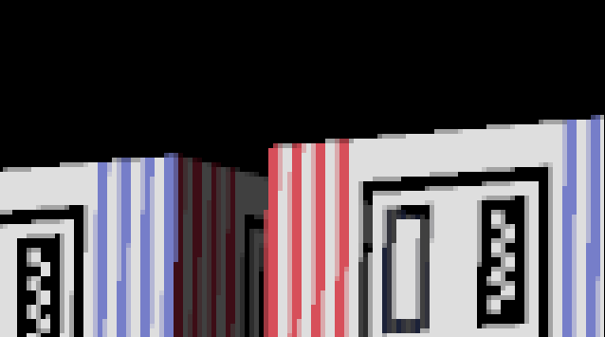
Image Quality
4x MSAA
4x SSAA
Shader AA
Inferior edge AA
Alpha testing AA

Slide 11

Image Quality
4x SSAA
Rotated Grid Resolve 4x SSAA
Smoother overall
Blurrier

Slide 12

Image Quality
4x SSAA
Per Sample 4x SSAA
Better edge AA
Better shader AA
Better alpha test AA

Slide 13
Performance
Technique | Scene Cost (ms) | Resolve Cost (ms) | Total Frame Time (fps)
None | 1.3 | 0.15 | 529
4x MSAA | 1.39 | 0.35 | 463
4x SSAA | 4.26 | 0.4 | 192
4x SSAA Sample Freq. | 4.34 | 0.79 | 177
AMD Radeon 7970GHz Edition
AMD SSAA11 Demo
2560x1600 R8G8B8A8 render target

Slide 14
Other Considerations
Merge SSAA resolve into first stage of post process
SSAA is easier/quicker to implement for deferred renderers

Slide 15
Conclusions
SSAA is a viable alternative to MSAA
Definite improvement in image quality over standard MSAA
Free if you are CPU bound
Easy way to future proof your game

Slide 16
Trademark Attribution
AMD, the AMD Arrow logo and combinations thereof are trademarks of Advanced Micro Devices, Inc. in the United States and/or other jurisdictions. Other names used in this presentation are for identification purposes only and may be trademarks of their respective owners.
©2008 Advanced Micro Devices, Inc. All rights reserved.

