Slide 1
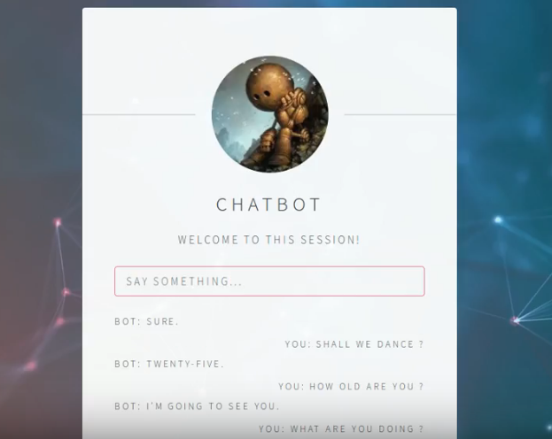
Non-Deterministic Open-Domain Chatbot

Slide 2
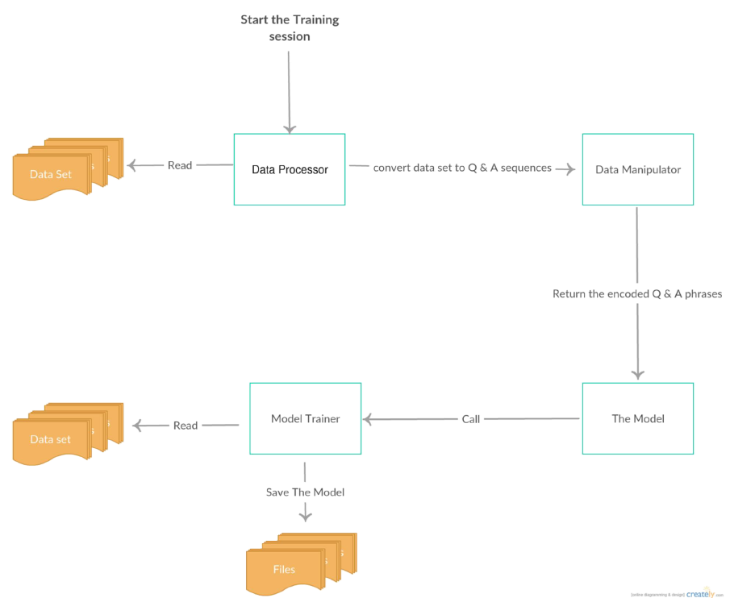
Training Structure:
The architecture flow is that, the data preprocessor reads the dataset corpuses, and
converts them into Question and Answer style, so it will be able to use it later as
training instances, and then it passes these instances to the data manipulator which
encodes these sequences using the word embeddings made by Google in 2015. The
model then call the training module to train itself on the encoded dataset, and try to
adapt the weights of the model in order to make it better and more accurate in the generalization phase, then it saves the weights in a file to read them back while
testing.

Slide 3
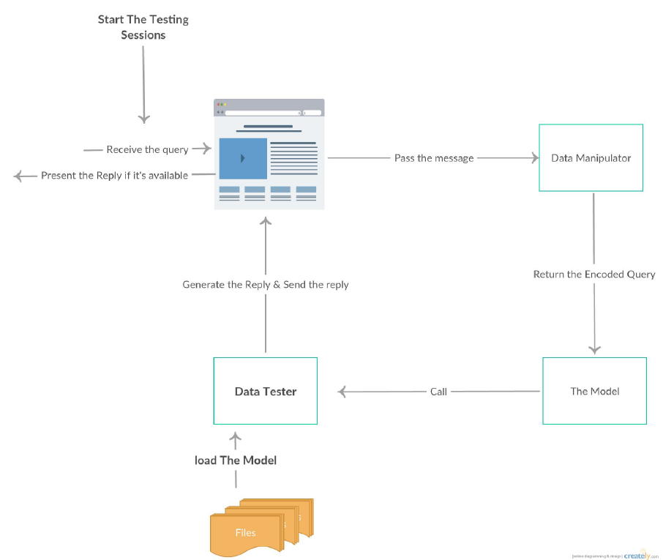
Testing Structure:
The architecture flow is that, the website (the UI) receives a query (after logging in
and so), the interface send this query to the data manipulator to encode it, then it
send this encoded query to the model which calls the tester, the tester loads the
saved model which is the weights of the model, and use these weights to generate
the answer for this query, then it decodes the answer into words.

Slide 4
Feature Selection:
Data source:
Cornell Movie-Dialogs Corpus:
220,579 conversational exchanges between 10,292 pairs of movie characters
OpenSubtitles dataset:
total number of sentence fragments: 3.35G
And more
N-grams: used to find probability of sentence S
Word Classes: similar words appear in similar context
Bag of Words: word frequency vector
Word2Vec: similar words have close word vector
Notes:
Add dataset source

Slide 5
Context Recognition:
Choosing sentence headings: POS, dependency graph, NER, 4 steps of IE
Finding similarities:
-Word embedding
-Word alignment
-Word vector
-Continuous bag of words: predict certain word
-Skip gram: predict word neighbors

Slide 6
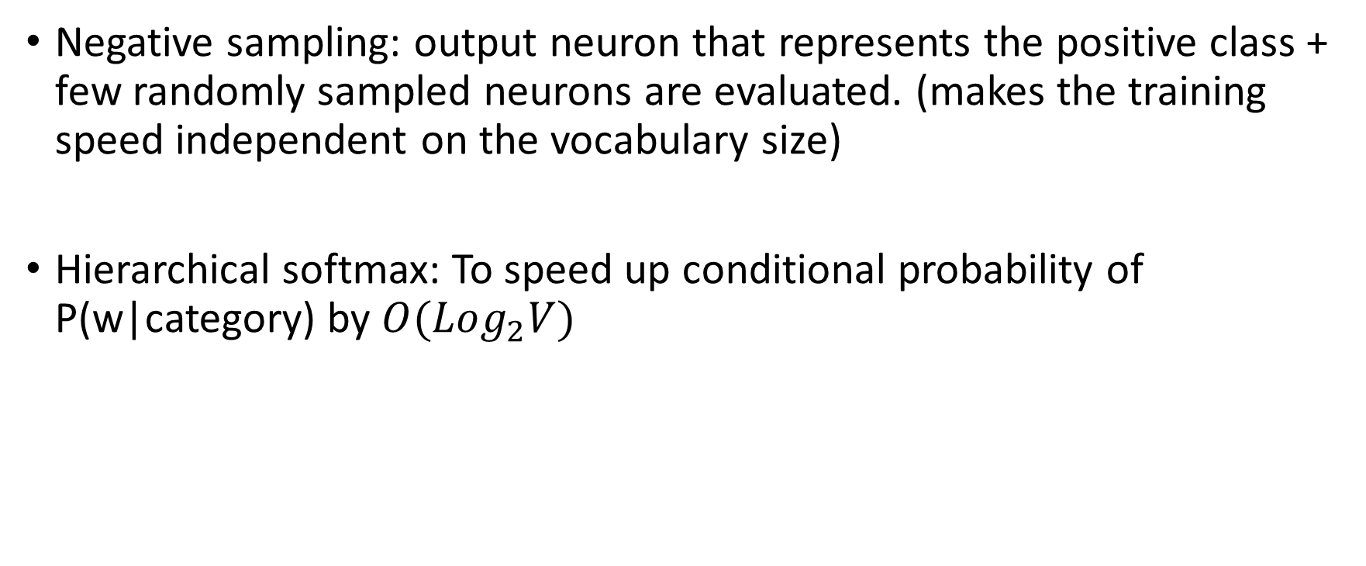
Word vector training:
Negative sampling: output neuron that represents the positive class + few randomly sampled neurons are evaluated. (makes the training speed independent on the vocabulary size)
Hierarchical softmax: To speed up conditional probability of P(w|category) by $O(Log_{2}V)$

Slide 7
Testing:
Granular Conversation Test:
-Semantics: “Does the response make sense by itself?”
-Structure: “Is it understandable and does it follows a structure a human
would use?”
-Context: “Does the response make sense in the context?”
-Feeling: “Does the response feel human?”
0/1 scoring and takes average of all four components

Slide 8
Challenges:
Implementation is Q&A based
Q&A answering system is deterministic
Each Q&A are independent of each other

Slide 9
Our approach:
Transfer learning on targeted domain: achieve better performance on target domain while benefiting from source domain (dialog space is both source and target domain)
Intent based dialog management using LSTM
Interlocutor tracking system

Slide 10
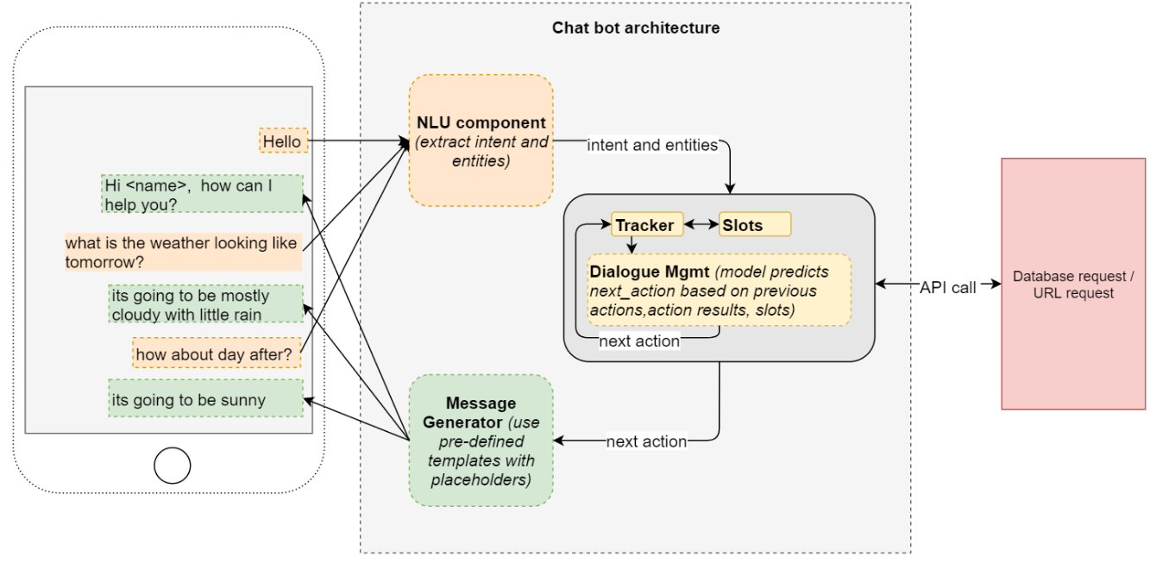
Intent based dialog management using LSTM

Slide 11
B/W Image Color Restoration with Super Resolution

Slide 12
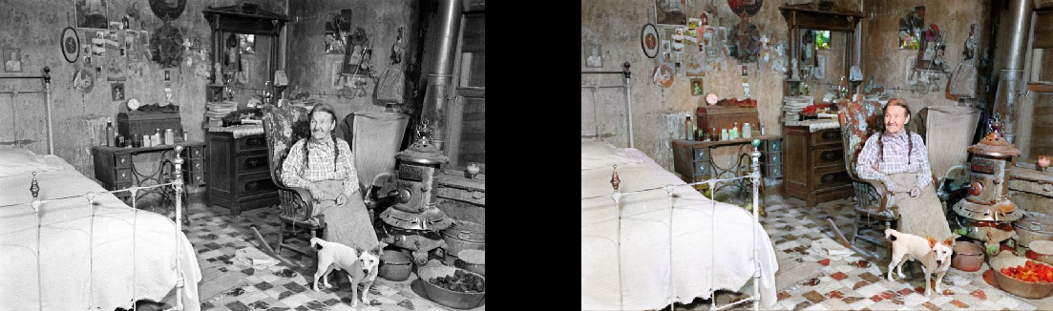
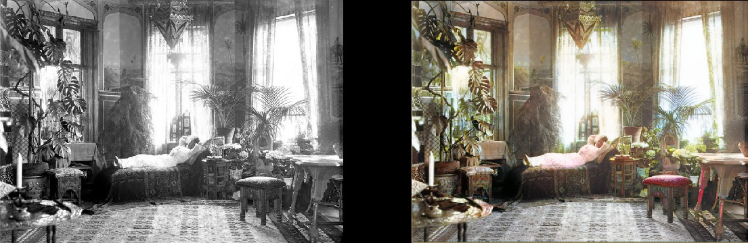

Slide 13
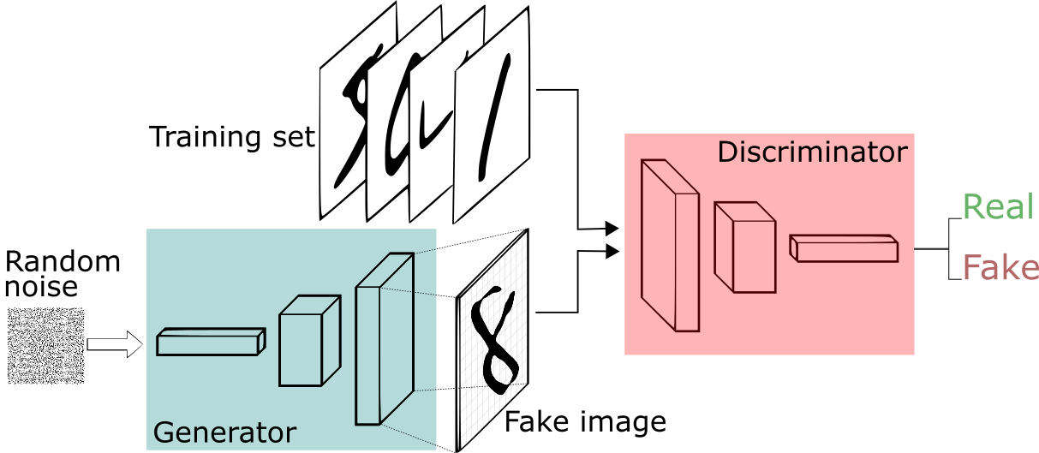
GAN structure - Generator & Discriminator:
Two Time-Scale Update Rule: gen / dis iteration, higher learning rate on the discriminator
Feature loss on generator
Hinge loss on discriminator

Slide 14
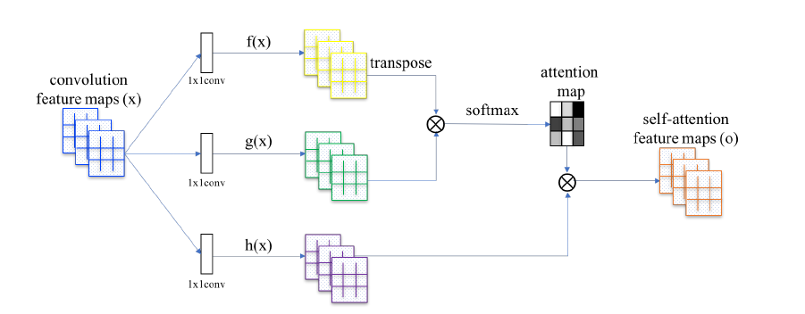
Self-Attention Generative Adversarial Networks:
-Non-local method to allow generator and the discriminator to efficiently model relationships between widely separated spatial regions
-SAGAN applies to both generator and discriminator

Slide 15
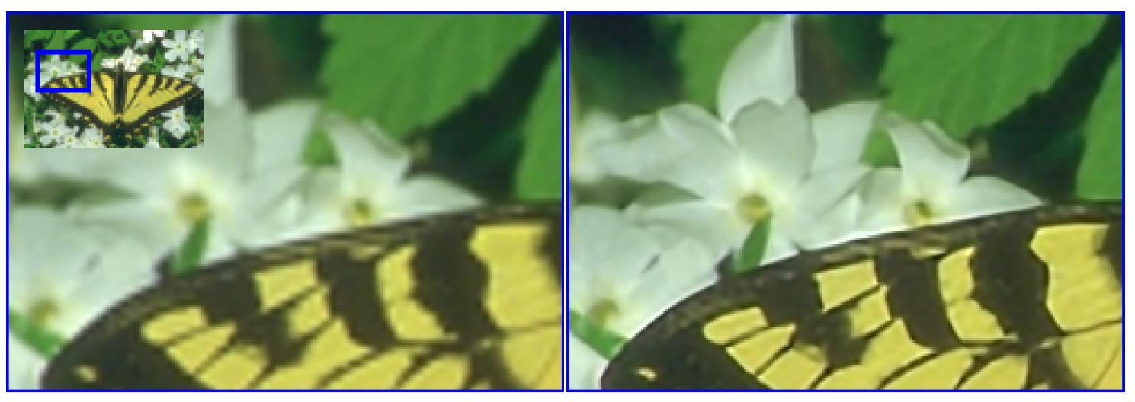
Single Image Super Resolution:

Slide 16
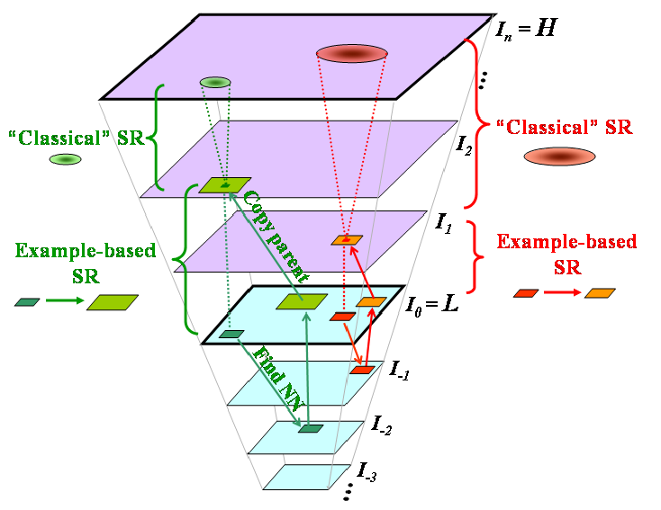
Single Image Super Resolution:
Patch Search for Low Res-Images

Slide 17
Data Source
We could easily find datasets of images online and apply B/W filter to create desired B/W images.
Example image dataset includes:
ImageNet: 1.5M images
Open images dataset: 9M images

Slide 18
Challenges
Color restoration favors Blue colors (might be biases from dataset)
Cannot identify artwork colors
Super resolution takes large amount of resources

Slide 19
Thanks.

