Slide 1
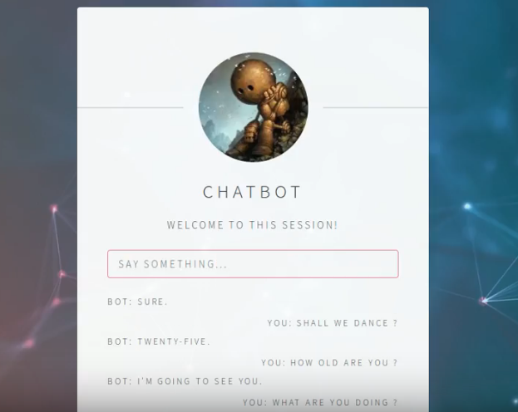
Non-Deterministic Open-Domain Chatbot

Slide 2
Overview
Generative : Our baseline and goal
Encoder-decoder generator
Retrieval
query-response pair
Optimize: From Q&A to chatbot
Multi-view model, SMN, DUA: Modern representation method

Slide 3
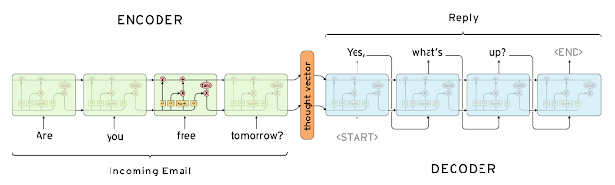
Overview
Classical seq2seq model (Googlebot, 2015) : LSTM layers without attention
Supported corpora: Cornell, OpenSubtitles, Ubuntu and ScotusFeature loss on generator
Seq2seq loss & perplexity based
Q&A system: without dialog tracking, not a chatbot

Slide 4
Challenges
Simplest Q&A system:
Deterministic: Q&A system is not a chatbot
Independent: Each Q&A pair is independent of others
Bad performance: attention, transformer, and modern architecture
Not friendly to current version
No personality
Costly evaluation
Friendly API for various dataset (Twitter, Reddit)

Slide 5
Goal
Chatbot
Chat with real person : Turning Test
Memory : Dialog tracking, Have the “same” answer on simple questions
Handle simple situations : Book a movie, search for restaurants nearby
Personality or emotion: Rude vs rude
Open domain
Large scale of dataset
Handle unfamiliar situation
Non deterministic

Slide 6
Our approach
[Core] Implementation
[basic] seq2seq model + attention + beam search
[basic] Friendly interface on Web
[basic] memory network / neural turning machine
[Discussion] Our ideas
Goal-oriented chatbot
Transfer learning on targeted domain: achieve better performance on target domain while benefiting from source domain (dialog space is both source and target domain)
Intent based dialog management using LSTM
Interlocutor tracking system
Hierarchical recurrent encoder-decoder
Transformer

Slide 7
Our approach
seq2seq model + attention + beam search
Friendly interface on Web
memory network / neural turning machine

Slide 8
Our approach
Transfer learning on targeted domain: achieve better performance on target domain while benefiting from source domain (dialog space is both source and target domain)
Intent based dialog management using LSTM
Interlocutor tracking system

Slide 9
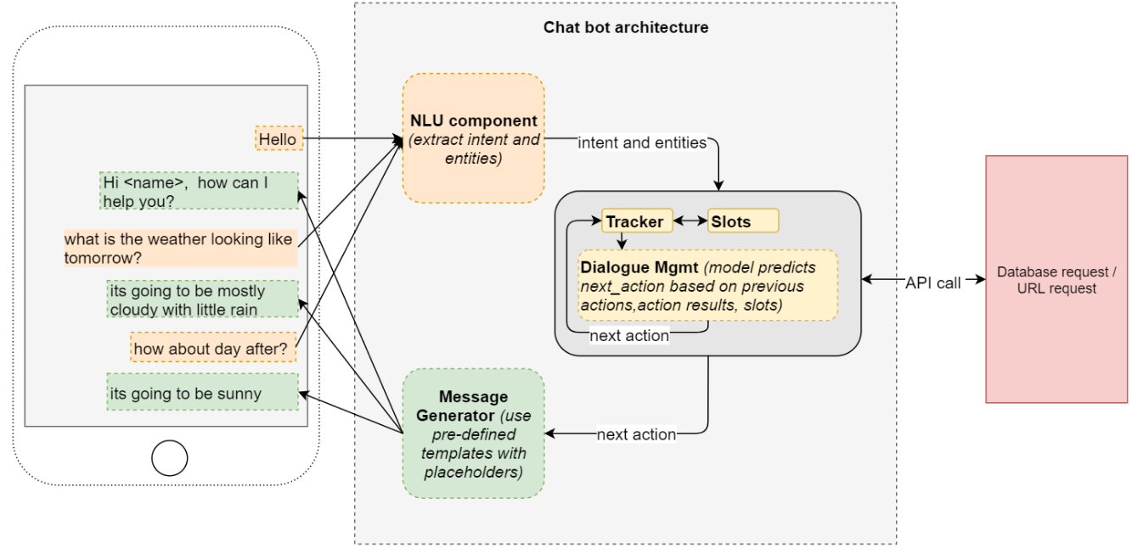
Intent based dialog management using LSTM

Slide 10
TODO / Ideas to explore
Simple tricks on transformer, see its performance and find some ideas
Combine generative and retrieval model
Build two bots: conversational, task-oriented, combine
Build two bots: encoder-decoder to generate pairs, retrieval model to optimize
memory network / neural turning machine

Slide 11
Evaluation
Granular Conversation Test:
Semantics: “Does the response make sense by itself?”
Structure: “Is it understandable and does it follows a structure a human would use?”
Context: “Does the response make sense in the context?”
Feeling: “Does the response feel human?”
0/1 scoring and takes average of all four components
Amazon Mechanical Turk

Slide 12
B/W Image Color Restoration with Super Resolution

Slide 13
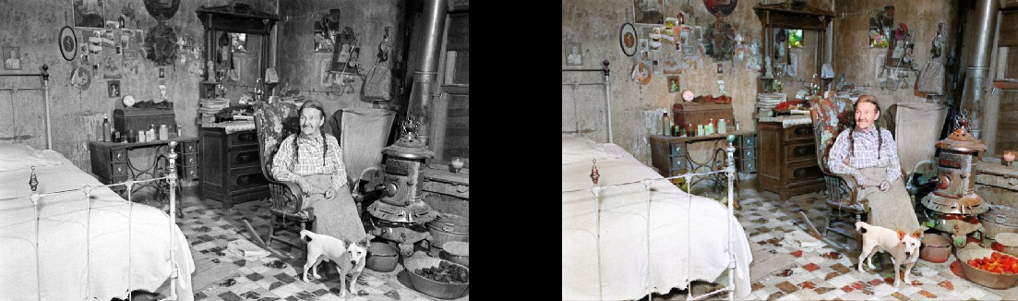


Slide 14
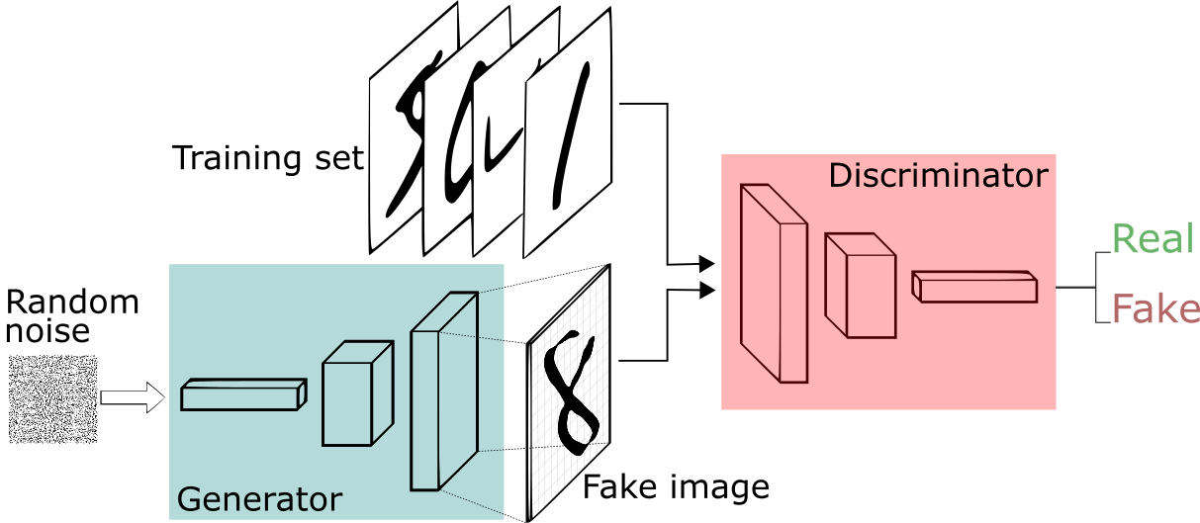
GAN structure - Generator & Discriminator:
Two Time-Scale Update Rule: gen / dis iteration, higher learning rate on the discriminator
Feature loss on generator
Hinge loss on discriminator

Slide 15
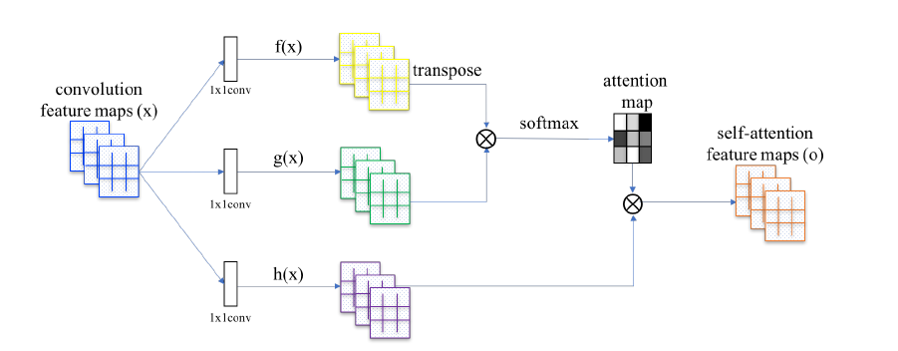
Self-Attention Generative Adversarial Networks:
-Non-local method to allow generator and the discriminator to efficiently model relationships between widely separated spatial regions
-SAGAN applies to both generator and discriminator

Slide 16
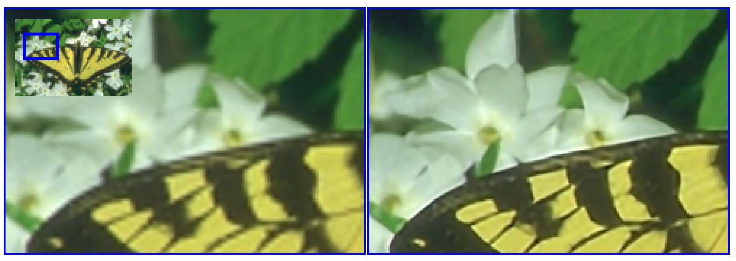
Single Image Super Resolution:

Slide 17
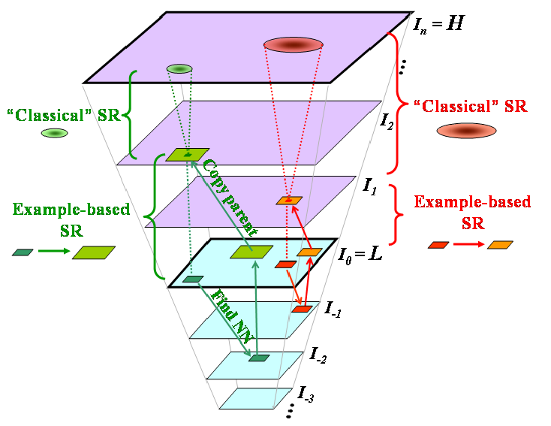
Single Image Super Resolution:
Patch Search for Low Res-Images

Slide 18
Data Source
We could easily find datasets of images online and apply B/W filter to create desired B/W images.
Example image dataset includes:
ImageNet: 1.5M images
Open images dataset: 9M images

Slide 19
Challenges
Color restoration favors Blue colors (might be biases from dataset)
Cannot identify artwork colors
Super resolution takes large amount of resources

Slide 20
Interesting tips
Music generation
Neural Architecture Search
Segmentation on medical images
3D re-construction on Angiography

Slide 21
Thanks.

