Slide 1
MSc Bioinformatics - Probability theory & statistical concepts
Marc Henrion

Slide 2
Session 1: Probability theory & statistical concepts

Slide 3
Preliminaries
In this session we will (re)view the basic fundaments of probability and statistical theory that you need to know for later sessions.
Participant packs
https://github.com/gitMarcH/COM_STA621_2020
Copy of slides & some R codes.
Note
These slides have been generated by using R Markdown.

Slide 4
Outline
Statistics & uncertainty
Probability theory
Random variables
Common distributions
Central Limit Theorem
Simulating data (using R)

Slide 5
Statistics & uncertainty

Slide 6
Statistics & uncertainty
Flip a (balanced) coin: the probability of H or T is exactly 0.5.
Flip the coin 10 times:
you would expect 5 H and 5 T
yet sometimes you will see 3 H, sometimes 6 H, sometimes 5 H, …
there is inherent uncertainty in the experiment
H<-rbinom(5,size=10,prob=0.5) print(H)
## [1] 2 5 4 5 5

Slide 7
Statistics & uncertainty
Let’s repeat this 1000 times:
H<-rbinom(1000,size=10,prob=0.5) tibble(H) %>% ggplot(mapping=aes(x=H)) + geom_bar() + scale_x_continuous(breaks=0:10) + coord_cartesian(xlim=c(0,10)) + xlab("number of heads") + theme(text = element_text(size=20))

Slide 8
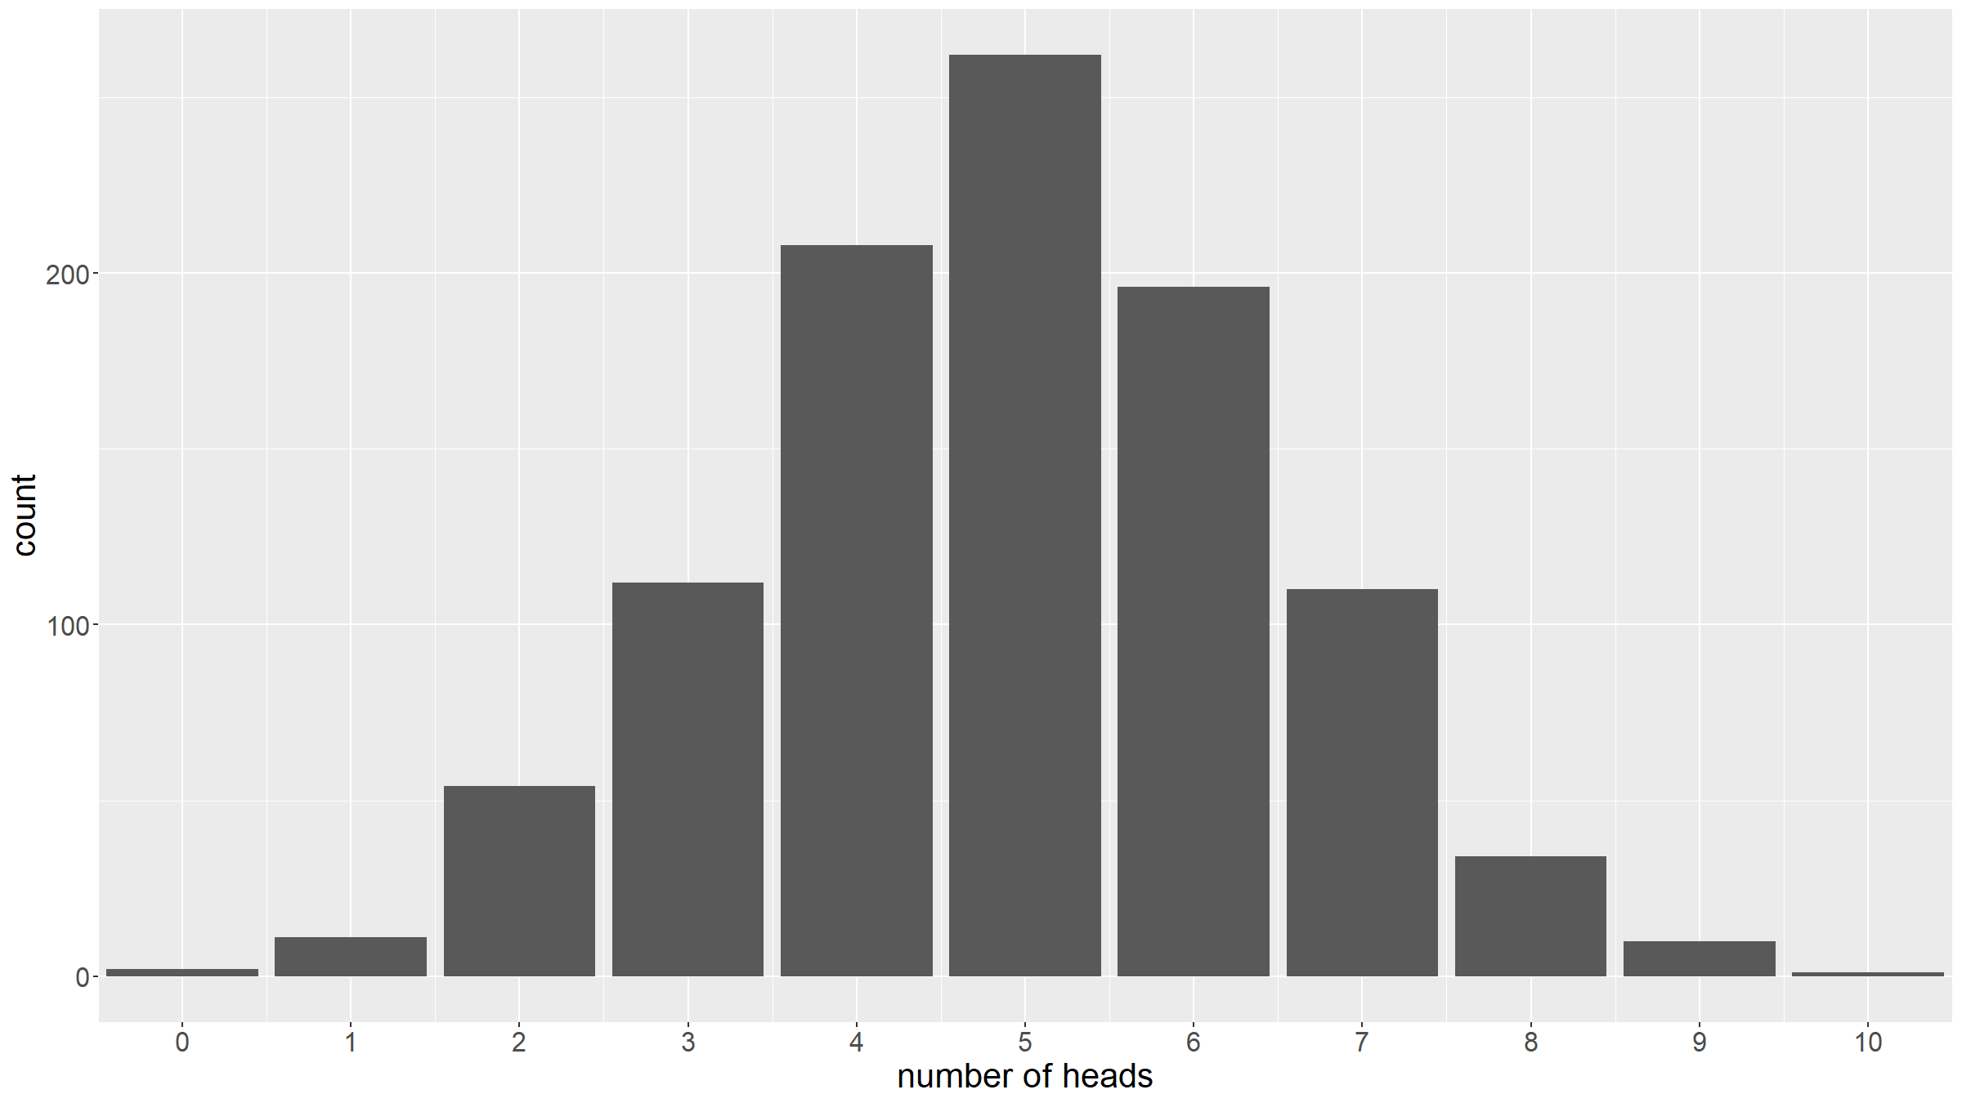

Slide 9
Statistics & uncertainty
Let’s continue with this example: suppose we have 2 biased coins
first coin has $P_{1}(H)=0.3$
second coint has $P_{2}(H)=0.6$
dat<-data.frame( coin=c(rep("coin1",500),rep("coin2",500)), H=c(rbinom(500,size=10,prob=0.3),rbinom(500,size=10,prob=0.6)) )

Slide 10
Statistics & uncertainty
Sometimes the coin with a lesser probability of heads yields more heads.
dat %>% count(coin,H) %>% complete(coin,H,fill=list(n=0)) %>% ggplot(mapping=aes(fill=coin,y=n,x=H)) + geom_bar(position="dodge",stat="identity") + scale_x_continuous(breaks=0:10) + coord_cartesian(xlim=c(0,10)) + xlab("number of heads") + ylab("count") + theme(text = element_text(size=20))

Slide 11
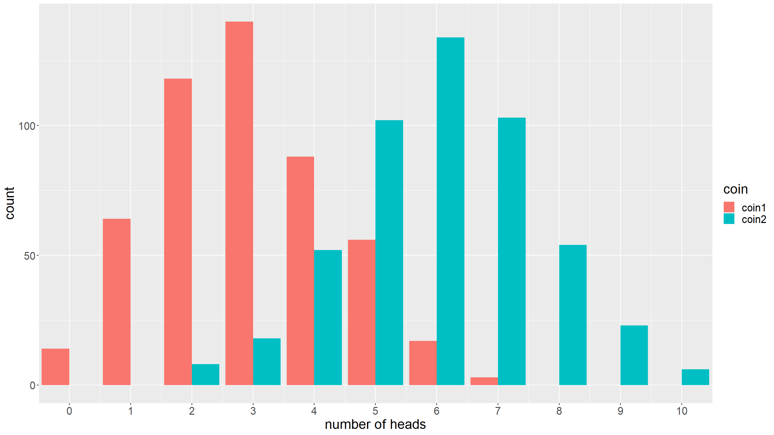

Slide 12
Statistics & uncertainty
Suppose weight was a deterministic function of a toddler’s age: you start off at 3.5kg, and then your weight follows a logarithmic curve until age 24 months at which point you reach 11.5kg.
This is obviously not what happens in real life (though an OK approximation for US girls).
ageMonths<-runif(100,min=0,max=24) # sample some random ages weight<-3.5+2.5*log(ageMonths+1) # compute the weights dat<-tibble(ageMonths,weight) dat %>% ggplot(mapping=aes(x=ageMonths,y=weight)) + geom_point(color="steelblue") + xlab("age in months") + ylab("weight in kg") + ggtitle("Toddlers' weights versus ages") + theme(text = element_text(size=20))

Slide 13
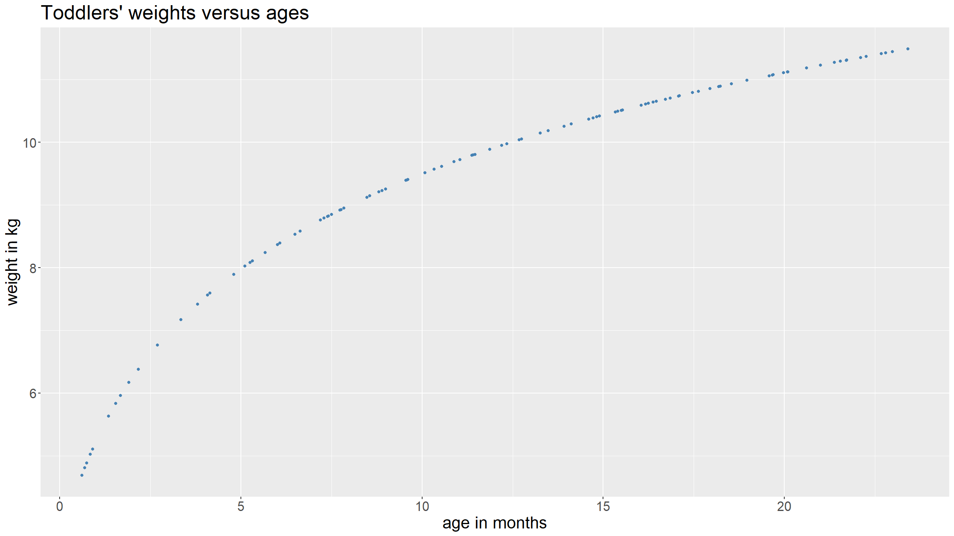

Slide 14
Statistics & uncertainty
Now suppose when we measure a toddler’s weight, the accuracy of our measurement is not perfect: each time we record a slightly different value than the true one, though on average we get it right.
dat<-mutate(dat,weightWithError=rnorm(nrow(dat),mean=weight,sd=0.25)) dat %>% ggplot(mapping=aes(x=ageMonths,y=weightWithError)) + geom_point(color="steelblue") + xlab("age in months") + ylab("weight in kg") + ggtitle("Toddlers' weights versus ages") + theme(text = element_text(size=20))

Slide 15
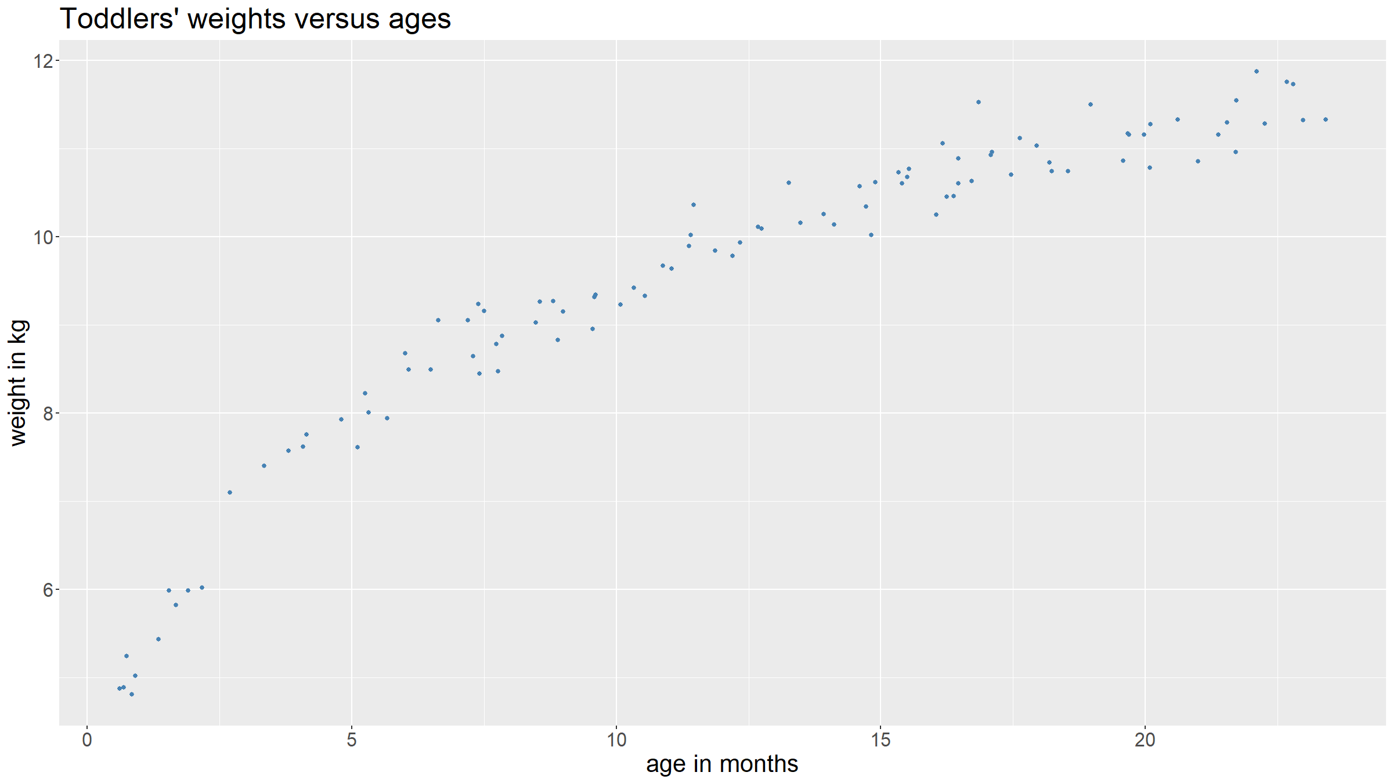

Slide 16
Statistics & uncertainty
Now suppose we can measure weights perfectly again. But now suppose that there are unobserved characteristics (e.g. genetic factors, nutritional status, …) that impact on children’s weights.
dat<-dat %>% mutate(latentFactor1=rnorm(nrow(dat),mean=0,sd=0.5)) %>% mutate(latentFactor2=rnorm(nrow(dat),mean=0,sd=0.1)) %>% mutate(weightGivenLatentFactors=3.5+latentFactor1+(2.5+latentFactor2)*log(ageMonths+1)) dat %>% ggplot(mapping=aes(x=ageMonths,y=weightGivenLatentFactors)) + geom_point(color="steelblue") + xlab("age in months") + ylab("weight in kg") + ggtitle("Toddlers' weights versus ages") + theme(text = element_text(size=20))

Slide 17
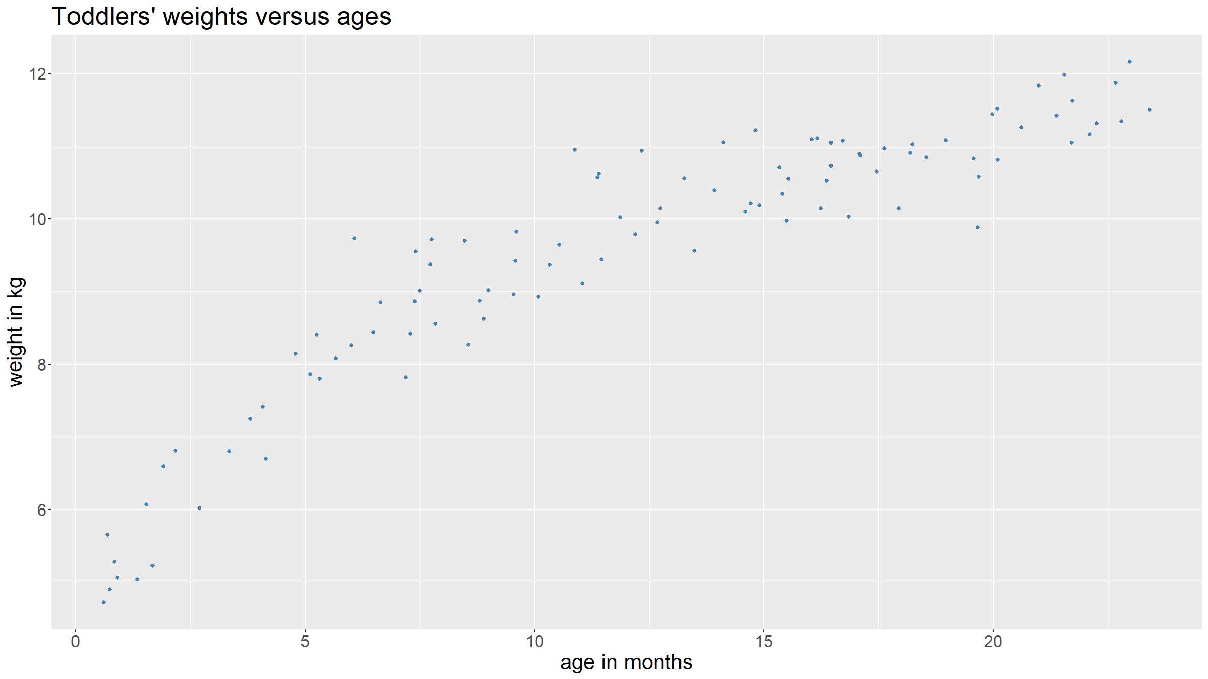

Slide 18
Statistics & uncertainty
We have seen 3 sources of uncertainty:
inherent uncertainty / randomness of an experiment
measurement error
unobserved relevant variables
There can be many other sources of uncertainty.

Slide 19
Statistics & uncertainty
PROBABILITY
To quantify uncertainty we need to use the tools of probability theory.
STATISTICS
To gain insights from observational data we need to make statistical inference.

Slide 20
Probability theory

Slide 21
Probability theory
This section is largely based on and in places quoted verbatim from
Feelders, Ad J. (2007), ‘Statistical Concepts’, in Berthold, M., Hand, D.J. (eds.) Intelligent Data Analysis, 2nd ed., Springer, pp.17-68

Slide 22
Probability theory: random experiments
A random experiment is an experiment that satisfies the following conditions:
All possible outcomes are known in advance.
In any particular trial, the outcome is not known in advance.
The experiment can be repeated under identical conditions.
The outcome space $Ω$ of an experiment is the set of all possible outcomes of the experiment.
Examples
In the coin tossing experiment earlier $Ω=\{H,T\}$.
When you roll a die $Ω=\{1,2,3,4,5,6\}$.

Slide 23
Probability theory: random experiments
An event is a subset of the outcome space.
Examples
“Coin lands head”: $A=\{x∈Ω| x is heads\}=\{H\}$
“Die shows even number”: $B=\{x∈Ω| x is even\}=\{2,4,6\}$
Special events
Impossible / empty event: $A=∅$
Sure event / outcome space: $A=Ω$
Singleton events: $A=\{H\}$, $A=\{3\}$
The complementary event: $\overline{A}=Ω\backslash A$

Slide 24
Probability theory: probability
Classical definition of probability:
Let $|.|$ denote the operator measuring the size of an event. The probability of an event $A⊆Ω$ is defined as
$$P(A)=\frac{|A|}{|Ω|}$$
If all outcomes in $Ω$ are equally likely, then this means the probability of $A$ is the ratio of the number of outcomes in $A$ and the number of outcomes in $Ω$.
If your outcome space is not discrete, then $|.|$ is a function mapping outcome sets to the positive real line.

Slide 25
Probability theory: probability
Probability as a mathematical concept was formally introduced in the 17th century by French mathematicians Blaise Pascal and Pierre de Fermat when they were discussing games of chance.
Note: also a frequency and a subjective definition of probability.
The formal, mathematical derivation of probability theory follows from set theory and measure theory.

Slide 26
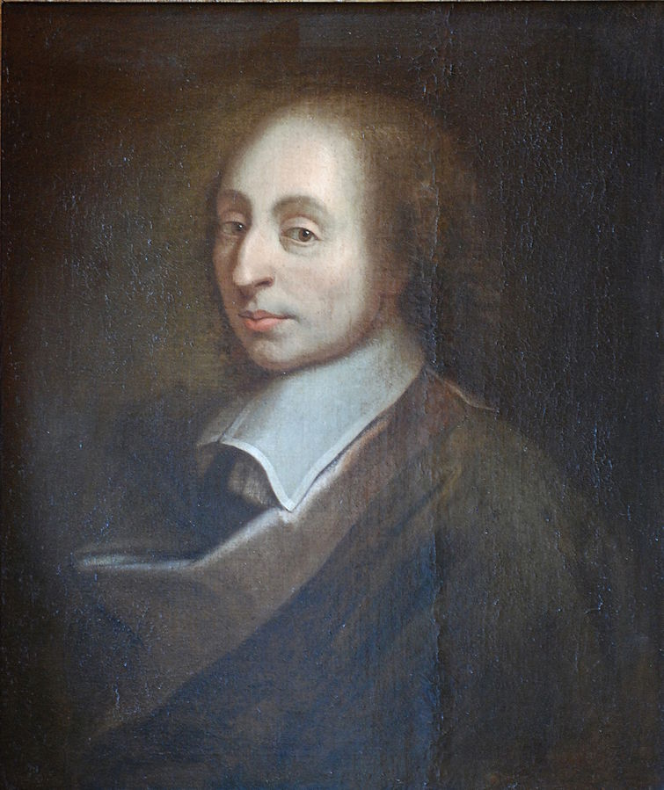
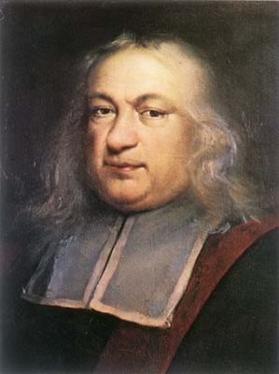
Probability theory: probability
Blaise Pascal (public domain / Wikipedia)
Pierre de Fermat (public domain / Wikipedia)

Slide 27
Probability theory: probability axioms
Probability is a function $P()$ from subsets $A$ of $Ω$ to the real line satisfying the following axioms:
$P(A)≥0$, for any subset $A$ of $Ω$
if $A∩B=∅$, then $P(A∪B)=P(A)+P(B)$, for any subsets $A,B$ of $Ω$
$P(Ω)=1$
Everything else in probability theory is derived from these 3 axioms.

Slide 28
Probability theory: conditional probability
The probability of an event $A$ can be influenced by information about the occurrence of an event $B$. The conditional probability of $A$ given $B$, denoted $P(A|B)$, is defined as the probability of event $A$ given that $B$ has occurred.
$$P(A|B)=\frac{P(A∩B)}{P(B)}$$
for $P(B)>0$.
Intuitively: $B$ is the new outcome space.

Slide 29
Probability theory: independence
Events $A$ and $B$ are said to be independent if the occurrence of one event does not influence the probability of occurrence of the other events.
$$P(A|B)=P(A)$$
$$P(B|A)=P(B)$$
This can more concisely be expressed as:
$$P(A∩B)=P(A)P(B)$$

Slide 30
Probability theory: Law of Total Probability
We define events $B_{1},B_{2},…,B_{n}⊆Ω$ to form a partition of $Ω$ if
$B_{i}∩B_{j}=∅$, $∀i≠j$
$\bigcup_{i=1}^{n}{B_{i}}=Ω$
From the probability axioms it follows that, for any event $A$ in $Ω$, $P(A)$ can be written as a sum:
$$P(A)=\sum_{i=1}^{n}{P(A|B_{i}) P(B_{i})}=\sum_{i=1}^{n}{P(A∩B_{i})}$$
This is known as the Theorem of Total Probability.

Slide 31
Probability theory: Law of Total Probability
Example:
A box contains 4 balls: 3 white, 1 red.
First draw one ball at random. Then, without replacing the first ball, draw a second ball from the box.
What is the probability that the second ball is a red ball?

Slide 32
Probability theory: Law of Total Probability
This is most easily calculated using the TTP.
Let $R_{1},R_{2}$ be the event of drawing a red ball on the first / second draw, and similarly for $W_{1},W_{2}$.
Note that ${\overline{R}}_{1}=W_{1}$, and hence $R_{1},W_{1}$ form a parition of $Ω$.
$$P(R_{2})=P(R_{2}|W_{1})P(W_{1})+P(R_{2}|R_{1})P(R_{1})=\frac{1}{3}⋅\frac{3}{4}+0⋅\frac{1}{4}=\frac{1}{4}$$

Slide 33
Probability theory: Bayes’ Rule
Bayes’ rule shows how probabilities change in light of evidence. First formulated by an 18th century English clergyman, Thomas Bayes, it was only published after his death.
$$P(B|A)=\frac{P(A|B)P(B)}{P(A)}$$
And for a partition $B_{1},…,B_{n}$ of $Ω$:
P(Bi|A)=P(A|Bi)P(Bi)j​P(A|Bj)P(Bj)

Slide 34
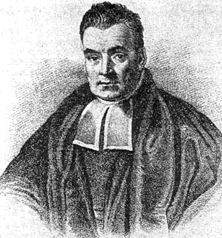
Probability theory: Bayes’ Rule
Thomas Bayes (public domain / Wikipedia)

Slide 35
Probability theory: Bayes’ Rule
Example: diagnostic test
Disease $D$, with $P(D)=0.001$, i.e. occurs only in $0.1\%$ of the population.
There is a diagnostic test, which can give a positive ($T$) or negative ($\overline{T}$) result. The diagnostic test has $95\%$ sensitivity (i.e. $P(T|D)=0.95$) and $98\%$ specificity (i.e. $P(\overline{T}|\overline{D})=0.98$).
What is the probability that a patient has the disease if the test result is positive?

Slide 36
Probability theory: Bayes’ Rule
Note that $D,\overline{D}$ is a partition of the outcome space.
Apply Bayes’s Rule:
$$\begin{matrix}P(D|T) & =\frac{P(T|D)P(D)}{P(T|D)P(D)+P(T|\overline{D})P(\overline{D})} \\ & =\frac{0.95⋅0.001}{0.95⋅0.001+(1−0.98)⋅(1−0.001)} \\ & =0.0454\end{matrix}$$
(0.95*0.001)/(0.95*0.001+(1-0.98)*(1-0.001))
## [1] 0.04538939

Slide 37
Random variables

Slide 38
Random variables
A random variable $X$ is a function from the outcome space $Ω$ to the real line:
$$X:Ω→R$$
Example: Consider the experiment of tossing a coin 2 times:
$$Ω=\{(H,H),(H,T),(T,H),(T,T)\}$$
The number of heads turning up is a random variable $X$:
$$X((H,H))=2$$
$$X((H,T))=1$$
$$X((T,H))=1$$
$$X((T,T))=0$$

Slide 39
Random variables: probability distribution
A probability mass function (pmf) $p$ assigns to each realisation $x$ of a discrete random variable X the probability $P(X=x)=p(x)$.
It follows from the axioms of probability that:
$p(x)≥0$
x​p(x)=1

Slide 40
Random variables: probability distribution
df<-tibble(x=0:10,pmf=dbinom(0:10,size=10,prob=0.5)) ggplot(data=df,mapping=aes(x=x,y=pmf)) + geom_bar(stat="identity") + xlab("number of heads") + ylab("probability mass") + ggtitle("pmf of the random variable counting numbers of H in 10 coin tosses") + scale_x_continuous(breaks=0:10) + coord_cartesian(xlim=c(0,10)) + theme(text = element_text(size=20))

Slide 41
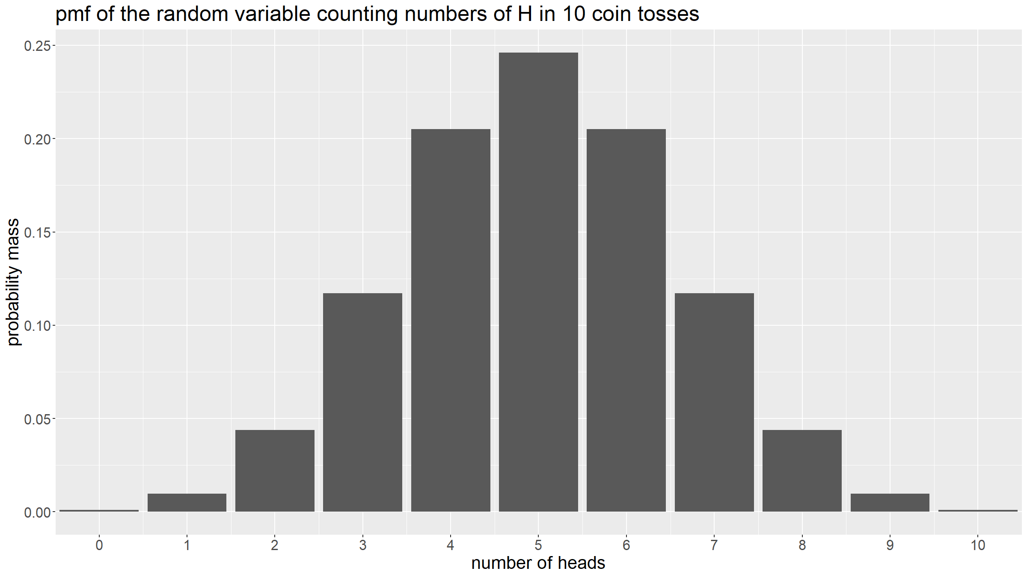

Slide 42
Random variables: probability distribution
What about continuous random variables?
For a continuous random variable $X$, $P(X=x)=0$ for all values of x (the probability of exactly realising one value among an infinity of possible values is 0). Hence it makes little sense to define a pmf.

Slide 43
Random variables: probability distribution
Instead, we will define probabilities as areas under a curve. A probability density function (pdf) is a function $p:R→R^{+}$ so that
$$P(a<X≤b)=\int_{a}^{b}{p}(x)dx$$
It follows from the axioms of probability that $p(x)≥0$ and $\int_{−∞}^{∞}{p(x)dx}=1$.
Note that while the axioms of probability imply that in the discrete case, a pmf satisfies $p(x)≤1$, in the continuous case, a pdf $p(x)$ does not have to be bounded above by 1.

Slide 44
Random variables: probability distribution
x<-seq(-4,4,by=0.01) xArea <- seq(-2,0.5,by=0.01) yArea <- dnorm(xArea) par(mar=c(5,5,5,1)) plot(x, dnorm(x), main="pdf of the standard normal", xlab="x", ylab="density", type="l", cex.lab=2.5,cex.axis=2.5,cex.main=2.5) polygon(c(-2,xArea,0.5),c(0,yArea,0),col='steelblue',lty=0) text(cex=2.5,"P(-2<X<0.5)=0.67",x=-2.5,y=0.25,col="steelblue")

Slide 45
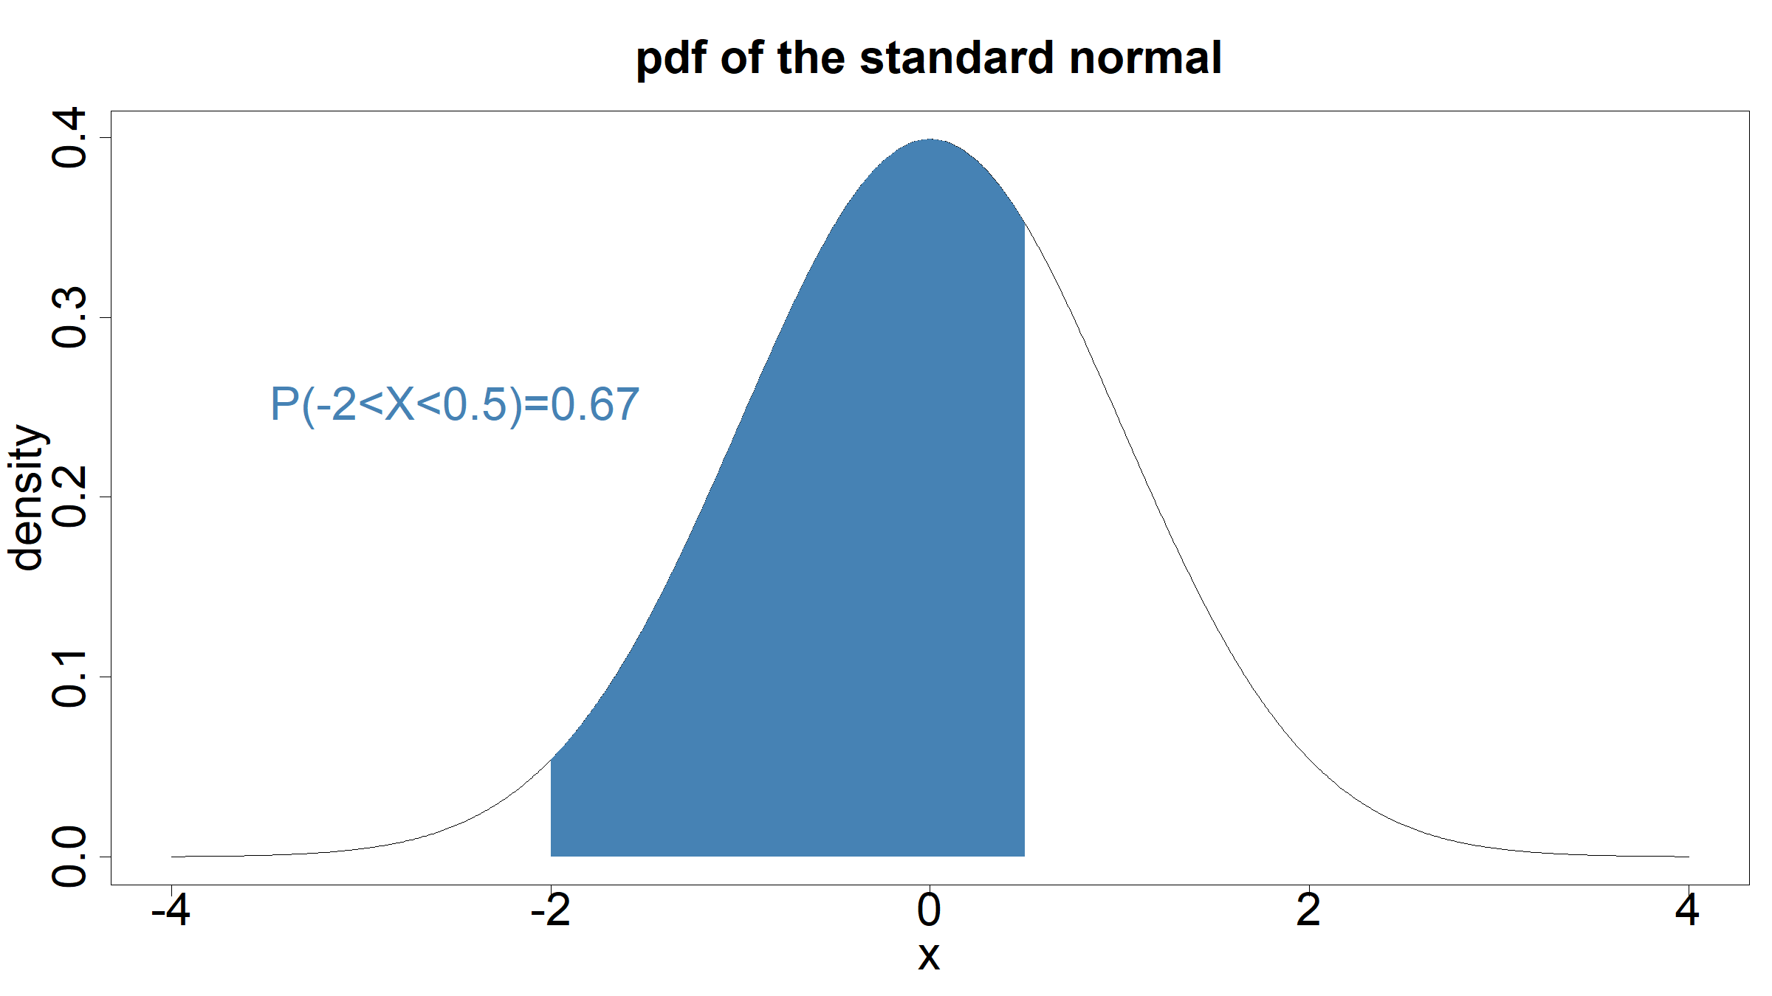

Slide 46
Random variables: probability distribution
Example:
If we have the pdf given by
$$p(x)=\left\{\begin{matrix}2 & for 0≤x≤0.5 \\ 0 & otherwise\end{matrix}\right.$$
Then it follows that
$$P(0.1<X≤0.3)=\int_{0.1}^{0.3}{2}dx=[2x]_{0.1}^{0.3}=0.6−0.2=0.4$$
pdf<-function(x){return(ifelse(x>=0 & x<=0.5,2,0))} integrate(pdf,0.1,0.3)
## 0.4 with absolute error < 4.4e-15

Slide 47
Random variables: probability distribution
x<-seq(-0.25,0.75,by=0.001) xArea <- seq(0.1,0.3,by=0.01) yArea <- dunif(xArea,min=0,max=0.5) par(mar=c(5,5,5,1)) plot(x, dunif(x,min=0,max=0.5), main="pdf of uniform distribution", xlab="x", ylab="density", type="l", cex.lab=2.5,cex.axis=2.5,cex.main=2.5,ylim=c(0,2.25)) polygon(c(0.1,xArea,0.3),c(0,yArea,0),col='steelblue',lty=0) text(cex=2.5,"P(0.1<X<0.3)=0.4",x=0.2,y=2.1,col="steelblue")

Slide 48
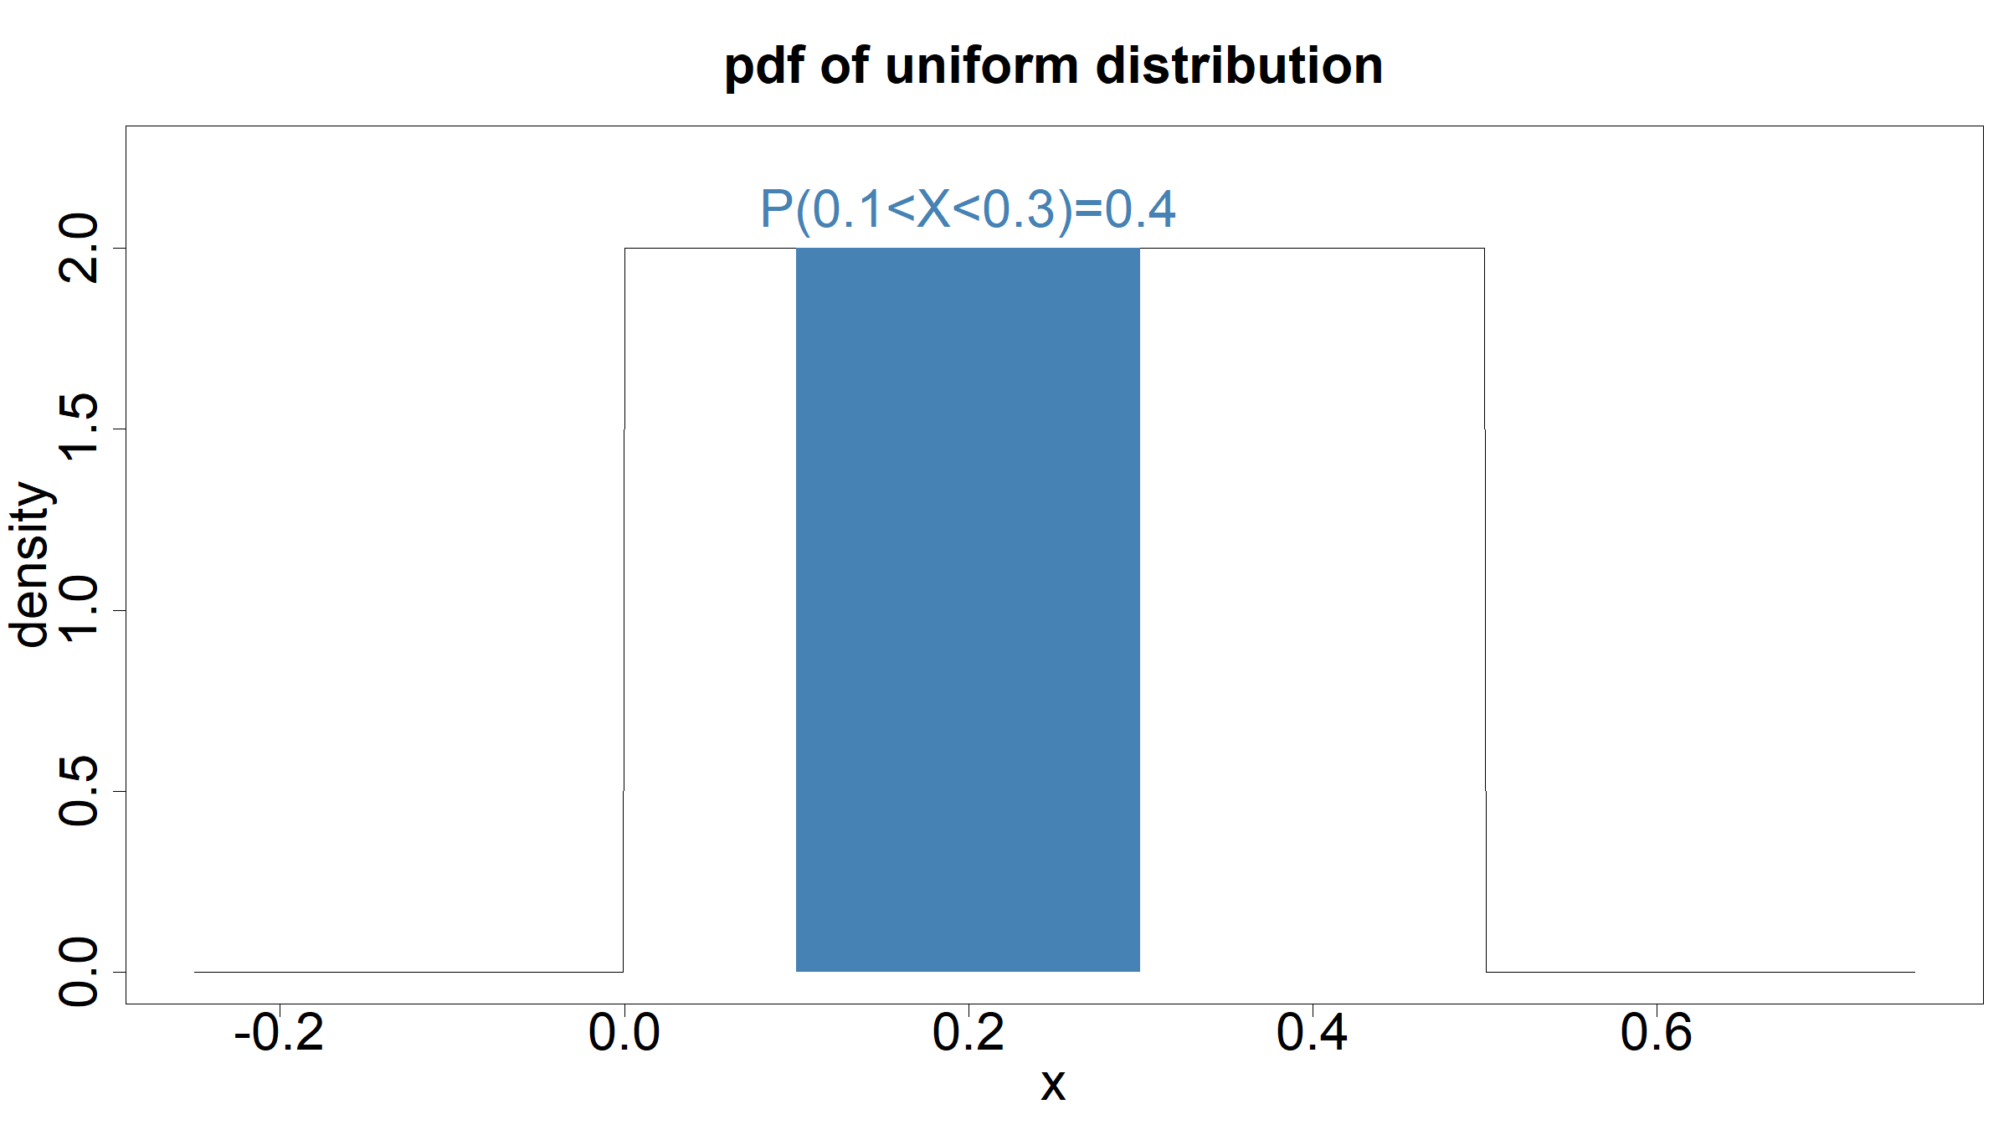

Slide 49
Random variables: expectation & variance
What is the expected or average / mean value for a given distribution? Let us define the expectation or the mean of a random value.
Discrete random variables:
E[X]=x​x p(x)
Continuous random variables:
$$E[X]=\int_{−∞}^{∞}{x p(x) dx}$$
Notation:
$$μ=E[X]$$

Slide 50
Random variables: expectation & variance
We can also compute expectations for arbitrary functions $h:R→R$ of a random variable:
E[h(X)]=x​h(x) p(x) if x is discrete−∞∞h(x) p(x) dx if x is continuous

Slide 51
Random variables: expectation & variance
One special case of such a function $h$ is $h(x)=(x−μ)^{2}$ and is used to define the variance of a random variable.
The variance $Var(X)=σ^{2}$ of a random variable $X$ is defined as spread around the mean and obtained by averaging the squared differences $(x−μ)^{2}$.
$$\begin{matrix}σ^{2} & = & E[(X−μ)^{2}] \\ & = & E[(X−E[X])^{2}]\end{matrix}$$
The standard deviation $σ$ has the advantage of being on the same scale as $X$.

Slide 52
Random variables: expectation & variance
In summary:
The expectation $E[X]$ characterises the central tendency / mean / average of a distribution.
The variance $Var(X)$ characterises the variability / spread of a distribution.
They are usually the most important properties of a distribution, but they do not say anything about the shape of the distribution (higher moments needed to look at skew or kurtosis of a distribution).

Slide 53
Random variables: conditional distributions
Discrete case:
$$p(x|C)=P(X=x|C)=\frac{P(\{X=x\}∩C)}{P(C)}$$
Continuous case:
$$p(x|C)=\left\{\begin{matrix}p(x)/P(C) & for x∈C \\ 0 & otherwise\end{matrix}\right.$$

Slide 54
Random variables: joint distributions
A pair of random variables $(X,Y)$ will have a joint distribution and this is uniquely determined by their joint probability function $p:R^{2}→R$.
Discrete case:
$$p(x,y)=P((X,Y)=(x,y))=P(X=x,Y=y)$$
From the axioms of probability: $p(x,y)≥0$ and x​y​p(x,y)=1.
Continuous case:
$$P(a<X≤b,c<Y≤d)=\int_{a}^{b}{\int_{c}^{d}{p}}(x,y)dxdy$$
From the axioms of probability: $p(x,y)≥0$ and $\int_{−∞}^{∞}{\int_{−∞}^{∞}{p}}(x,y) dxdy=1$.

Slide 55
Random variables: marginal probability
The marginal probability function of X can be obtained from the joint distribution function by summing (discrete case) or integrating (continuous case) over Y.
Discrete case:
pX(x)=P(X=x)=y​P((X,Y)=(x,y))=y​p(x,y)
Continuous case:
$$p_{X}(x)=\int_{−∞}^{∞}{p}(x,y) dy$$

Slide 56
Random variables: conditional probability
We can define the conditional distribution function of X given Y.
$$p(x|y)=\frac{p(x,y)}{p_{Y}(y)}$$
As before for events, we define random variables $X,Y$ to be independent if
$$p(x,y)=p_{X}(x)p_{Y}(y) for all (x,y)$$

Slide 57
Common distributions

Slide 58
Common distributions
Parametric distributions depend on parameters who completely define the shape and properties of the distribution. Parametric distributions are important because many arise naturally and because they provide an easy way to model real-world data.
For any given distribution it is important to know its
Support (what range of values are possible?)
Shape (bell-shaped, flat, skew, symmetric, …?)
Mean / median / mode (central tendancy)
Variance (how much spread in values does it allow?)
We will look at discrete distributions first, then continuous distributions.

Slide 59
Common distributions: discrete uniform
$X∼ Unif(k,n)$ if
$$P(X=x)=\left\{\begin{matrix}1/k & if x∈\{a,a+1,…,a+k−1\} \\ 0 & otherwise\end{matrix}\right.$$
$$E(X)=a+\frac{k−1}{2}, Var(X)=\frac{k^{2}−1}{12}$$
This distribution occurs when there are k equally likely outcomes, each of which occurs with probability $1/k$.
Example:
Roll a die

Slide 60
Common distributions: discrete uniform
plotDUnif<-function(k,col,maxK=10){ x<-seq(1,k,by=1) px<-rep(1/k,k) df<-tibble(x=x,px=px) g<-ggplot(data=df,mapping=aes(x=x,y=px)) + geom_bar(stat="identity",fill=col) + ylab("P(X=x)") + theme(text = element_text(size=20)) + ggtitle(paste(sep="","Discrete uniform with a=1, k=",k)) + scale_x_continuous(breaks=1:maxK) + coord_cartesian(xlim=c(0.5,maxK+0.5),ylim=c(0,1)) return(g) } g1<-plotDUnif(1,"darkgrey"); g2<-plotDUnif(2,"steelblue") g3<-plotDUnif(5,"salmon"); g4<-plotDUnif(10,"orange") grid.arrange(g1,g2,g3,g4)

Slide 61
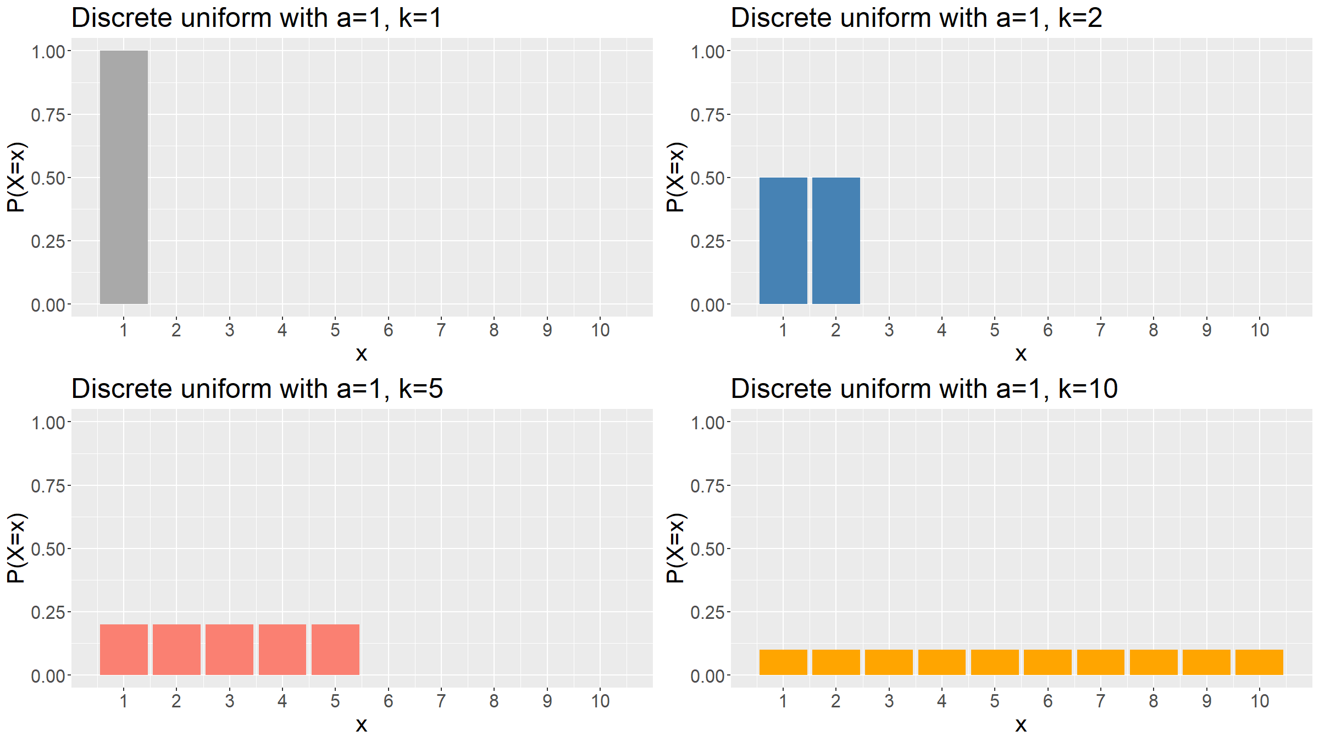

Slide 62
Common distributions: Bernoulli
$X∼ Bern(p)$ if
$$P(X=x)=\left\{\begin{matrix}p & if x=1 \\ 1−p & if x=0 \\ 0 & otherwise\end{matrix}\right.$$
$$E(X)=p, Var(X)=p(1−p)$$
This distribution occurs when there are only 2 outcomes, one of which occurs with probability $p$.
Example:
Coin tossing experiment

Slide 63
Common distributions: Bernoulli
plotBern<-function(p,col){ x<-seq(0,1,by=1) px<-dbinom(x,size=1,prob=p) df<-tibble(x=x,px=px) g<-ggplot(data=df,mapping=aes(x=x,y=px)) + geom_bar(stat="identity",fill=col) + ylab("P(X=x)") + theme(text = element_text(size=20)) + ggtitle(paste(sep="","Bernoulli with p=",p)) + scale_x_continuous(breaks=0:1) + coord_cartesian(xlim=c(-0.5,1.5),ylim=c(0,1)) return(g) } g1<-plotBern(0,"darkgrey"); g2<-plotBern(0.25,"steelblue") g3<-plotBern(0.5,"salmon"); g4<-plotBern(0.9,"orange") grid.arrange(g1,g2,g3,g4)

Slide 64
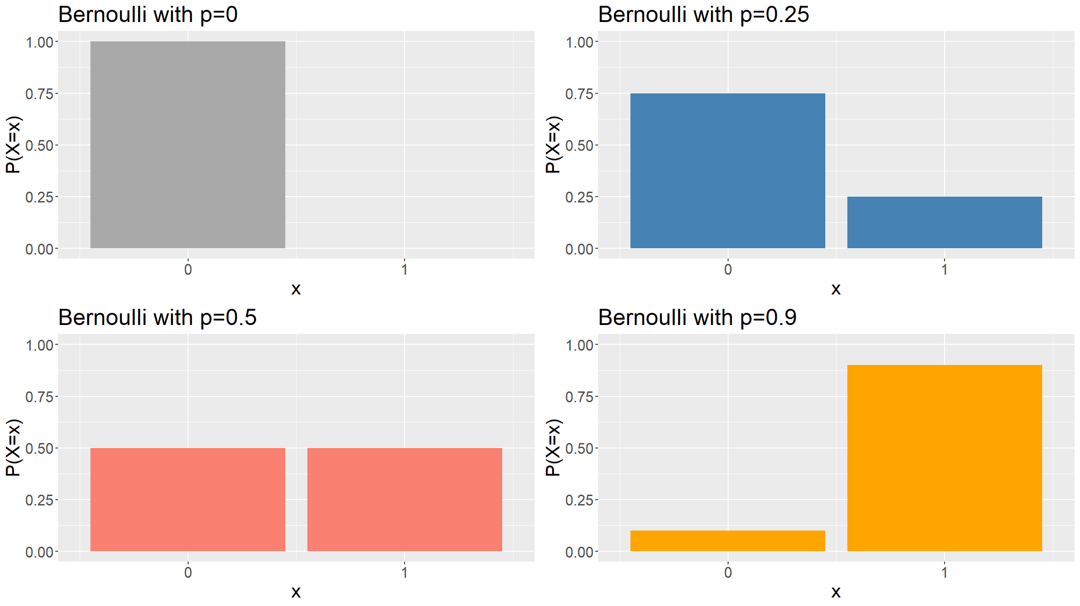

Slide 65
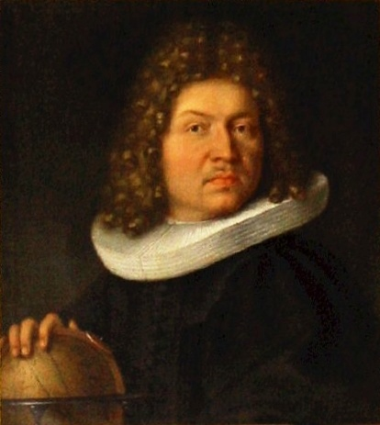
Common distributions: Bernoulli
Jacob Bernoulli (public domain / Wikipedia)

Slide 66
Common distributions: Binomial
$X∼ Bin(n,p)$ if
$$P(X=x)=\left\{\begin{matrix}\left({n \atop x}\right) p^{x} (1−p)^{n−x} & if x∈\{0,1,…,n\} \\ 0 & otherwise\end{matrix}\right.$$
$$E(X)=np, Var(X)=np(1−p)$$
The special case $n=1$ is the Bernoulli distribution. Also if $X_{1},X_{2},…,X_{n}∼_{iid} Bern(p)$, then $Y=\sum_{i=1}^{n}{X_{i}}∼ Bin(n,p)$.
It is the distribution that arises if you count the number of successes among $n$ independent Bernoulli trials.
Example: Counting the number of heads in 10 coin tosses.

Slide 67
Common distributions: Binomial
plotBin<-function(n,p,col,maxN=10){ x<-seq(0,n,by=1) px<-dbinom(x,size=n,prob=p) df<-tibble(x=x,px=px) g<-ggplot(data=df,mapping=aes(x=x,y=px)) + geom_bar(stat="identity",fill=col) + ylab("P(X=x)") + theme(text = element_text(size=20)) + ggtitle(paste(sep="","Binomial with n=",n,", p=",p)) + scale_x_continuous(breaks=0:maxN) + coord_cartesian(xlim=c(-0.5,maxN+0.5),ylim=c(0,1)) return(g) } g1<-plotBin(1,.2,"darkgrey"); g2<-plotBin(2,.2,"steelblue") g3<-plotBin(3,.2,"salmon"); g4<-plotBin(4,.2,"greenyellow") g5<-plotBin(5,.2,"mediumorchid"); g6<-plotBin(10,.2,"orange") grid.arrange(g1,g2,g3,g4,g5,g6,ncol=3)

Slide 68
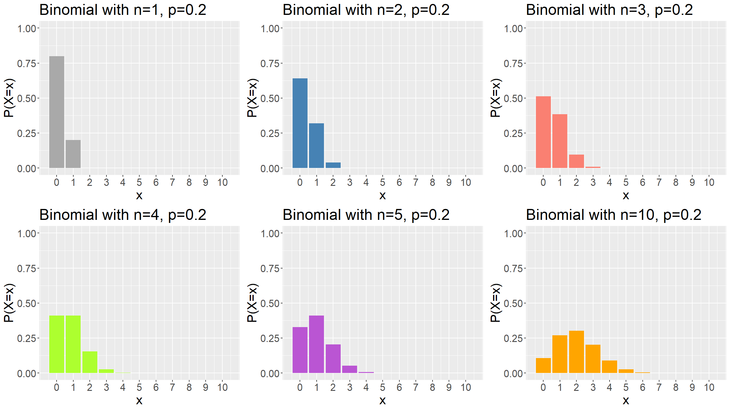

Slide 69
Common distributions: Multinomial
You can generalise the binomial to events with more than 2 outcomes.
This yields the multinomial distribution.

Slide 70
Common distributions: Poisson
$X∼ Poisson(λ)$ if
$$P(X=x)=\left\{\begin{matrix}\frac{λ^{x}e^{−λ}}{x!} & if x∈\{0,1,2,3…\} \\ 0 & otherwise\end{matrix}\right.$$
$$E(X)=λ, Var(X)=λ$$
This distribution arises if you count the number of events that occur during a fixed interval, with $λ$ the rate with which events occur.
The Poisson distribution is a limiting case of the Binomial:
Let $X_{n}∼ Bin(n,p)$ and $Y=\lim_{n→∞,p→0}X_{n}$.
If $np$ is kept fixed, then $Y∼ Poisson(λ)$ with rate $λ=np$.

Slide 71
Common distributions: Poisson
Examples:
number of mutations on strand of DNA per unit time,
number of asthma patient arrivals within a given hour of a walk-in clinic
number of births, deaths, …, over a given period
number of photons hitting a telescope image sensor
…

Slide 72
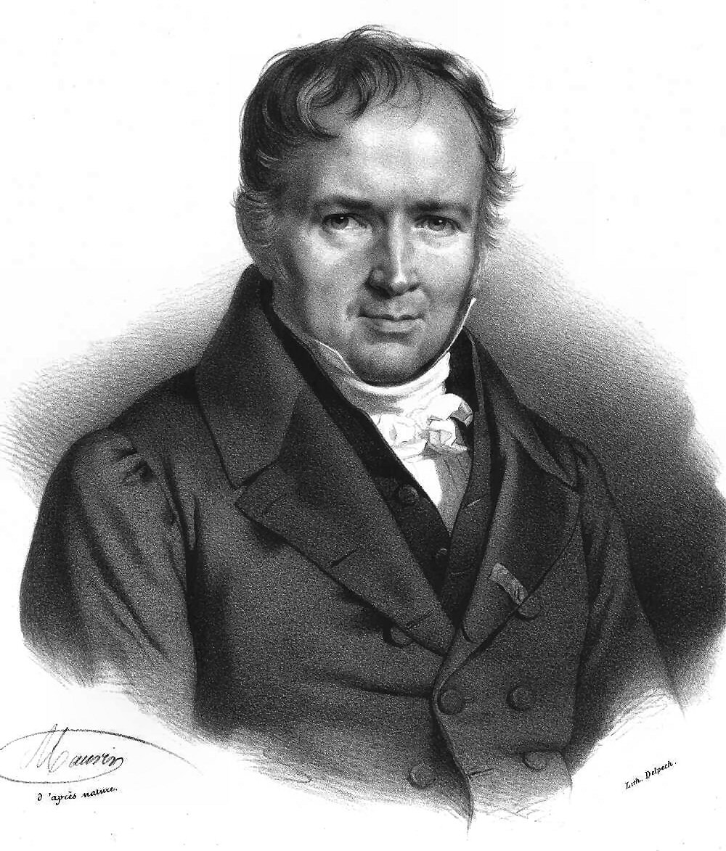
Common distributions: Poisson
Sim?on Denis Poisson (public domain / Wikipedia)

Slide 73
plotPois<-function(lambda,col,maxK=10){ x<-seq(0,maxK,by=1) px<-dpois(x,lambda=lambda) df<-tibble(x=x,px=px) g<-ggplot(data=df,mapping=aes(x=x,y=px)) + geom_bar(stat="identity",fill=col) + ylab("P(X=x)") + theme(text = element_text(size=20)) + ggtitle(paste(sep="","Poisson with rate=",lambda)) + scale_x_continuous(breaks=0:maxK) + coord_cartesian(xlim=c(-0.5,maxK+0.5),ylim=c(0,1)) return(g) } g1<-plotPois(0,"darkgrey"); g2<-plotPois(0.5,"steelblue") g3<-plotPois(1,"salmon"); g4<-plotPois(2,"greenyellow") g5<-plotPois(3,"mediumorchid"); g6<-plotPois(5,"orange") grid.arrange(g1,g2,g3,g4,g5,g6,ncol=3)

Slide 74
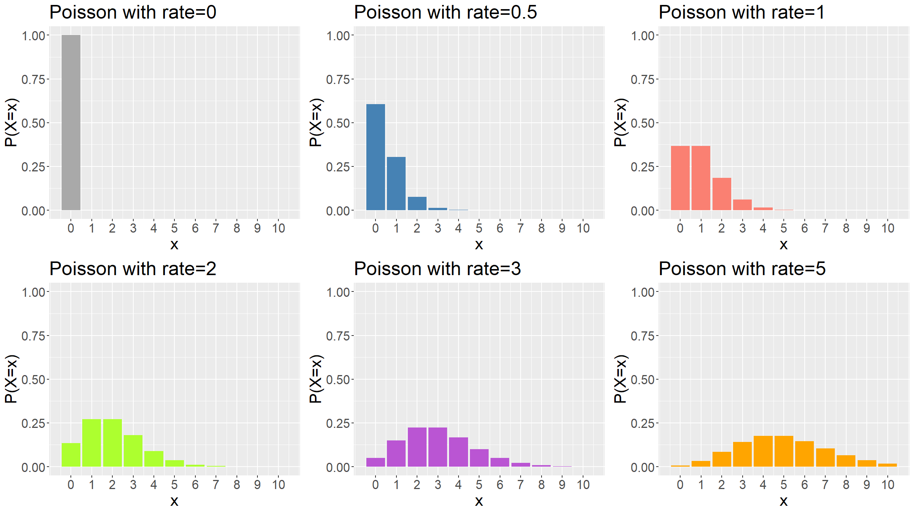

Slide 75
Common distributions: Negative binomial
$X∼ NB(k,p)$ if
$$P(X=x)=\left\{\begin{matrix}\left({x+k−1 \atop x}\right) p^{k} (1−p)^{x} & if x∈\{0,1,2,3…\} \\ 0 & otherwise\end{matrix}\right.$$
$$E(X)=\frac{k(1−p)}{p}, Var(X)=\frac{k(1−p)}{p^{2}}$$
This distribution arises if you count the number of failures in a sequence of identical and independent Bernoulli trials, each with probability of success $p$, until $k$ successes have been reached.
This is the parameterisation R is using.

Slide 76
Common distributions: Negative binomial
There are many alternative formulations / parameterisations for the Negative Binomial, so always check you know what the parameters mean (e.g. count the number of successes until a fixed number of failures have been reached).
Like the Poisson distribution, the negative binomial distribution is used in count data models. Unlike the Poisson it has 2 parameters, so is particularly useful when your counts show signs of overdispersion (i.e. larger variance than mean).
The negative binomial can be derived as a Gamma-Poisson mixture: Poisson distribution with variable rate parameter having a Gamma distribution.

Slide 77
Common distributions: Negative binomial
Example:
number of co-localised distant fragments in a genomic conformation capture experiment.
read counts per transcript in NGS transcriptomic data
number of larvae in a field
…

Slide 78
Common distributions: Negative binomial
plotNB<-function(k,p,col,maxK=25){ x<-seq(0,maxK,by=1) px<-dnbinom(x,size=k,prob=p) df<-tibble(x=x,px=px) g<-ggplot(data=df,mapping=aes(x=x,y=px)) + geom_bar(stat="identity",fill=col) + ylab("P(X=x)") + theme(text = element_text(size=20)) + ggtitle(paste(sep="","Negative binomial with k=",k,", p=",p)) + scale_x_continuous(breaks=0:maxK) + coord_cartesian(xlim=c(-0.5,maxK+0.5),ylim=c(0,1)) return(g) } g1<-plotNB(0,0.25,"darkgrey"); g2<-plotNB(1,0.25,"steelblue") g3<-plotNB(3,0.25,"salmon"); g4<-plotNB(0,0.6,"greenyellow") g5<-plotNB(1,0.6,"mediumorchid"); g6<-plotNB(3,0.6,"orange") grid.arrange(g1,g2,g3,g4,g5,g6,ncol=3)

Slide 79
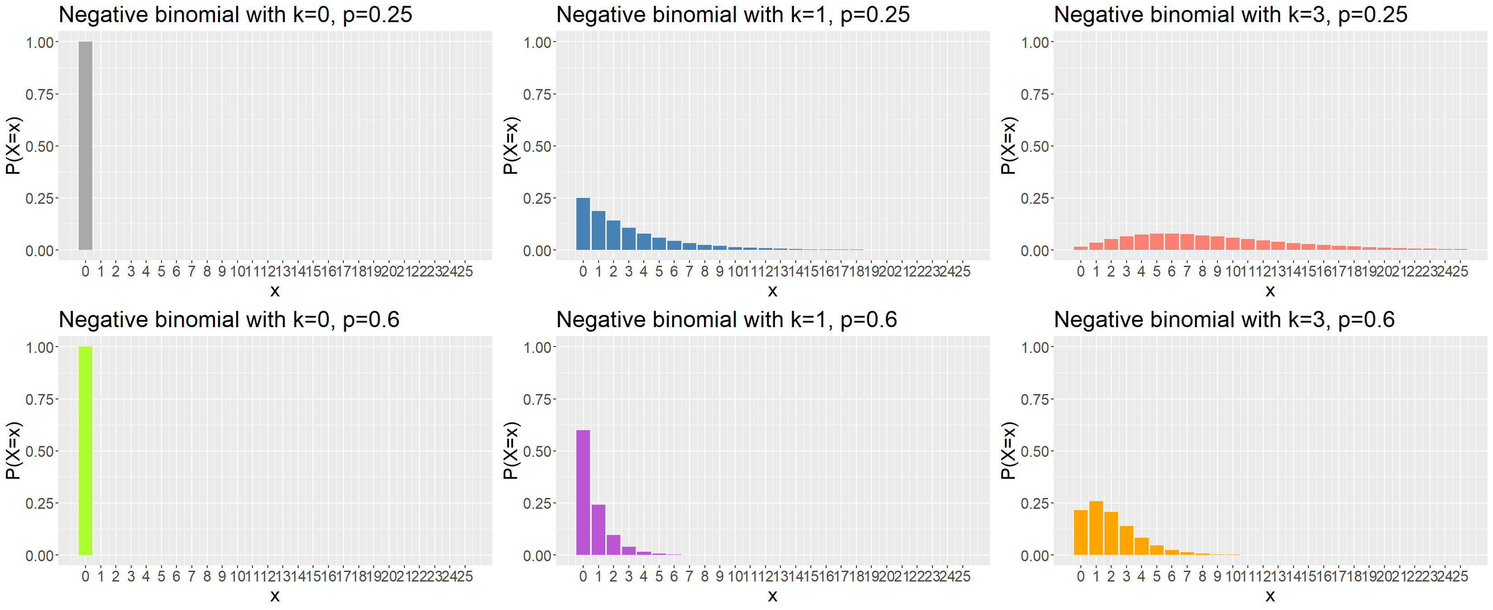

Slide 80
Common distributions: Geometric
$X∼ Geo(p)$ if
$$P(X=x)=\left\{\begin{matrix}p (1−p)^{x−1} & if x∈\{0,1,2,3…\} \\ 0 & otherwise\end{matrix}\right.$$
$$E(X)=\frac{1}{p}, Var(X)=\frac{1−p}{p^{2}}$$
This distribution arises if you count the number of trials until first success.
This is really just a special case of the Negative Binomial (for R’s parameterisation of the negative binomial, NB($1,p$)=Geo($1−p$)).

Slide 81
Common distributions: Uniform
$X∼ Unif(a,b)$ if
$$p(x)=\left\{\begin{matrix}\frac{1}{b−a} & if x∈[a,b] \\ 0 & otherwise\end{matrix}\right.$$
$$E(X)=\frac{b−a}{2}, Var(X)=\frac{(b−a)^{2}}{12}$$
This is the analogue, in the continuous case, of the discrete uniform.
For $a=0, b=1$ the distribution is often called the standard uniform. This is very important in sampling theory and algorithms.

Slide 82
Common distributions: Uniform
Any continuous distribution can be transformed to a uniform distribution by taking $F(X)=P(X≤x)$, the cumulative distribution function. $F(X)$ has a standard uniform distribution, whatever the distribution of $X$. this is important for copulas - a general technique for modelling joint distributions.
Example:
Take any statistical test involving a continuous distribution. If the null hypothesis is true, then the p-values of the test are standard uniformly distributed.

Slide 83
Common distributions: Uniform
plotUnif<-function(a,b,col,plotRange=c(-1,6)){ x<-seq(plotRange[1],plotRange[2],length=1000) px<-dunif(x,min=a,max=b) df<-tibble(x=x,px=px) g<-ggplot(data=df,mapping=aes(x=x,y=px)) + geom_line(colour=col,lwd=1.5) + geom_area(fill=col,alpha=0.25) + ylab("p(x)") + theme(text = element_text(size=20)) + ggtitle(paste(sep="","Uniform with a=",a,", b=",b)) + coord_cartesian(xlim=plotRange,ylim=c(0,2)) return(g) } g1<-plotUnif(0,0.5,"darkgrey"); g2<-plotUnif(0,1,"steelblue") g3<-plotUnif(0,2,"salmon"); g4<-plotUnif(1,5,"orange") grid.arrange(g1,g2,g3,g4,ncol=2)

Slide 84
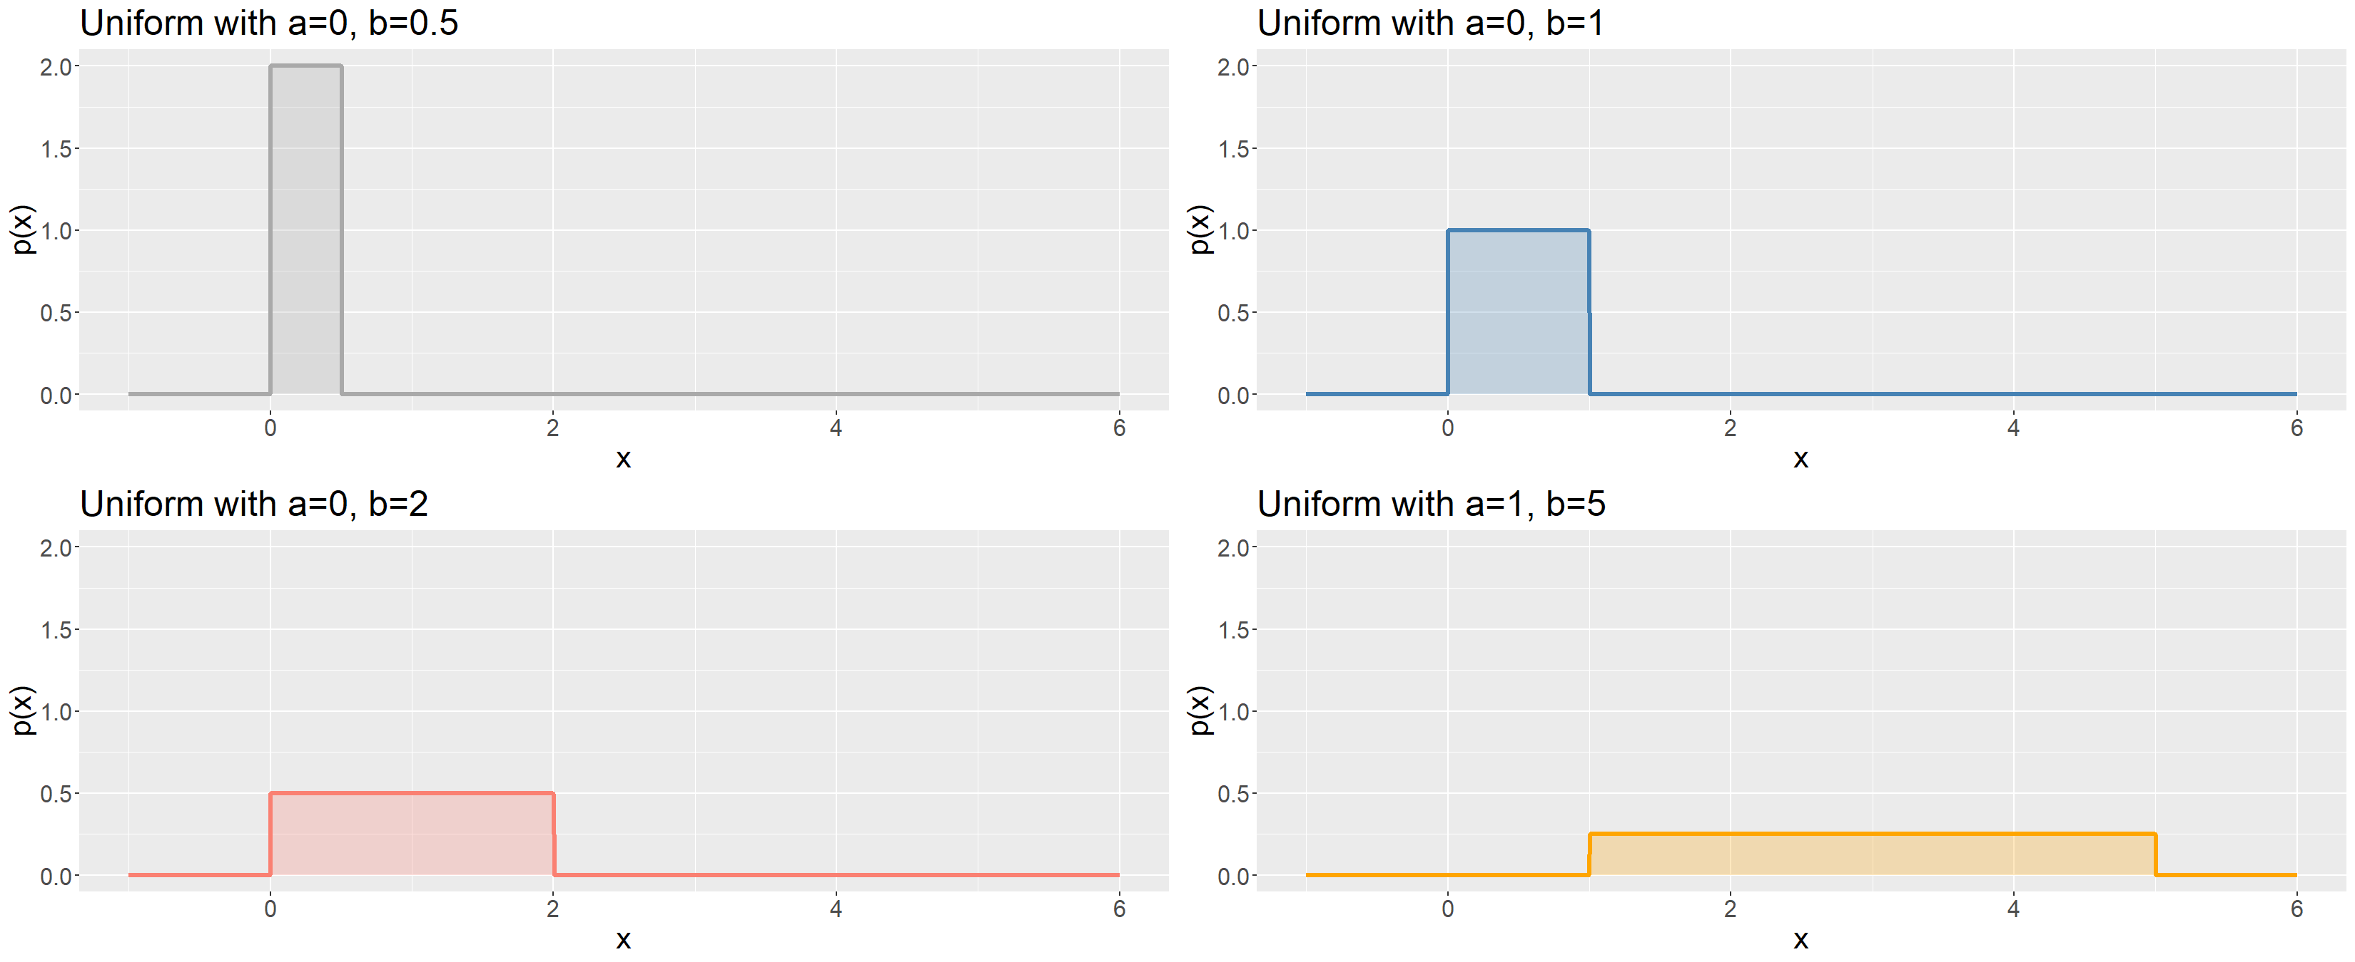

Slide 85
Common distributions: Exponential
$X∼ Exp(λ)$ if
$$p(x)=\left\{\begin{matrix}λe^{−λx} & if x>0 \\ 0 & otherwise\end{matrix}\right.$$
$$E(X)=\frac{1}{λ}, Var(X)=\frac{1}{λ^{2}}$$
The exponential distribution describes the waiting time between consecutive events in a Poisson process.
An important property of the exponential distribution is that it is memoryless: $P(X>x+y|X>y)=P(X>x)$.

Slide 86
Common distributions: Exponential
l<-1000; x<-seq(0,10,length=l) p1x<-dexp(x,rate=0.25); p2x<-dexp(x,rate=0.5) p3x<-dexp(x,rate=1); p4x<-dexp(x,rate=2) xFull<-rep(x,4); pFull<-c(p1x,p2x,p3x,p4x) pars<-factor(c(rep(1,l),rep(2,l),rep(3,l),rep(4,l))) df<-tibble(x=xFull,p=pFull,pars=pars) cols<-c("darkgrey", "steelblue", "salmon", "orange") labs<-paste(sep="","k=",c(0.25,0.5,1,2)) ggplot(data=df,mapping=aes(x=x,y=p,colour=pars,fill=pars)) + geom_line(lwd=1,alpha=0.75) + geom_area(alpha=0.1,position="dodge") + scale_color_manual(values=cols) + scale_fill_manual(values=cols,labels=labs) + labs(fill="parameters") + guides(colour=F) + ylab("density") + ggtitle("Exponential distributions") + theme(text = element_text(size=20))

Slide 87
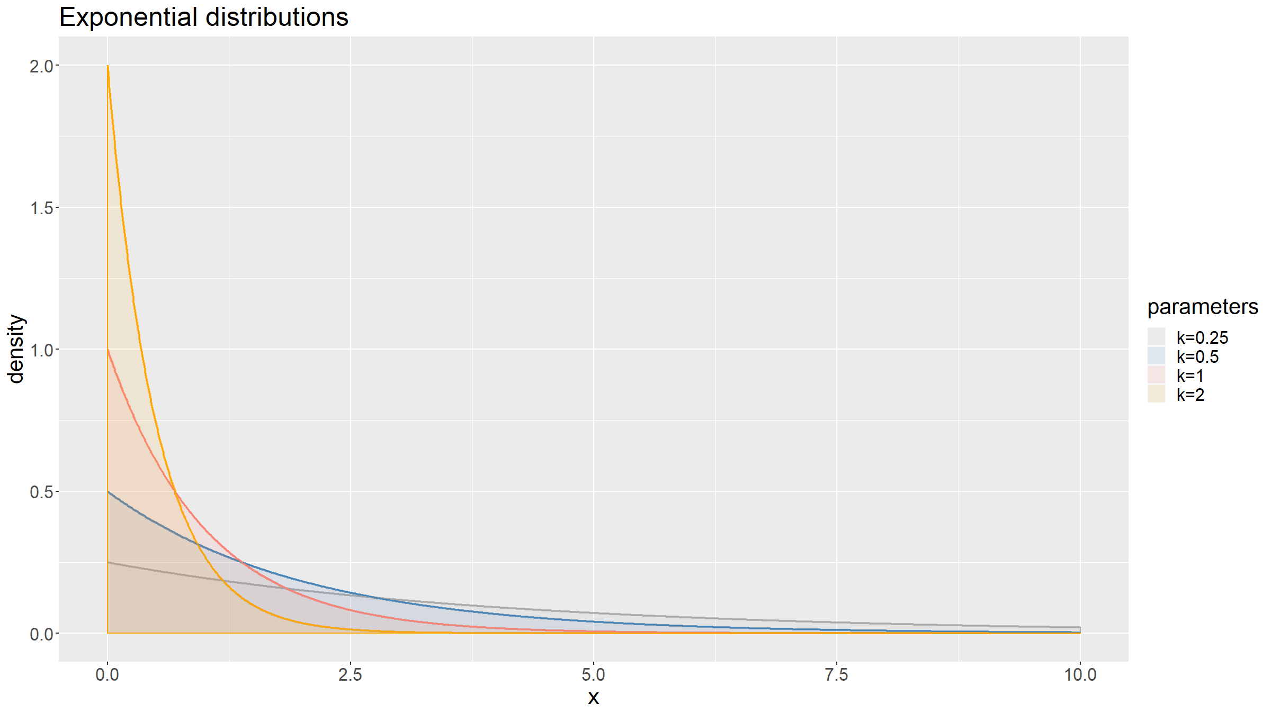

Slide 88
Common distributions: Gamma
$X∼Γ(α,β)$ if
$$p(x)=\left\{\begin{matrix}\frac{β^{α}x^{α−1}e^{−βx}}{Γ(α)} & if x>0 \\ 0 & otherwise\end{matrix}\right.$$
where $Γ(α)=\int_{0}^{∞}{z^{α−1}}e^{−z}dz$ is the gamma function.
$$E(X)=\frac{α}{β}, Var(X)=\frac{α}{β^{2}}$$

Slide 89
Common distributions: Gamma
The gamma distribution arises as a sum of independent exponentially distributed random variables.
It is an important conjugate prior distribution in Bayesian statistics.
Example:
Inter-spike intervals in neuroscience.

Slide 90
Common distributions: Gamma
l<-1000; x<-seq(0,20,length=l) p1x<-dgamma(x,shape=1,rate=0.5); p2x<-dgamma(x,shape=1,rate=2) p3x<-dgamma(x,shape=0.5,rate=1); p4x<-dgamma(x,shape=2,rate=1) p5x<-dgamma(x,shape=4,rate=1); p6x<-dgamma(x,shape=8,rate=1) xFull<-rep(x,6); pFull<-c(p1x,p2x,p3x,p4x,p5x,p6x) pars<-factor(c(rep(1,l),rep(2,l),rep(3,l),rep(4,l),rep(5,l),rep(6,l))) df<-tibble(x=xFull,p=pFull,pars=pars) cols<-c("darkgrey", "steelblue", "salmon", "orange", "greenyellow", "mediumorchid") labs<-c(expression(paste(sep="",alpha,"=1, ",beta,"=0.5")), expression(paste(sep="",alpha,"=1, ",beta,"=2")), expression(paste(sep="",alpha,"=0.5, ",beta,"=0.5")), expression(paste(sep="",alpha,"=2, ",beta,"=1")), expression(paste(sep="",alpha,"=4, ",beta,"=1")), expression(paste(sep="",alpha,"=8, ",beta,"=1")))

Slide 91
Common distributions: Gamma
ggplot(data=df,mapping=aes(x=x,y=p,colour=pars,fill=pars)) + geom_line(lwd=1,alpha=0.75) + geom_area(alpha=0.1,position="dodge") + scale_color_manual(values=cols) + scale_fill_manual(values=cols,labels=labs) + labs(fill="parameters") + guides(colour=F) + ylab("density") + ggtitle("Gamma distribution") + theme(text = element_text(size=20)) + coord_cartesian(ylim=c(0,1.5))

Slide 92
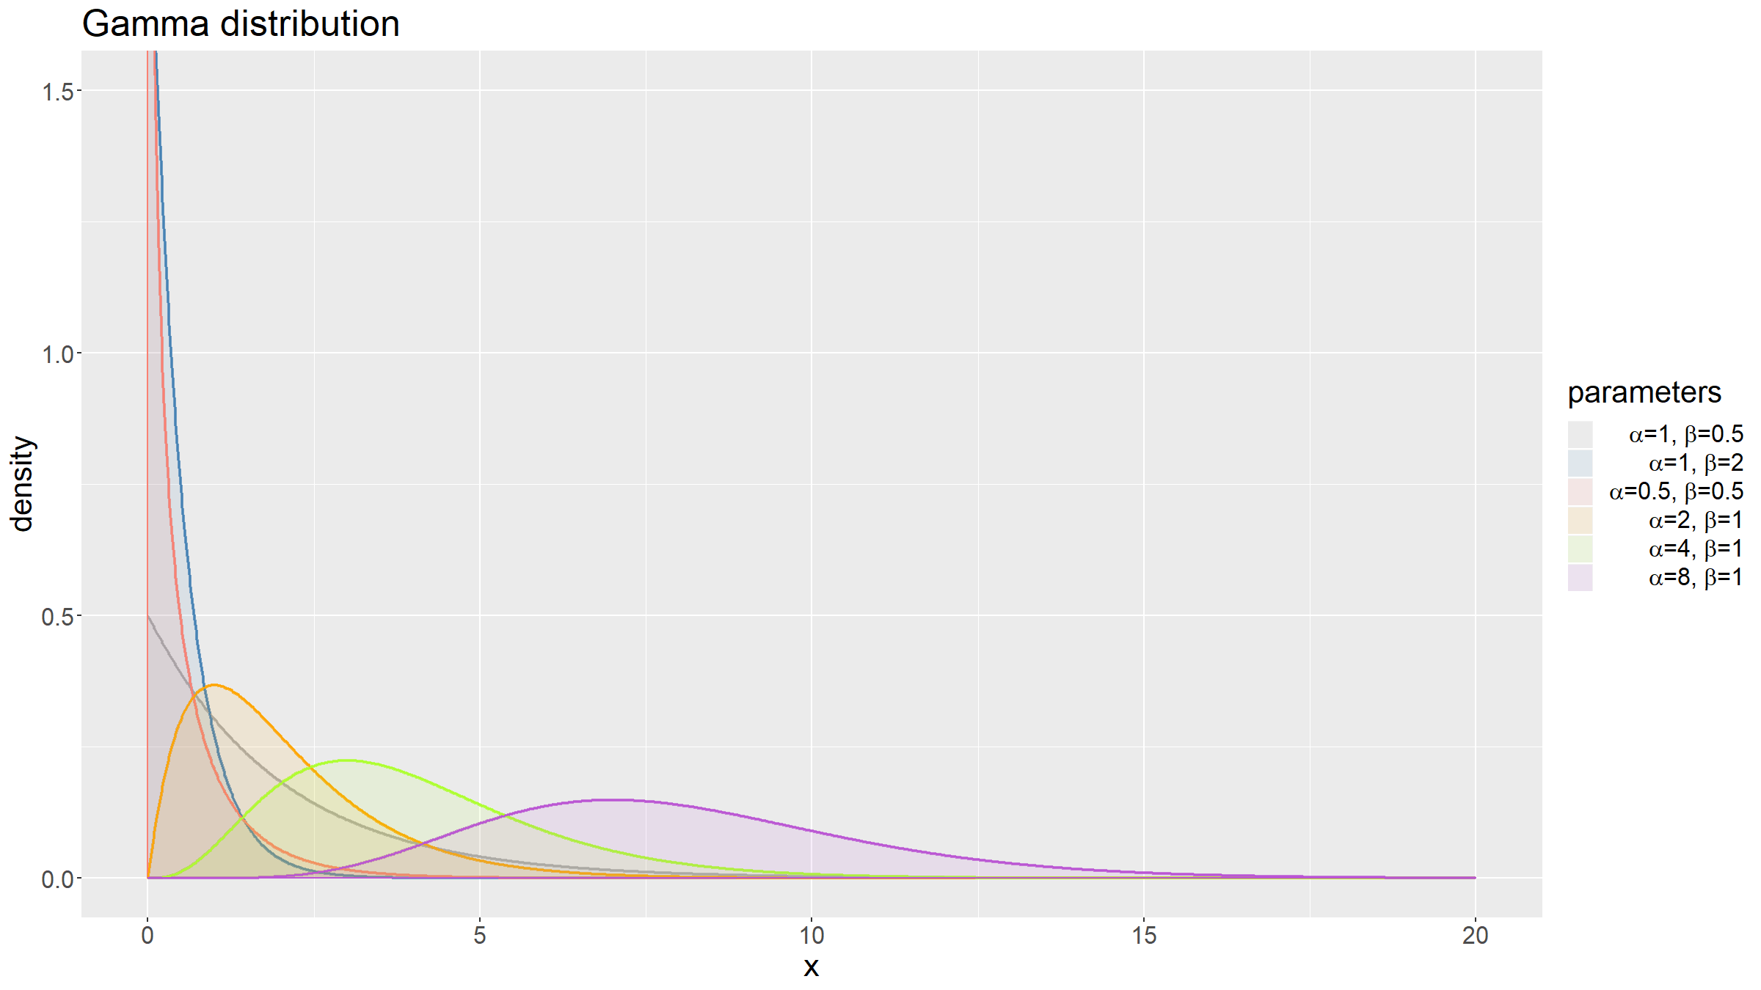

Slide 93
Common distributions: Beta
$X∼β(α,β)$ if
$$p(x)=\left\{\begin{matrix}\frac{x^{α−1}(1−x)^{β−1}}{B(α,β)} & if x∈[0,1] \\ 0 & otherwise\end{matrix}\right.$$
where $B(α,β)=\frac{Γ(α)Γ(β)}{Γ(α+β)}$
$$E(X)=\frac{α}{α+β}, Var(X)=\frac{αβ}{(α+β)^{2}(α+β+1)}$$

Slide 94
Common distributions: Beta
A flexible distribution useful to model continuous variables with support on an interval of finite length.
An important conjugate prior distribution in Bayesian statistics for a number of discrete distributions.

Slide 95
Common distributions: Beta
l<-1000; x<-seq(0,1,length=l) p1x<-dbeta(x,shape1=0.5,shape2=0.5); p2x<-dbeta(x,shape1=1,shape2=1) p3x<-dbeta(x,shape1=2,shape2=2); p4x<-dbeta(x,shape1=1,shape2=3) p5x<-dbeta(x,shape1=2,shape2=5); p6x<-dbeta(x,shape1=5,shape2=1) xFull<-rep(x,6); pFull<-c(p1x,p2x,p3x,p4x,p5x,p6x) pars<-factor(c(rep(1,l),rep(2,l),rep(3,l),rep(4,l),rep(5,l),rep(6,l))) df<-tibble(x=xFull,p=pFull,pars=pars) cols<-c("darkgrey", "steelblue", "salmon", "orange", "greenyellow", "mediumorchid") labs<-c(expression(paste(sep="",alpha,"=0.5, ",beta,"=0.5")), expression(paste(sep="",alpha,"=1, ",beta,"=1")), expression(paste(sep="",alpha,"=2, ",beta,"=2")), expression(paste(sep="",alpha,"=1, ",beta,"=3")), expression(paste(sep="",alpha,"=2, ",beta,"=5")), expression(paste(sep="",alpha,"=5, ",beta,"=1")))

Slide 96
Common distributions: Beta
ggplot(data=df,mapping=aes(x=x,y=p,colour=pars,fill=pars)) + geom_line(lwd=1,alpha=0.75) + geom_area(alpha=0.1,position="dodge") + scale_color_manual(values=cols) + scale_fill_manual(values=cols,labels=labs) + labs(fill="parameters") + guides(colour=F) + ylab("density") + ggtitle("Beta distribution") + theme(text = element_text(size=20)) + coord_cartesian(ylim=c(0,3))

Slide 97
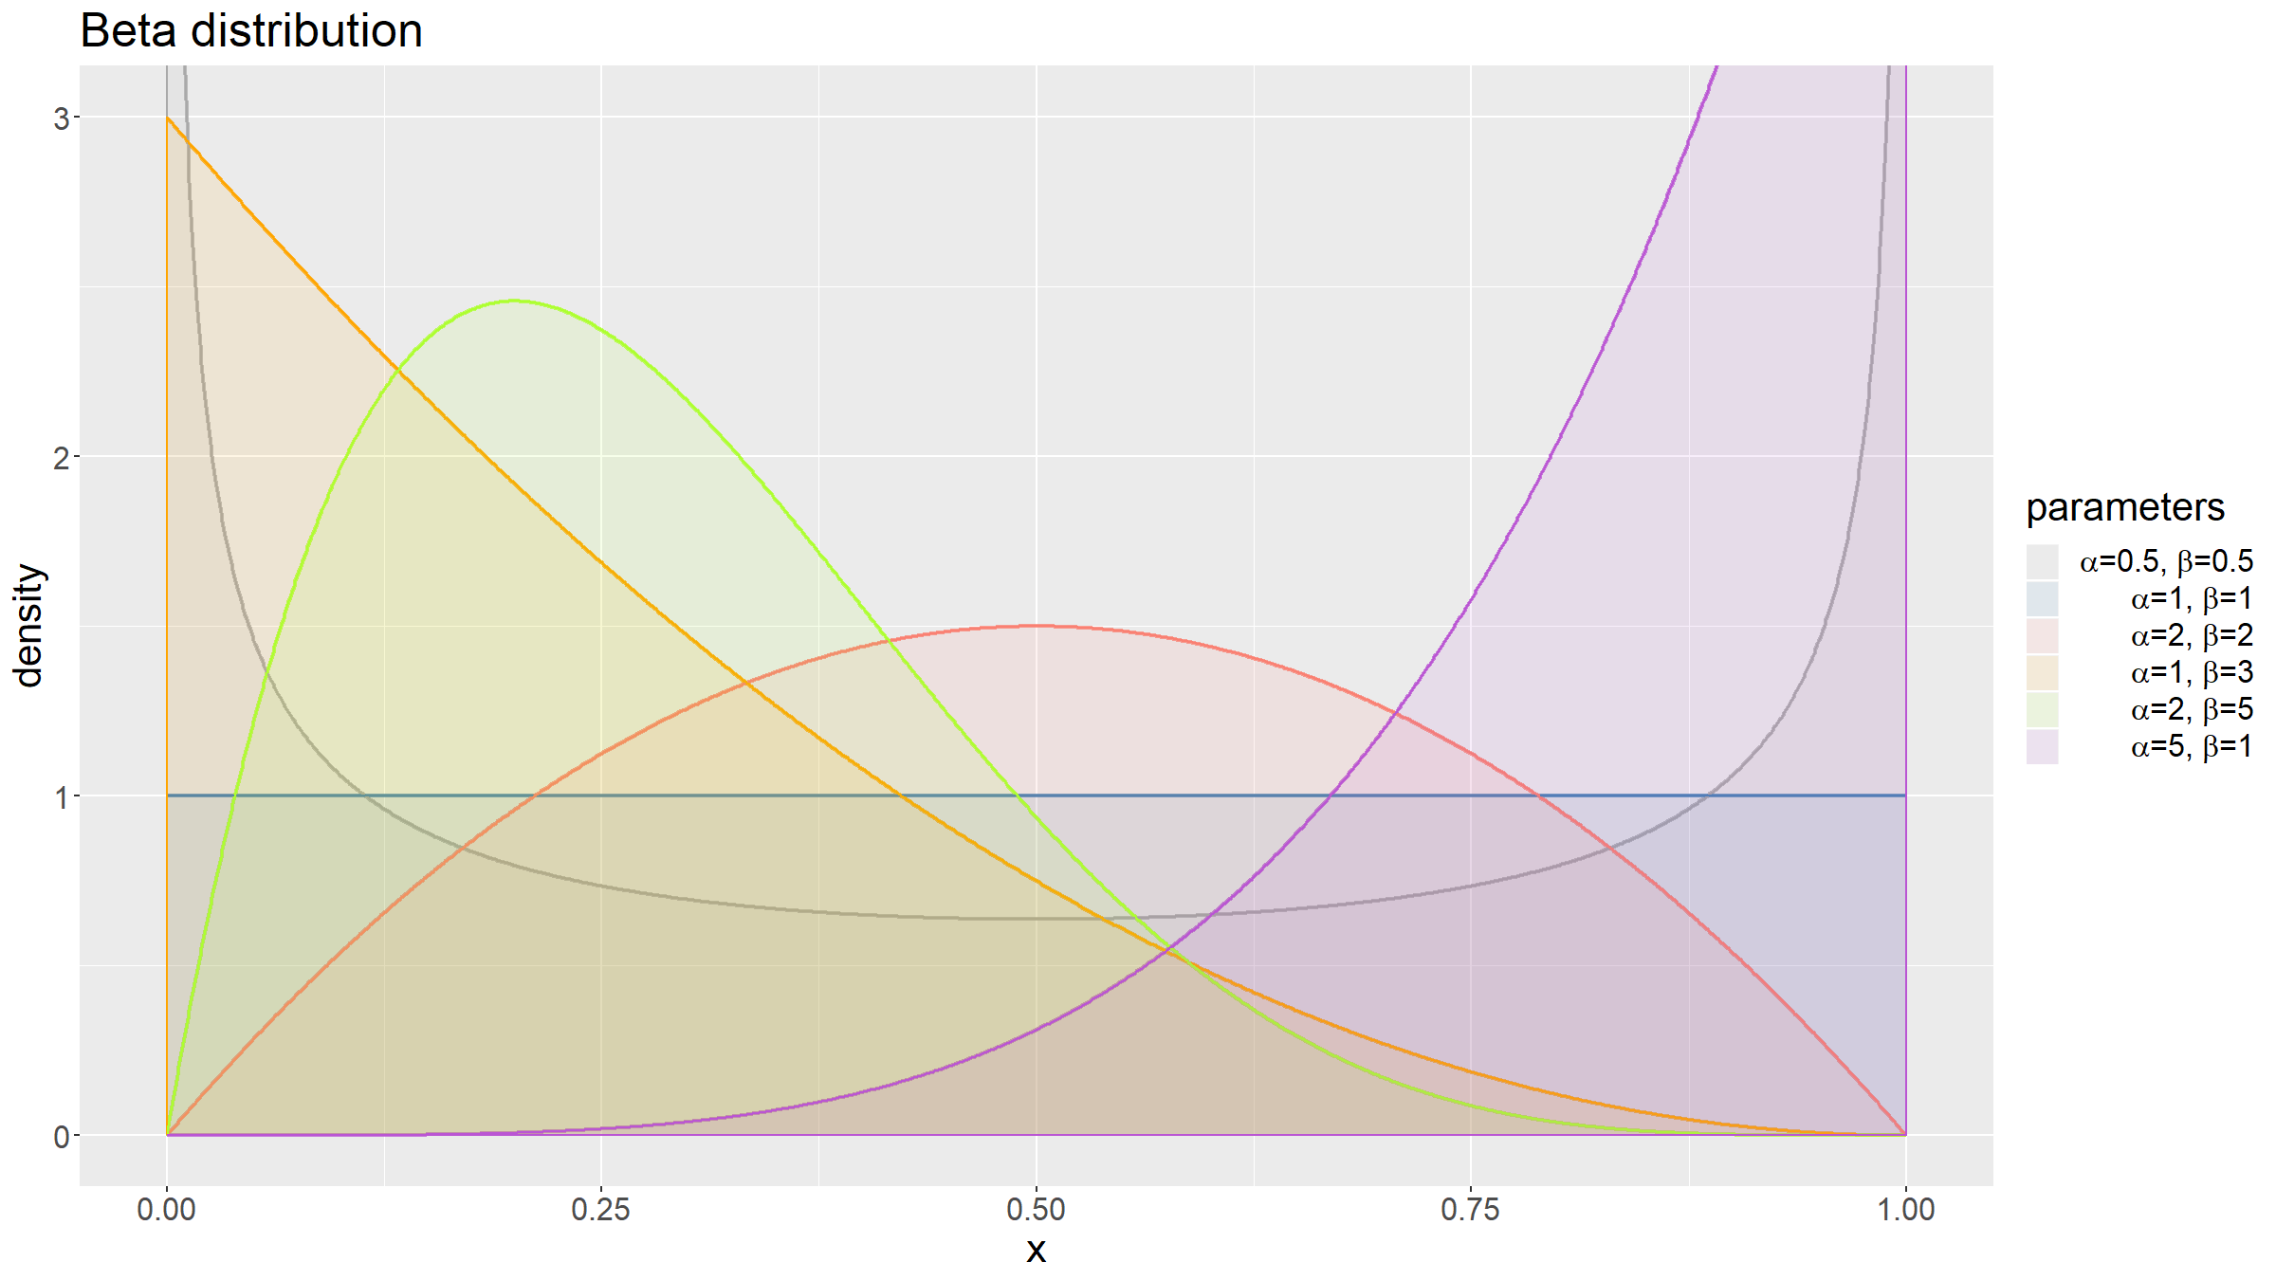

Slide 98
Common distributions: Normal / Gaussian
$X∼N(μ,σ^{2})$ if
$$p(x)=\frac{1}{\sqrt{2πσ^{2}}}e^{−\frac{(x−μ)^{2}}{2σ^{2}}}$$
$$E(X)=μ, Var(X)=σ^{2}$$
This distribution is very important.
Because of the Central Limit Theorem, the normal distribution both arises in many real life situations and plays a major role in statistical inference.

Slide 99
Common distributions: Normal / Gaussian
The normal distribution is characteristed by a symmetric bell-shaped curve around the mean.
Important special case: $N(0,1)$, the standard normal.
Example:
A random variable measuring the height of men.

Slide 100
Common distributions: Normal / Gaussian
l<-1000; x<-seq(-5,5,length=l) p1x<-dnorm(x,mean=0,sd=1); p2x<-dnorm(x,mean=0,sd=2) p3x<-dnorm(x,mean=0,sd=0.5); p4x<-dnorm(x,mean=2,sd=1) xFull<-rep(x,4); pFull<-c(p1x,p2x,p3x,p4x) pars<-factor(c(rep(1,l),rep(2,l),rep(3,l),rep(4,l))) df<-tibble(x=xFull,p=pFull,pars=pars) cols<-c("darkgrey", "steelblue", "salmon", "orange") labs<-c(expression(paste(sep="",mu,"=0, ",sigma,"=1")), expression(paste(sep="",mu,"=0, ",sigma,"=2")), expression(paste(sep="",mu,"=0, ",sigma,"=0.5")), expression(paste(sep="",mu,"=2, ",sigma,"=1")))

Slide 101
Common distributions: Normal / Gaussian
ggplot(data=df,mapping=aes(x=x,y=p,colour=pars,fill=pars)) + geom_line(lwd=1,alpha=0.75) + geom_area(alpha=0.25,position="dodge") + scale_color_manual(values=cols) + scale_fill_manual(values=cols,labels=labs) + labs(fill="parameters") + guides(colour=F) + ylab("density") + ggtitle("Normal distribution") + theme(text = element_text(size=20))

Slide 102
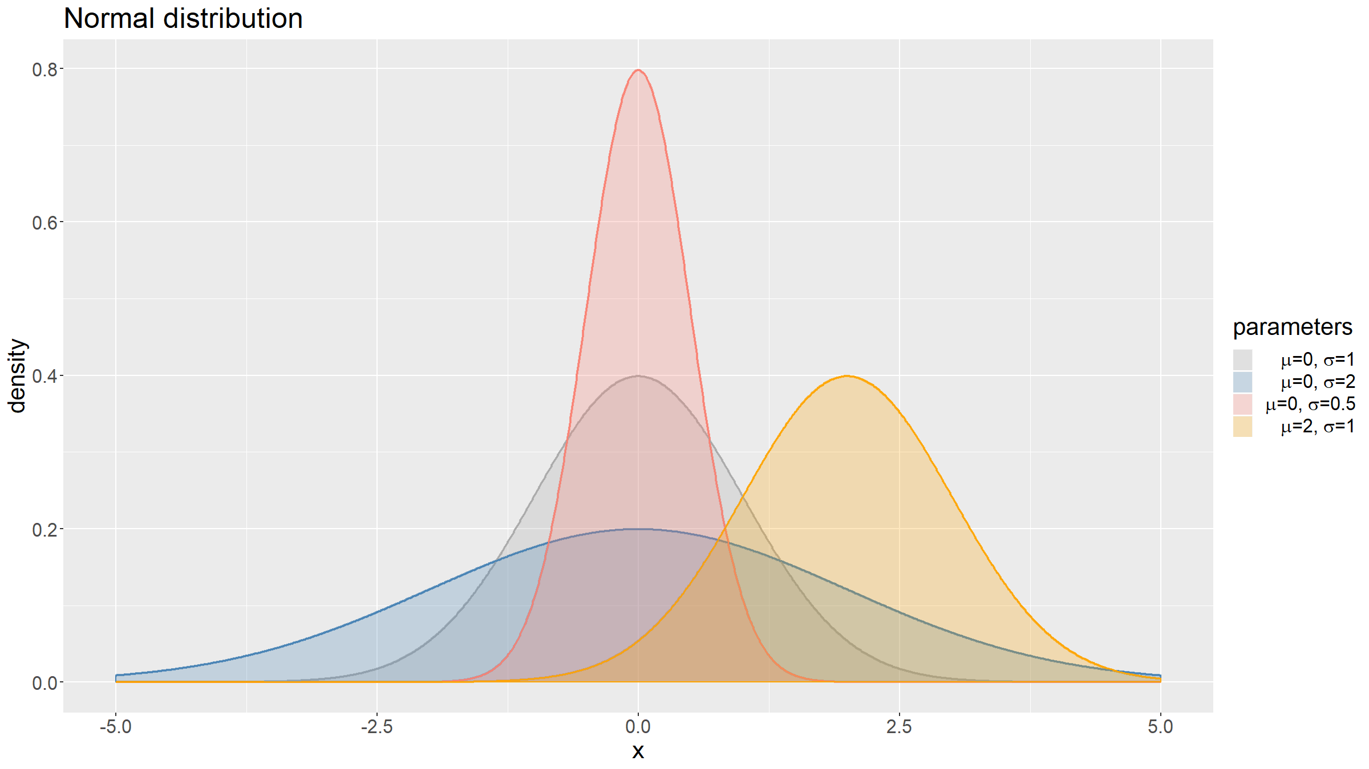

Slide 103
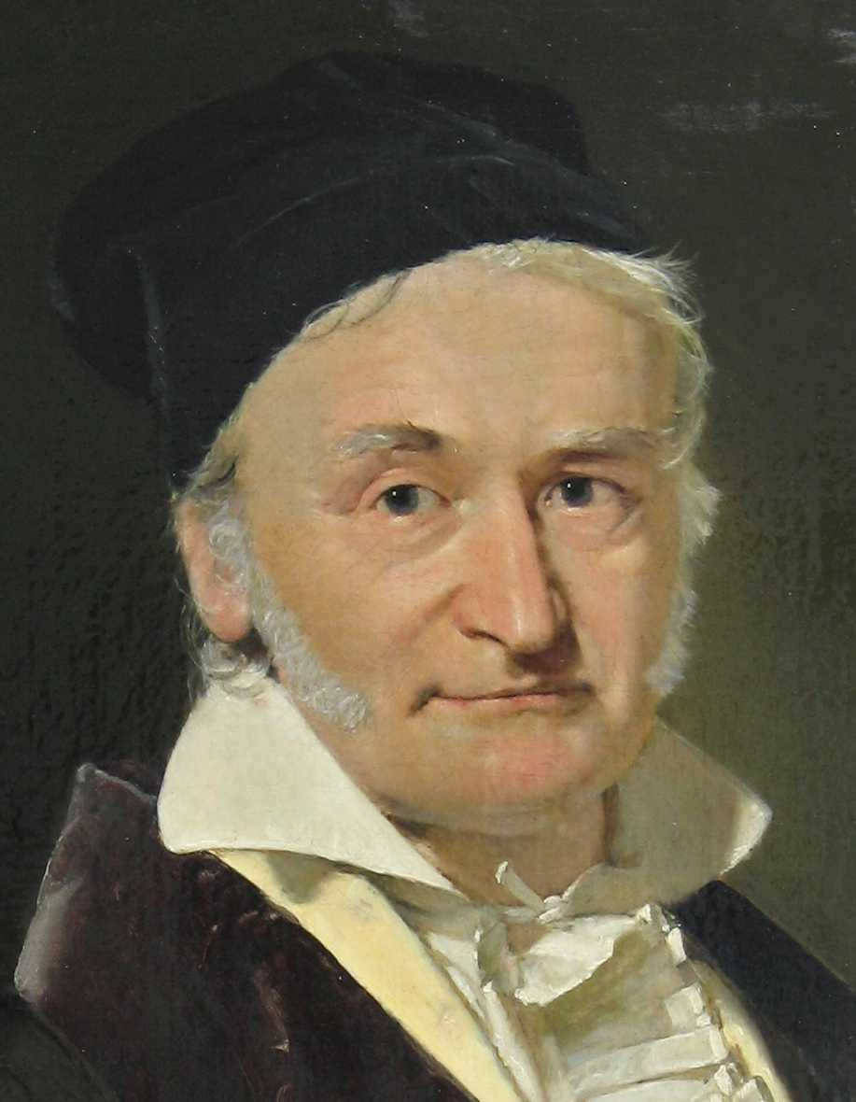
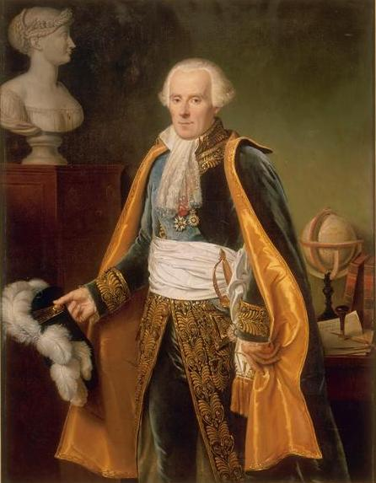
Common distributions: Normal / Gaussian
Carl Friedrich Gauss (public domain / Wikipedia)
Pierre Simon Laplace (public domain / Wikipedia)

Slide 104
Common distributions: Chi-squared
The sum of $k$ independent, standard normal distributed random variables follows a $χ^{2}$ distribution with $k$ degrees of freedom.
$$Z_{i}\underset{iid}{∼}N(0,1),i=1,...,k ⇒ X=\sum_{i=1}^{k}{Z_{i}^{2}}∼χ_{k}^{2}$$
$$E(X)=k, Var(X)=2k$$
Important in statistical hypothesis testing, more rarely used to directly model data.

Slide 105
Common distributions: Student’s t
This distribution arises in parameter estimation and hypothesis testing.
Let $X_{i}∼_{iid}N(μ,σ^{2}),i=1,...,n$. Define
$\overline{X}=\frac{1}{n}\sum_{i=1}^{n}{X_{i}}$ and $S^{2}=\frac{1}{n−1}\sum_{i=1}^{n}{(}X_{i}−\overline{X})^{2}$
Then
$$T=\frac{\overline{X}−μ}{S/\sqrt{n}}∼t_{n−1}$$

Slide 106
Common distributions: Student’s t
The degrees of freedom of the distribution, $ν=n−1$ above, does not need to be integer valued, but can take any real value $ν>0$.
$$E(X)=1 if ν>1 otherwise undefined$$
$$Var(X)=ν/(ν−2) if ν>2, ∞ if 1<ν≤2, undefined otherwise$$
Like the normal distribution, the t distribution is bell-shaped, but has heavier tails, meaning observations further away from the mean are more likely.

Slide 107
Common distributions: Student’s t
l<-1000; x<-seq(-8,8,length=l) p1x<-dt(x,df=0.25); p2x<-dt(x,df=1) p3x<-dt(x,df=5); p4x<-dt(x,df=100) xFull<-rep(x,4); pFull<-c(p1x,p2x,p3x,p4x) pars<-factor(c(rep(1,l),rep(2,l),rep(3,l),rep(4,l))) df<-tibble(x=xFull,p=pFull,pars=pars) cols<-c("darkgrey", "steelblue", "salmon", "orange") labs<-paste(sep="","k=",c(0.25,1,5,100)) ggplot(data=df,mapping=aes(x=x,y=p,colour=pars,fill=pars)) + geom_line(lwd=1,alpha=0.75) + geom_area(alpha=0.05,position="dodge") + scale_color_manual(values=cols) + scale_fill_manual(values=cols,labels=labs) + labs(fill="parameters") + guides(colour=F) + ylab("density") + ggtitle("Student's t distribution") + theme(text = element_text(size=20))

Slide 108
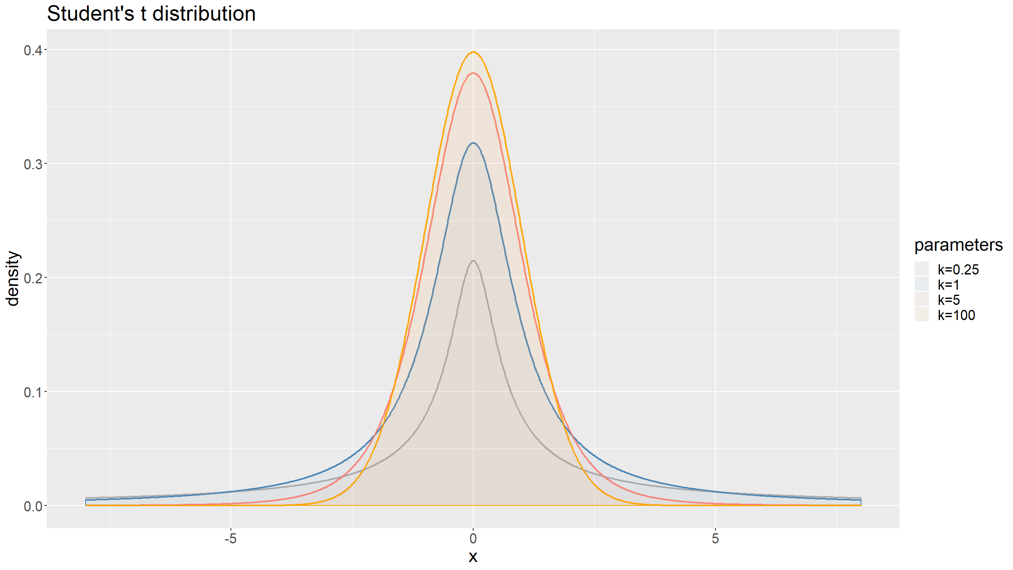

Slide 109
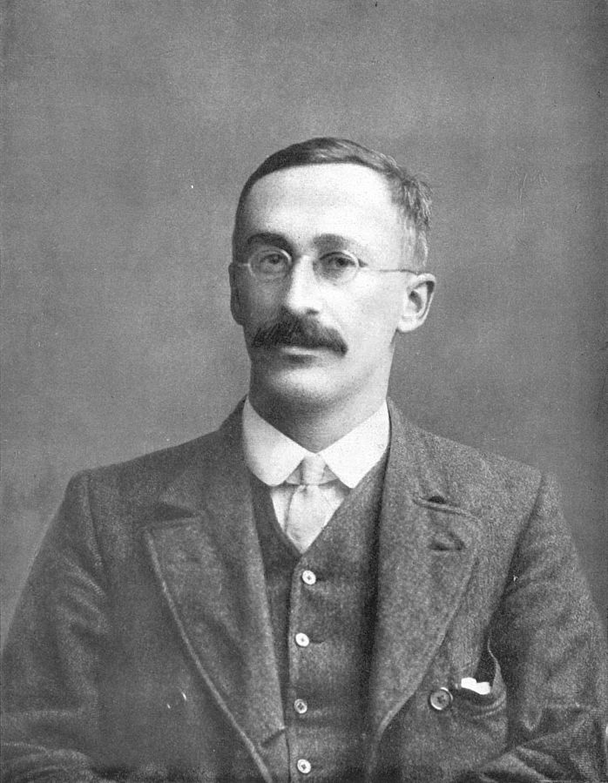
Common distributions: Student’s t
William Sealy Gosset, aka “Student” (public domain / Wikipedia)

Slide 110
Common distributions: F
Also a distribution that arises as the null hypothesis of a test statistic.
If two independent random variables $X_{1}∼χ_{k1}^{2}$, $X_{2}∼χ_{k2}^{2}$, then
$$F=\frac{X_{1}/k_{1}}{X_{2}/k_{2}}∼F_{k_{1},k_{2}}$$

Slide 111
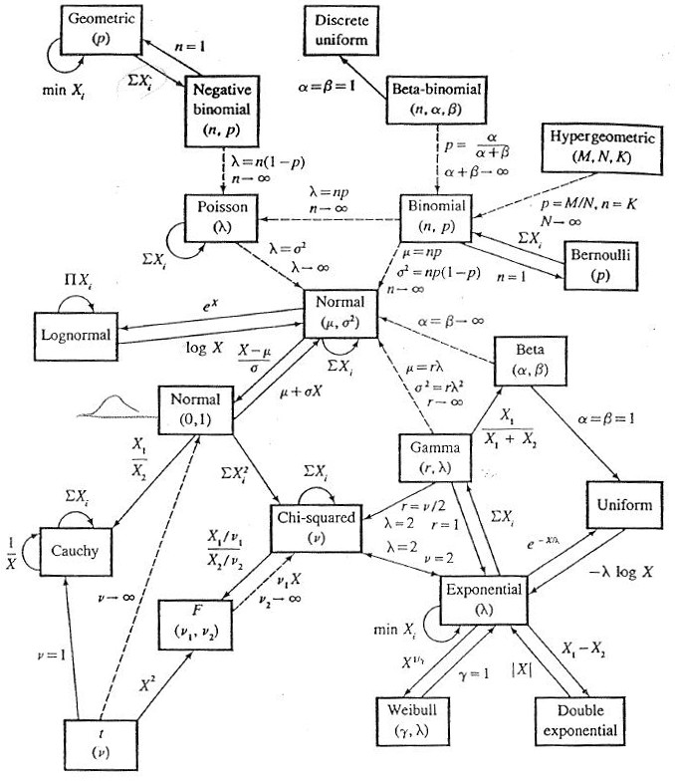
Common distributions: relationships
Relationships between common distributions. (Casella, G., Berger, R.L. (2002), Statistical Inference, 2nd ed., Duxbury)

Slide 112
Central Limit Theorem

Slide 113
Sampling distributions
Almost all of the studies you will work on will consist of drawing one (or several) samples that permits you to make inferences about a population (or several) of interest.
How you sample from your population will impact your analysis. Objective assessment can only be made for probability samples, i.e. for samples where the inclusion probability is known and positive for every unit in the target population. In a simple random sample all units are sampled with equal probability from the target population.
For every unit in the sample you observe one or several variables. In probability samples, these can be viewed as random variables.

Slide 114
Sampling distributions
Usually we are not interested in the individual outcomes of the sample, but rather in some sample statistic. A statistic is a function of the sample observations $X_{i}$ and is therefore itself a random variable.
Examples
the sample mean $\overline{X}=\frac{1}{n}\sum_{i=1}^{n}{X_{i}}$ (sample fraction if $X_{i}$ binary)
the sample variance $S^{2}=\frac{1}{n−1}\sum_{i=1}^{n}{(}X_{i}−\overline{X})^{2}$

Slide 115
Sampling distributions
The probability distribution of a sample statistic is called its sampling distribution.
In practice it can be hard to derive the sampling distribution analytically and we need to rely on approximations of this distibution based on so called asymptotic results.
The most important of these results is the Central Limit Theorem.

Slide 116
Law of Large Numbers
Let $X_{1},...,X_{n}$ be a sequence of iid random variables, with $X_{i}∼F$, where F is a distribution with some finite mean $μ$ and a finite variance $σ^{2}$. Let ${\overline{X}}_{n}=\frac{1}{n}\sum_{i=1}^{n}{X_{i}}$ be the sample average.
The Law of Large Numbers (LLN) states that as $n→∞$, ${\overline{X}}_{n}→μ$
Note that there is a strong and a weak version of this law, depending on what exactly you mean by “$→$” and they differ slightly in necessary conditions for them to hold.

Slide 117
Central Limit Theorem
While the LLN states that a sample average will get closer and closer to the true mean as the number of samples increases, fluctuating ever more closely around this value, the Central Limit Theorem (CLT) goes a step further and describes the distribution of these fluctuations.
Let $X_{1},...,X_{n}$ a sequence of iid random variables, $X_{i}∼F$ a distribution with finite mean $μ$ and finite variance $σ^{2}$. Then
$$\frac{\overline{X}−μ}{σ/\sqrt{n}}\overset{D}{→}N(0,1)$$
where $\overset{D}{→}$ denotes convergence in distribution.

Slide 118
Central Limit Theorem
The CLT is central / key in statistics because:
Any statistic that is a sum of enough random variables with similar distributions will be approximately normally distributed.
The normal distribution can be used to approximate the sampling distributions of many statistics, and the statistical theory for the normal distribution can be used to derive properties.
Examples
Normal approximation to the binomial.
t test robust against deviations from normality.
Height distributions of humans.

Slide 119
Central Limit Theorem
generateMeans<-function(n=c(1,2,5,10,50,100,500,1000),col=cols,N=1e4,rDistFun,xlim=NULL,...){ sim<-matrix(nrow=N,ncol=length(n)) for(j in 1:length(n)){for(i in 1:N){ sim[i,j]<-mean(rDistFun(n[j],...)) }} par(mar=c(1.5,2.5,1.5,0.5),mfrow=c(length(n),1)) for(j in 1:length(n)){ if(length(xlim)<2){ hist(breaks=100,sim[,j],main=paste(sep="","n = ",n[j]),yaxt="n",col=col[j]) }else{ hist(breaks=100,sim[,j],main=paste(sep="","n = ",n[j]),xlim=xlim,yaxt="n",col=col[j]) } } }

Slide 120
Central Limit Theorem
generateMeans(rDistFun=rnorm,xlim=c(-3,3))

Slide 121
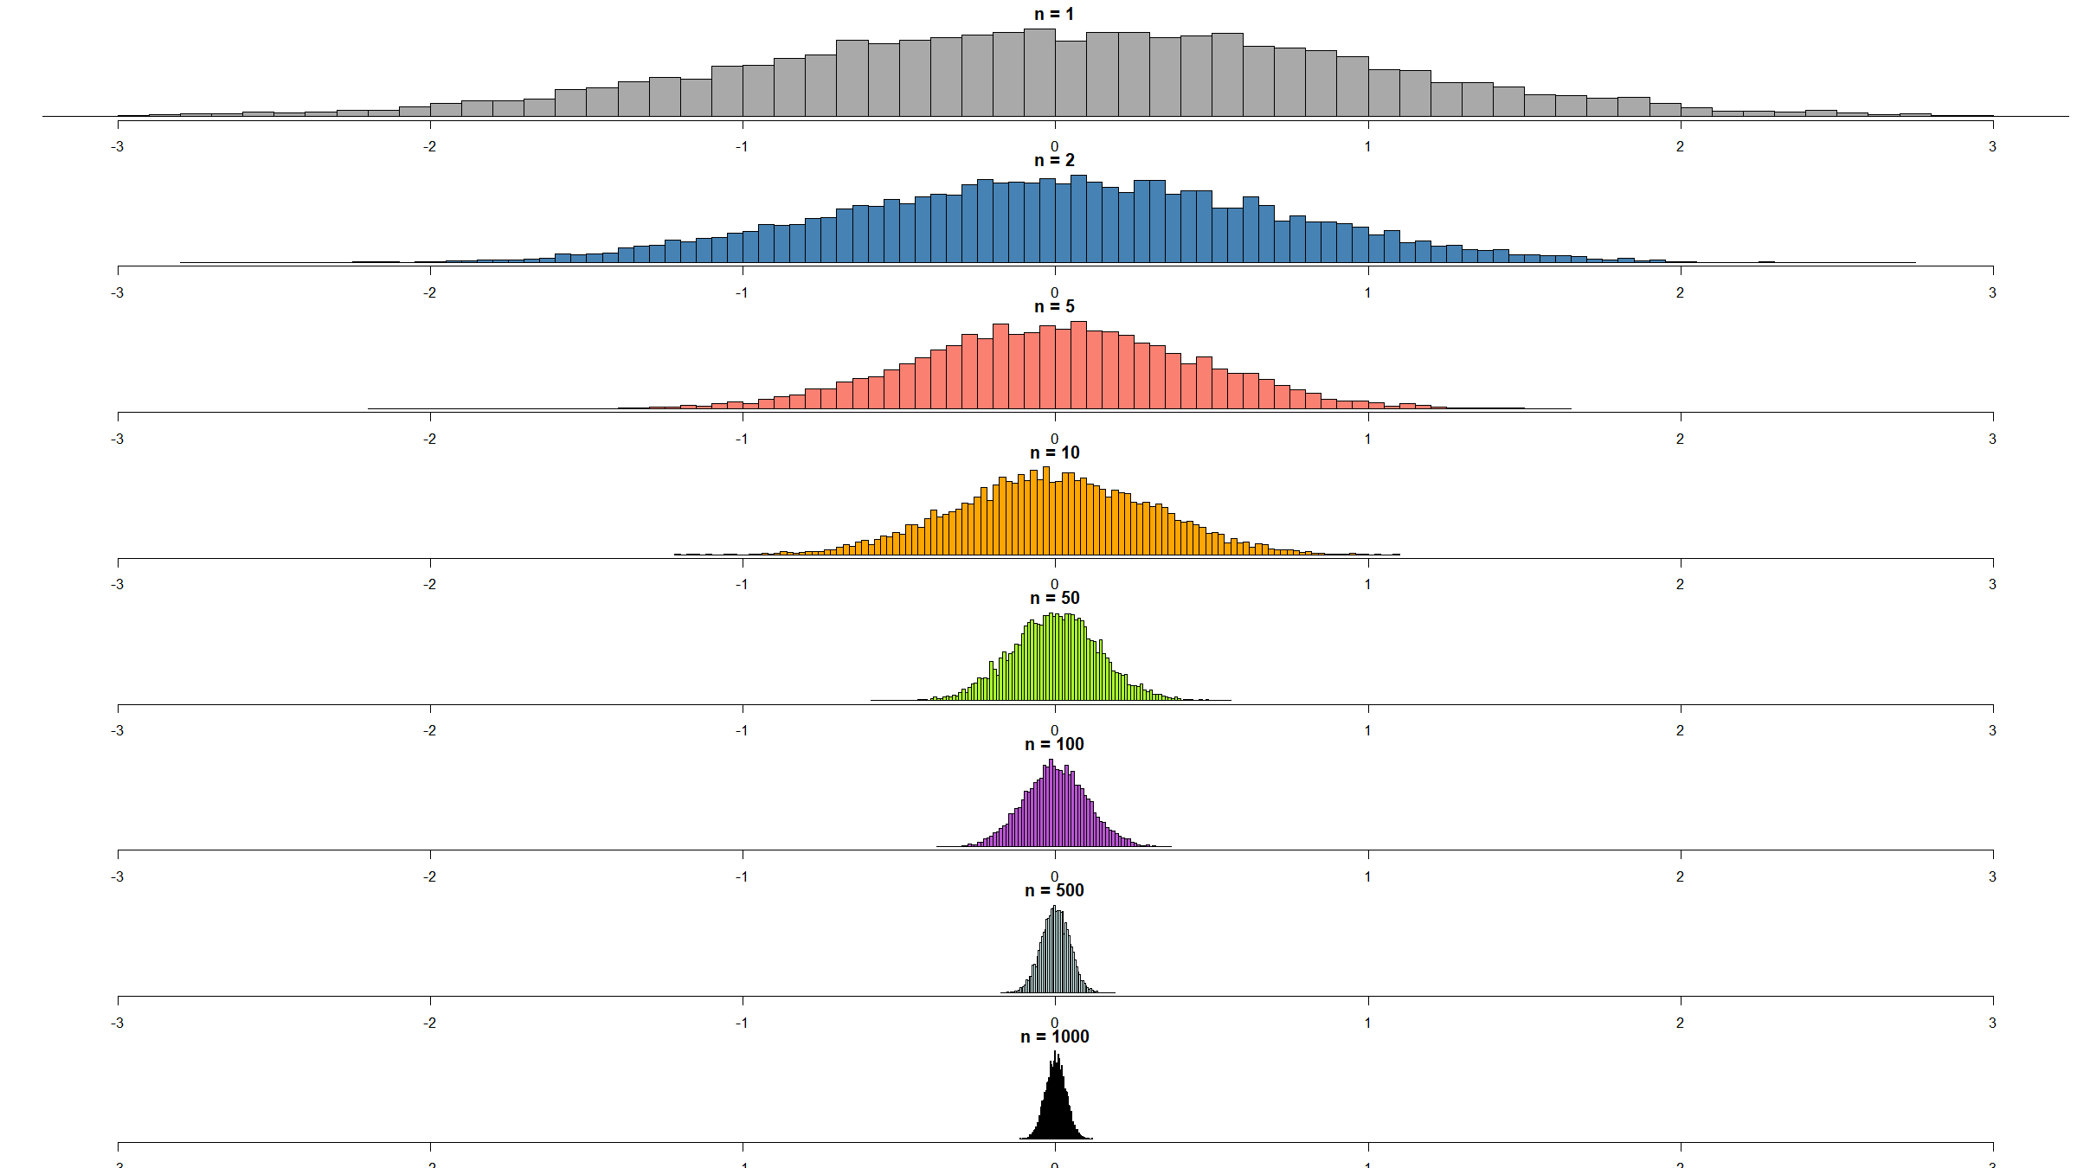

Slide 122
Central Limit Theorem
generateMeans(rDistFun=rbeta,shape1=0.5,shape2=0.5,xlim=c(0,1))

Slide 123
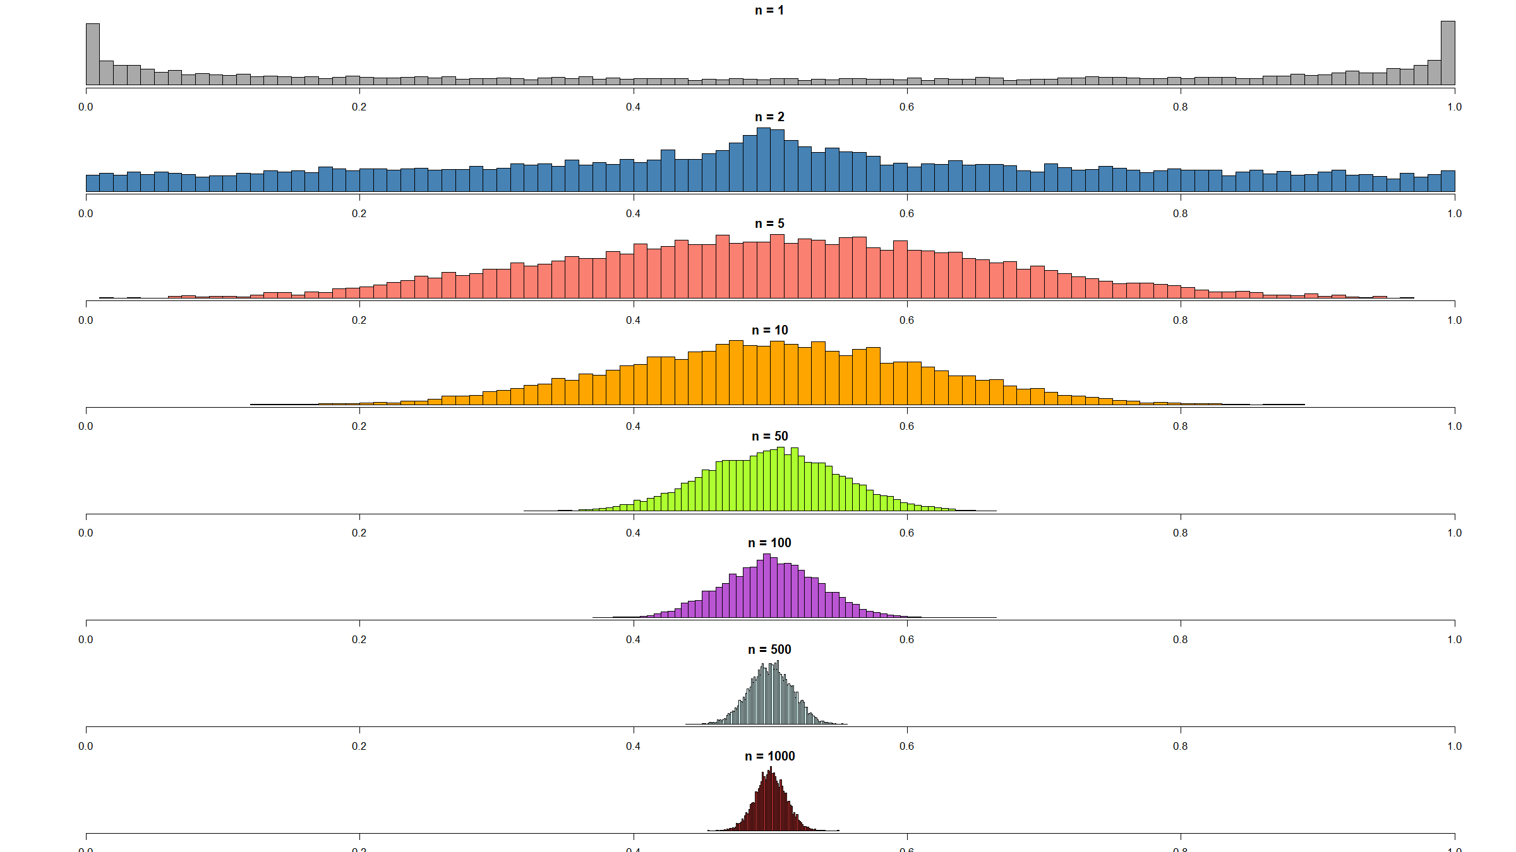

Slide 124
Central Limit Theorem
generateMeans(rDistFun=rbinom,size=2,prob=0.25,xlim=c(0,2))

Slide 125
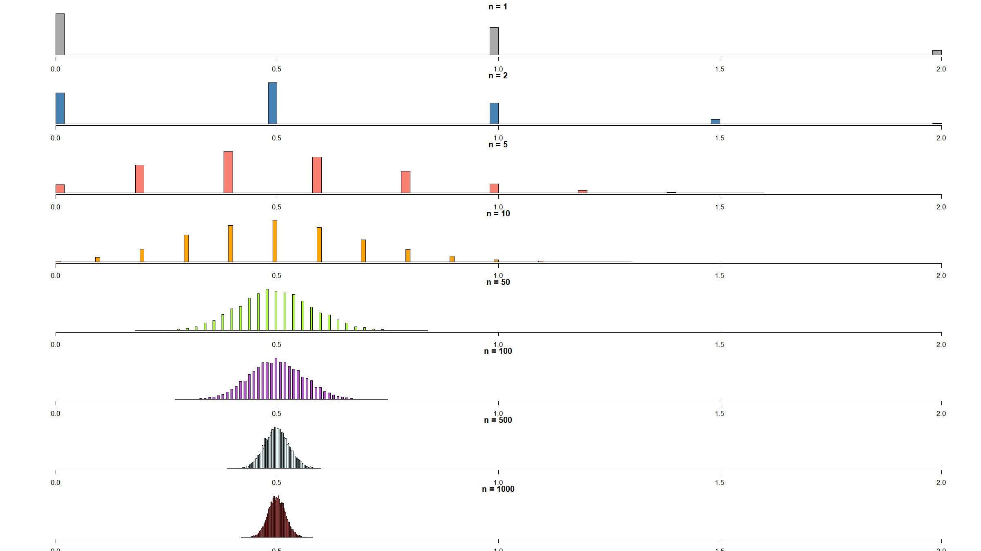

Slide 126
Simulating data

Slide 127
Simulating data
You have seen common distributions in this session and how / when they arise.
You have seen commands in R (e.g. rnorm(), rpois()) to generate draws from specific distributions.
This and your expert knowledge about the types of diseases and populations you study, can allow you to generate artificial data according to a hypothesised model. This is called simulating data.
This can be useful in its own right, but most helpful at the planning stages for a study: it can allow you to compute more accurate sample sizes than when relying on simple, approximate formulas (which you will cover tomorrow).

Slide 128
Simulating data
Example
You plan to run a vaccine trial. You will randomise 800 participants to the placebo and 800 participants to the experimental vaccine arms respectively. Your primary outcome is the number of events requiring hospitalisation over 1 year.
From previous data you expect the control group to have a rate of 0.3 events per person-year and the vaccine group a rate of 0.25 events per person-year. Due to loss-to-follow-up you expect each participant, in each group, to contribute on average 0.87 years of observation time over the study period.

Slide 129
Simulating data
Example (cont’d)
Simulate data like this 5,000 times and plot the distributions of the estimated event rates in each group.
How many times is the estimated rate in the vaccine group lower than the one in the control group?

Slide 130
Simulating data
simFun<-function(N,r1,r2,n1,n2,obsTime){ df<-data.frame(treat=factor(c(rep("placebo",n1),rep("vaccine",n2)))) for(j in 1:N){ df[,paste(sep="","sim",j)]<-c(rpois(n1,lambda=r1*obsTime),rpois(n2,lambda=r2*obsTime)) } return(df) } N<-5e3 df<-simFun(N=N,r1=0.3,r2=0.25,n1=800,n2=800,obsTime=0.87) estRates<-data.frame( treat=factor(c(rep("placebo",N),rep("vaccine",N))), rate=c(apply(FUN=mean,MARGIN=2,X=df[df$treat=="placebo",-1]), apply(FUN=mean,MARGIN=2,X=df[df$treat=="vaccine",-1]))/0.87)

Slide 131
Simulating data
ggplot(data=estRates,mapping=aes(x=rate,fill=treat)) + geom_histogram(bins=50,position="dodge") + ggtitle("Distribution of estimated event rates") + theme(text = element_text(size=20))

Slide 132
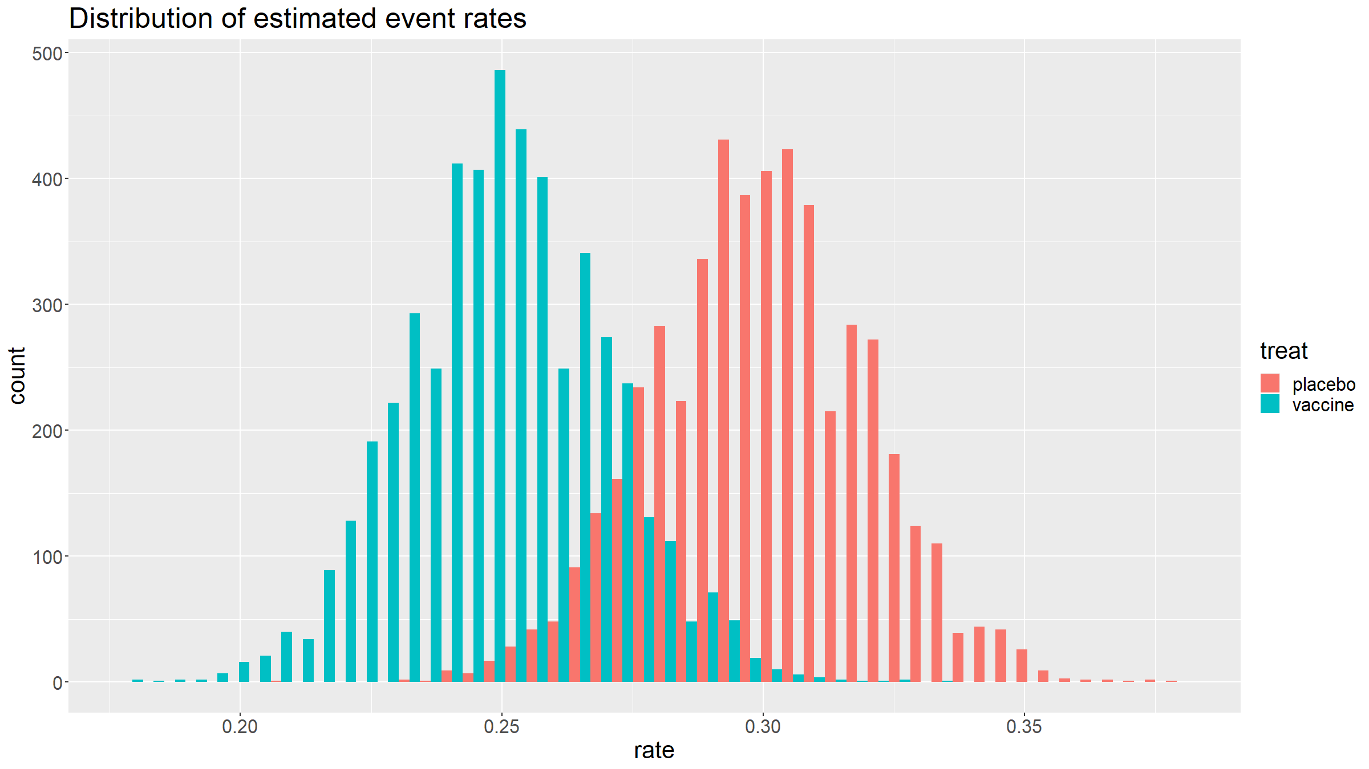

Slide 133
print(sum(estRates$rate[estRates$treat=="vaccine"]<estRates$rate[estRates$treat=="placebo"]))
## [1] 4790

Slide 134
Simulating data
Exercise
Think about a study you are working on.
Can you think of a model that could generate data that you are collecting / are plannning to collect? Try simulating data for your study.

Slide 135
Simulating data
Binary distributions
rbinom(n,size=1,prob)
sample(size,x=c("cat1","cat2"),prob=c(p,1-p),replace=T)
Count data
rbinom(n,size,prob)
rgeom(n,prob)
rpois(n,lambda)
rnbinom(n,size,prob)
Continuous variables
runif(n,min,max)
rnorm(n,mean,sd)
rexp(n,rate)
rt(m,df)
rgamma(n,shape,rate)
rbeta(n,shape1,shape2)
…

Slide 136
[end of Session 1]

