Slide 1
MSc Bioinformatics
James Chirombo

Slide 2
Hypothesis testing

Slide 3
Outline
Definition
T tests
One sample and two sample t test
Paired t tests
One way analysis of variance (anova)
Non-parametric tests
Non-parametric equivalent of the above tests
Tests for proportions
One sample / two sample proportion test
Use of p-values in statistics

Slide 4
Preliminaries
Read in the data that was previously shared:
The data are in CSV format
df <- read.csv("btTBreg.csv",header = TRUE)

Slide 5
Statistical hypothesis
Definition:
Definition: A supposition, arrived at from observation or reflection, that leads to refutable predictions
Any claim cast in a form that will allow it to be tested and refuted
A statement that we make about a population parameter that can be tested after drawing a sample.
For example, one can hypothesize that the average age at first marriage among girls in Blantyre rural is 20.
A new mosquito trap is more effective than the standard trap.
This hypothesis has to be tested and conclusion made.

Slide 6
Steps in hypothesis testing
Come up with the hypothesis
Formulate the hypothesis – both null and alternative
Set the decision rule
Collect data
Calculate the test statistics.
Construct rejection regions.
Obtain p-value based on a known distribution and make decision.
Interpret p-value and make conclusion.

Slide 7
Statistical hypothesis testing
Is there a statistically significant “difference”?
OR “effect”, or “association” or “relationship”.
Is the observed difference due to chance?

Slide 8
When can hypothesis testing be used
Hypothesis testing can be done in different scenarios
Is there a difference in means
Is there a difference in proportions
Difference in odds rations or relative risks

Slide 9
Null hypothesis
Definition 1: There is NO association between the risk factor and outcome in a population.
Definition 2: The hypothesis that the factor of interest is not associated with or not different from another factor or a pre-specified value.
Example:
There is no difference in the efficacy of a new drug (Drug A) for malaria prophylaxis in contrast to a currently approved drug (Drug B).
Formal basis for testing statistical significance.
Start with proposition that there is no difference.
Statistical tests can estimate the probability an observed association could be due to chance.

Slide 10
Alternative hypothesis
Is generally the hypothesis that is believed by the researcher.
Is the opposite of the null hypothesis.
One-tailed Hypotheses: (one-sided) specifies a direction of association between a predictor and outcome variable.
E.g. The new drug (Drug A) for malaria prophylaxis has better efficacy in preventing malaria in contrast to a currently approved drug (Drug B).
Two-tailed Hypotheses: (two-sided) specifies only that an association exists; it does not specify a direction.
E.g. The new drug (Drug A) for malaria prophylaxis has a different efficacy in preventing malaria in contrast to a currently approved drug (Drug B).
In other words, Drug A could be worse than Drug B OR Drug A could be better than Drug B.

Slide 11
Type I and Type II Errors
Type I error: (False positive) reject a null hypothesis that is actually true in a population.
In other words saying that the new drug (Drug A) for malaria prophylaxis has better efficacy in preventing malaria in contrast to a currently approved drug (Drug B), when it does not.
Type II error: (False negative) fail to reject a null hypothesis that is actually false in the population.
In other words saying that there is no difference in the efficacy of a new drug (Drug A) for malaria prophylaxis in contrast to a currently approved drug (Drug B), when Drug A is better than Drug B

Slide 12
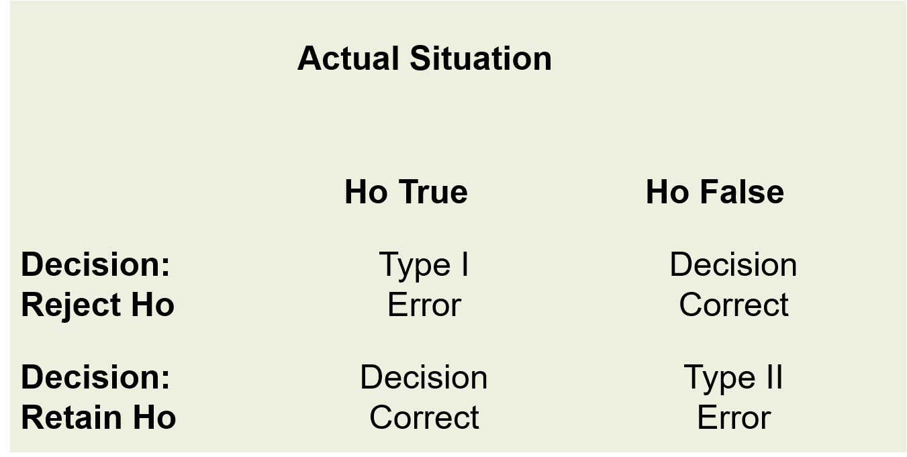
Errors in hypothesis testing
Types of errors in hypothesis testing

Slide 13
Alpha and Beta
Alpha $α$: The probability of making a Type I error (rejecting the null hypothesis when it is true).
Beta $β$: The probability of making a Type II error (failing to reject the null hypothesis when it is actually false).
Power = 1-β (The probability of finding a significant result if one exists)
Ideally alpha and beta would be set to zero.
In practice they are made as small as possible.
Reducing them requires an increase in sample size.
Most studies use an alpha=0.05 and a beta=0.20.

Slide 14
One-sample t test
This test is used to check whether a sample mean is different from a known/hypothesized mean
How different is the sample mean from the true population mean
Continuous data
Assumptions:
Random sample from the population
The data must be continuous
Data must follow the normal distribution

Slide 15
One-sample t test
Suppose we want to test the hypothesis that the mean age is 24
$$H_{0}:μ=24$$
$$H_{1}:μ≠24$$
This is a two-sided test.

Slide 16
Check the assumptions
Histogram to check normality.
par(cex.axis=2,cex.lab=2) hist(df$age, main = "Distribution of age", xlab = "Age", freq = FALSE, col = "#ffa500")

Slide 17
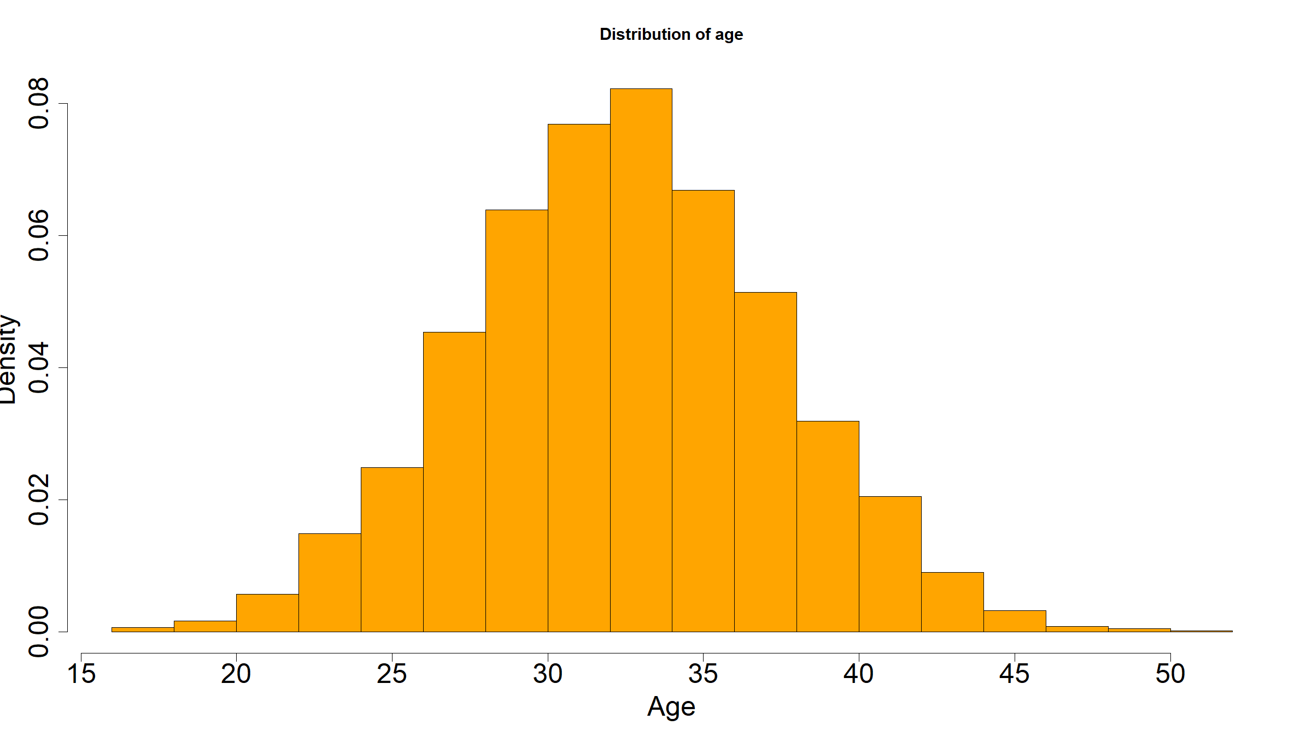

Slide 18
One sample t-test
t.test(df$age,mu=24)
## ## One Sample t-test ## ## data: df$age ## t = 98.616, df = 2999, p-value < 2.2e-16 ## alternative hypothesis: true mean is not equal to 24 ## 95 percent confidence interval: ## 32.76225 33.11775 ## sample estimates: ## mean of x ## 32.94

Slide 19
One sample t-test - one sided
t.test(df$age,mu=24,alternative="less")
## ## One Sample t-test ## ## data: df$age ## t = 98.616, df = 2999, p-value = 1 ## alternative hypothesis: true mean is less than 24 ## 95 percent confidence interval: ## -Inf 33.08916 ## sample estimates: ## mean of x ## 32.94

Slide 20
Two sample t-test
The data are continuous
The data must follow a normal distribution
The two samples are independent
Both samples are random samples of the respective underlying population
The variances within the two groups are equal (homoscedasticity)

Slide 21
Two sample t-test
In the dataset provided, it is hypothesized that the mean age is the same for both men and women.
We can test this hypothesis
$$H_{0}:μ_{1}=μ_{2}$$
$$H_{1}:μ_{1}≠μ_{2}$$

Slide 22
Assumptions
Check if the two populations are normally distributed.
par(mfrow=c(1,2), cex.axis=2,cex.lab=2) hist(df$age[df$sex==1],main="Histogram for Age: Males",xlab = "Age", col = "#0e9ed8") hist(df$age[df$sex==2],main="Histogram for Age: Females",xlab = "Age", col = "#ff9994")

Slide 23
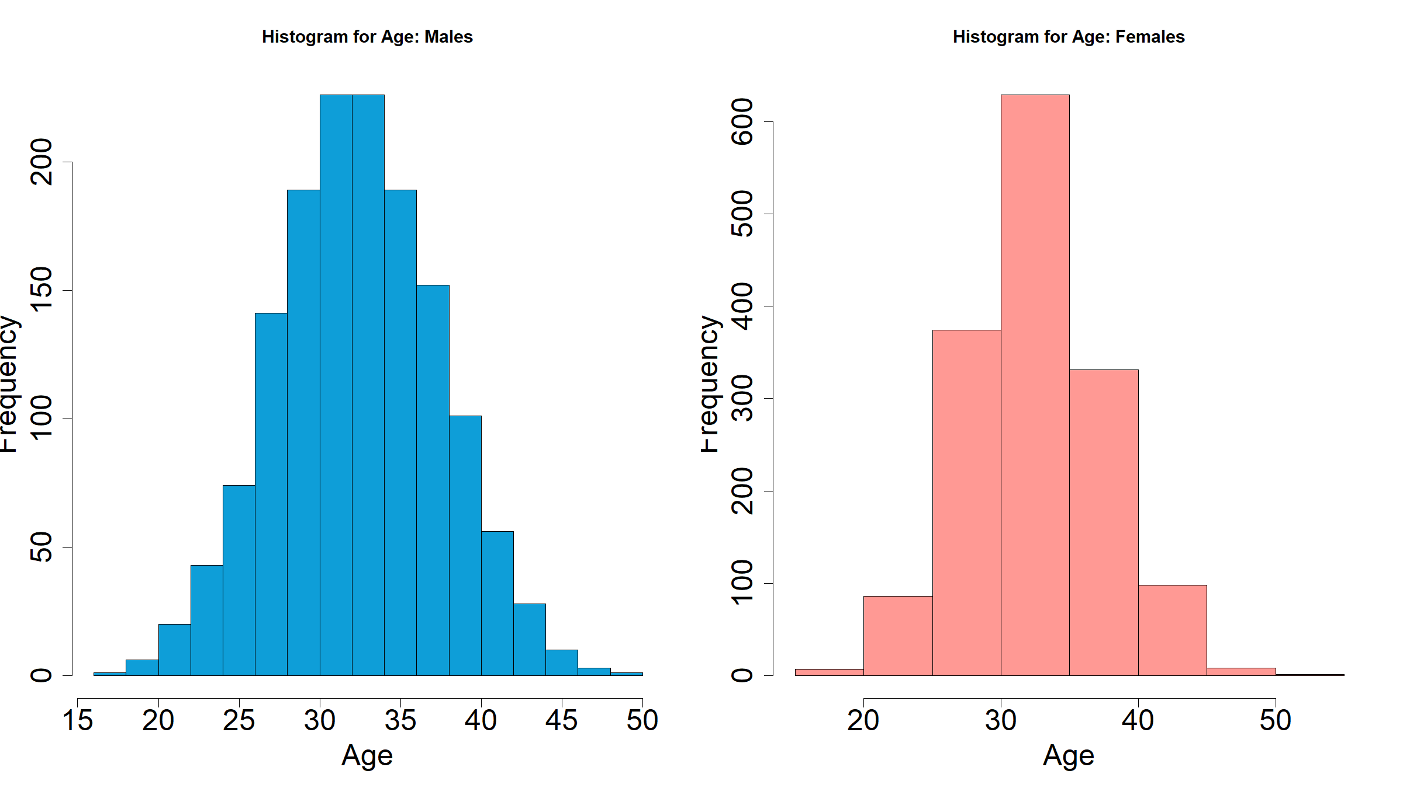

Slide 24
Assumptions
Check if the variances are the same
par(cex.axis=2,cex.lab=2) boxplot(age ~ sex, data=df,names=c("Male","Female"), col=c("#0e9ed8","#ff9994"))

Slide 25
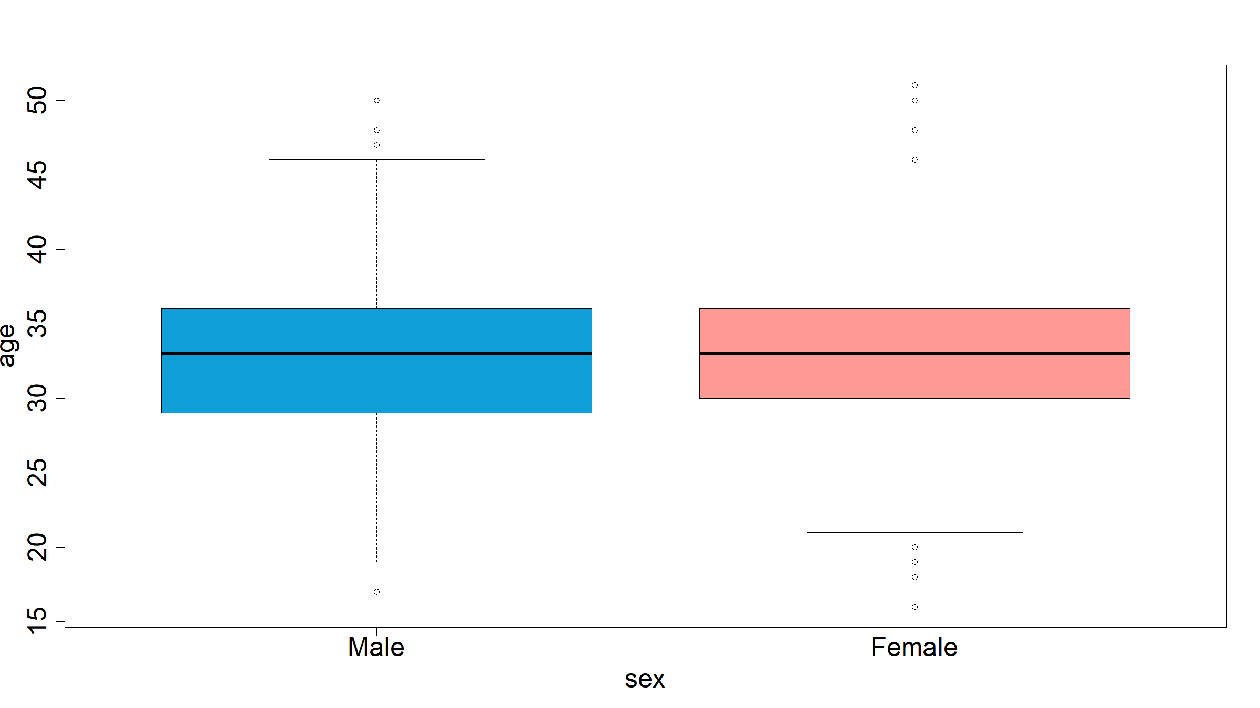

Slide 26
Two sample t-test
t.test(age~sex,data=df)
## ## Welch Two Sample t-test ## ## data: age by sex ## t = -0.69127, df = 2982.6, p-value = 0.4895 ## alternative hypothesis: true difference in means is not equal to 0 ## 95 percent confidence interval: ## -0.4812899 0.2303877 ## sample estimates: ## mean in group 1 mean in group 2 ## 32.87585 33.00130

Slide 27
Paired t-test
$$H_{0}:μ_{1}=μ_{2}$$
$$H_{1}:μ_{1}≠μ_{2}$$
t.test(df$cd41,df$cd42,paired = TRUE)
## ## Paired t-test ## ## data: df$cd41 and df$cd42 ## t = -98.346, df = 2999, p-value < 2.2e-16 ## alternative hypothesis: true difference in means is not equal to 0 ## 95 percent confidence interval: ## -203.1804 -195.2370 ## sample estimates: ## mean of the differences ## -199.2087

Slide 28
Comparing means - more than one group
Sometimes we want to compare means of a variable in more than 2 groups
For example, we might want to compare the mean CD4 among the 5 hospitals.
Use one way analysis of variance (anova)
Based on assumptions:
Data within the groups follows a normal distribution
Equal variation within groups
Independent and identically distributed variables

Slide 29
One-way anova
A total of 3000 study participants were recruited in 5 hospitals providing ART. Each participant’s CD4 count upon entry into study was measured. We would like to investigate whether there is a difference in mean CD4 count at the entry into the study across the 5 participating facilities. State the hypothesis to be tested and your conclusion.

Slide 30
One-way anova
$$H_{0}:μ_{1}=μ_{2}=μ_{3}=μ_{4}=μ_{5}$$
$$H_{1}:μ_{i}≠μ_{j}$$
oneway.test(cd41 ~ hosp, data = df)
## ## One-way analysis of means (not assuming equal variances) ## ## data: cd41 and hosp ## F = 0.22905, num df = 4, denom df = 1496, p-value = 0.9222

Slide 31
One-way anova
res.hosp <- aov(cd41 ~ factor(hosp), data = df) summary(res.hosp)
## Df Sum Sq Mean Sq F value Pr(>F) ## factor(hosp) 4 2204 551.1 0.229 0.922 ## Residuals 2995 7194212 2402.1

Slide 32
Tests for proportions – one sample test
A recent survey found that approximately 23% of the population in a district are HIV positive. A researcher thinks that the current proportion of the adult population that is HIV+ is greater than 23%. The researcher takes a random sample of 3000 and finds that 560 tested positive. State the hypotheses and your conclusion

Slide 33
Tests for proportions – one sample test
A recent survey found that approximately 23% of the population in a district are HIV positive. A researcher thinks that the current proportion of the adult population that is HIV+ is greater than 23%. The researcher takes a random sample of 3000 and finds that 560 tested positive. State the hypotheses and your conclusion
$$H_{0}:p≤0.23$$
$$H_{1}:p>0.23$$

Slide 34
Tests for proportions – one sample test
prop.test(560,3000,0.23,alternative = "greater")
## ## 1-sample proportions test with continuity correction ## ## data: 560 out of 3000, null probability 0.23 ## X-squared = 31.565, df = 1, p-value = 1 ## alternative hypothesis: true p is greater than 0.23 ## 95 percent confidence interval: ## 0.1750871 1.0000000 ## sample estimates: ## p ## 0.1866667

Slide 35
Test of proportion – Two sample tests
Example: We would like to investigate whether there is enough evidence that the proportion of HIV cases is different between men
$$H_{0}:p_{1}=p_{2}$$
$$H_{1}:p_{1}≠p_{2}$$
We need to calculate the proportions in each group before doing the test.
Proportion of men that tested positive; $p_{1}=n_{1}/N_{1}$
Proportion of women that tested positive; $p_{2}=n_{2}/N_{2}$

Slide 36
Test of proportion – Two sample tests
table(df$sex,df$hiv)
## ## 0 1 ## 1 1204 262 ## 2 1236 298
prop.test(c(262,298),c(1466,1534))
## ## 2-sample test for equality of proportions with continuity ## correction ## ## data: c(262, 298) out of c(1466, 1534) ## X-squared = 1.093, df = 1, p-value = 0.2958 ## alternative hypothesis: two.sided ## 95 percent confidence interval: ## -0.04408002 0.01298849 ## sample estimates: ## prop 1 prop 2 ## 0.1787176 0.1942634

Slide 37
Non-parametric tests
When assumption of normality are violated.
Have non-parametric equivalent for the parametric tests

Slide 38
Non-parametric tests: Comparison of means
Example:
In the data set, we have two other variables for CD4 count that are skewed
par(cex.lab=2,cex.axis=2) plot(density(df$cd42.sk),main = "",col="red",lwd=3)

Slide 39
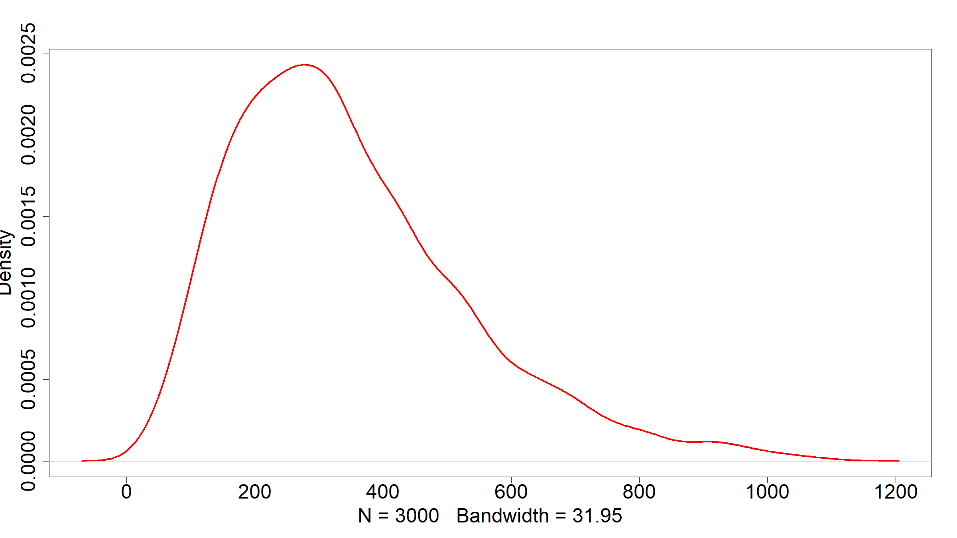

Slide 40
Non-parametric one sample test
When assumption of normality are violated.
Have non-parametric equivalent for the parametric tests.
One sample non-parametric test.
Suppose we want to test that the mean value of CD4 is 200.
wilcox.test(df$cd41.sk,mu=200)
## ## Wilcoxon signed rank test with continuity correction ## ## data: df$cd41.sk ## V = 1921134, p-value = 3.727e-12 ## alternative hypothesis: true location is not equal to 200

Slide 41
Non-parametric two sample test
Example:
Let’s test the hypothesis that the CD4 count is different between those aged 30 and less and those aged above 30 years
# create variable df$agecat <- ifelse(df$age <=30,1,2) wilcox.test(cd41.sk ~ agecat,data = df)
## ## Wilcoxon rank sum test with continuity correction ## ## data: cd41.sk by agecat ## W = 952349, p-value = 0.456 ## alternative hypothesis: true location shift is not equal to 0

Slide 42
Non-parametric – paired test
Example:
Test the hypothesis that the CD4 counts are the same at the two time points
wilcox.test(df$cd41.sk,df$cd42.sk,paired = TRUE)
## ## Wilcoxon signed rank test with continuity correction ## ## data: df$cd41.sk and df$cd42.sk ## V = 782047, p-value < 2.2e-16 ## alternative hypothesis: true location shift is not equal to 0

Slide 43
Non-parametric tests – more than 3 groups
Analogous to one way anova
Example: It is claimed that differences exist in the mean CD4 at the enrolment into the study according to the social-economic status

Slide 44
Non-parametric tests – more than 3 groups
Analogous to one way anova
Example: It is claimed that differences exist in the mean CD4 at the enrolment into the study according to the social-economic status
kruskal.test(cd41.sk ~ ses,data=df)
## ## Kruskal-Wallis rank sum test ## ## data: cd41.sk by ses ## Kruskal-Wallis chi-squared = 9.5175, df = 4, p-value = 0.04939

Slide 45
ASA statement on statistical signigicance and p-values
P-values indicate degree to which data are incompatible with a given statistical model.
P-values do not measure the probability of $H_{0}$ being true.
Decision-making should not be based solely on whether a p-value is below a certain threshold.
Proper inference requires full reporting and transparency.
A p-value does not measure the size of an effect / importance of a result. Context matters: a p-value by itself does not provide a good measure of evidence regarding a model or hypothesis.

Slide 46
Note on p-values
Stop the use of P-values in the conventional, dichotomous way.
P-values alone should not be used to refute or support a scientific hypothesis.
Rebrand confidence intervals to “compatibility intervals”.
Discuss all values that fall within the confidence interval / are compatible with the data.
Do acknowledge that the point estimates and values close to it are more compatible than values at the extremes of the interval.
Emphasize / embrace uncertainty.
Check the special issue on p-values in the American statistician journal for more discussion
Vol. 73, Supplement Issue 1 (20 March 2019)
43 papers and 1 editorial on p-values & statistical significance (401 pages)
The special issue can be found on https://www.tandfonline.com/toc/utas20/73/sup1

