Slide 1
MSc Bioinformatics - Data types, summarising & exploring data
Marc Henrion

Slide 2
Session 2: Types of data, summarising & exploring data, measures of association

Slide 3
Preliminaries
In this session we will (re)view the basic fundaments of probability and statistical theory that you need to know for later sessions.
Participant packs
https://github.com/gitMarcH/COM_STA621_2020
Copy of slides & some R codes.
Note
These slides have been generated by using R Markdown.

Slide 4
Introduction

Slide 5
Why summarise & explore data?
Quality control & data cleaning:
Identify data collection / recording issues.
Identify severe outliers.
Get a feel for the data / precursor to more complex analyses:
What are the distributions of the various variables?
What analyses / modelling techniques will be appropriate?
Any unexpected trends or patterns?

Slide 6
Main methods for summarising & exploring data.
Summary statistics & listings
Frequency & contingency tables
Basic graphs
Simple regression & association statistics [Section 7]

Slide 7
Types of data

Slide 8
Types of data
There are several ways to classify data into different types:
Quantitative & qualitative / categorical data.
Discrete & continuous data.
Categorical, ordinal, interval & ratio data.

Slide 9
Quantitative vs. qualitative data.
Quantitative data are measured by numbers. Arithmetic operation such as addition, subtraction, multiplication, division can be used and yield meaningful results.
Qualitative or categorical data are measured by levels or classes of a categorical variable:
Marital status: single, married, divorced, widowed.
Colour: red, green, blue.
Severity of a disease: low, medium, high.
…
Note: here “qualitative” does not refer to data from a qualitative study.

Slide 10
Discrete vs. continuous data.
Qualitative / categorical data are always discrete. Quantitative data can be either discrete or continuous.
Discrete data can take either a set of finite values or values among a countable set of possible values.
Survival status: alive or dead.
Number of heads in 2 successive throws of a coin: 0, 1, 2
Number of patients attending A&E during a specific time window: 0, 1, 2, 3, 4, …
Continuous data take values that lie on a continuum, e.g. an interval.
Height, weight or age of a person.
Cost of a medical treatment.
IgG concentration.

Slide 11
Levels of measurement
A data variable has one of 4 levels of measurement:
nominal - classifies observations into different categories
alive / dead
human, fish, goat, bird
ordinal - different categories, but categories are ordered
low < medium < high
bad < good
interval - ordered data with degree of difference; ratios not meaningful
temperature in centigrade: difference betwen 10ºC and 20ºC is the same as between 50ºC and 60ºC but 20ºC not twice as hot as 10ºC
ratio - interval data with a unique, non arbitrary zero value; ratios meaningful
temperature in Kelvin
length

Slide 12
More on categorical variables
A special case of a categorical variable is a binary or dichotomous variable: such a variable has only 2 levels.
alive / dead
healthy / diseased
adult / child
male / female
Often such variables are coded numerically, taking the values 0 and 1. This allows them to be used easily in a regression model, for example.

Slide 13
More on categorical variables
A multi-level categorical variable with $k$ different levels, can be coded as a set of $k−1$ binary variables, sometime called dummy variables.
Disease_severity = no disease, mild, severe
Disease_mild = 0, 1; Disease_severe = 0, 1

Slide 14
More on cateogrical variables
Continuous variables can be categorised or dichotomised:
BMI continuous, taking values $≥0$
underweight ($<18.5 kg/m^{2}$), normal weight ($≥18.5,<25 kg/m^{2}$)
overweight ($≥25,<30 kg/m^{2}$), obese ($≥30 kg/m^{2}$)
Plasma glucose, continuous, taking values $≥0$
diabetic ($>11.1$ mmol/L), non-diabetic ($≤11.1$ mmol/L)
Age, continuous, taking values in [0,125]
10-year age bands
While sometimes useful, from a purely statistical point of view information is lost $⇒$ less statistical power, larger sample sizes.
Notes:
Highest ever recorded & confirmed human age: 122 years, 164 days

Slide 15
Exercise

Slide 16
Exercise
On the next slide are the first few rows of a longitudinal dataset monitoring systolic & diastolic blood pressure in a set of patients.
What are the types of the different variables?

Slide 17
SampID | PatID | Visit | Age | Sex | SystBP | DiasBP | BPgroup
S11 | P1 | 1 | 21 | F | 105 | 70 | normal
S12 | P1 | 2 | 31 | F | 104 | 72 | normal
S13 | P1 | 3 | 41 | F | 110 | 71 | normal
S21 | P2 | 1 | 28 | M | 132 | 81 | pre-hyper
S22 | P2 | 2 | 38 | M | 141 | 88 | hyper
S31 | P3 | 1 | 26 | M | 115 | 78 | normal
S32 | P3 | 2 | 36 | M | 124 | 80 | pre-hyper
S33 | P3 | 3 | 46 | M | 129 | 82 | pre-hyper
Notes:
SampID = categorical - nominal
PatID = categorical - nominal
Visit = cateogrical - ordinal (in fact here it may be quantitative - discrete as visits seem to be spaced exactly 10 years apart)
Age = quantitative - continuous - ratio (even if recorded only in full years)
Sex = categorical - nominal (in fact binary)
SystBP = quantitative - continuous - ratio
DiasBP = quantitative - continuous - ratio
BPgroup = categorical - ordinal

Slide 18
Summary & exploratory statistics

Slide 19
Summary & exploratory statistics
When presented with a new dataset it is important to familiarise yourself with it.
Crucially, you want to get a feel for the data: data format, how many observations, how many reported variables, empirical distributions for important variables, numbers & patterns of missing values, …
This will help you to know what statistical tests and models can be used for this dataset and any issues that you may face during the data analysis.

Slide 20
Counts / frequencies
For categorical and discrete variables with a manageable number of different levels / values, a simple table (or graph - see later in this lecture) giving the frequency of each value in the dataset is a very intuitive and clear summary description of that variable.
It is usually helpful to not only list the frequencies but also the percentage, out of all observations, for each level.

Slide 21
sex | freq | percentage
F | 560 | 74.67%
M | 190 | 25.33%

Slide 22
age | freq | percentage
10 | 90 | 12.00%
11 | 149 | 19.87%
12 | 172 | 22.93%
13 | 136 | 18.13%
14 | 98 | 13.07%
15 | 55 | 7.33%
16 | 31 | 4.13%
17 | 11 | 1.47%
18 | 6 | 0.80%
19 | 0 | 0.00%
20 | 2 | 0.27%

Slide 23
status | freq | percentage
unexposed, uninfected | 402 | 53.60%
exposed, uninfected | 167 | 22.27%
infected | 181 | 24.13%

Slide 24
Counts / frequencies
For datset with categorical variables only, count tables can be a very concise way of storing / displaying an entire dataset.
For example, the dataset recording age status (child / adult), sex (male / female), class of travel (1st, 2nd, 3rd or crew) and survival status (alive / dead) can be recorded as 2,201 individual records:
## class age sex survival ## 112 1st Adult Male dead ## 900 Crew Adult Male alive ## 396 3rd Adult Male alive ## 125 1st Adult Male dead ## 299 2nd Adult Male dead ## 1342 Crew Adult Male dead

Slide 25
Counts / frequencies
But the entire dataset can also be shown as 14 rows of data:
## class age sex survivors dead ## 1 1st Adult Male 57 118 ## 2 2nd Adult Male 14 154 ## 3 3rd Adult Male 75 387 ## 4 Crew Adult Male 192 670 ## 5 1st Child Male 5 0 ## 6 2nd Child Male 11 0 ## 7 3rd Child Male 13 35 ## 8 1st Adult Female 140 4 ## 9 2nd Adult Female 80 13 ## 10 3rd Adult Female 76 89

Slide 26
Counts / frequencies
## class age sex survivors dead ## 11 Crew Adult Female 20 3 ## 12 1st Child Female 1 0 ## 13 2nd Child Female 13 0 ## 14 3rd Child Female 14 17

Slide 27
Tabular data / contingency tables
A very useful way to summarise two categorical variables together is to produce a cross-tabulation table, also called a contingency table.
Apart from summarising 2 variables simulateneously, a contingency table is also useful to assess whether the 2 variables are associated with each other and a first step in an association test (see Sections 7 & 8).

Slide 28
Tabular data / contingency tables
For instance, in the Titanic dataset we can cross-tabulate class and survival:
## ## 1st 2nd 3rd Crew ## alive 203 118 178 212 ## dead 122 167 528 673
Or age and survival:
## ## alive dead ## Adult 654 1438 ## Child 57 52

Slide 29
Central tendency
For any arbitrary distributions of quantitative variables, it is often helpful to summarise its central tendency: a central or typical value for this distribution. If one had to summarise an entire distribution by just one number, this number would be some measure of central trendency.
There are are more than one possible measure that we can use to estimate the central tendency of a distribution. Commonly, central tendency statistics are called averages.
We will cover the 3 most commonly used one: mean, median, mode.

Slide 30
Central tendency
Mean
We have already seen the mean for theoretical, parametric distributions: it is the expected value $μ=E[X]$. For observed data $x=\{x_{1},…,x_{n}\}$, we can calulate the sample mean:
$$\overline{x}=\frac{1}{n}\sum_{i=1}^{n}{x_{i}}=(x_{1}+…+x_{n})/n$$

Slide 31
Central tendency
Mean
Note that the above is the arithmetic mean. Unless otherwise specified, ‘mean’ will usually refer to the arithmetic mean. There are however two more commonly used means:
The geometric mean: ${\left(\prod_{i=1}^{n}{x_{i}}\right)}^{1/n}=\sqrt[n]{x_{1}⋅x_{2}⋅…⋅x_{n}}$.
The harmonic mean: $\frac{n}{1/x_{1}+…+1/x_{n}}$.
Notes:
Geometric mean = useful for variables that are meant to be multiplied together or are exponential in nature
Harmonic mean = appropriate for averaging rates

Slide 32
Central tendency
Median
The mean is a good measure of central tendency for symmetrically distributed random variables: it will be equal to the value around which the data are symmetric.
For skewly distributed data, the median is a better measure of central tendency: it is the value so that half of the data are less or equal than it and half of the data are greater or equal than it. In other words, it is the value separating the lesser and greater halves of the dataset.
Formally, for a random variable $X$, the median m is so that:
$$m∈Ω:P(X≤m)=P(X≥m)=0.5$$

Slide 33
Central tendency
Median
For observed data $x=(x_{1},…,x_{n})$, sort the data from smallest to largest: $x_{(1)}≤x_{(2)}≤…≤x_{(n)}$.
The median is then the value with index $(n+1)/2$.
If the number if observed value is odd, this is simply the middle value; if the number of values is even it is the average of $x_{(n/2)}$ and $x_{(n/2+1)}$.

Slide 34
Central tendency
Mode
Another measure of central tendency is the mode of the distribution: it is the value where the distribution function (pmf or pdf) reaches its maximum.
For general distributions and observed data, there is no simple formula to calculate the mode. In fact, it may even not be unique and for some pathological distributions it is not defined.

Slide 35
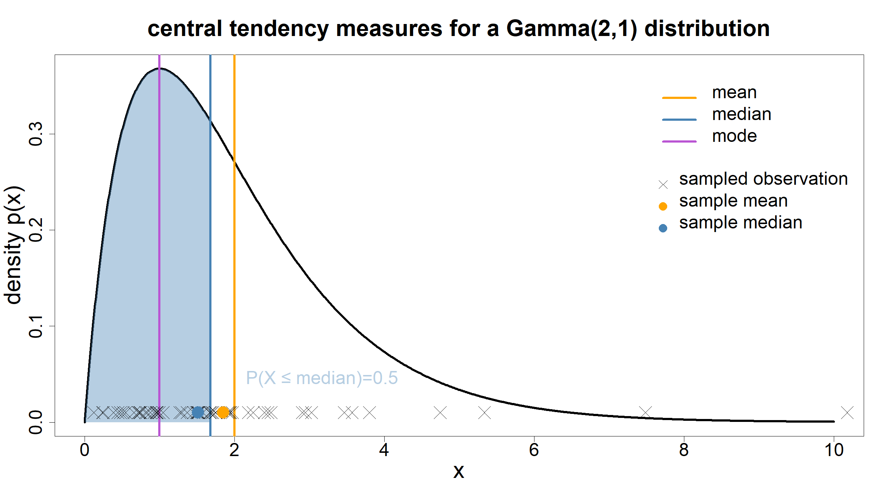
Central tendency

Slide 36
Dispersion
Having a measure of central tendency, allows us to summarise one aspect of the data and/or their distribution. However, central tendency does not tell us anything about how spread out around this central value the data are.
For this we need a measure of dispersion. The smaller the dispersion, the better the mean or median represent the data as a whole.
Again, there are many such measures, but the most important ones are the range, the interquartile range and the variance.

Slide 37
Dispersion
Range
In statistics, the word range has 2 meanings:
In descriptive statistics, the range of a random variable $X$ is the shortest interval containing all possible values of $X$.
As a measure of dispersion, range is the difference between the largest / maximimum and smallest / minimum values in an observed dataset: $range=max−min$.

Slide 38
Dispersion
Range
The minimum and maximum are not robust statistics: they can be quite extreme values if outliers are present in the data. A single, arbitrarily large data value is sufficient for the range to become arbitrarily large as well. As a consequence, the range (both as an interval and a measure of dispersion) is not robust either.
For this reason, measures that summarise the average or central spread are often preferred.
Notes:
The breakdown value for min/max is just 1 observation.

Slide 39
Dispersion
Quantiles & the interquartile range
q-quantiles of a random variable are ordered values dividing the range of a random variable $X$ into $q$ intervals of equal probability. When $q=4$, the q-quantiles are called quartiles, when $q=100$, the q-quantiles are called percentiles.
The median is a special case of a quantile: it is the only 2-quantile and it is equal to the 2nd quartile and the 50th percentile.

Slide 40
Dispersion
Quantiles & the interquartile range
The interquartile range (IQR) summarises the central dispersion:
In descriptive statistics, it is given by the interval from the 25th to the 75th percentile of the data. The 25th percentile is also called the 1st quartile and the 75th percentile is the 3rd quartile. In other words, the IQR contains the middle 50% of the data.
As a measure of dispersion, the IQR is defined as the difference between the 3rd quartile and the 1st quartile: $IQR=Q_{3}−Q_{1}$.
The IQR is more robust that total range: at least 25% of the data need to be arbitrarily large for it to become arbitrarily large.
Notes:
The breakdown value for IQR is 25%.

Slide 41
Dispersion
Standard deviation & variance
We have seen that one can calculate the expectation of a function $h(.)$ of a random variable $X$: $E[h(X)]$. If $h(x)=(x−E(X))^{2}=(x−μ)^{2}$, then this expecation is called the variance of the random variable $X$. It computed the average spread around the mean value $μ$. The variance is often denoted $σ^{2}$.
$$σ^{2}=Var(X)=E\left[(X−E[X])^{2}\right]=E\left[(X−μ)^{2}\right]$$

Slide 42
Dispersion
Standard deviation & variance
For observed data $X=(x_{1},…,x_{n})$, we can calculate the sample variance:
$$s^{2}=\frac{1}{n−1}\sum_{i=1}^{n}{(}x_{i}−\overline{x})^{2}$$
where $\overline{x}$ is the sample mean.

Slide 43
Dispersion
Standard deviation & variance
The standard deviation $σ$ is defined as the square root of the variance. The standard deviation has the advantage to be on the same scale of measurement as the random variable or the data.
$$σ=\sqrt{E\left[(X−E[X])^{2}\right]=E\left[(X−μ)^{2}\right]}$$
$$s=\sqrt{\frac{1}{n−1}\sum_{i=1}^{n}{(}x_{i}−\overline{x})^{2}}$$

Slide 44
Confidence intervals
If we have a dataset, we can compute, say, the sample mean. If we sampled the population again to generate another dataset, we would get a slightly different value for the sample mean.
To quantify this uncertainty in our point estimate, we can compute a confidence interval.
A $100⋅(1−α)$% confidence interval for a population parameter of interest $θ$, is a random interval $[L,U]$ so that $P(θ∈[L,U])=1−α$.

Slide 45
Confidence intervals
Imagine repeating an experiment a very lage number of times, e.g. $N=10,000$, and that each time you compute a 95% confidence interval for the same parameter. Assuming the model you use to construct the confidence intervals is correct, then you would expect that 9,500 of the confidence intervals you computed contained the true, unknown but fixed population value of $θ$.
In other words, we are 95% sure, for each of the 95% confidence interval, that it contains the true value.

Slide 46
Confidence intervals
The width of a confidence interval depends on:
The confidence level $1−α$.
The variance $σ^{2}$ of the data.
The number of sampled observations $n$.
A CI is narrower the larger $α$ is, the lower $σ^{2}$ is and the larger $n$ is.

Slide 47
Confidence intervals
Confidence interval for the sample mean
Let’s return to the sample mean. It is a point estimate of the population mean from an observed dataset $x=(x_{1},…,x_{n})$.
If $n$ is large, as a result of a probability theory result called Central Limit Theorem, or if the data are normally distributed, then a 95% confidence interval for the mean can be constructed as
$$\overline{x}±z_{1−α/2}\frac{σ}{\sqrt{n}}$$
where $z_{1−α/2}$ is the $100⋅(1−α/2)^{th}$ percentile of the standard normal distribution $N(0,1)$. For $α=0.05$, $z_{1−α/2}≈1.96$.

Slide 48
Confidence intervals
Confidence interval for the sample mean
$σ/\sqrt{n}$ is known as the standard error of the mean.
If the standard deviation $σ$ is unknown, it can be estimated by the sample standard deviation $s$.
In this case, the approximate distribution of the sample mean is not $N(\overline{x},σ^{2})$ distributed, but rather $(\overline{x}−μ)/s$ follows a $t$-distribution with $n−1$ degrees of freedom (approximately normal for large $n$).
A $100⋅(1−α)$% CI is then constructed as:
$$\overline{x}±t_{1−α/2}\frac{s}{\sqrt{n}}$$

Slide 49
Moments of random variables
For any distribution of a random variable $X$, we can define the k^{th} moment:
$$E\left[X^{k}\right]$$
Further one can define the k^{th} central moment, assuming the distribution of $X$ has mean $μ$:
$$E\left[(X−μ)^{k}\right]$$
And the k^{th} standardised moment, assuming the distribution of $X$ has mean $μ$ and variance $σ^{2}$:
$$E\left[{\left(\frac{X−μ}{σ}\right)}^{k}\right]$$

Slide 50
Moments of random variables
The moments of a distribution carry information about its shape:
1st moment = $μ$ = mean / central tendency
2nd central moment = $σ^{2}$ = variance / dispersion
3rd standardised moment = $γ$ = skewness / symmetry
4th standardised moment = $κ$ = kurtosis / peakedness or heaviness of tails
(Note for kurtosis, often the excess kurtosis is reported which is $E\left[{\left(\frac{X−μ}{σ}\right)}^{4}\right]−3$. The kurtosis for the any normal distribution is 3, so excess kurtosis shows how much heavier the tails are compared to a normal distribution.)

Slide 51
Moments of random variables
3 examples:
$N(0,1)$; standard normal
$t_{5}$; t-distribution with 5 degree of freedom
$Γ(2,1)$; gamma distribution with shape parameter $k=2$ and scale parameter $θ=1$

Slide 52
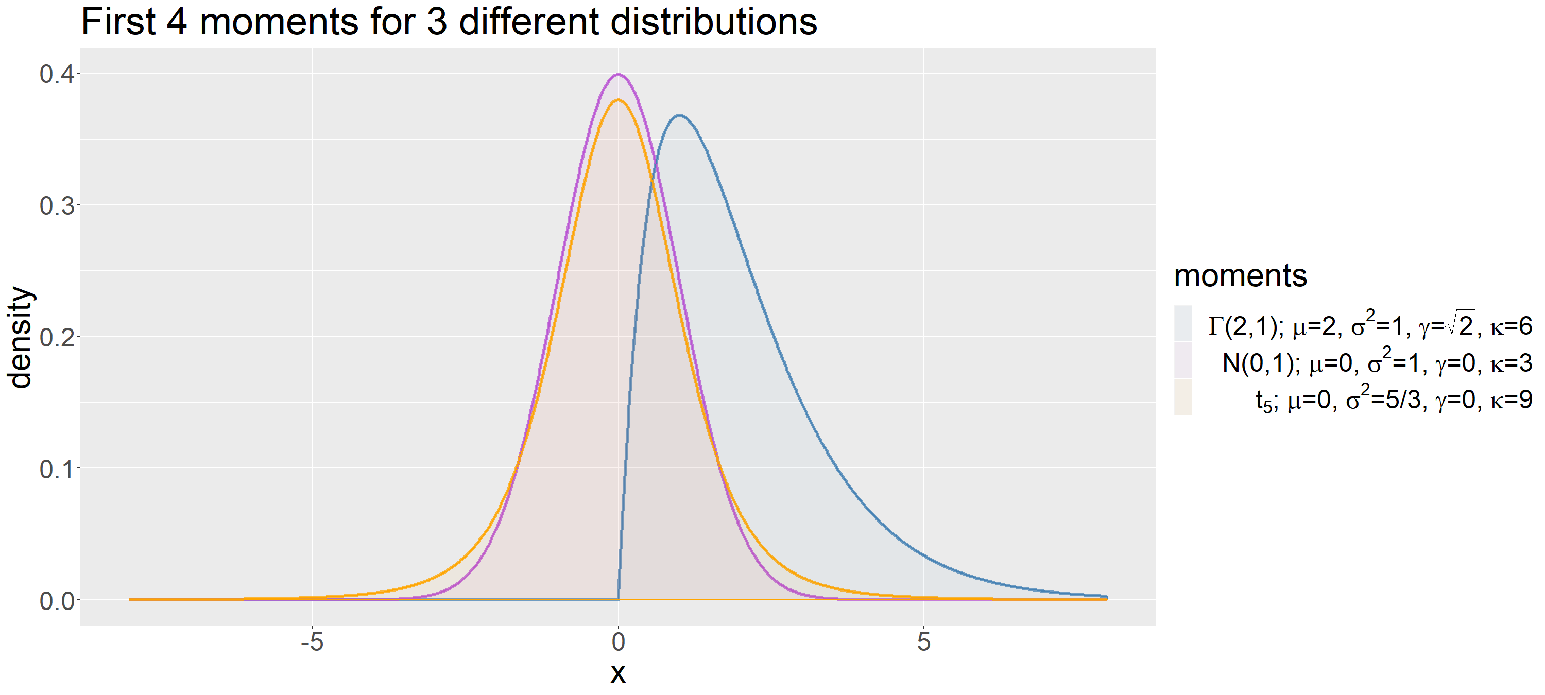
Moments of random variables

Slide 53
Missing values
Any real data that you are likely to collect will almost surely contain missing values: participants miss follow-up visits, data entry problems, unavailability of a specific test kit on a given day, …
It is important to report the amount of missing values for each variable in your dataset and per participant group (if results are to be analysed in separate groups or compared across groups).

Slide 54
Missing values
Why report?
There are 2 main effects that missing values can have on analysis results and it is for these reasons that it is important to report the scale of the missing values in your dataset:
Introduction bias if the missingness pattern is non-random, but the analysis assumes this.
Increased variance which will impact statistical power. (Note that if simple imputation schemes are used for dealing with the missing values, variance will be under-estimated.)

Slide 55
Missing values
How to report?
List the entire number of participants or records in the dataset, then for each variable, list the number and percentage of observations that are not missing. This is best done as part of a table with descriptive statistics.
Also report how, if at all, missing values have been dealt with during the analysis.

Slide 56
Summary statistics tables
Having covered most commonly reported baseline statistics, what and how do your report this in practice?
This depends on your study, the data you collected and the focus and scope of your paper.
There are a few helpful recommendations on what are appropriate summaries to report for different variables.

Slide 57
Summary statistics tables
Tukey’s 5 number summary
This is for quantitative, continuous variables.
Minimum
1st quartile (25th percentile)
Median (2nd quartile / 50th percentile)
3rd quartile (75th percentile)
Maximum

Slide 58
Summary statistics tables
2 number summary for symmetric distributions
For quantitative, continuous variables that are symmetrically distributed, reporting the central tendency and a measure of dispersion is often sufficient. For symmetric distributions, mean = median = mode (though for any finite sample of data, these will differ slightly).
Mean
Variance (or equivalently the standard deviation)

Slide 59
Summary statistics tables
Summaries for continuous & numeric variables
The following are recommended to be reported:
Total number of observations in dataset and number of observations with recorded data for the given variable.
Mean & standard deviation
Median & interquartile range
Range

Slide 60
Summary statistics tables
Summaries for binary variables
The following are recommended to be reported:
Total number of observations in dataset and number of observations with recorded data for the given variable.
Numbers in one or each of the 2 groups.
Percentage of non-missing observations in one or each of the 2 groups.

Slide 61
Summary statistics tables
Summaries for categorical variables
The following are recommended to be reported:
Total number of observations in dataset and number of observations with recorded data for the given variable.
Number of observations for each level of the categorical variable.
Percentage of non-missing observations for each level.

Slide 62
International reporting guidelines
Several international guidelines have been published on how to report study results. The two most relevant for this course are:
STROBE - for observational studies
CONSORT - for clinical trials
Many more guidelines exist. The EQUATOR NETWORK is a useful resource to identify what guidelines apply to your specific study:
https://www.equator-network.org/.

Slide 63
Activities

Slide 64
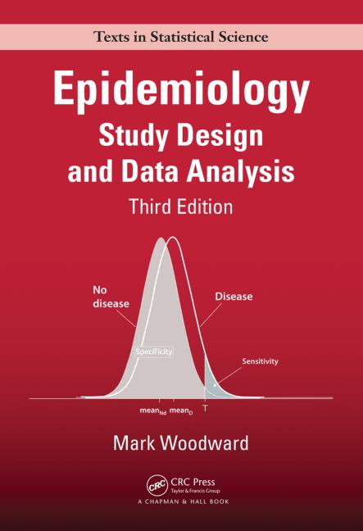
Activity - reading: Chapter 2
Woodward, M. (2014), Epidemiology: Study Design and Data Analysis, 3rd ed., ‘Chapter 2: Basic analytical procedures’, pp. 23-85

Slide 65
Activity - reading the STROBE statement and checklist
Read the STROBE statement and the 22-item checklist.
von Elm, E., Altman, D.G., Egger, M., et al. (2007), The Strengthening the Reporting of Observational Studies in Epidemiology (STROBE) statement: guidelines for reporting observational studies, Lancet, 370(9596):1453-1457.
PMID: 18064739
DOI: 10.1016/S0140-6736(07)61602-X
https://doi.org/10.1016/S0140-6736(07)61602-X

Slide 66
Activity - study some baseline tables
Download the 2 articles below and, for both, study Table 1:
Owolabi, M.O., et al. (2018), Dominant modifiable risk factors for stroke in Ghana and Nigeria (SIREN): a case-control study, Lancet Global Health, 6:e436–46, DOI 10.1016/S2214-109X(18)30002-0
Mulangu, S., et al. (2019), A Randomized, Controlled Trial of Ebola Virus Disease Therapeutics, New England Journal of Medicine, 381:2293-2303, DOI 10.1056/NEJMoa1910993
What information is presented?
Is the table clear to you? If yes, why? If not, what would you do differently?
One study is a clinical trial, the other an observational case-control study. Do you notice any differences in how the data are presented?

Slide 67
Graphs

Slide 68
Distribution graphs
Discrete data: barplots
We have seen that frequency tables are a good way to summarise categorical data. Often a plot can summarise the same information clearer and more concisely.
Barplots assign a bar to each possible level / value of a random variable and the height of the bar corresponds to either the frequency of that value in the dataset or its relative proportion / percentage. The entire distribution is summarised in this way.
Barplots are particularly useful when the data are stratfied by a second variable.

Slide 69
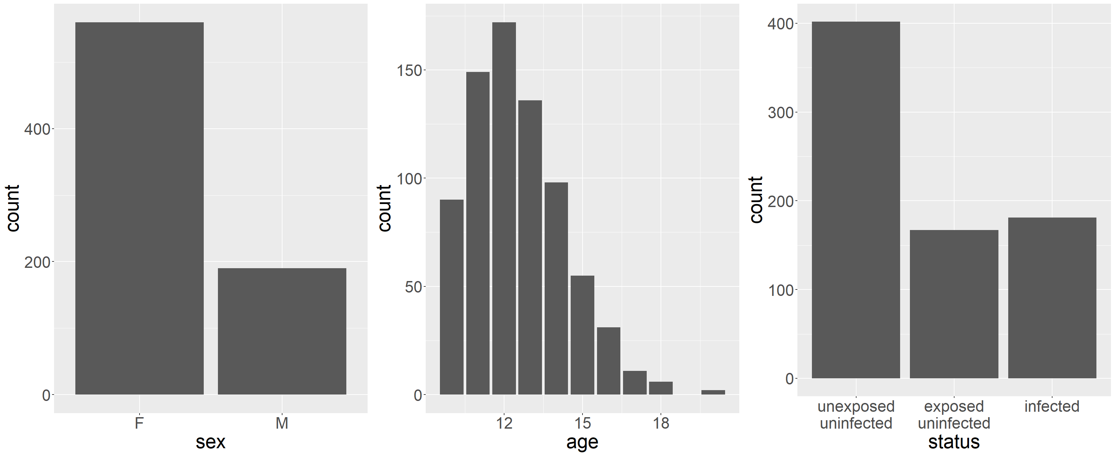
Distribution graphs - barplots

Slide 70
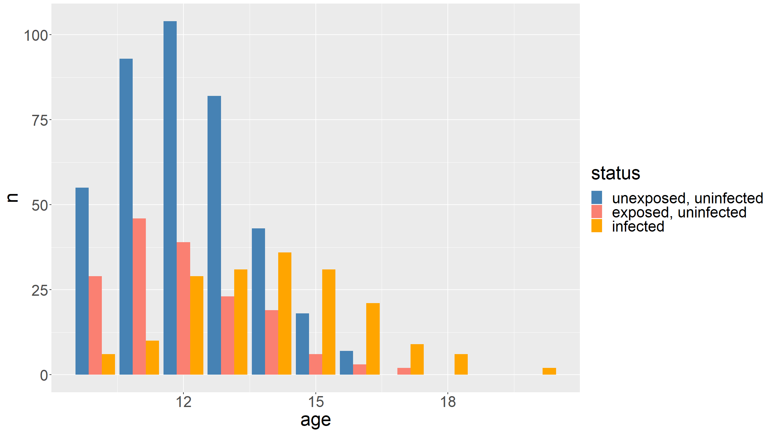
Distribution graphs - barplots

Slide 71
Distribution graphs - note on pie charts
Pie charts are another way of representing frequencies. Specifically the relative size of each slice of pie represents the overall proportion for that level of the categorical variable.
However, pie charts are not recommended: human brains are not well suited to easily compare areas and angles – which pie charts force one to consider. Barplots almost always give a clearer picture of the distribution of a categorical random variable.
e.g. On the figure on the next slide, how confidently can you say that there are more infected than exposed & uninfected individuals in the dataset?

Slide 72
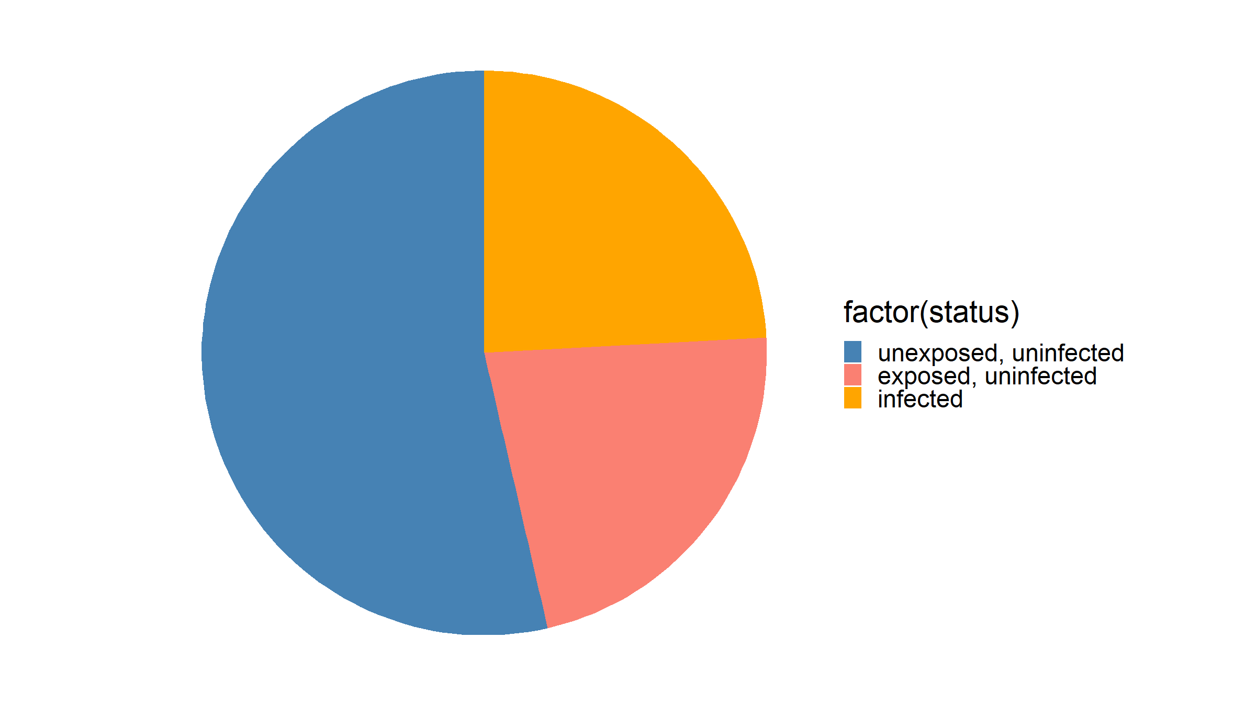
Distribution graphs - note on pie charts

Slide 73
Distribution graphs
Continuous data
For continuous data, there are several ways we can produce a plot of the distribution of a particular random variable. The two most commonly used - by far - are:
Histograms
Boxplots

Slide 74
Distribution graphs
Histograms & kernel density estimation
Histograms and kernel density estimation both give non-parametric estimates of the density function of a continuous random variable. Both depend on a tuning parameter that governs how detailed or smooth the resulting estimate is.
Histograms split the range of the variable into bins of an equal, pre-specified width, then count the number of observations falling in each bin.
Kernel density estimation puts a probability density of a fixed shape & width (the kernels) at the location of each observation. The density estimate is the summation of all of these individual density functions - normalised so that it integrates to 1.

Slide 75
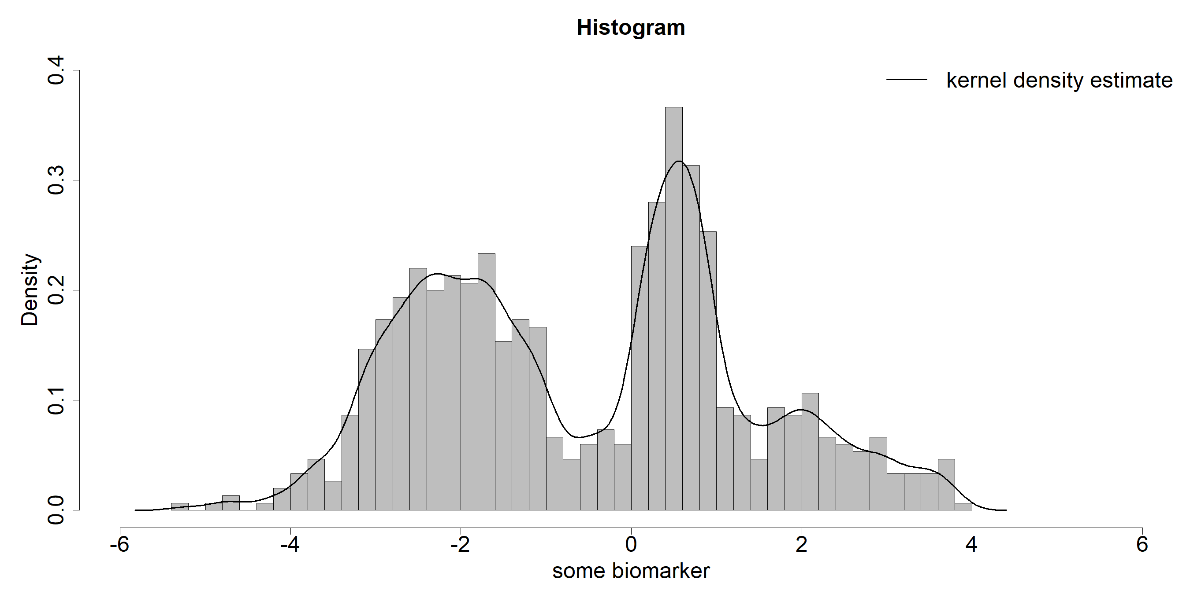
Distribution graphs

Slide 76
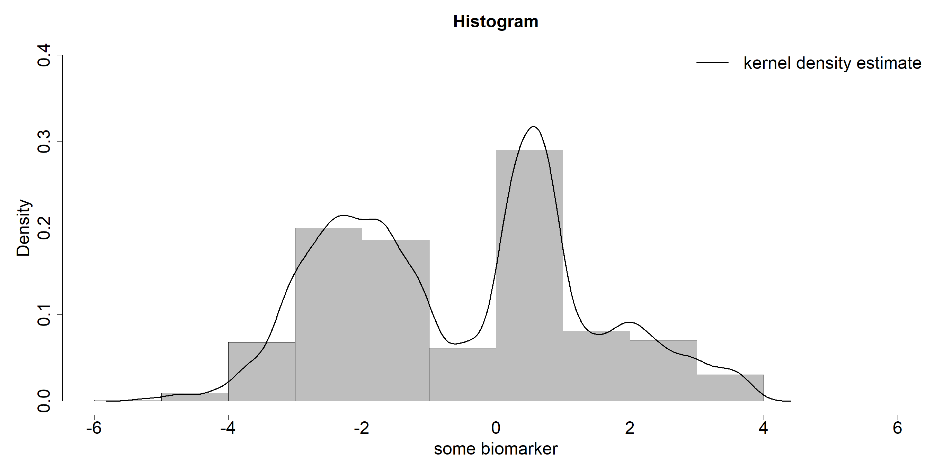
Distribution graphs - larger bin width

Slide 77
Distribution graphs
Boxplots & violin plots
A boxplot makes use of the quartiles to represent the distribution of a random variable. Data are typically represented vertically, so that different groups can be more easily compared by juxtaposing their boxplots.
A violin plot is similar, but instead of boxes, draws kernel density estimates on each side.

Slide 78
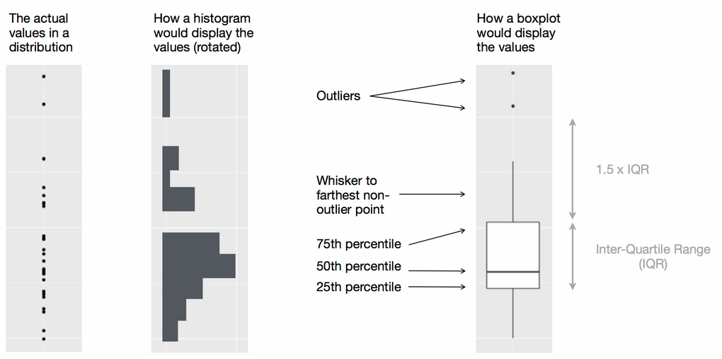
Distribution graphs
Wickham, H. & Grolemund G., R for Data Science, O’Reilly, 2016

Slide 79
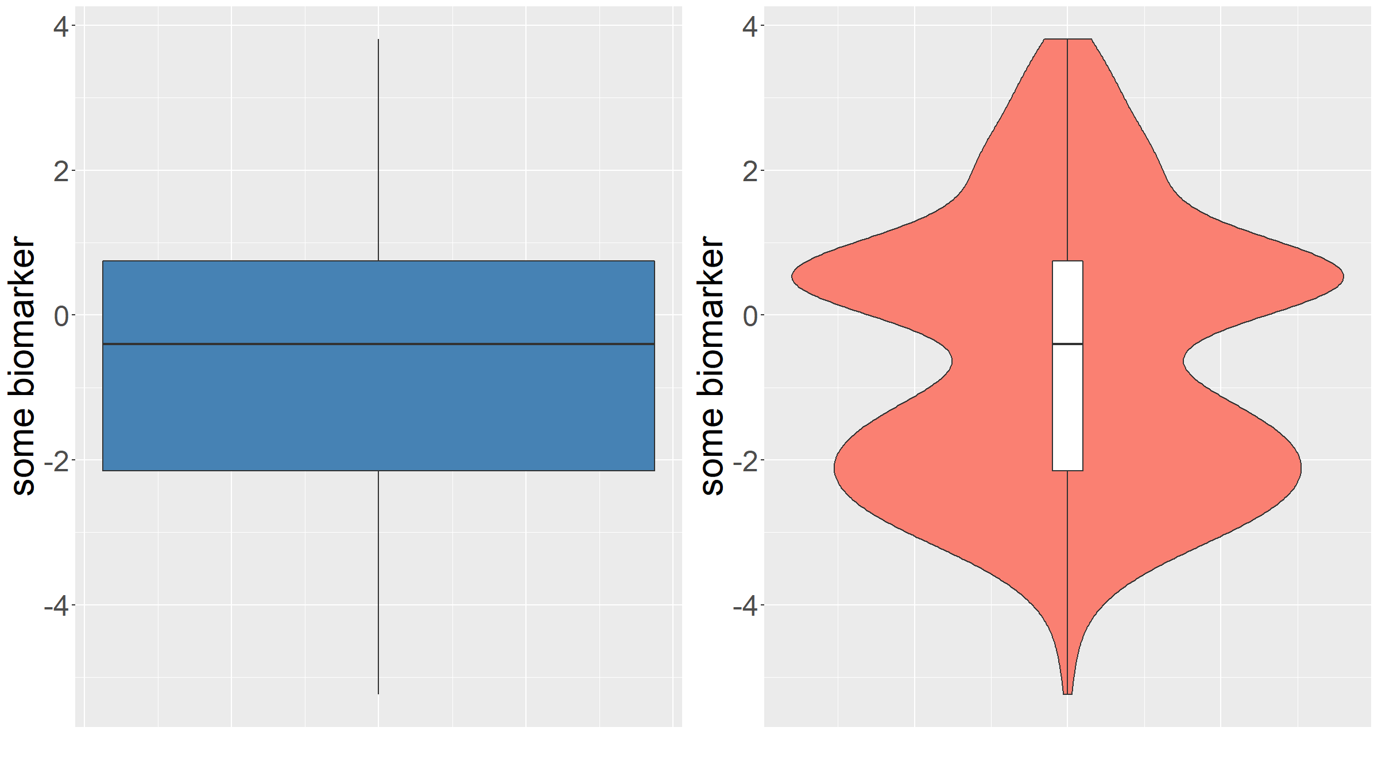
Distribution graphs

Slide 80
Covariation graphs
Often we want to get a feel for whether 2 variables are associated with each other: does the distribution of one variable impact the distribution of the other?
Depending on the type of data, several graphs can be helpful for this, at the exploratory stage:
Categorical & continuous: histograms for several groups
Categorical & continuous: boxplots & violin plots for several groups
Continuous & continuous: scatterplots

Slide 81
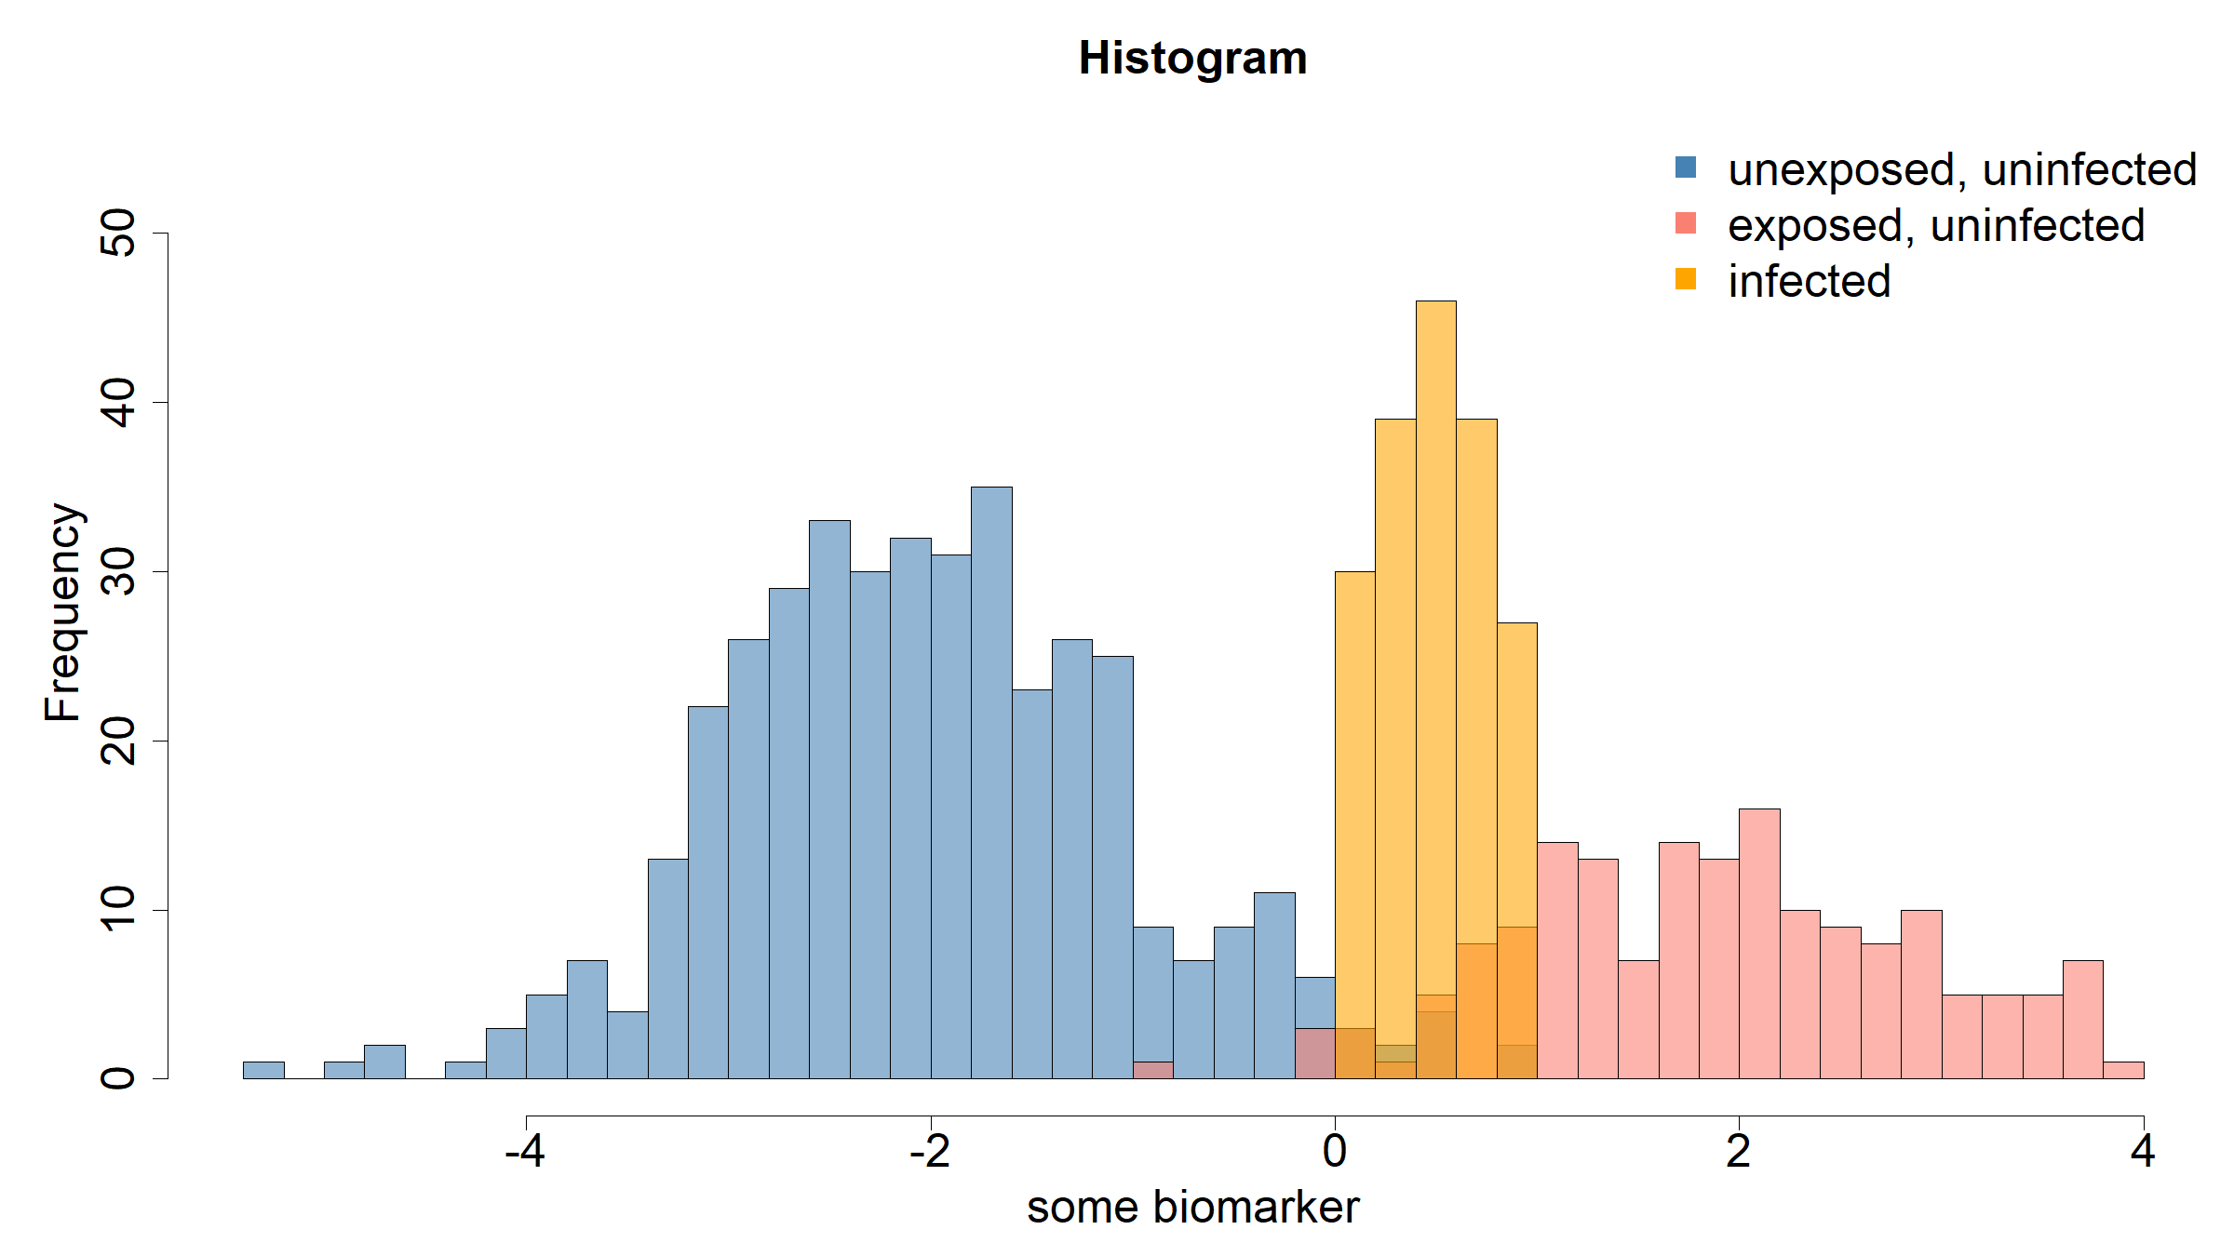
Covariation graphs - histograms for several groups

Slide 82
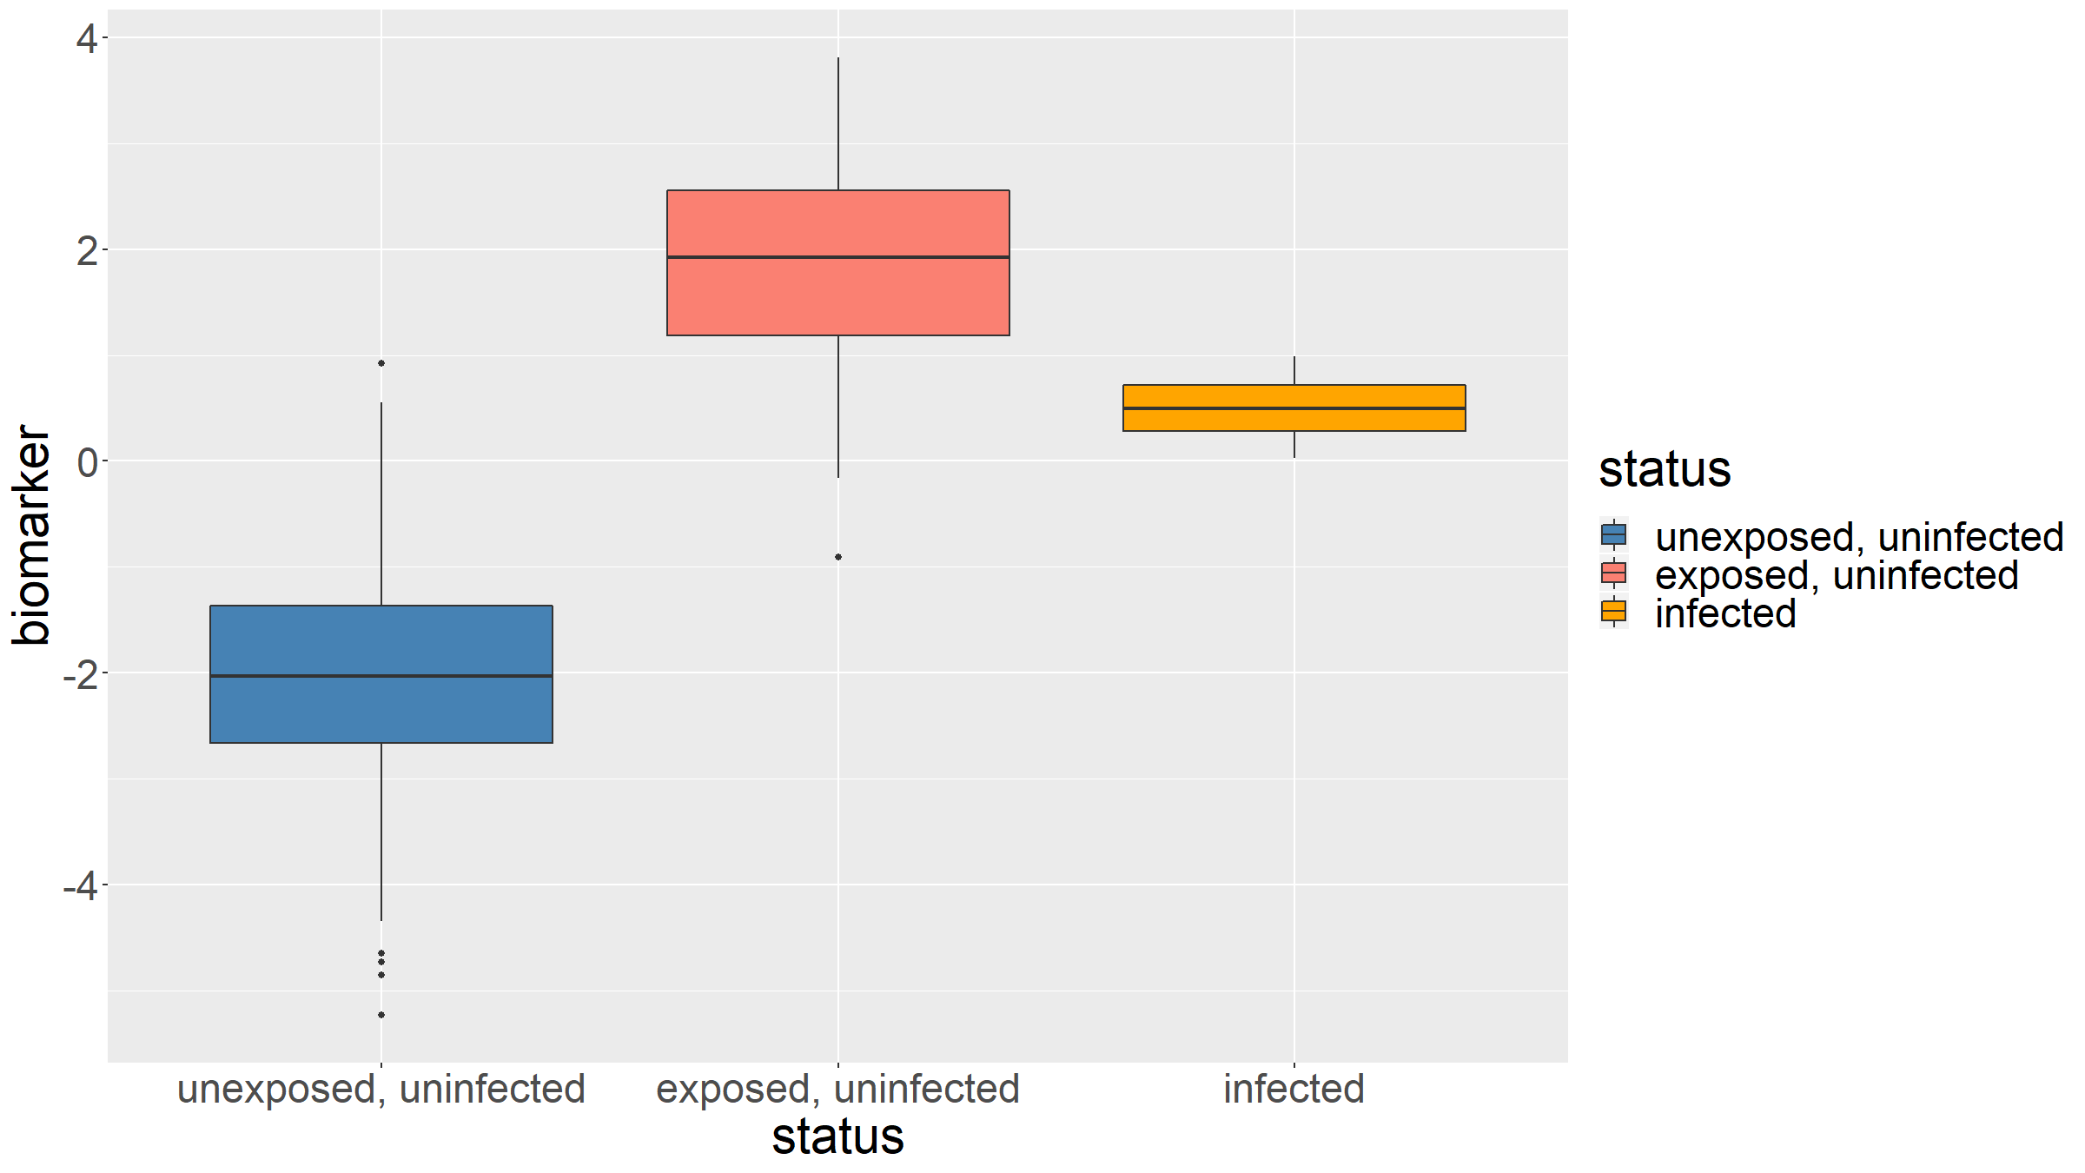
Covariation graphs - boxplots for several groups

Slide 83
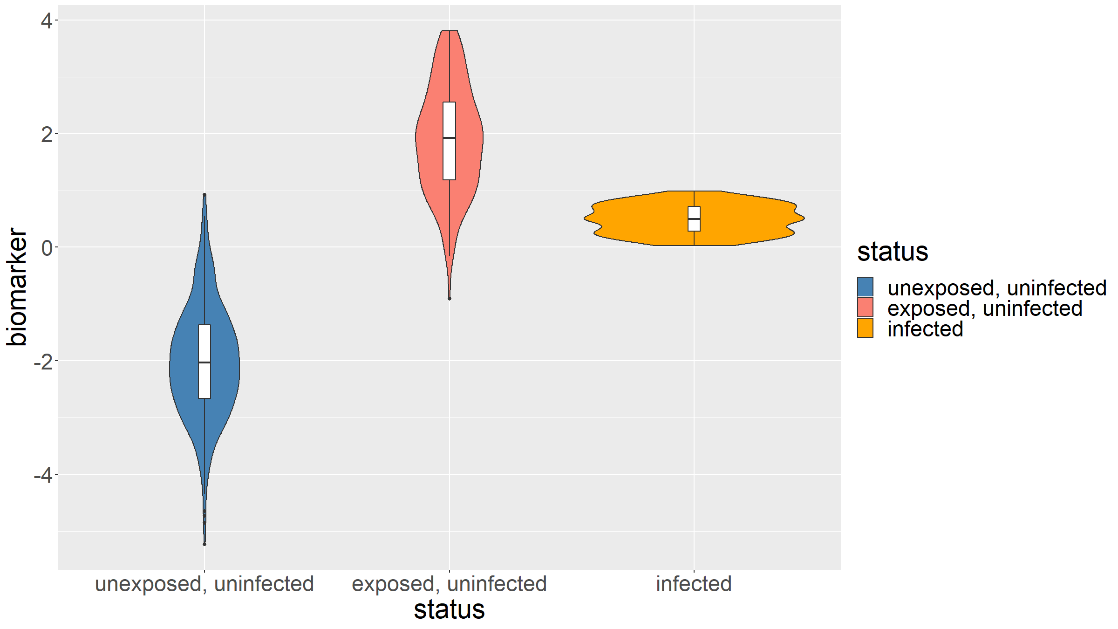
Covariation graphs - violin plots for several groups

Slide 84
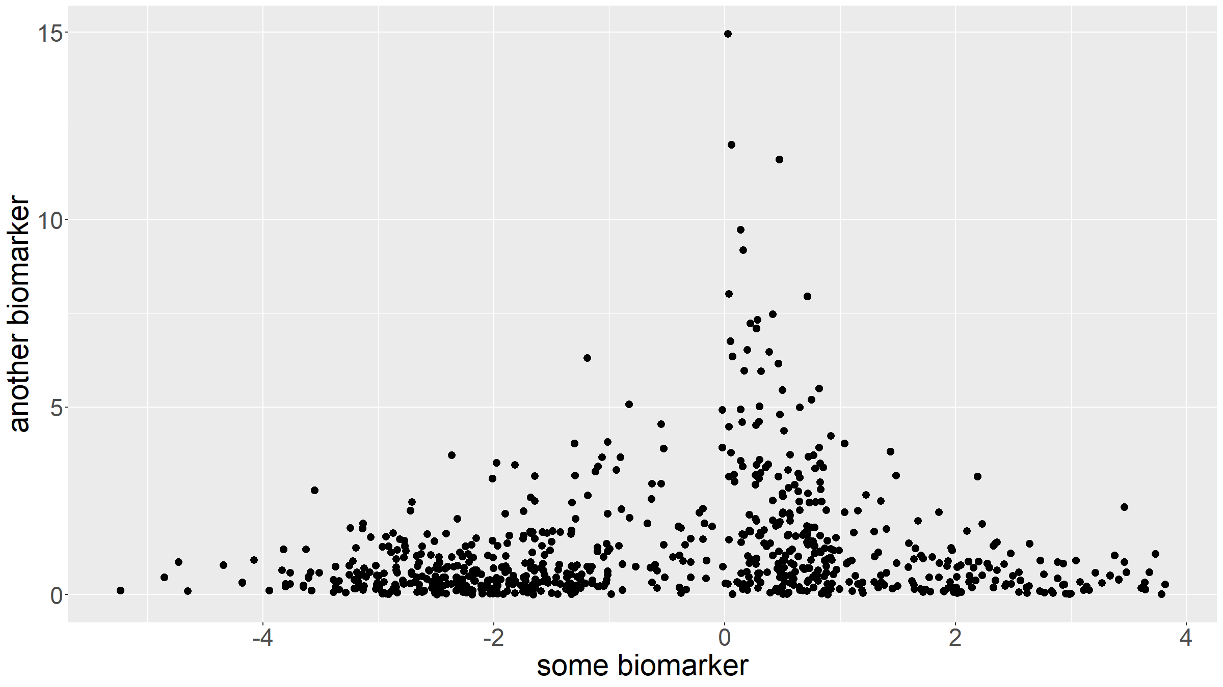
Covariation graphs - scatterplots

Slide 85
Time plots (longitudinal data)
For longitudinal data, where study participants are followed up over time, it is often helpful to produce a time plot. This is essentially a plot where the time series for each participant is plotted. Such plots are sometimes also called spaghetti plots.

Slide 86
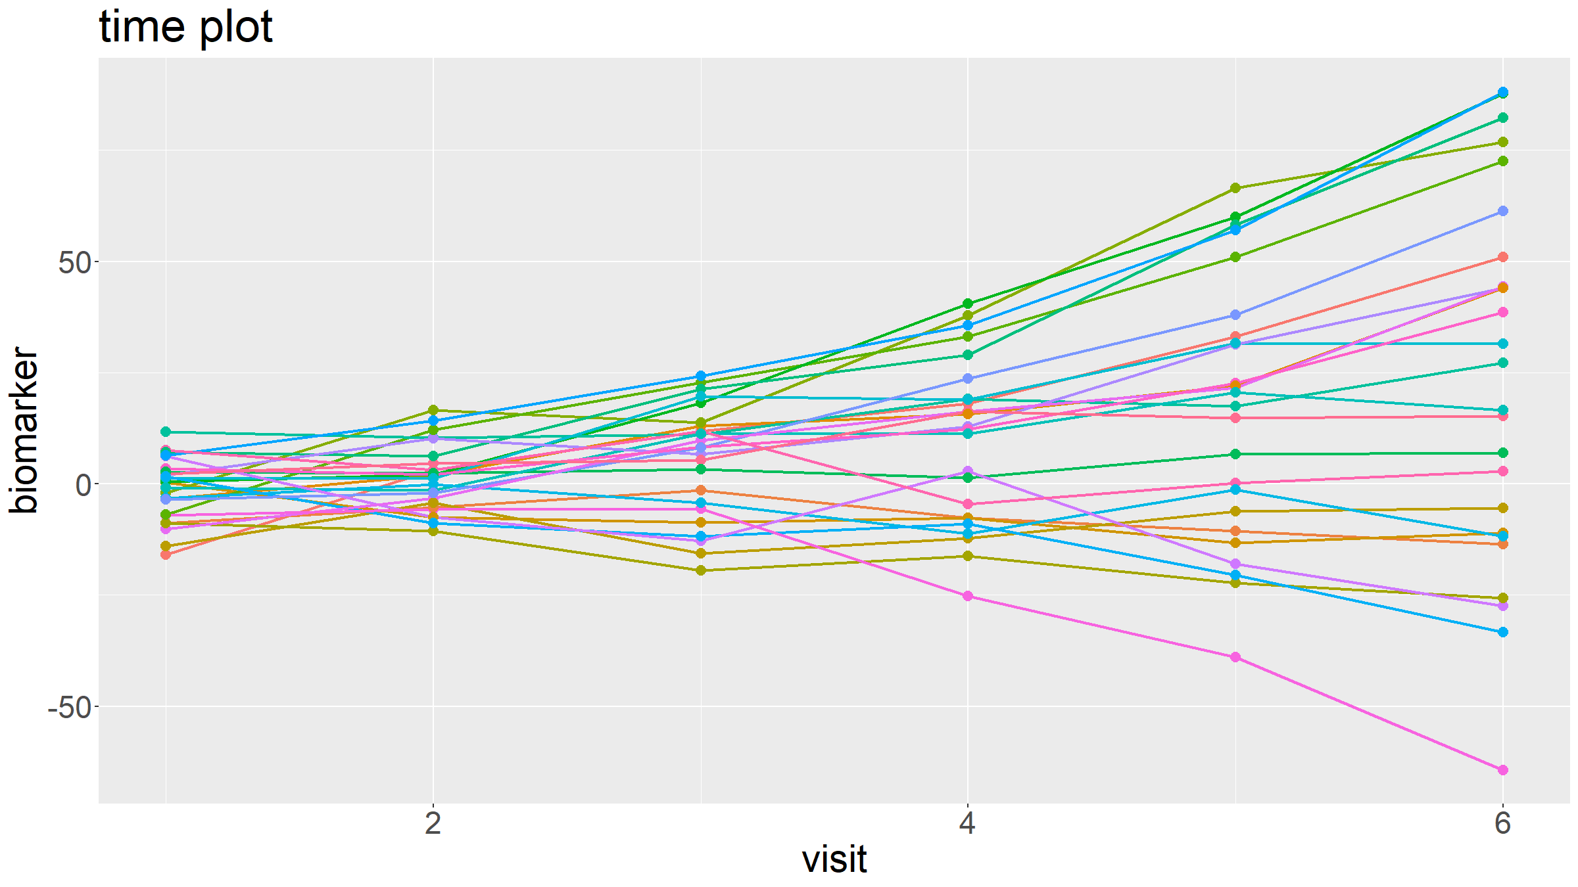

Slide 87
Activity

Slide 88
Activity: exercise
Download the dataset STA621_Session2.csv from the course website.
Explore the dataset:
How many observations are in the dataset?
How many variables?
For each variable (except ID), identify its type and produce a set of appropriate summary statistics.
For each variable (except ID), produce an appropriate distribution graph.
Pick a pair of variables for which it would make sense to explore whether they are associated with each other. Produce an appropriate covariation graph.
Ignoring the missing values (i.e. just discard missing observations), compute the sample mean for variable biomarker and compute the corresponding 95% confidence interval.

Slide 89
Measures of association

Slide 90
Measures of association
Measures of association are a special type of summary statistics designed to quantify a relationship between 2 given variables.
Association is present between 2 variables, if their distributions are related, i.e. if knowing the value of one variable affects the distribution of values of the second variable.
Measures of association quantify the relationship between 2 observed variables. Tests for statistical significance inform as to whether such a relationship is likely to be present in the population.
There exist many measures of association. Some can be difficult to interpret. The type of variables dictates which measures are appropriate.

Slide 91
Measures of association
If at least one of the 2 variables is categorical, we can only describe the pattern of association.
If however both variables are at least ordinal, then we can define the direction of association:
In a positive association, if one variables increases / decreases, then the other variable also tends to increase / decrease.
In a negative association, if one variables increases, then the other variable tends to decrease and vice-versa.

Slide 92
Measures of association
There are 2 types of measures of association: symmetric measures yield the same value regardless as to which variable is chosen to be the dependent and independent variable whereas asymmetric measures depend on the choice of dependent & independent variable.
Many measures of association are scaled so that
$$\begin{matrix}0 & ≡ & lack of association \\ 1 & ≡ & perfect association\end{matrix}$$
In the case of ordinal, interval & ratio variables, some measures also indicate direction of association, with $+1$ indicating perfect, positive association and $−1$ perfect, negative association.

Slide 93
Measures of association
Lowest level of measurement | Measure of association
Categorical | Pearson’s Phi
 | Cramer’s V
 | Lambda
Ordinal | Gamma
 | Spearman’s rank correlation coefficient
Interval, ratio | Correlation coefficient

Slide 94
Categorical - categorical
when the lowest level of measurement of the 2 variables is nominal / categorical, then there are broadly 2 types of measures of association:
$χ^{2}$ based measures
proportional reduction in error based measures
We will see examples of both.

Slide 95
Categorical - categorical
Given 2 categorical variables $V1$ (taking $c$ different values), $V2$ (taking $r$ different values) we can compute a cross-tabulation / contingency table.
$$\begin{matrix} & & & & V1 & \\ & & O_{11} & O_{12} & … & O_{1c} \\ & & O_{21} & O_{22} & … & O_{2c} \\ V2 & & … & & … & … \\ & & O_{r1} & O_{r2} & … & O_{rc}\end{matrix}$$

Slide 96
Categorical - categorical
Define:
n=i​j​Oij the total number of observations
pi.=1nj​Oij i=1,…,r the row marginal proportions
p.j=1ni​Oij j=1,…,c the row marginal proportions
$E_{ij}=n⋅p_{i.}⋅p_{j.} i=1,…,r, j=1,…,c$ the expected counts in each cell
We can then calculate the $χ^{2}$ statistic for this table:
χ2=i​j​Oij−Eij2Eij
$χ^{2}$ follows a chi-squared distribution with $(r−1)(c−1)$ d.f.

Slide 97
Categorical - categorical
$X^{2}$, the chi-squared statistic, is itself a measure of association. However the value of $X^{2}$ depends on the sample size $n$, the number of rows $r$ and the number of columns $c$.
For this reason, $χ^{2}$ based measures of association correct for these.

Slide 98
Categorical - categorical
A first $χ^{2}$ based measure of association is $ϕ$:
$$ϕ=\sqrt{\frac{χ^{2}}{n}}$$
$ϕ$ scales the $χ^{2}$ statistic by the sample size and takes the square root.
If there is no association between the variables, then $ϕ=0$. However, the maximum value of $ϕ$ depends on $r$ and $c$: the maximum $ϕ$ value is $1−k$, where $k=min(r,c)$.
This makes it hard to compare $ϕ$ between different pairs of variables where $n$ and/or $m$ vary.
For 2 binary variables: $ϕ=ρ$, the Pearson correlation coefficient $ρ$.

Slide 99
Categorical - categorical
A related measure, addresses this issue.
As before, define $k=min(r,c)$, then one can calculate Cramer’s V statistic:
$$V=\sqrt{\frac{χ^{2}}{n(k−1)}}$$
$V$ ranges from 0 (no association) to 1 (perfect association), but values between 0 and 1 are difficult to interpret.

Slide 100
Categorical - categorical
For nominal data, the most commonly used measure of proportional reduction in error is Goodman & Kruskal’s $λ$:
$$λ=\frac{E_{1}−E_{2}}{E_{1}}$$
where
$E_{1}$ is the overall non-modal frequency of the first / dependent variable
$E_{2}$ is the sum of the non-modal frequencies of the first / dependent variable for each level of the second / independent variable
$λ$ is an example of an asymmetric measure of association.
Note: $λ$ can be zero despite an obvious association if the modal frequency is the same at all levels of the independent variable.

Slide 101
Categorical - categorical
Example
Simulated dataset on 82 lung cancer patients, 200 unrelated, healthy controls and their smoking habits.
Given the contingency table, compute $χ^{2}$, $ϕ$, $V$, $λ$.
## ## neverSmoker pastSmoker currentSmoker ## noLungCancer 156 23 21 ## lungCancer 46 17 19

Slide 102
Categorical - categorical
Example - Solution
## X2 phi V lambda ## 13.97138 0.2225846 0.2225846 -0.02380952

Slide 103
Ordinal - Ordinal
For ordinal data, we have more information: we can order observations for an ordinal variable.
Measures of association for ordinal data are therefore based on the rank of observations in each of the 2 variables.
Both measures that we cover here are proportional reduction in error measures.

Slide 104
Ordinal - Ordinal
For any 2 observations in the data, we can define them to be
A concordant pair if their order is the same in both variables
A discordant pair if their order is reversed across the two variables
Now it is clear that if there exists
A positive association between the variables: then the dataset will contain a lot of concordant pairs.
A negative associations between the variables: then the dataset will contain a lof of discordant pairs.
No association: then there will be, on average, equal numbers of concordant and discordant pairs.

Slide 105
Ordinal - Ordinal
This is what underlies Goodman & Kruskal’s Gamma statistic:
$$G=\frac{n_{c}−n_{d}}{n_{c}+n_{d}}$$
where $n_{c}$ is the number of concordant pairs for the given set of 2 variables, $n_{d}$ the number of discordant pairs.

Slide 106
Ordinal - Ordinal
G is obviously a symmetric measure of association.
To calculate G in practice:
Build the contingency table where top to bottom and left to right indicates smaller to larger values.
For $n_{c}$: one can form a concordant pair between an observation in a given cell with any observation in a cell above and to the left of it. Start at the bottom left and work your way up, summing the multiplications of the pairs of cells.
For $n_{d}$: one can form a discordant pair between an observation in a given cell with any observation in a cell above and to the right of it. start at the bottom right and work your way up, summing the multiplications of the pairs of cells.
$G$ becomes unwieldy for ordinal variables with a wide range of possible values.

Slide 107
Ordinal - Ordinal
A very widely used measure of association is Spearman’s rank correlation coefficient.
This measure computes the rank for each observation in each of the 2 variables. It then calculates the difference in ranks $d_{i}$ between the 2 variables for each observation $i=1,…,n$.
Spearman’s $ρ$ is then obtained as:
ρ=1−6i​di2n(n2−1)
Observations that are tied in rank for a variable are assigned the average rank between them.
$ρ$ can also be obtained by calculating Pearson’s correlation coefficient on the ranks of observations in each variable.

Slide 108
Ordinal - Ordinal
Example
Calculate Goodman & Kruskal’s Gamma & Spearman’s $ρ$ for the following data:
## ## no diabetes diabetes ## underweight 31 2 ## normal 55 5 ## overweight 32 19 ## obese 20 19

Slide 109
Ordinal - Ordinal
Example - Solution
## G rho ## 0.6503582 0.3961945

Slide 110
Interval / ratio - interval / ratio
For interval and ratio data, one usually refers to correlation rather than association.
The most common measure of correlation is Pearson’s correlation coefficient. For 2 observed variables $x$ and $y$, each a vector of length $n$, it is defined as
r=i​(xi−x)(yi−y)i​(xi−x)2i​(yi−y)2
Which can also be obtained as the ratio of the sample covariance divided by the product of the sample standard deviations.

Slide 111
Interval / ratio - interval / ratio
Pearson’s $r$ is closely related to linear regression and is, in fact, just the standardised regression coefficient between both variables.
As such $r$ measures linear correlation and examples can be generated where variables are clearly related, but highly non-linearly and have an $r$ value close to 0.
$r^{2}$ is also called the coefficient of determination and can be interpreted as the proportion of variance of one variable that is explained by the other variable.
For this reason, $r$ is also a measure of proportional reduction in error.
$r$ and its relation to linear regression will be covered in more detail in the linear regression & GLM lecture.

Slide 112
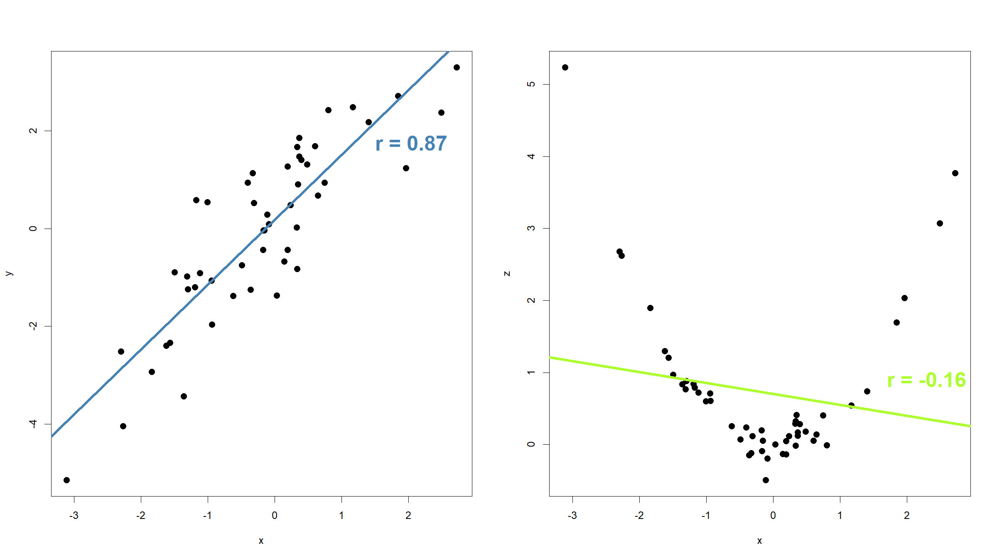
Interval / ratio - interval / ratio

Slide 113
What when a a mix of variable types
Usually one picks the measure of association for the lowest level of measurement of both variables.
Some special cases, e.g. point bi-serial correlation for a dichotomous and a continuous variable.

Slide 114
[end of Session 2]

