Slide 1
MSc Bioinformatics - Data visualisation in R
Marc Henrion

Slide 2
Session 7: Data visualisation in R

Slide 3
Preliminaries
In this session we will cover basic R commands, how to read data in, write data or results to files, merge data tables, produce various data summary statistics etc. We will not cover data visualisation (later session).
Participant packs
https://github.com/gitMarcH/COM_STA621_2020
Copy of slides & some R codes.
Note
These slides have been generated by using R Markdown.

Slide 4
Resource
We will only cover basic graphs here.
Much more complex & polished graphs will take quite a bit of coding and / or rely on dedicated libraries.
A superb resource for idenitfying what kind of figure you want to generate, with tutorials on how to do this, can be found at
https://www.r-graph-gallery.com/

Slide 5
Data types

Slide 6
Data types
Recall from Session 1: a variable has one of 4 levels of measurement:
nominal - classifies observations into different categories
alive / dead
human, fish, goat, bird
ordinal - different categories, but categories are ordered
low, medium, high
interval - ordered data with degree of difference; ratios not meaningful
temperature in centigrade: difference betwen 10º and 20º same as between 50º and 60º but 20º not twice as hot as 10º
ratio - interval data with a unique, non arbitrary zero value; ratios meaningful
temperature in Kelvin
length

Slide 7
Data types
R supports the following data types:
Character
Integer
Numeric / double
Logical / boolean
Factor / nominal

Slide 8
Data types
How to plot the data depends the types of the variable(s) you are going to plot.

Slide 9
Main graphical libraries

Slide 10
Graphical libraries
As we have seen in Session 1, there are 2 main ways to do R: base R and tidyverse R. The same is true for prooducing figures:
graphics library [base R]
A different function for each type of graph. Clunky syntax.
Lots of control over graphical parameters, generally functions do little guessing for sensible values and use fixed defaults.
You can usually get the figure to look exactly like you want.
ggplot2 library [tidyverse R]
“Grammar of graphics” $→$ consistent syntax for all types of graphs. Splits graphs into different elements: data, aesthetic mappings, geoms, …
Lots of automatic guessing for sensible parameter values. Sometimes tedious to override default behaviour.
Easier to quickly get nice looking figures, (sometimes) harder to get exactly what you want…
If used in functions / scripts, need to enclose plotting command in a print() statement.

Slide 11
Distribution figures

Slide 12
Distribution figures
Distributions: what values did you record for a given variable?
Discrete values (nominal, ordinal, integer-valued) values:
bar plots
pie charts
Continuous values
histograms

Slide 13
Distribution figures
Let’s generate some data:
typesTmp<- paste(sep="","type",1:3) type<-factor(sample(typesTmp, size=1000, replace=T, prob=c(0.45,0.3,0.25))) x1<-rbinom(1000,size=1,prob=0.25) x2<-rpois(1000,lambda=ifelse(type=="type3",6,4)) dat<-data.frame(type,x1,x2)

Slide 14
Distribution figures
Distributions: bar plots
graphics:
barplot(table(dat$x1),cex.names=2)

Slide 15
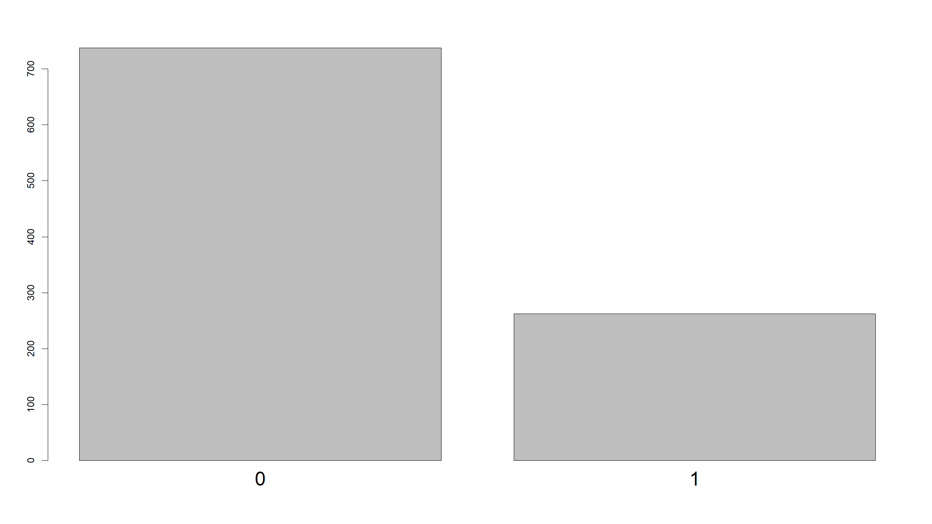

Slide 16
barplot(table(dat$x2),cex.names=2)

Slide 17
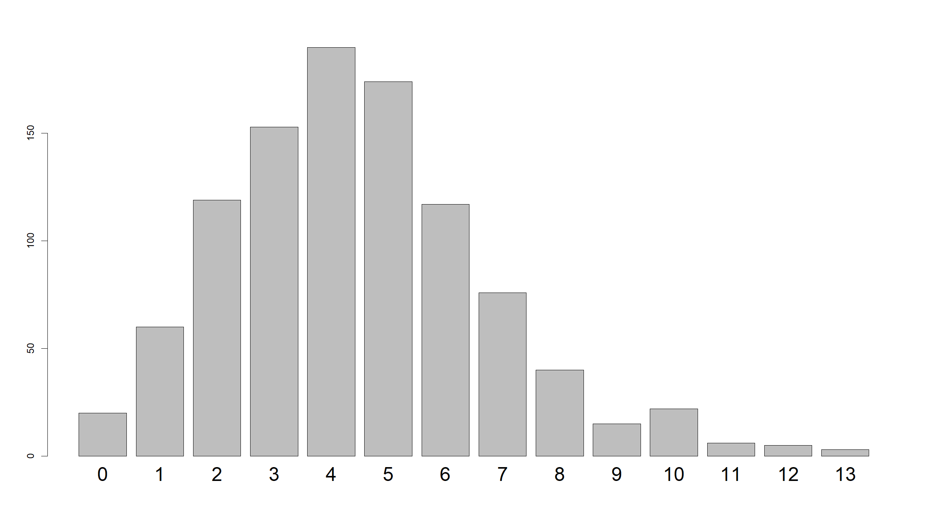

Slide 18
barplot(table(dat$type),cex.names=2)

Slide 19
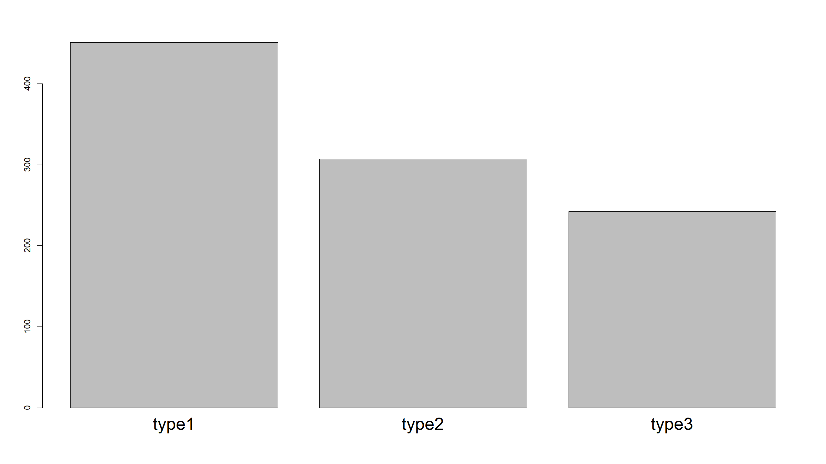

Slide 20
barplot(table(dat$type,dat$x2), beside=T, legend.text=levels(dat$type), cex.names=2)

Slide 21
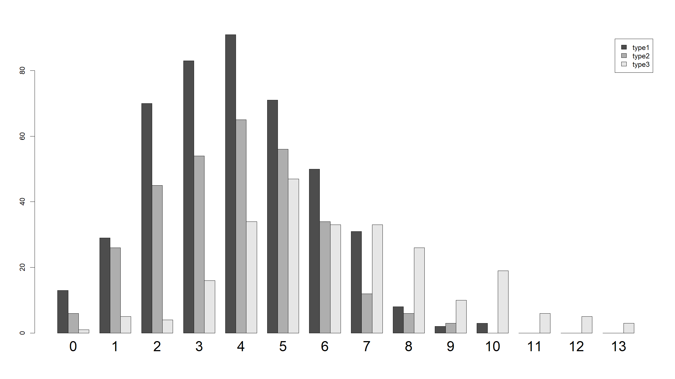

Slide 22
Can specify some options:
barplot(table(dat$x2), col="steelblue", xlab="values", ylab="count", main="Barplot", cex.names=2, cex.axis=2, cex.lab=2, cex.main=2)

Slide 23
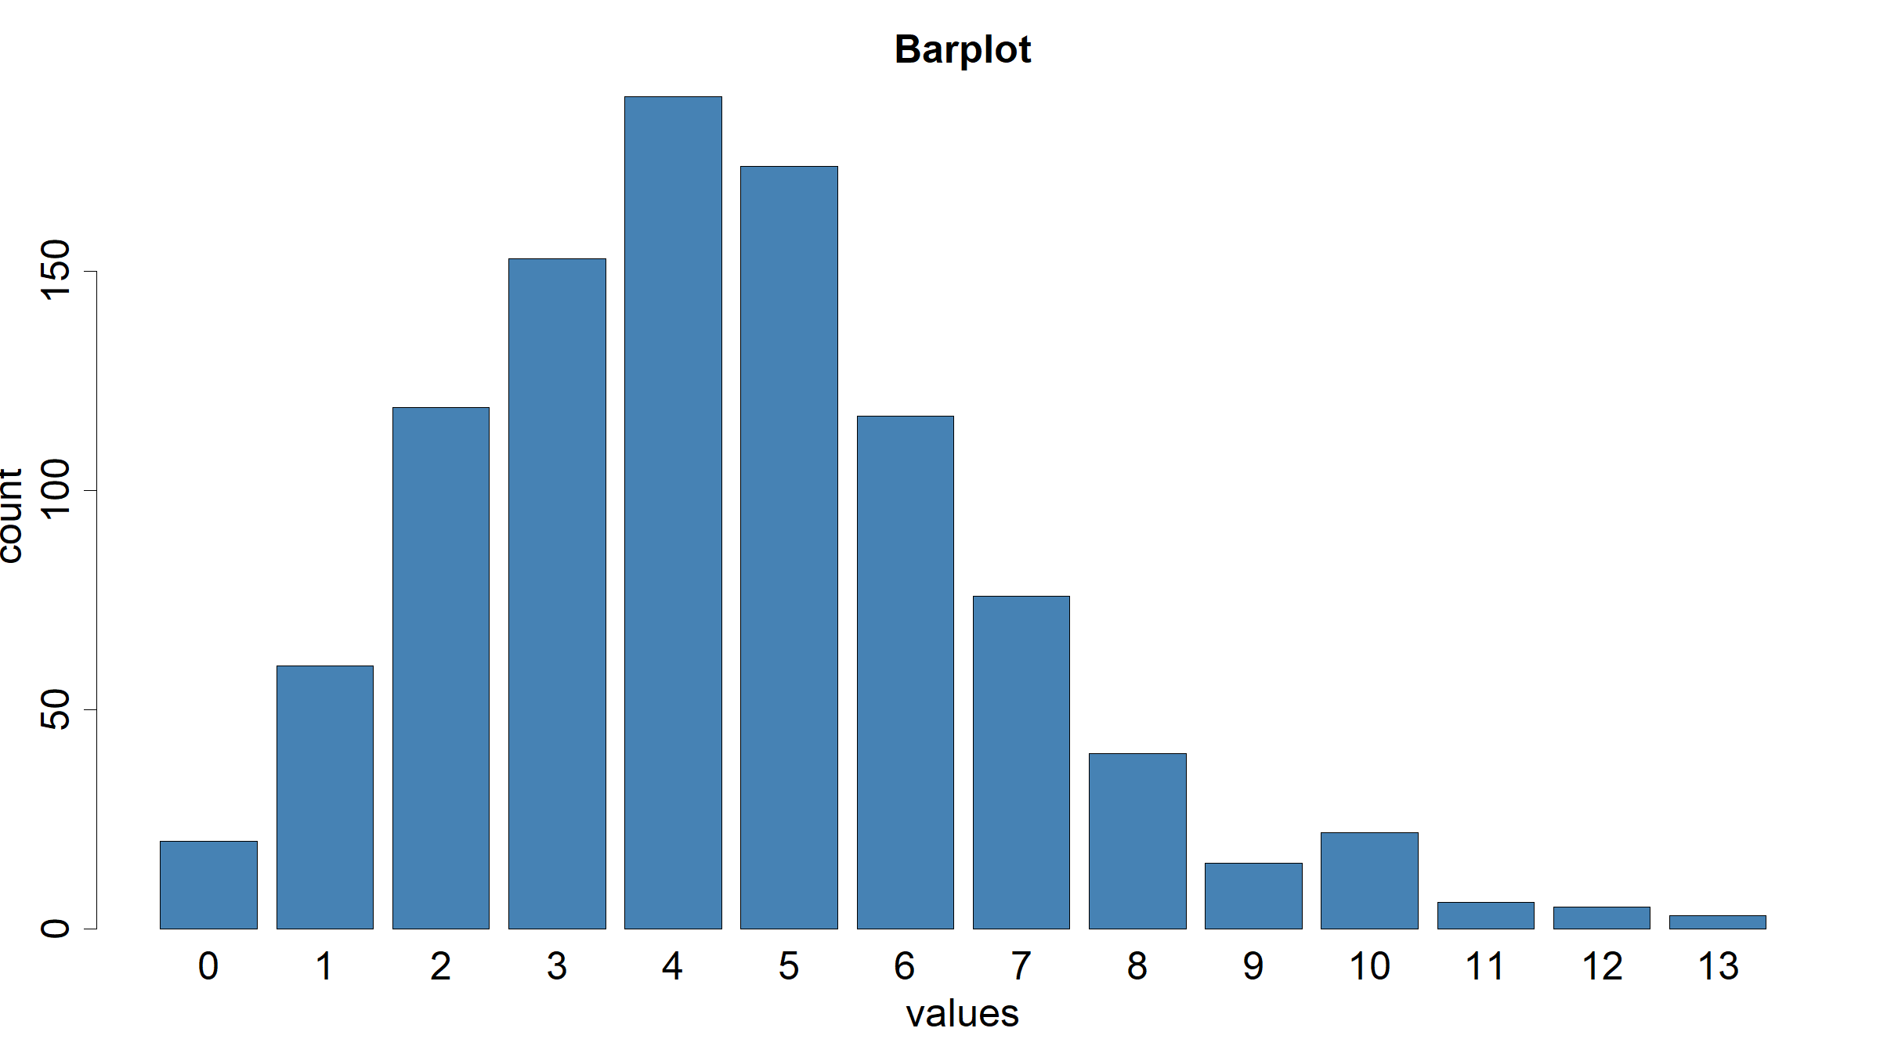

Slide 24
barplot(table(dat$x2),horiz=T,cex.names=2)

Slide 25
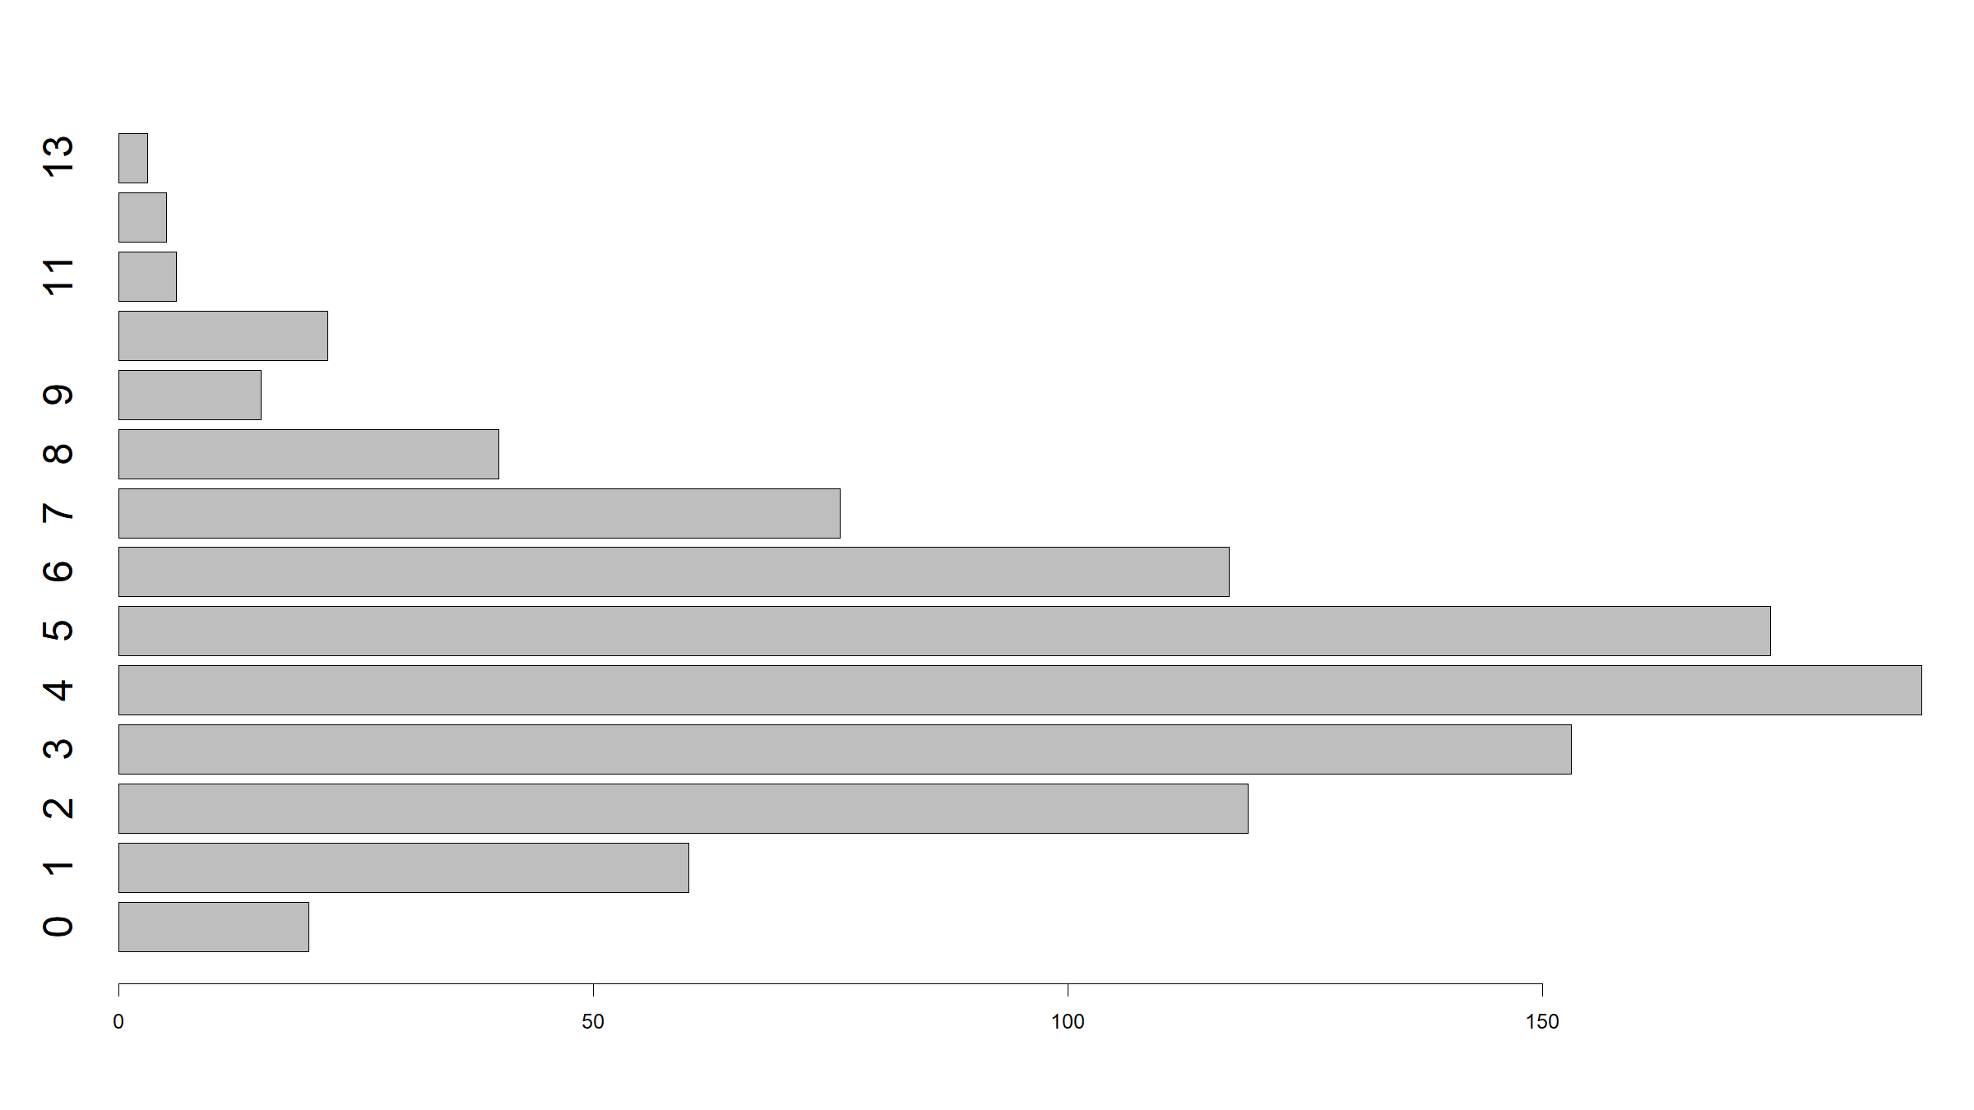

Slide 26
Distribution figures
ggplot2:
ggplot(data=dat,mapping=aes(x=x1)) + geom_bar()

Slide 27
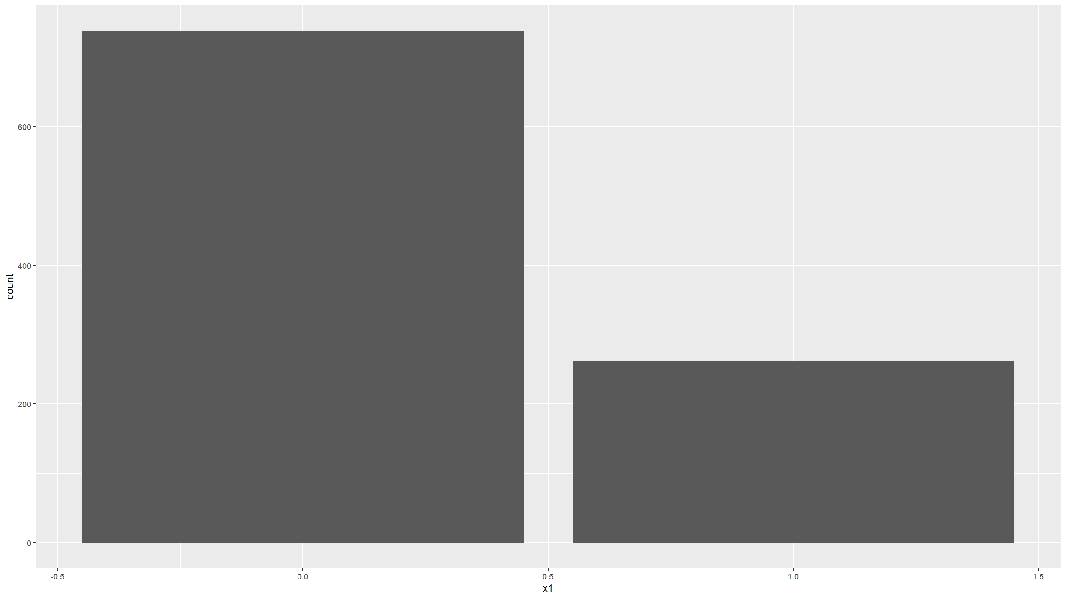

Slide 28
ggplot(data=dat,mapping=aes(x=x2)) + geom_bar()

Slide 29
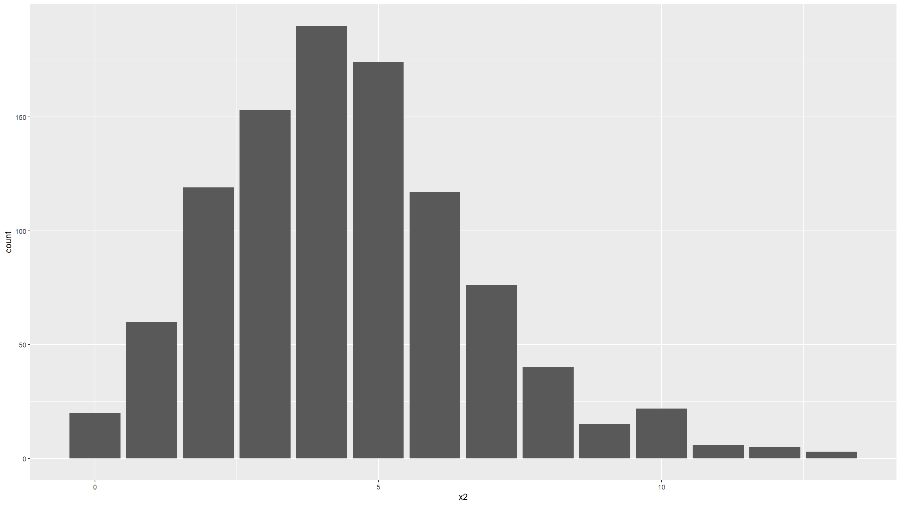

Slide 30
ggplot(data=dat,mapping=aes(x=type)) + geom_bar()

Slide 31
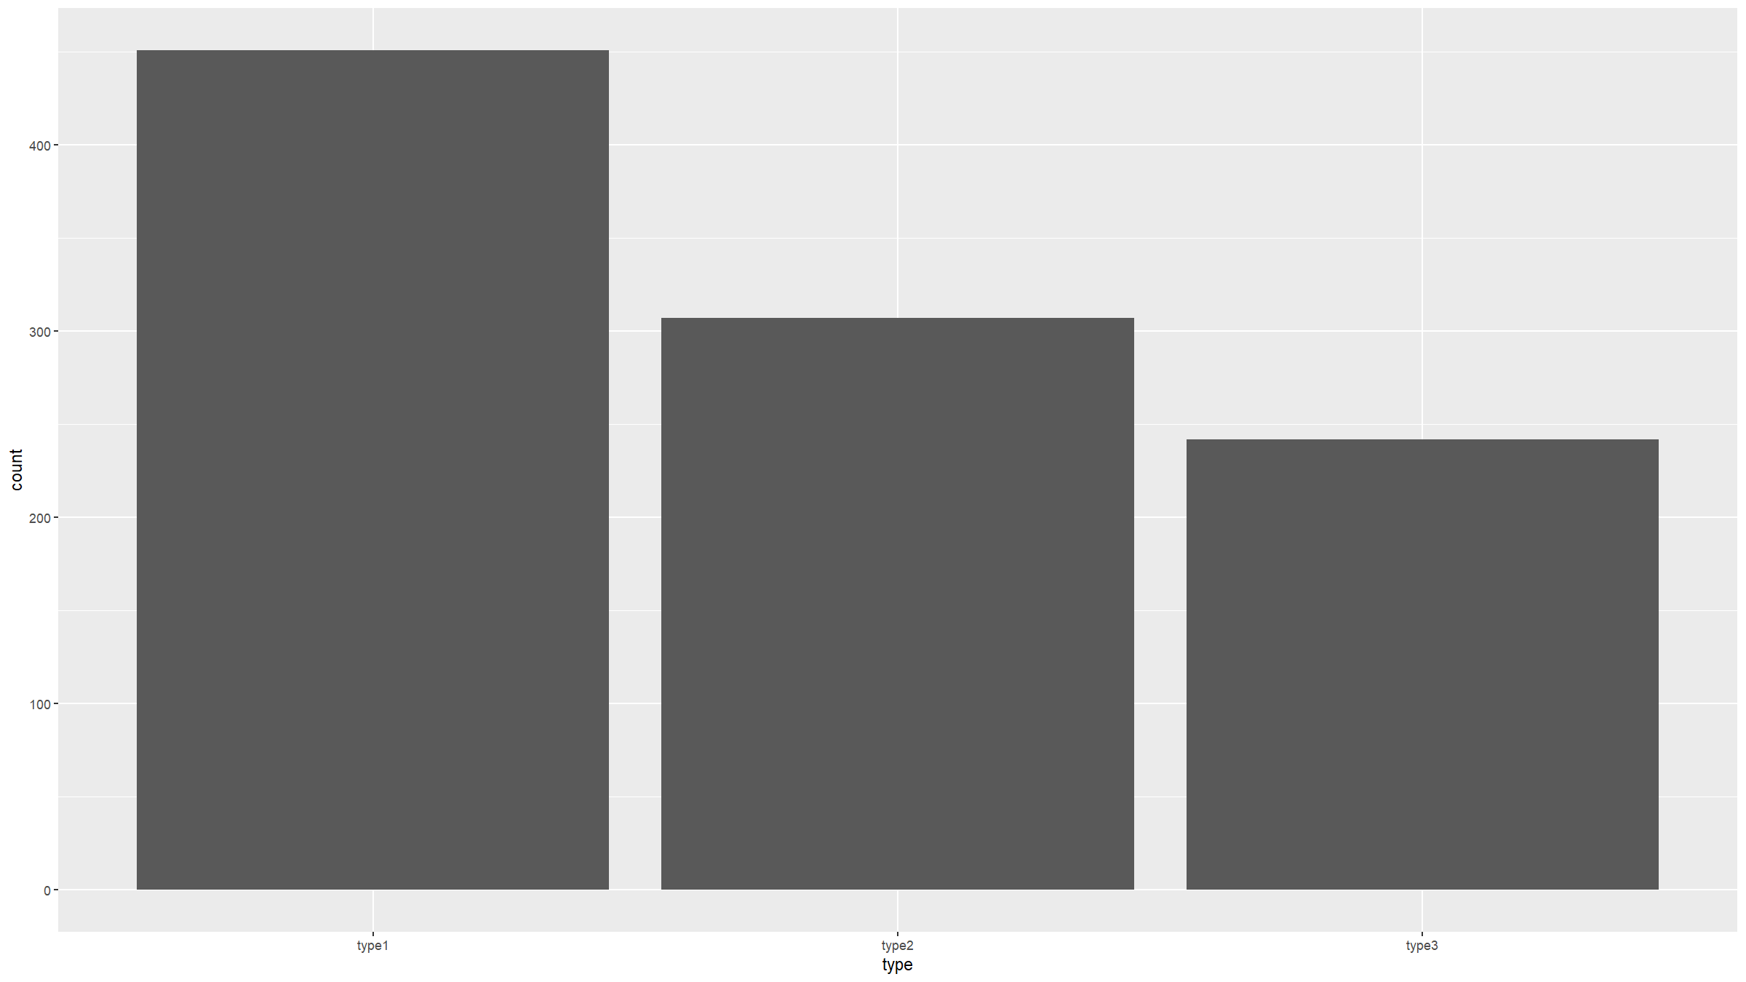

Slide 32
dat %>% count(type,x2) %>% complete(type,x2,fill=list(n=0)) %>% ggplot(mapping=aes(fill=type,y=n,x=x2)) + geom_bar(position="dodge",stat="identity") + theme(text = element_text(size=20))

Slide 33
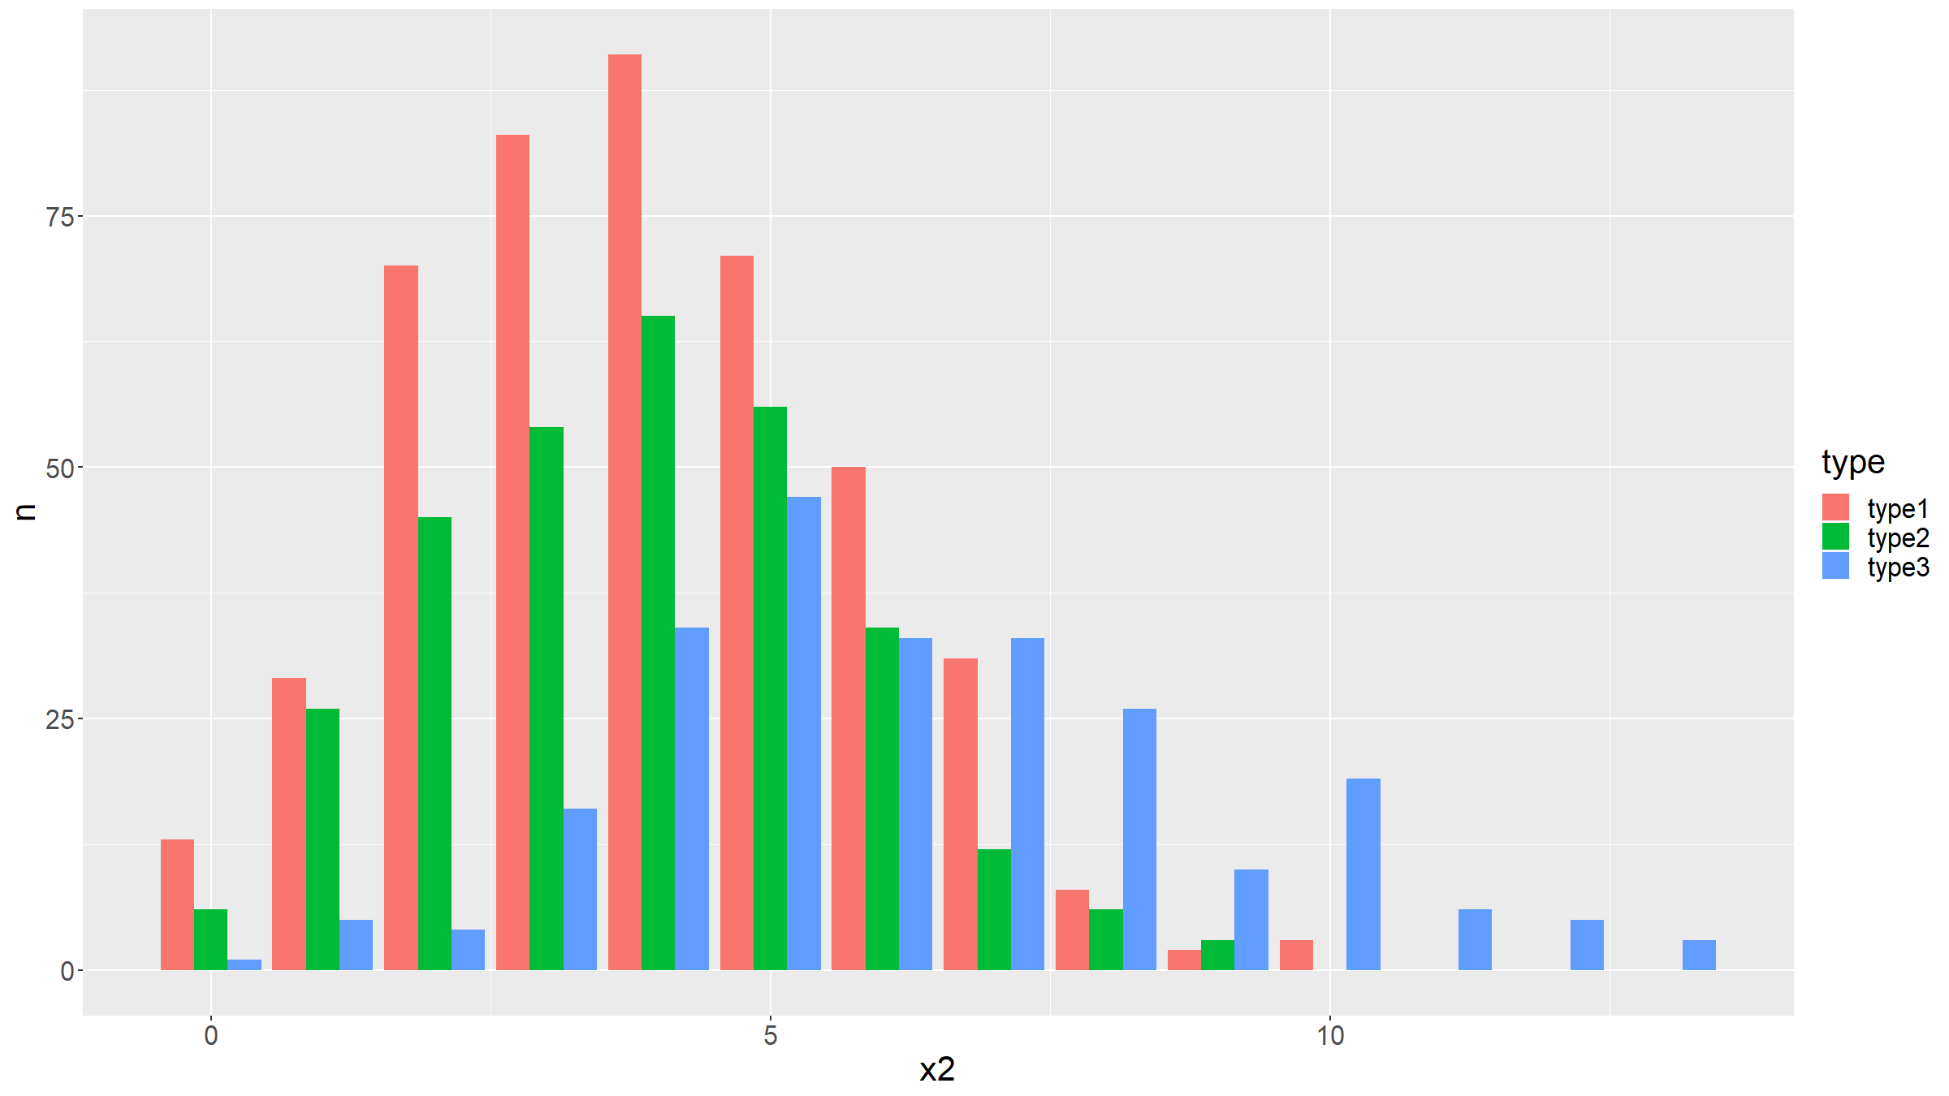

Slide 34
Can also specify options:
ggplot(data=dat,mapping=aes(x=x2)) + geom_bar() + coord_flip() + ggtitle("Barplot for variable x2") + xlab("values") + ylab("count") + theme(text = element_text(size=20))

Slide 35
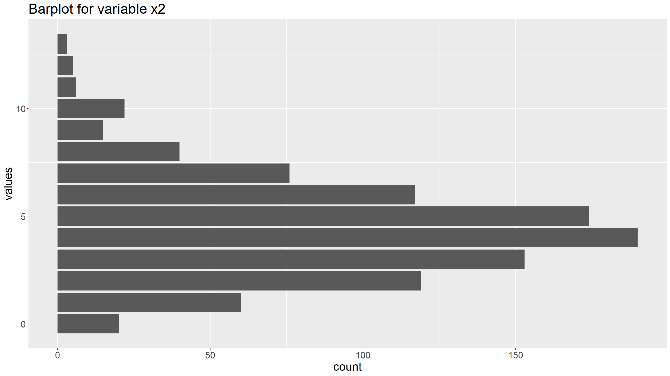

Slide 36
Distribution figures
Shortcut in ggplot2 for users more familiar with base R:
qplot(dat$x1,geom="bar") qplot(dat$x2,geom="bar") qplot(dat$type,geom="bar")

Slide 37
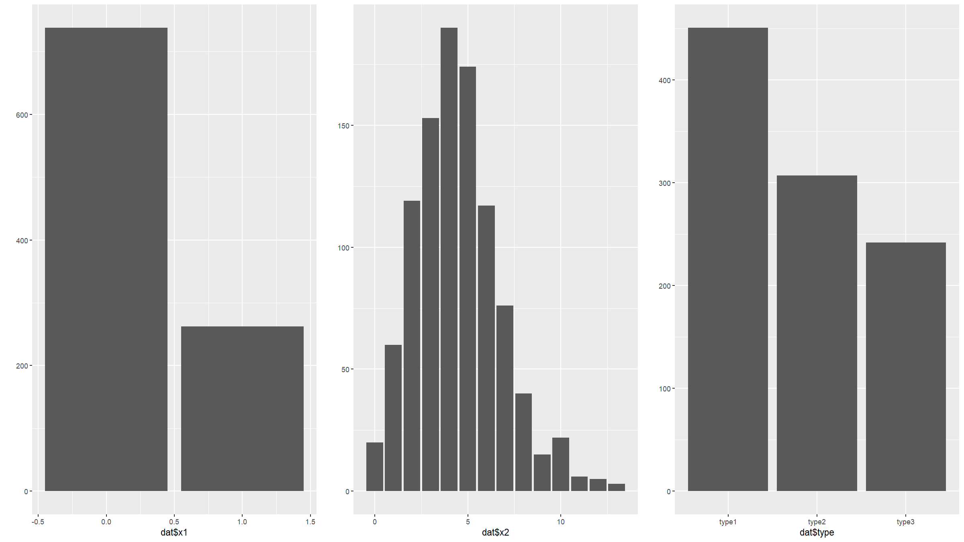

Slide 38
Distribution figures
Distributions: pie charts
graphics:
pie(table(dat$type))

Slide 39
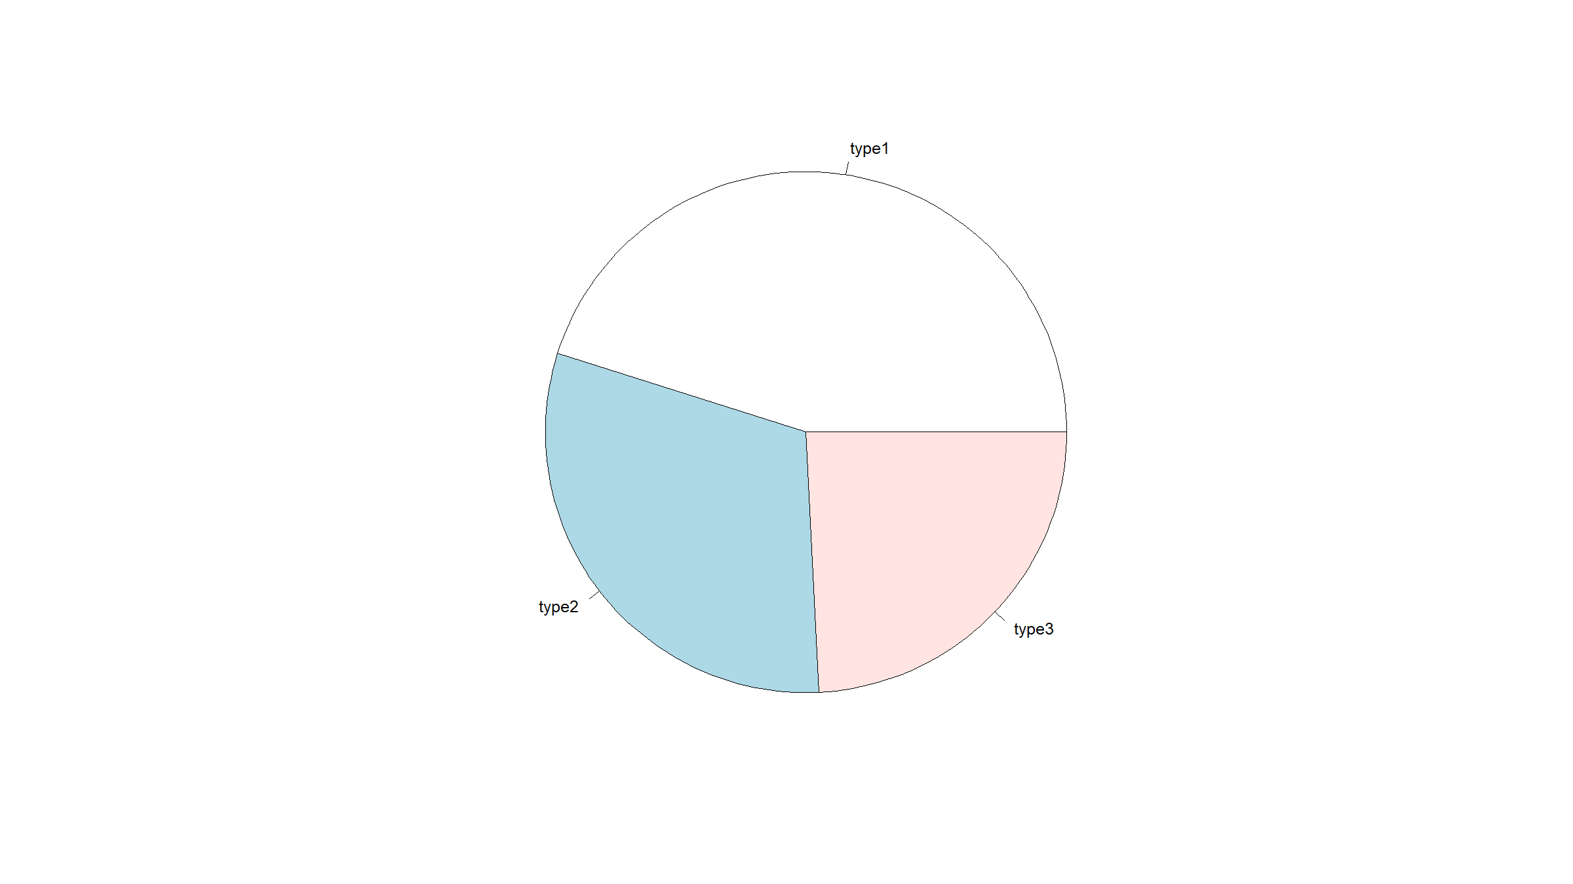

Slide 40
ggplot2:
ggplot(dat, mapping=aes(x=factor(1), fill=factor(type))) + geom_bar(width = 1) + coord_polar("y") + xlab("") + theme_void()

Slide 41
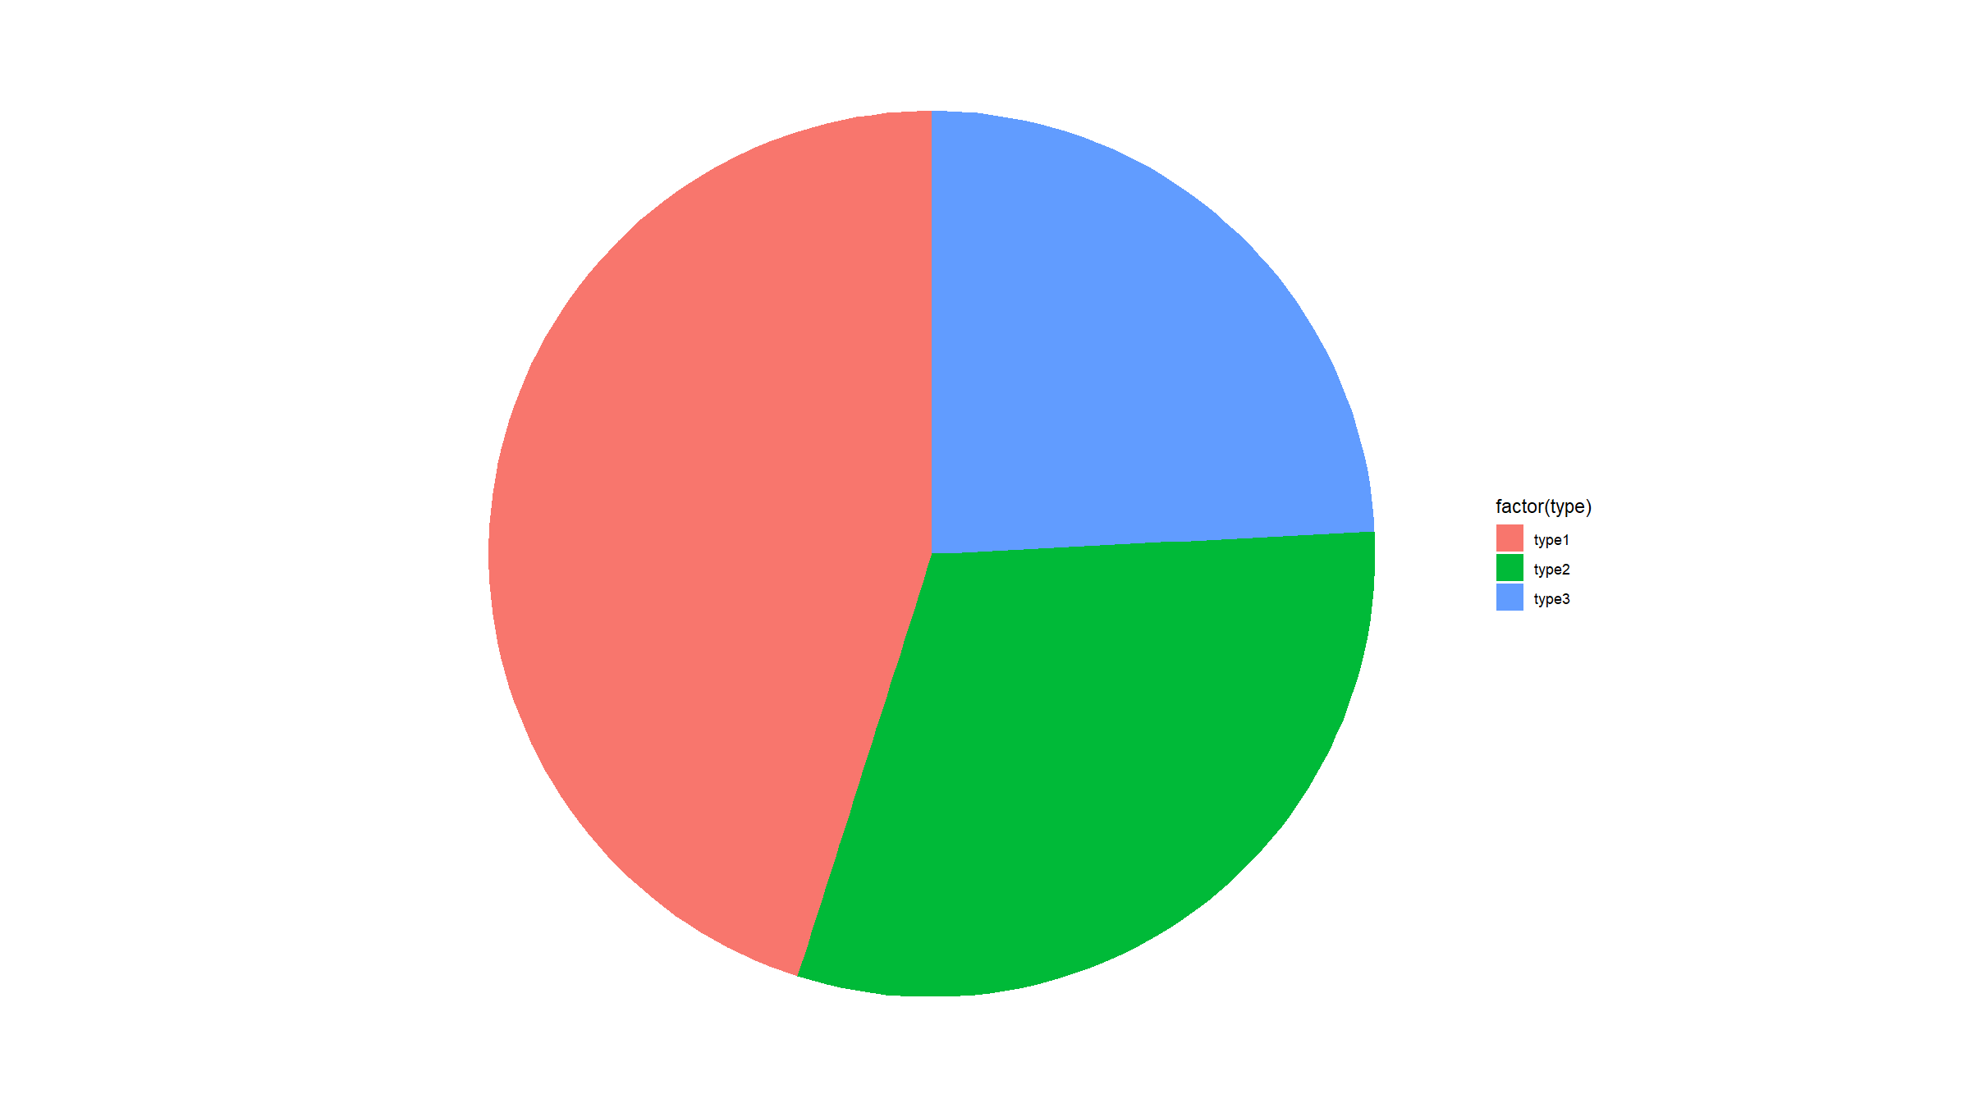

Slide 42
Note:
Generally, R discourages the use of pie charts (they are horrible & misleading).

Slide 43
Distribution figures
Distributions: histograms
Summarise the distribution of continuous variables, by binning data into discrete intervals.
Can be used for binary and discrete variables as well, but barplots better suited for such variables.
Let’s generate some more data:
dat<-mutate(dat, x3=ifelse(type=="type1", rnorm(500,mean=-2), ifelse(type=="type2", rnorm(500,mean=2), runif(500))))

Slide 44
Distribution figures
graphics:
hist(dat$x3)

Slide 45
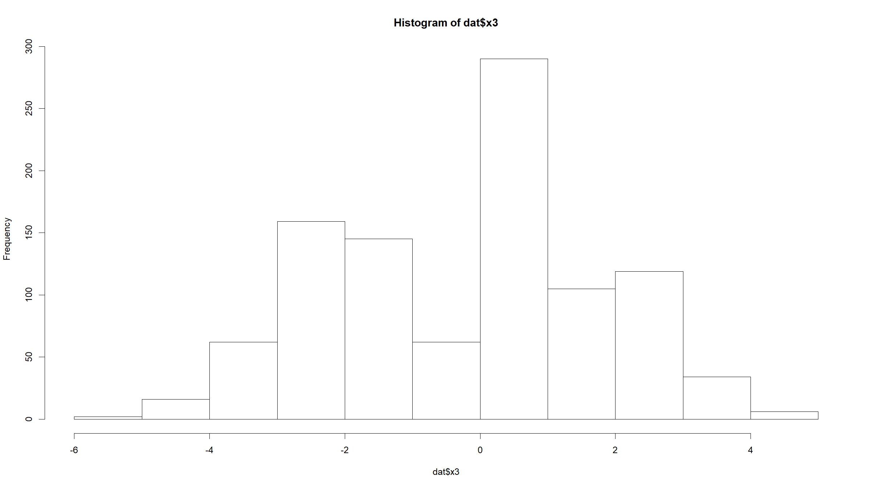

Slide 46
hist(dat$x3,xlab="normal data",main="Histogram",col="grey",breaks=50)

Slide 47
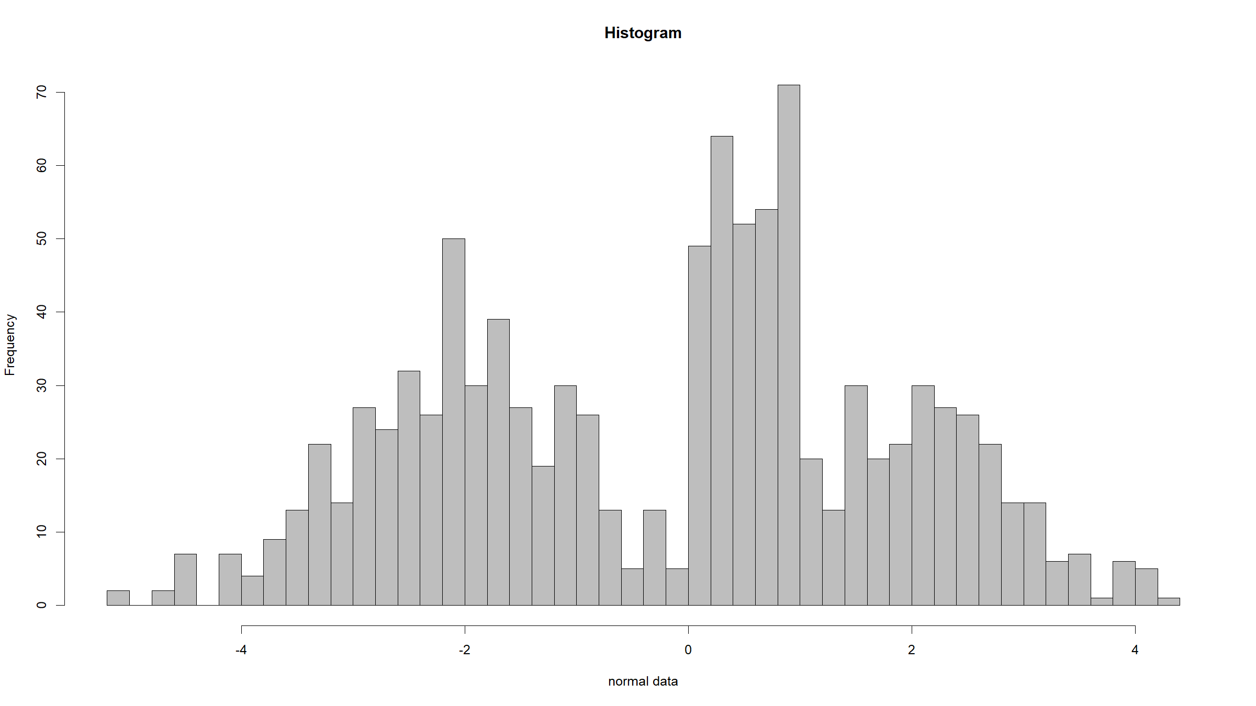

Slide 48
hist(dat$x3,xlab="normal data",main="Histogram",col="grey",freq=F)

Slide 49
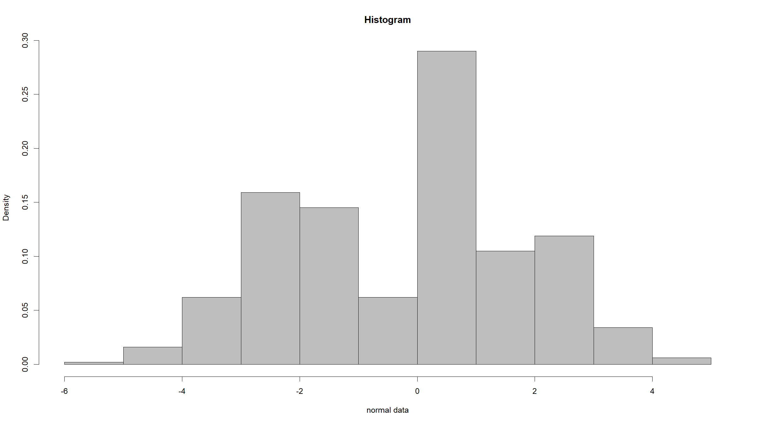

Slide 50
hist(dat$x3,xlab="normal data",main="Histogram",col="grey",xlim=c(-10,10))

Slide 51
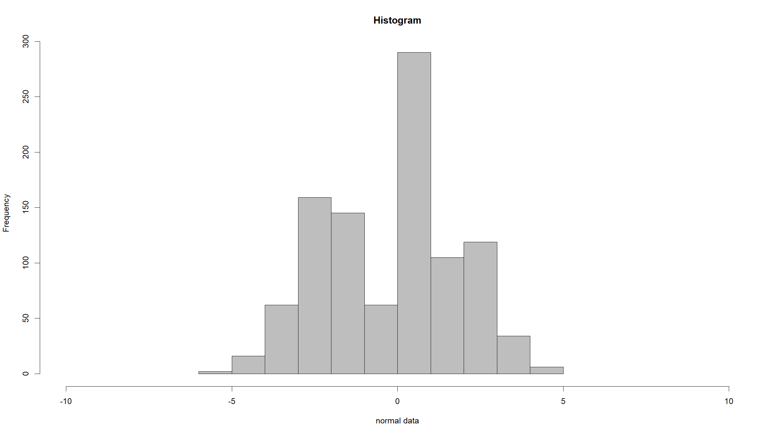

Slide 52
ggplot2:
ggplot(data=dat,mapping=aes(x=x3)) + geom_histogram()
## `stat_bin()` using `bins = 30`. Pick better value with `binwidth`.

Slide 53
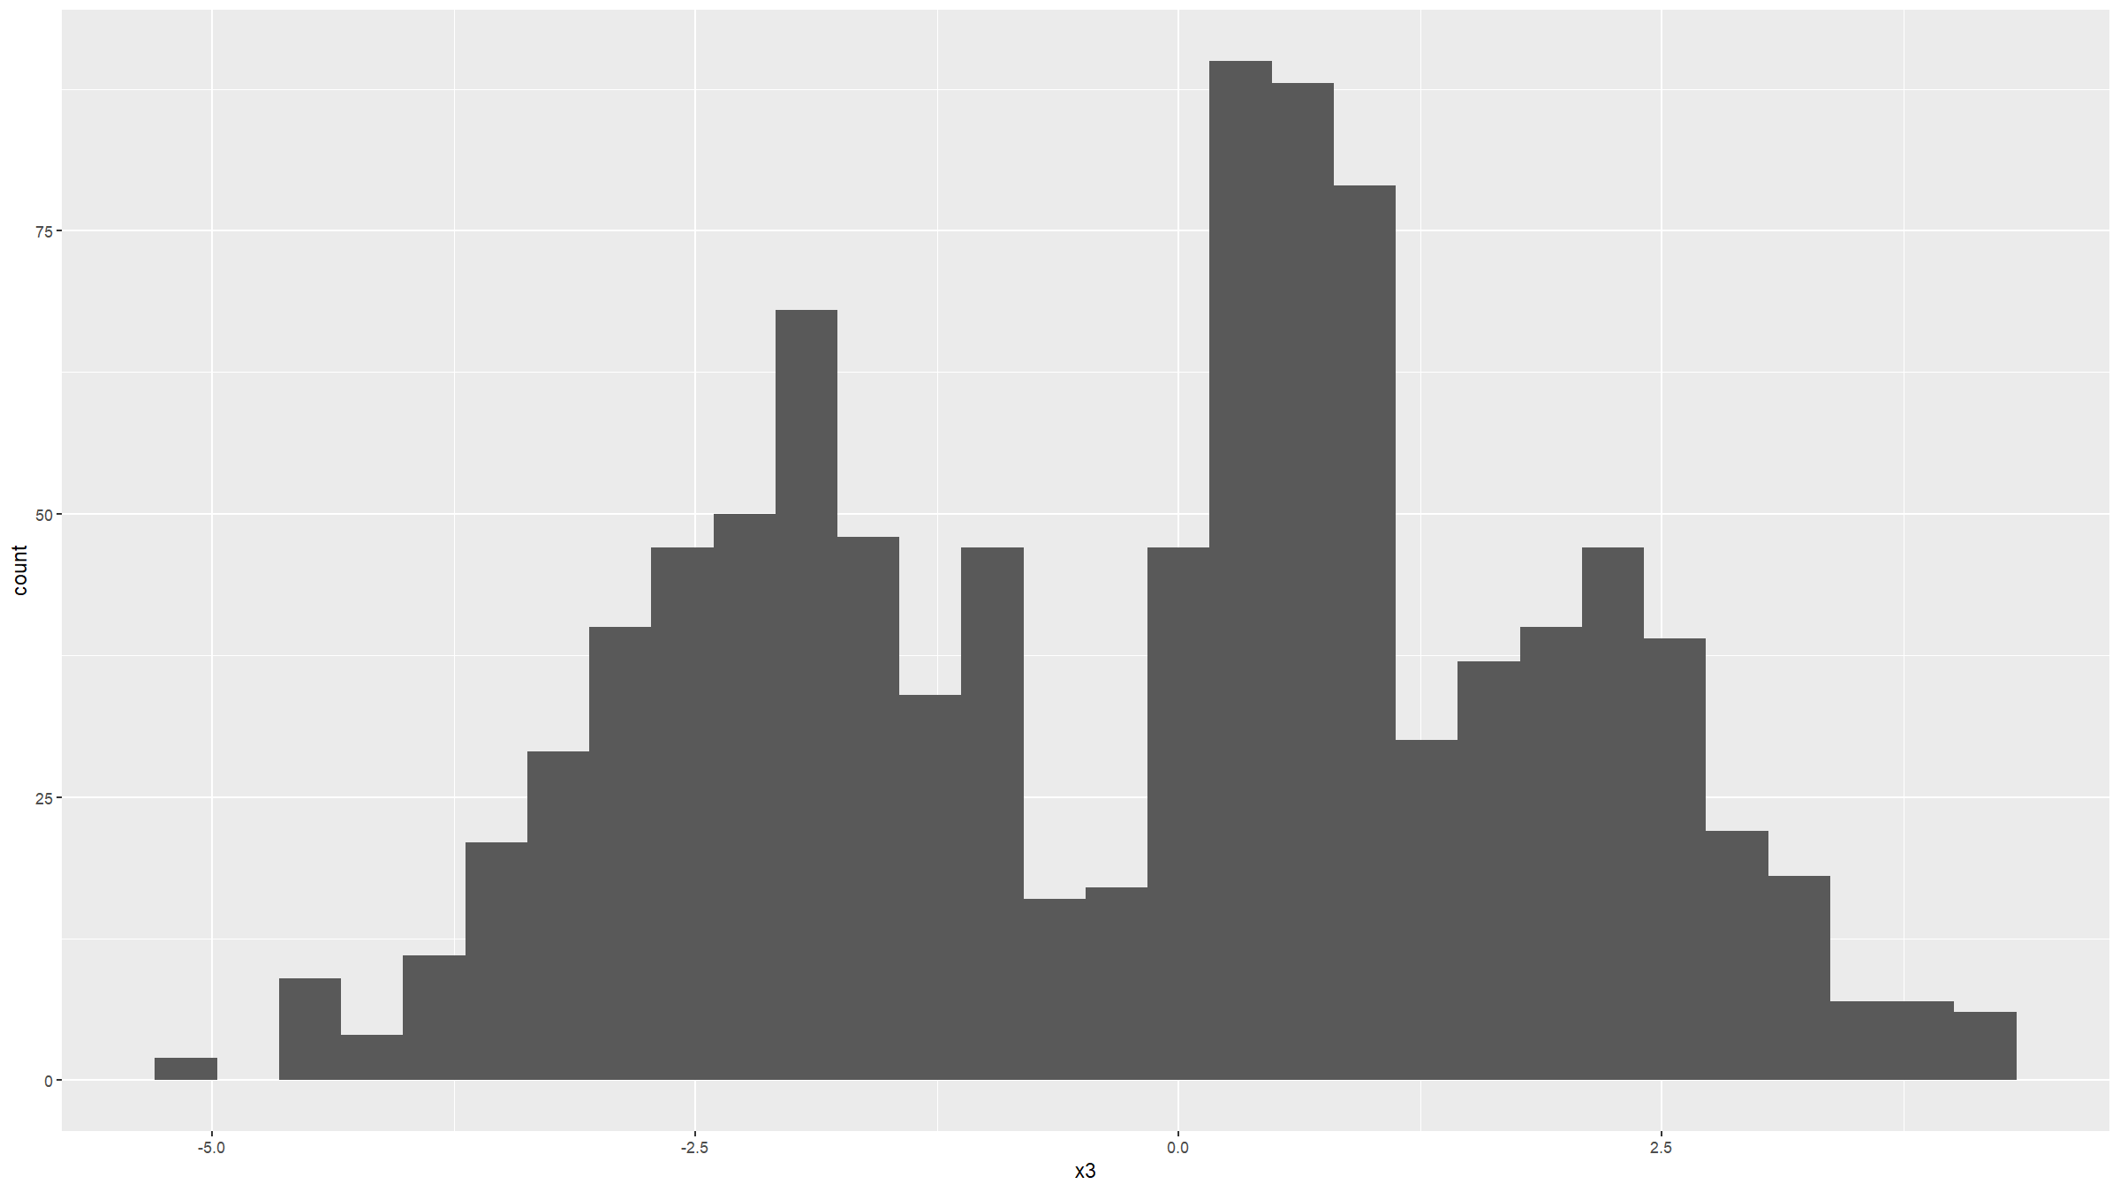

Slide 54
ggplot(data=dat,mapping=aes(x=x3)) + geom_histogram(binwidth=0.1)

Slide 55
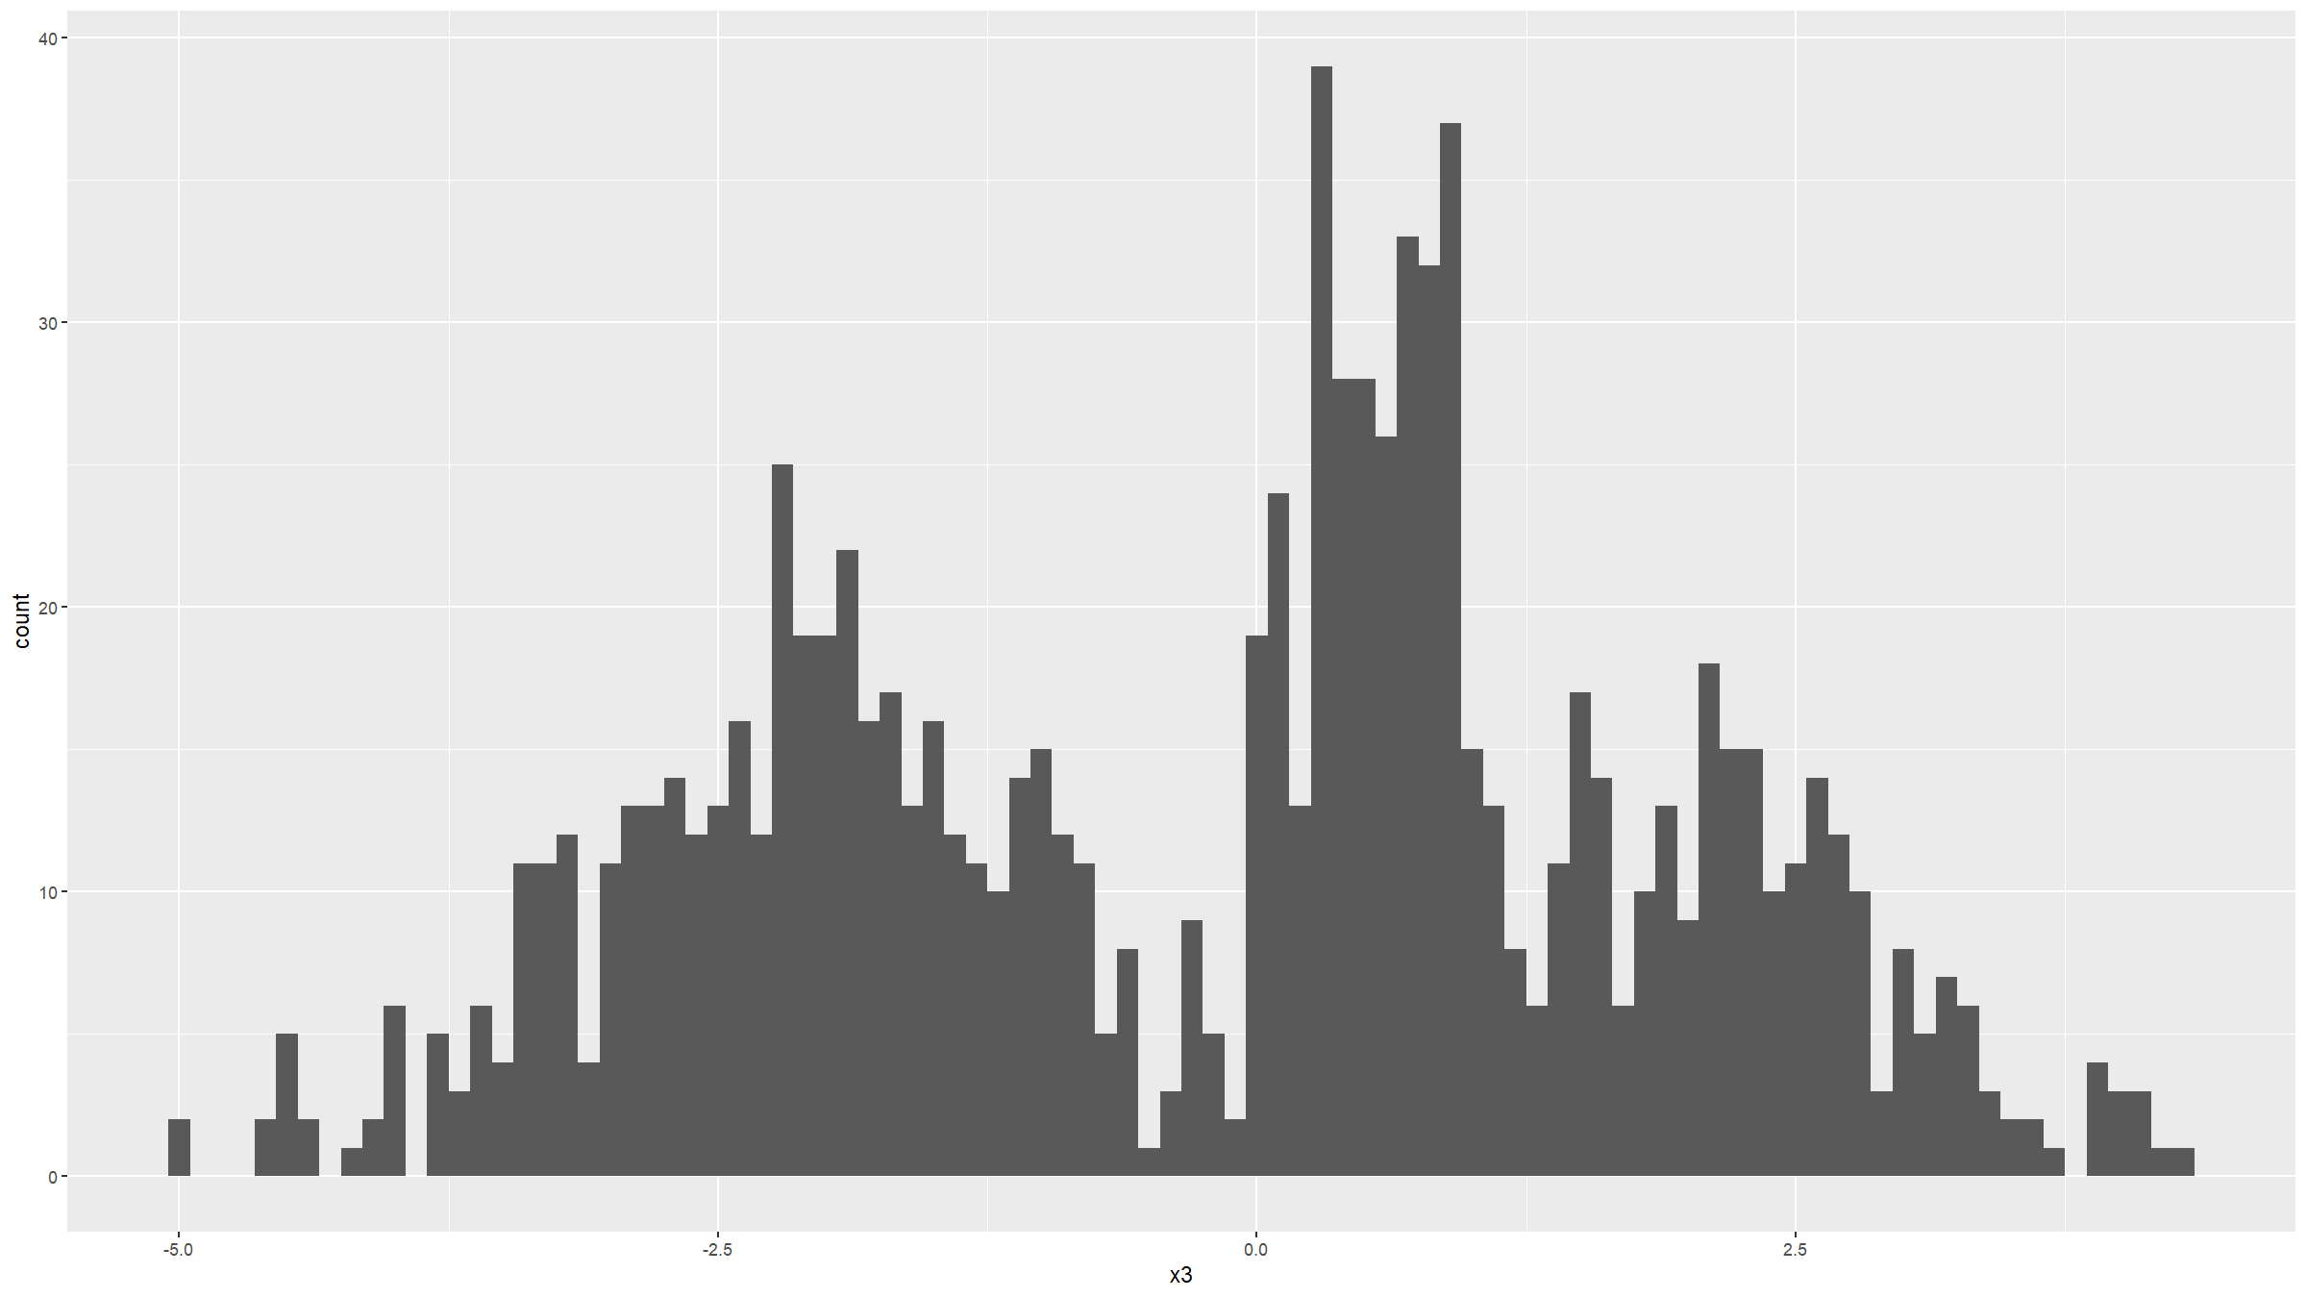

Slide 56
ggplot(data=dat,mapping=aes(x=x3,stat(density))) + geom_histogram(binwidth=0.15)

Slide 57
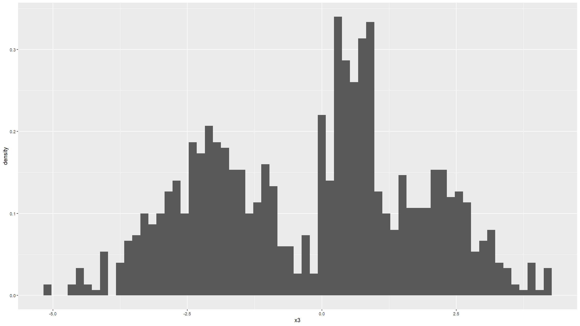

Slide 58
ggplot(data=dat,mapping=aes(x=x3,stat(density))) + geom_histogram(binwidth=0.15) + coord_cartesian(xlim = c(-10, 10)) + ggtitle("Histogram") + theme(text=element_text(size=24))

Slide 59
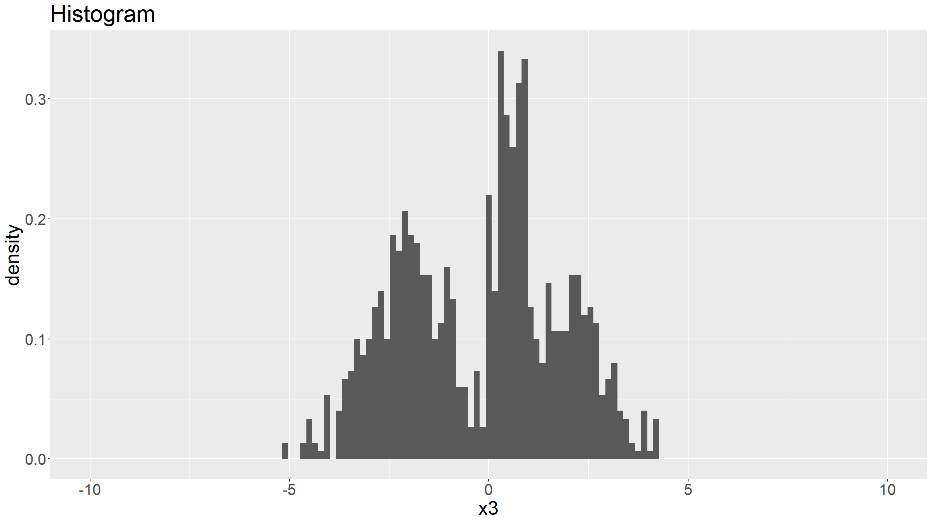

Slide 60
Distribution figures
graphics:
hist(dat$x3,xlab="normal data",main="Histogram",col="grey",freq=F,breaks=50) lines(density(dat$x3,bw="SJ")) h<-hist(dat$x3,breaks=50,plot=F) col1<-col2rgb("steelblue") col1<-rgb(col1[1],col1[2],col1[3],alpha=150,maxColorValue=255) col2<-col2rgb("salmon") col2<-rgb(col2[1],col2[2],col2[3],alpha=150,maxColorValue=255) col3<-col2rgb("orange") col3<-rgb(col3[1],col3[2],col3[3],alpha=150,maxColorValue=255) hist(dat$x3[dat$type=="type1"],xlab="x3",main="",col=col1,breaks=h$breaks,ylim=range(h$counts)) hist(dat$x3[dat$type=="type2"],col=col2,breaks=h$breaks,add=T) hist(dat$x3[dat$type=="type3"],col=col3,breaks=h$breaks,add=T) legend(x="topright",col=c("steelblue","salmon","orange"),pch=15,cex=2,legend=levels(dat$type),bty="n")

Slide 61
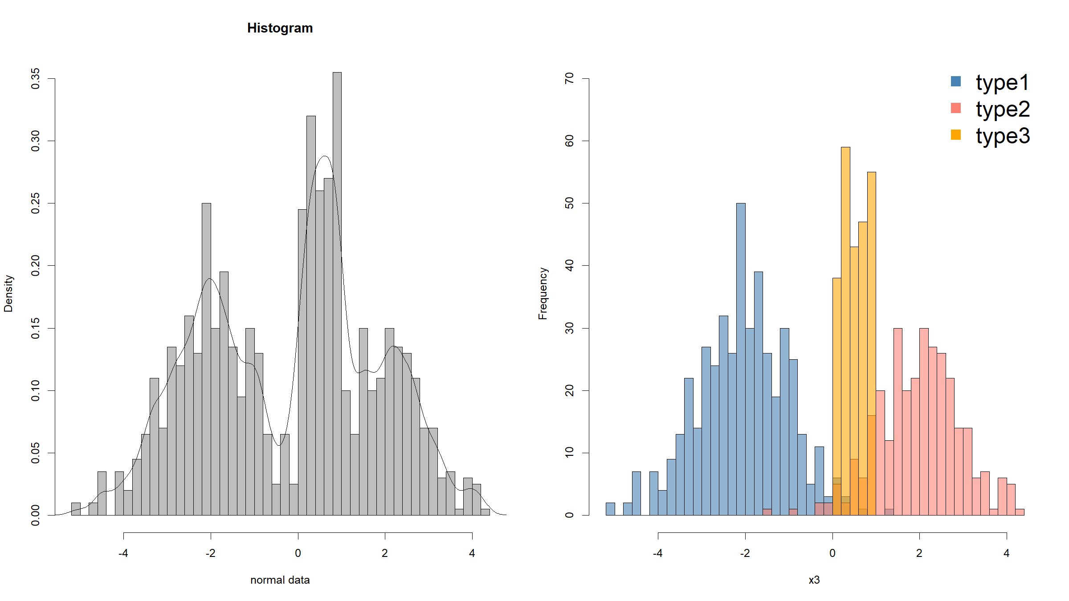

Slide 62
Distribution figures
ggplot2:
ggplot(data=dat,mapping=aes(x=x3,stat(density))) + geom_histogram(binwidth=0.15) + geom_density(bw="SJ",col="blue",lwd=1) ggplot(data=dat,mapping=aes(x=x3,fill=type)) + geom_histogram(binwidth=0.15,position="dodge")

Slide 63
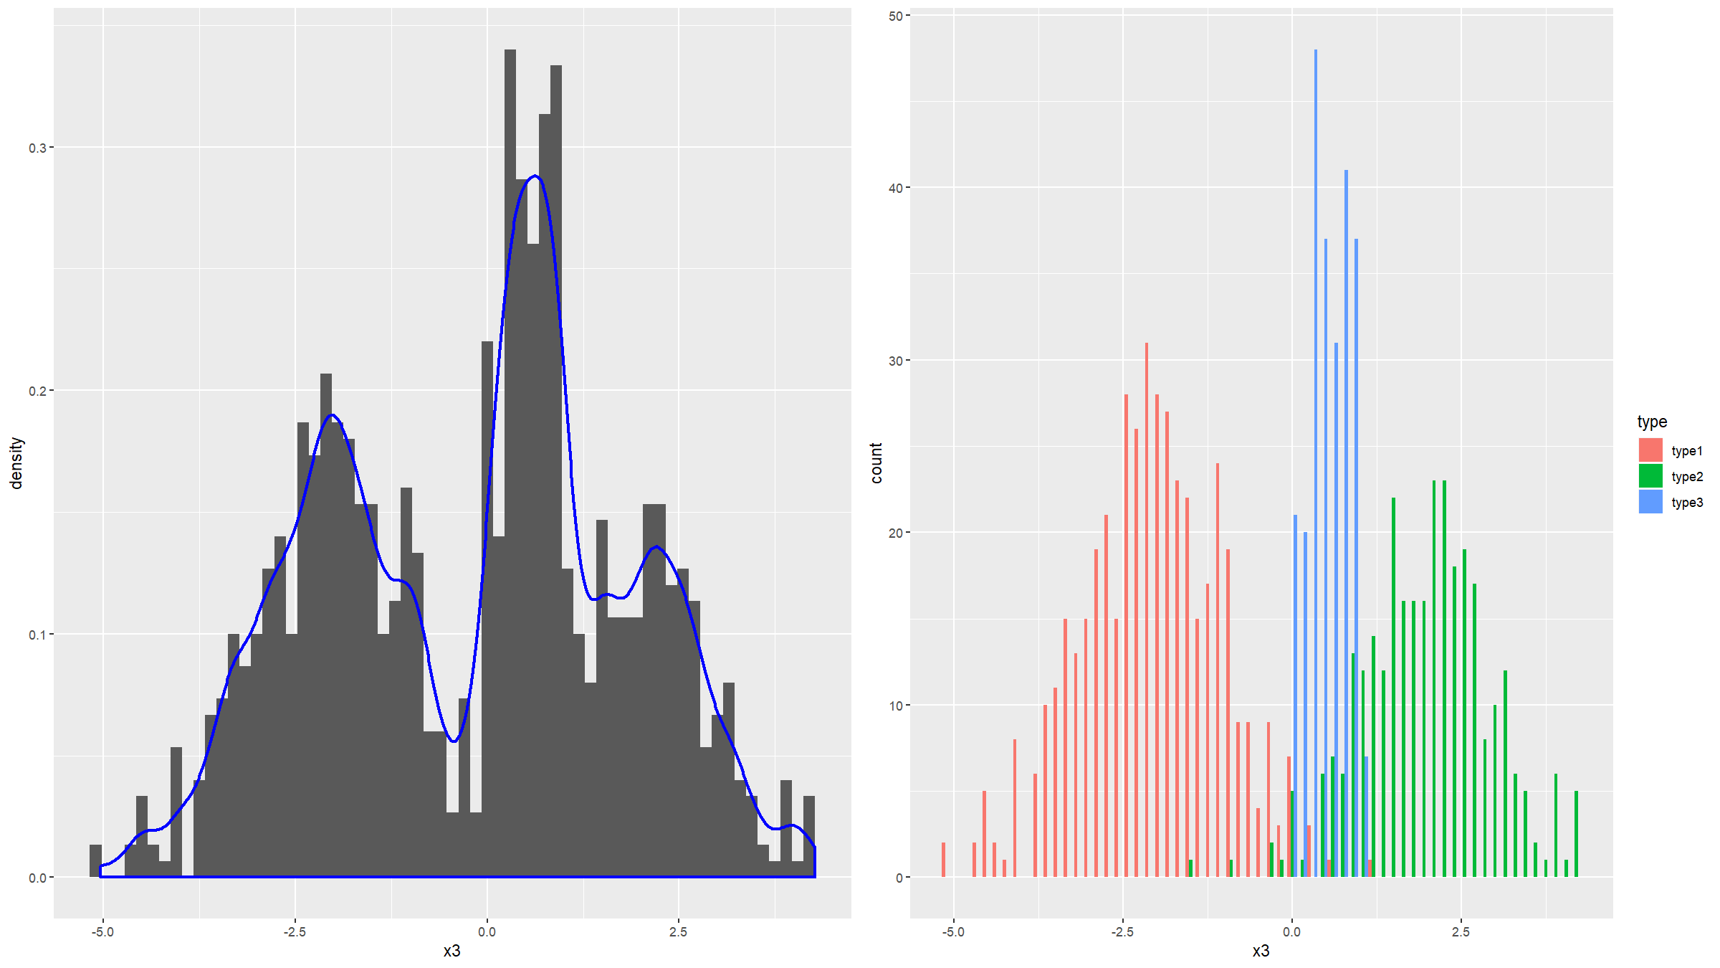

Slide 64
Covariation figures

Slide 65
Covariation figures
Covariation: box & whisker, violin plots
Is there a relationship between a binary / discrete / categorical and a continuous variable?
graphics:
boxplot(data=dat,x3~type)

Slide 66
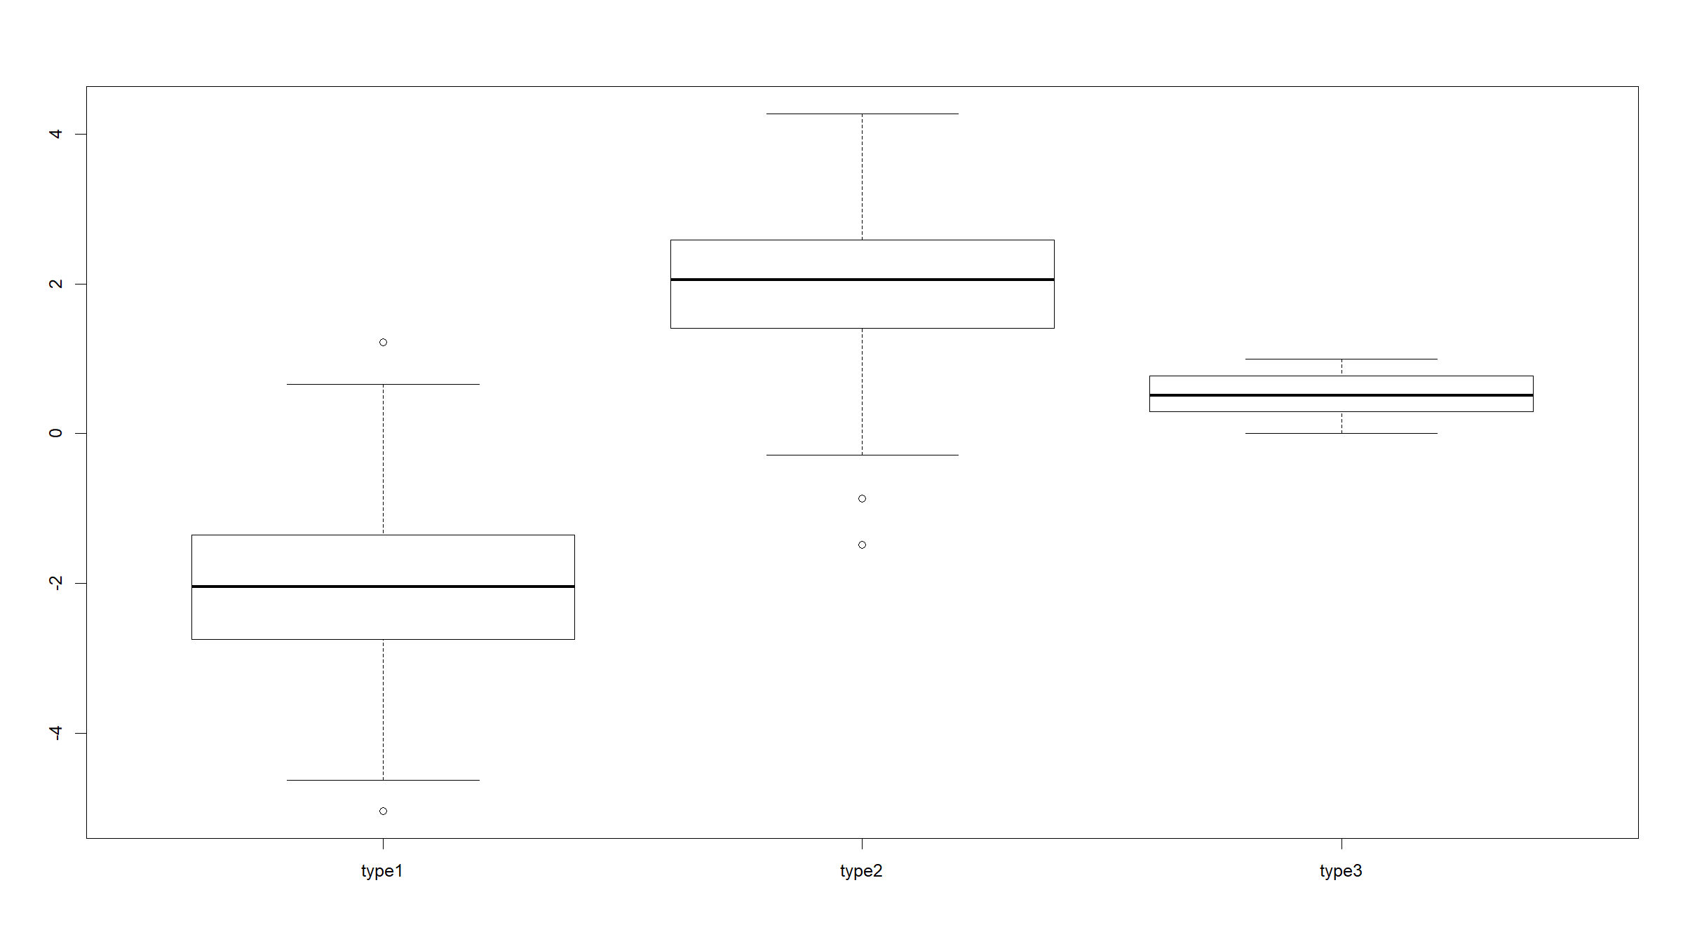

Slide 67
boxplot(data=dat,x3~type,horizontal=T)

Slide 68
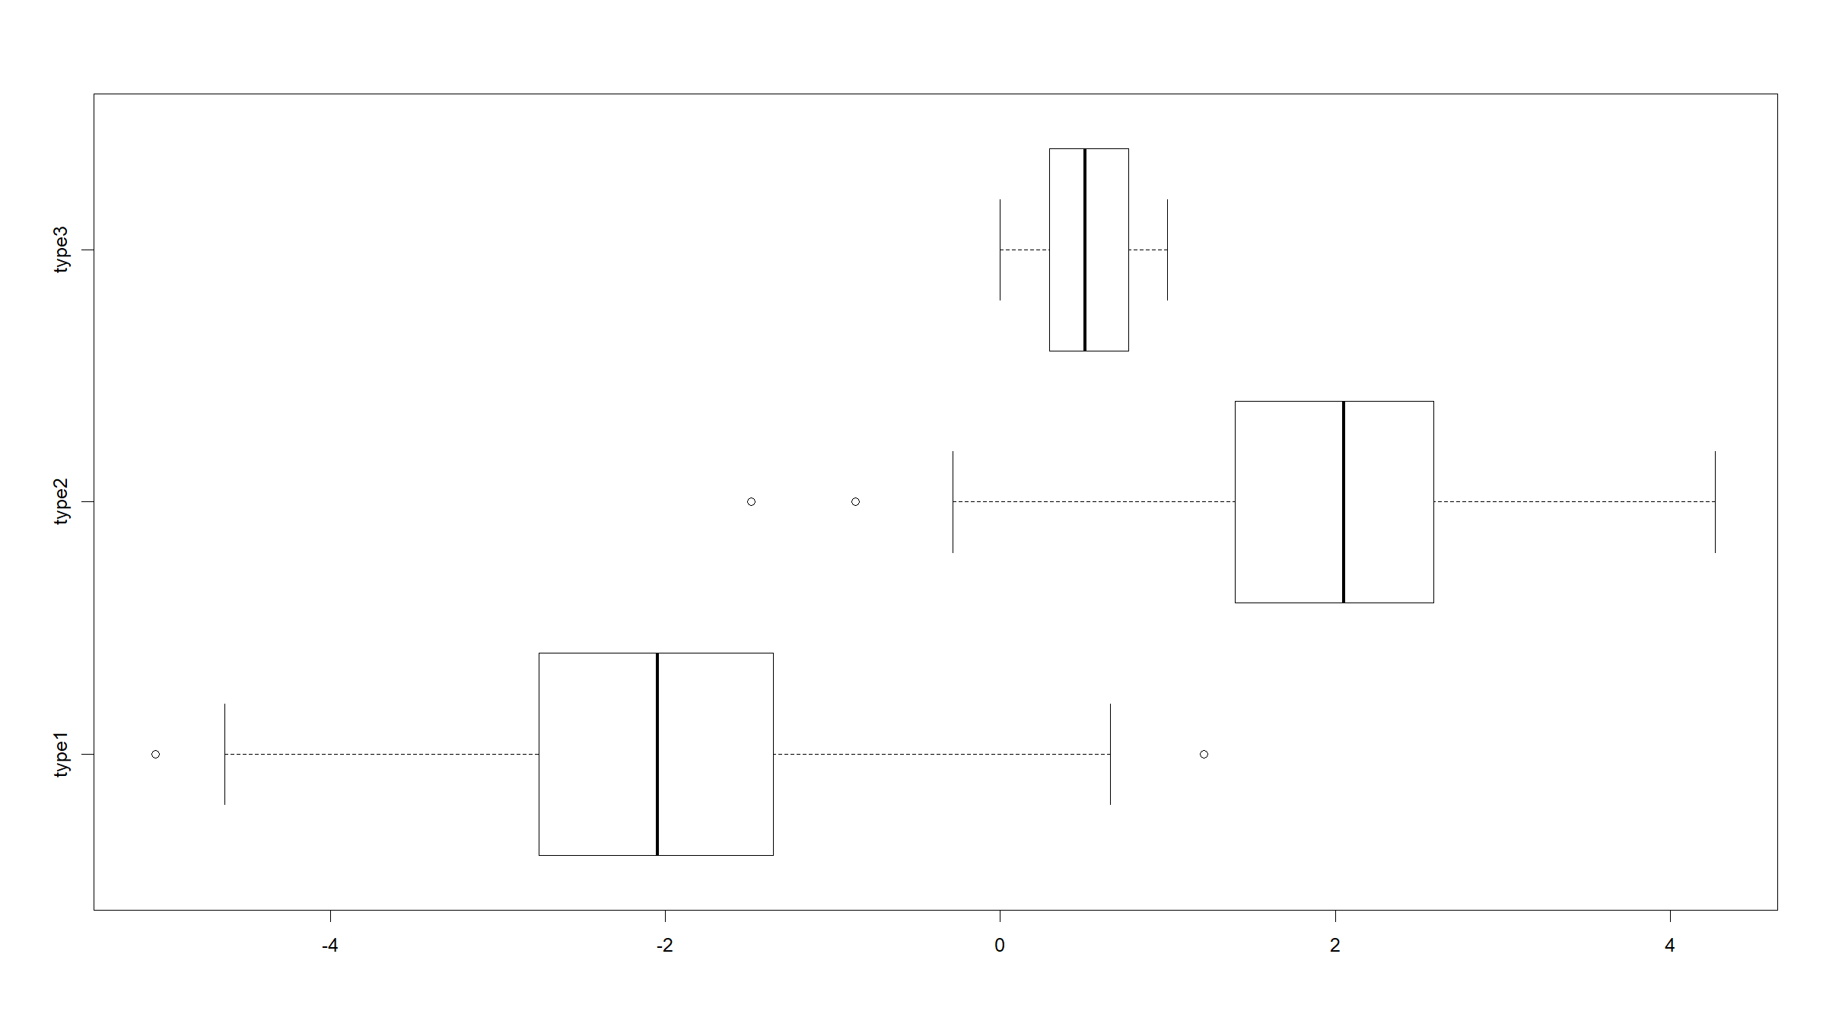

Slide 69
Covariation figures
ggplot2:
ggplot(data=dat,mapping=aes(x=type,y=x3)) + geom_boxplot()

Slide 70
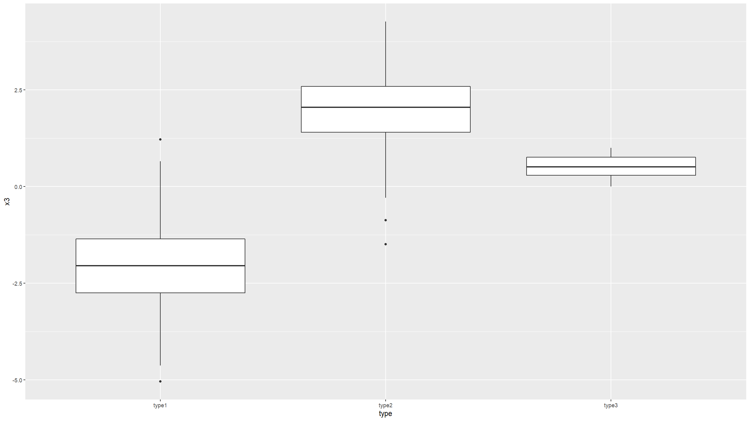

Slide 71
ggplot(data=dat,mapping=aes(x=type,y=x3)) + geom_boxplot() + coord_flip()

Slide 72
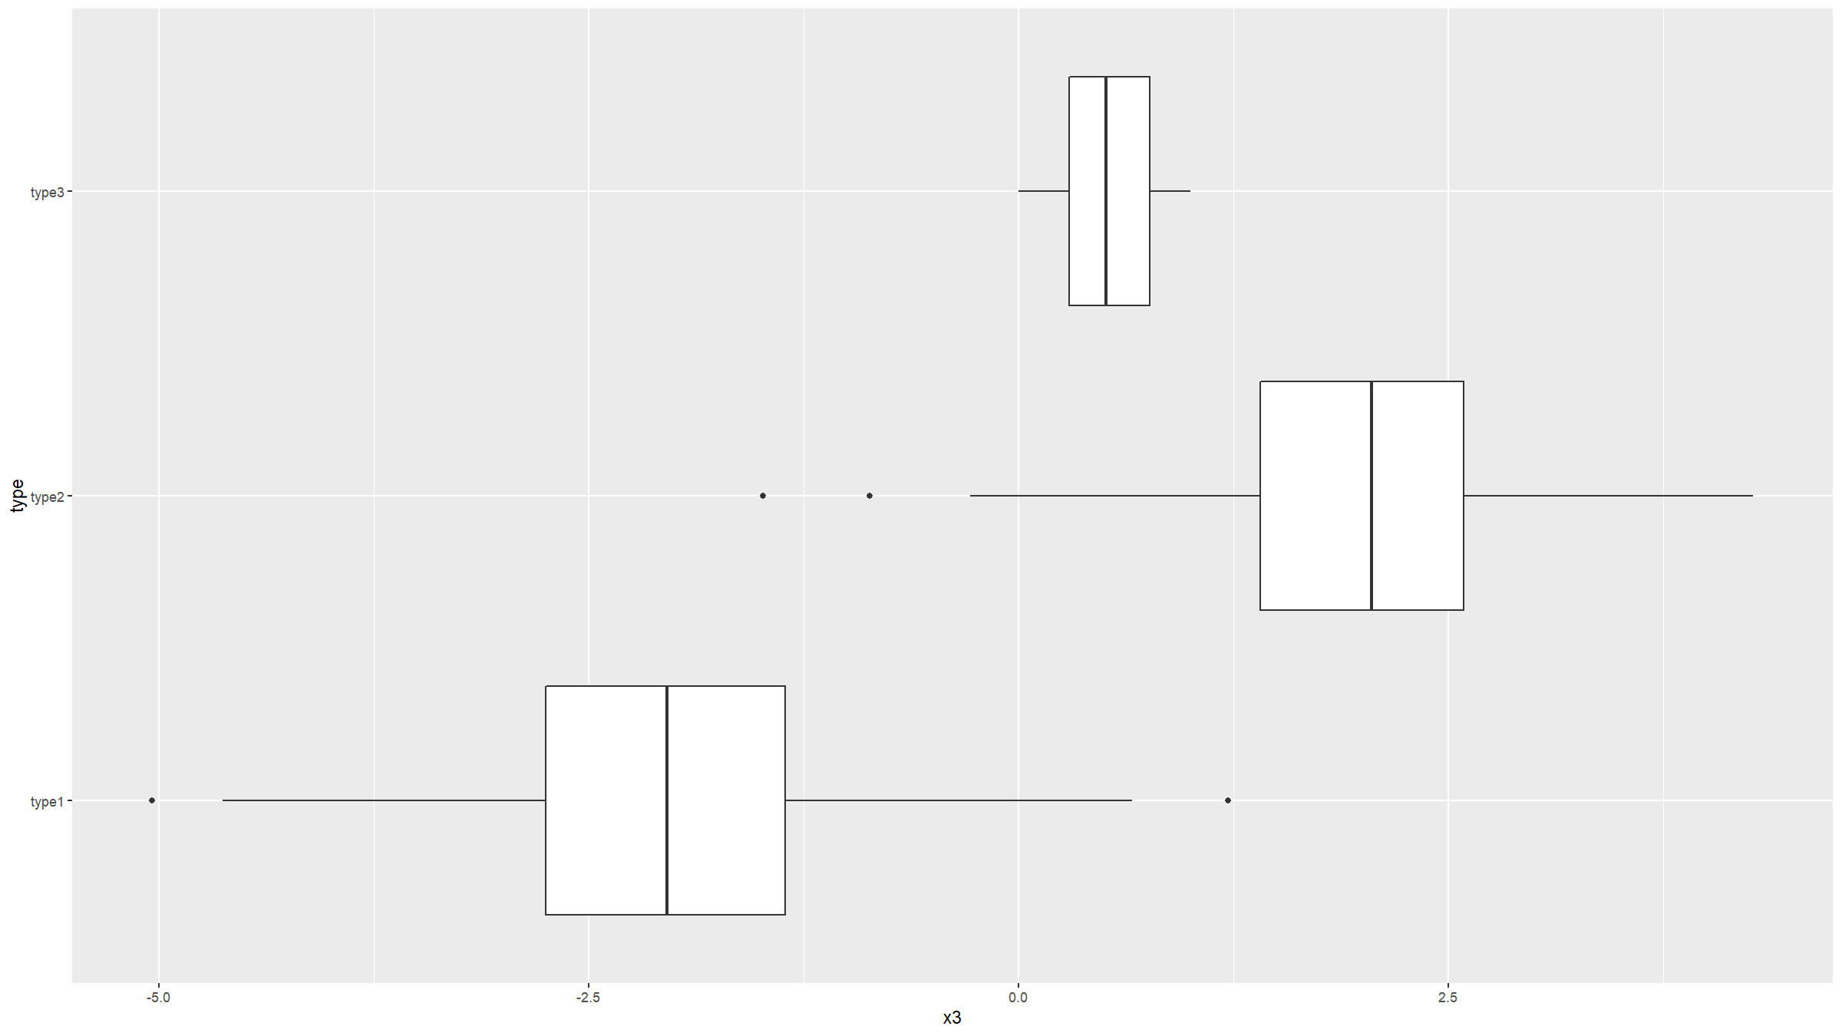

Slide 73
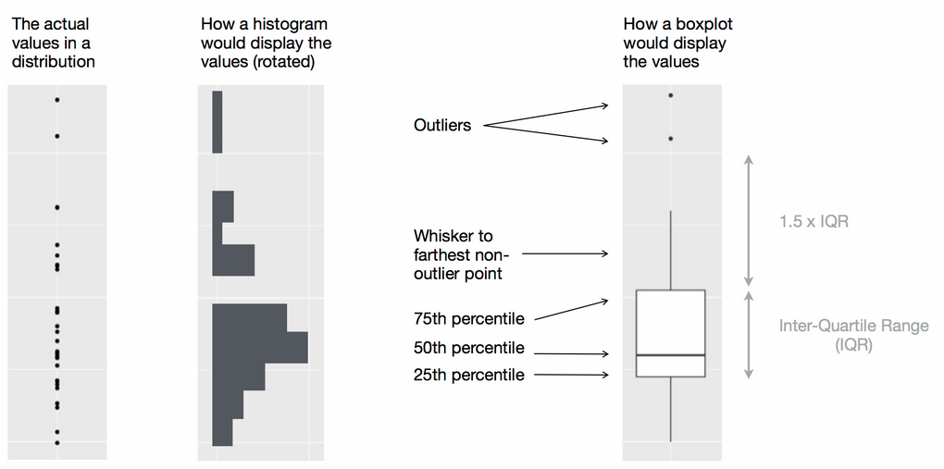
Covariation figures
Wickham, H. & Grolemund G., R for Data Science, O’Reilly, 2016

Slide 74
Covariation figures
Covariation: violin plots
Combines histogram and box plot.
Not natively supported by graphics library (need vioplot library), but is supported by ggplot2.
ggplot(data=dat,mapping=aes(x=type,y=x3,fill=type)) + geom_violin() + geom_boxplot(width=0.05, fill="white")

Slide 75
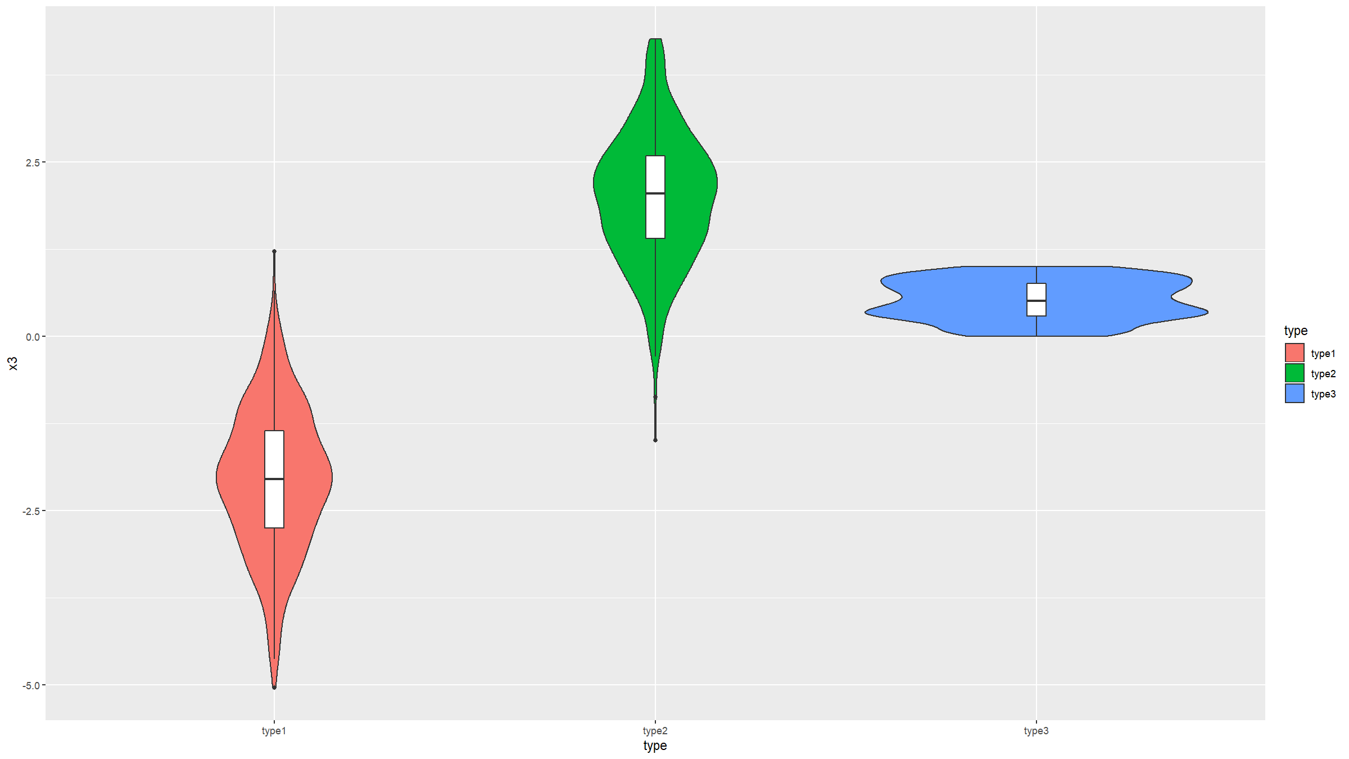

Slide 76
Covariation figures
Covariation: scatter plots
Probably the most basic, most used and most useful plot.
Let’s generate some more data.
dat<-mutate(dat,x4=rnorm(nrow(dat),mean=x3))
graphics:
plot(dat$x3,dat$x4)

Slide 77
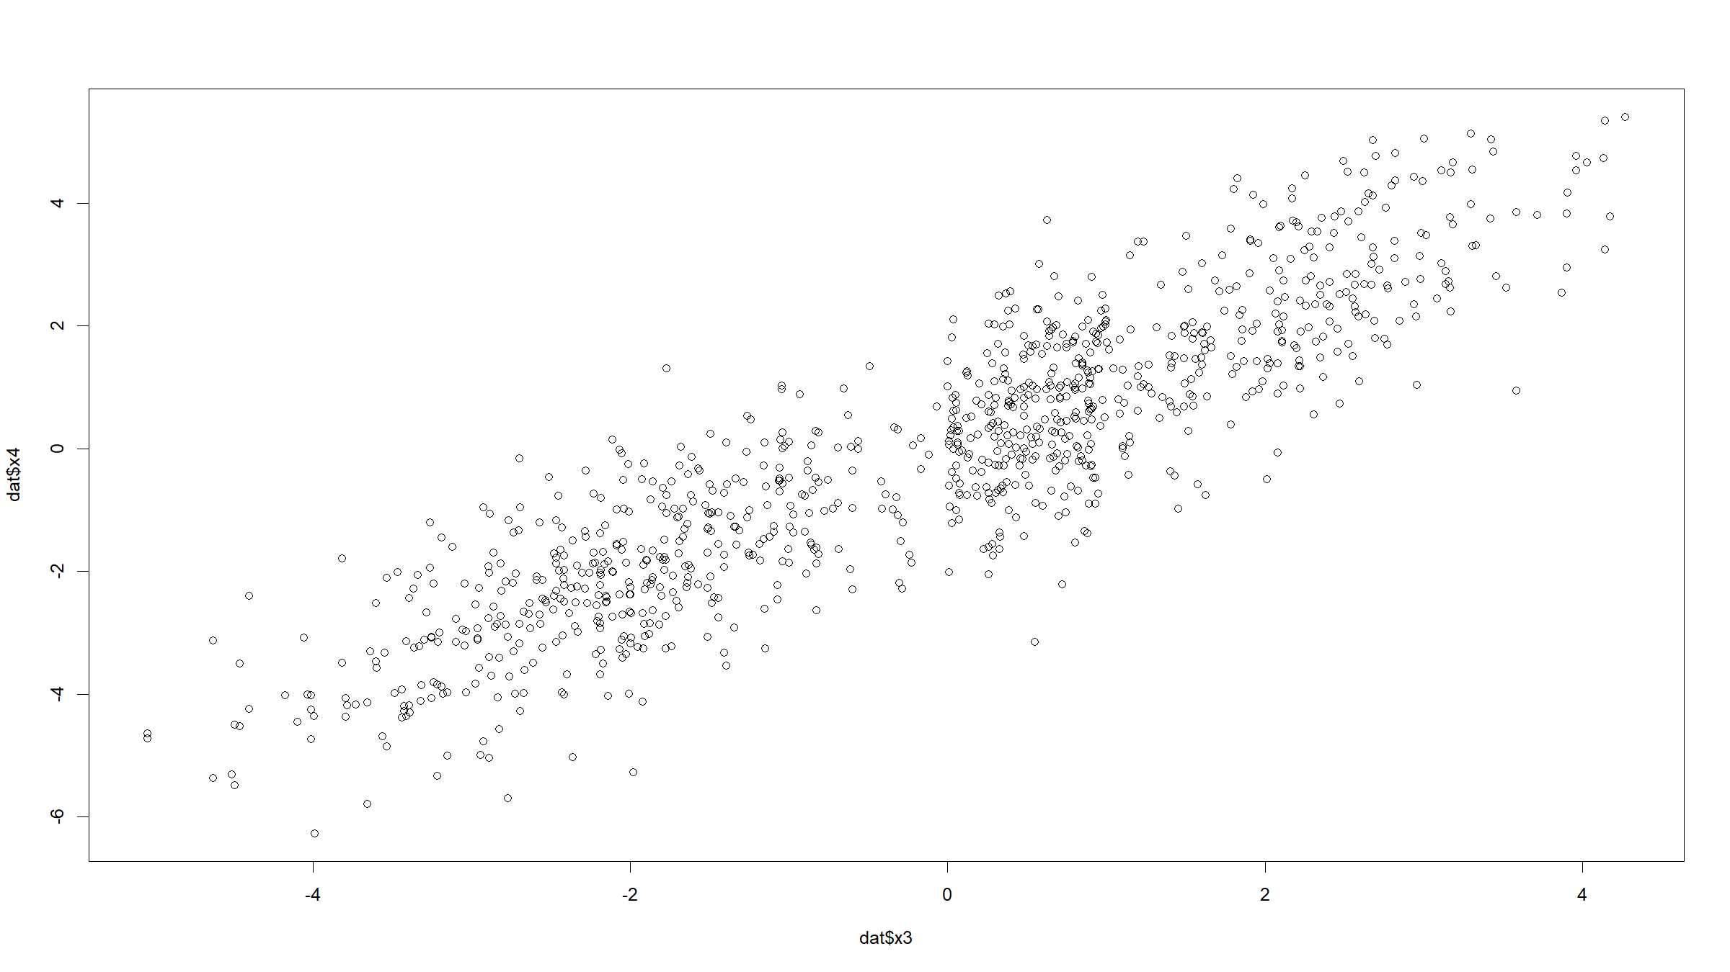

Slide 78
plot(x4~x3,data=dat)

Slide 79


Slide 80
Covariation figures
ggplot2:
ggplot(data=dat,mapping=aes(x=x3,y=x4)) + geom_point()

Slide 81
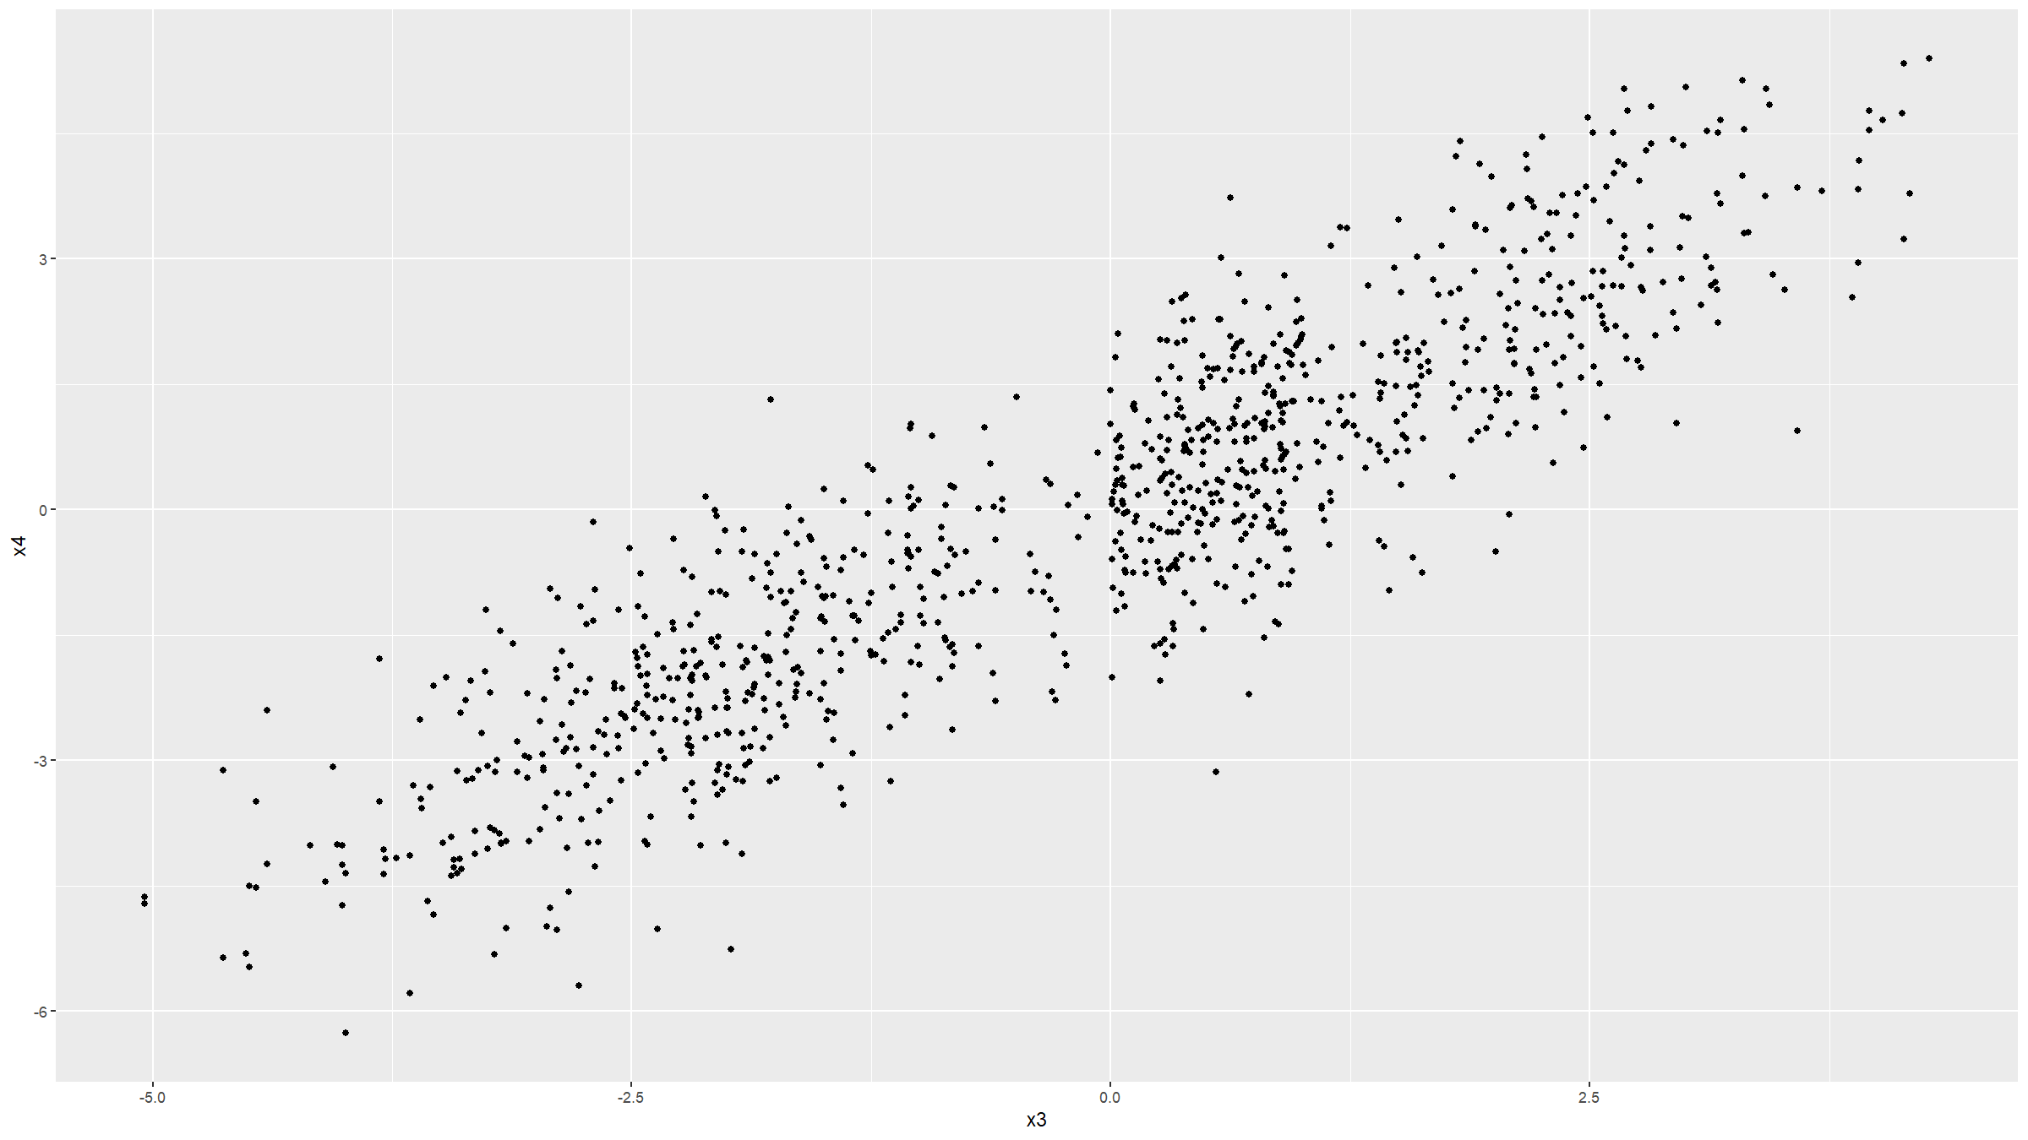

Slide 82
Covariation figures
graphics:
plot(x4~x3,data=dat,main="scatterplot", col=c("steelblue","orange","salmon")[as.integer(type)],pch=20) abline(a=0,b=1,lty=2,lwd=2,col="darkgrey") legend(x="topright",col=c("steelblue","salmon","orange"),pch=20, legend=levels(dat$type))

Slide 83
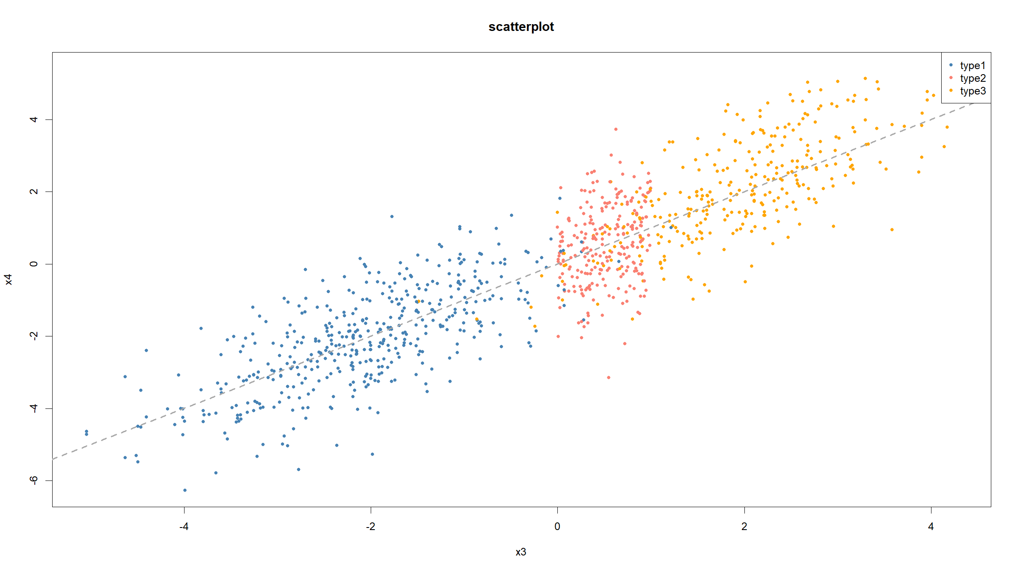

Slide 84
Covariation figures
ggplot2:
ggplot(data=dat,mapping=aes(x=x3,y=x4,col=type)) + geom_point() + geom_smooth()
## `geom_smooth()` using method = 'loess' and formula 'y ~ x'

Slide 85
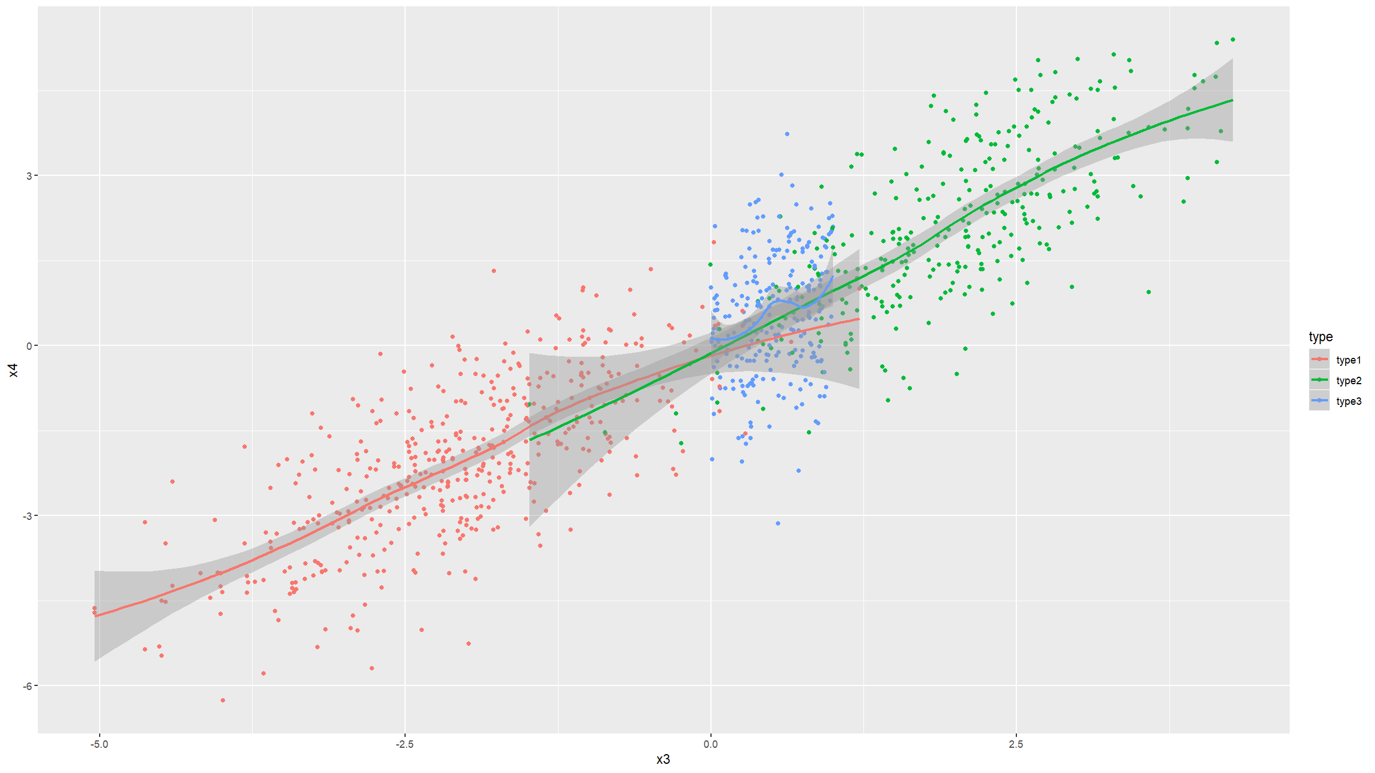

Slide 86
Covariation figures
Covariation: line & time plots
Prepare some data:
beaver<-rbind(beaver1[beaver1$day==346,],beaver2[beaver2$day==307,]) beaver<-data.frame( name=c(rep("beaver1",sum(beaver1$day==346)), rep("beaver2",sum(beaver2$day==307))),beaver)

Slide 87
Covariation figures
Covariation: line & time plots
graphics
plot(temp~time,data=beaver[beaver$name=="beaver1",],type="l")

Slide 88
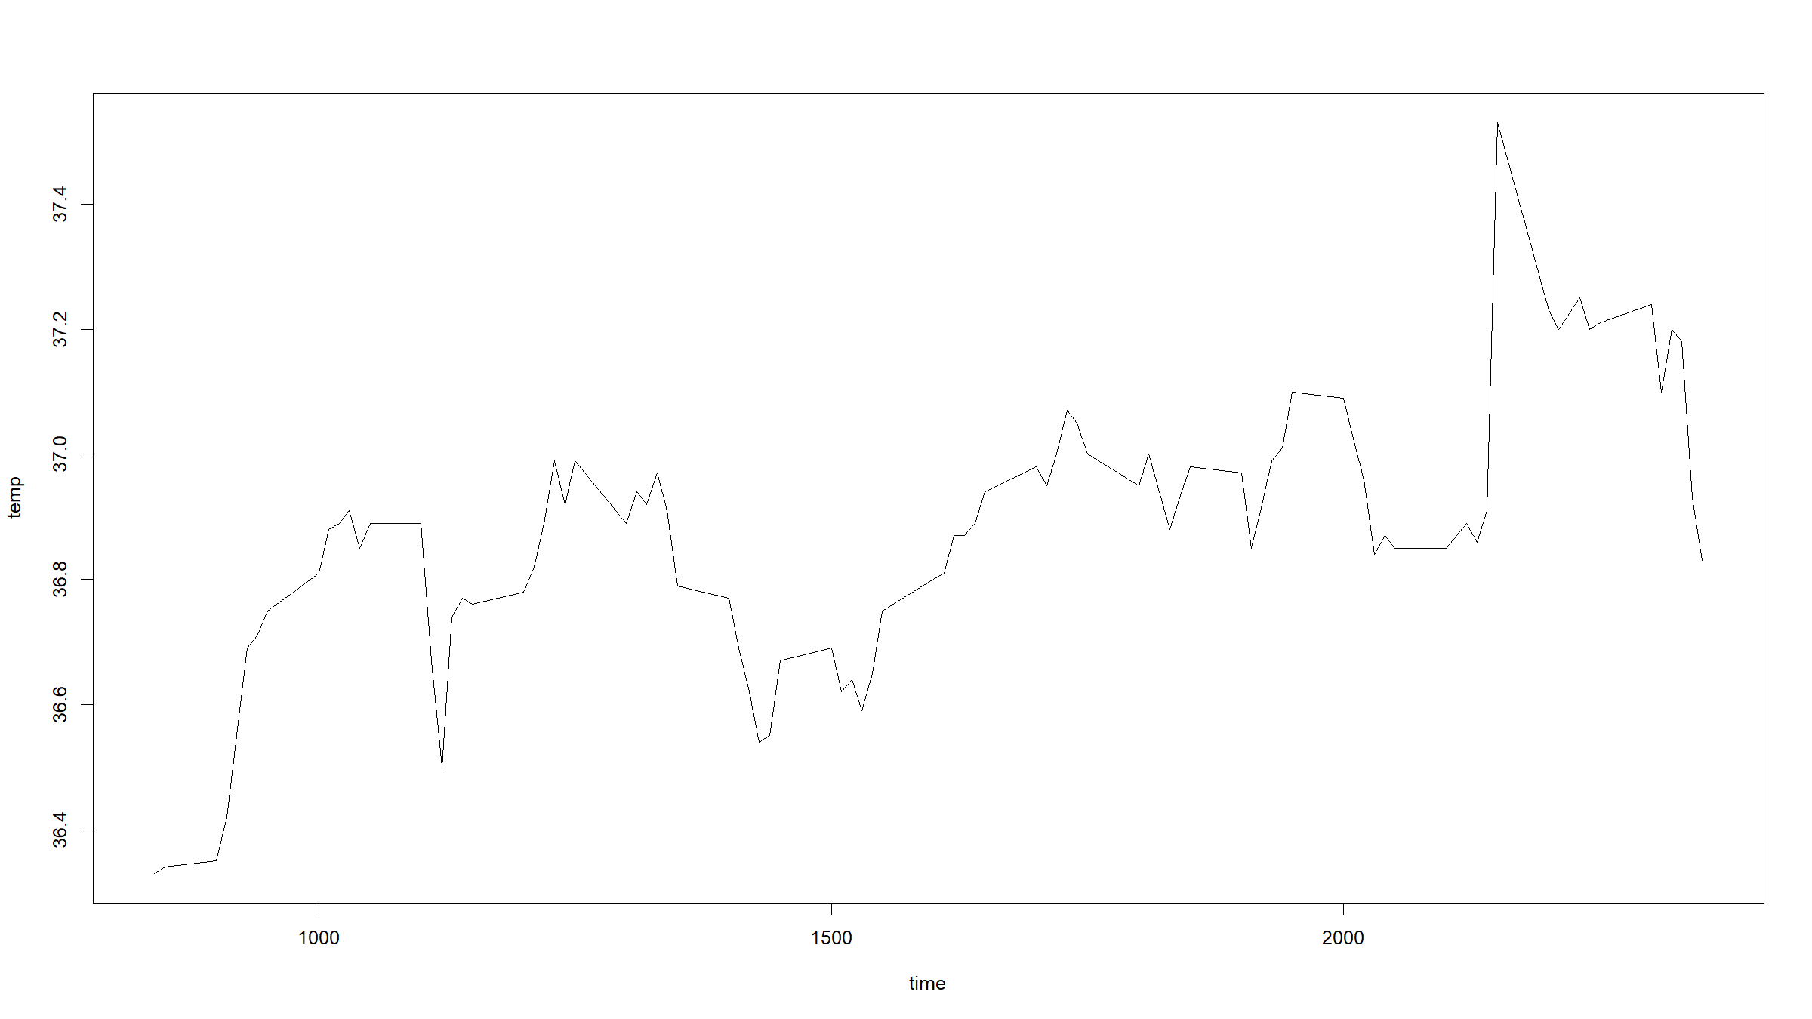

Slide 89
plot(temp~time,data=beaver,type="n",col="red",lwd=2) lines(temp~time,data=beaver[beaver$name=="beaver1",],col="red",lwd=2) lines(temp~time,data=beaver[beaver$name=="beaver2",],col="blue",lwd=2) legend(x="bottomright",col=c("red","blue"),lwd=2,legend=c("beaver1","beaver2"))

Slide 90
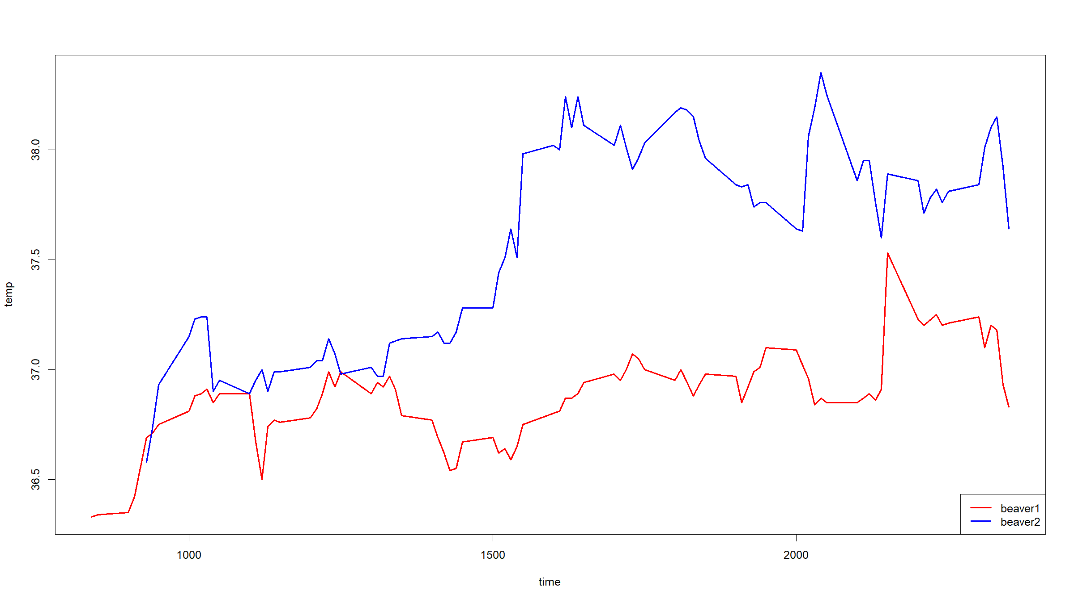

Slide 91
Covariation figures
ggplot2
beaver %>% filter(name=="beaver1") %>% ggplot(mapping=aes(x=time,y=temp)) + geom_line()

Slide 92
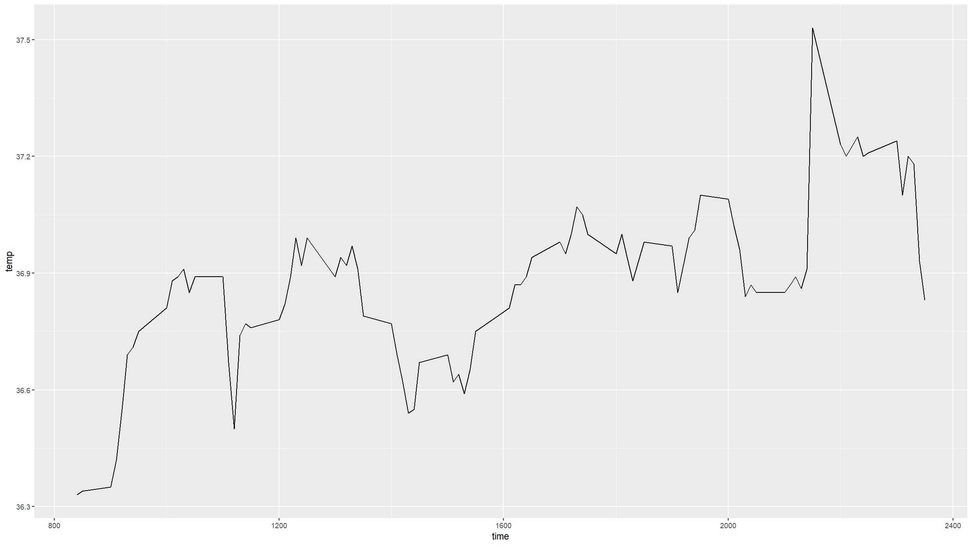

Slide 93
ggplot(data=beaver,mapping=aes(x=time,y=temp,colour=name)) + geom_line(lwd=2)

Slide 94
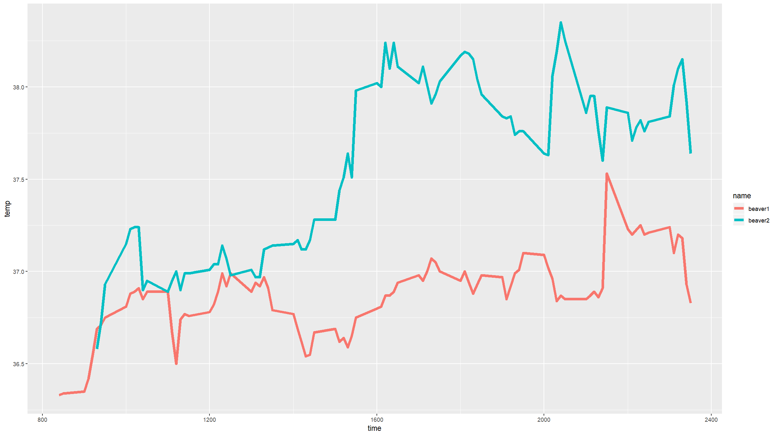

Slide 95
Covariation figures
Covariation: heat maps
data
dmnds<-diamonds %>% count(cut,color)
ggplot2
ggplot(data=dmnds, mapping=aes(x=color,y=cut,fill=n)) + geom_tile()

Slide 96
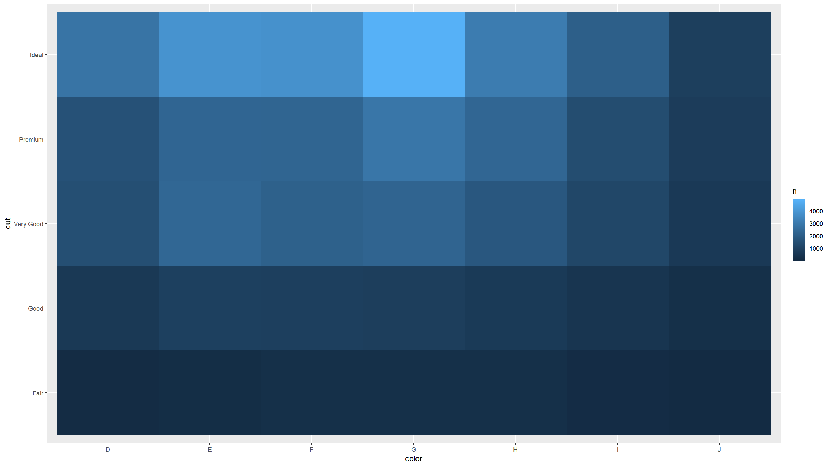

Slide 97
Covariation figures
graphics
plotData<-matrix(nrow=length(unique(dmnds$cut)),ncol=length(unique(dmnds$color))) rownames(plotData)<-unique(dmnds$cut) colnames(plotData)<-unique(dmnds$color) for(i in 1:nrow(plotData)){ for(j in 1:ncol(plotData)){ plotData[i,j]<-dmnds$n[dmnds$cut==rownames(plotData)[i] & dmnds$color==colnames(plotData)[j]] } } image(t(plotData),axes=F,xlab="colour",ylab="cut") axis(side=1,labels = colnames(plotData),at=seq(0,1,length=ncol(plotData))) axis(side=2,labels=rownames(plotData),at=seq(0,1,length=nrow(plotData)))

Slide 98
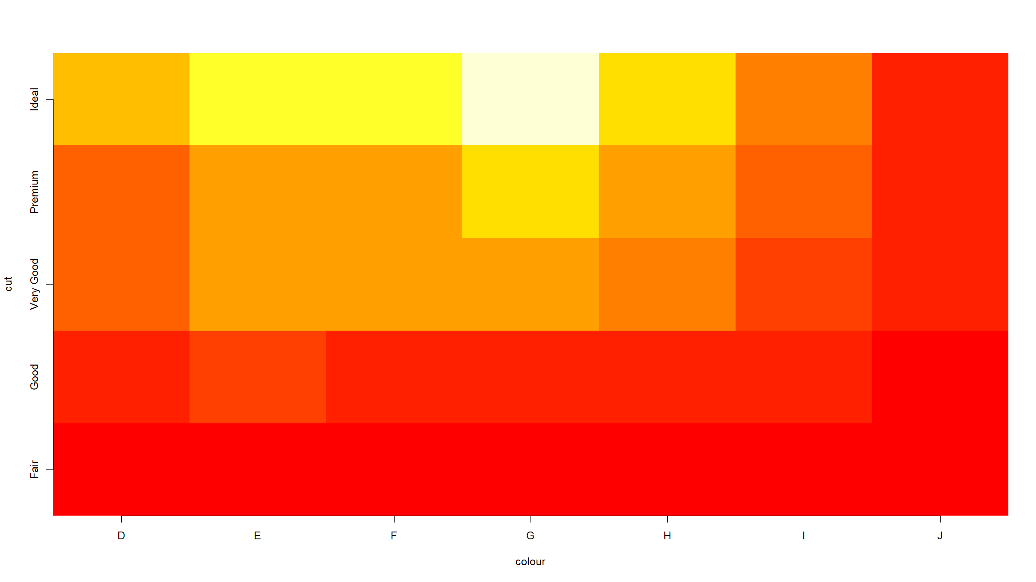

Slide 99
Covariation figures
Covariation: heat maps and contour plots
Generate some data:
dens<-function(x,y){ return( 0.35*dnorm(x)*dnorm(y,sd=1.5) + 0.65*dnorm(x,mean=2,sd=2)*dnorm(y,mean=3) ) } x<-seq(-2.5,6.5,length=100) y<-seq(-3,5.5,length=100) densSurf<-matrix(nrow=100,ncol=100) for(i in 1:100){ for(j in 1:100){ densSurf[i,j]<-dens(x=x[i],y=y[j]) } } densSurf2<-expand.grid(x=x,y=y) densSurf2$dens<-dens(x=densSurf2$x,y=densSurf2$y)

Slide 100
Covariation figures
graphics
clrs<-colorRampPalette(c("blue","red","orange","yellow","white")) image(densSurf,x=x,y=y,col=clrs(200))

Slide 101
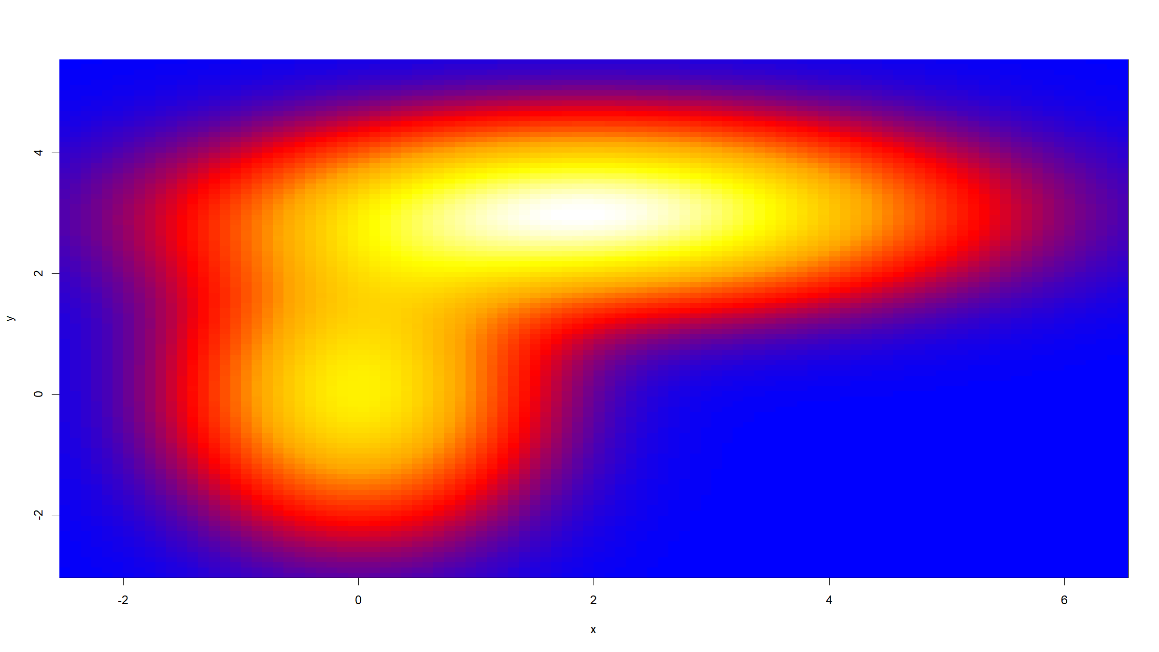

Slide 102
contour(densSurf,x=x,y=y)

Slide 103
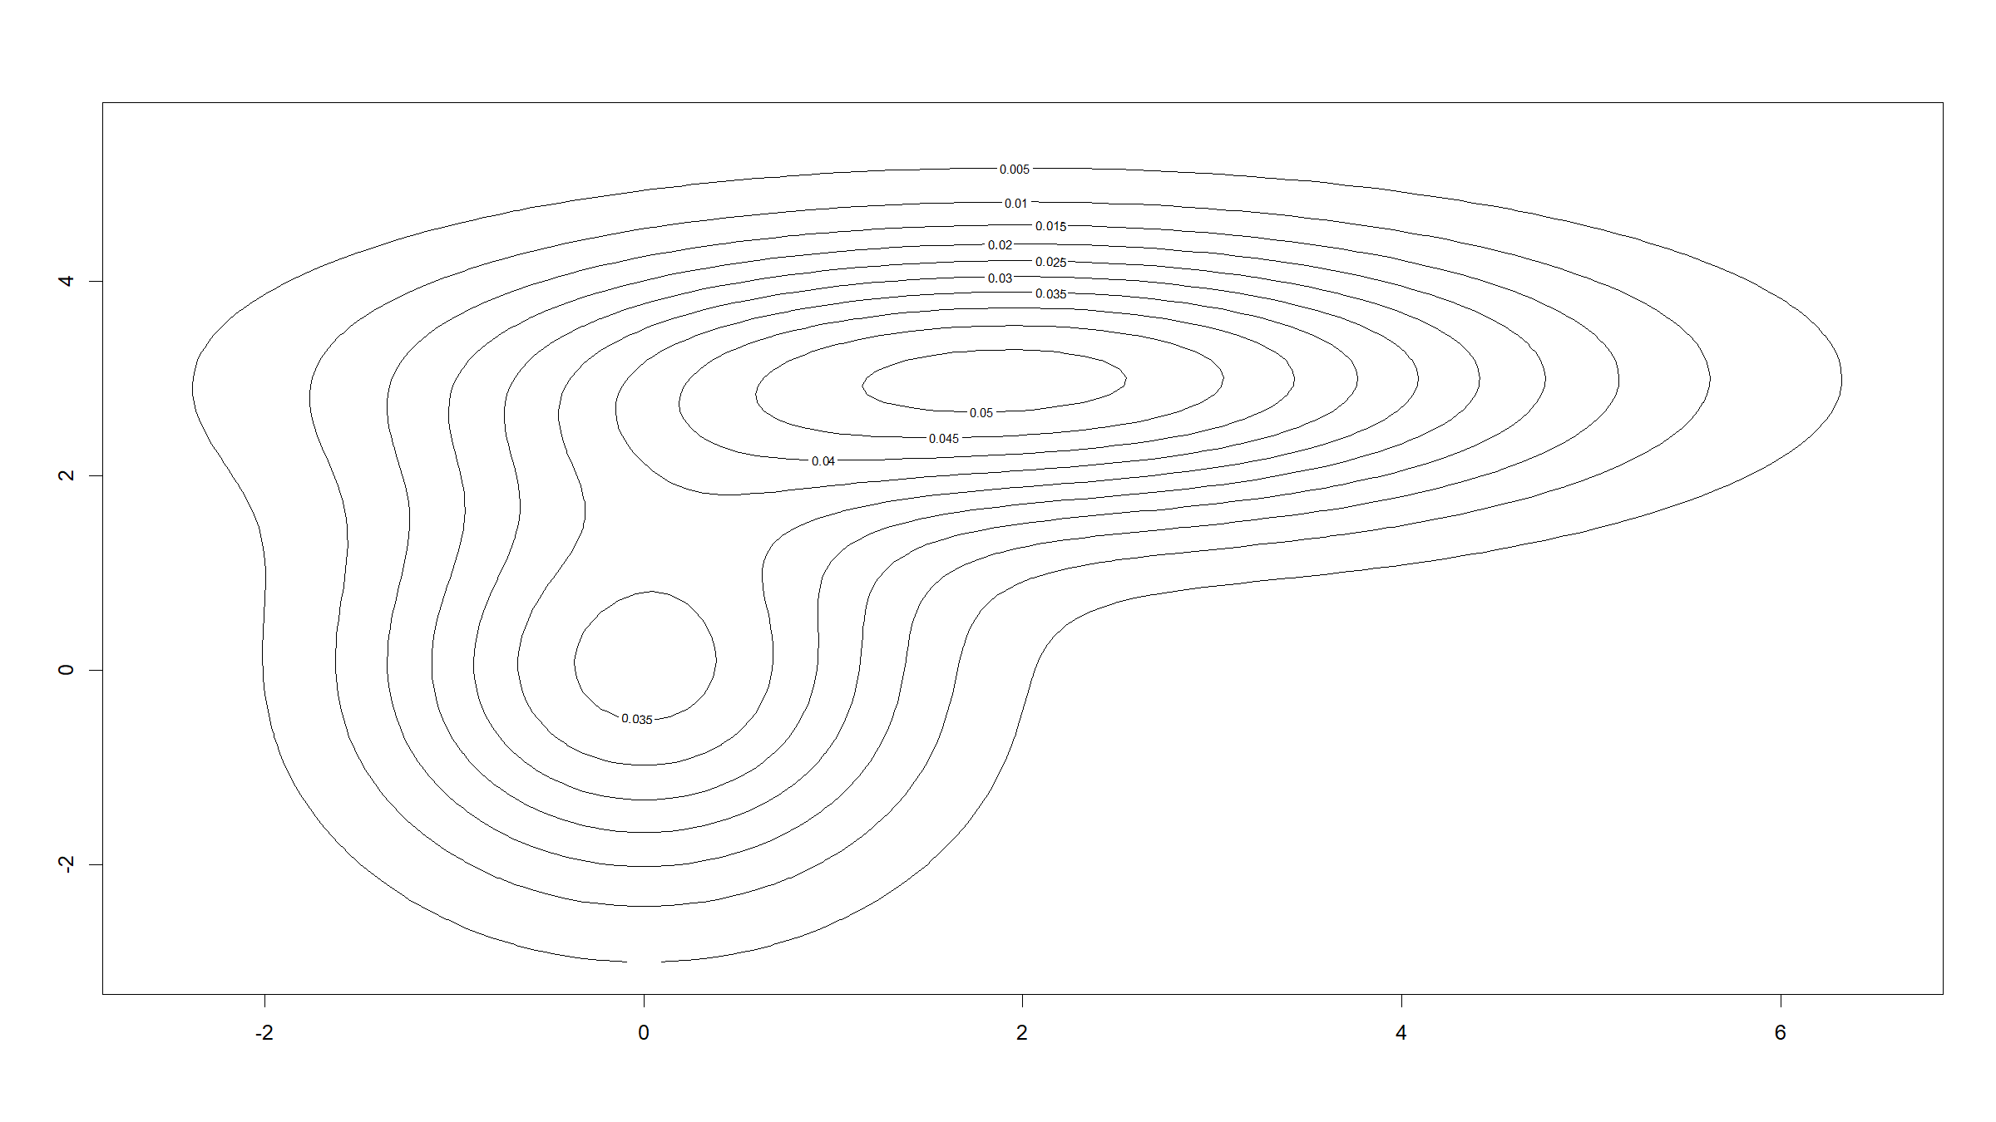

Slide 104
Covariation figures
ggplot2
ggplot(data=densSurf2,mapping=aes(x=x,y=y,z=dens)) + geom_contour()

Slide 105
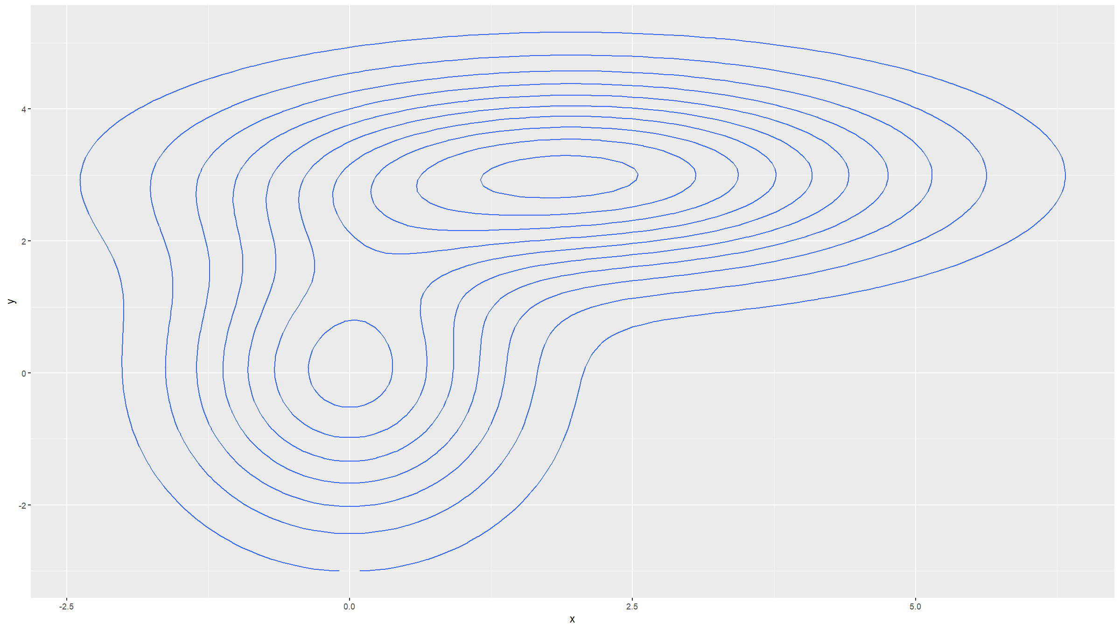

Slide 106
Covariation figures
Covariation: 2D density estimation
Generate some data:
library(MASS) X <- mvrnorm(1000, mu=c(1,3), Sigma=matrix(c(1,0.7,0.7,1), ncol=2))
graphics
z <- kde2d(X[,1], X[,2], n=50) plot(X, xlab="y", ylab="x",pch=19,cex=0.75) contour(z, drawlabels=FALSE, nlevels=11,col=clrs(14), add=TRUE)

Slide 107
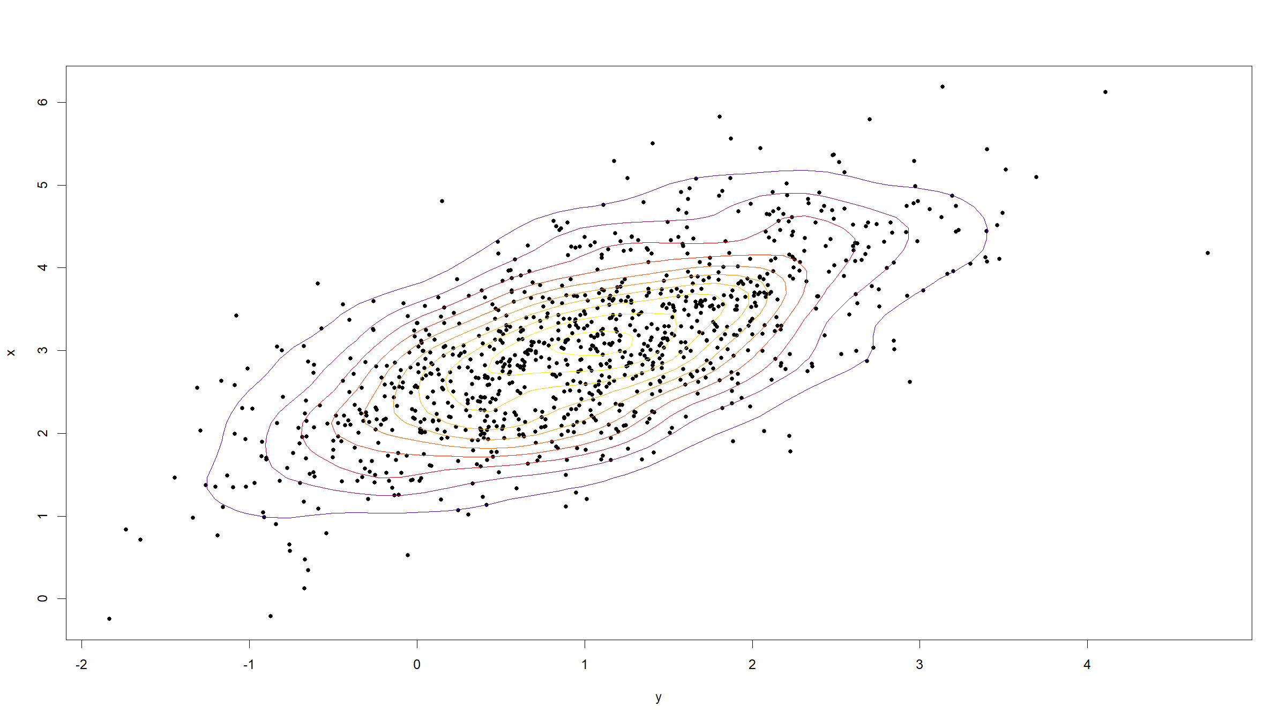

Slide 108
Covariation figures
ggplot2
X<-data.frame(x=X[,1],y=X[,2]) ggplot(data=X,mapping=aes(x=x,y=y)) + geom_point() + geom_density_2d()

Slide 109
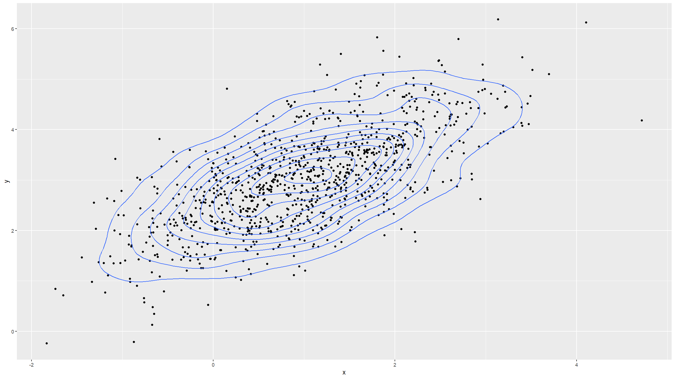

Slide 110
Multi-panel figures

Slide 111
Multi-panel figures
Several options:
graphics
par(mfrow=c(2,3)) # followed by commands for individual figures in order layout(matrix(nrow=2,col=3,byrow=T,c(1:3,4,5,3))) layout.show(5) # followed by commands for individual figures in order split.screen(c(2,3)) # select each panel with screen(i,new=F), then type plotting command for that panel; type close.screen(i) after each figure is done

Slide 112
Multi-panel figures
Example:
par(mfrow=c(2,3)) myPlotFun<-function(lab){ plot(0:1,0:1,type="n",axes=F,xlab="",ylab="") polygon(x=c(0,1,1,0),y=c(0,0,1,1),col="darkgrey",border=NA) text(x=0.5,y=0.5,adj=c(0.5,0.5),font=2,cex=3,lab) } for(i in 1:6){ myPlotFun(paste("Plot",i)) }

Slide 113
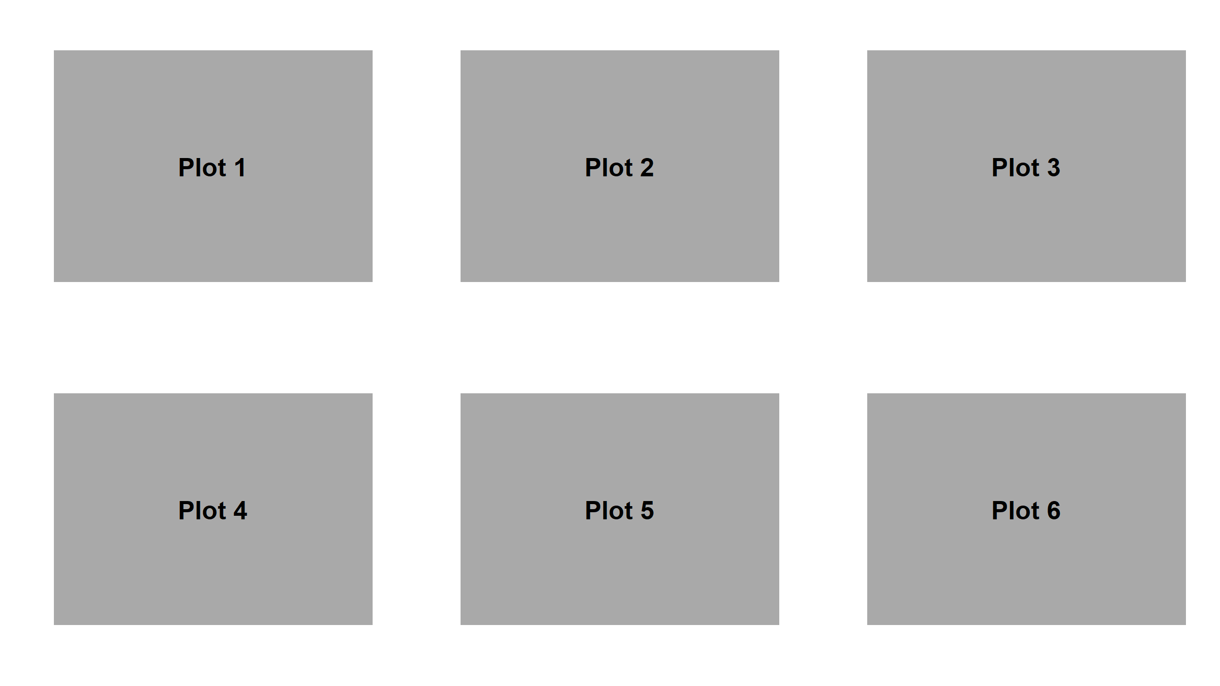

Slide 114
Multi-panel figures
ggplot2
Requires extra package: library(gridExtra)
Assign each ggplot() call to an object (p1<-ggplot(...) + ...)
Produce multipanel figure with grid.arrange(p1,p2,...,nrow=2)

Slide 115
Multi-panel figures
Example:
myGgplotFun<-function(lab){ ggplot(data=data.frame(x=0:1,y=0:1),mapping=aes(x=x,y=y)) + theme(panel.background=element_rect(fill="darkgrey")) + xlab("") + ylab("") + ggtitle(lab) } g1<-myGgplotFun("Plot 1") g2<-myGgplotFun("Plot 2") g3<-myGgplotFun("Plot 3") g4<-myGgplotFun("Plot 4") grid.arrange(g1,g2,g3,g4,nrow=2)

Slide 116
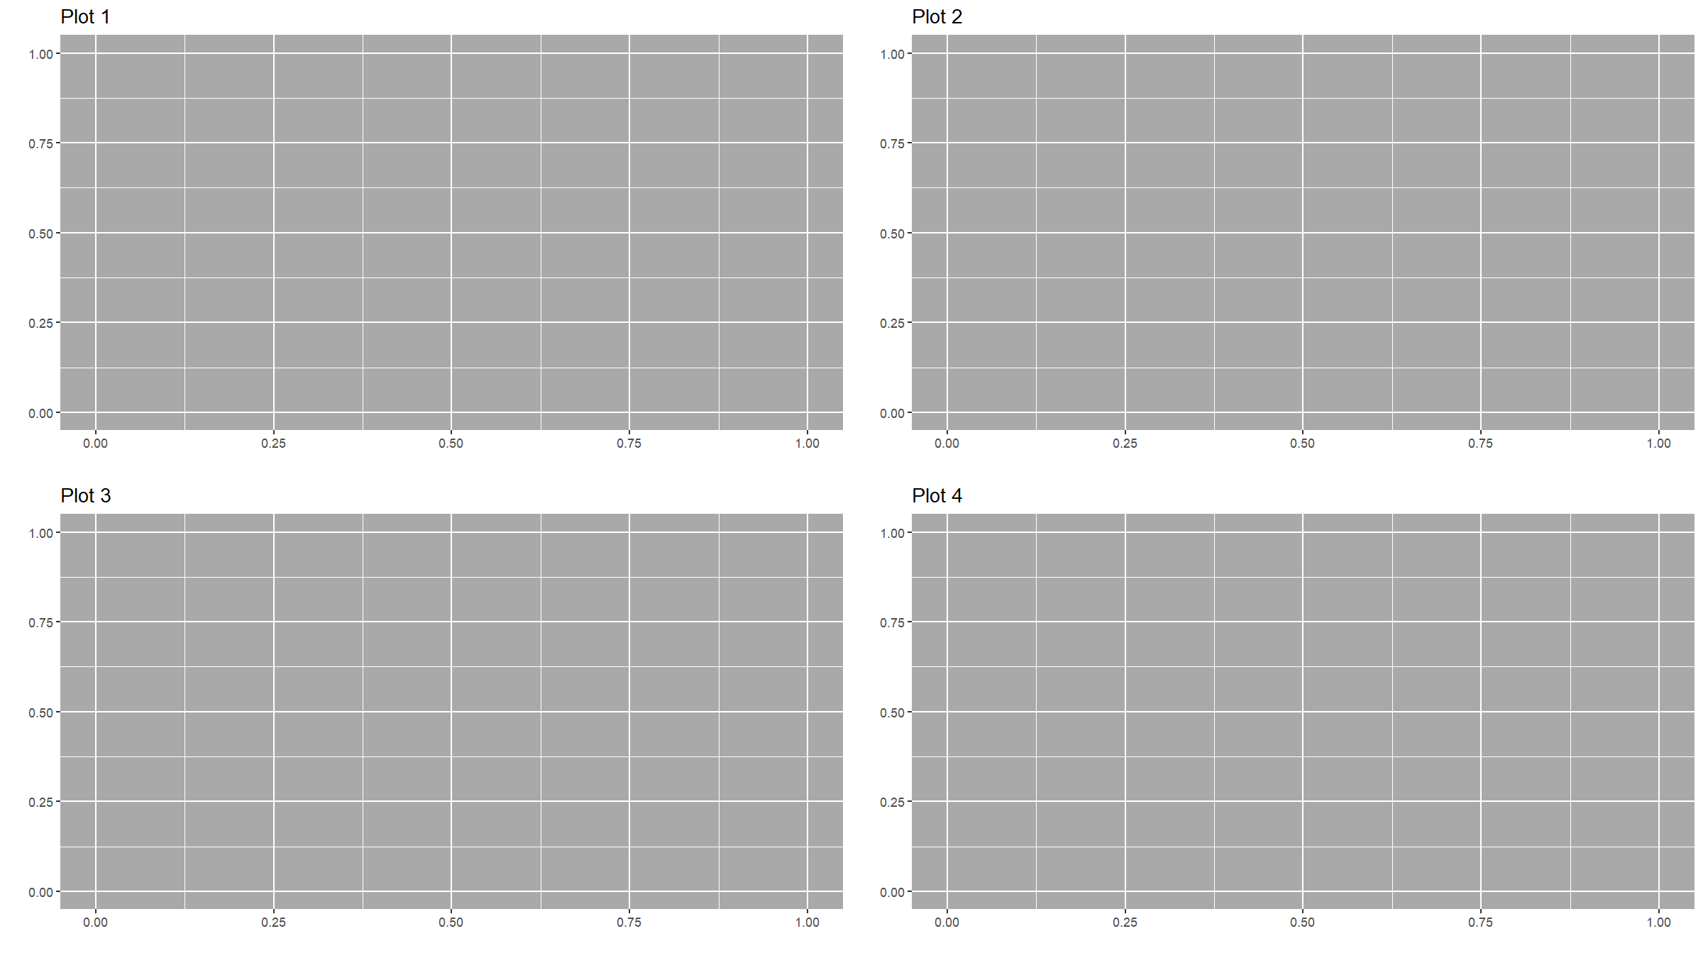

Slide 117
Saving graphs to files

Slide 118
Saving graphs to files
In order to write a graph directly to a file, you enclose your plotting code inside a statement that specifies a graphical device.
“Graphics device” means a pdf, png, jpg or other file.
Example:
pdf(width=16,height=9,file="myfile.pdf") # opens the device; pdf will produce vector graphics # plotting code here dev.off() # closes the device
Or:
png(width=16,height=9,units="in",res=450) # raster graphics # plotting code here dev.off()

Slide 119
[end of Session 2]

