Slide 1
MSc Bioinformatics - Machine learning primer
Marc Henrion

Slide 2
Session 8: Machine learning primer

Slide 3
Preliminaries
In this session we will have a very wuick look at some machine learning tools. We will focus primarily on a selection of tools for data exploration, clustering and classification / regression.
Participant packs
https://github.com/gitMarcH/COM_STA621_2020
Copy of slides & some R codes.
Note
These slides have been generated by using R Markdown.

Slide 4
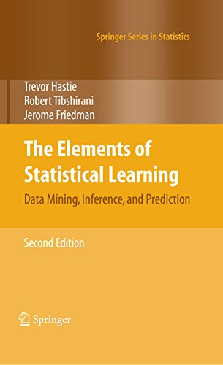
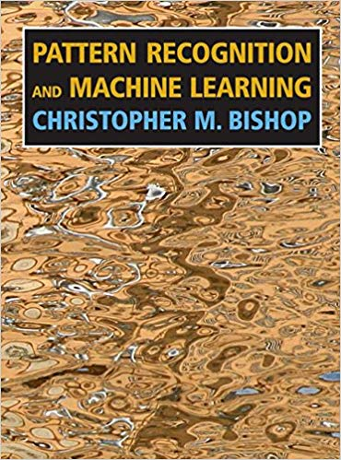
Useful references
Hastie, T., Tibshirani, R., Friedman, J., The elements of statistical learning, 2nd ed., 2009, Springer
Bishop, C.M., Pattern recognition and machine learning, 2006, Springer

Slide 5
Outline
Data exploration: PCA & MDS
Artificial intelligence, machine learning, statistics
Clustering
Classification & regression: 10 key techniques
Boostrap & resampling
Tools / further reading

Slide 6
Data exploration: PCA & MDS

Slide 7
PCA & MDS
You have multivariate data wit $p>2$ variables. You want to see whether some of your covariates drive some of the variation. In other words: do we see clusters / patterns in the data?
The problem: how do you look at high-dimensional data?

Slide 8
PCA & MDS
A first idea:
We can compute distances (for various distance metrics) between samples. Obviously one can also compute distances in 1-dimensional, 2-dimensional, … space.
Could we compute distances in the p-dimensional space, and then find a 2-dimensional projection that preserves these distances?
This is what multidimensional scaling (MDS) attempts to do.

Slide 9
PCA & MDS
Mathematically to do MDS, you start from a distance matrix, reconstruct a coordinate matrix, then do an eigenvalue decomposition. This is also what another technique, Principle Component Analysis (PCA) will do.
Both are part of a larger set of techniques to perform dimensionality reduction. MDS can be generalised, but in its classical form both MDS and PCA are linear dimensionality reduction techniques.

Slide 10
PCA & MDS
In PCA, you compute the sample covariance matrix, then do an eigenvalue decomposition of this matrix. You will end up with with a new set of p features that are just the projections of the data onto the ordered eigenvectors of the covariance matrix (ordered from largest to smallest eigenvalue).
This first new feature, the first principle component, will explain most of the variance among the new features, the second the next most and so on. Each pair of components are orthogonal to each other and explain different aspects of the variation in the data.

Slide 11
PCA & MDS
In an ideal world therefore, all of the “signal” in your data is on the first few principal components, whereas all the random noise is on the last few principal components.
To interpret the new coordinates, you can look at the factor loadings.
Important application: identify ancestry / ethnicity from NGS data.

Slide 12
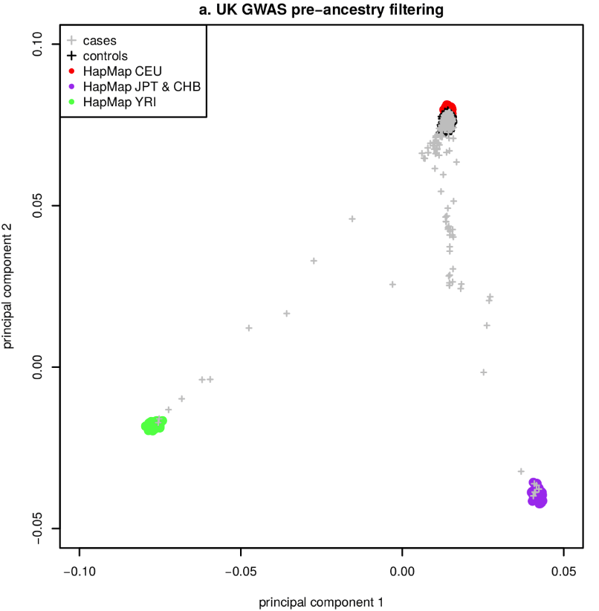
PCA & MDS
PCA for GWAS ancestry ( https://doi.org/10.1371/journal.pone.0122589)

Slide 13
PCA & MDS
In R:
MDS: cmdscale()
PCA: prcomp()
loc<-cmdscale(eurodist) plot(loc[,1],-loc[,2],xlab="",ylab="",axes=F,type="n",main="MDS for distances between European cities",cex=2) text(loc[,1],-loc[,2],labels=rownames(loc),cex=2)

Slide 14
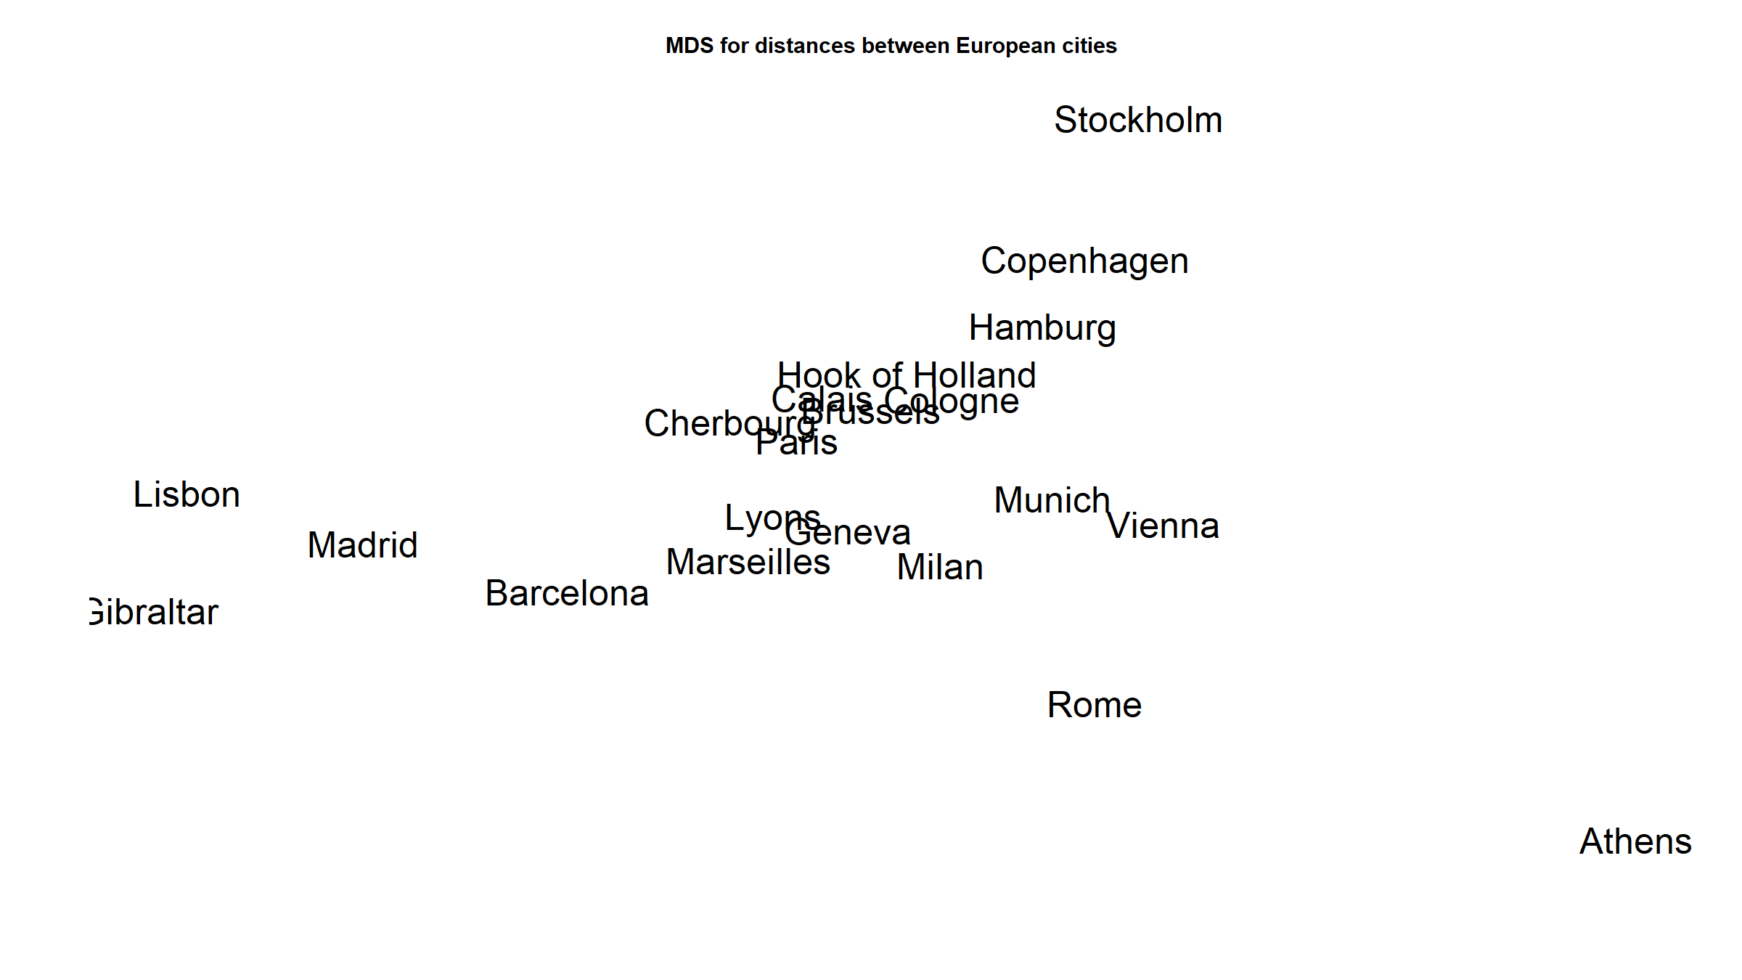

Slide 15
Artificial intelligence, machine learning, statistics

Slide 16
AI, machine learning, statistics
Artificial general intelligence
Ability of a machine to represent the human mind and perform any human intellectual task.
Artificial narrow intelligence
Ability of a machine to perform a single or a few well-defined intellectual tasks extremely well.

Slide 17
AI, machine learning, statistics
Machine learning
Often used interchangeably with AI (technically a sub-discipline).
Expert systems
Requires (i) knowledge base and (ii) reasoning engine
Natural language processing
Automated planning & scheduling
…

Slide 18
AI, machine learning, statistics
Given a set of training data vectors $x=\{x_{1},...,x_{n}\}$, learn / tune / estimate a certain parameter of an adaptive model $M$.
Focus is on how to instruct a computer to do this task.
“The field of machine learning is concerned with the question of how to construct computer programs that automatically improve with experience.” (Mitchell, T.M., Machine Learning, McGraw-Hill, 1997)
In practice, the goal is usually prediction.

Slide 19
AI, machine learning, statistics
Supervised
Classification
Regression
Unsupervised
Clustering
Density estimation
Visualisation
Data mining
Reinforcement learning

Slide 20
AI, machine learning, statistics
“When you’re fundraising, it’s AI. When you’re hiring, it’s ML. When you’re implementing, it’s logistic regression.”
(The internet.)

Slide 21
AI, machine learning, statistics
A lot of these algorithms developed outside the context of statistical science. Many are heuristics – i.e. practical, not necessarily optimal.
Statisticians interested in knowing asymptotic properties of methods:
Given infinite amounts of data, are you actually going to get the right solution?
If not, by how far are you off?
How precise will your estimate be?
Estimated parameters have statistical properties: bias, variance, …
Much (most?) of statistics is about minimising the bias-variance trade-off.
In other words: While an algorithm may work on a particular dataset, will it work in general with any dataset?

Slide 22
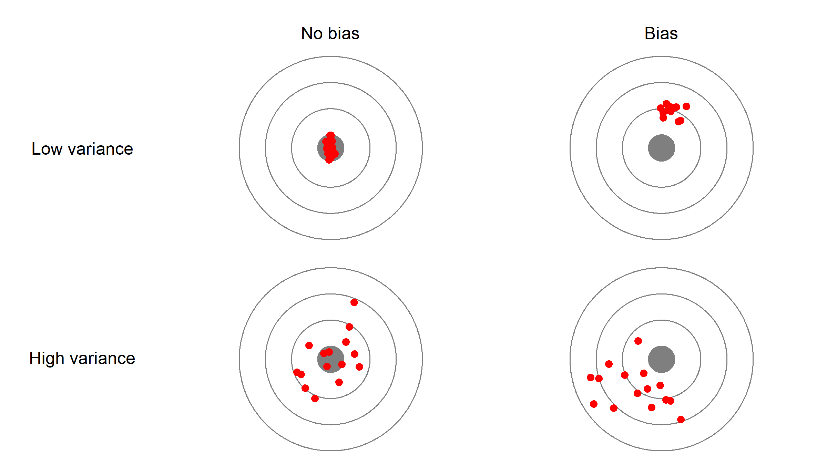
AI, machine learning, statistics

Slide 23
AI, machine learning, statistics
Assume that 2 random variables, $X,Y$ are related via the relationship $Y=f(X)+ϵ$, with $ϵ$ some random error.
One can estimate several models, each of which produces a prediction $hatY$ of $Y$. The total error may be lowest not for the model with the lowest bias but with the best bias-variance trade-off.
One can show that the total squared error $E[(Y−\hat{Y})^{2}]$ for an estimator $\hat{Y}$ of $Y$ is given by:
$$\begin{matrix}E[(Y−\hat{Y})^{2}] & = & (E[\hat{Y}]−Y)^{2} & + & E[(\hat{Y}−E[\hat{Y}])^{2}] + σ_{ϵ}^{2} \\ & & & & \\ squared error & = & {bias}^{2} & + & variance + irreducible error\end{matrix}$$

Slide 24
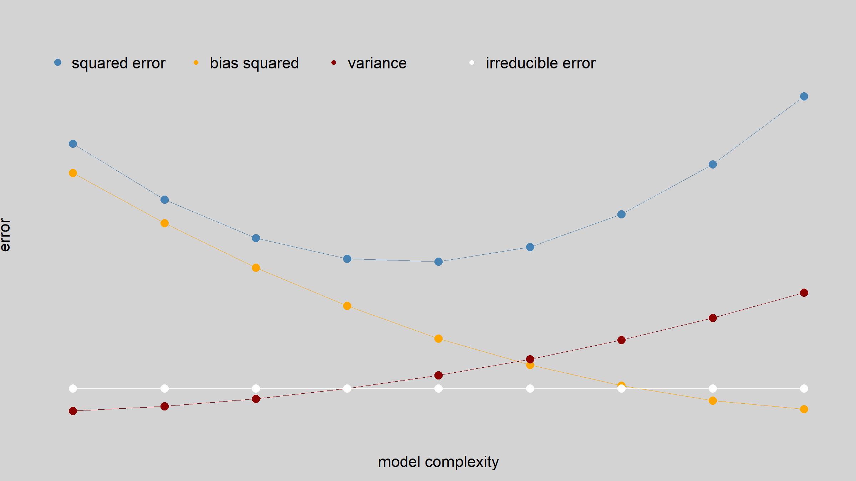
AI, machine learning, statistics

Slide 25
AI, machine learning, statistics
Sum of squares is the most common error function because it leads to a convex optimisation problem.
Statisticians tend not to optimise the sum of squared errors (least squares - LS), but rather maximise the likelihood (maximum likelihood - ML) of observing a given dataset assuming a given model. This is a more general approach, though it does make additional assumptions.
For many models, ML & LS are equivalent, for some they are not (e.g. non-normal errors in linear model).
In machine learning, usually predictive accuracy is optimised (using, e.g. cross-validation).

Slide 26
AI, machine learning, statistics
Arguably better to maximise predictive accuracy:
Consider not only how well a model fits the current dataset, but also how well it will perform on future data.
But this comes at a cost:
Not all the data is used to estimate the model parameters.
What should the focus be: inference or prediction?

Slide 27
AI, machine learning, statistics
For classification problems with a zero-one loss function (i.e. all misclassifications equally bad), one can show that the optimal classification rule is
$$\hat{C}(x)={argmax}_{c∈G}P(c|x)$$
This is known as the Bayes classifier and its error rate (the Bayes rate) is the lowest you can achieve.
The practical problem is how to estimate the probabilities $P(c|x)$.

Slide 28
AI, machine learning, statistics
Statistics
Focus on statistical inference about model parameters.
Do these 2 groups have different mean values?
Is this slope coefficient different from 0?
Machine learning
Focus on prediction.
What is most likely type of an object, given an image of it?
What is the most likely successful advert to display to a user?

Slide 29
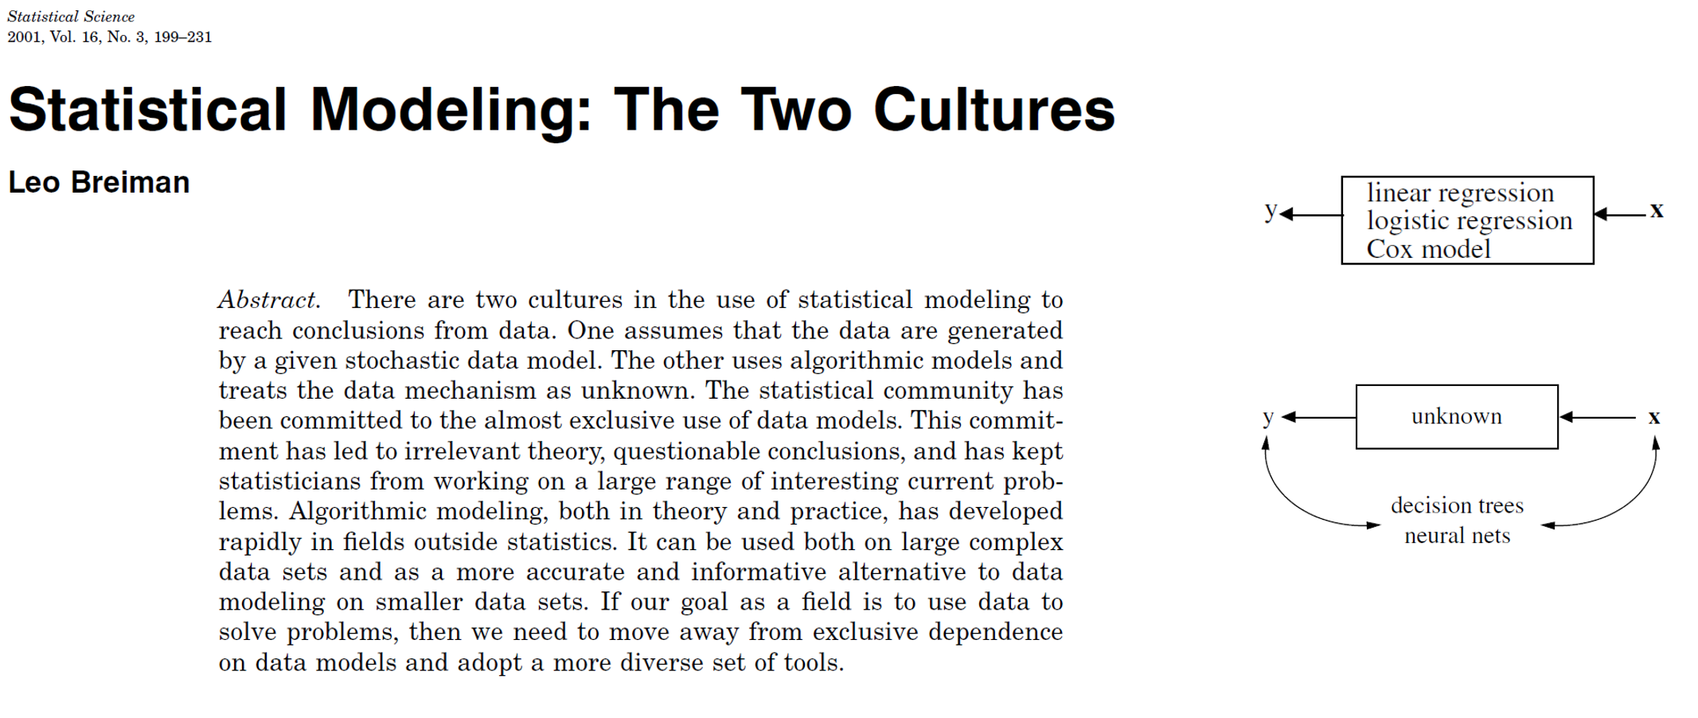
AI, machine learning, statistics
Breiman, L., Statistical Modeling: The two Cultures (2001). Statistical Science, 16:199-231.

Slide 30
AI, machine learning, statistics
$$\begin{matrix}Mathematics & → & Statistics \\ & & \\ Computer science & → & Machine learning \\ & & \\ Engineering & → & Pattern recognition\end{matrix}$$

Slide 31
AI, machine learning, statistics
$$\begin{matrix}Statistics & ↔ & Machine learning \\ & & \\ models & ↔ & networks, graphs \\ & & \\ parameters & ↔ & weights \\ & & \\ fitting, estimating & ↔ & learning \\ & & \\ test set performance & ↔ & generalisation \\ & & \\ & & \\ logistic regression & ≈ & perceptron\end{matrix}$$

Slide 32
Clustering

Slide 33
Clustering
MDS and PCA allow you to visualise high-dimensional data.
As discussed often this is to discover if there are patterns or clusters of your samples (and quite often you hope to look for clusters in terms of some covariates).
So whether you’ll do this on the raw data or the MDS / PCA transformed data, you will need to use techniques that can discover such patterns or clusters.

Slide 34
Clustering
Clustering refers to discovering groups / patterns / clusters of data without knowing how such clusters should be defined. This is also called unsupervised classification.
If you do know group labels, then you hope to learn rules from the data on how to predict these labels. This is called (supervised) classification (more on this later).

Slide 35
Clustering
We will look at 3 techniques:
hiearchical clustering
K-means clustering
(statistical) mixture models

Slide 36
Clustering
K-means clustering
We want to cluster some dataset $D=\{x_{i}\}$ into $K$ groups. We need to fix $K$, though nothing will stop us do try different values of $K$.
Algorithm:
We start by randomly selecting $K$ centres for the clusters: $c_{1},…,c_{K}$
Assign points to cluster whose centre is nearest.
Update the positions of the centres of the clusters.
Repeat steps 2. and 3. until convergence.

Slide 37
Clustering
Hiearchical clustering
You do not fix a number of clusters. Rather you group observations into clusters depending on how similar they are. You build a tree-like graph and the final step is where to “cut” the tree - this will define the clusters.

Slide 38
Clustering
Hiearchical clustering
Algorithm: 2 approaches
Bottom-up / agglomerative
Each observation is its own cluster.
Merge the two closest observations together
Continue until all observations are in a single cluster.
Top-down / divisive
All observations are in a single cluster.
Choose a cluster and a split for that cluster that best separates observations that are similar to each other from others.

Slide 39
Clustering
Hiearchical clustering
In R:
hclust() (agglomerative)
Also many dedicated packages for different types of hiearchical clustering and similarity metrics used along with them.

Slide 40
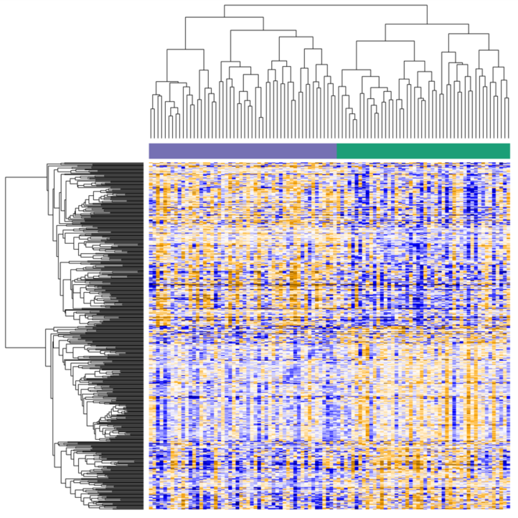
Clustering
Hiearchical sample and gene clustering for DE analysis (unpublished iPSC data)

Slide 41
Clustering
Mixture models
We can take a formal statistical approach. Suppose we have data $D=\{x_{i}\}$. For each observation $x_{i}$ we can write down it’s likelihood using the Theorem of Total Probability:
$$p(x_{i})=\sum_{k=1}^{K}{P(C_{i}=c_{k})⋅p(x_{i}|C_{i}=c_{k})}=\sum_{k=1}^{K}{π_{k}⋅p(x_{i}|C_{i}=c_{k})}$$

Slide 42
Clustering
Mixture models
The likelihood of the data is then simply
$$L(X|π_{1},…,π_{K})=\prod_{i=1}^{n}{p}(x_{i})$$
Because the classes are unknown we need special estimation algorithms. The most commonly used algorithm for these models is the Expectation Maximisation (EM) algorithm.
Start with initial parameters values, then iterate until convergence:
Expectation step: Do a soft assignment of observations to classes.
Maximisation step: Optimise the weighted likelihoods for each class.
Mixture models are a large class of models and have wide applicability.

Slide 43
Classification & regression

Slide 44
Classification & regression
We will cover 10 key techniques for regression and / or classification:
GLM: linear, log-linear, logistic, Poisson, …
Splines & GAM
Regularisation: lasso, ridge, elastic net
Simple classification / clustering: k-nearest neighbour, k-means
Kernel density estimation & classification
LDA, QDA, RDA
Decision trees & random forest
Neural networks & deep learning
Graphical models
Bootstrap & resampling techniques
But first, let’s generate some data.

Slide 45
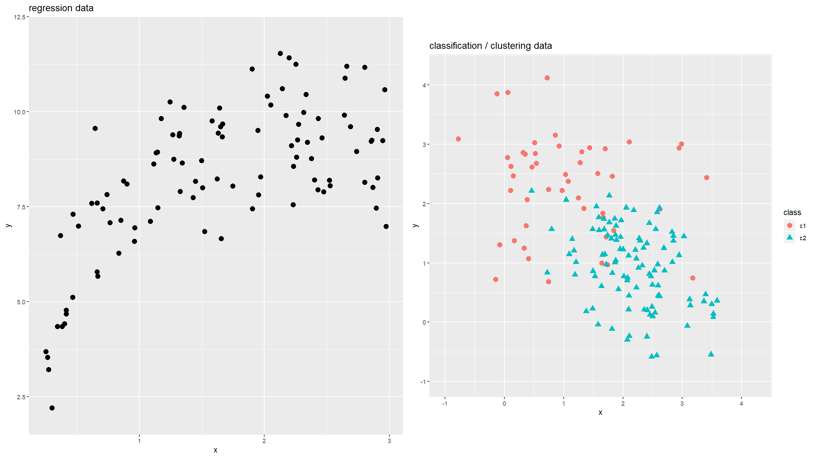
Classification & regression

Slide 46
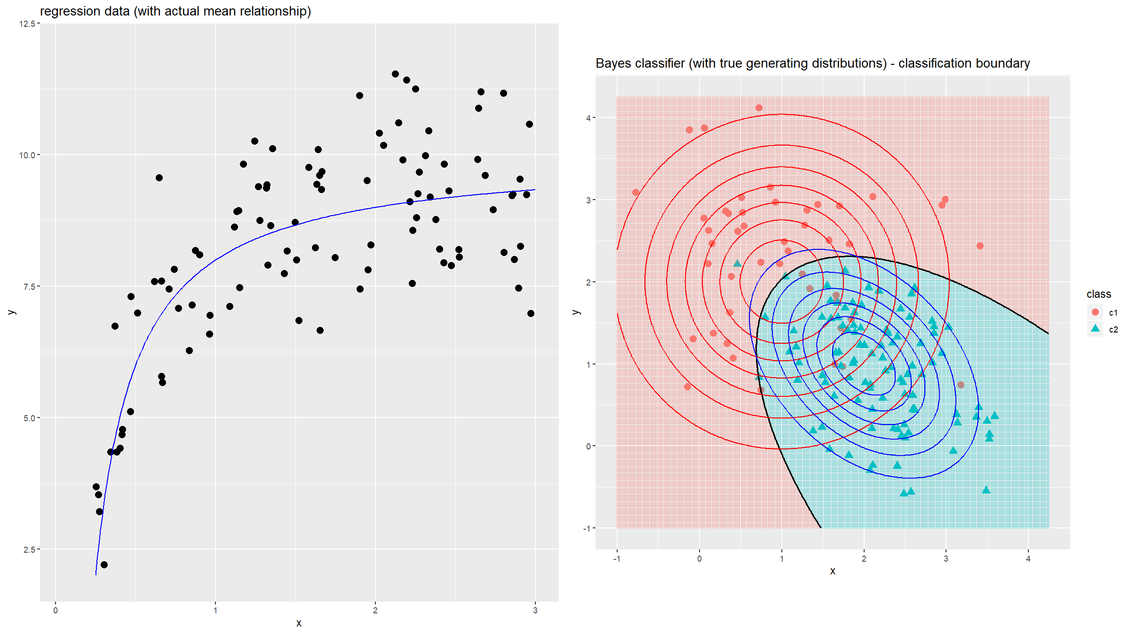
Classification & regression

Slide 47
Classification & regression - 1. GLM
GLM: linear, log-linear, logistic, Poisson, …
Linear model
$$Y=β_{0}+β_{1}X_{1}+β_{2}X_{2}+…+ϵ ϵ∼N(0,σ^{2})$$
Generalised linear model (GLM)
Includes logistic regression, Poisson regression, …
$$g(E[Y|X])=β_{0}+β_{1}X_{1}+β_{2}X_{2}+…$$
$$Y|X∼F$$

Slide 48
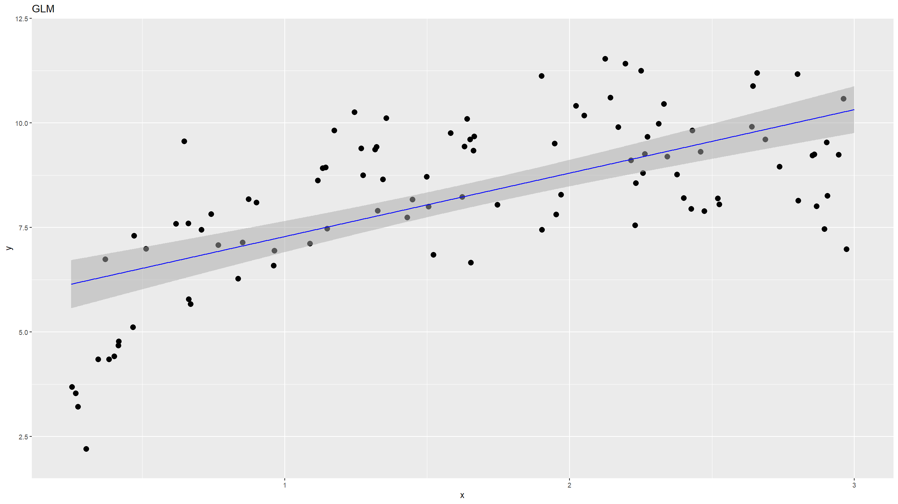
1. GLM

Slide 49
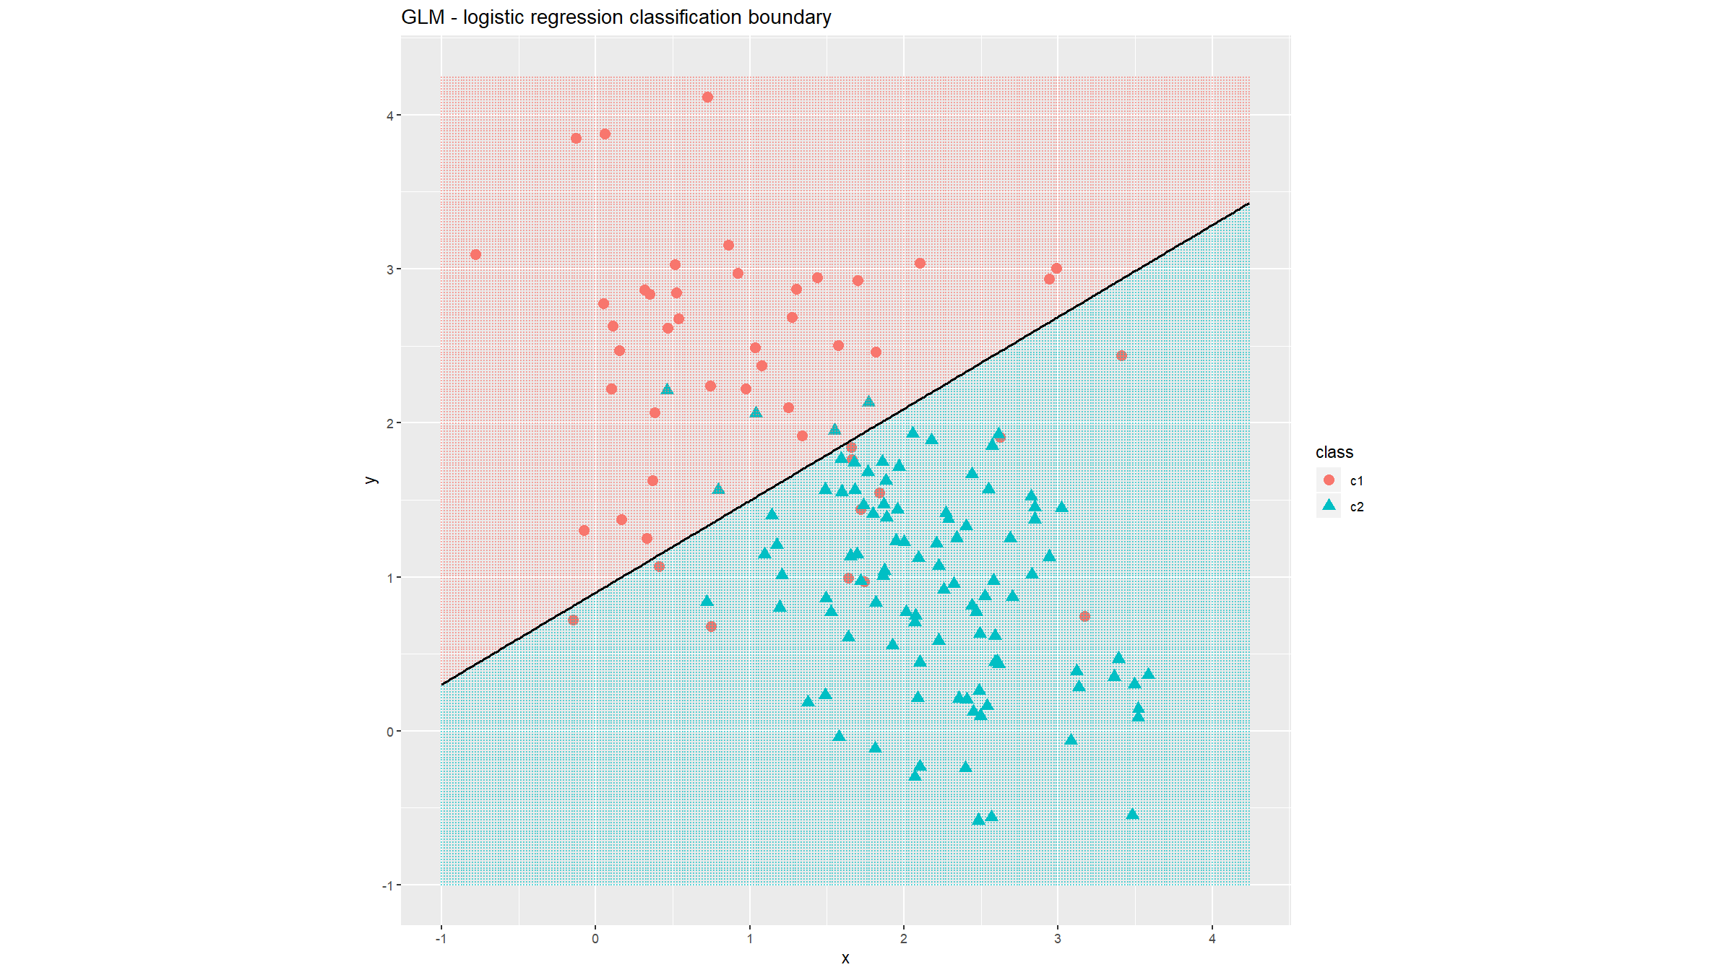
1. GLM

Slide 50
2. Splines & GAM
Splines and GAMS relax the linearity of GLMs and allow quite smooth fits.
Linear spline model
$$Y=β_{0}+β_{1}X+β_{2}(X−k)_{+}+ϵ ϵ∼N(0,σ^{2})$$
where $(X−k)_{+}=X−k$ if $X>k$ and $0$ otherwise.
Generalised additive model (GAM)
$$g(E[Y|X])=f_{1}(X_{1})+f_{2}(X_{2})+…$$
$$Y|X∼F$$

Slide 51
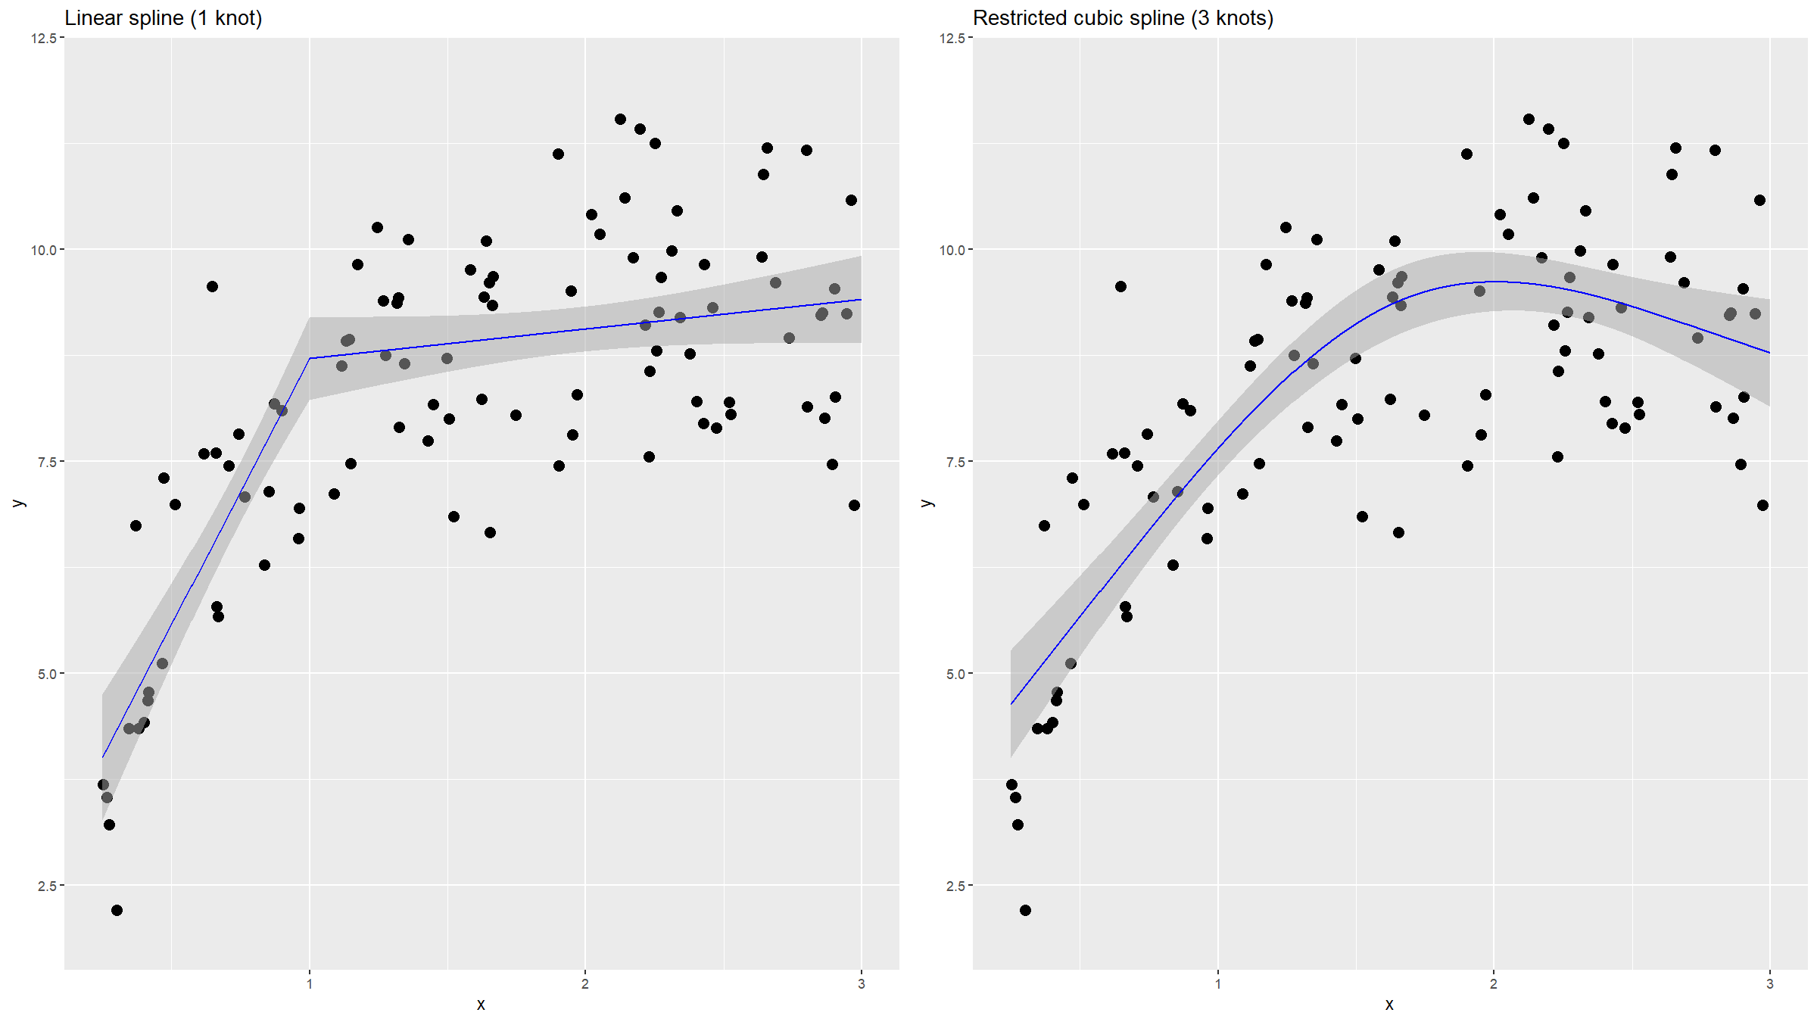
2. Splines & GAM

Slide 52
3. Regularisation / penalisation / shrinkage
GLM – but with additional parameter constraints to shrink parameters. This controls variability and helps with variable selection.
Ridge regression – L2 norm: λj​βj2
Coefficients are shrunk, but kept in the model.
Lasso regression – L1 norm: λj​|βj|
Coefficients are shrunk, some to exactly 0.
Elastic net – a compromise: λj​αβj2+(1−α)|βj|

Slide 53
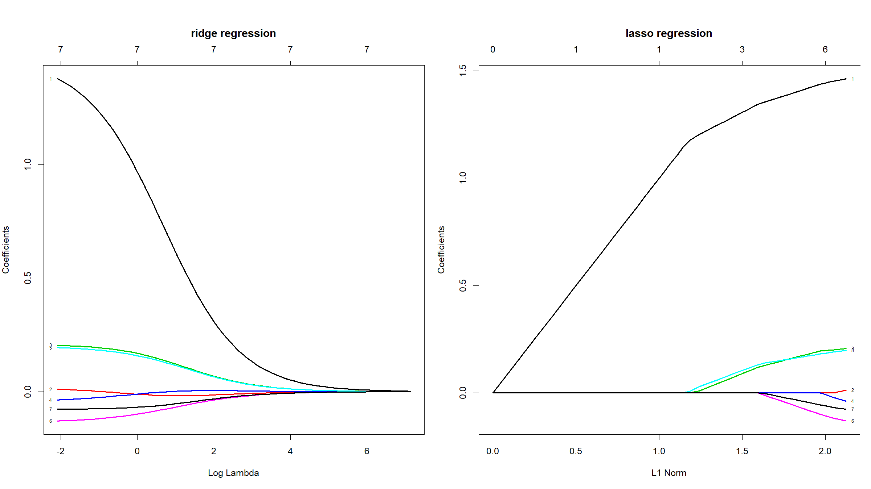
3. Regularisation / penalisation / shrinkage

Slide 54
4. Simple classification / clustering: kNN, k-Means
These are prototype, memory-based, model-free methods.
4.1 kNN
Assign to majority class among $k$ nearest data points in the training set.
Can also be used for regression: y=1kxi∈Nk​yi

Slide 55
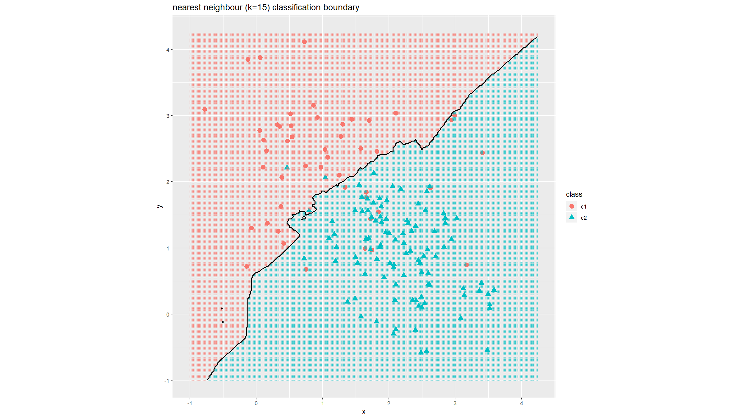
4. Simple classification / clustering: kNN, k-Means

Slide 56
Simple classification / clustering: kNN, k-Means
These are prototype, memory-based, model-free methods.
4.2 k-Means
Start with a random set of initial cluster centroids.
Assign samples to nearest centroid.
Recompute centroids for each cluster.
Iterate until convergence.

Slide 57
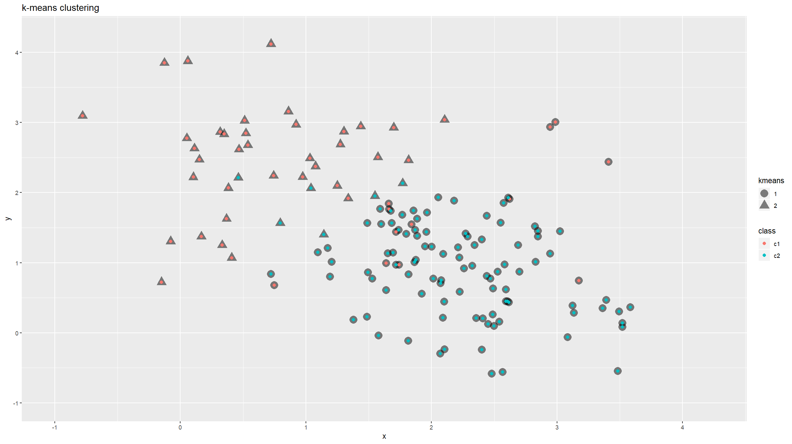
4. Simple classification / clustering: kNN, k-Means

Slide 58
5. kernel density estimation & classification
Kernel density estimation – drop a probability kernel at each observation:
$$\hat{f}(x)=\frac{1}{n}\sum_{i=1}^{n}{g}(x−x_{i}|θ)$$
For classification, estimate densities for each class, then use Bayes’ Rule:
P(C=j|x)=πjfj(x)k​πkfk(x)
Note: only need to estimate densities well near the decision boundary.

Slide 59
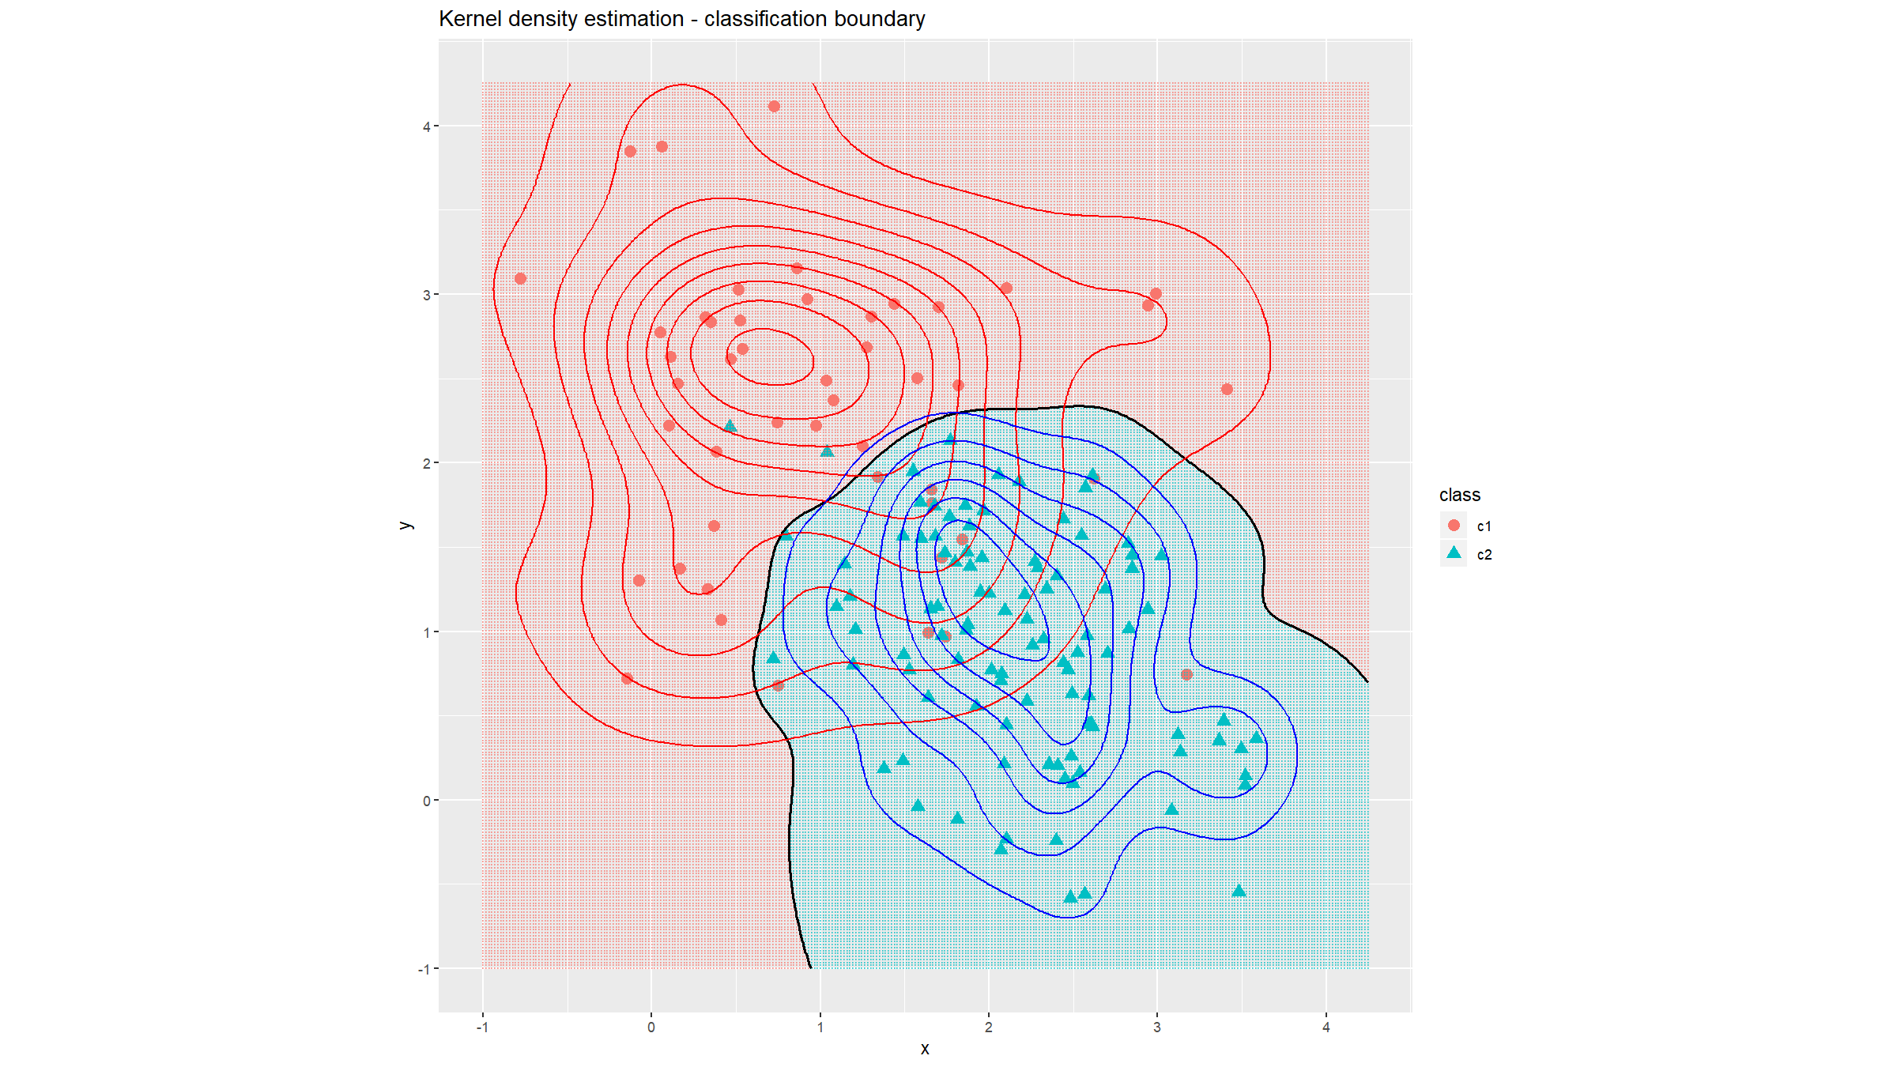
5. kernel density estimation & classification

Slide 60
5. kernel density estimation & classification
Naïve Bayes – useful in high-dimensional problems:
$$\hat{f}(x)=\prod_{m=1}^{p}{{\hat{f}}_{jm}}(x_{m})$$

Slide 61
6. LDA, QDA, RDA
As for kernel density estimation, classification is based on
P(C=j|x)=πjfj(x)k​πkfk(x)
But the $\hat{f}_j(\hatbf{x})$ are assumed to be normal distributions of which we estimate the parameters.
In a two-class problem, it is enough to consider the log-ratio of the posterior class probabilities.
LDA: assume equal covariance matrix for all classes – linear in $x$
QDA: unequal covariance matrices – quadratic in $x$
RDA: shrink QDA covariances to a common covariance matrix.

Slide 62
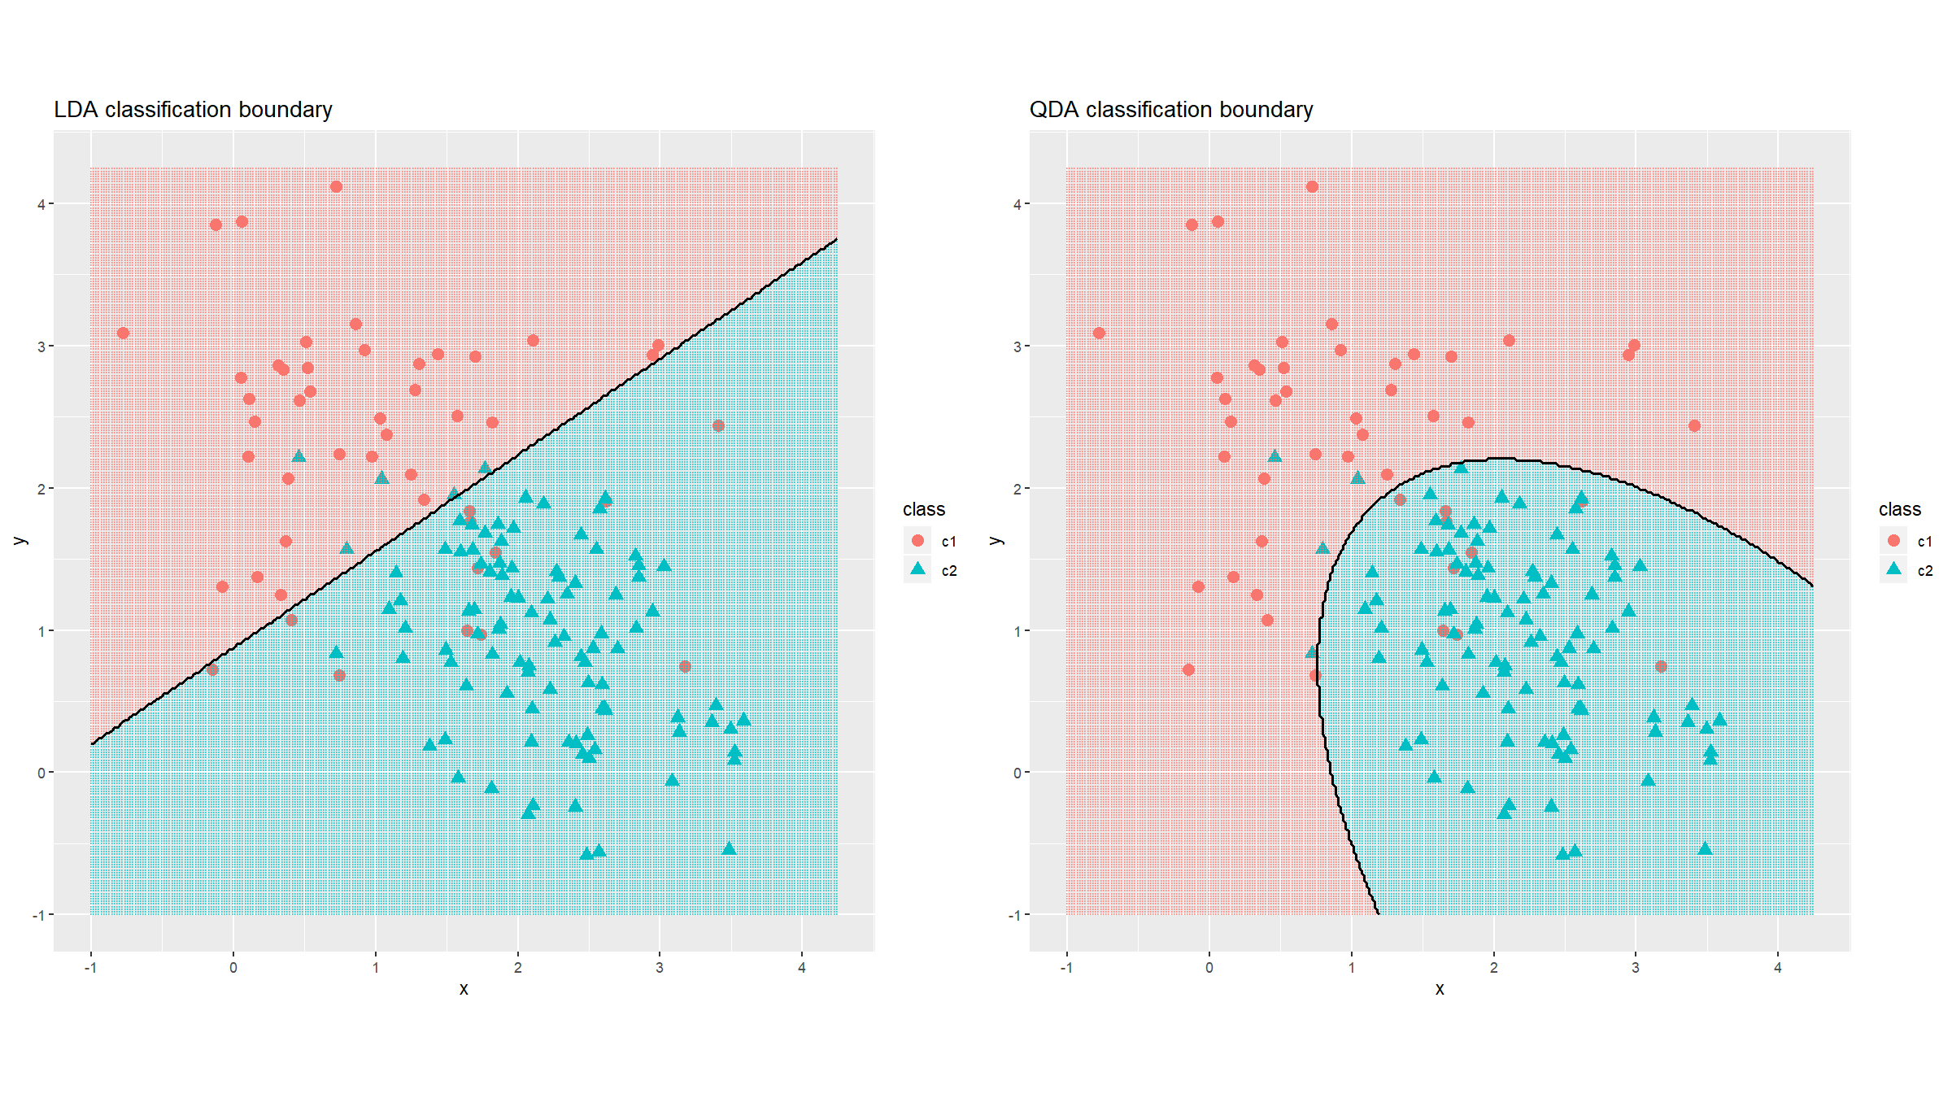
6. LDA, QDA, RDA

Slide 63
7. Decision trees & random forest
Decision trees aim to partition the feature space into sub-regions, with a simple model in each region:
Average value of response variable in region $R_{m}$ (regression).
Majority class in region $R_{m}$ (classification).
At each step the algorithm selects a variable and a split on that variable that minimizes a node impurity function.
Squared error node impurity (regression).
Misclassification rate / Gini coefficient / deviance (classification).
To avoid overfitting a cost-complexity function is optimised that penalises large trees.

Slide 64
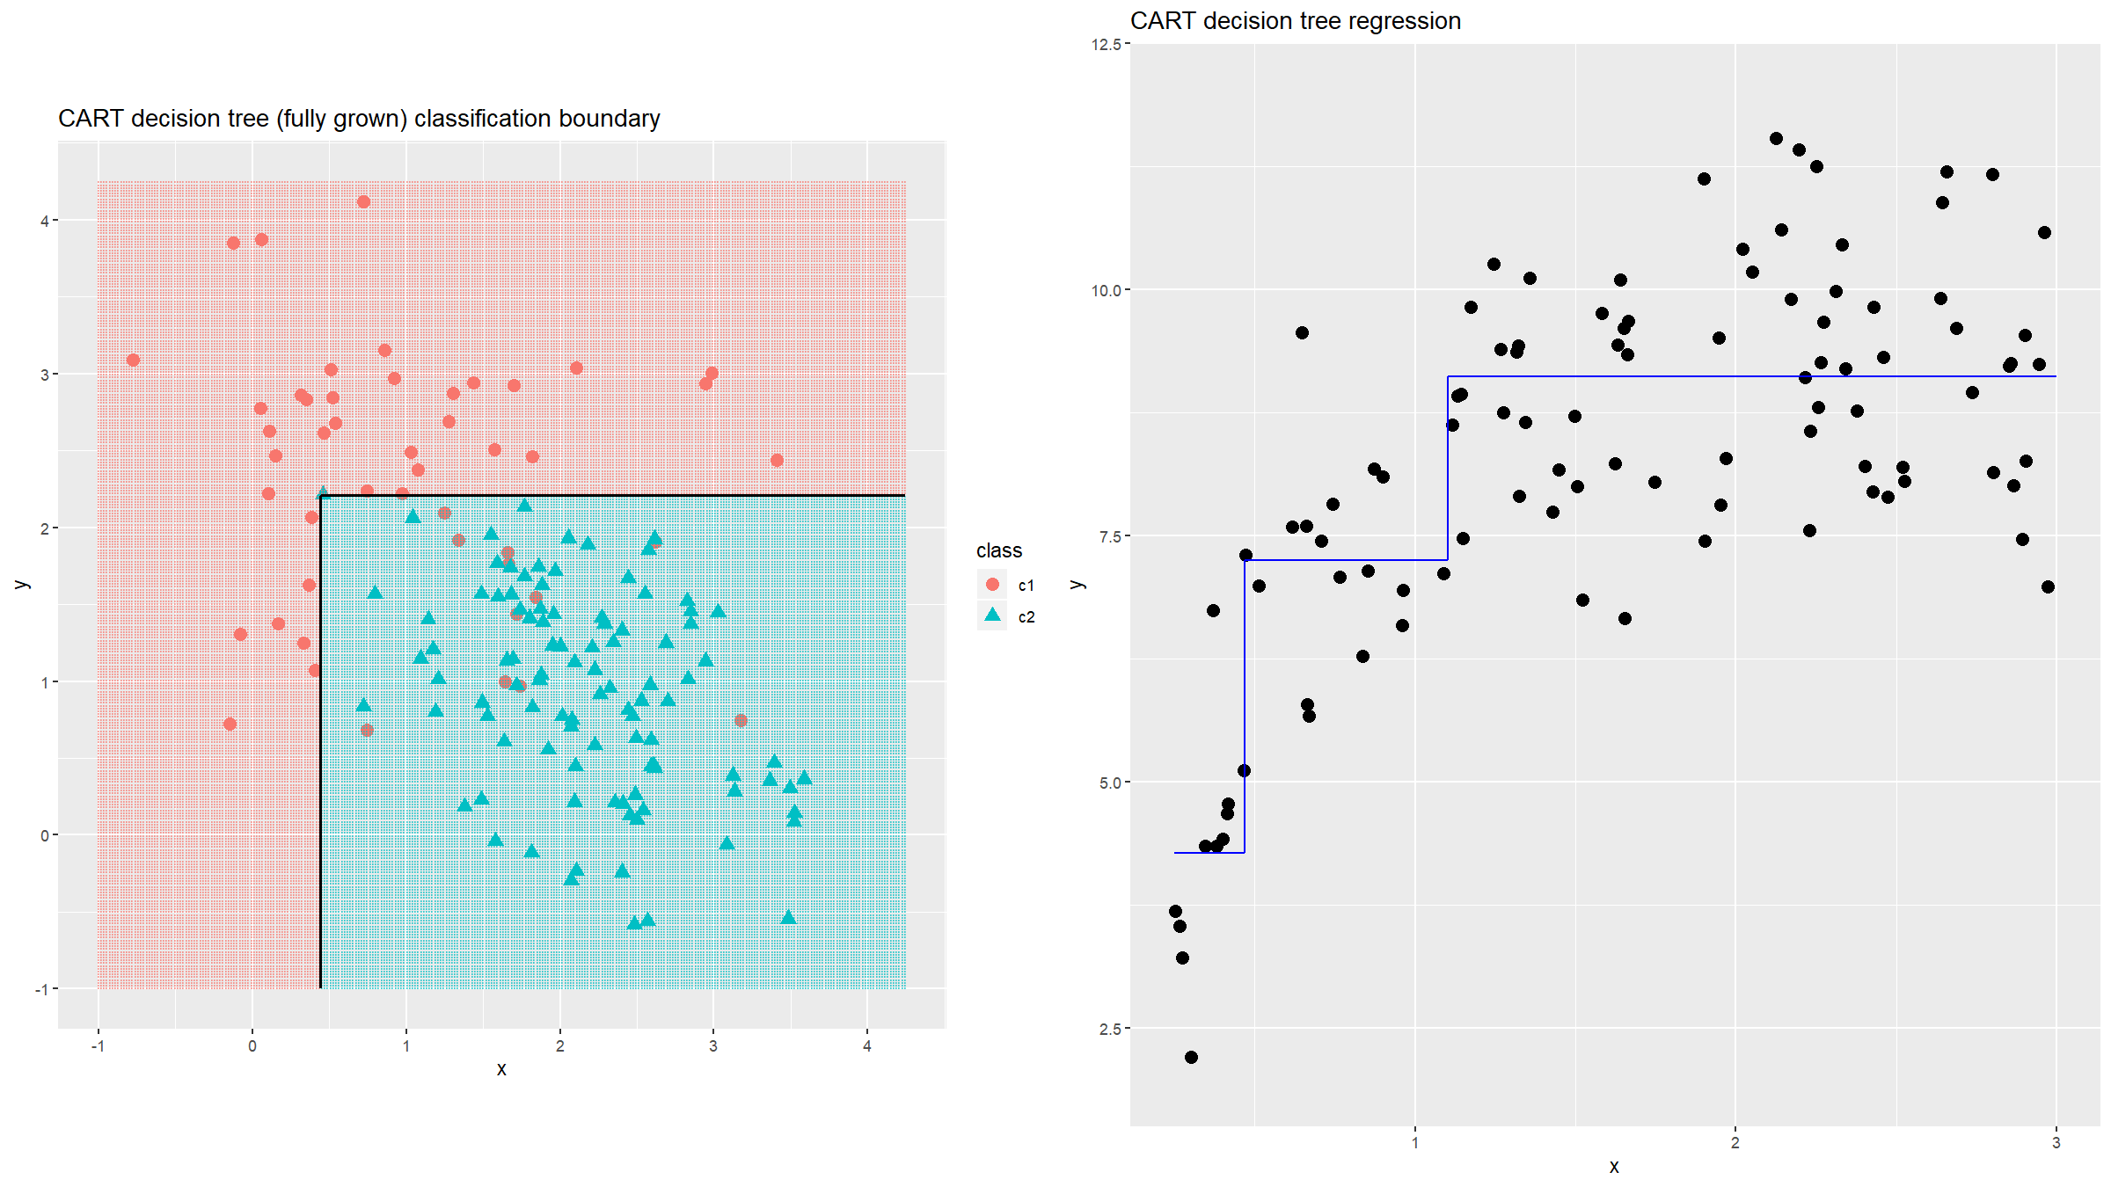
7.1 CART

Slide 65
7. Decision trees & random forest
Decision trees are highly
Interpretable.
Unstable (high variance).
Random forest tries to overcome the latter at the cost of the former:
Draw $B$ bootstrap samples.
Grow a tree for each bootstrapped dataset
Randomly select $m$ out of $p$ variables.
Pick best variable & split among the m variables.
Split the node.
Predict
Regression: average predicted value among the $B$ trees
Classification: majority vote among the $B$ trees

Slide 66
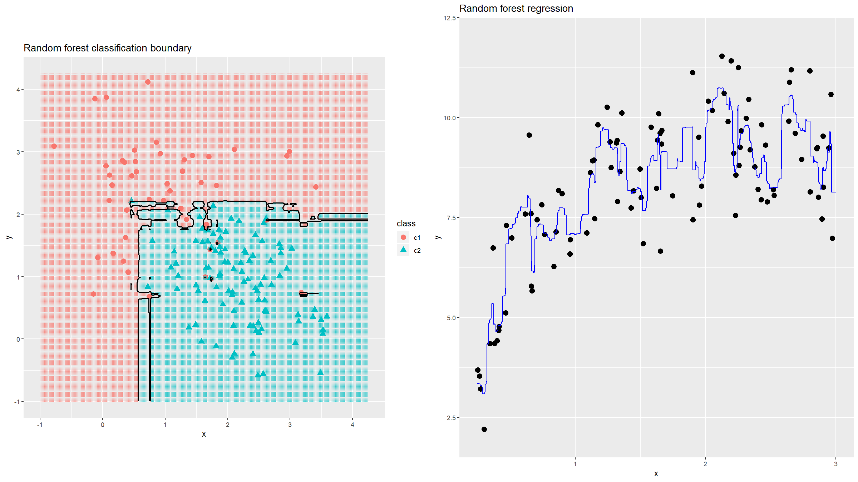
7.2 Random forest

Slide 67
8. Neural networks & deep learning
Developed independently in the fields of statistics (projection pursuit) and artificial intelligence.
The basic idea is: form non-linear functions of linear combination of non-linear functions of linear combinations of …
This results in a universal approximator: for large enough numbers of nodes in the model, any continuous function can be approximated arbitrarily well.
Large class of models (focus here on the multilayer perceptron - MLP).

Slide 68
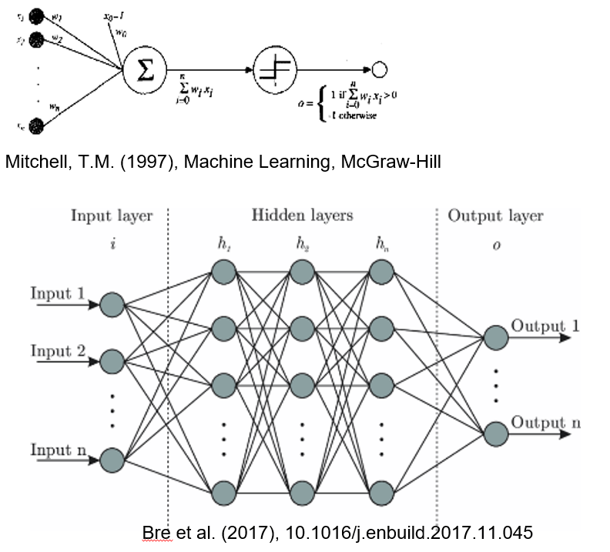
8. Neural networks & deep learning
The perceptron and a multilayer perceptron.

Slide 69
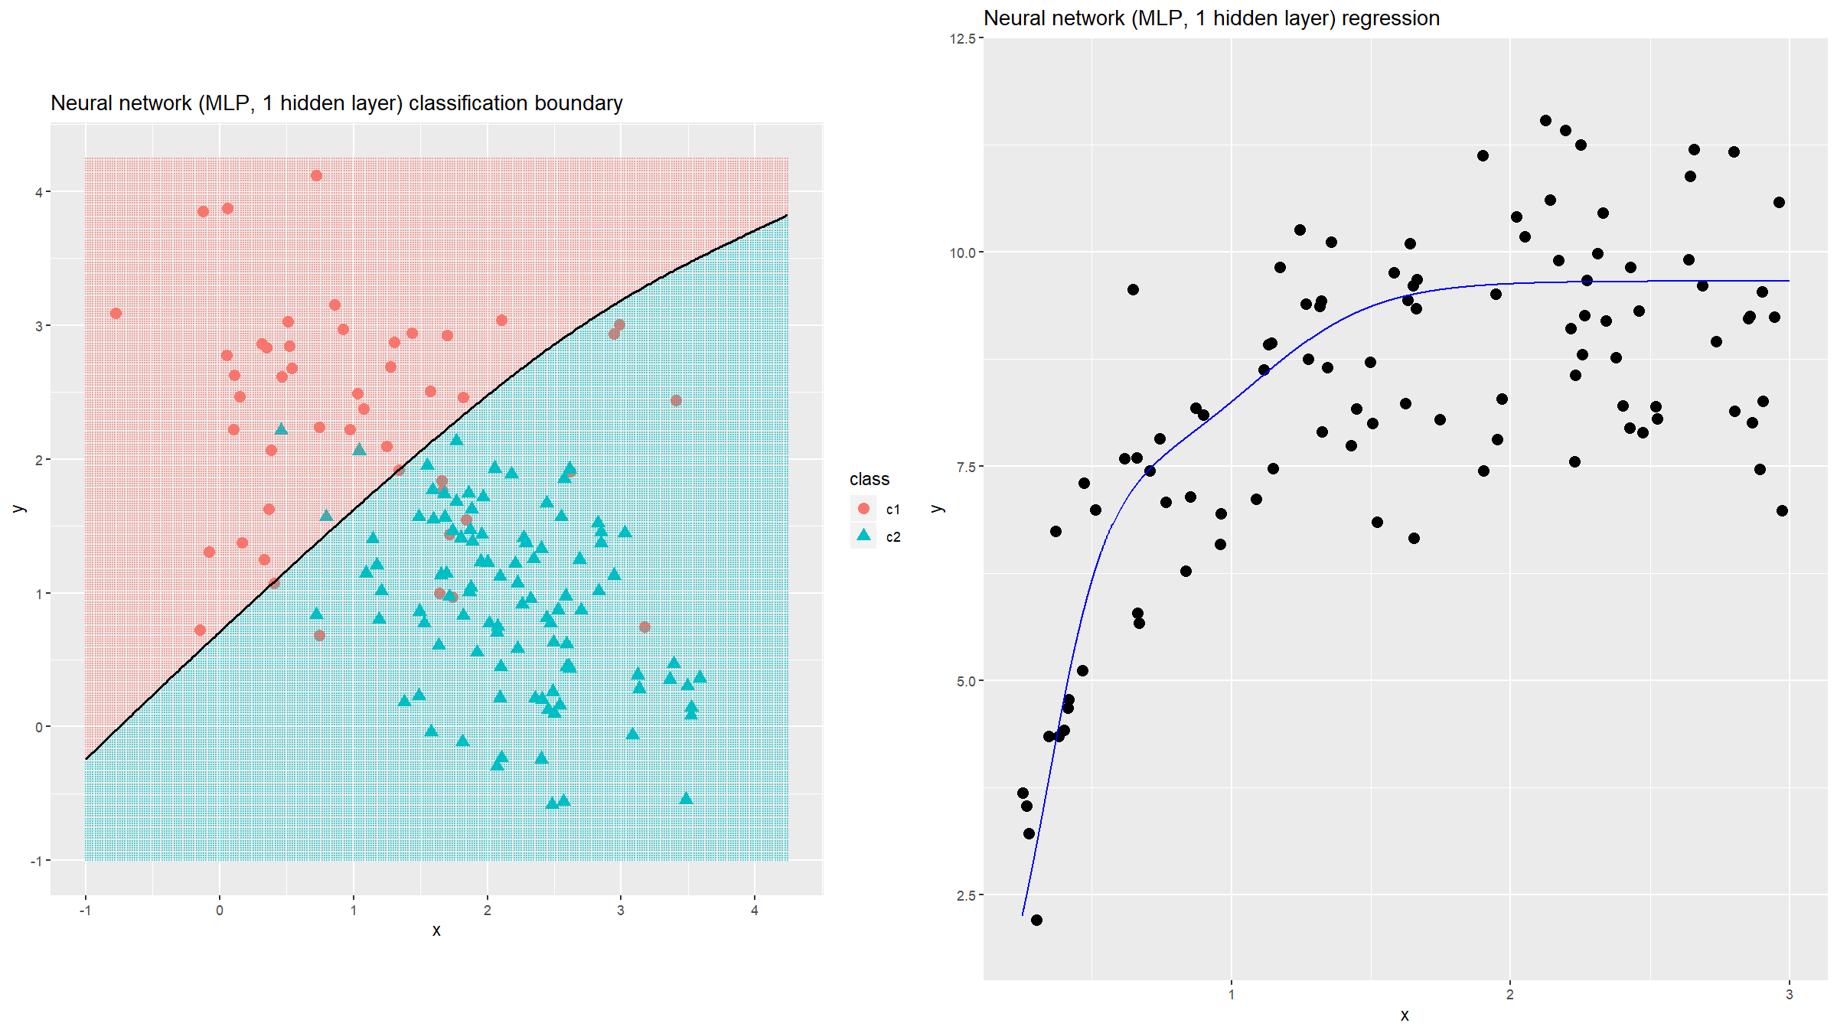
8. Neural networks & deep learning

Slide 70
9. Graphical models
A large class of models, that uses graphs (and graph theory) to represent the joint distribution of sets of random variables.
2 broad families:
Bayesian networks (directed acyclic graphs)
Markov graphs (undirected graphs)

Slide 71
10. Bootstrap & resampling techniques
This is a set of techniques to use the data itself, to do (usually) one of 3 things:
Estimate precision of estimated parameters.
Bootstrap (draw a new set of same size from the data with replacement)
Jackknife (systematic subsets of size n-1)
Perform statistical tests via permutation.
Permutation tests (permute labels)
Assess model performance.
Cross-validation, leave-one-out (draw random subsets)
Bootstrap

Slide 72
Tools / further reading

Slide 73
Tools / further reading
R package & library: caret
WEKA: https://www.cs.waikato.ac.nz/ml/weka/
TensorFlow: https://www.tensorflow.org/

Slide 74
[end of Session 8]

