Slide 1
Weather Station Simulator
ΓΕΩΡΓΙΟΣ ΠΑΠΑΖΑΧΑΡΙΟΥ
(1092681)
Εργαστήριο Επικοινωνιών ΙΙ

Slide 2
Contents
Objective & Deliverables
System Architecture Overview
Protocol & Message Flow
Server Internals
Client Internals
Consumer queries
Web Dashboard
Demo

Slide 3
Objective & Deliverables
Network System
3+ station clients sending data concurrently
TCP server ingesting JSON (line-delimited) batches
SQLite persistence with graceful shutdown
Web dashboard: stations, stats, chart, rolling average
Consumer client queries (stations / latest / recent)

Slide 4
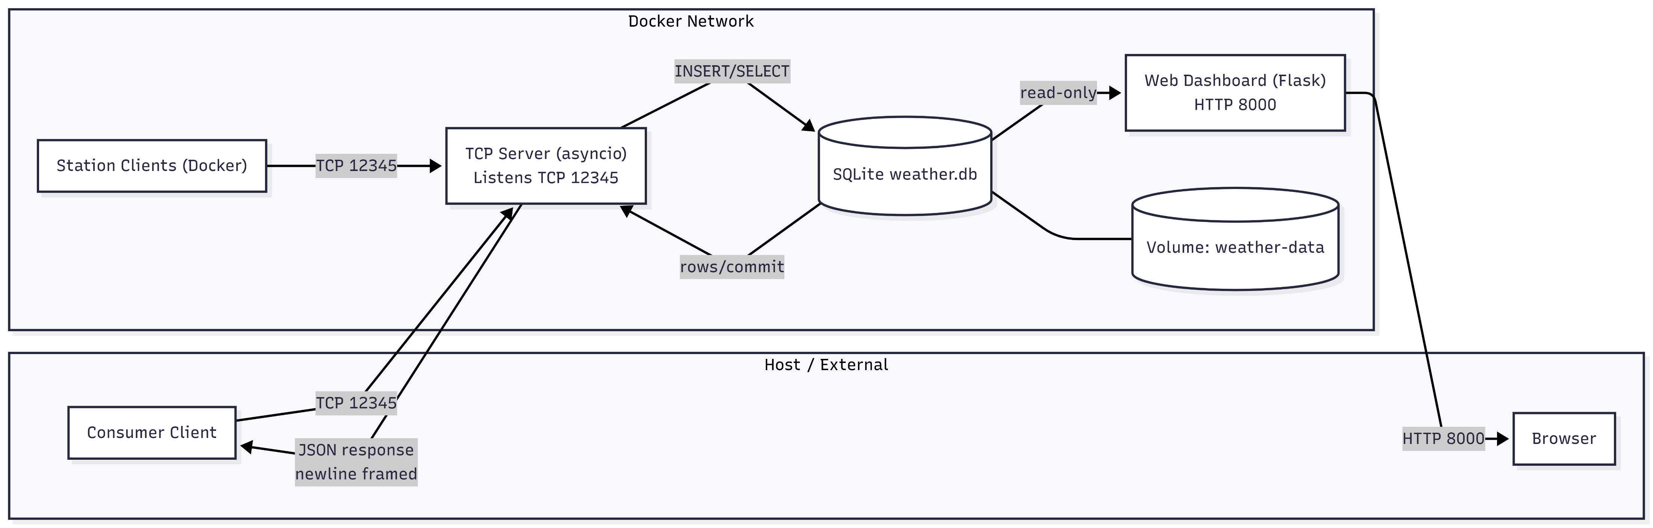
System architecture overview
TCP Server → SQLite: validate + enqueue + single DB writer (WAL)
Stations → TCP Server (12345): send NDJSON batches
Web Dashboard (8000) + Consumer: read/query stored data

Slide 5
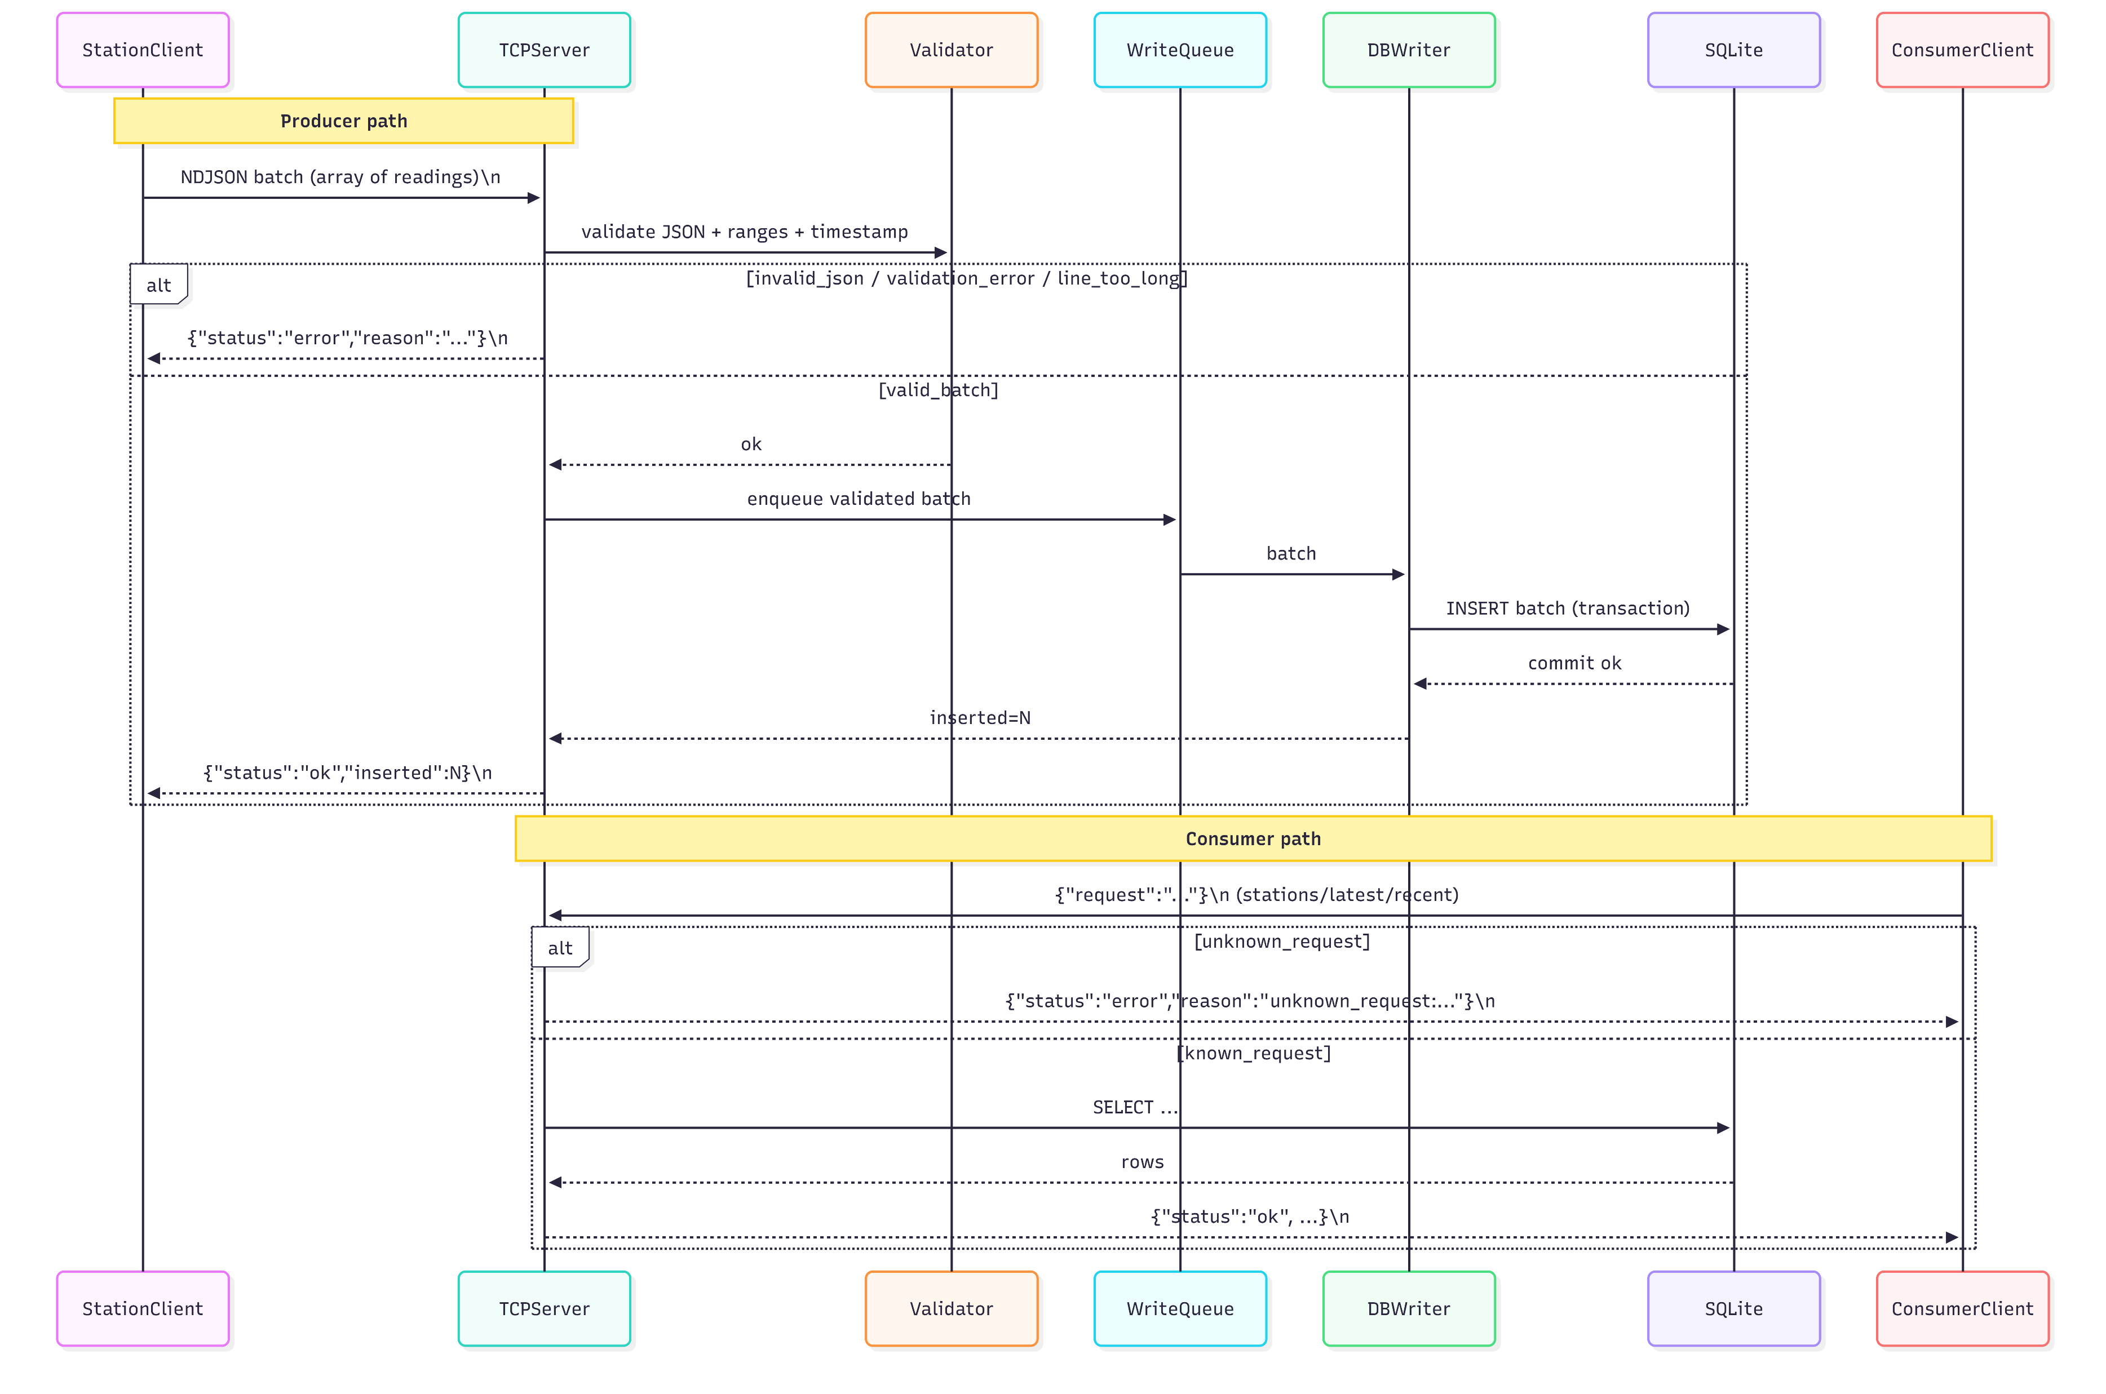
Protocol & Message Flow diagram
Client Station
Send batch
Receive
Validate
Queue and Write to SQLite
Reply OK / Error
Consumer
Send request
Receive
Validate request
Query SQLite
Reply JSON rows / Error

Slide 6
Validation & Data Quality
Validation ranges
Metric | Allowed range
--------------|----------------
temperature | -10 … 40 °C
humidity | 0 … 100 %
windspeed | 0 … 50 m/s
batch size | ≤ 50 readings
line size | ≤ 65,536 bytes
Required fields present (station_id, timestamp, metrics)
Timestamp format valid (ISO-8601) + not obviously wrong
Finite numbers only (reject NaN / Infinity)
Realistic ranges (e.g., temp/humidity/pressure within bounds)
Batch/line limits (max line size + max readings per batch)
On failure: reject the message and return error JSON (don’t write bad data)

Slide 7
Server internals
Async TCP server Handles many clients
(readline per batch)
Write queue Validated batches
queued for DB insert
SQLite (WAL) Single writer,
persistent volume
Asyncio TCP handles many clients
Parse per line (NDJSON) + validate
Queue decouples network from DB writes
Single writer + WAL avoids DB locked

Slide 8
Client internals
Generate readings and send in NDJSON batches
Automatic reconnect on failure (exponential backoff + jitter)
Buffer unsent batches in memory while disconnected
Flush buffered batches first after reconnect
Timeouts around connect / send / wait-for-ack (avoid hanging)

Slide 9
Consumer queries
Simple TCP client (runs outside Docker) that sends one JSON request per line
Requests supported: stations, latest (by station), recent (last N)
Server validates the request and queries SQLite
Response is JSON (rows + metadata) or error JSON for invalid requests
Demonstrates programmatic access to the same persisted data as the dashboard

Slide 10
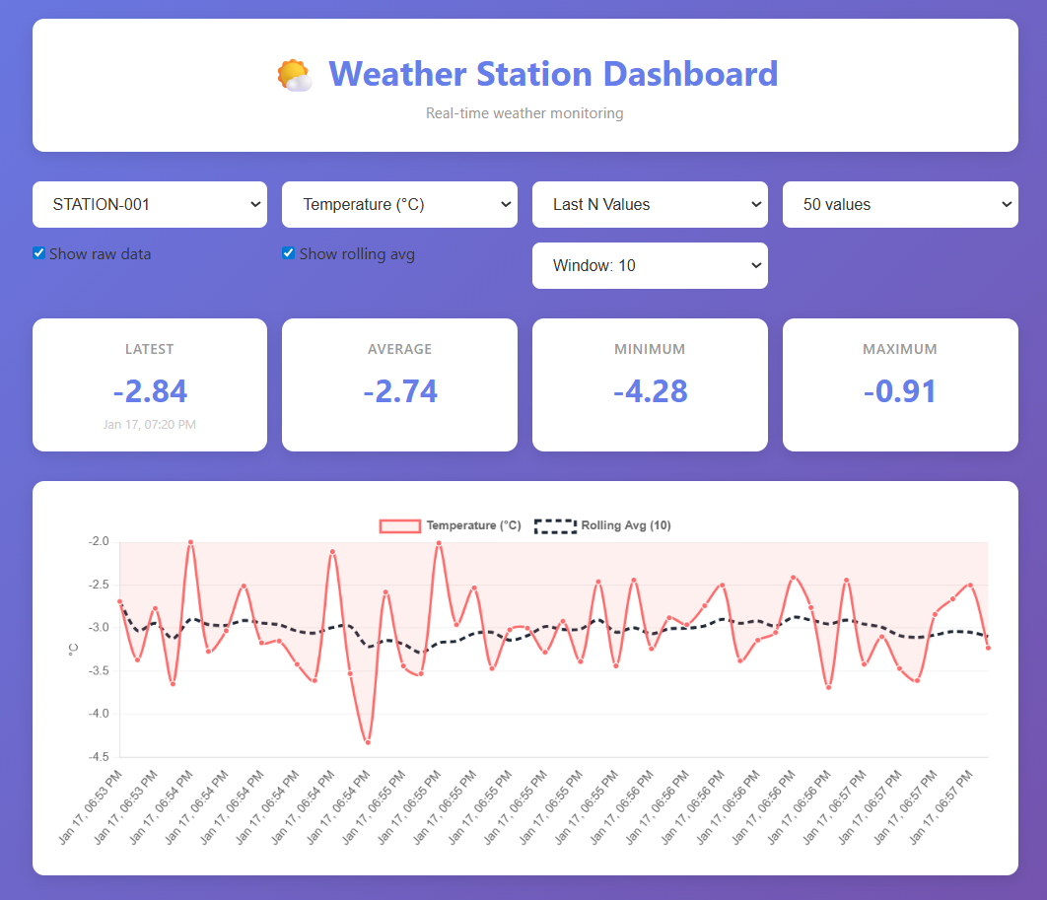
Web dashboard
Dashboard showing readings from SQLite
Select station to filter the chart and stats
Key stats (latest / min / max / average) update
Time-series chart of temperature / humidity / pressure

Slide 11
Docker
Docker Compose brings up the full topology (server + stations + web UI)
Exposes TCP 12345 (ingest/consumer) and HTTP 8000 (dashboard)
SQLite stored on a named volume so data persists across restarts
Easy to scale producers: run multiple station containers to simulate load
One command to run/demo: docker compose up -d --build

Slide 12
Demo (Simple & Stress)
Server starts and listens on TCP 12345 + web 8000
3 stations connect and begin sending batches (server logs show OK / inserted=N)
Dashboard loads and shows stations + updating chart/stats
Switch station filter and confirm the chart/stats change correctly
Run a consumer request (stations, latest, recent) and confirm valid JSON response
Scale up stations (many clients) and confirm the server stays responsive
No SQLite “database is locked” errors (single-writer + WAL working)
Insert rate remains steady (server continues replying OK / inserted=N)
Dashboard still loads/updates during load (queries remain responsive)
Consumers still get responses while producers are flooding data

Slide 13
Thank you
ΓΕΩΡΓΙΟΣ ΠΑΠΑΖΑΧΑΡΙΟΥ
(1092681)
Εργαστήριο Επικοινωνιών ΙΙ

