Slide 1
Optimal Low Thrust Transfers Between Planetary Parking Orbits
Padmanabha Prasanna Simha
SC14b034
Under the guidance of Dr. Ramanan. R. V
Indian Institute of Space Science and Technology

Slide 2
Presentation Overview
Problem description
Approaches used in literature and motivation
Mathematical formulation
Solution procedure and differential evolution
Optimal interplanetary transfers
Optimization strategy
Optimal transfers and comparison
Optimal EPO-Moon parking orbit transfers
Other optimal transfers considered,
Between geocentric orbits (Geosynchronous transfer orbit to Geosynchronous orbit)
Between heliocentric orbits (Presented in NCMDAO 2018 held at IISc Bangalore (23rd-24th March 2018))
High thrust results (optimal propulsive landing)

Slide 3
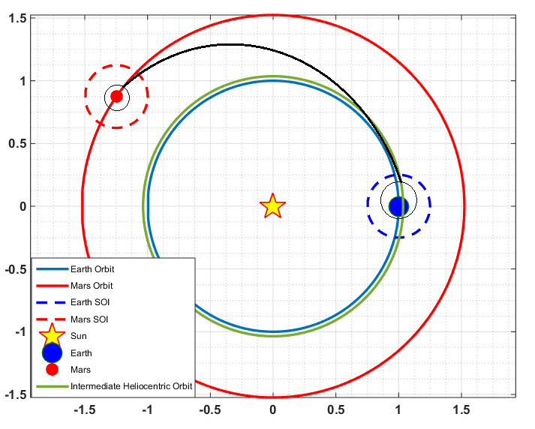
Problem Description
Interplanetary heliocentric phase
MPO
Mars SOI Spiral capture
Spacecraft is in an initial orbit around Earth
Transfer to an orbit around another planet (say Mars)
Using low thrust levels (electric propulsion)
Flight duration or fuel fraction to be minimized
For interplanetary missions,
Gravitational fields of planets have to be considered
Formulation should be capable of,
Handling both nuclear and solar electric propulsion.
Providing coast phases in fuel-optimal problems.
EPO
Earth SOI Spiral escape
Schematic of Earth-Mars transfer
For the actual transfer, JPL DE430 ephemeris is used for planetary positions and velocities. Sun’s influence is also considered within the planet’s mean SOI.

Slide 4
Approaches used in Literature and Motivation
Three stage trajectory optimization
Within Earth MSI – Maximum energy spiral escape
Interplanetary heliocentric phase – Minimum energy transfer
Within Mars MSI – Maximum energy spiral capture
Multi level optimization for continuous transfer geometry – Large computational requirements
Energy-optimal formulation
Solutions do not coincide with fuel-optimal formulation.
Variable specific impulse thrusters
Thruster specifications can be unrealistic
For fuel-optimal results in literature,
Between heliocentric orbits only.
Homotopy methods: From energy-optimal to fuel-optimal formulations.
Direct optimization methods and hybrid approaches for Earth-Moon transfers.
To the best of our knowledge, no fuel-optimal results for transfers between planetary parking orbits.
No indirect approach to fuel-optimal optimal transfer problem without homotopy.
Use of non gradient methods is scarce.
Current study includes
2 stage trajectory optimization
Indirect approach
Fuel-optimal
Homotopy free

Slide 5
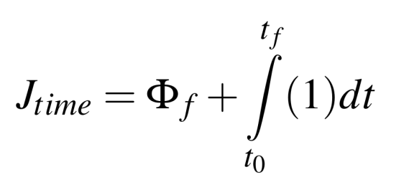
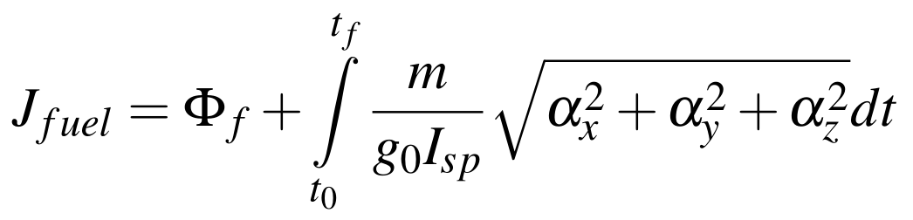
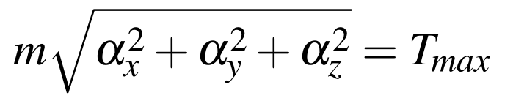
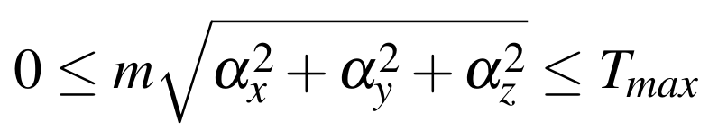
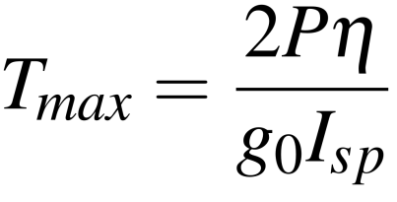
Mathematical Formulation I
Spacecraft motion is governed by differential equations with control variables. (Thrust vector)
Time and fuel optimal formulations require minimization of functionals.
Indirect approach to optimal control is applied using Pontryagin’s minimum principle,
Costates are introduced and Hamiltonians are formulated.
Costate dynamics is derived.
Optimal control law is derived using Pontryagin’s minimum principle and the KKT conditions.

Slide 6
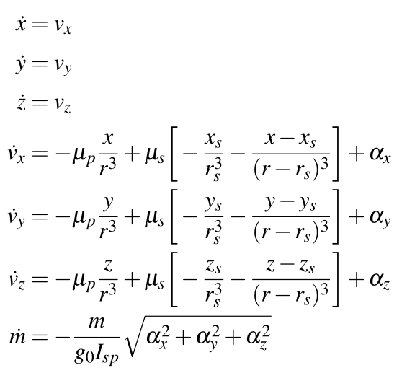
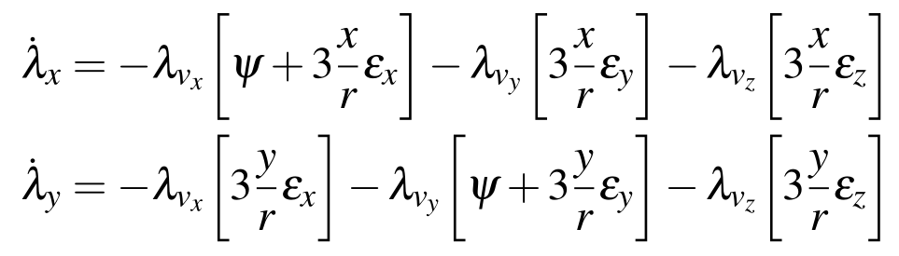
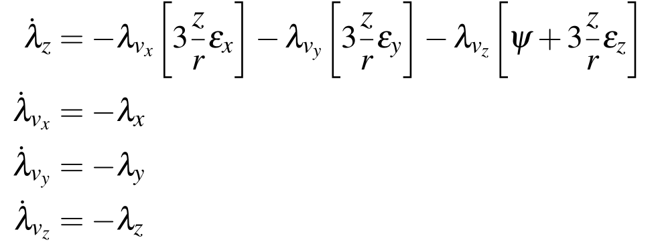
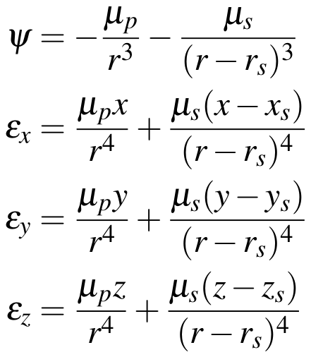
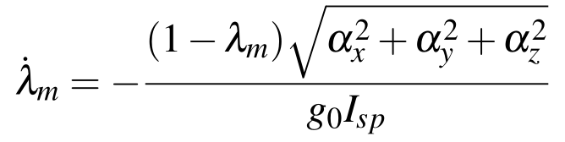
Mathematical Formulation II
State equations – Planetocentric
Costate Equations - Planetocentric

Slide 7
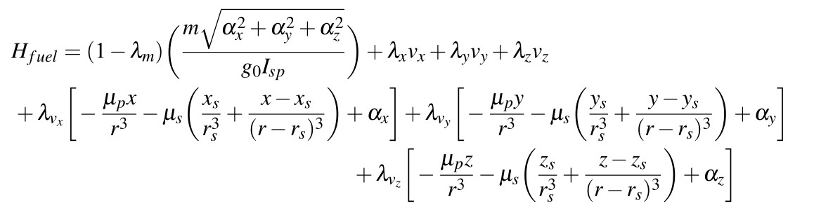
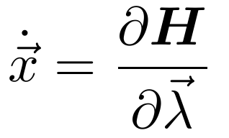
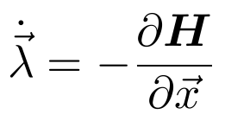
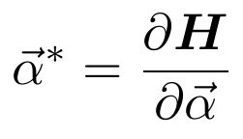

Mathematical Formulation III
Hamiltonian – fuel optimal

Slide 8
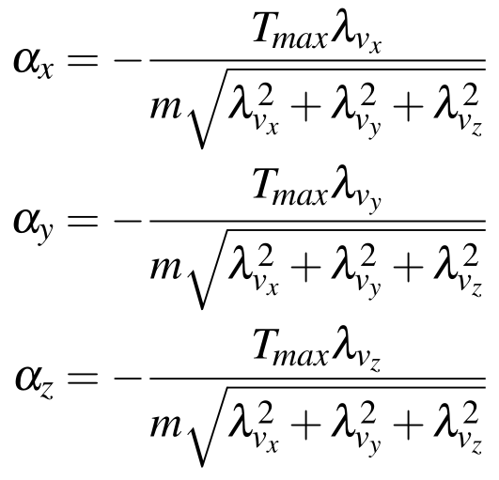
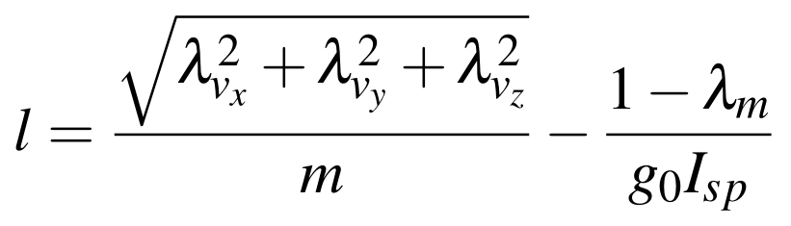
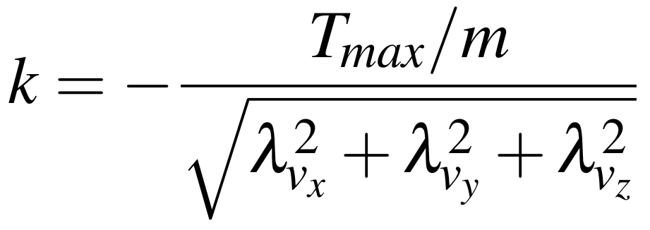
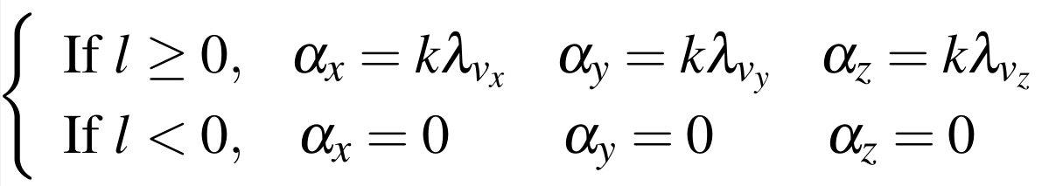
Mathematical Formulation IV
Time Optimal control law
Fuel optimal control law

Slide 9
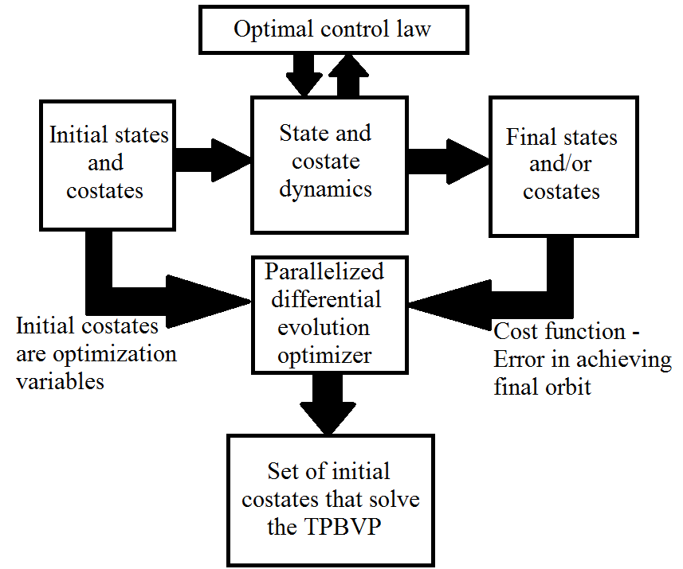
TPBVP and solution schematic
State and costate dynamics is numerically integrated by an adaptive RKF-7(8) order method with maximum step size limits.
RKF-7(8) permits highly accurate solutions with error control and lesser number of time steps.

Slide 10
Solution Procedure and Differential Evolution
Solution procedure
Differential evolution
Indirect approach to optimal control reduces the problem to a TPBVP with initial costates as the unknowns.
Provide a set of bounds for the initial costates.
Error in achieving the final orbit is set as the cost function.
Run the differential evolution algorithm.
The initial costates that drive the error in attaining the orbit are found.
Search based global optimization technique.
Fast convergence for a wide range of test problems.
Large radius of convergence.
Crossover, mutation and selection operations are used.

Slide 11
Optimal Interplanetary Transfers - Strategy
Current strategy does the splitting only into two phases.
Fuel-optimal transfer to an intermediate heliocentric orbit from the EPO
If performing an outward transfer,
Target an intermediate heliocentric orbit with slightly greater (2.5%-5%) semi-major axis than the departure planet.
If performing an inward transfer,
Target an intermediate heliocentric orbit with slightly lower (2.5%-5%) semi-major axis than the departure planet.
Fuel-optimal transfer from the intermediate heliocentric orbit to the arrival planetary parking orbit (Eg: Mars, Venus)
Total flight duration is fixed
Flight duration is left free in the first stage.
Second stage flight duration gets fixed based on the obtained flight duration of first stage.
No multi-level optimization required. (Near optimal results are obtained)

Slide 12
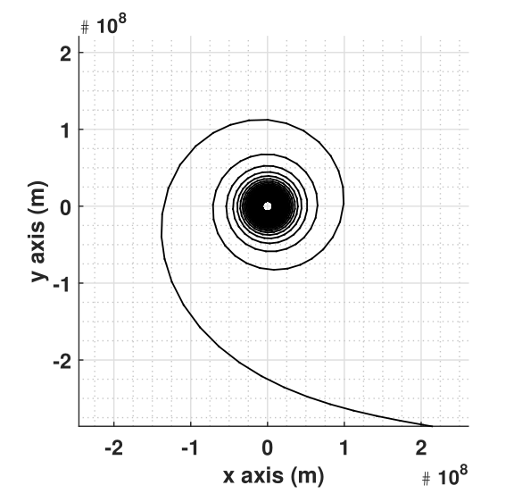
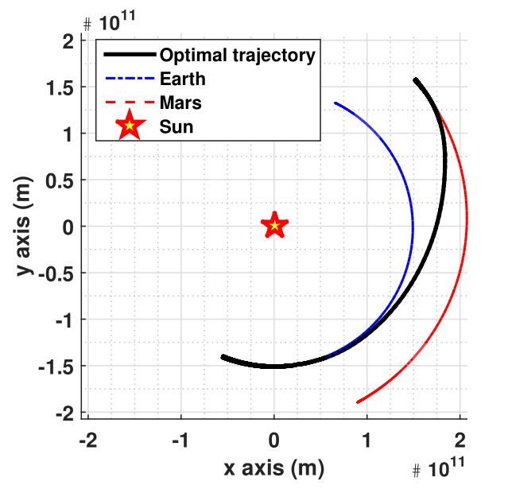
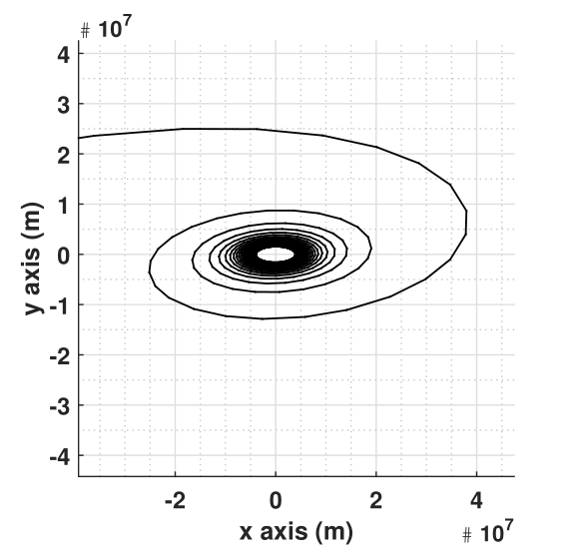
Optimal Interplanetary Transfers - Results
500km EPO 0 deg to Ecliptic -23.4 deg to Earth Equator
500km MPO
90 deg to Mars Equator
Earth Escape Phase
Heliocentric trajectory
Mars Capture Phase
Departure from EPO - 30th May 2020, 1200 hrs UTC
Arrival at MPO - 24th Nov 2020

Slide 13
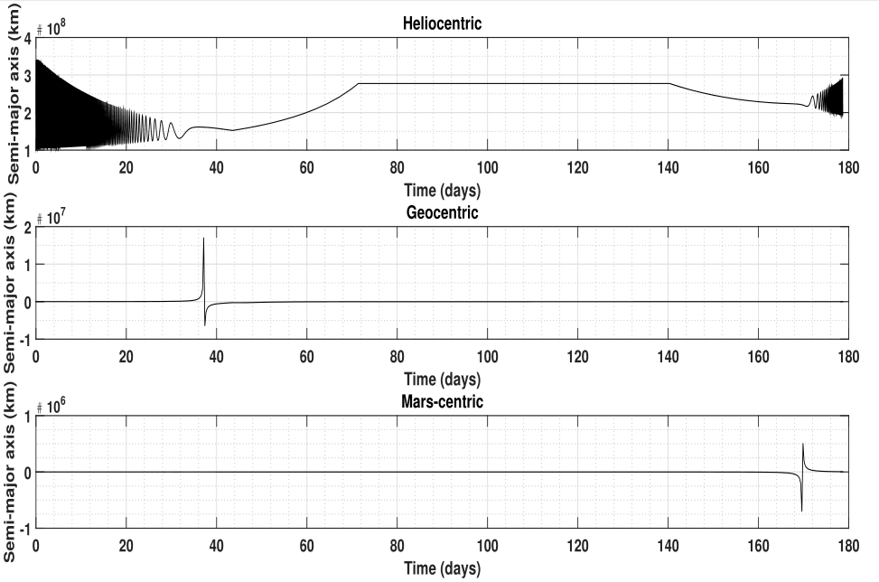
Optimal Interplanetary Transfers - Results
Semi-major axis profiles as seen from the Sun, Earth and Mars
Coasting
Coasting improves fuel fraction Visible as the flat region of the heliocentric semi-major axis profile
Earth escape
Mars capture

Slide 14
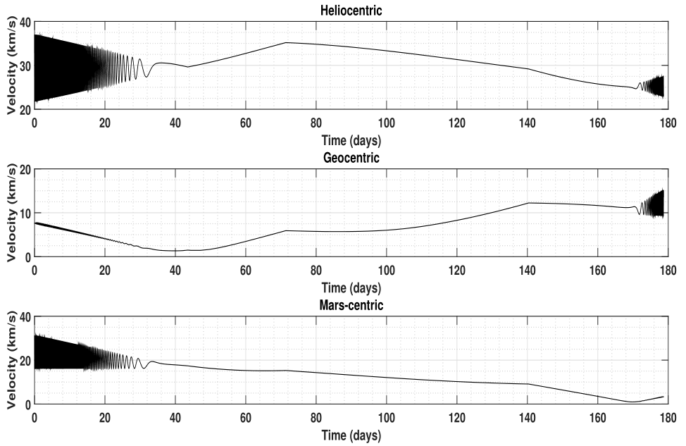
Optimal Interplanetary Transfers - Results
Velocity profiles as seen from the Sun, Earth and Mars
Since geocentric hyperbolic excess velocity magnitude is nonzero, it is necessary for split trajectory design methods to optimize the direction and magnitude. Current strategy of targeting an intermediate heliocentric orbit avoids the optimization step needed.

Slide 15
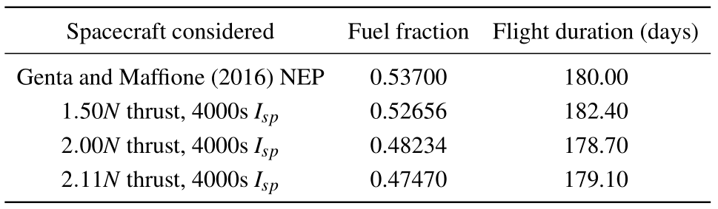
Optimal Interplanetary Transfers – Comparison of current results with literature
Variable thrust and variable Isp
Even with lower thrust levels, current method gives better results.
Selected operating point
Genta and Maffione (2016) use a variable Isp thruster.
Energy-optimal formulation is used with 3 stage trajectory splitting.
Multi-level optimization is also employed.
Current results with fuel-optimal formulation, 2 stage trajectory splitting and single level optimization.
Fixed Isp thruster is used by selecting a single operating point from Genta and Maffione (2016).

Slide 16
Optimal Interplanetary Transfers - Inferences
Multi-level optimization is avoided by using differential evolution. (Large convergence radius)
Fuel-optimal formulation gives substantially better results than energy-optimal formulation.
DE with fuel-optimal formulation allows for homotopy-free optimal results with coasting.
No information on control profile is required a priori.
Departure and arrival planet parking orbit sizes have significant influence.
Parking orbit inclinations, argument of periapsis and right ascension of the ascending node have minimal influence.

Slide 17
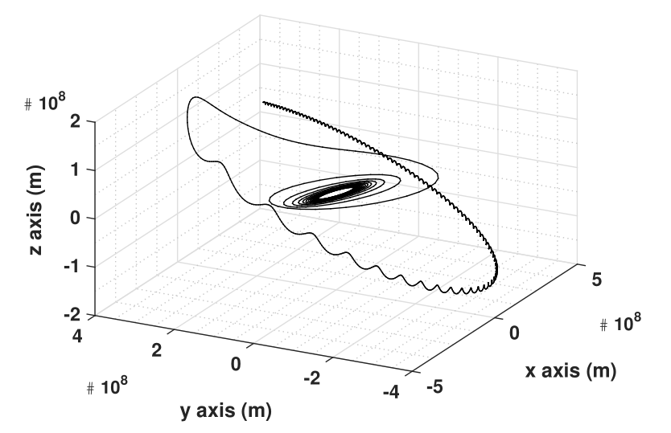
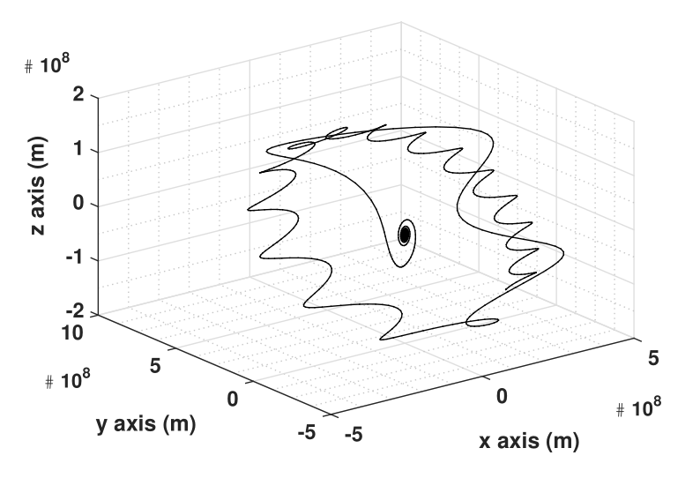
Earth-Moon transfers: Typical result -> Single step optimization strategy
1000kg spacecraft, 500mN, 2000s Isp Transfer time – 75.80 days Fuel fraction – 0.167
Earth-Moon transfer as seen from the Selenocentric frame. Final LPO is seen to be 90 deg with the Earth’s equator.
Typical Earth-Moon transfer as seen from the Geocentric frame 18 degree inclination GSO to 250km circular Lunar parking orbit.

Slide 18
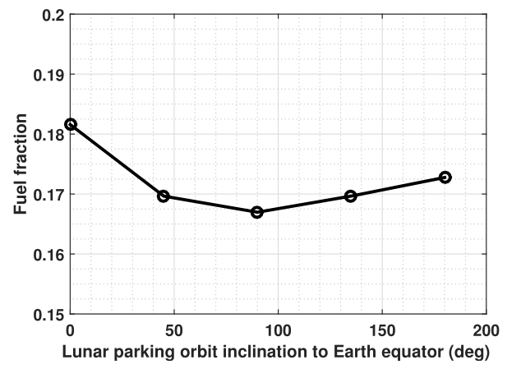
Earth-Moon transfers: Parametric study
Effect of LPO inclination on fuel fraction required EPO is 18 deg GSO.
LPOs are 250km with varying inclinations
0 deg and 180 deg LPOs do not lead to same fuel fractions due to different transfer orbit geometries.

Slide 19
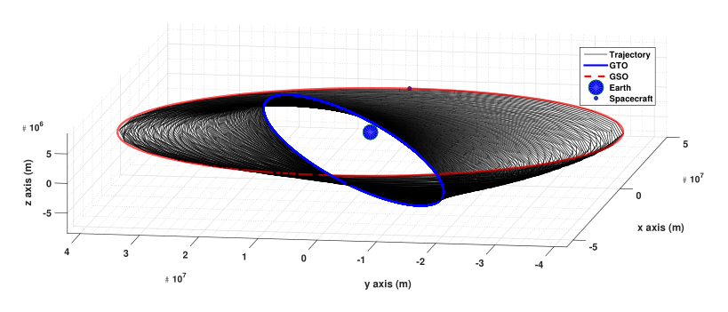
Geocentric transfers: Typical time-optimal result
GSO
GTO
GTO - 250kmX35786km altitude elliptic orbit
GSO - 35786km altitude circular orbit
GTO-GSO transfer with launch from Kennedy Space Center
1000kg spacecraft, 300mN thrust, 2000s Isp (realizable values)
With chemical propulsion about 480kg of propellant is required with single impulse transfers.
Transfer duration – 99.7 days, Propellant mass – 132.342kg

Slide 20
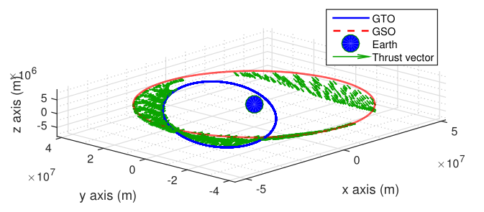
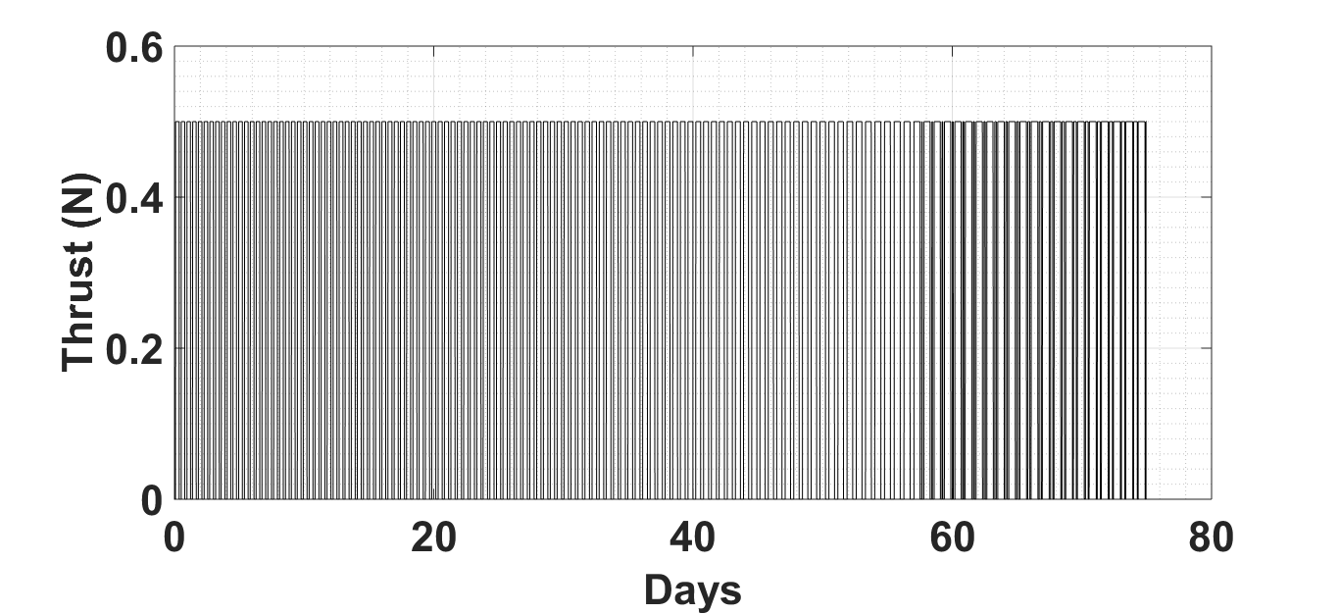
Geocentric transfers: Typical fuel-optimal result
Complex thrust profile with several coasts and thrust-coast switchings. Obtained without homotopy.
Thrust arcs of varying length seen near apogee of GTO. Final circularization to GSO results in additional thrusting at perigee
Large spatial region with coasting -> leads to lowered fuel consumption

Slide 21
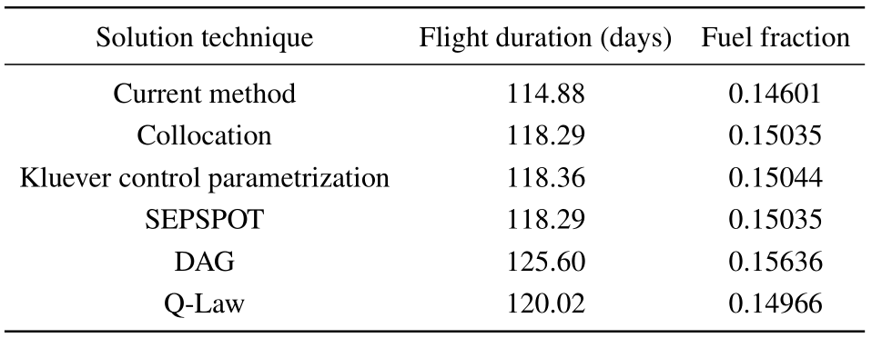
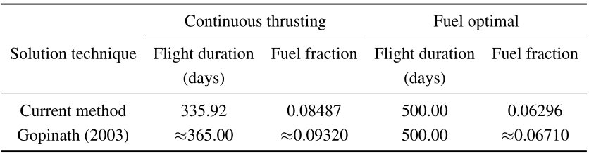
Geocentric transfers: Comparison of results with literature
1200kg spacecraft, 1800s Isp GTO - 185.6616kmX35786.3384km
GSO - 35786.3384km
Thrust level – 311.6mN
Time optimal GTO-GSO results
5365kg spacecraft, 5000s Isp Thrust level – 400mN
GTO-GSO transfer
Time and fuel optimal results

Slide 22
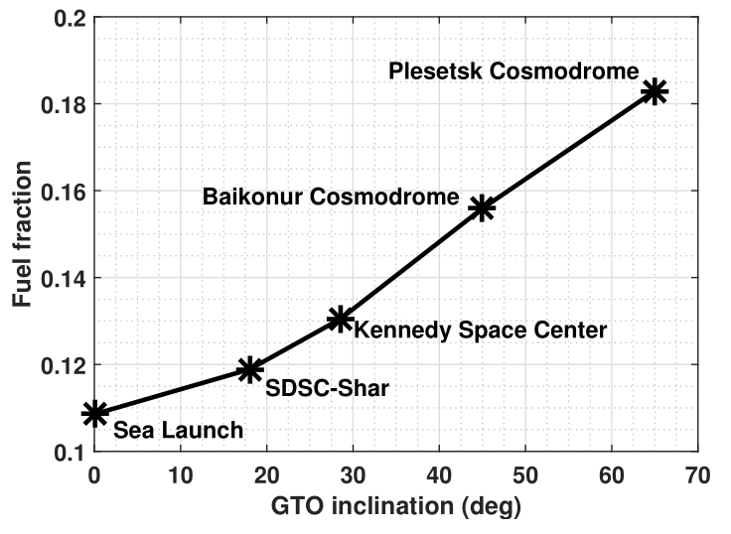
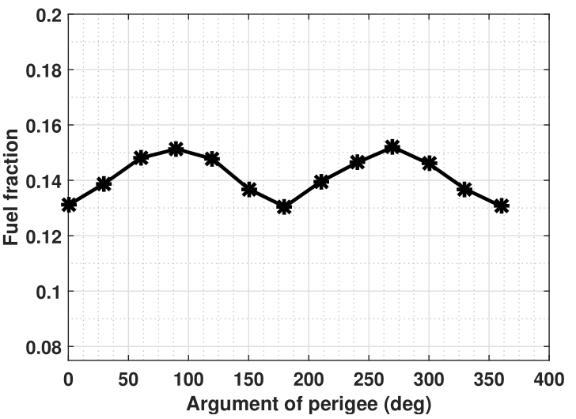
Geocentric transfers: Parametric studies
Influence of launch-site latitudes on GTO-GSO transfers
Impact of argument of perigee for GTO-GSO transfers from Kennedy Space Center

Slide 23
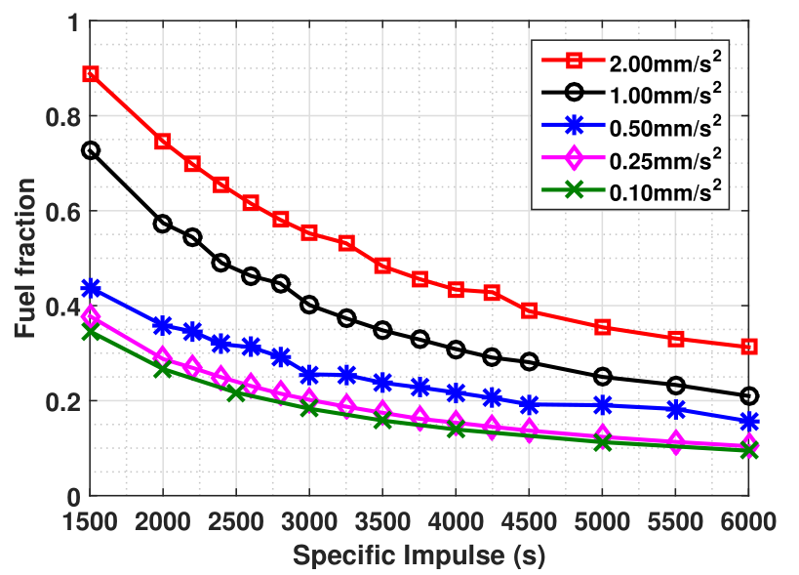
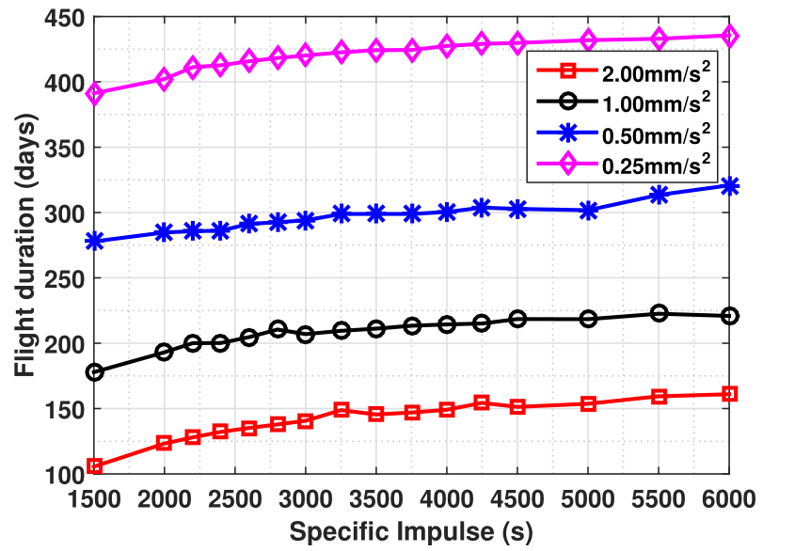
Heliocentric transfers: Time-optimal
1AU to 1.5AU nuclear electric propulsion transfers, time-optimal results

Slide 24
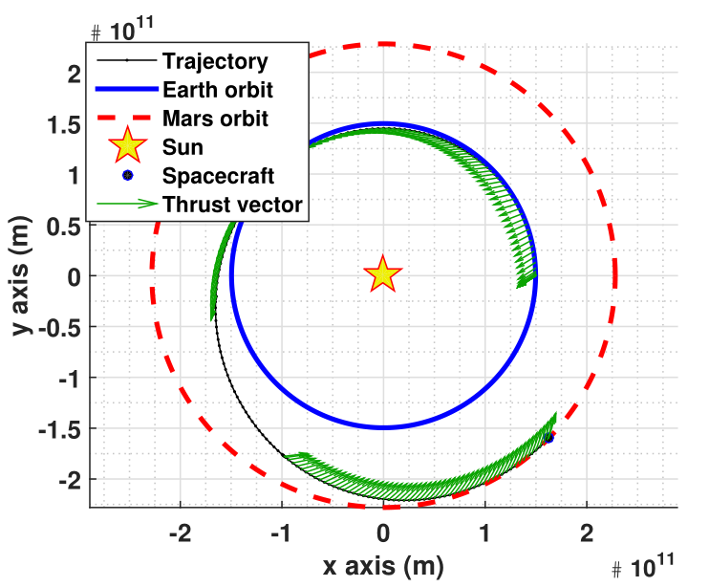
Heliocentric transfers: Fuel-optimal
1AU to 1.524AU, NEP 400 day fuel-optimal transfer 2000s Isp, 236mN thrust level (realistic values) Initial mass – 1000kg
Small retrograde thrust component seen initially

Slide 25
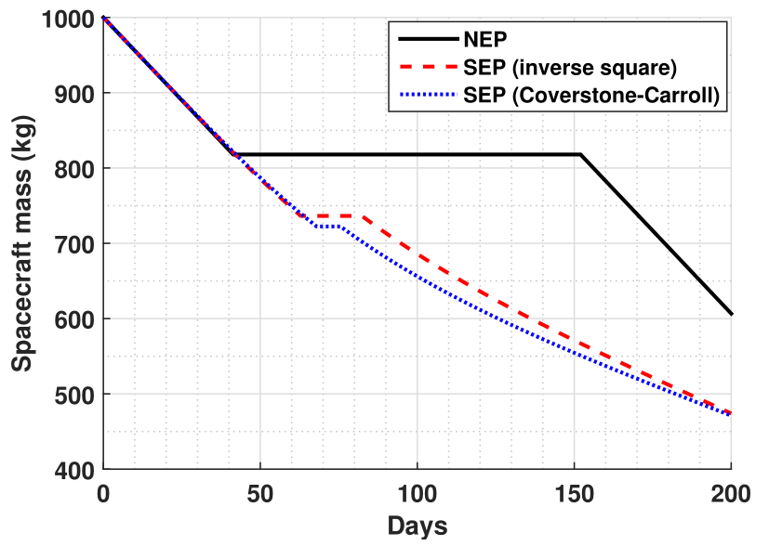
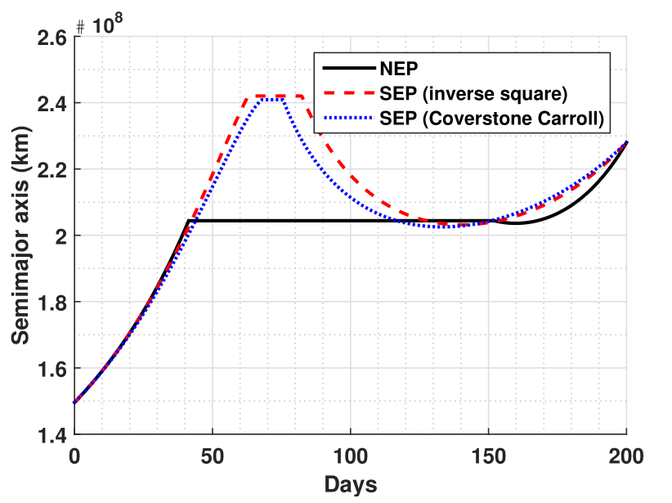
Heliocentric transfers: NEP vs SEP models
1AU to 1.524AU transfer, 2000s Isp, 1mm/s^2 initial acceleration level. Spacecraft instantaneous mass and semi-major axis profiles with varying power models. SEP models in fuel-optimal formulation show considerably lesser coast durations for outward transfers.

Slide 26
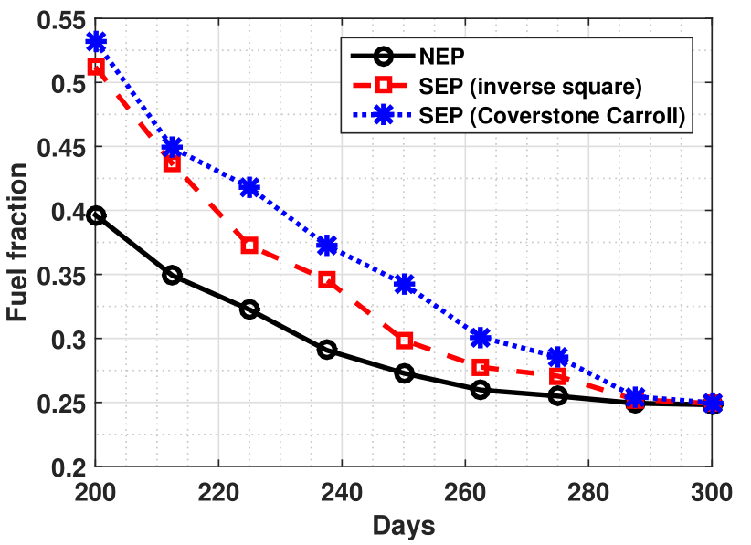
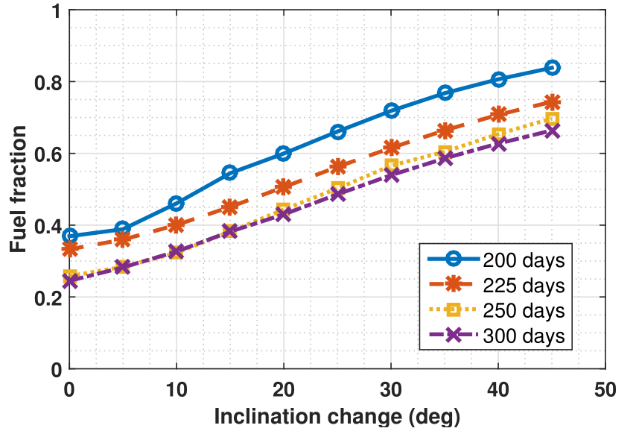
Heliocentric transfers: Parametric results
Planar results from 1AU to 1.524AU
1AU to 1.524AU with inclination change, NEP results

Slide 27
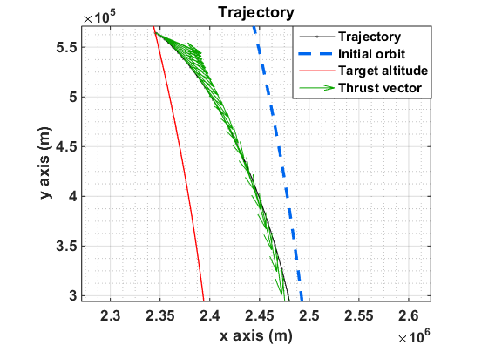
Propulsive landing: Typical trajectory (High thrust)
Typical trajectory for a Callisto lander mission
Initial orbit – 100km circular
1500kg initial mass lander
3.2kN thrust level, 312s specific impulse
(MMH-MON thrusters)
Propellant mass – 696.17kg,
Optimal descent time – 11.09 minutes
Arrows show the instantaneous optimal thrust vector direction.

Slide 28
Propulsive landing: High thrust results
Propulsive landing from 100km orbit around Callisto (A moon of Jupiter) Initial lander mass – 1500kg, 3.2kN thrust at 312s Isp.
Fuel-optimal results show reduced propellant consumption by the automatic introduction of coast phases.

Slide 29
Thank You

