Slide 1


STATEFUL DATA ANALYTICS
OVER
PROGRAMMING MODELS OF NETWORKS
Author : Gheorghe Pojoga
Supervisors : Prof. Dr. Boris Koldehofe, Bochra Boughzala

Slide 2

Networking - a way of life

Slide 3

Networking - a way of life

Slide 4

Networking - a way of life

Slide 5

Networking - a way of life

Slide 6

Networking - a way of life

Slide 7


Networking - a way of life

Slide 8

Networking - a way of life

Slide 9

Networking - a way of life

Slide 10

Networking - a way of life
Fixed Function Chip

Slide 11

Networking - a way of life
Fixed Function Chip
High performance

Slide 12

Networking - a way of life
Fixed Function Chip
High performance
Not programmable

Slide 13
Programmable Networks !

Slide 14

Programmable Networks !

Slide 15
Programmable Networks !

Slide 16

Programmable Networks !

Slide 17
Programmable Networks !

Slide 18
RMT Architecture
Programmable Networks !

Slide 19

RMT Architecture
Programmable Networks !
High performance

Slide 20
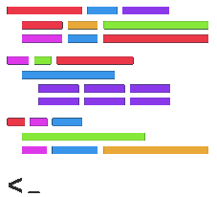
RMT Architecture
Programmable Networks !
High performance
Programmability

Slide 21

RMT Architecture
Programmable Networks !
High performance
Programmability
Prog. language

Slide 22

RMT Architecture
Programmable Networks !
High performance
Programmability
Prog. language
Compiler

Slide 23

RMT Architecture
Programmable Networks !
High performance
Programmability
Prog. language
Compiler
P4 Target

Slide 24
RMT Architecture
Programmable Networks !
Software Defined Networking
High performance
Programmability
Prog. language
Compiler
P4 Target

Slide 25
RMT Architecture
Programmable Networks !
Software Defined Networking
Data Plane
Control Plane
High performance
Programmability
Prog. language
Compiler
P4 Target

Slide 26


RMT Architecture
Programmable Networks !
Software Defined Networking
Data Plane
Control Plane
High performance
Programmability
Prog. language
Compiler
P4 Target

Slide 27





RMT Architecture
Programmable Networks !
Software Defined Networking
Data Plane
Control Plane
High performance
Programmability
Prog. language
Compiler
P4 Target

Slide 28
P4 Constraints

Slide 29



P4 Constraints

Slide 30

P4 Constraints
Floating Point Numbers
Loops

Slide 31
P4 Constraints
Floating Point Numbers
Loops

Slide 32
P4 Constraints
Floating Point Numbers
Loops

Slide 33
P4 Constraints
Floating Point Numbers
Loops

Slide 34
P4 Constraints
Floating Point Numbers
Loops

Slide 35
P4 Constraints
Floating Point Numbers
Loops

Slide 36
P4 Constraints
Floating Point Numbers
Loops

Slide 37
P4 Constraints
Floating Point Numbers
Loops

Slide 38

P4 Constraints
Floating Point Numbers
Loops

Slide 39
P4 Constraints
Floating Point Numbers
Loops
Limitations :
Constant time complexity is required
Limited amount of memory

Slide 40
Research Questions

Slide 41

Research Questions
What are the acceleration capabilities stateful data analytics inside the network ?

Slide 42

Research Questions
What are the acceleration capabilities stateful data analytics inside the network ?
What are the limitation of the in-network computing model ?

Slide 43

Research Questions
What are the acceleration capabilities stateful data analytics inside the network ?
What are the limitation of the in-network computing model ?
Is it viable to offload stateful end-host operators onto network devices ?

Slide 44
Sliding Window Average

Slide 45
Sliding Window Average
...
2
1
7
4
5

Slide 46
Sliding Window Average
...
2
1
7
4
5
...
1
7
4
5
3

Slide 47
Sliding Window Average
...
2
1
7
4
5
...
1
7
4
5
3
...
7
4
5
3
9

Slide 48
Sliding Window Average
...
2
1
7
4
5
...
1
7
4
5
3
...
7
4
5
3
9
P4-target Constraints
Division at runtime
Floating point numbers

Slide 49
Sliding Window Average
...
2
1
7
4
5
...
1
7
4
5
3
...
7
4
5
3
9
Sum = 17
Window size = 3
P4-target Constraints
Division at runtime
Floating point numbers

Slide 50
Sliding Window Average
...
2
1
7
4
5
...
1
7
4
5
3
...
7
4
5
3
9
Sum = 17
Window size = 3
...
4
5
3
9
7
Sum = Sum - 5
P4-target Constraints
Division at runtime
Floating point numbers

Slide 51
Sliding Window Average
...
2
1
7
4
5
...
1
7
4
5
3
...
7
4
5
3
9
Sum = 17
Window size = 3
...
4
5
3
9
7
Sum = Sum - 5
Sum = Sum + 7
P4-target Constraints
Division at runtime
Floating point numbers

Slide 52
Sliding Window Average
...
2
1
7
4
5
...
1
7
4
5
3
...
7
4
5
3
9
Sum = 17
Window size = 3
...
4
5
3
9
7
Sum = Sum - 5
Sum = Sum + 7
P4-target Constraints
Time Complexity : O(1)
Memory Complexity : O(n), n - the size of the window
Division at runtime
Floating point numbers

Slide 53
Median

Slide 54
Median
Constraints:
Only integers are accepted
The set of possible values must be known in advance

Slide 55
Median
Constraints:
Only integers are accepted
The set of possible values must be known in advance
1
4
5
7
9

Slide 56
Median
Constraints:
Only integers are accepted
The set of possible values must be known in advance
1
4
5
7
9
If (val < median) : Move Left
If (val == median) : Stay
If (val > median) : Move Right
1
4
5
7
9
1
4
5
7
9
1
4
5
7
9

Slide 57
Median
Constraints:
Only integers are accepted
The set of possible values must be known in advance
1
4
5
7
9
If (val < median) : Move Left
If (val == median) : Stay
If (val > median) : Move Right
1
4
5
7
9
1
4
5
7
9
1
4
5
7
9
P4-target Constraints
Nontrivial operations
Bit shift of more than 8 bits

Slide 58
Median
Constraints:
Only integers are accepted
The set of possible values must be known in advance
1
4
5
7
9
If (val < median) : Move Left
If (val == median) : Stay
If (val > median) : Move Right
1
4
5
7
9
1
4
5
7
9
1
4
5
7
9
P4-target Constraints
Time Complexity : O(1)
Memory Complexity : O(n), n - the number of possible values
Nontrivial operations
Bit shift of more than 8 bits

Slide 59
Performance Comparison

Slide 60

Performance Comparison
In-Network Computing
End-Host Computing

Slide 61
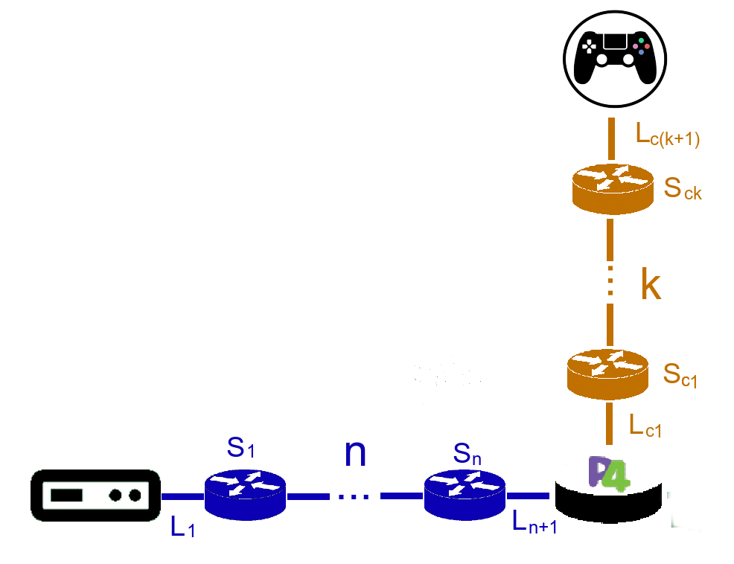
Performance Comparison
In-Network Computing
End-Host Computing
Create / Remove a flow (Latency)
P4

Slide 62
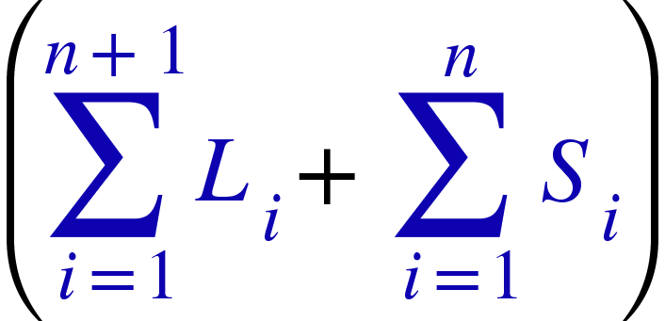
Performance Comparison
In-Network Computing
End-Host Computing
Create / Remove a flow (Latency)
P4

Slide 63
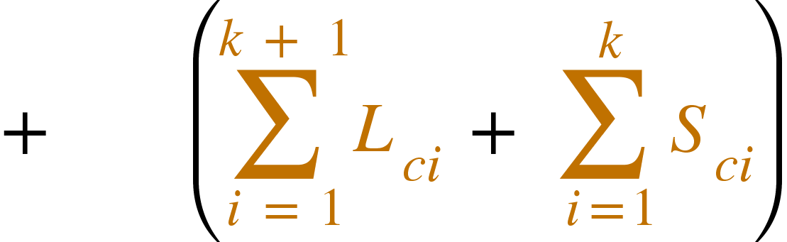
Performance Comparison
In-Network Computing
End-Host Computing
Create / Remove a flow (Latency)
P4

Slide 64
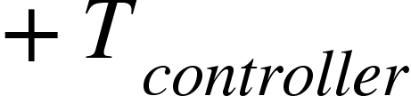
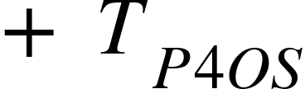
Performance Comparison
In-Network Computing
End-Host Computing
Create / Remove a flow (Latency)
P4
2

Slide 65
Performance Comparison
In-Network Computing
End-Host Computing
Create / Remove a flow (Latency)
P4
2
3

Slide 66
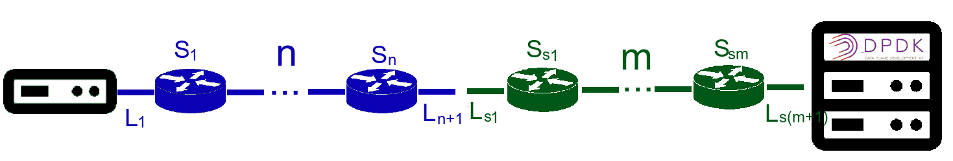
Performance Comparison
In-Network Computing
End-Host Computing
Create / Remove a flow (Latency)
P4
2
3
DPDK

Slide 67
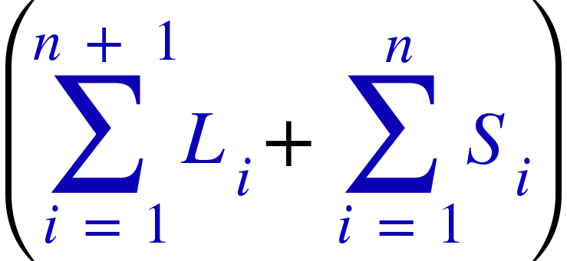
Performance Comparison
In-Network Computing
End-Host Computing
Create / Remove a flow (Latency)
P4
2
3
DPDK

Slide 68
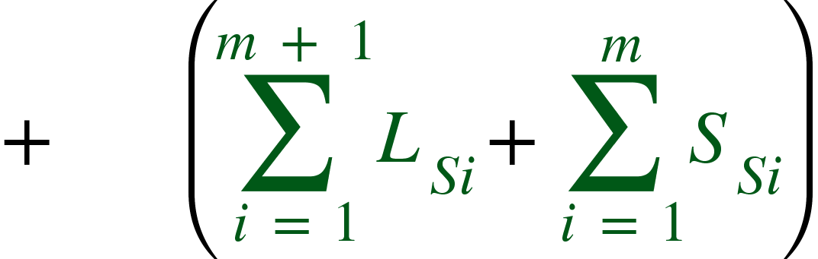
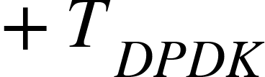
Performance Comparison
In-Network Computing
End-Host Computing
Create / Remove a flow (Latency)
P4
2
3
DPDK

Slide 69
Performance Comparison
In-Network Computing
End-Host Computing
Create / Remove a flow (Latency)
P4
2
3
DPDK
2
2

Slide 70
Performance Comparison
In-Network Computing
End-Host Computing
Create / Remove a flow (Latency)
P4
2
3
DPDK
2
2

Slide 71
Performance Comparison
In-Network Computing
End-Host Computing
Create / Remove a flow (Latency)
P4
2
3
DPDK
2
2
Process a packet (Latency)

Slide 72
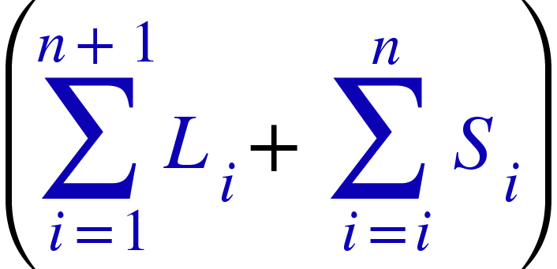
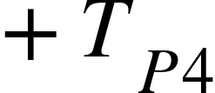
Performance Comparison
In-Network Computing
End-Host Computing
Create / Remove a flow (Latency)
P4
2
3
DPDK
2
2
Process a packet (Latency)
P4

Slide 73
Performance Comparison
In-Network Computing
End-Host Computing
Create / Remove a flow (Latency)
P4
2
3
DPDK
2
2
Process a packet (Latency)
P4
2

Slide 74
Performance Comparison
In-Network Computing
End-Host Computing
Create / Remove a flow (Latency)
P4
2
3
DPDK
2
2
Process a packet (Latency)
P4
2
DPDK

Slide 75
Performance Comparison
In-Network Computing
End-Host Computing
Create / Remove a flow (Latency)
P4
2
3
DPDK
2
2
Process a packet (Latency)
P4
2
DPDK
2
2

Slide 76
Performance Comparison
In-Network Computing
End-Host Computing
Create / Remove a flow (Latency)
P4
2
3
DPDK
2
2
Process a packet (Latency)
P4
2
DPDK
2
2

Slide 77
Conclusion

Slide 78

Conclusion
Elephant Flows : in-network computing

Slide 79

Conclusion
Elephant Flows : in-network computing
Mice Flows : end-host computing

Slide 80



Conclusion
Elephant Flows : in-network computing
P4
DPDK
Mice Flows : end-host computing
Performance
Flexibility

Slide 81
Conclusion
Elephant Flows : in-network computing
P4
DPDK
Mice Flows : end-host computing
Performance
P4 Constraints :
Flexibility
Lack of loops
Lack of support for floats
P4-Target Constraints :
Limited memory
Lack of support for non-trivial operations, such as
Multiplication
Division
Arbitrary bit shifting

Slide 82
Conclusion
Elephant Flows : in-network computing
P4
DPDK
Mice Flows : end-host computing
Performance
P4 Constraints :
Flexibility
Lack of loops
Lack of support for floats
P4-Target Constraints :
Viability depends on :
Limited memory
Lack of support for non-trivial operations, such as
Multiplication
Division
Arbitrary bit shifting
The ability of the operator to conform to the P4 and P4-target constraints
The topology of the network
The size of the flows

Slide 83


