Slide 1
ECE 3331-301
Texas Tech University
Fall 2025
Week 1
Chinedu Anijekwu
Kassav Shakya

Slide 2
Rover Mini Project
The end goal of this project is to have a functioning rover able to consistently accomplish our set parameters with accuracy and precision.
For this, code is to be written for proper PWM supply, direction control and overcurrent detection, while paying special attention to the physical circuit components.

Slide 3
Criteria
Objectives
Drive forward 1ft.
Turn ~90
Recover from forced stall.
Detect overcurrent.
Utilize 2 DC motors to drive the rover.
Use 4 GPIOs for direction input.
When stalled, cut PWM and set fault LED.

Slide 4
Assumptions
Requirements
The rover will travel on a straight, leveled surface.
The demo will take place in an indoor environment to prevent air resistance.
A 1 ft straight motion is achievable with available torque and battery capacity.
Completion of Lab Safety Training to gain access to labs.
Obtain MSP430 and L298 H-bridge, along with motors and remaining parts.
Soldering Tutorial

Slide 5
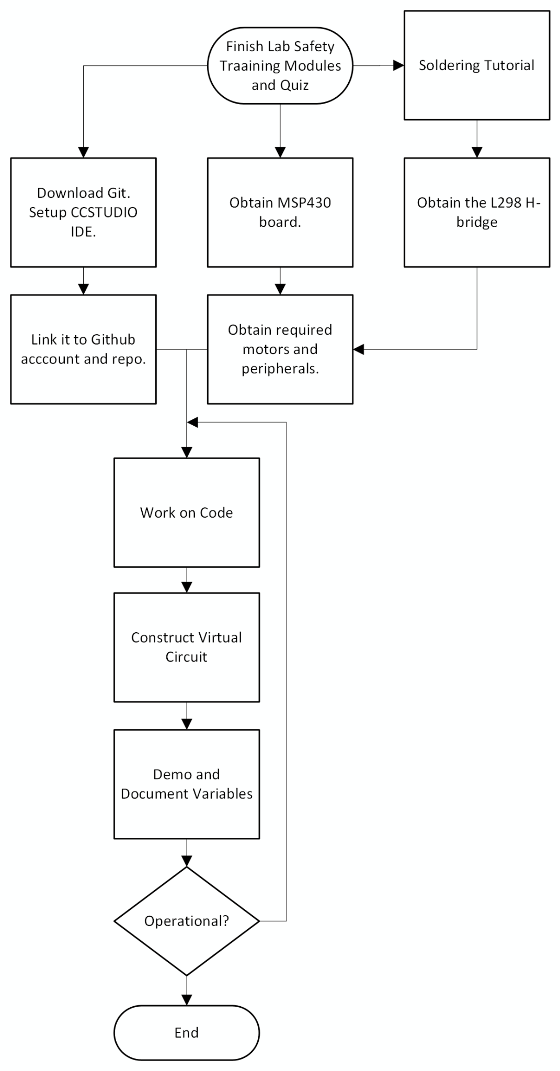
System Context

Slide 6
Choices and Trade-offs
Option | Pros | Cons | Pick
Windows vs MacOS | Better support | Worse battery life | Windows
5V vs 9V battery | Small robots | Bulkier in comparison | 5V

Slide 7
Verification Plan
Accuracy: Make use of two long rulers perpendicular to each other to make sure the rover follows a straight path and turns 90 degrees.
Recovery from forced stall: A simple test by picking the rover up, to check if it cuts off PWM.

Slide 8
BOM
The MSP430 board is to be acquired the following week.
Required peripherals shall be acquired as progress is made.

Slide 9
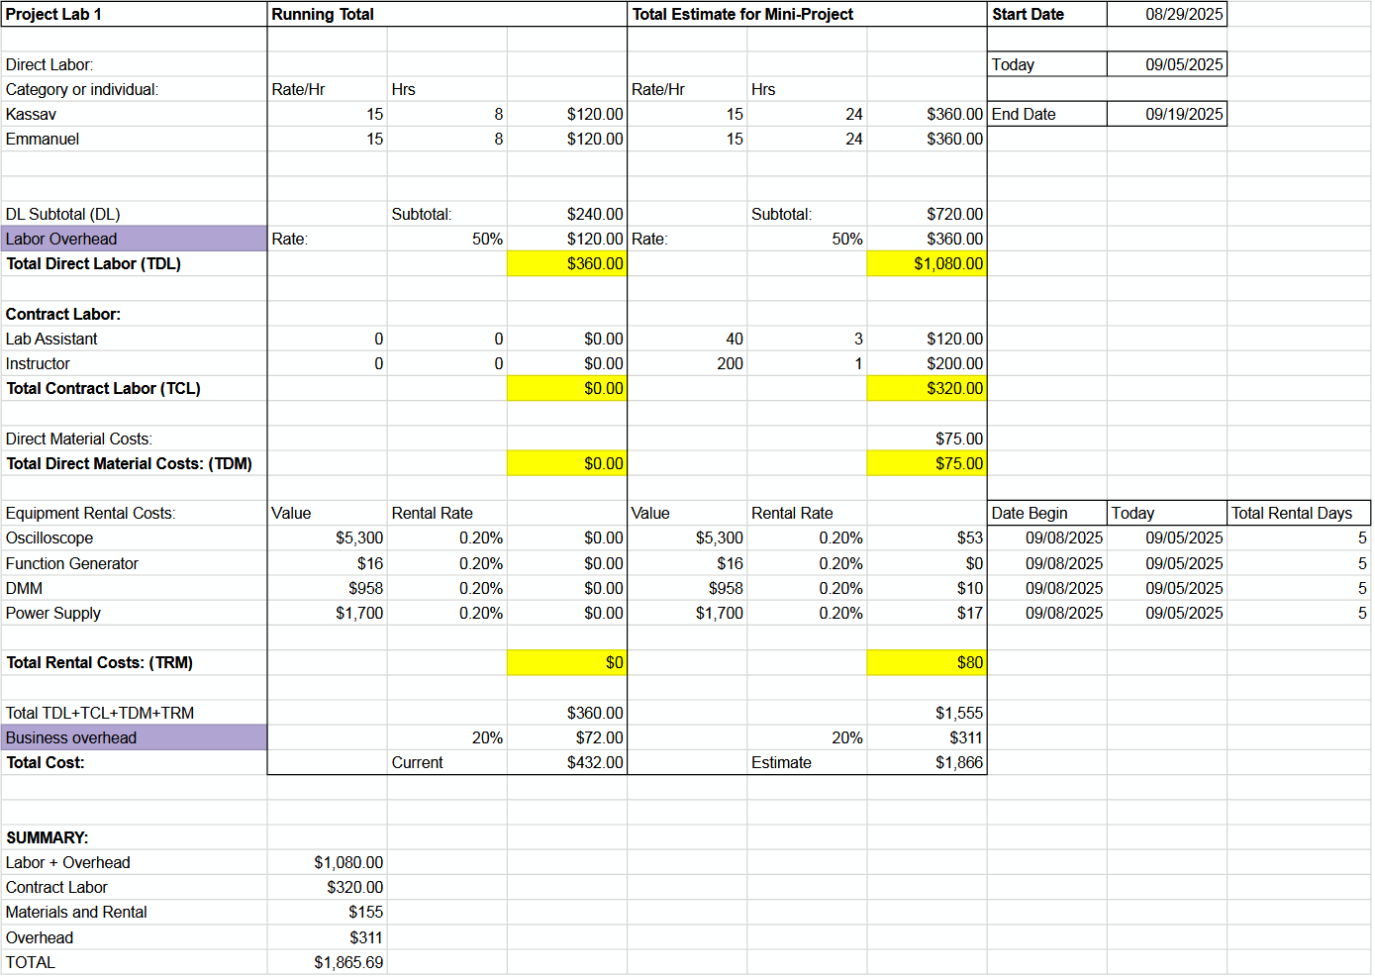
Sample Budget

Slide 10
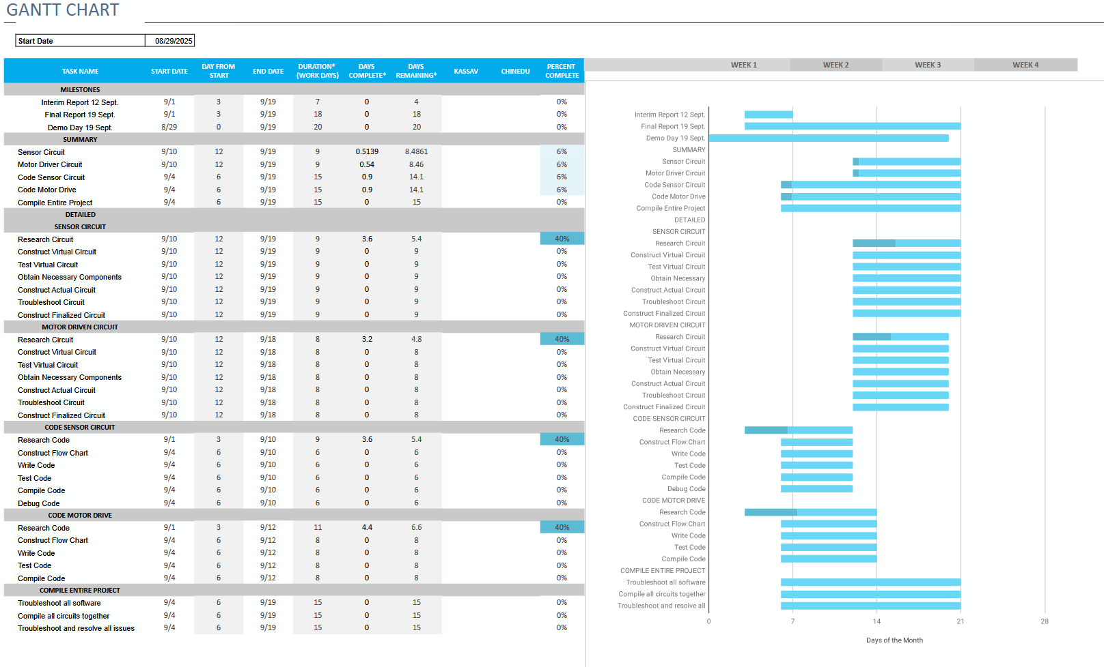
Gantt Chart

