Slide 1
Access Control for IoT devices through the Blockchain
Master Degree in Computer Science, ICT Solutions Architect curriculum
ICT Risk Assessment (a.y. 2020/21)
Giulio Purgatorio (516292)
Notes:
https://ieeexplore.ieee.org/document/8668769

Slide 2

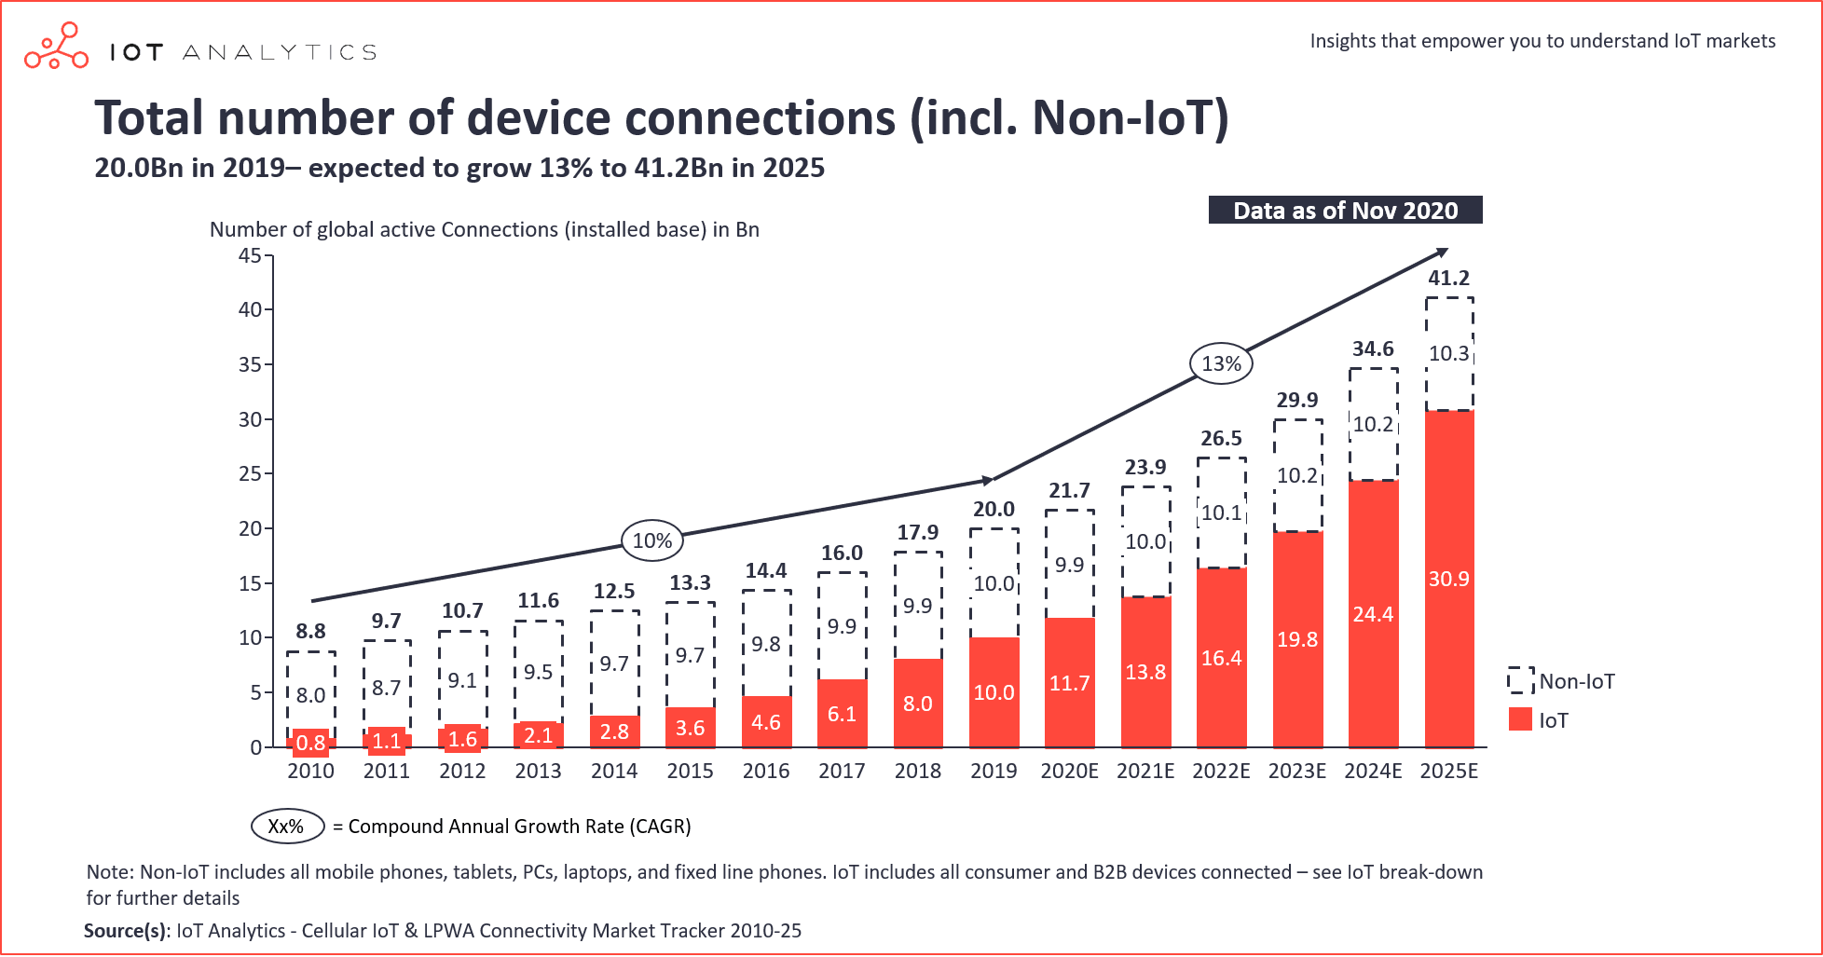
Internet of Things (IoT) is a hot topic in these last years
Used in an enormous amounts of different fields
Sharp increase in the number of device per year
New risks → new challenges!
Notes:
IoT is one of the most promising technologies in recent years and it ranges in a lot of different fields, as we can see in this picture on the right: we’re talking about smartphones, smart homes, smart lights, smart fridges, etc.
The number of devices in this field is sharply increasing and therefore has now gained attention from the security point of view: because the more a technology is used, the higher profit an attacker may gain by finding its vulnerabilities!
This time it’s a totally different environment than the typical one we are used to, and this means that there are different risks, or as we like to call them, new challenges! In the lower picture, it’s possible to see the steady predicted increase for these years: in 2010, there were mostly Non-IoT devices and just a bit of IoT ones. Then in our current year, we already have surpassed the 50:50 ratio, and this trend isn’t going to stop here.
https://iot-analytics.com/state-of-the-iot-2020-12-billion-iot-connections-surpassing-non-iot-for-the-first-time/
GP

Slide 3
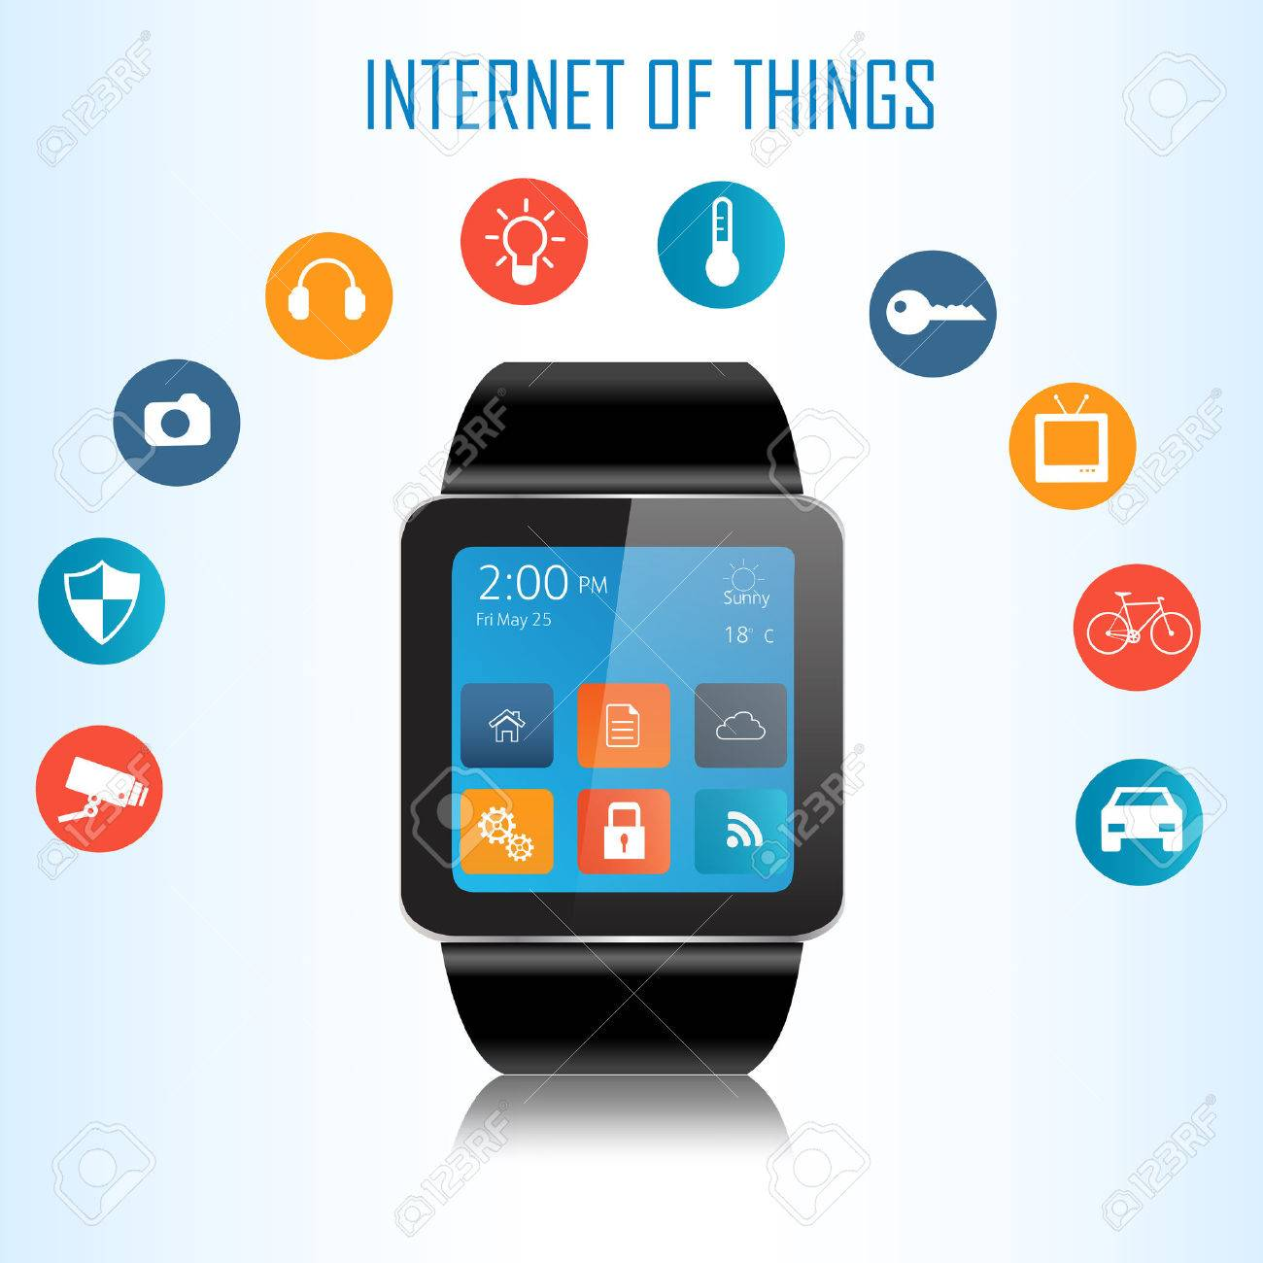

But these little devices have many constraints!
Computational power
Battery consumptions
Memory
…
IoT devices collect (and produce) sensitive data
This data is useful if, at some point, is read (and then used)
To do this, we first need to be able to access it
Data is then sent to specific systems (e.g. local applications, remote servers) that know how to handle it.
First concern: with all the different manufacturers, it’s hard to enforce a strict security control
Each competitor knows that he’s trustable, but wouldn’t (want to) trust anyone else (without a guarantee)
Goal: share the data while preventing unauthorized accesses (data leaks)
Notes:
Security in the IoT world is an afterthought. It’s already hard to create a cheap and reliable device with limited computational power, low battery consumptions, low memory usages, low overhead, that even asking for security is a tough task. The resources’ management is so strict that most IoT devices, to save power, don’t even implement a bit of encryption, or are directly exposed to the internet by opening ports from our network so that manufacturers may access them as needed (and so, this means that attackers may access them too).
What do we use these devices for? They are well known today for collecting and producing data: each piece of data, on its own, may be “useless”, but when combined with a lot of other informations coming from similar sources we may get to know personal informations that we want to stay private: think of our own heart rate measured by the simplest of nowadays smartwatch, which may reveal medical problems, or geolocalization features… if these are accessed by attackers, they will know when we’re out of our house. But this data still needs to be at some point read to be used, otherwise it’s useless: and to read it, the device has to share it, and this means having the rights to access these pieces of informations.
In the majority of cases, data is sent to specific systems, like specifically-built applications (see the ones on our smartphones) or even remote servers that then will handle it. But here comes our first concern: not everything that we may have on ourselves, our home, our car, will be from the same manufacturer (or at least, this isn’t required at all). And considering how “security” is dealt with in this environment, making every device collaborate with others coming from different manufacturers is really hard, and this means that it’s hard to enforce a strict security control. Of course, each competitor knows that he himself is trustable, but how can an organization trust another totally different one? Note that this doesn’t mean that it’s a “100% NO”, it’s just that they wouldn’t want to trust others UNLESS there’s a guarantee that things will go well.
So here we are presenting the final goal of this presentation: share this sensitive data while preventing unauthorized accesses, which leads to the well-known problem of data leaks.
GP

Slide 4
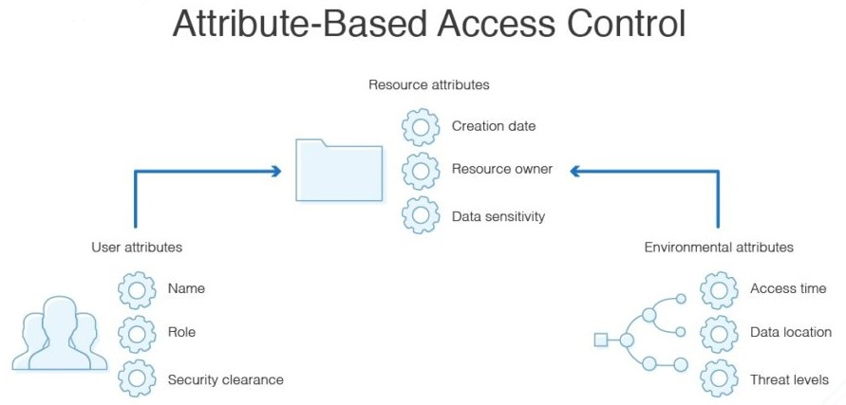
Access Authentication
Access Control is used to identify and authenticate an individual
Many models have been implemented, like:
Discretionary Access Control (DAC)
Mandatory Access Control (MAC)
Role/Rule-Based Access Control (IBAC)
We’ll use Attribute-based Access Control (ABAC)
Devices have attributes
Attribute Authorities give and revoke attributes
Actions are allowed by Access Policies, so Boolean formulas
By managing attributes, we simplify the access management
Low resource consumption
Low latency for IoT devices that require it
But this doesn’t help us with the «mutual trust» problem…
Notes:
To avoid unauthorized accesses, we’re talking about access control, which is used to identify and authenticate an individual. There are many famous models, like Discretionary Access Control, Mandatory Access Control, etc.
The one we’ll use is the Attribute-Based Access Control. The idea is simple: devices have attributes, while attribute authorities give and revoke them. Simple actions (like reading someone’s data) are allowed by access policies, which are boolean formulas over these attributes.
By managing attributes, we simplify the access management as we needed in our IoT scenario, so we’re reducing resource consumptions.
But this still doesn’t solve the “trust” problem we just spoke of.
https://www.techotopia.com/index.php/Mandatory,_Discretionary,_Role_and_Rule_Based_Access_Control
https://www.dnsstuff.com/rbac-vs-abac-access-control#what-is-abac
GP

Slide 5
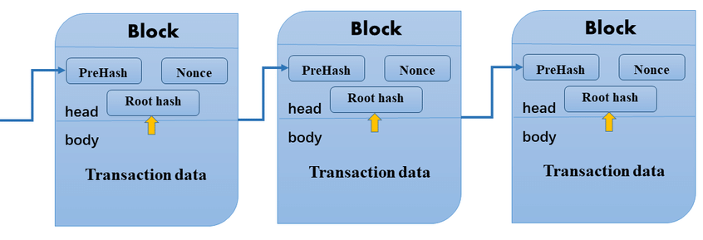
Blockchain
An append-only list of records (blocks)
Shared across many (distributed ledger)
Each block contains:
HEAD
BODY
"Impossible" (or very hard) to tamper
Consensus mechanism
It will act as the database for the attributes’ history
Notes:
That’s why we introduce blockchains. This technology is well-known nowadays due to the Bitcoin arise in recent years, but it actually offers a lot more: ranging from even different cryptocurrencies (e.g. Ethereum), to be an immutable decentralized database (e.g. BigchainDB).
Just a general view on how it works: as the name suggests, it’s a chain of blocks. It’s only possible to append at the end of this list and that’s its strength: immutability. To be more precise, it’s possible to fork it, but it’s infeasible due to the famous requirement of “the 51% of total power”.
Each block is composed of two parts, the HEAD and the BODY. The HEAD contains:
- the root hash of the Merkle tree ___ [all transactions contained in a block can be aggregated in a hash]
- the hash of the previous block (which itself accounts for the previous hash and so on), so every block is dependent on the entire blockchain history and therefore changing even one block it would be immediately apparent it had been tampered with.
- and many other things depending on the actual usage, like timestamps, Nonce, the Goal of the current Difficulty, etc.
In the BODY, instead, we find the data we’d like to save in the form of transactions: these need to be calculated through an algorithm such that it reaches a predefined objective (like a total number of consequent 0s in the final hash). Again, to put it simply and short, in the classic blockchain scenario, the first node that reaches the objective will be able to append its block to the real chain.
This technology will be our database for the attributes’ history.
https://medium.com/datadriveninvestor/what-is-a-block-in-the-blockchain-c7a420270373
GP

Slide 6
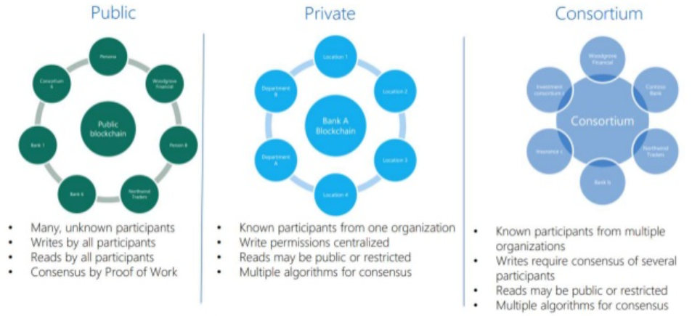
Blockchain
Public
Low trust (anonimity)
Consortium
Private
High trust (access control)
Fully decentralized
Requires no authorization to access data
Slower than alternatives
Partially decentralized
Multiple organizations
More centralized
Single organization
Notes:
Of course, blockchains then evolved in many different ways. A first classification is the triad “Public – Consortium – Private”: a generic view is shown in the picture.
Shortly, public (which is the most known one) is the fully decentralized where everyone is untrusted, anyone can access data by just consulting the blockchain and everyone may take part in the consensus mechanism, which of course we can’t choose in our scenario.
The private one is used in single organizations, when it’s needed to place restrictions on who is allowed to participate in the network and in what transactions. Even if the participation restriction would help, we need to consider that our problem requires the interaction of different organizations, so this type can’t help us, because here a single organization will look after the network.
Finally, in somewhat middle of these two, we have the consortium blockchain: it’s partially decentralized and allows for multiple organizations to be part of it: each organization will be represented by a set of preselected nodes that will handle all “its own” little ones. The consensus is calculated by these nodes only, not by devices themselves, and this will make the process lighter (making it faster, lower energy-consumptions, IoT devices are out of computational-intensive tasks, etc).
https://www.blockchain-council.org/blockchain/private-blockchain-vs-consortium-blockchain-a-comparison-guide/
GP

Slide 7
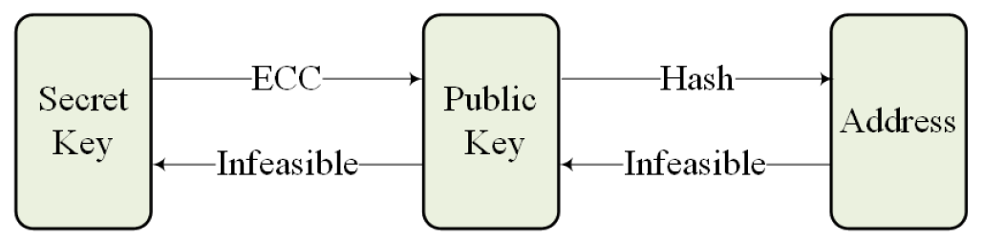
The model: Inventory
2 main entities
Attribute Authorities (Trusted)
They manage the blockchain
They share a Secret Key as the Master Private Key
They distribute attributes (through transactions)
They act as Key Generation Centers (KGC) for IoT’s registering phase
They can both read and write on the Blockchain
They agree on the same elliptic curve
ECDLP problem makes attacks infeasible
Open Design principle: the implementation is known and security relies on mathematical properties, not obscurity
IoT Devices (Untrusted)
They collect data and don’t verify transactions
Each device holds <public key, secret key>
SK acts as a certificate
With this pair, devices can mutually authenticate and find a session key
They can only read the blockchain
They verify if requesting devices can have access to their data (Attributes, Access Policies)
If not, terminate authentication
Their identity is represented by an address
"Let E be an elliptic curve over a finite field K. Suppose there are points P, Q ∈ E(K) given such that Q ∈ P, determine k such that Q = [k]P"
Notes:
So, recapping, in our model we do have two main entities: attribute authorities, which are the trusted ones, and IoT devices, which are untrusted. The first ones manage the blockchain, they share the Master Private Key (and so must be securely kept), distribute attributes (through transactions), act as Key Generation Centers for IoT’s registering phase. They can both read and write on the blockchain and must agree on the same elliptic curve, where the ECDLP (which stands for Elliptic Curve Discrete Logarithm Problem, shown below in blue) must be intractable: this satisfies the principle of Open Design, which means that we know the implementation of this scheme and it’s security relies on mathematical properties, not obscurity. They also have a personal secret key which will remain unknown to others, so that noone could forge the signature of a consortium node: aaand they know the public key of each other, so that they could verify the validity of each signature.
Devices on the other hand are considered untrusted because they may collude with each other to gain access to informations that they’re not supposed to read. In our scheme, they just need to hold their respective pair <publickey, secretkey>, because the secret key acts as a certificate of owning that specific address. As we previously said, they collect, process and share data, they do NOT verify transactions and can only read the blockchain. They will verify themselves if a device requesting to read “sensitive data” has the rights to do so, and if not they’ll just terminate the authentication. In the picture, it’s possible to see how the address is created from the Secret Key: details are in the next slide.
https://en.wikipedia.org/wiki/Master/Session
https://eprint.iacr.org/2008/099.pdf ECDLP
GP

Slide 8
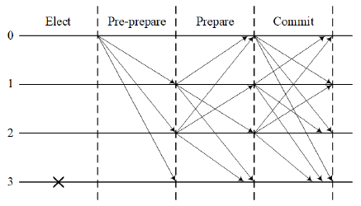
The scheme
System Initialization: {λ, E, G, PK_{m}, H₁, H₂}
λ security parameter
E elliptic curve (where ECDLP is intractable)
G is an element of E, with a large prime order r
H₁ and H₂ are two secure hash functions
PK_{m} is the Master Public Key, generated as SecretKey * G
Registration
AA -- <pub, pvt> → device (on a secure channel)
Address Creation (to apply for attribute i)
Address = Base58Check[H₂(PK_{i}||ID)]
Attribute Request
Transaction form: AA -- i → Address
Signed with Sig_{SK}[H₁(AA -- i -> Address||timestamp)]
Attribute Revocation:
Transaction form: AA <- i -- Address
It allows for dynamicity in the system
It also allows the Least-Privilege principle
Reaching a consensus
Notes:
So, the scheme constructs like this.
The system initialization algorithm takes in the security parameter lambda as input and outputs the global parameters for the system. The whole system will then agree on the same elliptic curve E, in which the ECDLP is intractable. G is an element of E with a large prime order, while H1 and H2 are two secure hash functions to map arbitrary bit string sizes into fixed ones. As we said, all attribute authorities share a Secret Key and keep it as the master private key: therefore it’s possible to create the corresponding master public key PK as SecretKey*G. These system parameters are then published as the shown tuple.
Registration: Each device must have an Identity in the system: in the registration phase, the attribute authority which the device belongs to will issue a pair of public and secret key to it in a secure channel upon verification of its identity.
Address Creation: To apply for an attribute i, each device generates an address by randomly choosing a secret key [depending on the large prime order r] that once multiplied to G (the known element of E with a large prime order) results in the public key PK for that specific attribute i. Then the address, will simply be the Base58Check encodinng of the hash of the concatenation of PKi||ID, as shown.
Attribute Request: Each attribute authority has its own pair of public and secret key. The public key is used to generate its own address AA, used in the first bullet point, and the secret key is used to sign transactions, as it’s shown in the second one. Attribute authorities, after controlling if the interacting device should be able to possess an attribute i, will generate a transaction of.. their own Address, (the given) attribute, and timestamp: all of this will be then hashed and signed through its Secret Key. Finally, the attribute authority will put all this into its own transaction pool. Consortium nodes will then periodically elect a block maker, who will broadcast its transaction pool to other consortium nodes for reaching a consensus. This way, every consortium node will verify the validity of the new block (which, in the picture, is the pre-prepare phase) and broadcast it in the same way. Once receiving the same block over and over, they will start broadcasting acknowledgment messages to others (in the prepare phase): when even these are broadcasted, the new block will be appended into the blockchain and repeat the process.
Revocation: attribute distributions should be dynamic and scalable for enforcing correct access control, so the system must be able to timely revoke expired attributes. To revoke an attribute, a new transaction with the “reverse form” of the arrow (as shown) is sufficient and will be treated as a regular transaction. This allows satisfying the Least-Privilege principle, because in this way we may prevent devices to have useless attributes that may lead to vulnerabilities.
https://en.bitcoin.it/wiki/Base58Check_encoding
GP

Slide 9
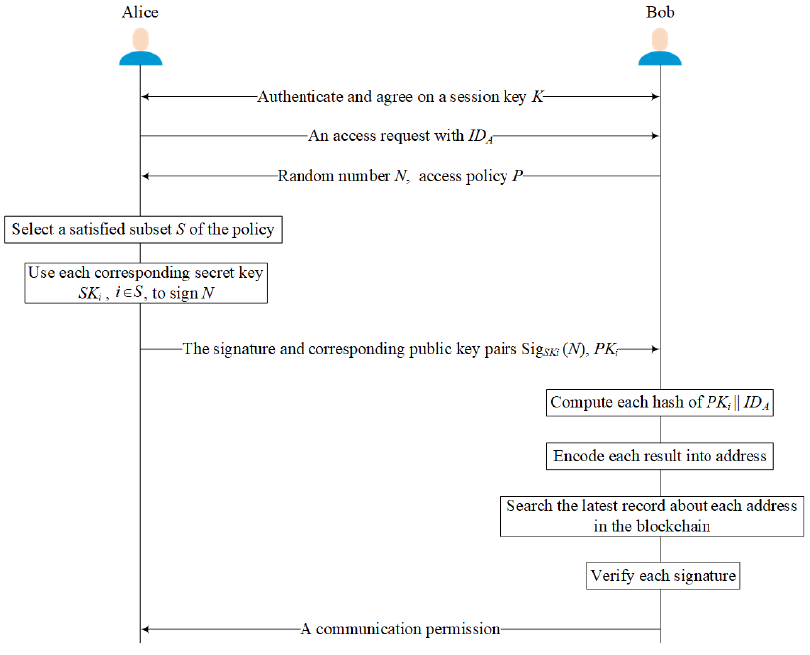
Access Control example
Notes:
A simple execution of the access control protocol is presented in the picture. Alice and Bob agree on a session key (K) [through a standard protocol… identity-based authentication and key agreement] and so communications are now secure. Then the conversation’s starter (Alice) will send it’s own ID [ID_{A}] to Bob. He’ll generate a random number (N) and send it back with its own access policy (P), which indicates who can communicate with him. Alice then picks a subset of her attributes (S) such that it satisfies the received policy, and uses each secret key whose corresponding address has been issued the matched attribute (i) to sign the random number (N). Then Alice returns Bob the satisfied subset of attributes through the pair “signature” and “public key” of “i” (Sig_{SKi}(N), PK_{i}). Bob encodes the hash of PKi||IDA to get the corresponding address [by Base58Check], then searches the blockchain to find out the latest related record about it. If this address contains the claimed attribute i, Bob uses the public key (PKi) to verify the signature by controlling if the given random number was correctly signed. If so, it demonstrates that Alice really possesses this address and the attribute. Once Bob is done doing this for all attributes, if they satisfy its own access policy, Bob will allow Alice’s request to access her data.
GP

Slide 10
Security Analysis
Access Policies for Sensitive data
[Confidentiality] Solve our authentication goal by defining the correct behavior of all users.
Devices have their own policies and they will verify themselves if these are satisfied
If they are, confidentiality is preserved as intended
If not, terminate the connection (Default Deny)
Attributes
[Integrity] Attributes are stored in the blockchain, which is secure by default
Consortium (and private) blockchains can actually be tampered, but the ECDLP problem makes this infeasible
[Availability] The Database is stored in the blockchain, which is shared across multiple organization
Everyone has its own copy of the blockchain
So no single authority can avoid the information’s sharing to others for their own purposes
Notes:
Now that we know how the protocol works, we may start talking about security. The first thing we should check is: is the CIA satisfied (where needed)? (CIA is an acronym standing for Confidentiality, Integrity and Availability). First of all, we’re trying to defend our “sensitive data”, which implies that we’re referring to Confidentiality. Access policies solve our authentication goal by defining the correct behavior of all users: if this behavior isn’t satisfied, the scheme follows a Default Deny and terminates the authentication. About Integrity and Availability, it all depends on the IoT device itself and isn’t related to the protocol.
Inversely, about Attributes, we may see that we can refer to both Integrity and Availability. Integrity because attributes can’t be modified that easily due to the nature of blockchain.
Availability too, because again the blockchain is a shared ledger and so anyone can access its own copy, without needing to “ask” it to others.
GP

Slide 11
Attribute Authorities
Security requirements hold as long as the AA’s Secret Key or the Master Private Key are not known.
The Master Private Key is shared across all Attribute Authorities, so even one leak would have an enormous impact
The model doesn’t specify a way to store them
That’s why we may use any of the current methods that rely on external devices.
HSM, Smart cards, PDA, Cell Phones, Key Disks, …
Using HSM for example, the key never leaves the device, which limits the damage with compromised hosts
Making an Attribute Authority node a Byzantine node is tolerated
As long as there are at most (n-1) / 3 Byzantine nodes: with this restriction, consensus of attribute distribution can be reached
The «sure» attacker’s gain is ONLY to be able to manage the blockchain, which doesn’t contain any sensitive data.
The attacker can read the blockchain, but so can any device
The attacker can’t simply write on the blockchain, due to consensus mechanism, leader election, etc.
The attacker may delete the local copy of the blockchain, but it’s shared so retrieving a copy isn’t hard
The secret key (if not on the compromised node) can’t be recalculated by knowing G for the ECDLP
It can be used to register other malicious devices!
RAFT (or other consensus algorithms like PBFT) may be used to replace PoW
More efficient (lower energy, faster)
It also allows the recovery of Byzantine nodes [RAFT: 2n+1] (avoid escalation!)
«Compromise AA not → compromise key»
Notes:
Then we may speak about security concerns on the Attribute Authorities side. They have two types of secret keys: the Master Private Key (which is shared across all Attribute authorities), so a leak on this would have an enormous impact, and the Secret Key used to sign transactions: a leak on this would mean that it’d be possible to sign malicious transactions, therefore enabling attributes on malicious devices. This has quite a decent impact, and it’s lowered only because of the consensus mechanism and the fact that only one block maker is elected at a time, preventing unlimited direct writes. The model doesn’t specify a way to store these important keys, therefore I suggest relying on external devices so that if the attacker is successful in compromising the node, he won’t compromise keys aswell. Possible solutions are listed and I’ve chosen the HSM, because the key never leaves the device and therefore enforces our need for isolation with the compromised host. The general mantra states that if the attacker is able to compromise a node, it shouldn’t be allowed to compromise keys as well in one shot!
But what happens if an Attribute Authority becomes a Byzantine node? It’s tolerated, as long as there are at most n -1 / 3 malicious nodes: this allows the reaching of attributes distribution consensus. But let’s see what the attacker actually gains once taking control of one of these nodes. He could read the blockchain, but it’d be some kind of a waste, because any IoT device can read it aswell and they’re relatively simpler to attack. They can’t directly write on it, due to the consensus mechanism, leader election, etc. If the attacker deletes the local copy, it can be easily retrieved because it’s a shared ledger. The secret key is still safe from being recalculated even when knowing G because of the ECDLP. The worst downside is the possibility to register other malicious devices, therefore a solution could be to store in a secure way a list of devices and their timestamps so that we could confront it with the “time of the attack”: some sort of Logging, as usual, always helps.
A final note on this is the consensus algorithm used, which can be changed from the standard Proof of Work to a more efficient RAFT or PBFT which also allows for the recovery of Byzantine nodes: in the RAFT example, it requires twice+1 the number of malicious nodes to recover, but this is needed because most attacks rely on escalation (so controlling more and more resources over time).
https://rangeshsripathi.com/2017/11/20/what-is-byzantine-node/
https://medium.com/coinmonks/detail-analysis-of-raft-its-implementation-in-hyperledger-fabric-d269367a79c0 Raft
https://www.researchgate.net/publication/2516268_Practical_Byzantine_Fault_Tolerance/link/575a8f9c08ae9a9c955165f9/download PBFT
GP

Slide 12
IoT Devices
Security requirements hold as long as the private key is not known (again).
What happens if a device is successfully attacked?
Attacker gains the device’s sensitive data (limited damage)
Attacker may gain other informations by requesting access to other devices (if attributes let him)
With the attributes’ dynamicity (revoking), the Least-Privilege principle ensures a lower impact
The model doesn’t specify how to recover these nodes once attacked
Just restarting the whole process would be enough
But obviously this doesn’t patch the vulnerability that was used, so it may reoccur.
But how can the attack actually go off?
Not by the model we’re defining, it’s a default deny with mathematical properties
Either abuse HW/SW bugs in the IoT device itself (which isn’t related to the protocol)…
… or have physical access to the device (again, not protocol-inherent)
The usual problem: having physical access to the machine makes it «impossible» to defend it
Notes:
On the Device side, we do have again the private key constraint of course (as any time we’re talking about any secret key). But what happens if the device is successfully attacked? First of all, the device was (and is) producing sensitive data and that one will be leaked. The good thing is that the amount of leaked data is usually limited, therefore also the damage is: remember that the real power in IoT comes from combining many informations’ resources! But if the device had enough attributes to ask to other devices for more data, the impact would increase dramatically! That’s why we defined earlier the attribute revoking, so that devices have the minimum set of attributes they needed to prevent this type of leaks.
However, the model doesn’t specify how to recover these nodes once attacked: a simple way would be to restart the process from the registering phase, but of course this isn’t patching any vulnerability that was used in the first place, making it possible to reoccur.
Anyway, we must note that the attack can’t go off by exploiting the protocol, because it’s a default deny with mathematical properties: therefore only the usual attacks, like exploiting bugs in the device itself or having physical access to it are the ways to go. We’ll see this more in depth in the next slide.
GP

Slide 13

Security Analysis
Common Attacks Analysis
Collusion Resistant
Bob policy: X ∧ (Y ∨ Z)
Alice has X, Eve has Y and colludes with Alice
Address = Base58Check[H₂(PK_{i}||ID_{A})]
Base58Check[H₂(PK_{Y}||ID_{A})] ≠ Base58Check[H₂(PK_{Y}||ID_{E})]
Impersonation Resistant
Bob wants to access Cindy’s data
Bob doesn’t have the needed set of attributes
Alice has that set and wants to access Bob’s data
Cindy can detect that Base58Check[H₂(PK||ID_{B})] has not been granted corresponding attributes
Notes:
Some common attacks will now be analyzed.
First, to endure correct access control, the scheme must be collusion resistant. Sometimes devices may collude with each other, driven by interests, attempting authentications with others for valuable data when they aren’t supposed to receive it: so they collude and together they have the right set of attributes. Suppose for example that Bob has a specified access policy X and (Y or Z), so only X and Y or X and Z can communicate with him. Imagine also that Alice has X and Eve has Y and they collude with each other: this means they now do have enough attributes to allow the (malicious) communication. How can Bob distinguish who submitted all attributes? In our scheme, to get the address of the claimed attribute i, Bob needs to hash the corresponding public key submitted by Alice together with Alice’s ID [IDA] and encode the result as shown in blue. Although Eve may give Alice his attribute Y, the difference in ID can’t be changed. So Bob will detect that the address on the left for attribute Y is not equal to the attribute submitted by Alice which is the one on the right (owned by Eve). In this case, Bob can just terminate the authentication and thus the control scheme is collusion resistant.
Impersonation Resistant: In our scheme, digital signature is a credible evidence to prove identity. As the digital signature is produced by the secret key that only the specific node should know, it’s obvious to believe that whoever has it will be thought to be who they claim to be. So, what if a malicious user intercepts a signature? In our scheme, it’d be useless in a new round because of the new randomly generated number N that needs to be signed, which will be different every time. Without the actual secret key, replaying signatures (even when correctly signed in the past), receivers can easily detect that the random number differs from the one they expected. Here’s an example: suppose we have Alice, Bob and Cindy. Bob wants to access Cindy’s data but doesn’t have the needed set of attributes; at the same time, Alice wants to access Bob’s data and she does have the right set of attributes needed by Bob. If Bob changes its access policy to match Cindy’s one and replays also the random number N given by Cindy, Alice will of course be able to respond. At this point, though, Bob can’t simply re-send the received message to Cindy, because by hashing and encoding PK||IDB Cindy would see that Bob has not the corresponding attributes. Therefore, the scheme is also impersonation resistant.
GP

Slide 14
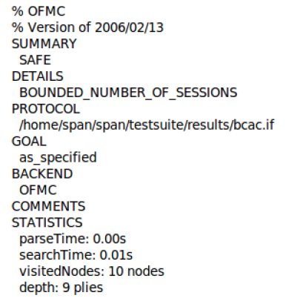
Security Analysis
Simulation
AVISPA
Specifying the protocol in High Level Protocol Specification Language
Automatically translate it into Intermediate Format
IF can be read by one of the AVISPA’s tools
in this case, the On-The-Fly Model Checker (OFMC) was used
Assumption: Dolev-Yao model
Results
Resistant to various attacks, e.g. man-in-the-middle attack, …
Notes:
From a more practical view, there’s a simulation done on AVISPA. To do so, it’s needed to first specify the protocol in High Level Protocol Specification Language that will be automatically translated into the Intermediate Format, which can be read by AVISPA tools. Then, the chosen AVISPA tool will output an analysis result based on whether the security goals are satisfied or violated. This specific simulation was done using the OFMC with an assumption such that the intruder model is a Dolev-Yao one, so he could take full control over the network (every message passes through him, he may analyze them, even modify them, send them to whoever he wants to, etc).
The analysis shows how the scheme could withstand various attacks, as the previously discussed ones (e.g. impersonation attacks), but even man-in-the-middle attacks, and so on.
http://www.avispa-project.org/
GP

Slide 15
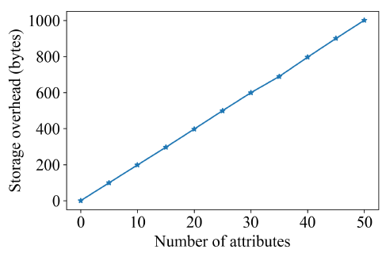
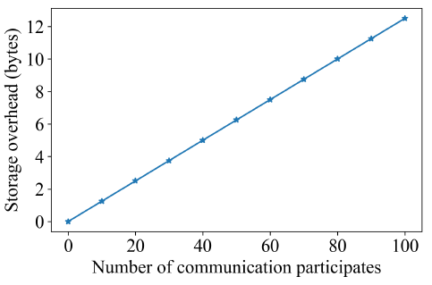
Performance Analysis
Storage
On access policies
Global parameters
Security Parameter, Elliptic curve, Hash functions, Master’s public key of AA, Secret key pair of the device
Fixed after system initialization
Sizes are obviously acceptable
Access policies
Linear in the number of attributes
Enumerating each attribute as a number helps due to space compression
50 attributes, less than one Kylobyte
Session keys
Linear to the number of communication participants
Cost almost negligible (100 participants, 12 bytes)
On session keys
Notes:
The last step is to see if this scheme is actually doable in the resource-constrained scenario we depicted at the beginning. About storage, there are three main kinds of additional data that needs to be stored locally for each device.
Global parameters, because all entities must share the same set ___ [security parameter, same elliptic curve, hash functions, Master’s public key, secret key pair of the device]. Of course these are fixed after system initialization and sizes are obviously acceptable.
Access policies sizes are linear to the number of attributes. We can see easily that even with 50 attributes, the size of the policy is just less than 1 Kilobyte: this is achieved by enumerating univoquely each attribute as a number, to compress space, so that each digit occupies only 1 byte. Therefore, even this is acceptable.
Finally, session keys: each pair of participants need to first authenticate each other and agree on a session key used for subsequent communications. Simply specifying an expiration time is enough to avoid congestion, and session key can be generated by any standard protocol ___ [Identity-Based authentication and key agreement protocol. For example, identity-based cryptographic algorithm and then AES-128 to ensure subsequent communications]. The storage overhead of session keys is linear to the number of communication participants and almost negligible in our scheme, getting at 100 participants up to 12 bytes.
GP

Slide 16
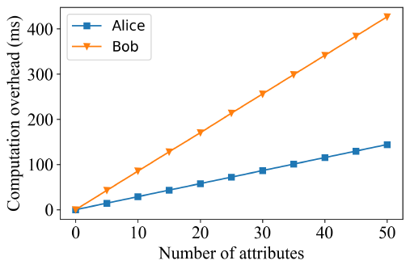
Performance Analysis
Overhead
For Alice: signing the random_number is the major computation overhead
Each SK -> one attribute of access policy
Bob has to:
Verify signatures provided by Alice
Hash each PK||ID_{A}
Both computation’s overheads are linear in the number of attributes (owned by Alice)
What if a malicious node spams requests? (DDOS-like)
Attributes should be a subset of the requested ones, otherwise just ignored at the beginning
Once it’s proved that a device doesn’t have an attribute, all others can be ignored and terminate the communication
Furthermore, we could remember (or better, signal) these devices that attempt to attack and prevent them by a timeout, etc.
A quality C++ implementation of ellipctic curve digital signature algorithm (ECDSA) typically spends 2.87ms to compute a NIST256P signature and 6.34ms to verify it: a total of 9.21ms.
Notes:
A final performance to take care of is the actual computation overhead, because in the IoT-scenario there are devices that absolutely need to be as fast as possible. We saw that using each proper secret key to sign the random number selected by Bob contributes to the major computation overhead of Alice. Each secret key is corresponding to an attribute matching the access policy of Bob: hence, as the number of attributes increases, so does the computation overhead and it’s linear to the number of attributes.
On the Bob’s side, he has both to: verify signatures provided by Alice and to hash each corresponding public key along with the Alice’s ID to get each address that has been issued the satisfied attribute. So Bob’s cost is also linear to the number of attributes owned by Alice and matches the access policy at the same time. In terms of numbers, a quality C++ implementation of this spends nearly 10 milliseconds, which is suitable in IoT scenarios.
If Alice, who starts the communication, tries to spam requests in a DDOS-fashion, it’d have a limited impact because attributes would have to be calculated from Alice’s side and then be ignored after the first incorrect one, terminating authentication immediately. Furthermore, we could remember (or better, signal, due to the memory constraints) these compromised devices.
https://www.example-code.com/cpp/ecdsa_sign_data.asp
GP

Slide 17
Conclusions
Recap
Future works
A novel attribute-based access control scheme using blockchain technology to improve the access management for resource-constrained devices in IoT.
IoT devices do not take part of the consensus process
Each organization has guarantees over one another
Lightweight protocol
The scaling is linear. This means that with very high number of attributes, this system won’t hold.
Specifying a consistent definition of the attributes across domains could increase complexity on policy management as the number of devices grows
Notes:
So, recapping, we proposed a novel attribute-based access control scheme using the blockchain technology to improve the access management for resource-constrained devices in IoT. Each organization can “trust” others by the use of the blockchain and devices do not need to use their limited resources to be part of it, making it a lightweight protocol.
Future works or limitations may be that the scaling, as we stated, is linear: with a very high number of attributes, this protocol wouldn’t hold. And finally, specifying a consistent definition of attributes across domains could increase complexity on policy management as the number of devices grows.
GP

Slide 18


