Slide 1

Huanchen Zhang Hyeontaek Lim, Viktor Leis, David G. Andersen Michael Kaminsky, Kimberly Keeton, Andrew Pavlo
SuRF: Practical Range Query Filtering with Fast Succinct Tries
Huanchen Zhang
Hyeontaek Lim, Viktor Leis, David G. Andersen Michael Kaminsky,
Kimberly Keeton, Andrew Pavlo

Slide 2


01
INTRODUCTION
CONTENTS
02
SUCCINCT RANGE FILTERS
03
FAST SUCCINCT TRIES
04
SuRF EVALUATION

Slide 3

01
INTRODUCTION

Slide 4
one
INTRODUCTION
Item retrieval in DBMS may incur multiple expensive disk I/Os. filters are a good match for this question because they are small enough to reside in memory.
Notes:
bloomfilter索引对于判断某个key是否存在是非常高效的，其能用极少的空间（与key长度无关），极低的出错概率判断key的存在性。
比如在RocksDB 里面，为了加速 key 查询的速度，使用了 Bloom filter，但 Bloom filter 只适用于 point get，

Slide 5
one
INTRODUCTION
Existing filters only support point filtering.
A student table in RocksDB
Is there anyone who is 18 in the table?
Eg: Bloom filters speed up point queries in RocksDB
Is there anyone between 22 and 25 in the table??
? ?

Slide 6
one
INTRODUCTION
This paper presents the Succinct Range Filter (SuRF), a fast and compact filter that provides exact-match filtering, and range filtering.

Slide 7
02
SUCCINCT RANGE FILTERS

Slide 8
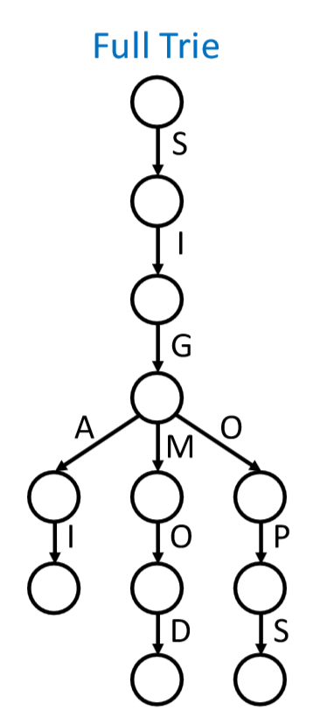


two
SUCCINCT RANGE FILTERS
Starting point: a complete trie stores complete keys
No FPR(False Positive Rate)
TOO BIG

Slide 9
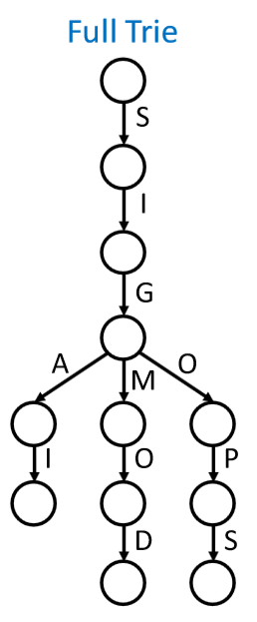
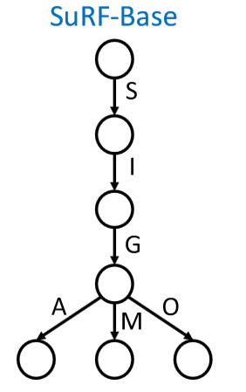

two
SUCCINCT RANGE FILTERS
Make it smaller: a truncated trie
SIGMOD
SIGMETRICS

Slide 10
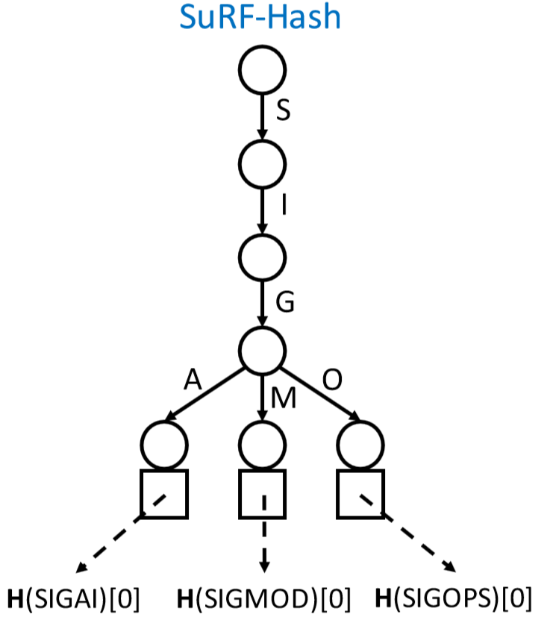
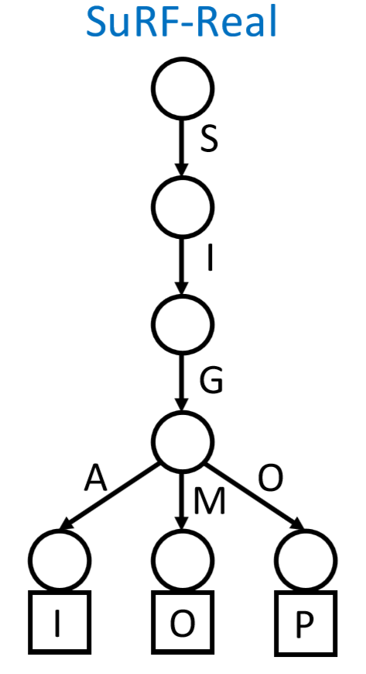


two
SUCCINCT RANGE FILTERS
SIGMOD
SIGMETRICS
Benefit point & range queries
Each bit reduces FPR by half
Weaker distinguishability
Cannot help range queries

Slide 11
two
SUCCINCT RANGE FILTERS
SuRF with Mixed KeySuffixes
Includes a combination of hashed and real key suffix bits
The lengths for both suffix types are configurable. SuRF-Mixed provides the full tuning spectrum(SuRF Hash and SuRF-Real are the two extremes) for mixed point and range query workloads.

Slide 12
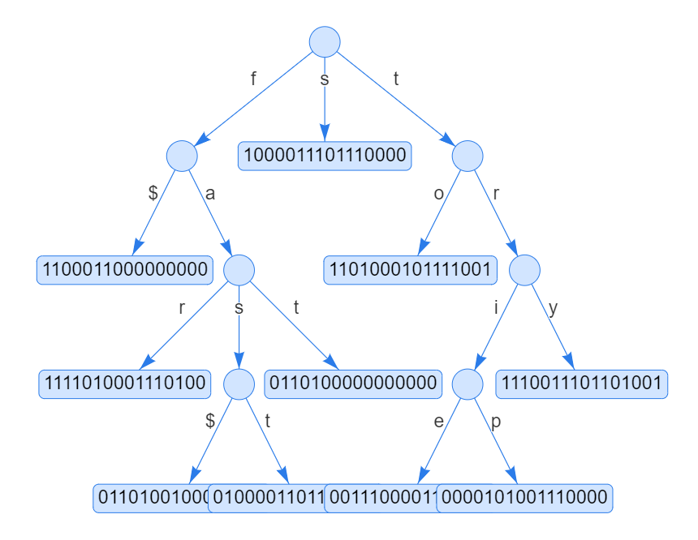
two
SUCCINCT RANGE FILTERS
Example of SuRF with Mixed KeySuffixes
f
farther
fas
fasten
fat
splice
toy
tries
tripper
trying

Slide 13
03
FAST SUCCINCT TRIES

Slide 14
three
FAST SUCCINCT TRIES
FST’s design is based on the Level-Ordered Unary Degree Sequence(LOUDS),
encoding rules of LOUDS:
Starting from the root nodes, it traverses a tree in breadth-first order
When seeing a node having n children (n > 0), n “1”s and one ” 0” are emitted

Slide 15
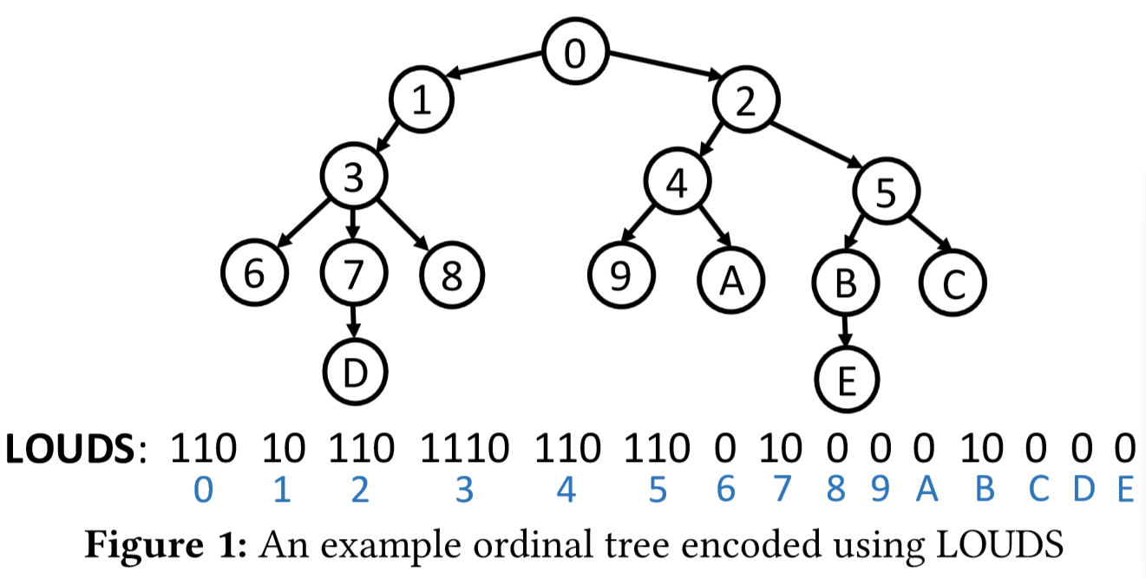
three
FAST SUCCINCT TRIES

Slide 16
three
FAST SUCCINCT TRIES
Operators:
rank₁(i) : count the number of 1’s up to position i
rank₀(i) : count the number of 0’s up to position i
select₁(i) : return the position of the i-th 1
select₀(i) : return the position of the i-th 0

Slide 17
three
FAST SUCCINCT TRIES
pos(i) | 0 | 1 | 2 | 3 | 4 | 5 | 6 | 7 | 8 | 9 | 10 | 11 | 12 | …
value | 1 | 1 | 0 | 1 | 0 | 1 | 1 | 0 | 1 | 1 | 1 | 0 | 1
rank₁(i) | 1 | 2 | 2 | 3 | 3 | 4 | 5 | 5 | 6 | 7 | 8 | 8 | 9
rank₀(i) | 0 | 0 | 1 | 1 | 2 | 2 | 2 | 3 | 3 | 3 | 3 | 4 | 4
select₁(i) | 0 | 1 |  | 3 |  | 5 | 6 |  | 8 | 9 | 10 |  | 12
select₀(i) |  |  | 2 |  | 4 |  |  | 7 |  |  |  | 11

Slide 18
three
FAST SUCCINCT TRIES
Tree navigation:
对任何一个位置，开始位置到该点之间的bit 0出现的个数表示该点前面有多少个节点。
对任何一个位置，开始位置到该点之间的bit 1出现的个数表示该点前面的节点加上其直接孩子的节点数目。
Position of the i-th node
select₀(i) + 1
Position of the k-th child of the node started at p select₀(rank₁(p +k)) +1
Eg : for node4
position: select₀(4) + 1 = 12
position of its child
rank₁(12) = 9
select₀(9) +1 = 22
Notes:
对任何一个位置，开始到该点之间的bit 0出现的个数表示前面有多少个节点。
对任何一个位置，开始到该点之间的bit 1出现的个数表示前面的节点加上其直接孩子的节点。

Slide 19
three
FAST SUCCINCT TRIES
Tree navigation:
Position of the parent of the node started at p
select₁( rank₀(p) )
Eg : for node9(its position is 22)
rank₀(22) = 9
select₁(9) = 12

Slide 20
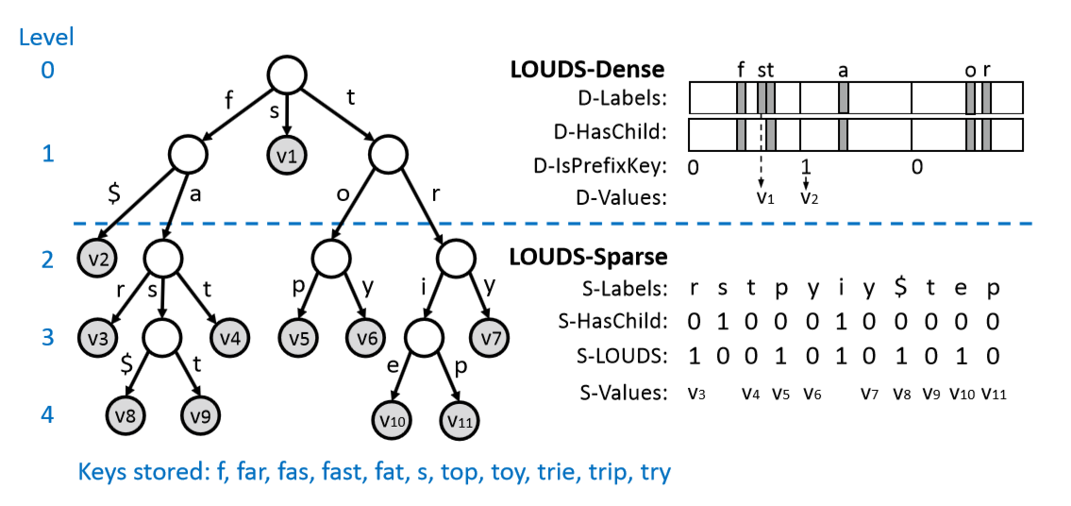
three
FAST SUCCINCT TRIES
LOUDS-DS Encoded Trie
Notes:
基于LOUDS编码方式, FST对LOUDS进行了进一步压缩, 下图介绍了基本的压缩方法:

Slide 21
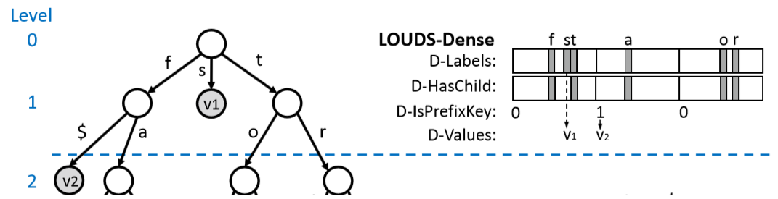
three
FAST SUCCINCT TRIES
LOUDS-Dense
Encodes each trie node using three bit maps of size 256 and a byte-sequence for the values
D-Labels : record the branching labels for each node.
D-HasChild : indicate whether a branch points to a sub-trie or terminates

Slide 22
three
FAST SUCCINCT TRIES
LOUDS-Dense
D-IsPrefixKey : indicate whether the prefix that leads to the node is also a validkey (one bit per node)
D-Values : store the fixed-length values mapped by the keys. (e.g.,pointers)

Slide 23
three
FAST SUCCINCT TRIES
Example
D-Labels : 000...010000000000001100…000
D-HasChild : 000...010000000000000100…000
(102) (115)(116)
D-IsPrefixKey : 0
D-Values : pointers(hashed key suffixes)

Slide 24
three
FAST SUCCINCT TRIES
Tree navigation
Eg:
Position(t) = 116
rank1(D-HashChild) = 2
pos = 256 * 2 = 512
given pos where D-HasChild[pos] = 1, position of the first child node
D-ChildNodePos(pos)=256×rank₁(D-HasChild, pos)

Slide 25
three
FAST SUCCINCT TRIES
Tree navigation
Eg:
Position(t) = 623
⌊pos/256⌋ = 2
select1(D-HashChild) = 116
position of the parent node
D-ParentNodePos(pos) = select₁(D-HasChild, ⌊pos/256⌋)

Slide 26
three
FAST SUCCINCT TRIES
LOUDS-Sparse
LOUDS-Sparse encodes a trie node using four byte or bit-sequences
S-Labels (bit-sequences): record the branching labels for each node.
S-HasChild(one bit) : indicate whether a
branch points to a sub-trie or terminates.
Notes:
LOUDS-Sparse使用3个bit序列来对trie树进行编码, 在整个bit序列中, 每个节点的长度相同, 这三个bit序列分别是:

Slide 27
three
FAST SUCCINCT TRIES
LOUDS-Sparse
LOUDS-Sparse encodes a trie node using four byte or bit-sequences
S-LOUDS(one bit) : denote node
boundaries: if a label is the first in a node,
Its S-LOUDS bit is set.
S-Values : store the fixed-length values
mapped by the keys. (e.g.,pointers)

Slide 28
three
FAST SUCCINCT TRIES
Tree navigation
given pos where D-HasChild[pos] = 1, position of the first child node
S-ChildNodePos(pos) = select₁(S-LOUDS, rank₁(S-HasChild, pos) + 1)
Eg:
D-HasChild[5] = 1
rank₁(S-HasChild, pos) = 5 + 2 =7
7+1-3 =5
select₁(S-LOUDS, 5) = 9

Slide 29
three
FAST SUCCINCT TRIES
Tree navigation
position of the parent node
S-ParentNodePos(pos) = select1(S-HasChild, rank₁(S-LOUDS, pos) -1);
Eg:
pos = 9
rank₁(S-LOUDS, pos) = 8
select₁(S-HasChild, 7) = 6
Notes:
LOUDS-Sparse使用3个bit序列来对trie树进行编码, 在整个bit序列中, 每个节点的长度相同, 这三个bit序列分别是:

Slide 30
three
FAST SUCCINCT TRIES
Space and Performance Analysis
Suppose the trie has H levels
LOUDS-Dense-Size(l) : from 0 to l
LOUDS-Sparse-Size(l) : from l(inclusive) to H
(0 ≤ l ≤ H)
A size ratio R between LOUDS-Sparse and LOUDS-Dense to determine the dividing point among levels.
LOUDS-Dense-Size(l) × R ≤ LOUDS-Sparse-Size(l)
Using R=64 as the default.
Notes:
LOUDS-Sparse使用3个bit序列来对trie树进行编码, 在整个bit序列中, 每个节点的长度相同, 这三个bit序列分别是:

Slide 31
three
FAST SUCCINCT TRIES
Space and Performance Analysis
Given n keys, LOUDS-Sparse uses 8n bits for S-Labels, n bits for S-HasChild and n bits for S-LOUDS. A total of 10n bits.
LOUDS-Dense’s size is restricted by the ratio R to ensure that it does not affect the over all space-efficiency of LOUDS-DS.
Notes:
LOUDS-Sparse使用3个bit序列来对trie树进行编码, 在整个bit序列中, 每个节点的长度相同, 这三个bit序列分别是:

Slide 32
04
SuRF EVALUATION

Slide 33
four
SuRF Evaluation
The datasets
100M 64-bit random integer keys generated by YCSB
25M email drawn from a real-world dataset (average length = 22 bytes, max length = 129 bytes ).
The machine Config
two Intel Xeon E5-2680v2 CPUs@2.80GHz
DRAM: 32 G
A single thread
Constructing the filter under test using half of the dataset selected at random
Executing 10M point, range or mixed(50% point and 50% range) queries on the filter

Slide 34
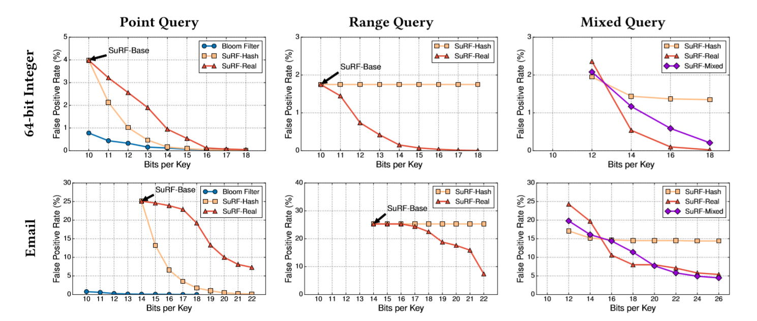
four
SuRF Evaluation
False positive rate comparison between SuRF variants and the Bloomfilter (lower is better)

Slide 35
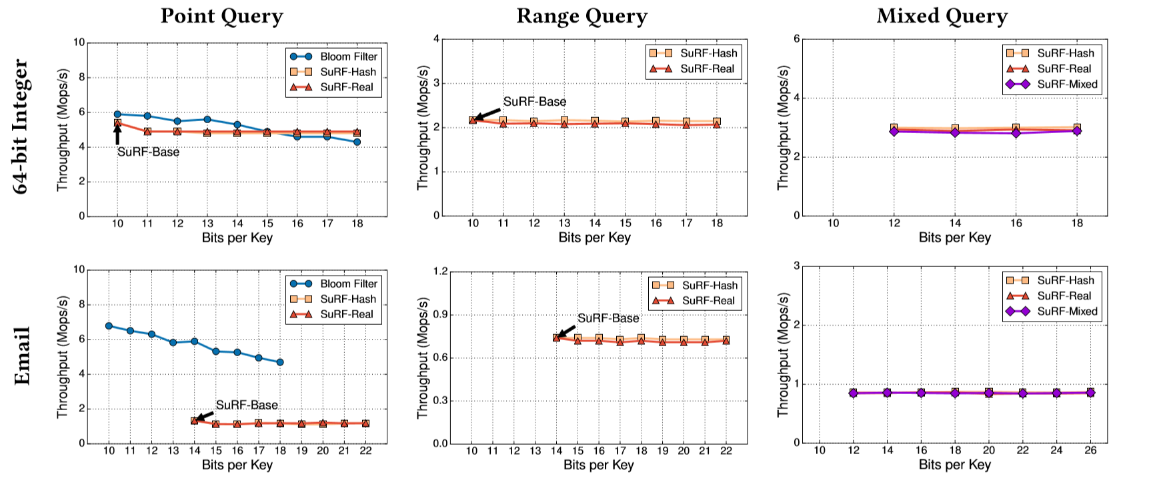
four
SuRF Evaluation
Performance comparison between SuRF variants and the Bloom filter (higher is better)

Slide 36
four
SuRF Evaluation
Creating four instances of RocksDB with different filter options:
(1)no filter
(2)Bloom filter (14 bits per key)
(3)SuRF-Hash (4 bit suffix per key)
(4)SuRF-Real (4 bit suffix per key)
Test machine
Intel Core i7-6770HQ CPU, 32GB RAM, an Intel 540s 480GB SSD
The total size of the raw records is approximately 100G
The query keys are randomly generated.

Slide 37
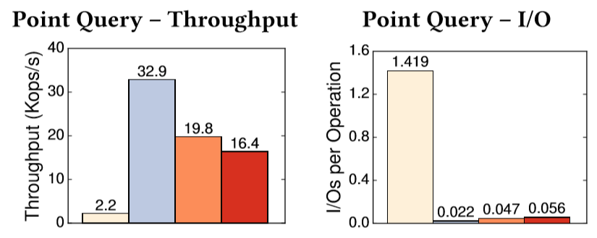
four
SuRF Evaluation

Slide 38
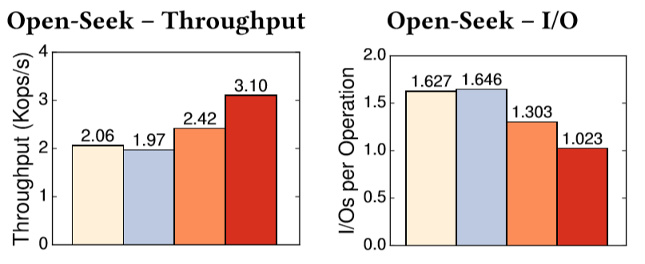
four
SuRF Evaluation

Slide 39
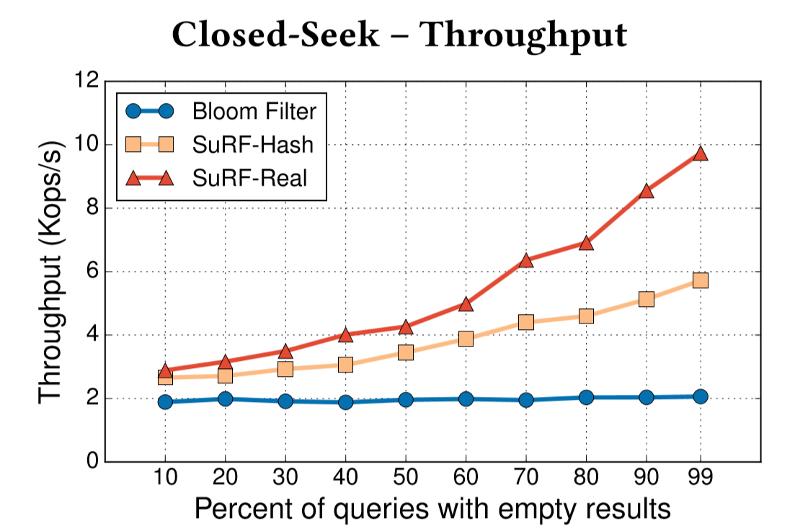
four
SuRF Evaluation
Rocks DBClosed Seek query evaluation under different filter configurations and range sizes

Slide 40
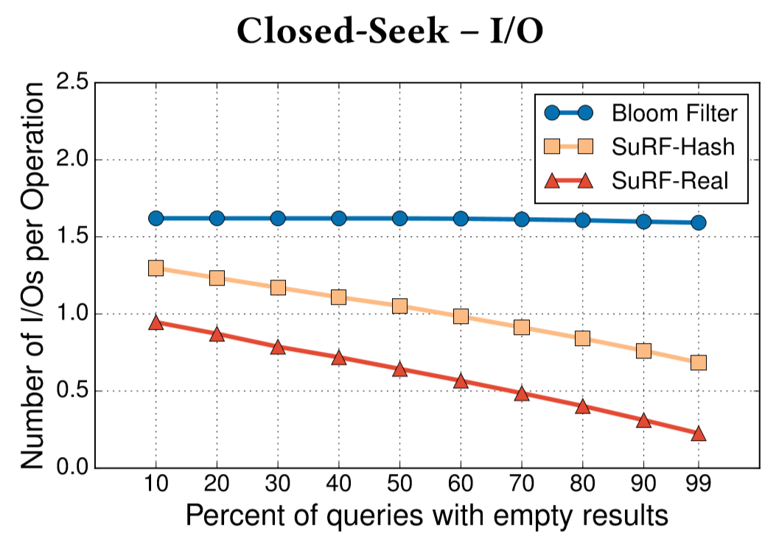
four
SuRF Evaluation
Rocks DBClosed Seek query evaluation under different filter configurations and range sizes

Slide 41
four
SuRF Evaluation
Conclusion
SuRF can perform range filtering while the Bloom filter cannot;
If the target application only needs point query filtering with moderate FPR requirements, the Bloom filter is usually a better choice than SuRF;
SuRF is memory efficient, and its space/false positive rate scan be tuned by choosing different amounts of suffix bits to include.
Replacing the Bloom filters with SuRFs in RocksDB, substantially reduced I/O and improved throughput for range queries with a modest cost on the worst-case point query throughput

Slide 42
END
Thank you

