Slide 1
Home Page
Top:
Register
Sign In
Filter to select the country (as of now only India)
Add a Review (Button)
If not logged in take to login/register page.
If logged in take to Tenant Form page.
About Us
Why?
News (RSS Feed should be linked)
FAQ
BODY: See Home Page- Body
Bottom:
Privacy Policy
Cookie Policy
Terms and Conditions – X
Terms and Conditions – Y
Acceptable Use Policy
Terms of Use
Contact Us

Slide 2
Home Page - Body
Welcome to Talk Tenant.
How do you know the house you are planning to stay is a good fit for you.
We will give you the answer.
Rate the Property/House Owner
Leave a review about your renting experience
Review your rental property
Rate your House Owner
Find a Review
Search for reviews and find your next dream home.
Find reviewed properties and local information.
HOW TO RATE PROPERTY
1. Register & Verify your email
2. Once verified, rate your property
3. Viola, other can see your review now.

Slide 3
Search
Search by House owner:
Phone number (note: only the 10 digits)
Search by address:
Search (Search can be via)
Pin code field (Mandatory)
House number field (Mandatory)
Street Name field
Action: When searched list of search results should appear in nice format.
Action: There should be option to comment on this review. Only logged in user can comment.
Action: When a particular row is selected, further info about the result should be shown.
Action: When further complete info is shown and if the user is logged in Challenge button should be visible.
Action: For every result, customer can share the content in FB, twitter, email, Instagram.
Action: When searched without login, only partial information should be shown.

Slide 4
Search - contd
If no properties found:
Show properties nearby sorted by distance
If more than one entry found:
Show properties sorted by review submitted date
When clicked on one entry
Take to search outcome for that entry.
See slide Search Outcome

Slide 5
Search Outcome
Top will be google street view result for that address
Next will be review results
Sample in slide Tenant Form

Slide 6
Challenge Button
Action: When challenge button is clicked, customer should get a form to fill
Free flow text box
Attachments
Action: When submitted message should be sent to the email and customer should be presented with thank you message.

Slide 7
Contact Us
Name
Email
Message
Action: When submitted message should be sent to the email
Action: Also publish email - info@talktenant.com

Slide 8
Register
Register via google, twitter, Instagram, Facebook
Action: Customer data should be stored in the DB
Independent Register Option
Action: Customer data should be stored in the DB
Action: Thanks for Signing message
Action: Verification link to be sent
Action: When customer click verification link in email. Confirm verification screen should be present
Action: OTP or verification should be sent to mobile via message.
Action: When customer click verification link in message. Confirm verification screen should be present.
Action: When customer logs in to his online account. Verify mobile should be stressed.
Action: Without mobile and email verification, customer should be restricted for every service.

Slide 9
Login
Login via google, twitter, Instagram, Facebook or via username/email
Action: once logged in take to home page
Looks for slide “Home Page – Body”

Slide 10
Rate Button
Action: Once Rate button is clicked, customer needs to fill out a form (Tenant Form)
Few Text Box for every field
Few rating meter for few fields (Colour Coding)
Few yes or no q/a
Free flow Comment
Picture upload. Reduce the size and upload the pic to DB.
Action: Once all the fields are entered with data, customer can submit and the data needs to be in DB
Action: Thanks for submitting your house review.
Action: Note: Your review will be moderated and in case of invalid data, review will be deleted and notified.

Slide 11
Tenant Form
Pin code(mandatory) (no space allowed)
House number (mandatory) (no space allowed)
Landlord phone number (no space allowed)
Landlord Name:
Bedrooms:
Bathrooms:
Rent: (only numbers) (no space or special characters or ,)
Tenancy Start Date:
Tenancy End Date:
Leaks: 1 to 5 & Comment box
5 is good, 1 is bad
Flooring & Carpets: 1 to 5 & NA & Comment box
Brightness: 1 to 5 & Comment box
Noise level: 1 to 5 & Comment box
Insects: 1 to 5 & Comment box
Parking: 1 to 5 & Comment box
Safety & Security: 1 to 5 & Comment box
Traffic: 1 to 5 & & Comment box
Electricity or Wiring or switches : 1 to 5 & Comment box
Feels like a home: 1 to 5 & Comment box
Deposit handling: 1 to 5 & Comment box
Landlord: 1 to 5 & Comment box
Comment Box: Free flow text
Images: max 10 images can be attached.
See next page to see how rating should be highlighted
Once the form is submitted all data should go into DB along with submitter details.
Submitted details = UserName

Slide 12
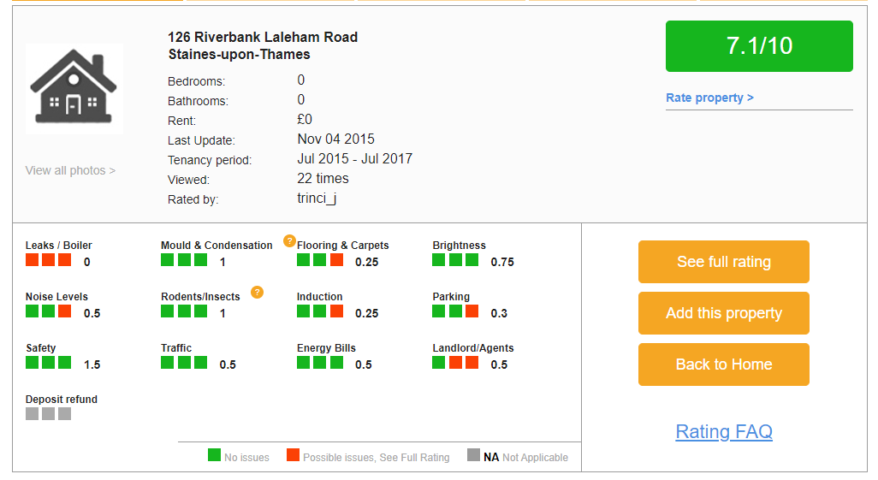
Tenant Form
Similar to

Slide 13
Privacy Policy, FAQ, About us, News, Body, Cookie Policy, Terms and Conditions, Acceptable Use Policy, Terms of Use, Contact Us,
Ask for the content, images etc

Slide 14
Competitors
https://www.rentbaba.com/
http://www.flatgradings.com/
https://asktenants.co.uk/

