Slide 1
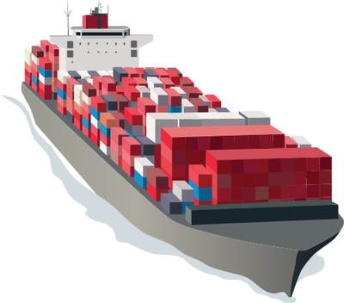
Containing
Joshua Bergsma, Remco de Bruin, Melinda de Roo, Arjen Pander, Jeffrey Harders & Yme van der Graaf

Slide 2
Contents
Introduction
Process
Allocation of roles & responsibilities
Approach
Analysis
Server
Protocol
Client
Server
Protocol
Client
Management interface
Testing
Conclusion
Evaluation
Tips & questions
Demonstration

Slide 3


introduction
Project members
Joshua Bergsma
Remco de Bruin
Melinda de Roo
Arjen Pander
Jeffrey Harders
Yme van der Graaf

Slide 4

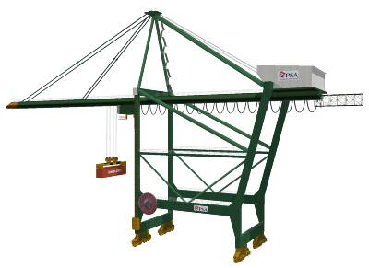
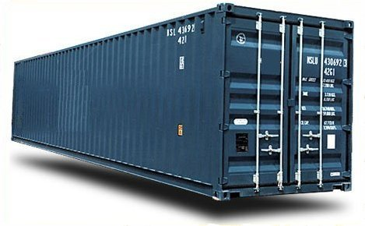


assignment
Port of Rotterdam
Controller & Simulator
Management Interface

Slide 5

Allocation of roles & responsibilities
Manager
Documentarian
Secretary

Slide 6
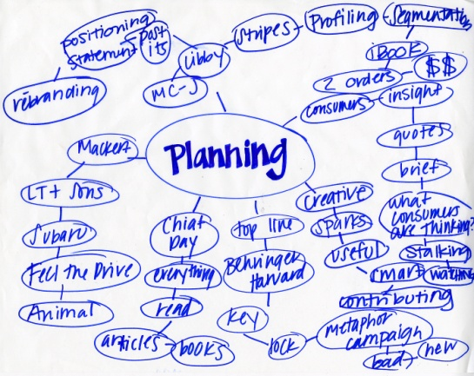
Approach
Analysing the project
Plan
Assign roles/tasks

Slide 7

Analysis
Java
Used tools

Slide 8
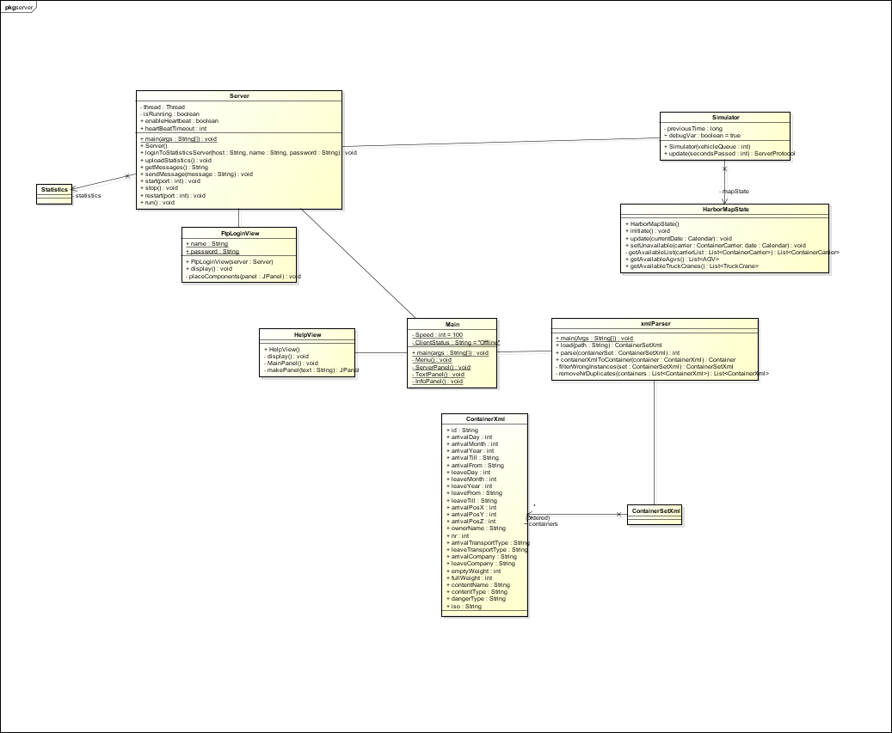
Analysis server

Slide 9
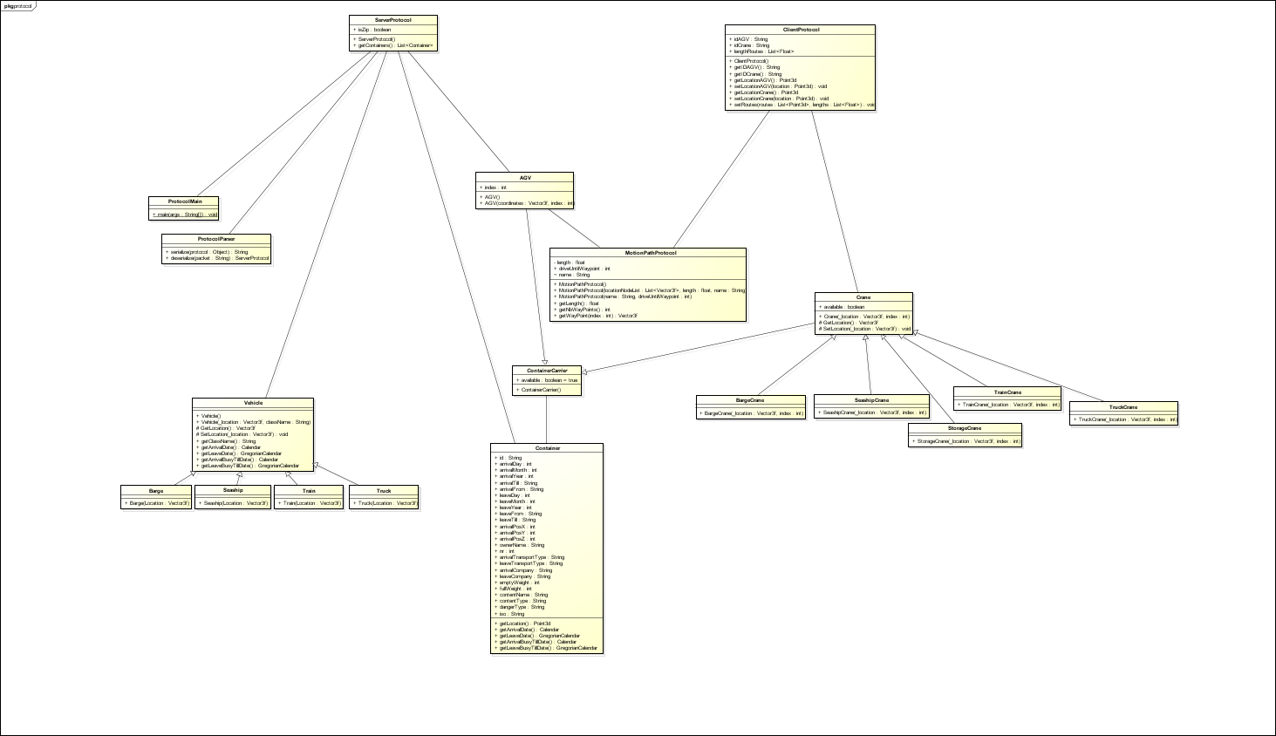
Analysis protocol

Slide 10
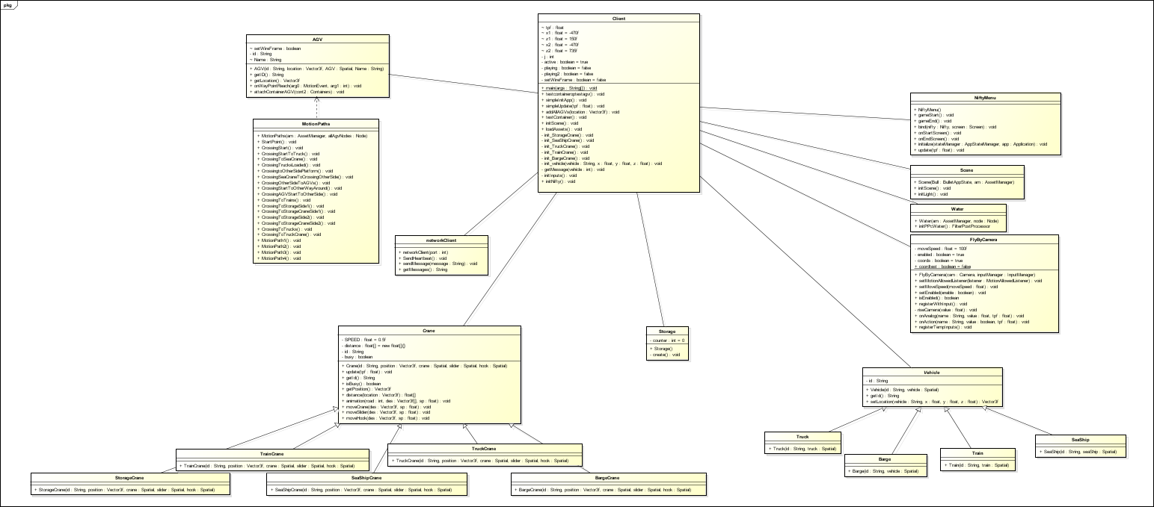
Analysis client

Slide 11

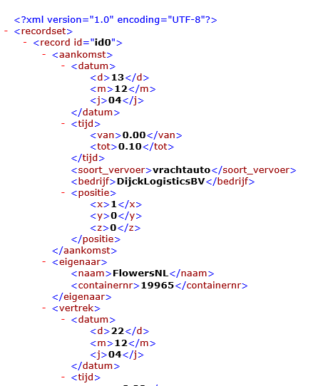
server
XML parser
Sync

Slide 12


protocol
Send data
Receive data
Process data

Slide 13
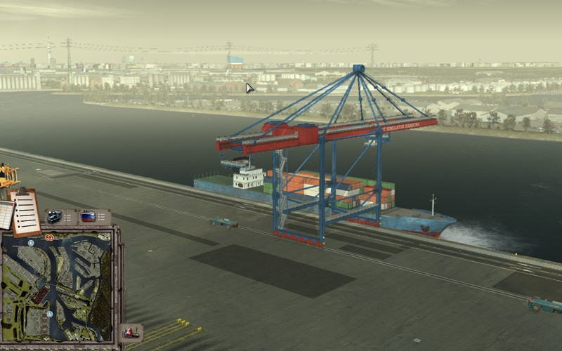
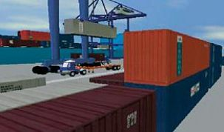
Client
Receive data
Process data
Simulation

Slide 14
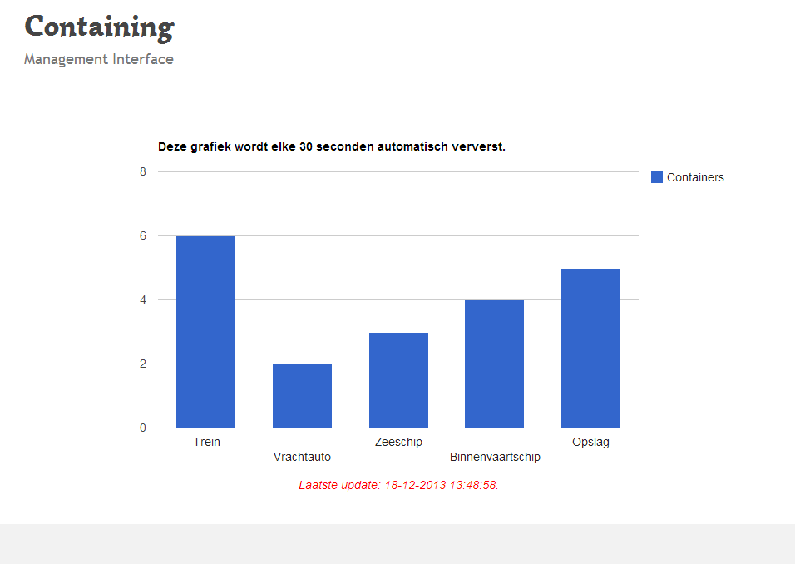
Management interface

Slide 15

Testing
Plan for testing
Coverage tests
Unit testing
JUnit

Slide 16

Conclusion

Slide 17

Evaluation

Slide 18

Tips & questions
Tips for a next Containing project

Slide 19
Demonstration

