Slide 1
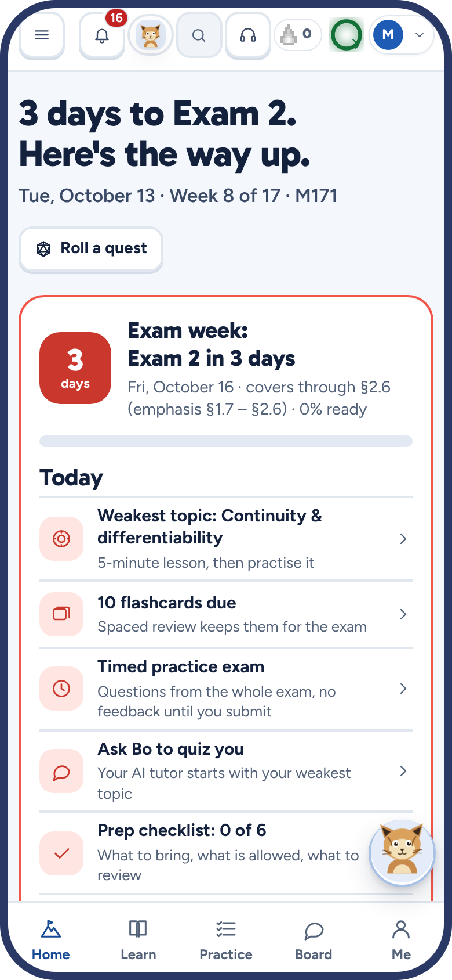
Mathub
HACKATHON DEMO · FALL 2026
Every class, every exam, and an AI tutor who sees your screen.
Nikoloz Nonikashvili · Montana State University · mathub.space
Notes:
Hi, I’m Nikoloz, a student at Montana State. This is Mathub: a study hub for every class I take, built from each class’s real syllabus, with an AI tutor called Bo who can see what you’re working on.

Slide 2



Studying for a class is scattered
THE PROBLEM
Too many places
Help runs out
Exam prep is a guess
The syllabus PDF, Canvas, the textbook, online homework, your notes, the group chat.
Office hours end in the afternoon. The question you’re stuck on comes up at eleven at night.
What is on the exam? What am I weak at? Am I ready? Nobody tells you until the grade comes back.
Notes:
Every student knows this. The information you need is spread across six places, help isn’t there when you study, and you walk into the exam not knowing if you’re ready.

Slide 3
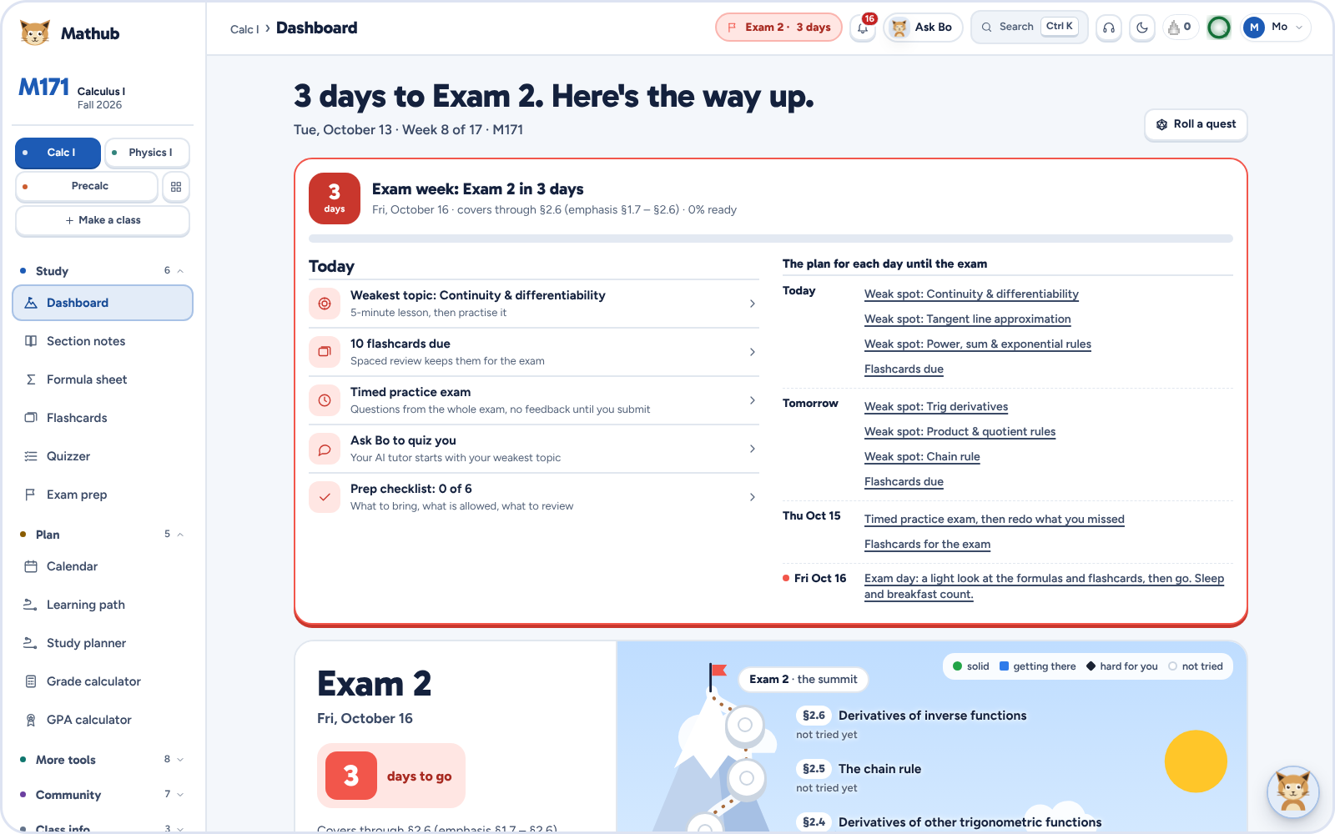
One hub per class, built from its real syllabus
THE IDEA
Notes for every topic, linked to the free textbook
Every exam and deadline, plus the Canvas calendar
A readiness score for the next exam, topic by topic
Notes:
Mathub reads each class’s syllabus: topics, exam dates, grading. Open a class and the dashboard says what’s next. Here it’s three days to Calculus Exam 2, with a plan for today and for every day until the exam.

Slide 4
Every class is a climb to the next exam
HOW IT WORKS
Syllabus
Learn
Practice
Readiness
Exam
Topics, dates and grading
A note and a short lesson per topic
Endless questions and flashcards
How close you are, topic by topic
The summit, with a plan for each day
Each topic is a stop on the trail. The more you get right, the higher your readiness score, and the dashboard always shows the next step.
Notes:
The metaphor is a mountain: the topics are the trail and the next exam is the summit. Students always know where they are and what to do next.

Slide 5
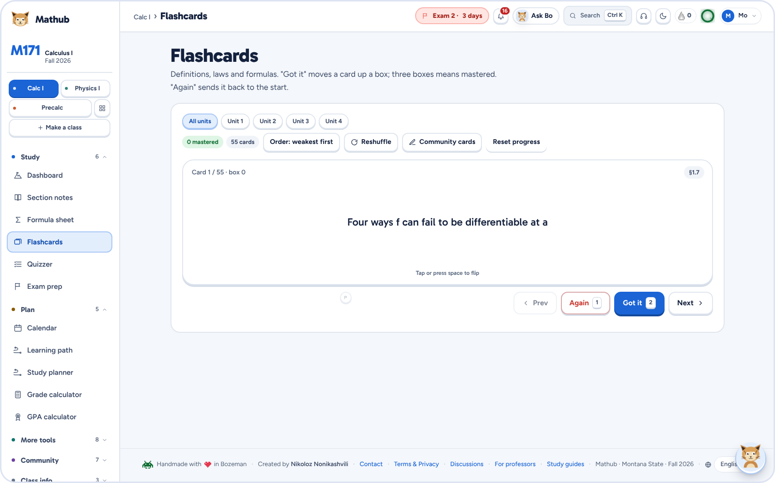
Practice that sticks,
and never runs out
PRACTICE
Endless generated questions, each with a worked answer
Flashcards that come back right before you forget
A Today plan: ten minutes across every class
Streaks, XP, quests and weekly leagues
Notes:
The practice never runs out: questions are generated, so there is always another one, with the worked solution. Flashcards use spaced repetition. Today pulls it all into a ten-minute plan, and the game layer keeps students coming back.

Slide 6

Meet Bo.
MATHUB MAX
An AI tutor who knows your syllabus, your exams and where you’re stuck. In a chat, on a call, and now on every page.
Notes:
Bo is the heart of Mathub. He’s a bobcat, MSU’s mascot, and he’s an AI tutor built on Claude. What makes him different from a general chatbot is context: he knows the syllabus, the exam dates, your weakest topics and the questions you missed.

Slide 7
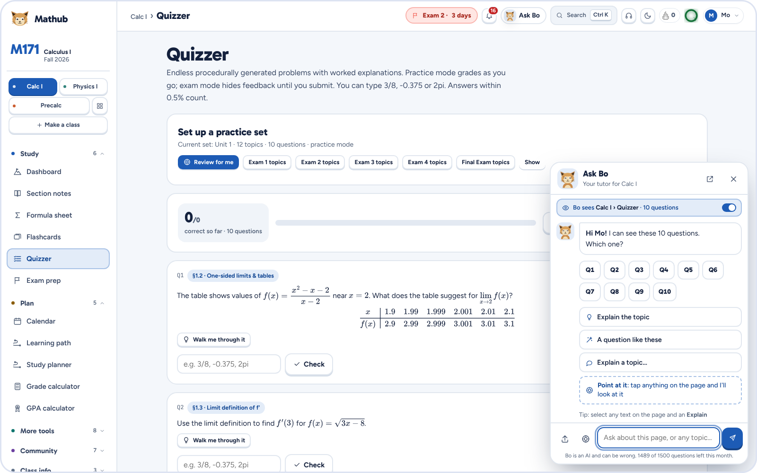




Bo is on every page
NEW THIS WEEK
He reads the page
The questions by number, your answers, right or wrong
Tap Q3
He walks you through it, a hint before the answer
Point or select
Tap any part, or highlight text and hit Explain
Problem sets
Drop in a photo or a PDF
Notes:
New this week: Bo floats in the corner of every page. Tap him and he already knows what you’re looking at: the ten questions on this quiz, which ones you got wrong, the notes you’re reading. One tap on Q3 and he walks you through Q3, with a hint before the answer.

Slide 8
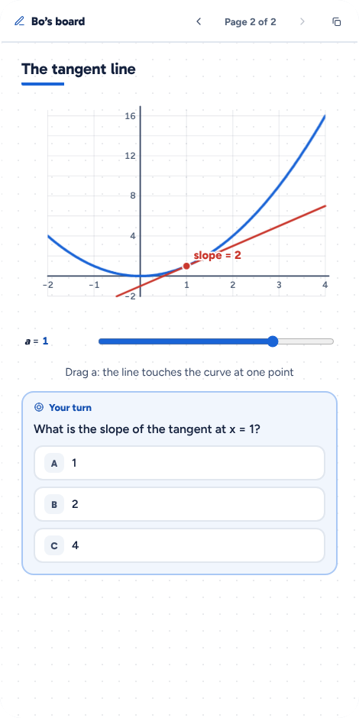
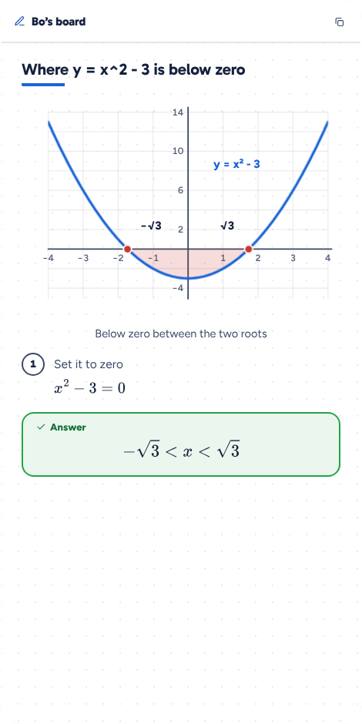
He works it out on a board, not in a wall of text
BO’S WHITEBOARD
13 kinds of drawings: graphs, tangent lines, Riemann sums, the unit circle, Venn diagrams, normal curves…
Sliders you drag, and the graph redraws
A question to answer right on the board, marked at once
Notes:
Great tutors draw. Bo writes numbered steps on a whiteboard and draws: here a tangent line with a slider you can drag, and a parabola with the negative part shaded. Then he puts a question on the board for you to answer, so you check your understanding instead of just reading.

Slide 9



Chat with him, call him, or let him write the class
THREE WAYS IN
Chat
Call
Write a class
Ask anything, snap a photo of a problem. Answers stream in with board pages, then one tap to go on.
Talk out loud. He answers in about half a second, lets you cut in, and draws while he talks.
Taking something Mathub doesn’t have? Drop in its syllabus: notes, practice, flashcards and the calendar in a minute or two.
Notes:
Three ways to use Bo. The chat, with photos. Live voice calls, real conversation where you can interrupt him. And for any class Mathub doesn’t have yet, Bo reads the syllabus and writes the whole class.

Slide 10
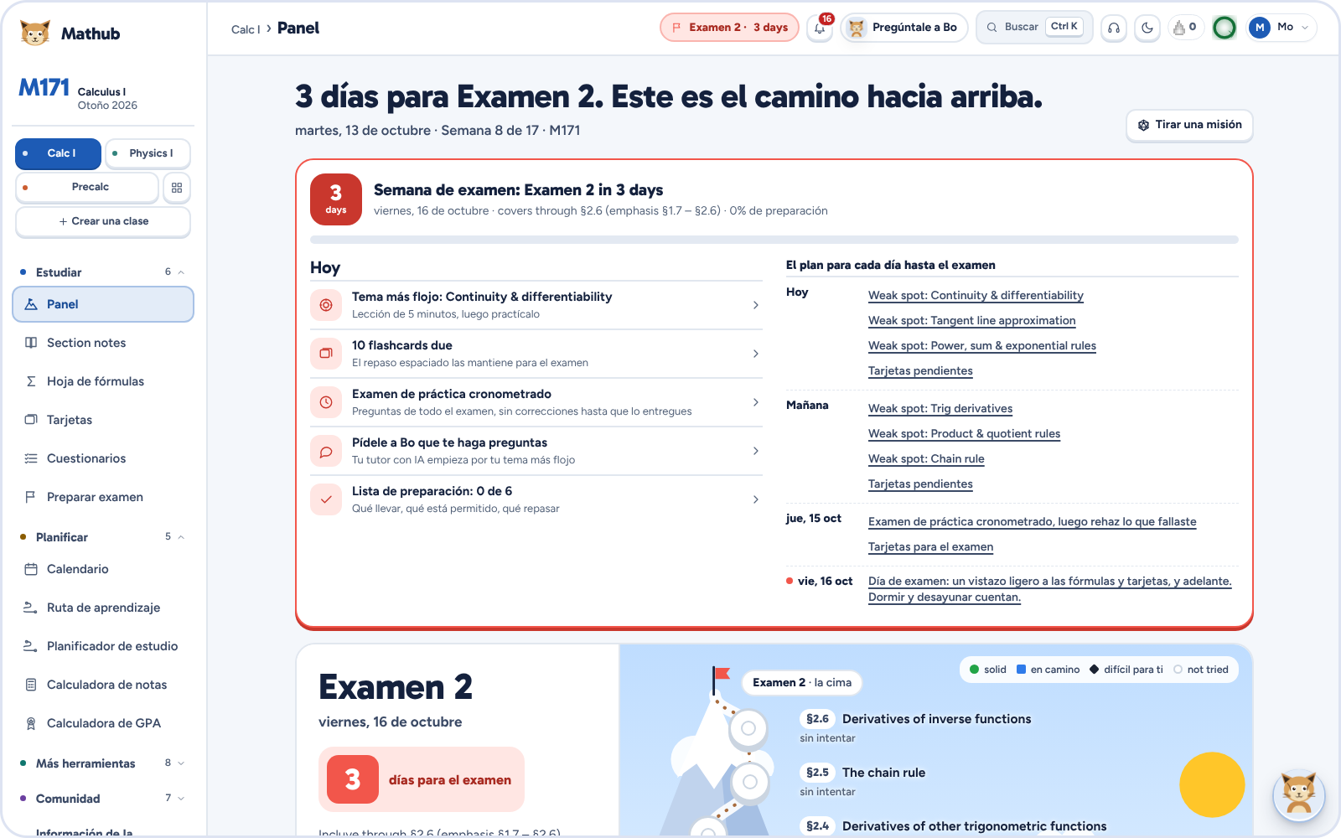
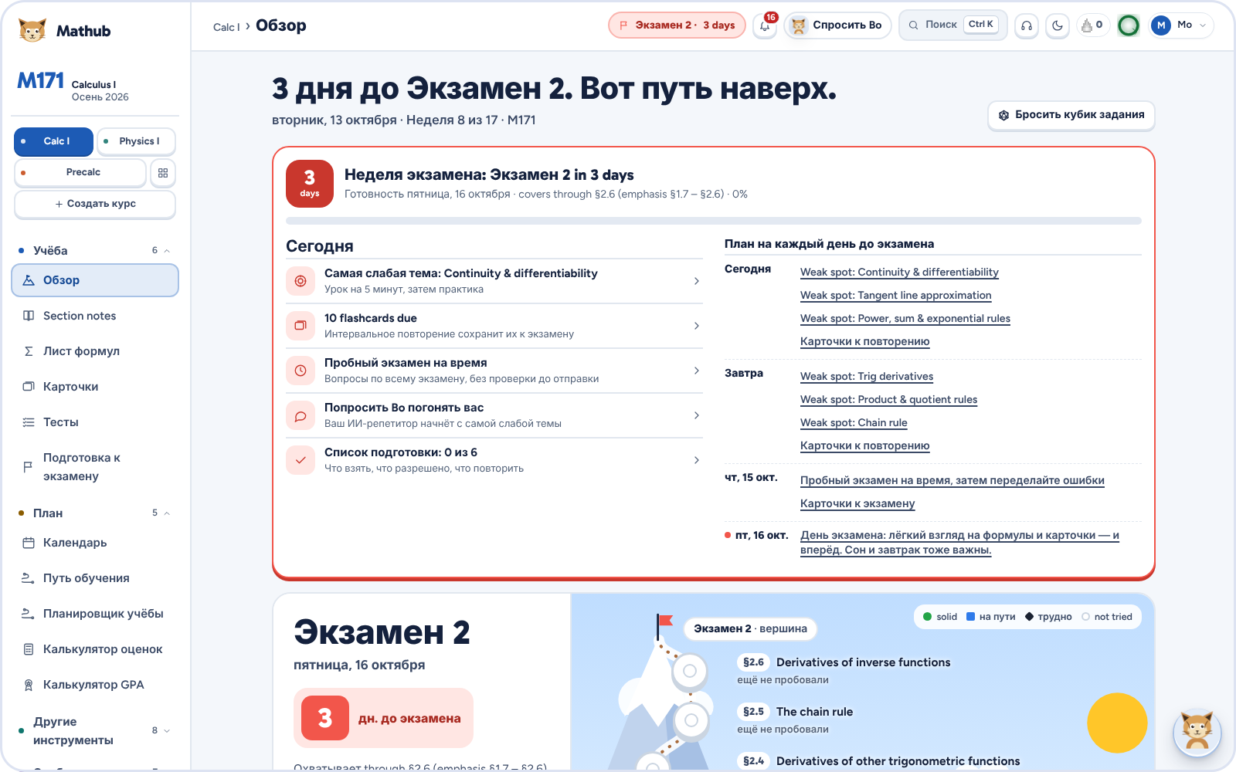
English, Español, Русский
LANGUAGES
Pick a language at the foot of any page. Bo answers in it too, and gives the English term in brackets, because the exams are in English.
Notes:
International students can use Mathub in Spanish or Russian, with French, Italian, Portuguese and German on the way. The interface switches and Bo answers in their language, while the class material stays in English so it matches the exam.

Slide 11






Under the hood
HOW IT’S BUILT
Front end
Server
AI
Plain JavaScript, no framework. Works offline. MathJax for math, Python running in the browser.
PHP and SQLite: accounts, sync, discussions, plans through RevenueCat and Stripe.
Claude by Anthropic for the chat, reading the page and writing classes; OpenAI Realtime for calls.
Quality
Languages
Reach
1,212 automated browser checks across 43 test files, run before a release.
A layer that translates the interface as it draws, so the code stays in one language.
191 public study pages for search, plus iPhone and Android app builds.
Notes:
For the technical judges: it’s a plain JavaScript single-page app with a PHP and SQLite backend, so it runs on cheap shared hosting. Claude powers the tutor; OpenAI’s realtime model powers voice. Every release runs over a thousand automated browser checks.

Slide 12
Free to study. Pay for Bo.
THE MODEL
Free
Pro
Max
$0
$15 /mo
$50 /mo
Every built-in class: notes, practice, flashcards, Today, the Focus room, the GPA calculator.
Bo writes your classes from any syllabus, and you can share them.
Everything in Pro, plus Bo the tutor: chat, calls and Bo on every page.
Notes:
The studying is free, so every student gets value. We charge for the AI, which is where our costs are: Pro at fifteen dollars a month writes classes from a syllabus, and Max at fifty adds Bo as a personal tutor, which is a fraction of what an hour of private tutoring costs.

Slide 13
What’s next
ROADMAP
1
Four more languages
2
More classes
French, Italian, Portuguese and German are partly translated.
Students request a class with its syllabus; the most requested go live first.
3
Instructors
4
The app stores
Mathub Faculty: professors write their syllabus and run their class with a code.
The iPhone and Android apps, with Bo as a tab.
Notes:
Next: finish the four remaining languages, grow the class list from student requests, bring instructors in through Mathub Faculty, which is already built, and ship the mobile apps.

Slide 14
mathub.space
TRY IT
Thank you. Questions?
Nikoloz Nonikashvili · Montana State University
Notes:
Mathub is live at mathub.space. Thank you, and I’m happy to show a live demo: open a quiz, tap Bo, tap a question.

