Slide 1

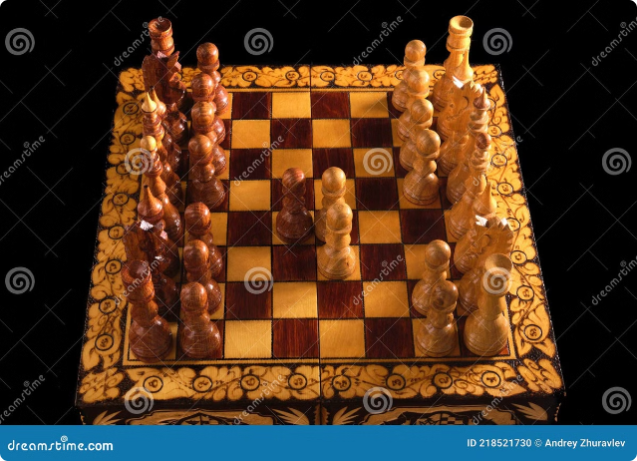
The N-Queens Puzzle: A Java Exploration
Welcome to a presentation on my Java coding project, which explores and visualizes the classic N-Queens problem. This project aims to provide a comprehensive solution and a visually engaging way to understand this intriguing puzzle.
by GAURAV RAJ SINGH 12222030

Slide 2

The N-Queens Problem: A Classic
1
The Challenge
2
Key Constraint
3
Problem Complexity
The N-Queens problem asks: how can you place N chess queens on an N x N chessboard so that no two queens threaten each other?
Queens can move horizontally, vertically, and diagonally, so no two queens can occupy the same row, column, or diagonal.
As the board size increases, the number of possible solutions explodes, making it a challenging puzzle to solve.

Slide 3


Java Coding Project Overview
1
Problem Definition
First, the project clearly defines the N-Queens problem, outlining the rules and constraints.
2
Algorithm Implementation
It implements a suitable algorithm, such as backtracking, to systematically explore possible queen placements.
3
Solution Visualization
The project generates visual representations of the solutions, showcasing the queen positions on a chessboard.
4
User Interface
It provides a user-friendly interface to interact with the program, allowing users to choose the board size and view the solutions.

Slide 4
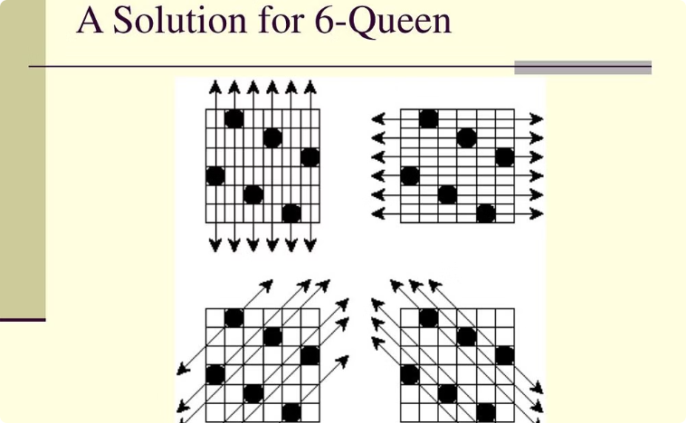
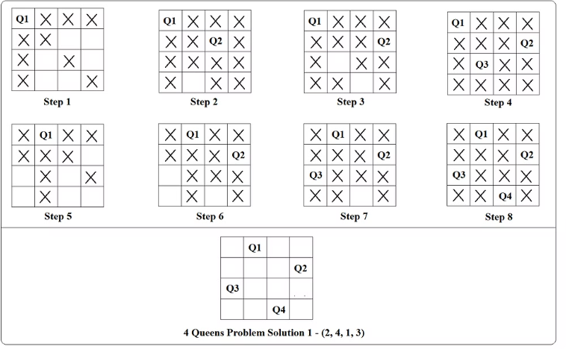
Visualizing N-Queens: Bringing the Puzzle to Life
Chessboard Representation
Queen Placement
The project visualizes the chessboard with a grid layout, using distinct colors for squares and queens.
It clearly marks the positions of queens on the board, making it easy to understand the solution.

Slide 5
Algorithms and Techniques
Backtracking
Data Structures
Optimization
The project employs a backtracking algorithm to explore possible queen placements systematically. It starts with an empty board and tries placing a queen in each column. If a placement is valid, it moves to the next column. If a placement leads to a conflict, it backtracks and tries a different position in the previous column.
The project utilizes appropriate data structures, such as arrays or lists, to represent the chessboard and queen positions efficiently. It also uses boolean arrays or bitsets to keep track of occupied rows, columns, and diagonals.
The implementation may include optimizations to enhance performance, such as pruning branches that lead to invalid solutions or using heuristics to guide the backtracking search. These optimizations help to reduce the search space and find solutions faster.

Slide 6
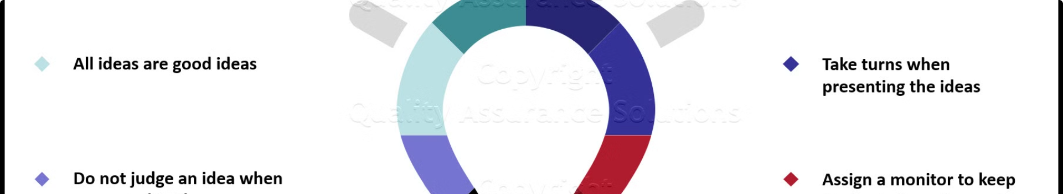




Challenges and Problem-Solving
Complexity
Optimization
Visualization
User Interface
Handling the combinatorial explosion of possible solutions as the board size increases.
Developing efficient algorithms and data structures to find solutions quickly.
Creating a clear and visually appealing representation of the chessboard and queen placements.
Designing an intuitive and user-friendly interface for interacting with the program.

Slide 7

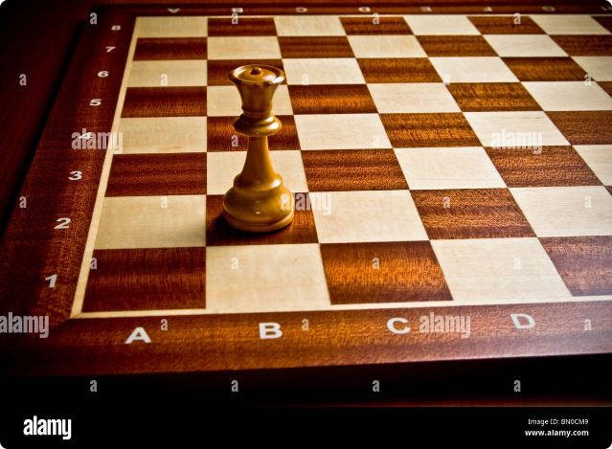
Demonstration: Unveiling the Solutions
N-Queens
Possible Solutions
4
2
8
92
10
724

Slide 8
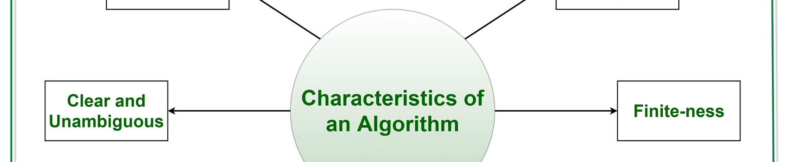
Benefits and Applications
Educational Tool
Problem Solving
Logic and Reasoning
The project serves as an educational tool for understanding algorithms, problem-solving techniques, and computer science concepts.
It demonstrates the application of algorithms and data structures to solve real-world problems.
It encourages logical thinking and problem-solving skills, making it relevant to various fields.

