Slide 1
Planning and designing simulation studies
Marta Bofill and Jordi Cortés
UPC
01 February 2018

Slide 2
Material of this session
Tim Morris and Ian White
MRC Clinical Trials Unit at UCL
22 May 2017
Review of simulation studies
A review of practice in articles published in Volume 34 of Statistics in Medicine (2015) - 264 research articles.
Course Tutorial
Introduce a structured approach for planning and reporting simulation studies.

Slide 3
Contents
Aims of simulation studies
Analogy with RCTs
Framework for simulation studies:
Aims
Data generating mechanism
Method(s)
Estimand
Performance measures
Sample size for simulation studies
Importance of reporting the plan/protocol
PRACTICE

Slide 4
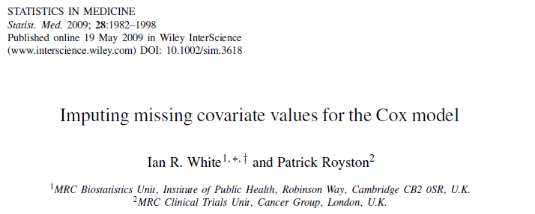
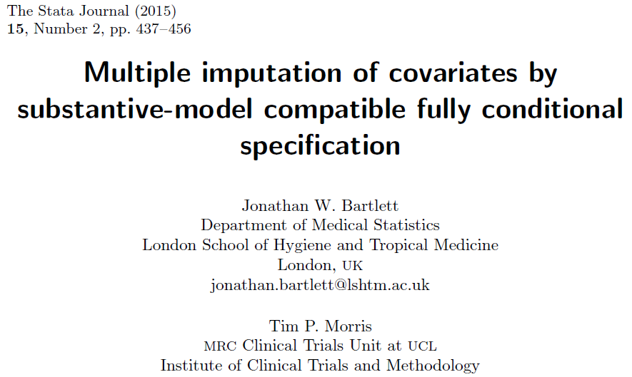
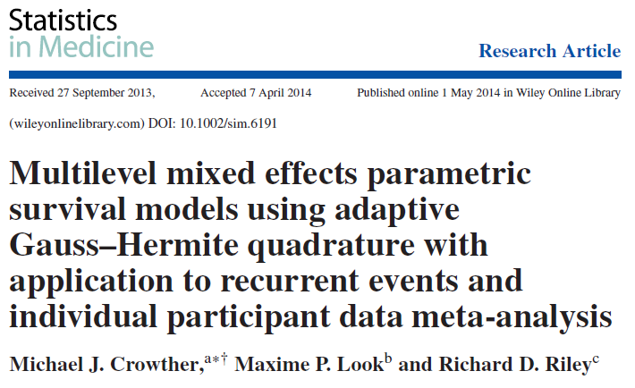
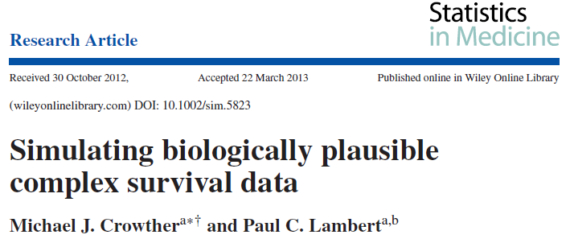
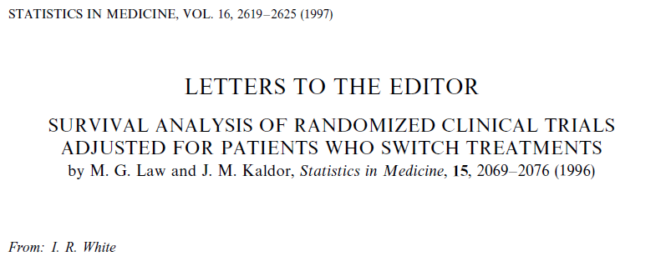
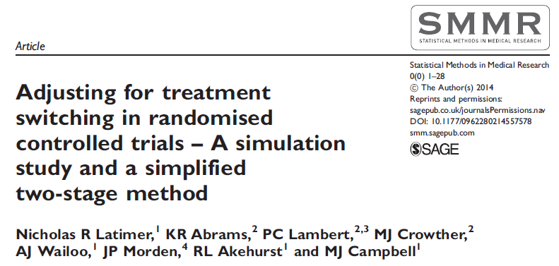
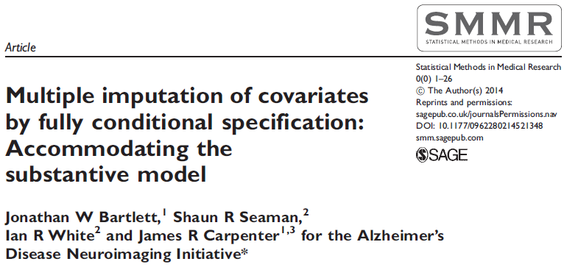
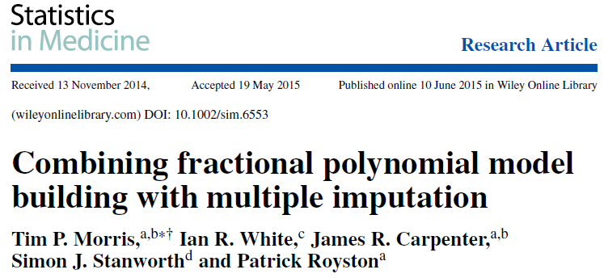
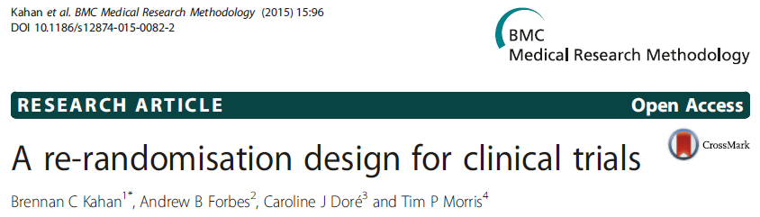
Where have we used simulation?

Slide 5
Aims of simulation studies
Simulation studies can be, and have been, used to:
Check that code does the intended analysis
Check robustness of programs
Check algebra
Evaluate new (or existing) statistical methods
Compare two or more methods
Calculate sample size / power
…

Slide 6
Reproducible research in statistics
ADMEP for simulation studies
Aim(s)
Data-generating mechanism(s)
Method(s)
Estimand(s)
Performance measure(s)
Notes:
Before you do a study, do take a paper first and write down a strategy first!

Slide 7
Analogy with RCTs

Slide 8
ADMEP: Aims
Before starting, we need to…
Know what we want to learn
Work out how we can learn it
So, are we checking…
Whether/when an estimation procedure converges?
Consistency?
Small-sample issues?
Comparison with other approaches?
Robustness to model misspecification?
Notes:
These are examples of aims…

Slide 9
ADMEP: Data-generating mechanism
Two choices:
Simulate data from a known model (parametric simulation)
Resample with replacement from a set of data
Factorial designs:
Determine factors to vary and levels of factors to use.
Notes:
Two choices for data generation: parametric simulation and resampling (idea of bootstrapping). Parametric simujlatino is more popular.

Slide 10
ADMEP: Method/s
What are we investigating?
Comparison of new method to existing? Include ‘control’ method if available
Usually have comparator(s) but not necessary, unlike RCT
Notes:
Comparator = e.g. a methods that is not that good, but people use it all the time (like lin regression).

Slide 11
ADMEP: Estimand/s
Estimand = the thing we are trying to estimate
Sometimes called ‘target of inference’
Important to understand
The aims of analysis in practice
Whether the analysis targets the estimand
Note:
Estimator – the method for estimating an estimand
Estimate – number output by the estimator

Slide 12
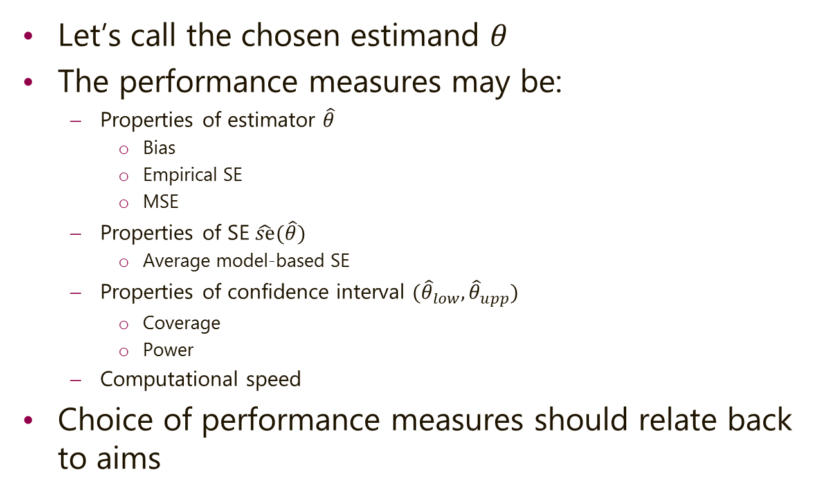
ADMEP: Performance measures
Let’s call the chosen estimand $θ$
The performance measures may be:
Properties of estimator $\hat{θ}$
Bias
Empirical SE
MSE
Properties of SE $\hat{se}(\hat{θ})$
Average model-based SE
Properties of confidence interval $({\hat{θ}}_{low},{\hat{θ}}_{upp})$
Coverage
Power
Computational speed
Choice of performance measures should relate back to aims

Slide 13
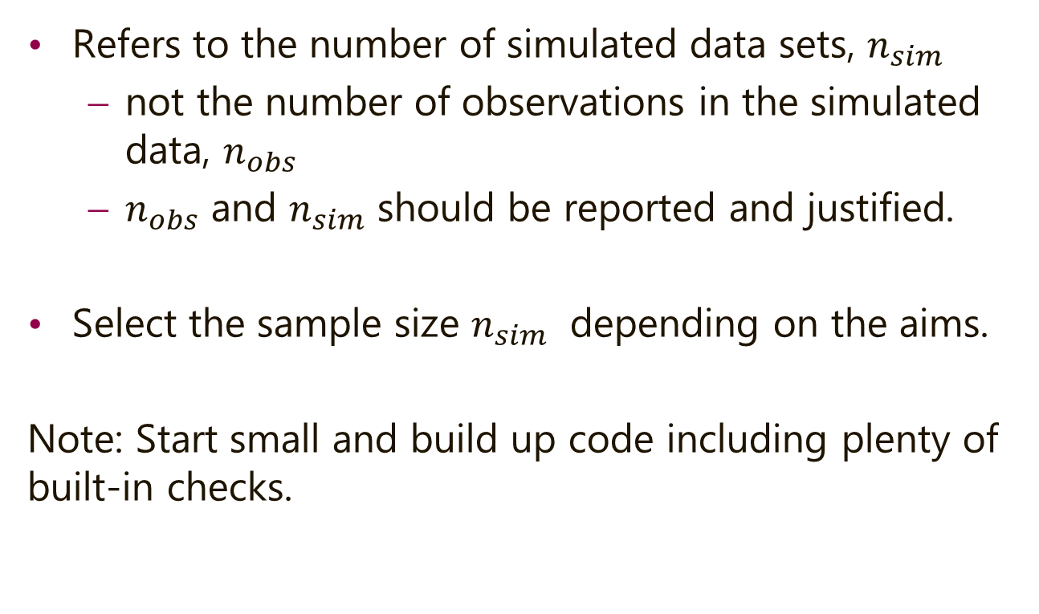
Sample size for simulation studies
Refers to the number of simulated data sets, $n_{sim}$
not the number of observations in the simulated data, $n_{obs}$
$n_{obs}$ and $n_{sim}$ should be reported and justified.
Select the sample size $n_{sim}$ depending on the aims.
Note: Start small and build up code including plenty of built-in checks.

Slide 14
Importance of reporting the plan/protocol
Makes life easier in the long run!
Makes reproducibility possible
Contributes to increasing our visibility (e.g. on arXiv.org, GitHub)
See:
Pustejovsky – Designing simulation studies in R
Smith and Marshall (2011) – a view on simulation protocols in drug development

Slide 15

Practice!
ADMEP
Aim(s)
Data-generating model(s)
Method(s)
Estimand(s)
Performance measure(s)

