Slide 1
Planning and designing simulation studies
Practica 1
Marta Bofill and Jordi Cortés
UPC
01 February 2018

Slide 2
Purpose
When we wish to estimate the difference in mean of a quantitative variable Y between two groups, we often use a two-sample t test.
The theory of the t test is well known for normal data with equal variances, but what happens if we have skew data and/or different variances?
Do we know if it is unbiased? Do confidence intervals still cover with the claimed frequency? And do the answers to these questions differ when the two group sizes are unequal?

Slide 3
ADMEP
Aim(s)
To investigate the performance of the two-sample t test when data are skew
To investigate the performance of the two-sample t test when variances are unequal in the two groups

Slide 4
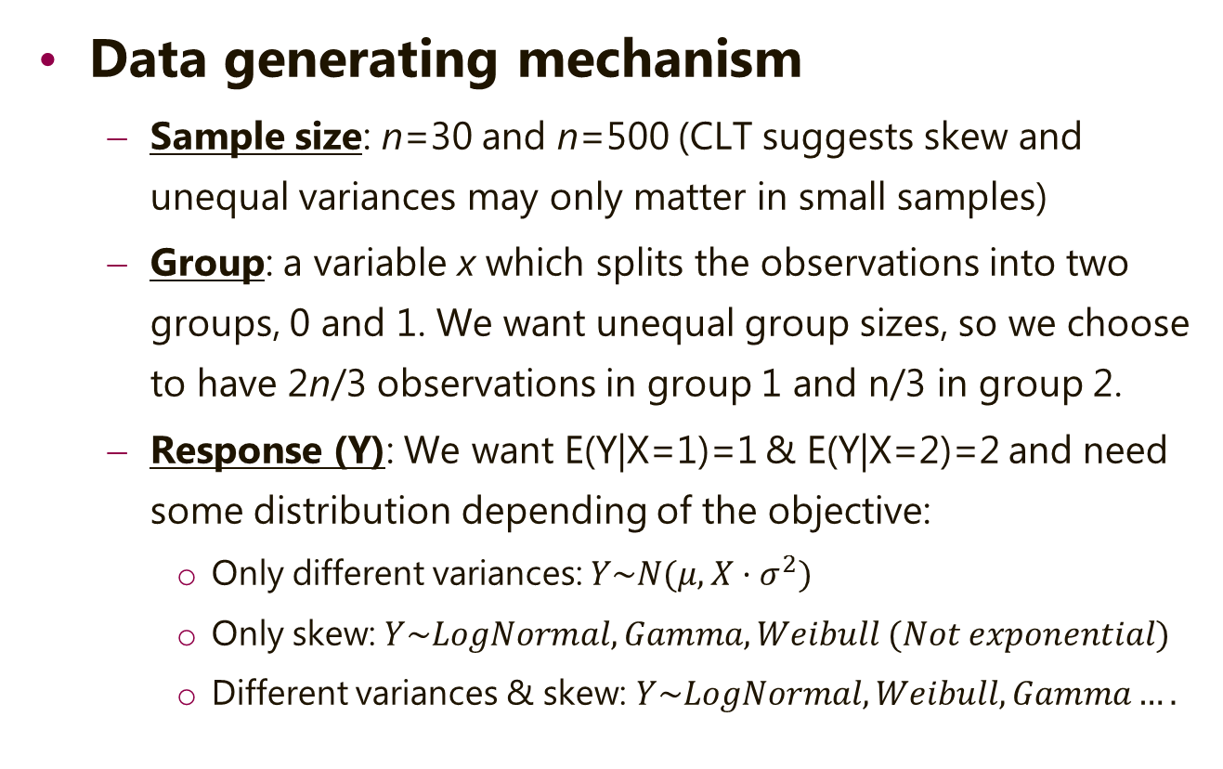
ADMEP
Data generating mechanism
Sample size: n=30 and n=500 (CLT suggests skew and unequal variances may only matter in small samples)
Group: a variable x which splits the observations into two groups, 0 and 1. We want unequal group sizes, so we choose to have 2n/3 observations in group 1 and n/3 in group 2.
Response (Y): We want E(Y|X=1)=1 & E(Y|X=2)=2 and need some distribution depending of the objective:
Only different variances: $Y\sim N(μ,{X·σ}^{2})$
Only skew: $Y\sim LogNormal,Gamma, Weibull (Not exponential)$
Different variances & skew: $Y\sim LogNormal, Weibull, Gamma….$

Slide 5

ADMEP
Method(s)
T test for independent samples
$$\hat{t}=\frac{{\overline{y}}_{1}−{\overline{y}}_{2}}{s_{pool}\sqrt{\frac{1}{n_{1}}+\frac{1}{n_{2}}}}\sim t_{n_{1}+n_{2}−2} under H_{0}$$
$$s_{pool}^{2}=\frac{\left(n_{1}−1\right)·S_{1}^{2}+\left(n_{2}−1\right)·S_{2}^{2}}{n_{1}+n_{2}−2}$$

Slide 6

ADMEP
Estimand(s)
Difference in mean of y for grouping of x:
$θ=E\left(y\right| x=1)−E\left(y\right| x=0)$

Slide 7
ADMEP
Performance
Coverage of the confidence interval
Comparison of the Empirical Standard Error with the Theoretical Standard Error (Bias)
Comparison of the Empirical Power with the Theoretical Power (Efficiency)

Slide 8
Planning and designing simulation studies
Practica 1
Marta Bofill and Jordi Cortés
UPC
01 February 2018

