Slide 1
Implementing DevOps practices to accelerate developer productivity
Notes:
Plan a Java application migration to Azure Spring Apps is the first lab is a series of nine labs spanning three days.
This first lab is a mix of conceptual information and explanation the hands-on activities meant to set the stage for migrating apps, monitoring, and security.
Overview:
Azure Spring Apps makes it easy to deploy Spring Boot applications to Azure without any code changes. The service manages the infrastructure of Spring Cloud applications so developers can focus on their code. Azure Spring Apps provides lifecycle management using comprehensive monitoring and diagnostics, configuration management, service discovery, and blue-green deployments.
Encouraged students to share ideas, strategies, and what works with their fellow students.
Reinforce that the labs are mostly self-driven by the students and full of opportunities for students to help students. The team lead and coach’s role is to guide the students through the labs and assist them through setbacks.
Perhaps review the Prerequisites
Intermediate-level familiarity with and local installations of the following tools: Git, Java JDK 8 or later, and a Java IDE or text editor.
Basic Git commands, including cloning, committing files, and pushing changes to GitHub.
Intermediate-level familiarity with Azure.

Slide 2
Setup Development Environment
Exercise 1

Slide 3
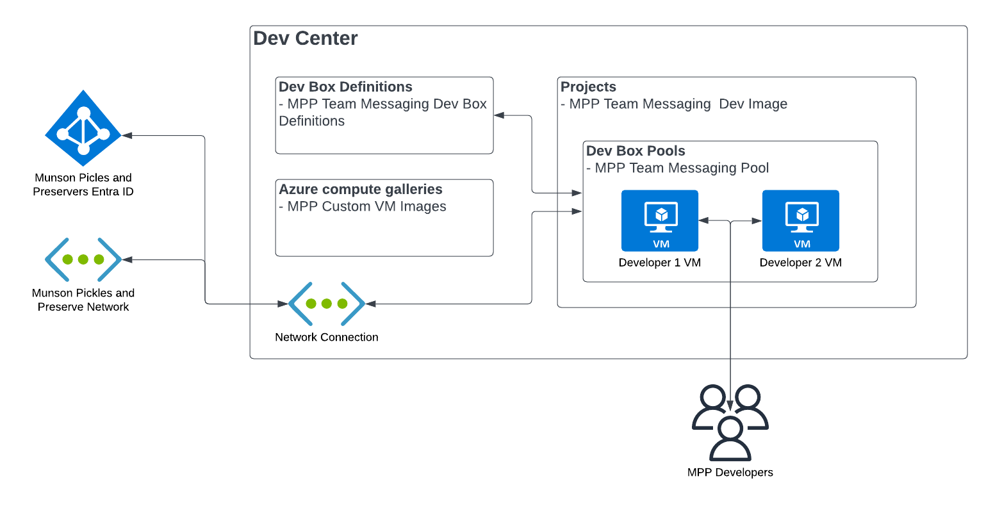
Lab 1 Architecture
Azure Dev Box
Notes:
The Challenges will focus on the following parts of the Petclinic solution:
Challenge 02: Migrate a Spring Apps microservices application to Azure Kubernetes Service

Slide 4
Introductions: Set up development environment
In this lab, you’ll setup a development environment
After completing this lab, you’ll be able to:
Deploy the necessary infrastructure for an Azure Dev Box
Create an image for your Dev Box
Create a Dev Box
Grant users permissions to create and access their Dev Box
Notes:
Speaker notes:
In the previous lab, you established a plan for migrating the Spring Petclinic application to the Azure platform. It's now time to perform the actual migration of the first Spring Petclinic components.
The Spring Cloud service provides a config server for your sample apps to use.
In this lab, you'll begin by creating a Git repo. After you've created the Git repo, you'll create a config server for your Spring Cloud instance to connect to your Git repo. You'll then create a MySQL database service. After the MySQL database service in place, you can deploy the microservices to the Azure Spring Apps service. Lastly, you'll test the application through a publicly available endpoint to make sure everything is working.
Learning objectives
After completing this lab, you'll be able to:
Create an Azure Spring Apps Enterprise service
Set up the config repository
Set up the Application Configuration Service for Azure Spring Apps Enterprise
Create an Azure MySQL Database service
Deploy the Spring Petclinic app components to the Spring Apps service
Provide a publicly available endpoints for the Spring Petclinic application
Test the application through the publicly available endpoints

Slide 5
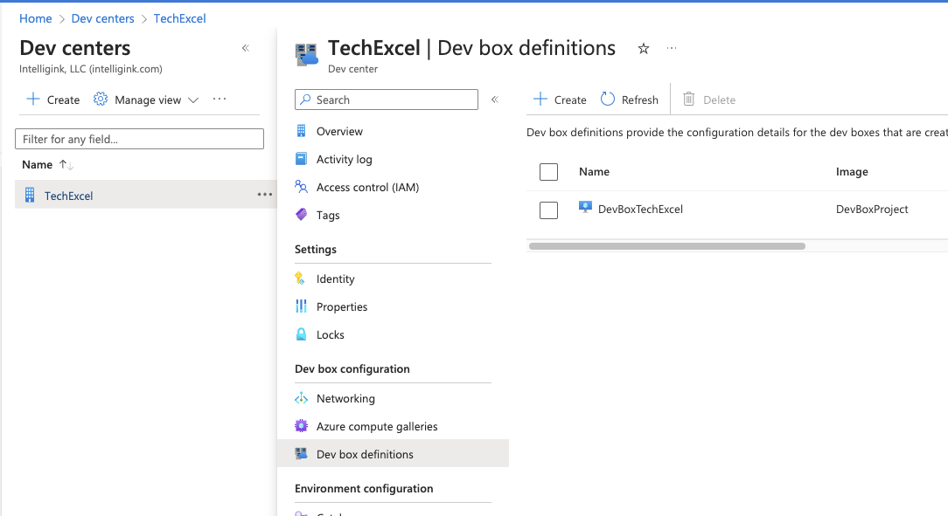
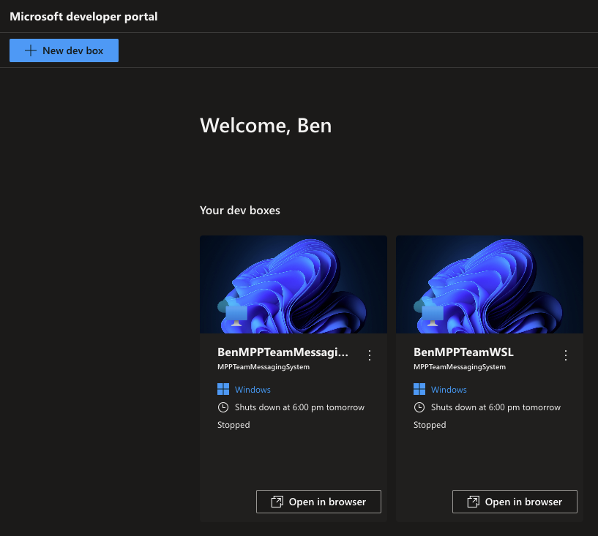
Create a Dev Box definition
Notes:
Speaker notes:
Azure Spring Apps is a platform as a service (PaaS) for Spring developers. Manage the lifecycle of your Spring Boot applications with comprehensive monitoring and diagnostics, configuration management, service discovery, CI/CD integration, and blue-green deployments.
Use the procedures to deploy an instance of Azure Spring Apps.

Slide 6
Make things secure
Exercise 5

Slide 7
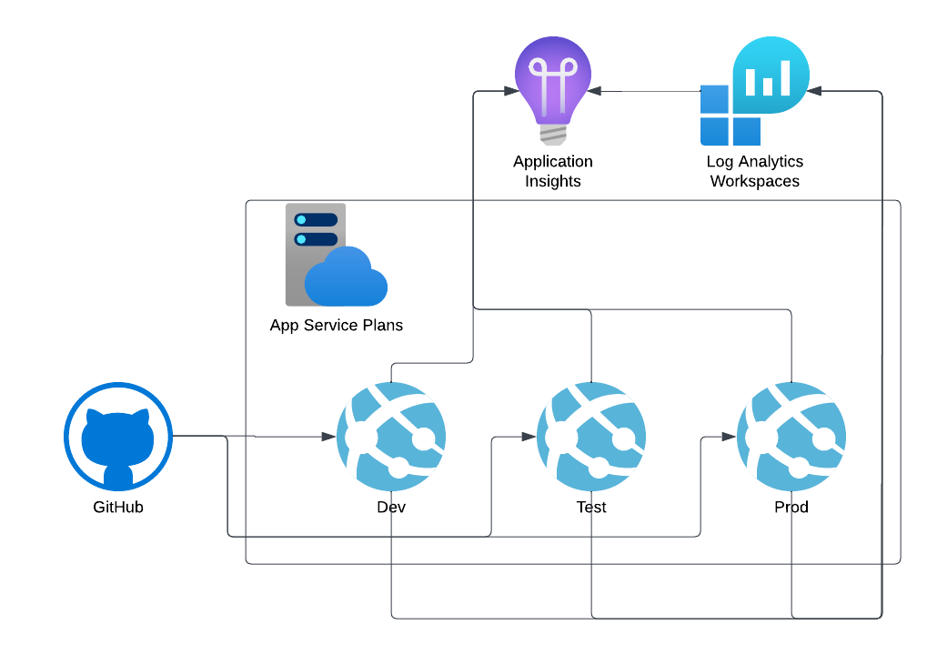
Lab 5 Architecture
Notes:
The Challenges will focus on the following parts of the Petclinic solution: Enable monitoring and end-to-end tracing

Slide 8
Introductions: Security & Monitoring
In this lab, you’ll add security to GitHub and monitoring to you application
After completing this lab, you’ll be able to:
Configure branching in GitHub
Setup protected branches
Setup a GitHub security policy
Configure code security and vulnerability scanning
Create app monitoring dashboards
Configure app availability monitoring
Notes:
Speaker notes:
You've created your first Spring Apps service, installed your microservices as applications, and exposed them through the api-gateway.
Now that everything is up and running, it would be beneficial to monitor your applications availability. Monitoring helps you determine if there are errors or exceptions within your applications.
In this challenge, you'll add end-to-end monitoring to your applications.
Learning objectives
After completing this lab, you'll be able to:
Live stream the logs from your apps
Configure Application Insights to receive monitoring information from your apps
Analyze app-specific monitoring data
Configure diagnostics settings
Analyze logs

Slide 9
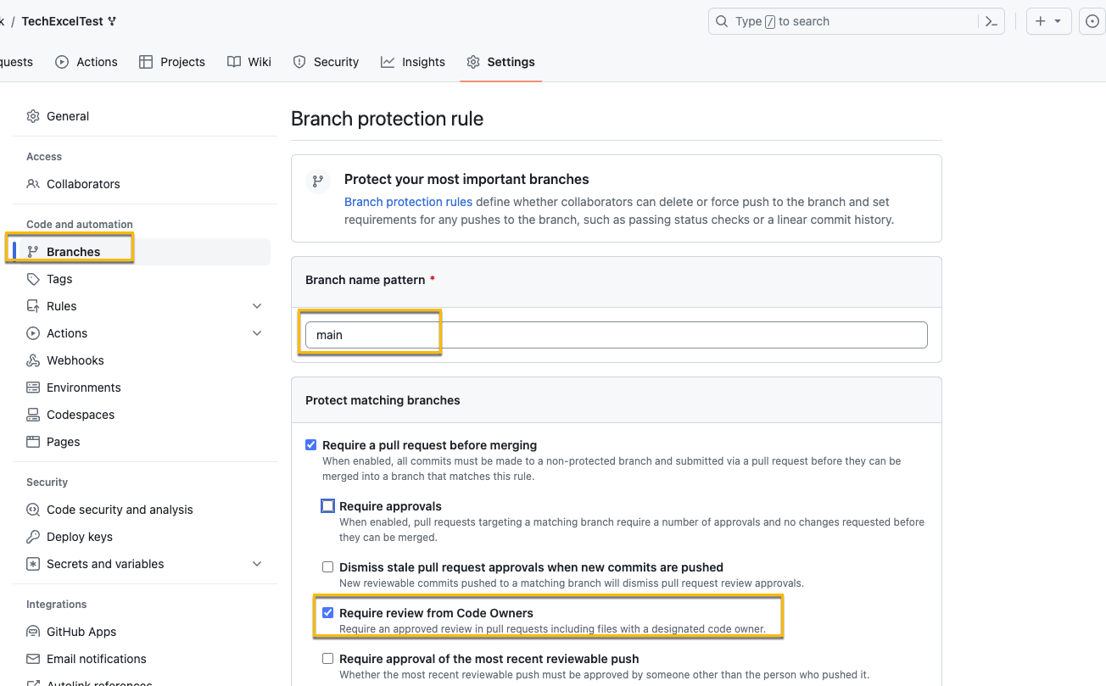
Branch Policies
Branch Policies prevent committing code directly to production without review
The rule above protect the main branch and require review from Code Owners
Notes:
Speaker notes:
Azure Spring Apps enables log streaming using Azure CLI to get real-time application console logs for troubleshooting.
You’ll live stream the logs of the customer and the visits services.
To live stream the logs for the customer service, use the following statements:
az spring app logs \ --name customer-service \ --resource-group $RESOURCE_GROUP \ --service $SPRING_APPS_SERVICE –follow
The action above will stream the customer service app logs to your console.
Switch to the web browser displaying the Spring Petclinic application and navigate throughout the interface. Notice that your actions trigger display of new log entries in the console output.
Enter Ctrl+c to stop streaming the logs.

Slide 10
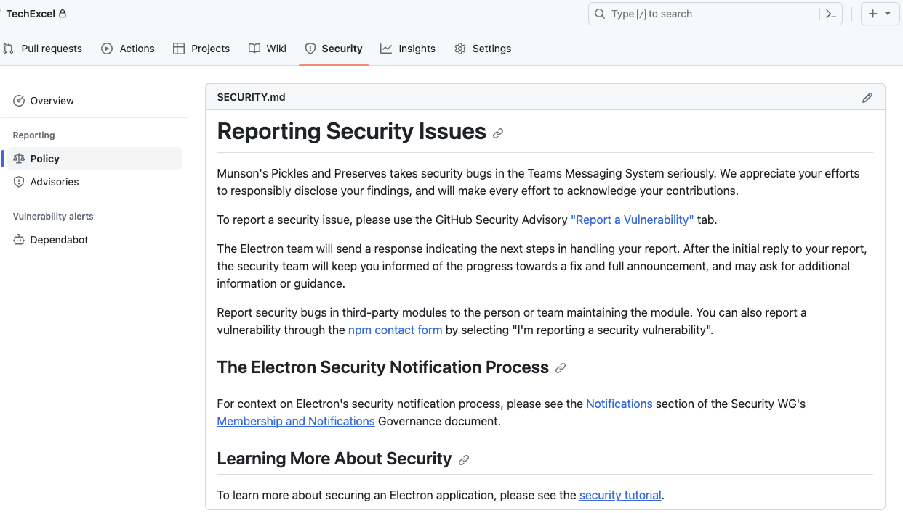
Setup a security policy for a GitHub Repo
GitHub allows you to write your own securityy policy in Markdown and place it into the repo to be surfaced in the security tab.
A security policy enables you to inform those accessing the repo about the security policy as well as how to handle any security issues or vulnerabilities.
Notes:
Speaker notes:
To use Application Insights, you either install a small instrumentation package (SDK) in your app, or enable Application Insights by using the Application Insights agent.
You can instrument the web app, any background components, and the JavaScript in the web pages themselves. The app and its components don't have to be hosted in Azure.
The instrumentation monitors your app and directs the telemetry data to an Application Insights resource by using a unique instrumentation key.
You can pull in telemetry like performance counters, Azure diagnostics, or Docker logs from host environments. All these telemetry streams are integrated into Azure Monitor.
The diagram above shows how Application Insights instrumentation in an app sends telemetry to an Application Insights resource.
Spring Apps Service uses an in-process Java Agent for Application Insights. When you initially created your service, an Application Insights resource was created for you by default.
You'll need to check whether an Application Insights instance is linked to your Spring Apps Service. If the instance isn't linked, then relink Application Insights.

Slide 11
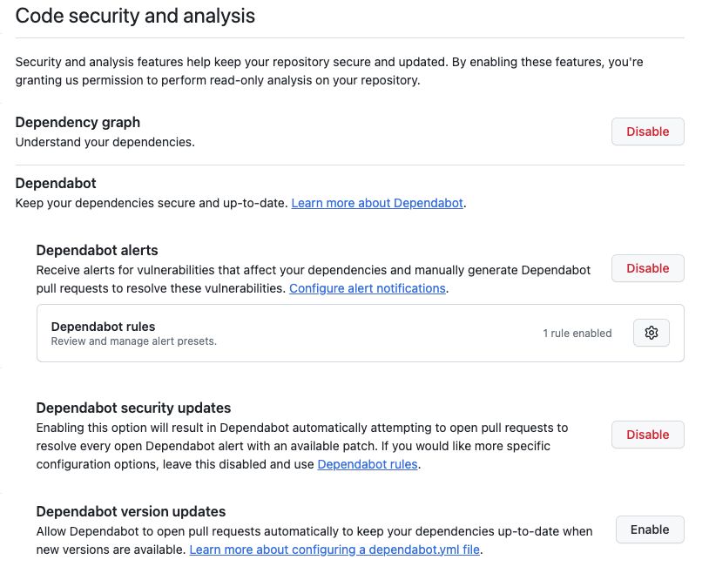
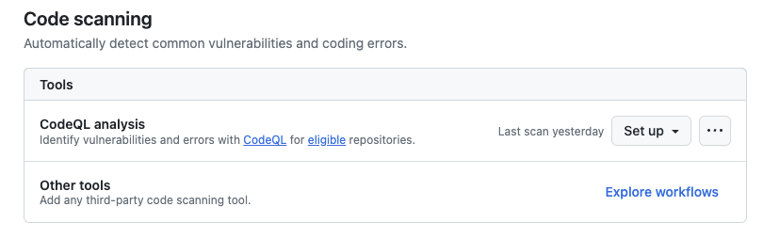
Code security and analysis
With code security and analysis, you can look for vulnerabilities. For CodeQL the repo must be public.
In this procedure, you’ll enable the following items:
Dependabot
CodeQL
Notes:
Speaker notes:
Now that Application Insights is configured, you can use the service to monitor what's happening in your application.
In this unit, you'll view the following items:
The Application Map
Performance data
Failures
Metrics
Live Metrics
Availability
Logs
To analyze monitoring data, do the procedure.

Slide 12
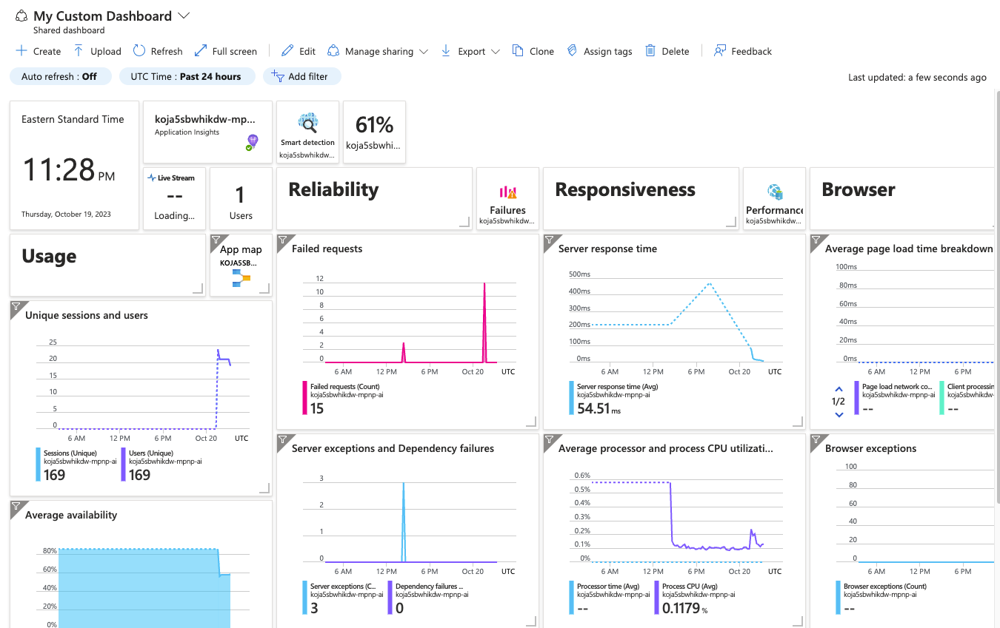
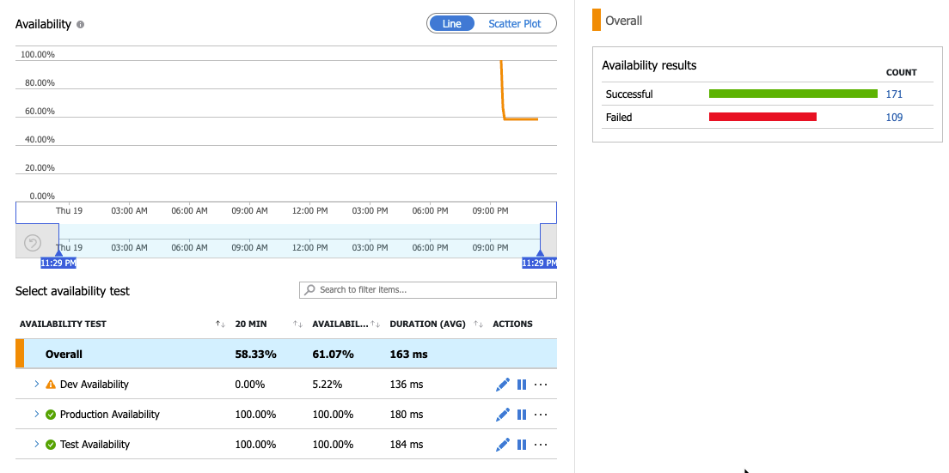
Monitor the Application
With the data from the application being logged to Log Analytics, you can create dashboards and monitoring.
In this section, you’ll work with app insights
Customize the App Insights Dashboard
Setup availability monitoring
View availability alerting
Notes:
Speaker notes:
Now that you’ve been collecting log data from your Spring Apps Service, your next step will be to query the log data.
In this section, you'll view the following entries:
Log entries containing errors or exceptions
Ingress log entries.
Container log entries
To view the log entries, do the following procedures.

Slide 13
Secure MySQL database and Key Vault using a VNet and Private Endpoint

Slide 14
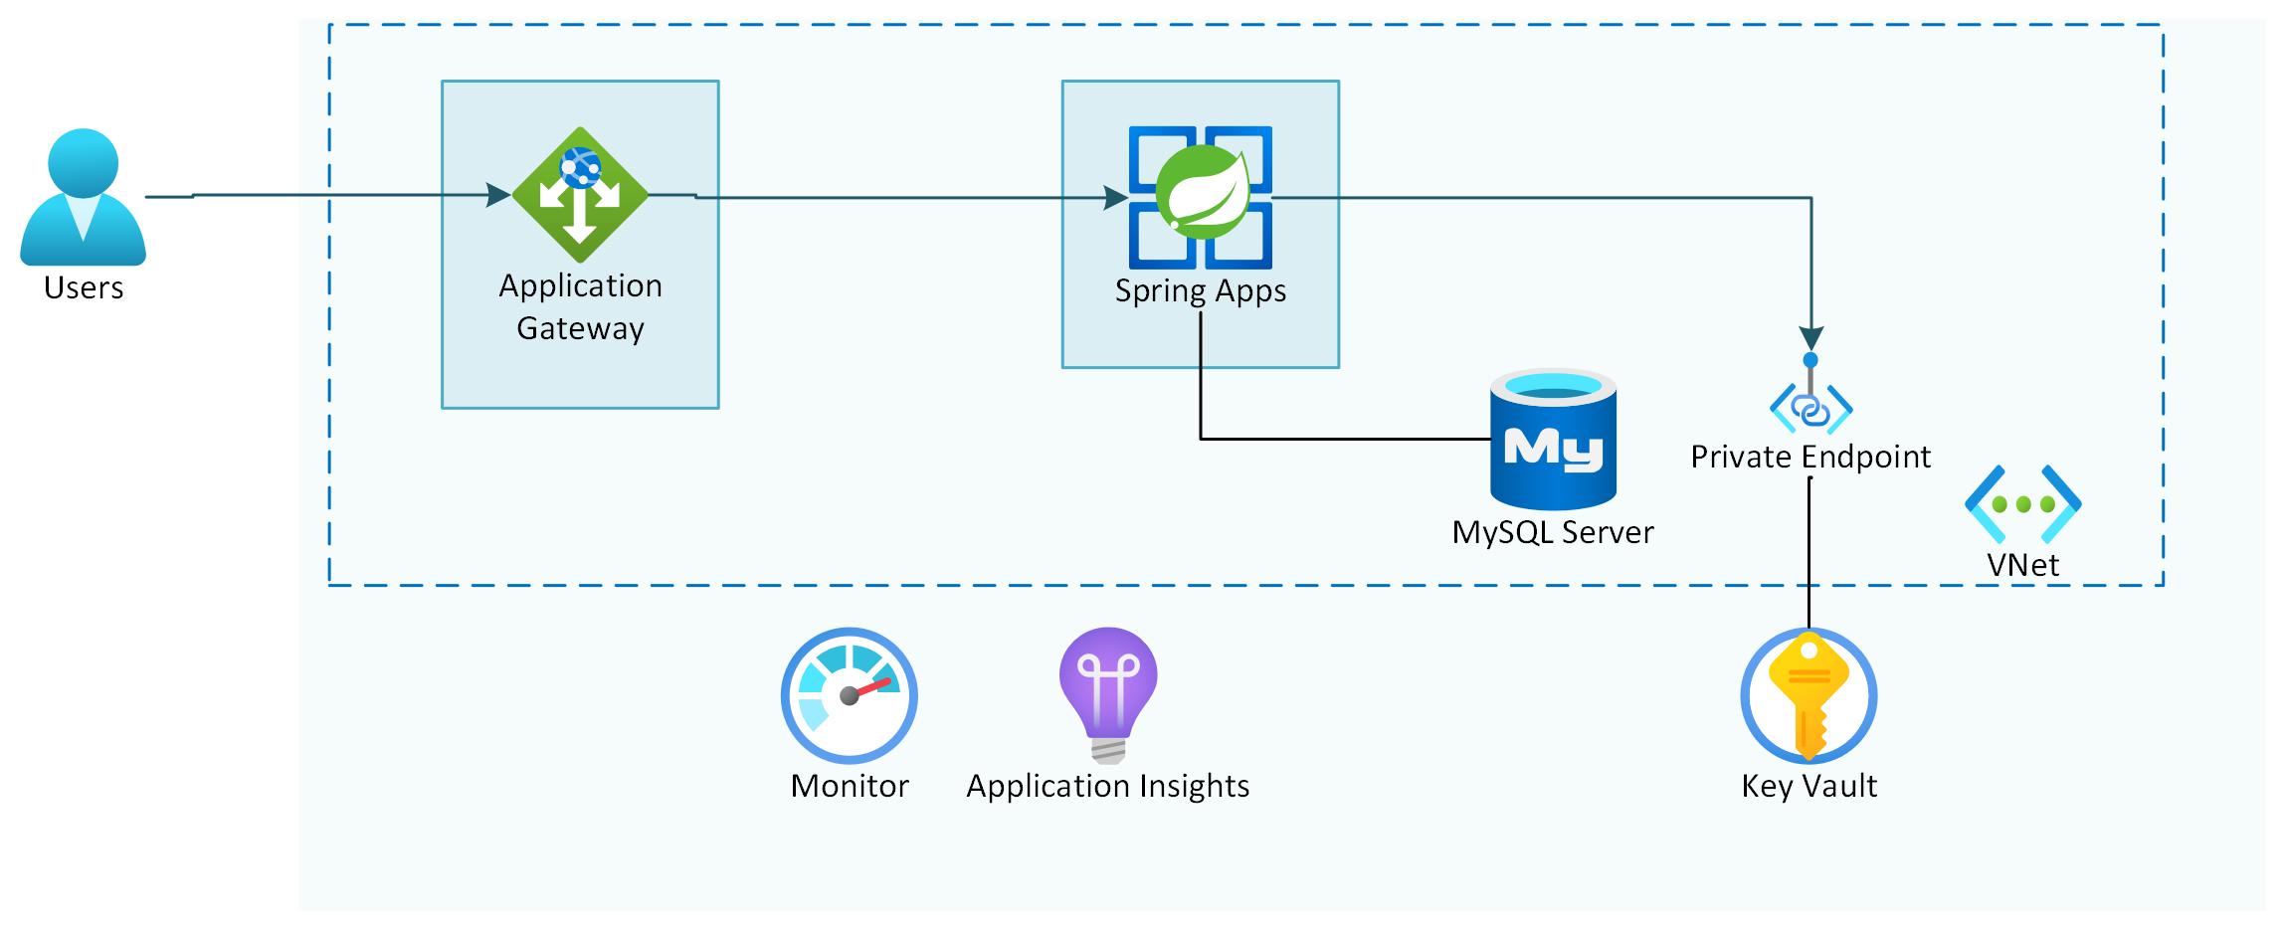
Lab 9 Architecture
Petclinic application architecture
Notes:
The Challenges will focus on the following parts of the Petclinic solution: Secure MySQL database and Key Vault using a VNet and Private Endpoint

Slide 15
Introduction: Secure MySQL database and Key Vault using a Private Endpoint
In this lab, you’ll implement a configuration where connections that originate from within your virtual network are accepted.
After completing this lab, you’ll be able to:
Lock down the Azure Database for MySQL Flexible Server instance by redeploying it in a subnet.
Recreate the service connections to the new MySQL Flexible Server instance.
Lock down the Key Vault instance by using a private endpoint.
Test your setup.
Notes:
Speaker notes:
You now have an Azure Spring Apps Enterprise application deployed into a virtual network. All incoming application connection requests from the internet must pass through an Application Gateway instance using a Web Application Firewall. The apps communicate with the backend services, such Azure Database for MySQL Single Server and Key Vault using public endpoints.
In this lab, you'll implement a configuration where connections that originate from within your virtual network are accepted.
Learning objectives
After completing this lab, you'll be able to:
Lock down the Azure Database for MySQL Flexible Server instance by redeploying it in a subnet
Recreate the service connections to the new MySQL Flexible Server instance
Lock down the Key Vault instance by using a private endpoint
Test your setup

Slide 16
Lock down the Azure Database for MySQL Flexible Server instance by redeploying it in a subnet
You’ll lock down access to your MySQL database by integrating it in your VNet. Once you’ve redeployed the MySQL in a subnet, you can block public access to your database.
Virtual Network (VNet) integration for an Azure Database for MySQL - Flexible Server enables you to lock down access to the server to only your virtual network infrastructure.
Your VNet can include all your application and database resources in a single virtual network or may stretch across different VNets in the same region or a different region.
Azure Database for MySQL - Flexible Server supports client connectivity from:
Virtual networks within the same Azure region. (locally peered VNets)
Virtual networks across Azure regions. (Global peered VNets)
Subnets enable you to segment the virtual network into one or more subnetworks and allocate a portion of the virtual network's address space to which you can then deploy Azure resources.
Notes:
Speaker notes:
You’ll lock down access to your MySQL database by integrating it in your VNet.
Virtual Network (VNet) integration for an Azure Database for MySQL - Flexible Server enables you to lock down access to the server to only your virtual network infrastructure.
Your VNet can include all your application and database resources in a single virtual network or may stretch across different VNets in the same region or a different region.
Azure Database for MySQL - Flexible Server supports client connectivity from:
Virtual networks within the same Azure region. (locally peered VNets)
Virtual networks across Azure regions. (Global peered VNets)
Subnets enable you to segment the virtual network into one or more subnetworks and allocate a portion of the virtual network's address space to which you can then deploy Azure resources. .
Once you’ve redeployed the MySQL in a subnet, you can block public access to your database.

Slide 17
Recreate the service connections to the new MySQL Flexible Server instance
You’ll need to recreate each of the service connections of the customers, visits and vets services to the database
VM_NAME=jumpbox-$APPNAME-$UNIQUEID
VM_ADMIN=<username>
VM_PASS=<password>
az vm create \
--name $VM_NAME \
--admin-username $VM_ADMIN \
--admin-password $VM_PASS \
--image Debian11 \
--resource-group $RESOURCE_GROUP \
--vnet-name $VIRTUAL_NETWORK_NAME \
--subnet $JUMPBOX_SUBNET_NAME \
--generate-ssh-keys \
--output json \
--verbose
This needs to be executed from a prompt with network line of sight to your database server.
Therefore you'll be creating a jumpbox in the VNet and a bastion host for connecting to it.
You can then execute the needed steps from the jump box.
Notes:
Speaker notes:
As a next step you will need to recreate each of the service connections of the customers, visits and vets services to the database. If you would try to do this from your git bash window, the creation of these will fail, since te statement needs to be executed from a prompt with network line of sight to your database server.
For your current git bash prompt that is not the case.
For executing these steps, you will be creating a jumpbox in the VNet and a bastion host for connecting to it. You can then execute the needed steps from the jump box.

Slide 18
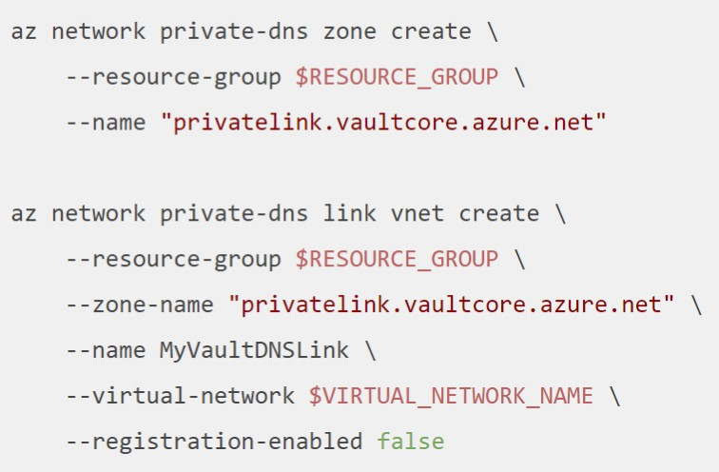
Secure Key Vault with a Private Endpoint
You’ll create a setup to protect the Key Vault content.
1
Create a private endpoint for the Key Vault instance.
2
Create a private DNS zone, this time for privatelink.vaultcore.azure.net.
Create the A record to link the Azure Key Vault instance name to the IP address of the private endpoint.
3
Notes:
Speaker notes:
Now that you've locked down the internet access to the MySQL database, you'll perform a similar setup to protect the Key Vault content.
Create a private endpoint for the Key Vault instance.
Create a private DNS zone, this time for privatelink.vaultcore.azure.net.
Create the A record to link the Azure Key Vault instance name to the IP address of the private endpoint.

Slide 19
Test the configuration
As the final step of this exercise, you should once again test your setup.
You should still be able to navigate to your application through the custom domain that you configured on your Application Gateway and view the listing of owners and veterinarians.
If you don’t see any data when navigating the menu options in the application, try redeploying the customers, visits, and vets apps again to Azure Spring Apps Enterprise.
Notes:
Speaker notes:
As the final step of this exercise, you should once again test your setup.
You should still be able to navigate to your application through the custom domain that you configured on your Application Gateway and view the listing of owners and veterinarians.
If you don't see any data when navigating the menu options in the application, try redeploying the customers, visits and vets' apps again to Azure Spring Apps Enterprise.

