Slide 1
Start working in GitHub

Slide 2
Introductions: Start working in GitHub
In this lab, you’ll begin by creating a GitHub repository. From there, you will create a GitHub Project and associate issues with that project. Finally, you will create a simple GitHub Actions workflow.
After completing this lab, you’ll be able to:
Create a GitHub repository.
Create a GitHub Project.
Assign issues to teammates and navigate a project board.
Add custom fields to issues.
Create a GitHub Actions workflow.
Extend a GitHub Actions workflow with multiple jobs.
Incorporate workflow actions from the GitHub Marketplace.
Notes:
Speaker notes:
In the previous lab, you create a Dev Box to perform development work.
In this lab, you will create a GitHub repository and work through some of the mechanics of GitOps, including project board management, issue management, and the creation of a GitHub Actions workflow.
Learning objectives
After completing this lab, you'll be able to:
Create a GitHub repository
Create a GitHub Project
Assign issues to teammates and navigate a project board
Add custom fields to issues
Create a GitHub Actions workflow
Extend a GitHub Actions workflow with multiple jobs
Incorporate workflow actions from the GitHub Marketplace

Slide 3
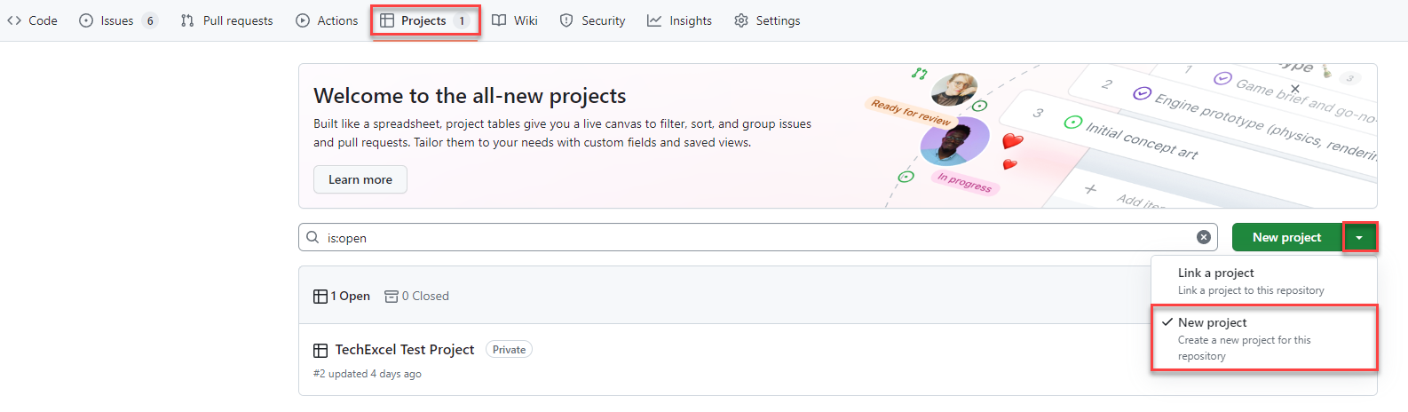
Create a GitHub Project
Notes:
Speaker notes:
GitHub Projects allow development teams and project managers to manage issues, using either a scrum or kanban motif.

Slide 4
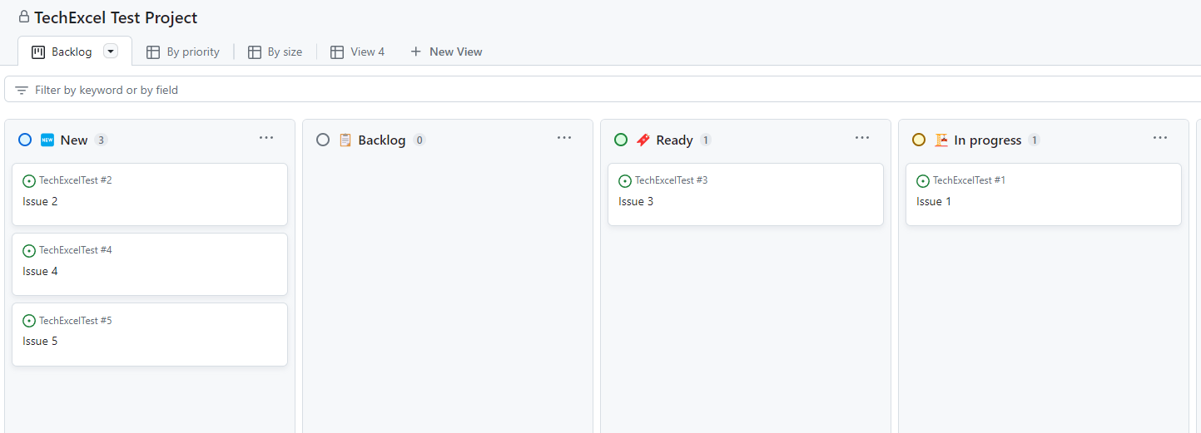
Navigate the project board
Notes:
Speaker notes:
You will create a series of issues on a project board and see how you can manipulate the board to keep track of the status of issues. You will assign issues to teammates and add a custom field to issues.

Slide 5
Create a GitHub Actions workflow
You’ll create the first of several GitHub Actions workflows.
name: First Workflow
on:
workflow_dispatch:
issues:
types: [opened]
jobs:
job1:
runs-on: ubuntu-latest
steps:
- name: Step one
run: echo "Log from step one"
- name: Step two
run: echo "Log from step two"
job2:
needs: job1
runs-on: ubuntu-latest
steps:
- name: Cowsays
uses: mscoutermarsh/cowsays-action@master
with:
text: 'Ready for prod--ship it!'
color: 'magenta'
Allow the workflow to run manually.
Each workflow has one or more jobs. We will create two jobs.
Each workflow job has one or more steps.
You’ll include the cowsays action from the GitHub Marketplace.
Notes:
Speaker notes:
GitHub Actions workflows allow you to perform actions on specific events, such as push code into a branch, creating a pull request, creating an issue, or manual execution.
For this first workflow, you will create a workflow which executes manually. In it, there will be two jobs. The first job will write statements into logs. The second will use the “cowsays” action from the GitHub Marketplace to write a statement into the logs.

Slide 6
Improve and deploy your application

Slide 7




Lab 3 Architecture
Munson’s Pickles & Preserves application architecture
App Service Plan
App Insights
App Service (Dev)
App Service (Test)
App Service (Prod)
Container Registry
Notes:
This lab will focus on deploying the Munson’s Pickles and Preserves Team Messaging System application into Azure.

Slide 8
Introductions: Improve and deploy your application
In this lab, you’ll deploy Azure resources and introduce CI/CD pipelines to your GitHub repo.
After completing this lab, you’ll be able to:
Configure GitHub Copilot and use it to assist with C# code changes.
Deploy ARM and Bicep templates via GitHub Actions workflow.
Create a GitHub Actions workflow for deploying .NET web applications.
Automatically build and deploy a Docker image as part of a workflow.
Update an Azure Web App whenever the GitHub Actions workflow deploys a new Docker image.
Notes:
Speaker notes:
You've created a GitHub repository containing application code and a Bicep script. In this lab, you will create resources in an Azure resource group, including an App Service Plan, three App Services, one Application Insights service, and one Container Registry. You will also use GitHub Copilot in Visual Studio Code to assist you with making a change to the Team Messaging System.
After deploying Azure resources, you will create a new GitHub Actions workflow that builds and deploys a Docker container image based on the .NET web application code. Then, whenever the application code changes, you will build a new image, deploy it to the Container Registry, and use that new image in your App Services.
Learning objectives
After completing this lab, you'll be able to:
Configure GitHub Copilot and use it to assist with C# code changes
Deploy ARM and Bicep templates via GitHub Actions workflow
Create a GitHub Actions workflow for deploying .NET web applications
Automatically build and deploy a Docker image as part of the workflow
Update an Azure Web App whenever the GitHub Actions workflow deploys a new Docker image

Slide 9

Follow the GitHub Flow
The GitHub Flow is a common process for managing code changes through GitHub.
Create a GitHub Issue
Create a feature branch
Fetch repo changes locally
VS Code
Commit and push changes
GitHub allows you to tie issues, branches, and pull requests together, letting GitHub close issues and delete feature branches after code moves to the main branch.
Pull request to main
Code review
Complete pull request
Notes:
Speaker notes:
The GitHub flow is a standard process for making code changes in a GitHub repository. There are several steps to the GitHub flow:
Create a GitHub Issue describing the problem you would like to solve. This may involve discussion with team members, project managers, issue reporters, and relevant stakeholders. The GitHub Issue should include enough details to prompt a code change.
Create a new branch. This new branch, called a feature branch, will allow you to work on your code independent of other developers. It will also allow you to experiment without breaking important code release branches like a development or main branch.
After creating the new branch, fetch changes locally and switch to the newly created feature branch. At this point, any changes you make locally will be in the feature branch, isolating your changes from others.
Make any necessary changes in tools like Visual Studio Code. If you have correctly configured Visual Studio Code and installed the C# extension, you should be able to run the .NET web application locally and try it out in a browser.
After you have completed all code changes, you can commit these changes locally. Then, when you are ready to complete the task, you can push your changes to the remote feature branch.
After you have pushed your changes, you can create a pull request. In this case, we will pull request directly to the main branch, though some repositories may have a series of branches such as dev, test, and main.
A teammate should perform a code review of the code in your pull request. This allows a second set of eyes to review the code changes and ensure that these are appropriate and correct changes.
After the code review completes, completing the pull request is the final step. In this process, you may wish to delete the feature branch and close the originating issue.

Slide 10
Deploy a Bicep template
GitHub allows you to execute ARM and Bicep templates as part of a GitHub Actions workflow.
To deploy resources, you will need to log into Azure and then use the arm-deploy action.
- uses: azure/login@v1
with:
creds: ${{ secrets.AZURE_CREDENTIALS }}
- name: Run ARM deploy
uses: azure/arm-deploy@v1
with:
subscriptionId: ${{ secrets.AZURE_SUBSCRIPTION_ID }}
resourceGroupName: ${{ secrets.AZURE_RG }}
template: ./InfrastructureAsCode/main.bicep
parameters: environment=${{ github.event.inputs.appenv }}
The action above will deploy a file called main.bicep to Azure whenever the GitHub Actions workflow runs.
Notes:
Speaker notes:
GitHub allows you to execute ARM and Bicep templates as part of a GitHub Actions workflow. To do this, you can use the azure/arm-deploy action from the GitHub Marketplace. It needs several parameters, including a subscription ID, a resource group name, the location of the ARM or Bicep template file, and a set of input parameters.
The arm-deploy action can work with both ARM and Bicep templates because Bicep is fully translatable into ARM.
You will create a GitHub Actions workflow to perform this operation. In practice, this would allow you to automate resource changes whenever the Bicep template changes, automating your Infrastructure as Code process.

Slide 11
CI/CD for .NET websites with GitHub Actions
Create another GitHub Actions workflow for deploying the website
steps:
- uses: actions/checkout@v3
- name: Setup .NET
uses: actions/setup-dotnet@v3
with:
dotnet-version: 6.0.x
- name: Restore dependencies
run: dotnet restore
- name: Build
run: dotnet build --no-restore
- name: Test
run: dotnet test --no-build
Create a GitHub Actions .NET workflow and configure each of the steps.
Add environment variables to manage deployment.
Build a Docker image from the .NET code and deploy it to Azure Container Registry. Then, update the Web App with that new container image.
Notes:
Speaker notes:
The final step in this lab is to create a Continuous Integration and Continuous Delivery (CI/CD) process for deploying the .NET website. You will use yet another GitHub Actions workflow, this one based around .NET CI/CD. The core of this workflow includes three commands: dotnet restore to restore any dependencies in NuGet packages, dotnet build to compile the application and create binaries, and dotnet test to run unit tests against the compiled binaries.
In addition, you will extend this workflow to build a Docker image from the .NET code and deploy it into an Azure Container Registry. Then, for each newly tagged image, you will update each environment’s Web App with that container image.

Slide 12
Implement load testing secure practices

Slide 13


Lab 4 Architecture
Munson’s Pickles & Preserves application architecture
App Service Plan
App Insights
Chaos Experiment
App Service (Dev)
App Service (Test)
App Service (Prod)
Container Registry
Load Testing
Notes:
This lab will focus on extending the current Azure solution to include load testing and Azure Chaos Studio.

Slide 14
Introductions: Implement load testing and secure practices
In this lab, you’ll create an Apache JMeter load test, use this load test in an Azure Load Test service, and design a chaos experiment using Azure Chaos Studio.
After completing this lab, you’ll be able to:
Design a load test for a web application.
Create a load test using Apache JMeter.
Create an Azure Load Testing service and execute the JMeter load test in Azure.
Design and create a stress test using the Azure Load Testing service.
Design a chaos experiment in Azure Chaos Studio.
Notes:
Speaker notes:
Now that the Team Messaging System website is up and running, it would be beneficial to understand how well the application performs under load. To do this, you will design a load test scenario and then implement it using Apache JMeter, an open source solution for load testing.
After running the load test manually, you will create an Azure Load Testing service. The Load Testing service supports importation of JMeter scripts, so you will be able to use the work you’ve created so far and create a performance baseline for the application. You may also be able to observe performance issues in particular actions, which you can remedy.
After that, you will extend the load test to become a stress test, attempting to push enough traffic at the website to generate failure. You will also use Azure Chaos Studio to generate a chaos experiment, learning how the application behaves when certain services fail.
Learning objectives
After completing this lab, you'll be able to:
Design a load test for a web application
Create a load test using Apache JMeter
Create an Azure Load Testing service and execute the JMeter load test in Azure
Design and create a stress test using the Azure Load Testing service
Design a chaos experiment in Azure Chaos Studio

Slide 15
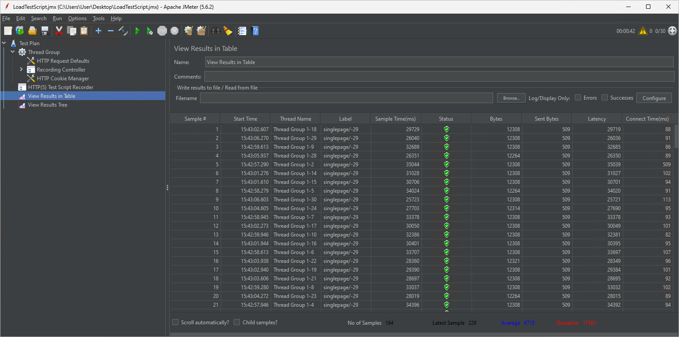
Build and run a load test
Apache JMeter is an open source tool for building and running load test scripts.
Apache JMeter
A load test allows us to simulate a certain amount of traffic against an application to ensure that the application can handle that level of load.
Notes:
Speaker notes:
Apache JMeter is an open source tool for building and running load test scripts. It requires Java 8 or later to be installed and was one of the tools you installed on your Dev Box. You will be able to build a load test using the JMeter GUI, after which you can either run the test in the GUI itself or via command line.
These load tests allow us to simulate a certain amount of traffic against an application. You will design the test and specify how many concurrent users will run this workload. The intent is to ensure that the App Service you created will be able to handle a certain amount of traffic without failure.

Slide 16
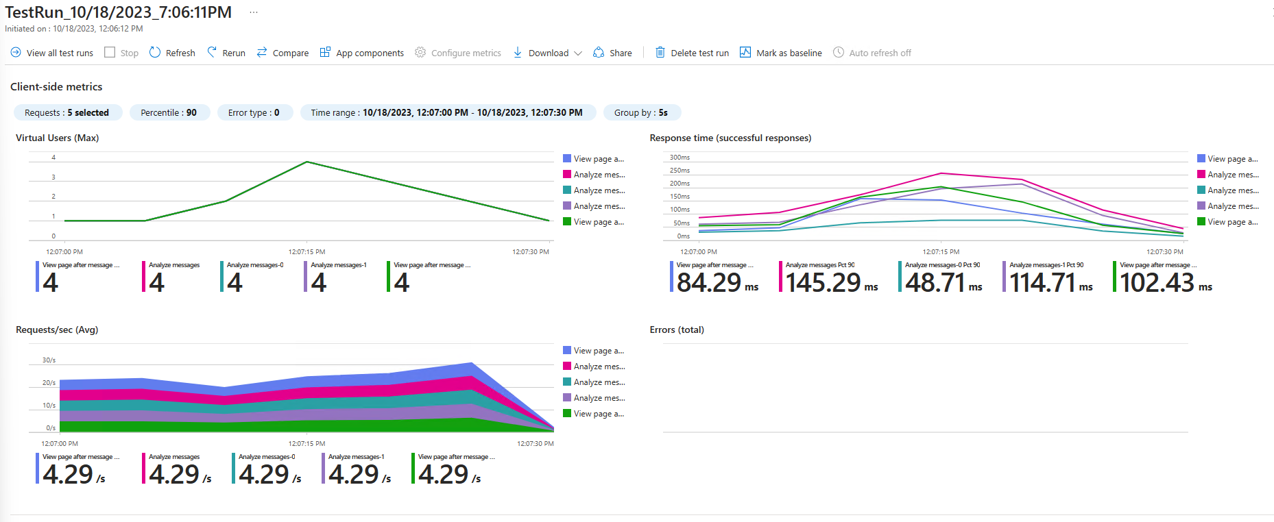
Working with Azure Load Testing
Notes:
Speaker notes:
In addition to running load tests directly via JMeter, you will also create an Azure Load Testing service and run load tests from it. Azure Load Testing accepts JMeter scripts, so you can use the script you have already created as the basis for additional testing. This will provide you with additional information on response times and allow you to link your load test to specific Azure resources and see how the level of load affects those services.
For this lab, you will link the load test to your App Service.

Slide 17
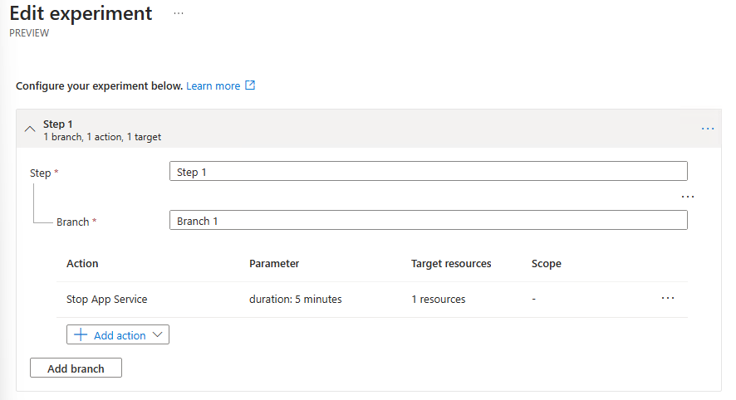
Build an Azure Chaos experiment
You’ll create a chaos experiment to observe behavior when the App Service stops.
Azure Chaos Studio allows us to design experiments that disable resources and test the resiliency of applications.
During the experiment, you will run a load test to simulate activity, observing what happens when a service fails.
Notes:
Speaker notes:
Load testing is not the only form of testing you can run in Azure. You can also run chaos experiments to simulate service failures.
Azure Chaos Studio allows you to design experiments that disable specific resources for a given amount of time. Azure Chaos Studio is currently in preview and supports a limited number of services, so for this lab, we will stop the App Service for a fixed amount of time, seeing how it impacts a running load test.

