Slide 1
Header Space Analysis: Static Checking For Networks
Peyman Kazemian (Stanford University)
George Varghese (UCSD, Yahoo Labs)
Nick McKeown (Stanford University)
November 7th, 2012
IRTF

Slide 2
Motivation
It is hard to understand and reason about end-to-end behavior of networks:
Can host A talk to host B?
What are all the packet headers from A that can reach B?
Are there any loops or black holes in the network?
Is Slice X isolated totally from Slice Y?
What will happen if I remove an entry from a router?

Slide 3
Motivation
There are two reason for this complexity:
Networks are getting larger.
Network functionality becoming more complex.
Firewalls, ACLs and deep packet inspection MBs.
VLAN and inter-VLAN routing.
Encapsulation (MPLS, GRE).
ToS-based routing.
nondeterministic routing.
Application
Transport
Internet
Access
Notes:
There are two high level reasons for this:
networks are getting larger, while 15 years ago, not everyone has a personal computer and not every computer was connected to internet, these days people own about half a dozen computing devices that is connected to internet. This means that networks should be larger with more switches. Routers and capacity.
Networks are getting more complex. as more people are connected to the network and more application are using the network, more functionality, beyond simple routing, is expected from the network:
security concerns lead to introduction of firewalls, ACLs and deep packet inspection middle boxes.
The growth in number of local hosts and security constraints lead to introduction of VLANs and therefore inter-VLAN routing.
Encapsulation mechanism such as GRE and MPLS were invented to provide specialized routing.
QoS requirements lead to ToS-based routing.
And load balancing requirement introduced nondeterminism in the packet routing.
Therefore the faith of packet is no longer determined by IP layer, but every bit in the packet header can contribute. And it is unlikely that this trend changes any time soon, in fact probably the protocol and header boundaries will probably become looser overtime as new overlays and middle boxes are introduced or as SDNs makes it more flexible to introduce new protocols and headers. So what can we do, despite this, to gain a more solid understanding of networks, and operate and manage networks more correctly?

Slide 4

Looking at the other fields
Communication Systems:
S
Frequency
Modulation
De-
Modulation
D
Amplifier
Antenna
Antenna
Band Pass Filter
Cos(wt)
Cos(wt)
Notes:
To get some insight, let’s look at the field of communication systems. There is a similar problem there: given a complex system consisting of many different elements, we are interested to know how an input signal will be received at the receiver. Let’s look at an example system. Consider this system that consists of different components such as amplifier, modulator and demodulator, Antenna and filter. Our goal is to find out how the receiver will receive the signal. To solve the problem we first find the Fourier representation of the input signal. This gives us a simple and common way to represent any signal from voice and video to data. Then we model each component of the system by its transfer functions. The beauty of this approach is that once we have the transfer function of these components, they all look the same: we no longer care about whether it is an antenna, an amplifier or the transmission medium. Then we apply the input signal to the transfer functions one by one and find the signal at the receiving end.

Slide 5
Header Space Analysis
A simple abstraction to model all kinds of forwarding functionalities regardless of specific protocols and implementations.

Slide 6
Header Space Framework Simple Observation: a packet is a point in the space of possible headers and a box is a transformer on that space.

Slide 7
Header Space Framework
Step 1 - Model packet header as a point in {0,1}^{L} space – The Header Space
Header
Data
01110011…1
0xxxx0101xxx
L

Slide 8
Header Space Framework
Step 2 – Model all networking boxes as transformer of header space
1101..00
3
Transfer Function:
1
Packet
Forwarding
1110..00
2
Match
Action
+
0xx1..x1
+
11xx..0x
Send to port 3
Rewrite with 1xx011..x1
Send to port 2
Rewrite with 1x01xx..x1

Slide 9
Header Space Framework
Example: Transfer Function of an IPv4 Router
172.24.74.0 255.255.255.0 Port1
172.24.128.0 255.255.255.0 Port2
171.67.0.0 255.255.0.0 Port3
1
2
3
(h,1) if dst_ip(h) = 172.24.74.x
T(h, p) =
(h,2) if dst_ip(h) = 172.24.128.x
(h,3) if dst_ip(h) = 171.67.x.x

Slide 10
Header Space Framework
Example: Transfer Function of an IPv4 Router
172.24.74.0 255.255.255.0 Port1
172.24.128.0 255.255.255.0 Port2
171.67.0.0 255.255.0.0 Port3
1
2
3
(dec_ttl(h),1) if dst_ip(h) = 172.24.74.x
T(h, p) =
(dec_ttl(h),2) if dst_ip(h) = 172.24.128.x
(dec_ttl(h),3) if dst_ip(h) = 171.67.x.x

Slide 11
Header Space Framework
Example: Transfer Function of an IPv4 Router
172.24.74.0 255.255.255.0 Port1
172.24.128.0 255.255.255.0 Port2
171.67.0.0 255.255.0.0 Port3
1
2
3
(rw_mac(dec_ttl(h),next_mac) , 1) if dst_ip(h) = 172.24.74.x
T(h, p) =
(rw_mac(dec_ttl(h),next_mac) , 2) if dst_ip(h) = 172.24.128.x
(rw_mac(dec_ttl(h),next_mac) , 3) if dst_ip(h) = 171.67.x.x

Slide 12
Example Rules:
FWD & RW: rewrite bits 0-2 with value 101
(h & 000111…) | 101000…
Encapsulation: encap packet in a 1010 header.
(h >> 4) | 1010….
Decapsulation: decap 1010xxx… packets
(h << 4) | 000…xxxx
Load Balancing:
LB(h,p) = {(h,P₁),…(h,P_{n})}

Slide 13
Header Space Framework
Properties of transfer functions
Composable:
Invertible:
R1
R2
R3
T₁(h, p)
T₃(h, p)
T₂(h, p)
Domain (input)
Range (output)

Slide 14
Header Space Framework
Step 3 - Develop an algebra to work on these spaces.
Every object in Header Space, can be described by union of Wildcard Expressions.
We want to perform the following set operations on wildcard expressions:
Intersection
Complementation
Difference

Slide 15
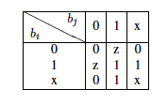
Header Space Framework
Finding Intersection:
Bit by bit intersect using intersection table:
Example:
If result has any ‘z’, then intersection is empty:
Example:
See the paper for how to find complement and difference.

Slide 16
Use Cases of Header Space Framework These are only some example use cases that we developed so far…

Slide 17

Use Cases
Can host A talk to B?
All Packets that A can use to communicate with B
A
T⁻¹₁
Box 1
Box 2
T⁻¹₂
T₂(T₁(X,A))
T⁻¹₁
T₁(X,A)
T⁻¹₄
T₄(T₁(X,A))
T⁻¹₃
Box 4
Box 3
B
T⁻¹₃
T₃(T₂(T₁(X,A)) U T₃(T₄(T₁(X,A))

Slide 18
Use Cases
Is there a loop in the network?
Inject an all-x text packet from every switch-port
Follow the packet until it comes back to injection port
T₁(X,P)
Box 2
T₂(T₁(X,P))
T⁻¹₂
Box 1
T⁻¹₁
T⁻¹₃
Box 3
Original HS
T⁻¹₄
Returned HS
T₃(T₂(T₁(X,P)))
T₄(T₃(T₂(T₁(X,P))))
Box 4

Slide 19
Use Cases
Is the loop infinite?
Finite Loop
Infinite Loop
?

Slide 20
Use Cases
Are two slices isolated?
What do we mean by slice?
Fixed Slices: VLAN slices
Programmable Slices: slices created by FlowVisor
Why do we care about isolation?
Banks: for added security.
Healthcare: to comply with HIPAA.
GENI: to isolate different experiments running on the same network.

Slide 21
Use Cases
Are two slices isolated?
1) slice definitions don’t intersect.
2) packets do not leak.
Box 2
Box 1
Box 3
Box 4

Slide 22
Header Space Framework
A Powerful General Foundation that gives us
A common model for all packets
Header Space.
A unified view of almost all type of boxes.
Transfer Function.
A powerful interface for answering different questions about the network.
T(h,p) and T⁻¹(h,p)
Set operations on Header Space

Slide 23
Implementation And Evaluation

Slide 24
Implementation
Header Space Library (Hassel)
Written in Python and C.
Implements Header Space Class
Set operations
Implements Transfer Function Class
T and T⁻¹
Implements Reachability, Loop Detection and Slice Isolation checks.
< 50 lines of code
Includes a Cisco IOS parser, Juniper Junos Parser and OpenFlow table dump parser.
Generates transfer function from CLI output.
Keeps the mapping from Transfer function rule to line number in the CLI output.
Publicly available: git clone https://bitbucket.org/peymank/hassel-public.git

Slide 25
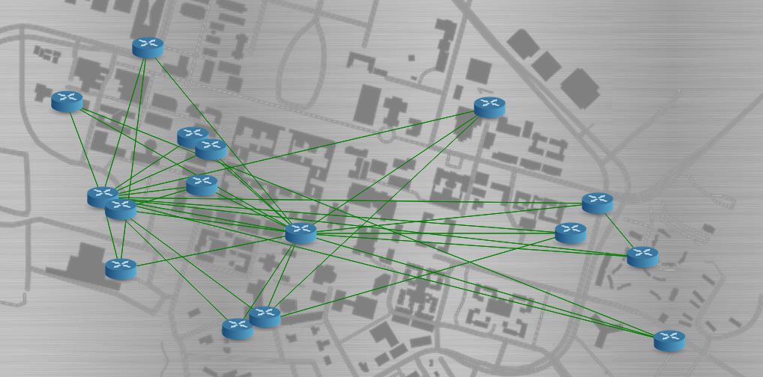
Stanford backbone network
~750K IP fwd rule.
~1.5K ACL rules.
~100 Vlans.
Vlan forwarding.

Slide 26

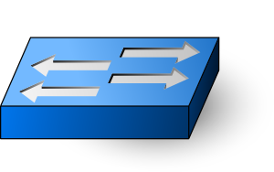
Stanford backbone network
Loop detection test – run time < 10 minutes on a single laptop.
Vlan RED Spanning Tree
Vlan BLUE Spanning Tree

Slide 27
Performance
Performance result for Stanford Backbone Network on a single machine: 4 core, 4GB RAM.
 | Python | C
Generating TF Rules | ~150 sec | -
Loop Detection Test (30 ports) | ~560 sec | ~5 sec
Average Per Port | ~18 sec | ~40ms
Min Per Port | ~8 sec | ~2ms
Max Per Port | ~135 sec | ~1sec
Reachability Test (Avg) | ~13 sec | ~40ms

Slide 28
Next Steps
Automatic Test Packet Generation (To appear in CoNEXT 2012).
Uses HSA model to Generate minimum number of test packets to maximally cover all the “rules” in the network. (Data Plane Testing)
One error detected, find the location of error in data plane.
NetPlumber: Real Time Network Policy Checker.
A tool to run HSA-style checks in real time by incrementally updating results as network changes.
Achieve on average, sub-ms run time per update for checking more than 2500 pairwise reachability checks on Google WAN.

Slide 29
Summary
Introduced Header Space Analysis As
A common model for all packets (Header Space).
A unified view of almost all type of boxes. (Transfer Function.)
A powerful interface for answering different questions about the network. (T, T⁻¹, Header Space Set Algebra)
Showed that direct implementation of HSA algorithms scales well to enterprise-size networks.

Slide 30
Thank You!
Questions?

Slide 31
Complexity
Run time
Reachability: O(dR²)
Loop Detection: O(dPR²)
R: maximum number of rules per box.
d: diameter of network.
P: number of ports to be tested
Slice Isolation Test: O(NW²)
W: number of wildcard expressions in definition of a slice.
N: number of slices in the network.
See paper for more details.

Slide 32
Complexity of Reachability and Loop Detection Tests
Run time
Reachability: O(dR²)
Loop Detection: O(dPR²)
R: maximum number of rules per box.
d: diameter of network.
P: number of ports to be tested
Assumption: Linear Fragmentation
c²R
c²R/9
c²R/9
cR
c²R/9
W₁,..W_{R}
E₁ : Match M₁,..
E₂ : Match M₂,..
E₃ : Match M₃,..
.
.
.
E_{R} : Match M_{R},..
cR/3
W₁,..W_{R}
R
W₁,..W_{R}
cR/3
c²R/9
W₁,..W_{R}
c²R/9
W₁,..W_{R}
cR/3
c²R/9
c²R/9
c²R/9
c²R/9

