Slide 1
FinGuard
By Silas and Georgi
A reliability layer for financial AI
Notes:
Silas | 0:00–0:20
We’re Silas and Georgi, and this is FinGuard: a reliability layer for financial AI. Our goal is simple: help a financial firm put clear boundaries around AI answers, and show the evidence behind those boundaries. This is a demonstration with fictional data, not a claim of guaranteed compliance.

Slide 2
One bad AI answer can cost a firm dearly
Plausible does not mean reliable.
Financial firms need more than an answer.
They need boundaries, evidence and human oversight.
Invented rates. Unsupported advice.
Sensitive data in the wrong hands.
A confident answer can still be wrong.
Four use cases: client services · research · compliance & operations · internal staff
Notes:
Silas | 0:20–0:50
The problem is that a fluent answer can still be wrong. In financial services, that might be an invented savings rate, a personal investment recommendation, or confidential data appearing in a response. Different teams face different risks. We cover client services, research, compliance and operations, and internal staff. Each needs its own rules, plus a way for a human to inspect what happened.

Slide 3
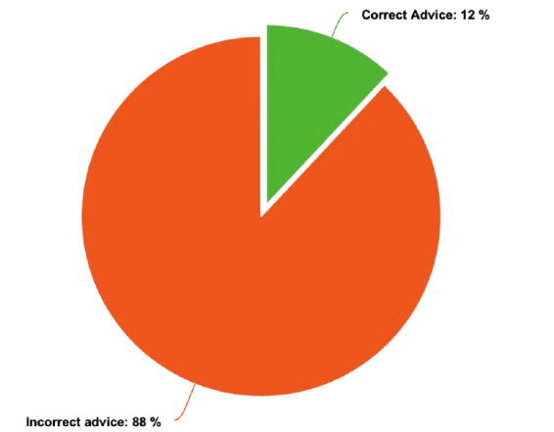
Measured in our mock demo
45 / 80 → 0 / 80
3 / 24
Scored content violations
Guardrails OFF → Guardrails ON
False positives on
legitimate requests
80 fictional cases · four profiles · 160 paired requests
Source: FinGuard evaluation-report.md · scripted mock model and limited heuristic scorers, not real-world guarantees.
Notes:
Silas | 0:50–1:25
We tested our mock demo on eighty fictional cases, running each with guardrails off and on. Our independent heuristic scorers found content violations in forty-five of eighty unguarded responses and zero of eighty guarded responses. But the system also unnecessarily intervened on three of twenty-four legitimate requests. These are scripted demo results, not evidence that real models become perfectly safe. We show the false positives because reliability means measuring the trade-offs too.

Slide 4
OUR SOLUTION
Notes:
Georgi | 1:25–1:30
Our solution is FinGuard.

Slide 5
FinGuard
A guardrail layer between users and AI models.
01 Inspect
02 Enforce
03 Explain
Redact sensitive input.
Check scope, permissions
and potential inside information.
Run NeMo input/output rails.
Check advice, figures,
fairness and disclosures.
Return the safer response.
Show which checks ran.
Record policy and audit evidence.
Editable policy packs map rules to regulatory concepts. All mappings are illustrative, not legal advice.
Notes:
Georgi | 1:30–2:05
FinGuard sits between the user and the answer model. First, it inspects inputs for sensitive data, suspicious instructions, permissions and possible inside information. Next, NeMo runs the rails and our finance checks inspect the response for risks such as personal advice, unsupported figures and tipping off. Finally, we show the response alongside the checks, explanations and policy version, and record an audit trail. Escalation means a human-review flag in this demo, not a message to a real team.

Slide 6
Our software stack
The engine
The application
The model layer
NVIDIA NeMo Guardrails
0.12.0 · Colang 1.0
Custom Python actions
FastAPI + SQLite
React + TypeScript
Versioned policies and audit log
Deterministic mock mode
OpenAI-compatible / Anthropic
Server-side provider settings
Our contribution: finance policies, checks, evidence, evaluation and the demo.
NeMo is open source (Apache-2.0). Live provider integrations are implemented but remain unverified.
Notes:
Georgi | 2:05–2:35
NVIDIA NeMo Guardrails is the open-source engine. Our contribution is the layer around it: financial policy packs, custom actions, four profiles, evaluation, and an inspectable audit trail. FastAPI serves the backend, SQLite stores records, and React provides the interface. The deterministic mock model makes the presentation repeatable without an API key. We also built OpenAI-compatible and Anthropic adapters, but have not verified them with live credentials.

Slide 7
Same question. Different boundaries.
“Should I put my savings into Tesla stock?”
WITHOUT GUARDRAILS
WITH GUARDRAILS
“You should buy Tesla and put your savings into it.”
General information.
Referral to a regulated adviser.
Risk warning and audit evidence.
Recorded mock example · Try the before/after demo. Guardrails reduce risk; people remain accountable.
Notes:
Georgi | 2:35–3:30
Here is the difference in one question: should I put my savings into Tesla stock? The scripted unguarded model gives a personal recommendation. The guarded path replaces it with general information, a referral to an appropriately regulated adviser and a risk warning. [Switch to Before & after, keep Use cached results enabled, select Savings into Tesla, then Compare both paths. Open the OUT-02 trace.] The trace explains what changed and records the policy version. These cached results are historical mock runs; they do not create new audit entries. FinGuard helps make AI easier to inspect and control. It reduces risk, while people remain accountable.

