Slide 2





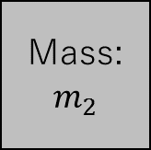






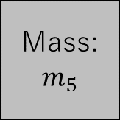



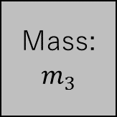








$$u_{5}(x,y)$$
$$u_{6}(x,y)$$
$$k_{6},l_{6},θ_{6}$$
$$k_{4},l_{4},θ_{4}$$
Mass:
$$m_{4}$$
$$k_{5},l_{5},θ_{5}$$
Mass:
$$m_{5}$$
Mass:
$$m_{6}$$
$$c_{6}$$
$$u_{3}(x,y)$$
$$k_{3},l_{3},θ_{3}$$
$$k_{2},l_{2},θ_{2}$$
Mass:
$$m_{3}$$
Mass:
$$m_{2}$$
$$k_{1},l_{1},θ_{1}$$
Mass:
$$m_{1}$$
$$c_{3}$$
$$v_{0}$$
$$c_{2}$$
$$u_{4}(x,y)$$
$$c_{7},l_{7}$$
$$u_{2}(x,y)$$
$$u_{1}(x,y)$$
Mass:
$$m_{7}$$
$$u_{7}(y)$$

Slide 3
