Slide 2





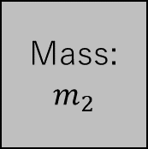






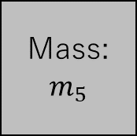



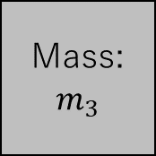



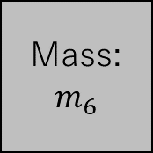
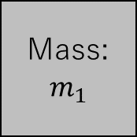



$$u_{5}$$
$$u_{6}$$
$$k_{6}$$
$$k_{4}$$
Mass:
$$m_{4}$$
$$k_{5}$$
Mass:
$$m_{5}$$
Mass:
$$m_{6}$$
$$c_{6}$$
$$u_{3}$$
$$k_{3}$$
$$k_{2}$$
Mass:
$$m_{3}$$
Mass:
$$m_{2}$$
$$k_{1}$$
Mass:
$$m_{1}$$
$$c_{3}$$
$$v_{0}$$
$$c_{2}$$
$$u_{4}$$
$$c_{7}$$
$$u_{2}$$
$$u_{1}$$
Mass:
$$m_{7}$$
$$u_{7}$$

Slide 3
