Slide 1
EZ-Drive
Members: Grant Galinger, Josh Phillips, Kyle Spraggins
Advisor: Professor Annexstein

Slide 2

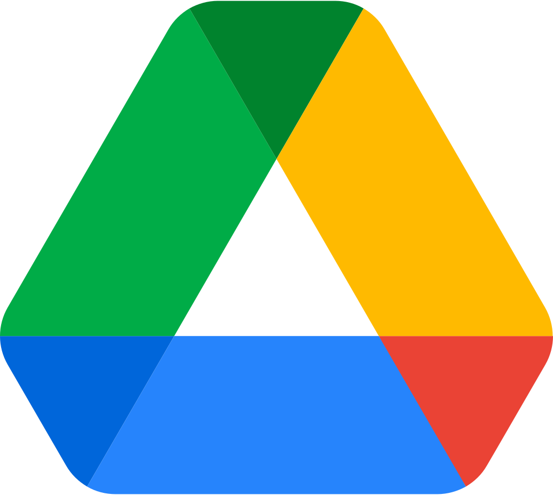
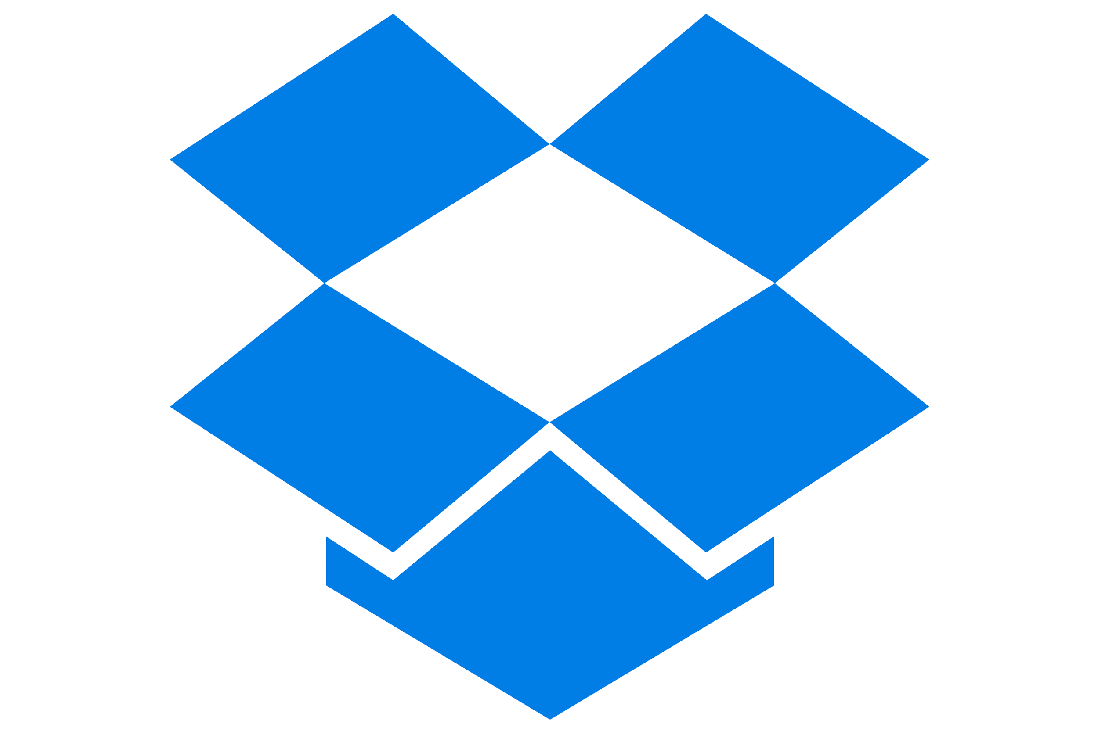
Background & Goals
EZ-Drive is a web application geared towards easily backing up user files using multiple cloud service APIs.
Google Drive OneDrive Dropbox

Slide 3
Background & Goals
We hope to achieve the following by the end of this project:
Provide an easy solution for backing up user files
Combine multiple APIs into one web application
Create well designed, easy-to-use, and aesthetically pleasing interfaces

Slide 4
Intellectual Merits
The Cloud Service APIs
Google Drive, OneDrive, Dropbox
The services allow us to connect user accounts to our application through OAuth 2.0.
Google Drive API: Introduction to Google Drive API bookmark_border
OneDrive API: Get started using OneDrive API - OneDrive dev center
Dropbox API: Getting Started - Developers
OAuth 2.0 Authorization
This industry standard protocol allows our application to gain access to user resources from their cloud service provider
Learn more about OAuth 2.0
Dropzone.js
Dropzone is an open-source library that provides drag’n’drop file uploads with image previews

Slide 5
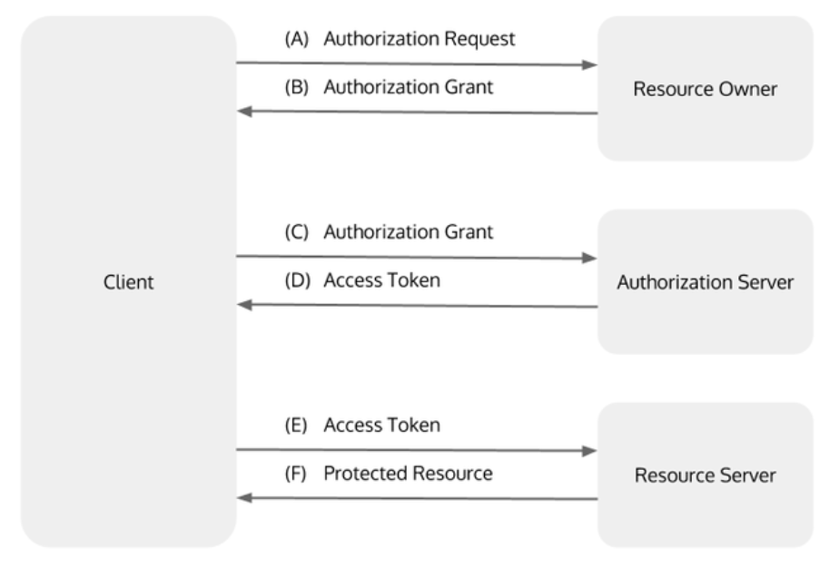
Intellectual Merits
OAuth 2.0 Authorization flowchart:

Slide 6
Broader Impacts
Our application provides ease of use to the user allowing them to backup their important files seamlessly between the three most prominent cloud services.
This not only saves the user time, but also provides peace of mind knowing that their files have been backed up through multiple sources.

Slide 7
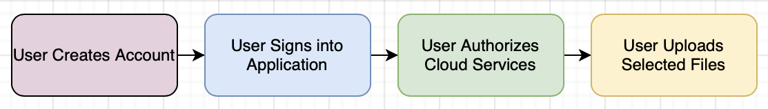
Design Specifications
System Overview:
EZ-Drive is built upon a user-based login system. When accessing our application, users will be prompted to log in or create an account. Once a user is signed in, they can begin connecting their cloud service accounts.
Here is a basic design diagram:

Slide 8
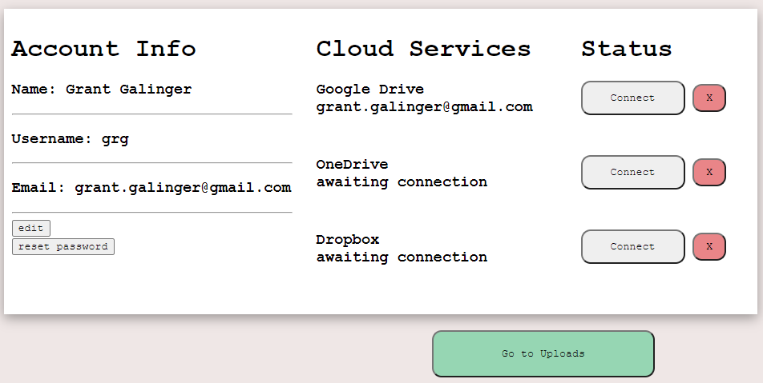
Design Specifications
System Overview:
At the Home screen, users are presented with an overview of their account status and can connect to their cloud service accounts.

Slide 9
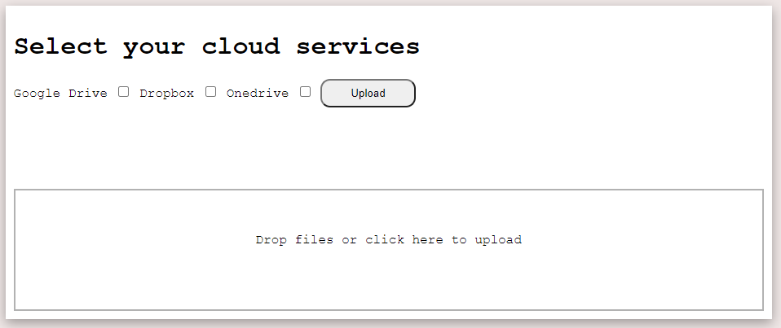
Design Specifications
System Overview:
Once the users desired cloud service accounts have been authorized and connected, they can proceed to the Uploads page. Here, they can either select or drag’n’drop their files to be uploaded.

Slide 10
Design Specifications
System Overview:
After files have been successfully uploaded, a Results page will be displayed showing a list of the files, as well as links to each of the cloud services.
“Results page is in progress, no image atm”

Slide 11


Technologies
EZ-Drive is built primarily on PHP and JavaScript technologies. Our application is powered through a PHP database known as phpMyAdmin, and the design is created through HTML and CSS.
The Cloud Service APIs are implemented through a technology called Composer. This allows our project to import pre-existing libraries built for utilizing these APIs.

Slide 12
Technologies
PHP is a server-side scripting language that is used to develop static/dynamic websites or web applications.
Our application uses PHP for:
Cloud Service API integration
Creating and displaying user account information
Creating user sessions
Uploading user files (in combination with Dropzone.js)
Transferring data to and from our database

Slide 13

Technologies
Our application is powered through the PHP database known as phpMyAdmin. Here, all our user data is stored, as well as the authorization data for each of the cloud services our users are connected to.
PHP Documentation: Welcome to phpMyAdmin's documentation! — phpMyAdmin 5.2.0-dev documentation

Slide 14
Technologies
Composer is a tool for dependency management in PHP. It allows you to declare the libraries your project depends on and it will manage (install/update) them for you.
These are the libraries our application uses:
Google Drive - google/apiclient
OneDrive - krizalys/onedrive-php-sdk
Dropbox - kunalvarma05/dropbox-php-sdk

Slide 15


Technologies
Our application is designed through HTML and CSS. We decided to go with a sleek and minimalistic approach to our design. We feel that this adds to the overall clean and simple aesthetic we are trying to achieve.
Follow the link here to view a gallery of photos so far of our application: EZ-Drive Image Portfolio

Slide 16
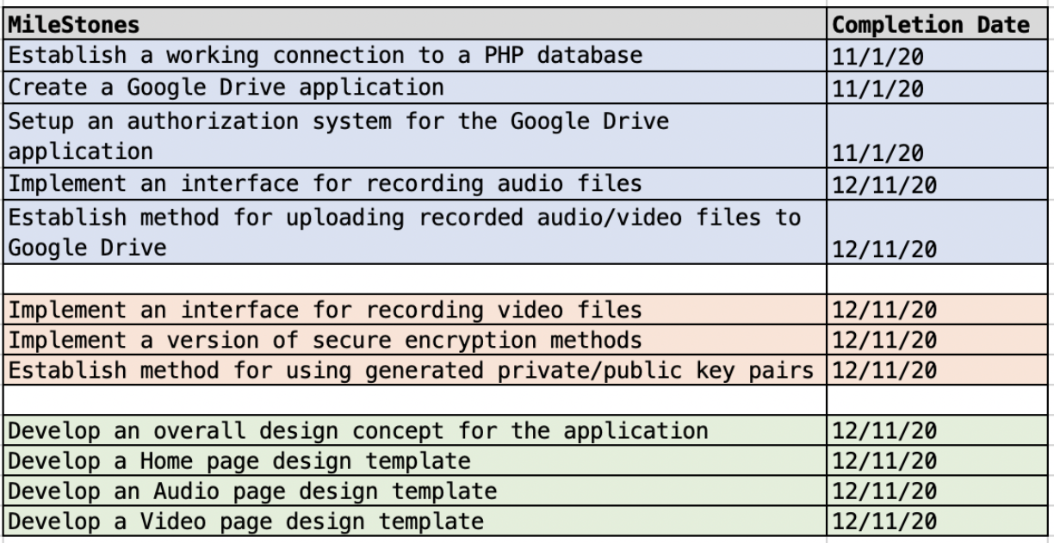
Milestones
Here is a list of our original milestones for this project. Our vision for this application has changed slightly overtime, so some of the milestones will be altered in the future.

Slide 17
Results
So far, we have achieved several major milestones progressing our project forward:
User based login system and account creation (Jan 10th)
Connecting/utilizing phpMyAdmin database (Jan 10th)
Google Drive API implementation (Jan 25th)
Dropzone.js file uploading system (Jan 31st)
Dropbox API implementation (Feb 10th)
Created and designed most of the pages and interfaces (Feb 18th)

Slide 18
Challenges
So far, there have been several challenges in getting the application to its current state.
Configuring and setting up each of the Cloud Service APIs was challenging at times and certainly a learning experience.
Each of them have similarities in how they function, so once we got the first one working, which was Google Drive, the next two were not as time-consuming.
Another challenge we are currently facing is getting Composer to work properly with all three of our required libraries.
Initially, when building the foundation for one of the Cloud Service APIs, we do so in a separate project to minimize potential errors. Then, once we get it to work, we migrate our testing into our main project.
When updating our Composer install in our main project, we are sometimes getting errors. This is something we are currently debugging.
One challenge we will soon face is migrating our application to a hosted url.
This will be one of the last major hurdles for our project so that it can be viewed and accessed by the public.

