Slide 1

Securing Solar to the Grid (S2G):
Standard Cyber-physical Test Systems for Solar PV / DER:
Demonstration on a large-scale, operations-focused distribution model (9500-node)
Manisha Maharjan
Shiva Poudel
PI: Scott Mix

Slide 2
Introduction
Growth of solar penetration along with historical lack of cybersecurity standards and industry awareness drives need for research and deployment-ready solutions
Develop tools and resources for cyber risk assessment and work with industry to address gaps in solar cybersecurity standards
Increase the safety and security of the electric grid when it has high penetration levels of solar PV and other forms of DER/IBR, through analysis, assessment, and standards development.
Develop publicly available standard cyber-physical test systems for solar PV/DER that enables development, replication and benchmarking of cybersecurity procedures

Slide 3
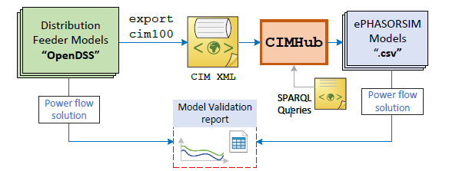
Standard Cyber-physical Test Systems
(CPYDAR) for Solar PV/ DER
Task Description: Translate publicly available distribution system models, covering a range of sizes from 13 to 9500 nodes, to enable the development, replication and benchmarking of cybersecurity test procedures and results at different laboratories.
Model translation and validation: OpenDSS models are converted to CIM XML, then CIMHub generates ePHASORSIM spreadsheets
Motivation: Standard, publicly available cyber-physical test systems (CPYDAR) in variety of sizes and configurations help researchers develop new algorithms or test procedures of increasing complexity, and then benchmark their results against those of others.
Task Outcomes from BP1, BP2:
Three publicly available cyber-physical test systems (IEEE 13 node, IEEE 123 node, EPRI DPV J1) available in ePHASORSIM, suited for hardware-in-loop (HIL) simulation
https://github.com/GRIDAPPSD/CIMHub/tree/feature/SETO/CPYDAR
Validated the test systems with OpenDSS, GridLAB-D for sanity checks
Publication that demonstrates the use of the test systems for cybersecurity testing
“Cybersecurity Assessment in DER-rich Distribution Operations: Criticality Levels and Impact Analysis”, IEEE ISGT 2024 (accepted and presented at IEEE ISGT 2024 – Feb 19-22, 2024)
Demonstrated examples of determining the R1 Resource Criticality Level, from EPRI Security Architecture, for DER
Demonstrated of cybersecurity attack scenarios in real-time simulation platform-ePHASORSIM
Demonstrated that intelligent attackers with network information and DER criticality levels can significantly impact feeder and its components
Heat map showing criticality level of various nodes based on location (distance from substation) and DER injections for IEEE 123 bus feeder

Slide 4
CPYDAR for Solar PV/ DER
Task Outcomes for BP3:
Convert 9500-node and a taxonomy feeder (R3-12-47-2)§ to ePHASORSIM model*
Converted models published on GitHub as CPYDAR test systems
Video demonstration of cybersecurity attack scenarios and impact of large-scale DERs on reconfiguration and restoration
§ https://github.com/GRIDAPPSD/Powergrid-Models/tree/develop/platform
* https://github.com/GRIDAPPSD/CIMHub/blob/feature/SETO/CPYDAR/ePHASORSIM.py

Slide 5
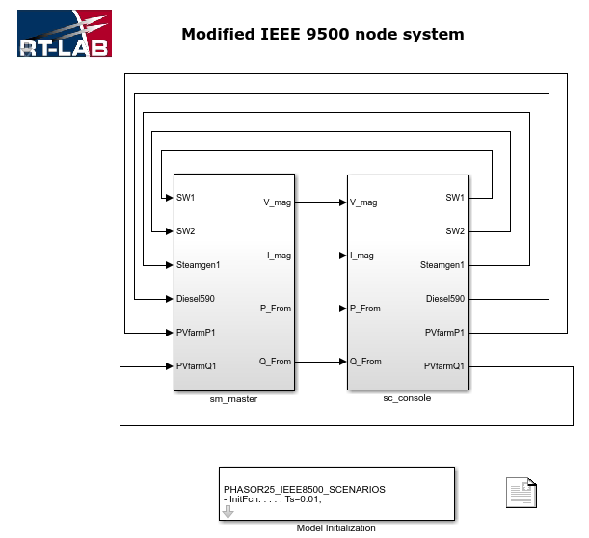
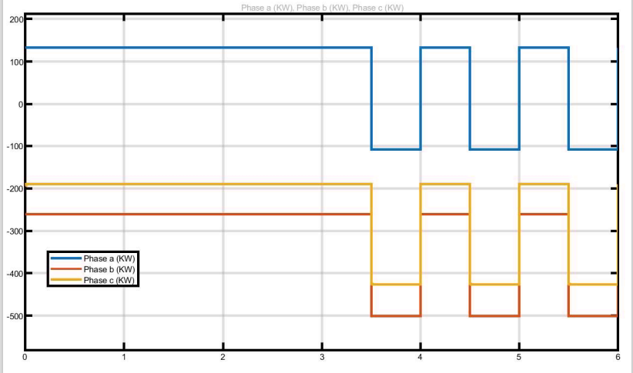
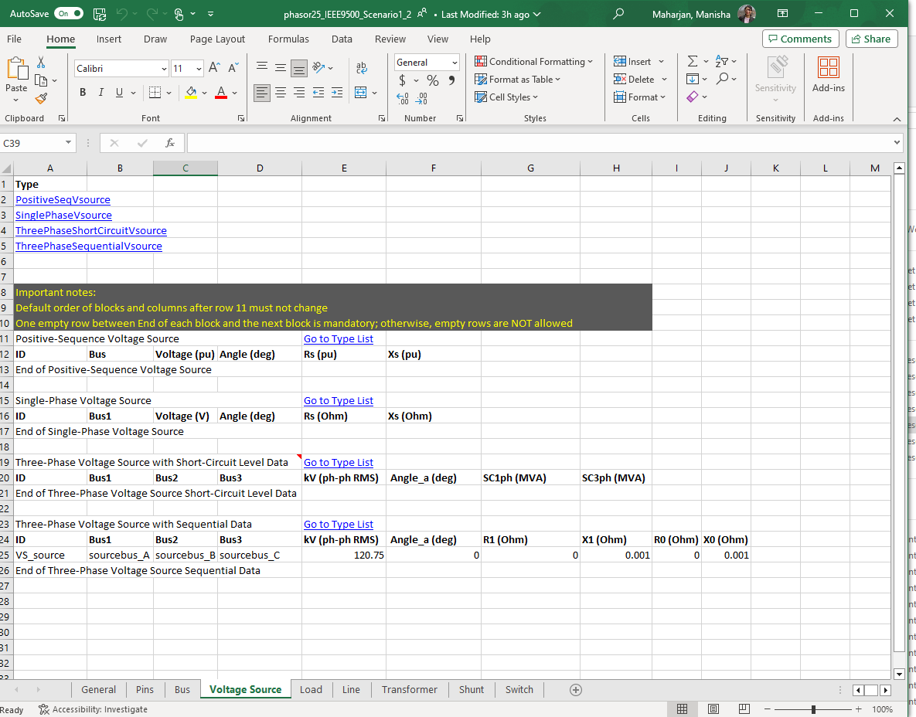
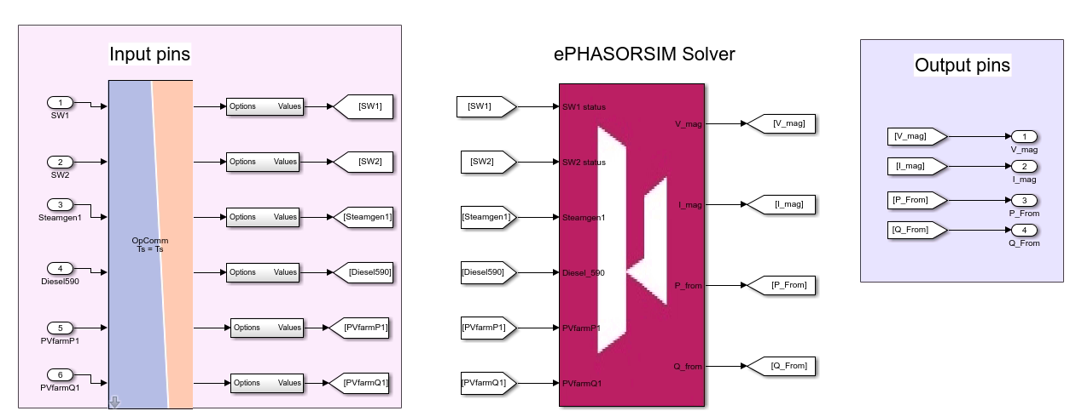
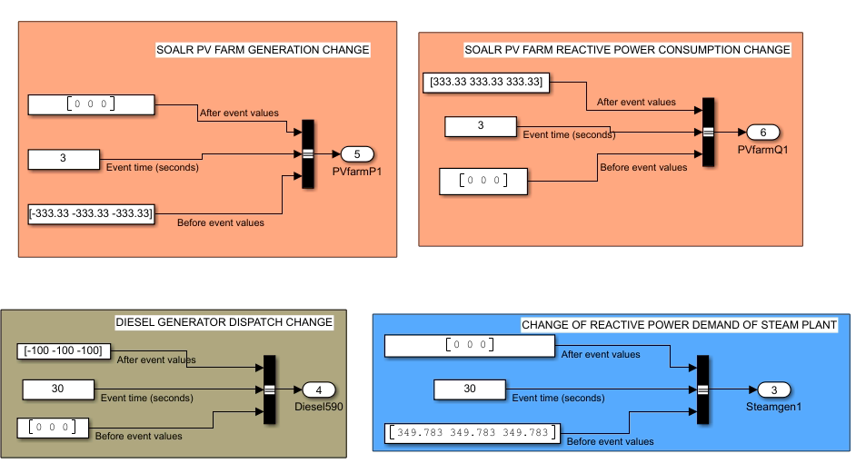
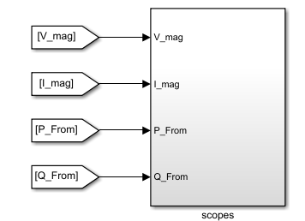
OPAL-RT-ePHASORSIM simulation model
Network model in excel
Output response
Console block
Master block
Input commands
ePHASORSIM | Electro-Mechanical Phasor
In
OPAL-RT Simulator (real-time)
Output responses

Slide 6
OPAL-RT-ePHASORSIM model demonstration
ePHASORSIM, a unique electromechanical real-time simulation tool based on OPAL-RT simulator; enables simulating extraordinarily large mixed T&D networks in real time.
Video demonstration in ePHASROSIM

Slide 7
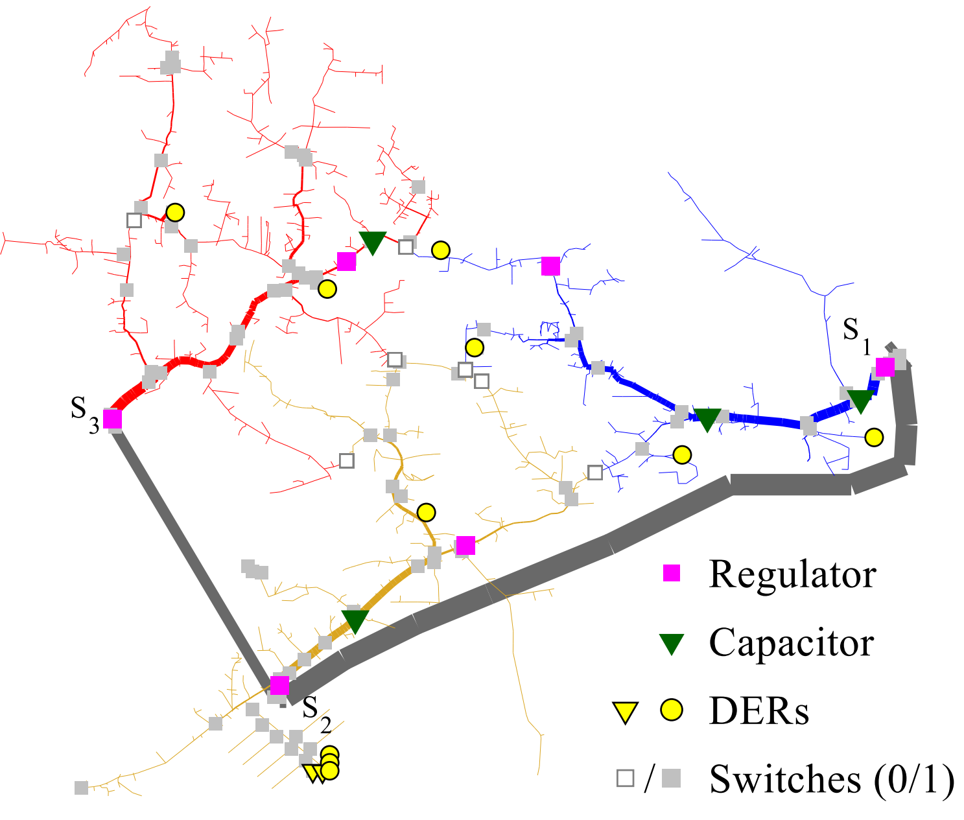
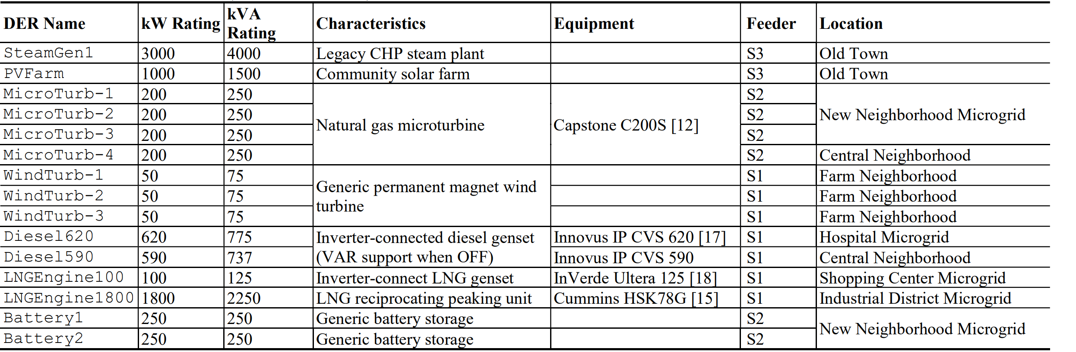
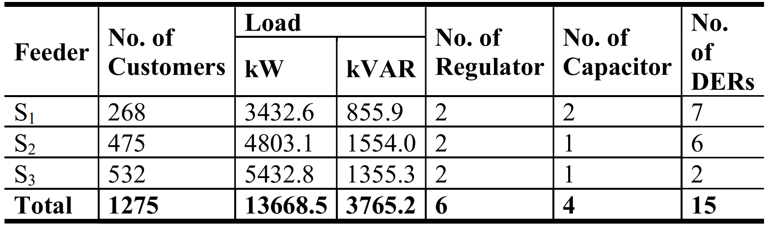
IEEE 9500 model
A “right-sized” distribution system model with multiple feeders supplied by multiple substations
Ability to demonstrate switching operations, feeder reconfiguration, volt-var operation, and dispatch of distributed generation.

Slide 8
Use cases
Attacker interrupts communication signals from the control center to the controllers at the local DERs and switches
Scenario 1 : DER dispatch change
Setpoints of DERs changed from the control center to DER controllers
Scenario 2 : Solar PV setpoints change
Setpoints of PVs changed from the control center to PV controllers
Scenario 3 : Reconfiguration causing feeder outage
Settings of switches changed resulting false reconfiguration

Slide 9
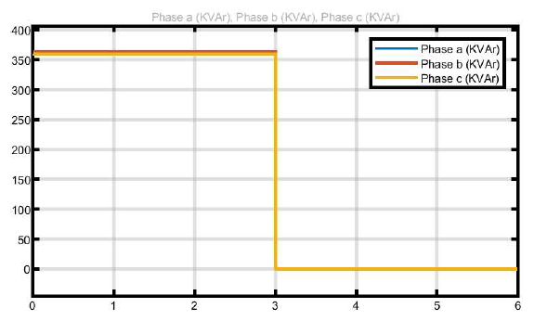
Scenario 1: DER dispatch change
Reduced reactive power consumption of steam plant from 1MVAr to 0 MVAr
Reactive power flow at LN50002chp-1 (steam power plant)
~350 kVAr
0 kVAr

Slide 10
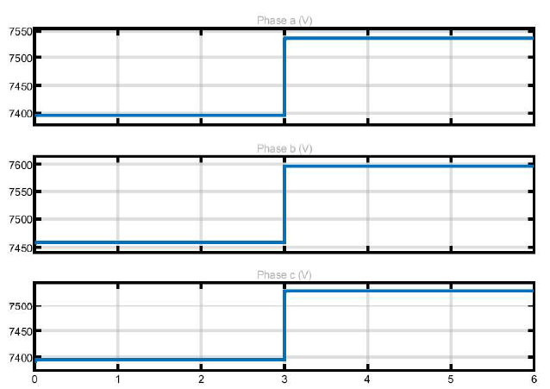
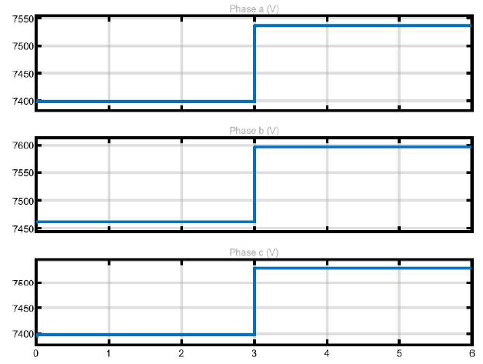
Scenario 1: DER dispatch change
Regulating voltage, abnormal conditions in voltage
Reduction in reactive power absorption--overvoltage
Voltage at Bus l2822871
Voltage at Bus l3235257
1.048 pu
1.048 pu
1.027 pu
1.027 pu
1.055 pu
1.055 pu
1.036 pu
1.036 pu
1.045 pu
1.045 pu
1.027 pu
1.027 pu

Slide 11
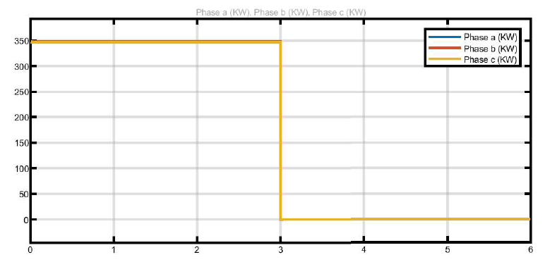
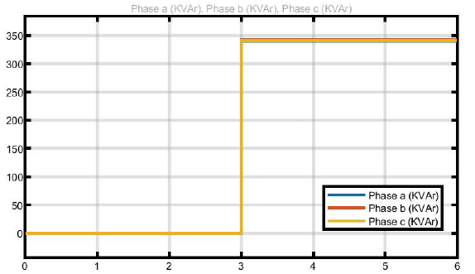
Scenario 2: Solar PV setpoints change
Active power flow at LN1047pvfrm (solar PV farm)
Change in solar PV farm active and reactive power setpoints
~350 kW
Impact on voltage regulation
0 kW
Reactive power flow at LN1047pvfrm (solar PV farm)
~350 kVAr
0 kVAr

Slide 12
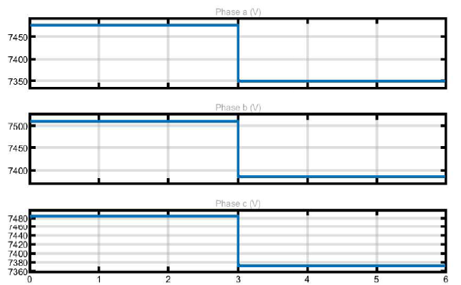
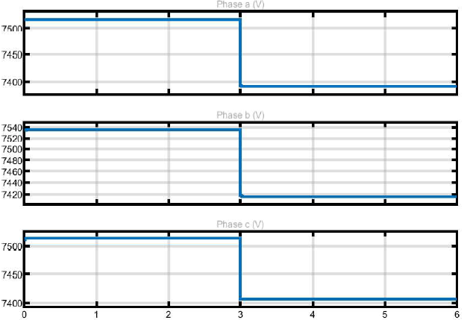
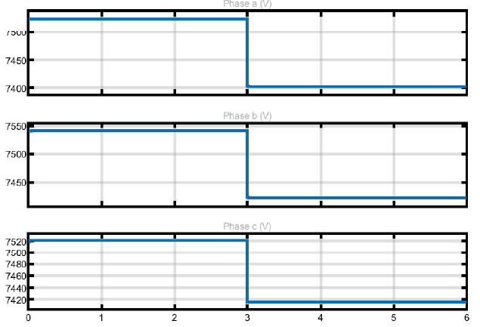
Scenario 2: Solar PV setpoints change
Change in solar PV farm active and reactive power setpoints
Voltage drop due to reduction in injection by PV
This unintended change in dispatch causes regulator and capacitor operation.
Voltage at Bus m1047520
Voltage at Regulator Bus m1047558
Voltage at Regulator Bus m1047568
1.038pu
1.045pu
1.043pu
1.021pu
1.027pu
1.026pu
1.041pu
1.047pu
1.046pu
1.025pu
1.031pu
1.030pu
1.039pu
1.044pu
1.043pu
1.024pu
1.030pu
1.028pu

Slide 13
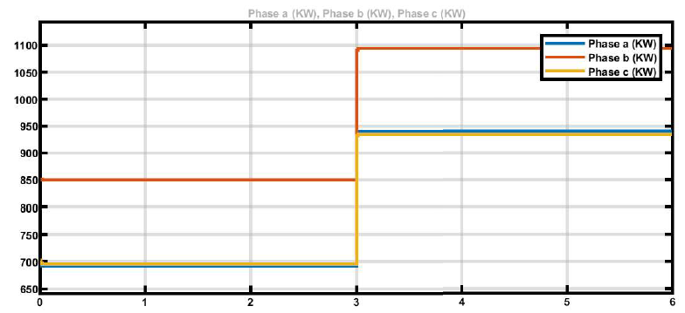
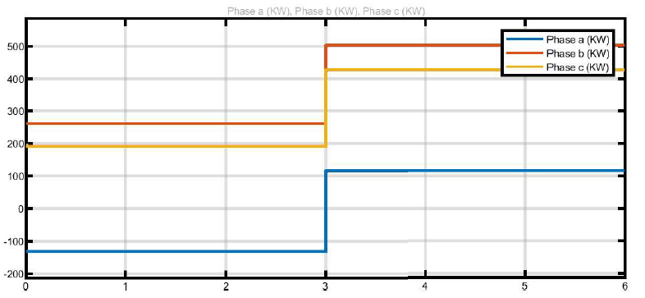
Scenario 2: Results
Change in solar PV farm active and reactive power setpoints
Increase in line flows as more power is drawn from the main grid
Power needs to travel longer distance increase in losses
Line flow of LN6350543-1
Line flow of LN5932236-6
1090 kW
500kW
940 kW
430 kW
260 kW
850 kW
190 kW
115 kW
690 kW
-133 kW

Slide 14
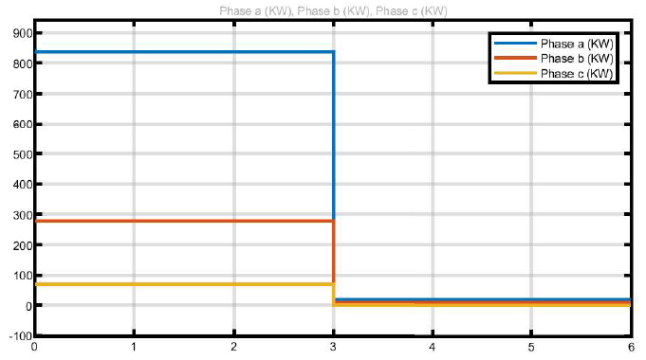
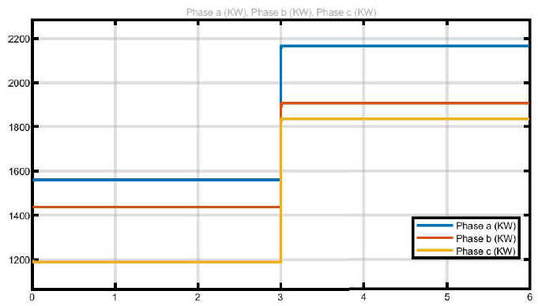
Scenario 3: Reconfiguration causing feeder outage
Reconfiguration of switches at 3 sec
LN4625696_SW : CLOSE to OPEN
A8645_48332_SW : OPEN To CLOSE
Substation #1 picking loads from Substation #2
Line flow of LN5744341-1 near Substation 2
Line flow of LN6291242-1 near Substation 1
2160 kW
840 kW
1900 kW
1830 kW
280 kW
1560 kW
1440 kW
70 kW
~0 kW
1190 kW

Slide 15
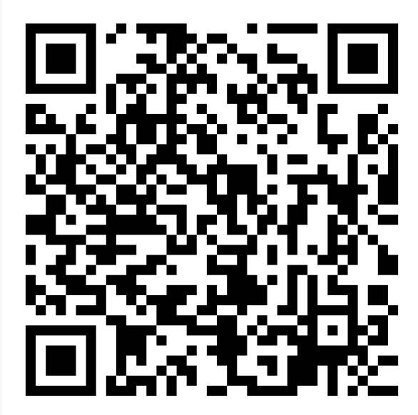
Conclusion
Developed five publicly available models (GitHub) in ePHASORSIM and demonstrated use-cases
Publicly available benchmark models enables development, replication and benchmarking of cybersecurity procedures
Models, Paper and Video demonstration available:
https://github.com/GRIDAPPSD/CIMHub/tree/feature/SETO/CPYDAR

Slide 16
Acknowledgement
This work is supported by the U.S. Department of Energy’s Office of Renewable Energy and Energy Efficiency (EERE) under the Solar Energy Technologies Office Award Number 38451.

Slide 17
THANK YOU!
For additional information contact:
Scott Mix| scott.mix@pnnl.gov

