Slide 1
AI on the Edge
Using the G-Edge board

Slide 2
Agenda
1
IOT, IOT & AI, Edge Computing
5
ML using these datasets
2
Using the G-Edge board
6
ML and DL on G-Edge
3
Google Colab + Python Basics
4
Generating datasets with G-Edge

Slide 3




IDEs & Languages

Slide 4





Data Science Libraries

Slide 5

Internet of Things - IOT
Information
Control
A system of internet-connected ‘things’ that can collect and transfer data over a wireless network without human intervention

Slide 6
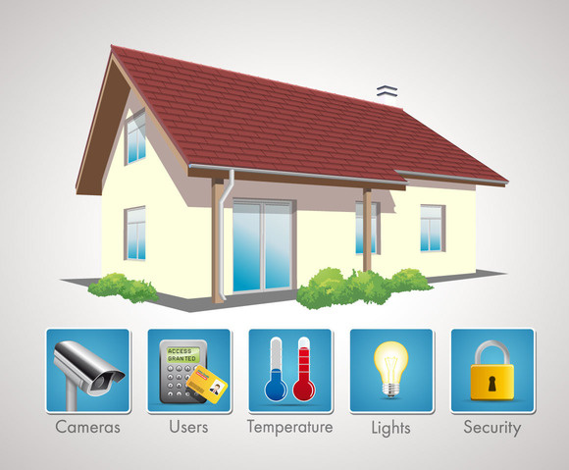
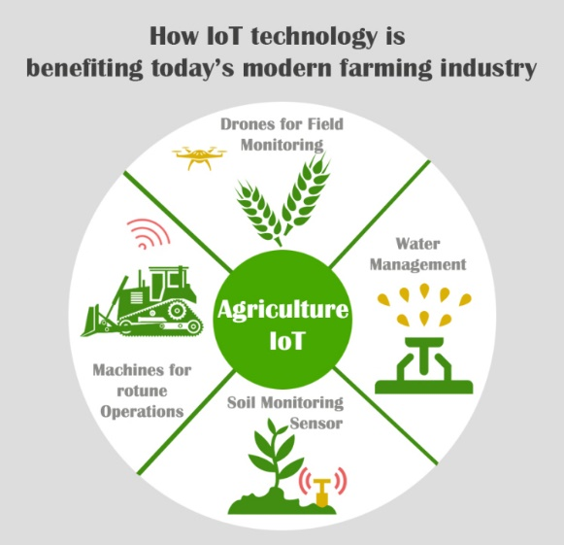
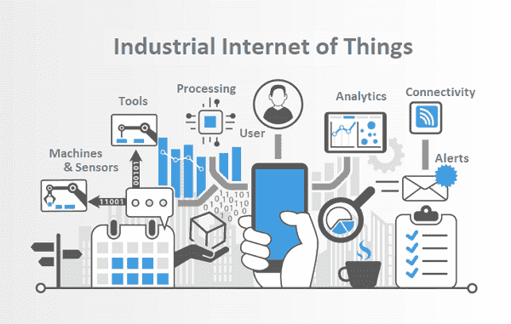
IOT Applications
Intrusion detection
Door/Window open
LPG Gas Leak detection
Appliance Control
Soil moisture
Temperature, humidity, leaf wetness sensing
Watering schedules
Industrial IOT
Manufacturing plants
Process plants

Slide 7

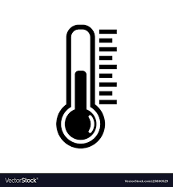



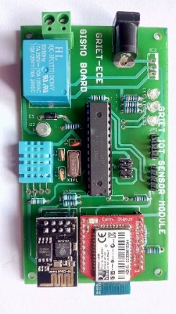

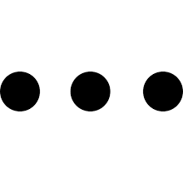
IOT @ GRIET
Cloud
IOT eco-system
Sensors
Data acqusition board
Internet connectivity
Web services
UI using mobile app
Mobile
GISMO
GRIET IOT Sensor Module

Slide 8
IOT + AI = more value
IOT
Sensors implanted in ‘things’ offering streams of data thru’ Internet connectivity
AI
Gives systems the ability to ‘think’ and take decisions
+
Actionable Information

Slide 9

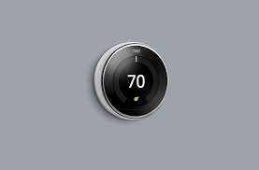
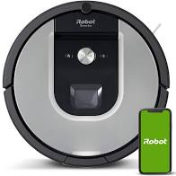
IOT + AI
Tesla's self-driving cars are the best example of IoT and AI working together. With the power of AI, self-driving cars predict the behavior of pedestrians and cars in various circumstances.
Nest’s smart thermostat solution is a good example of AI-powered IoT. The smartphone integration can check and manage the temperature from anywhere based on the work schedule and temperature preferences of its users.
Robots in manufacturing
iRobot Roomba home cleaning robot that can avoid obstacles, detect spots and optimize cleaning operation by learning the room topologies

Slide 10
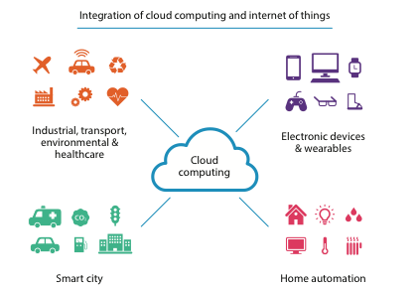
IOT and Cloud computing

Slide 11

Public Cloud Providers

Slide 12
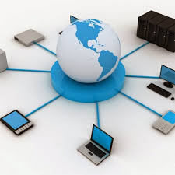
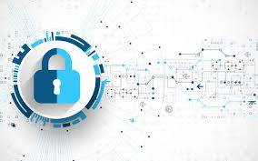
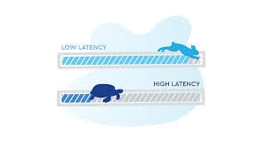
Disadvantages of cloud computing
Internet connectivity – 24/7
Data security
Latency

Slide 13
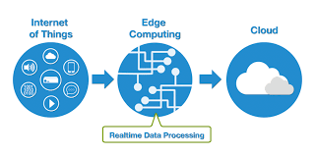
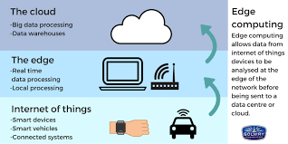
Edge Computing

Slide 14
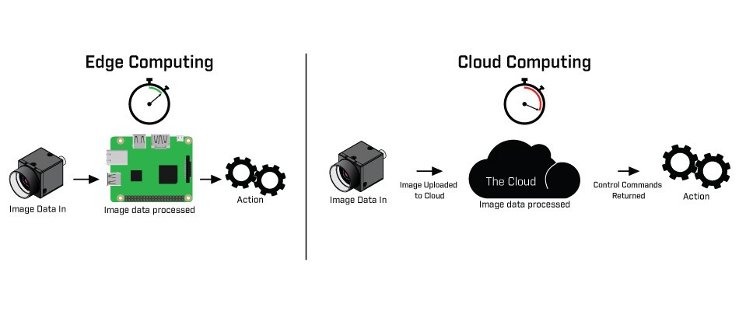
Edge vs Cloud computing

Slide 15
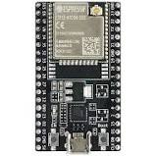

Driving forces for Edge Computing
Much less expensive and more powerful processors and sensors
ESP32 32bit processor with WiFi and Bluetooth
Dual core , Normal speed: 80MHz
“Small data” analytics done at the edge
Smaller trained model sizes
ML/DL and other techniques continue to improve
Google’e Tensor Flow Lite is a cse in point

Slide 16
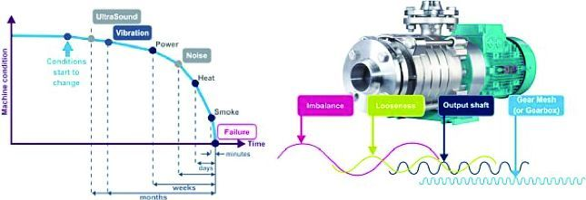
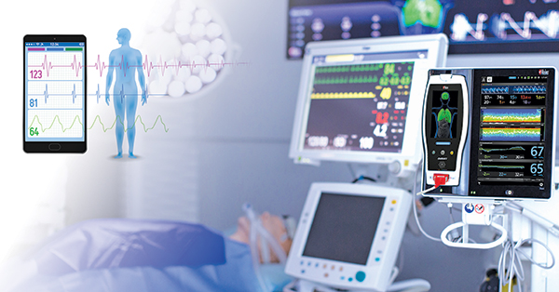

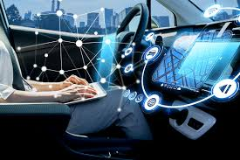
Edge Computing use cases
Predictive Maintenance
In-patient monitoring
Remote Monitoring of Oil & Gas assets
Autonomous vehicles

Slide 17
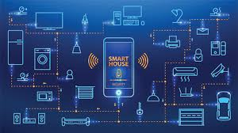
Edge Computing use cases
Smart Home

Slide 18
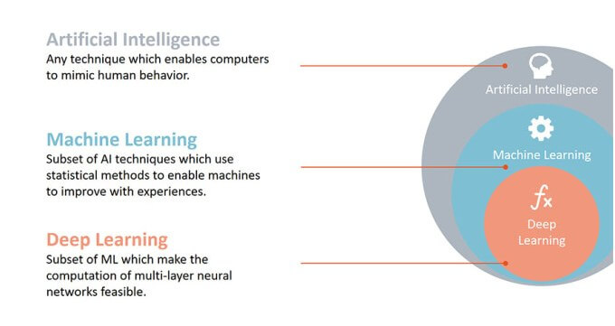
AI

Slide 19
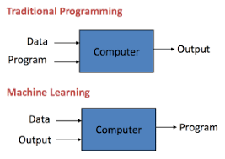
Machine Learning

Slide 20
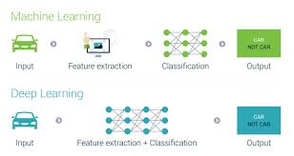
ML & DL

Slide 21
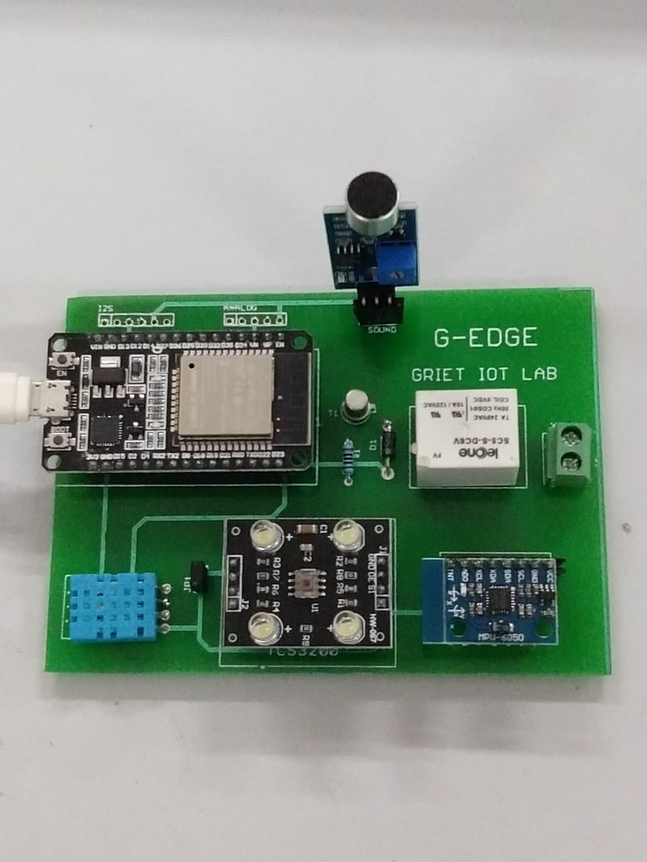
G-Edge
Resources
ESP32 DevKitC
DHT11 :Temperature and humidity sensor
MPU6050: 3-axes accelerometer and gyro
TCS3200: Color recognition sensor
Sound sensor
Relay

Slide 22
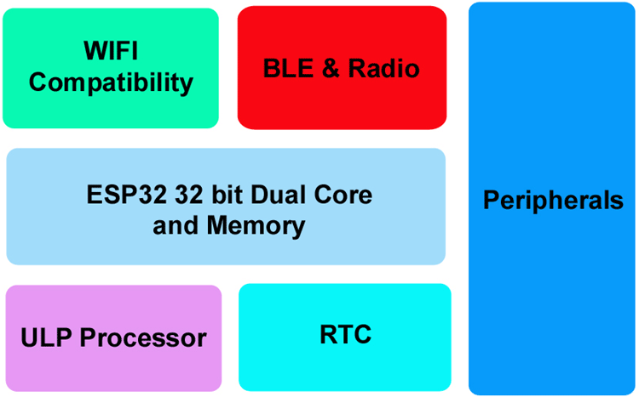
ESP32 Development Board

Slide 23
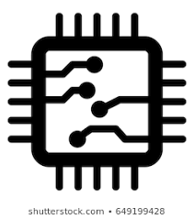
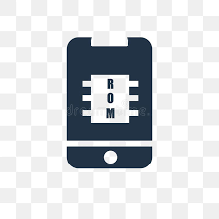
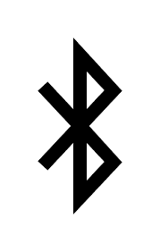
ESP32 features
ESP32 has Xtensa® Dual-Core 32-bit LX6 microprocessors. The ESP32 will run on breakout boards and modules from 160Mhz upto 240MHz
Internal Memory : 448 KB ROM for booting and core functions & 520 KB SRAM for data and instructions
External Flash : 4MB external Flash extendable to16MB
WiFi: ESP32 implements TCP/IP, full 802.11 b/g/n/e/i WLAN MAC protocol
Bluetooth : ESP32 supports the latest BLE Bluetooth 4.2, as well as classic Bluetooth

Slide 24

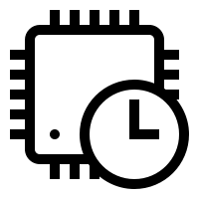
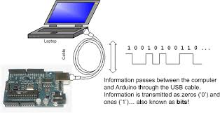
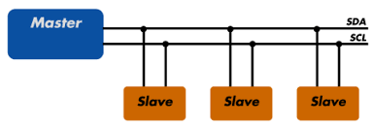
ESP32 peripherals
GPIO
Timers and Watchdog
Real Time Clock
ADC and built-in Sensors
Digital to Analog Convertor (DAC)
Touch Sensor
Ultra Low Power(ULP) Co-processor
Ethernet MAC Interface
Universal Asynchronous Receiver Transmitter (UART)
I2C Interface
I2S Interface
SPI Interface
Pulse Width Modulation (PWM)

Slide 25
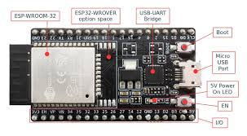
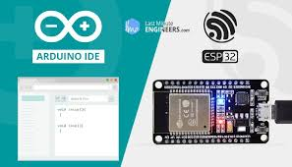
ESP32 – powering & programming

Slide 26
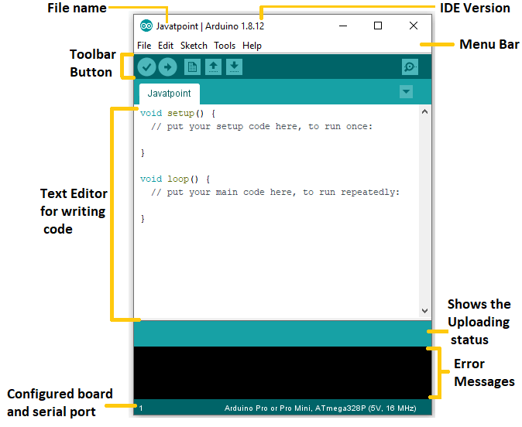
ESP32 – Arduino IDE
In the Tools tab, go to
Board -> ESP32 Arduino -> ESP32 Dev Module
In the Tools tab, go to
Port-> COMX

Slide 27
Arduino IDE
pinMode(2,OUTPUT);
pinMode(3,INPUT);
pinMode(4,INPUT_PULLUP);
2
4

Slide 28
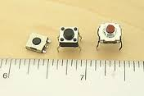
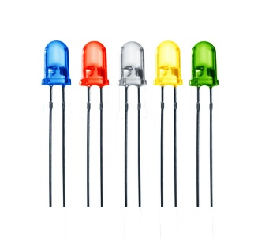
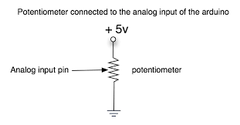
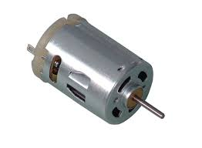
The Arduino IDE
Input
Output
digitalRead ()
digitalWrite ()
Digital
analogRead ()
analogWrite()
Analog

Slide 29
Your first program
void setup(){
pinMode(2,OUTPUT);
}
void loop(){
digitalWrite(2,HIGH);
delay(1000);
digitalWrite(2,LOW);
delay(1000);
}
Press the Boot button and upload

Slide 30
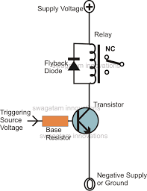
Relay operation
ESP32
void setup(){
pinMode(19,OUTPUT);
}
void loop(){
digitalWrite(19,HIGH);
delay(2000);
digitalWrite(19,LOW);
delay(2000);
}
19

