Slide 1
AI on the Edge
Using the G-Edge board

Slide 2
Agenda
1
IOT, IOT & AI, Edge Computing
5
ML using these datasets
2
Using the G-Edge board
6
ML and DL on G-Edge
3
Google Colab + Python Basics
4
Generating datasets with G-Edge

Slide 3
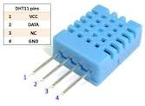
DHT11 – Humidity & Temperature sensor
DHT11
Measures humidity and temperature
Humidity : 20-90% RH
Temperature : 0-50 deg. C
Single wire interface
40 bit data
8 bit int. RH
8 bit dec. RH
8 bit int. RH
8 bit dec. RH
Checksum

Slide 4
DHT11
#include “DHTesp.h”
#define DHTpin 23
DHTesp dht;
void setup(){
Serial.begin(115200);
Serial.println();
Serial.println(“Status\tHumidity(%)\tTemperature(C)”);
dht.setup(DHTpin,DHTEesp::DHT11);
}
void loop(){
delay(2000);
float h = dht.getHumidity();
float t = dht.getTemperature();
Serial.print(dht.getStatusString());
Serial.print(“\t”);
Serial.print(h);
Serial.print(“\t”);
Serial.println(t);}

Slide 5
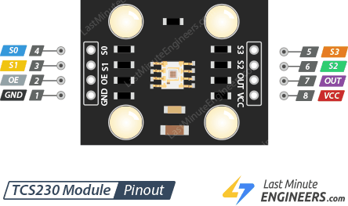
TCS3200 – Color sensor
The sensor detects color with the help of an 8 x 8 array of photodiodes, of which sixteen photodiodes have red filters, 16 photodiodes have green filters, 16 photodiodes have blue filters, and remaining 16 photodiodes are clear with no filters.
S2 | S3 | Photodiode type
LOW | LOW | Red
LOW | HIGH | Blue
HIGH | LOW | No Filter
HIGH | HIGH | Green

Slide 6
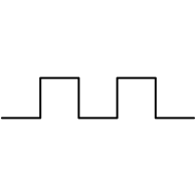
Functional Block Diagram
Output
Photodiode Array
Current-to-Frequency Converter
Light
S2 S3

Slide 7
pulseIn function
Start timer
Stop timer
pulseIn(pin,LOW)
Reads a pulse on a pin. If value is LOW, pulseIn() waits for the pin to go from HIGH to LOW, starts timing, then waits for the pin to go HIGH, stops timing and returns the time interval in microseconds

Slide 8
#define S2 16
#define S3 17
#define sensorOut 18
int frequency =0;
void setup(){
pinMode(S2,OUTPUT);
pinMode(S3,OUTPUT);
Serial.begin(115200);}
void loop(){
digitalWrite(S2,LOW);
digitalWrite(S3,LOW);
frequency = pulseIn(sensorOut,LOW);
Serial.print(“R = “);
Serial.print(frequency);
Serial.print(“ “);
delay(100);
digitalWrite(S2,HIGH);
digitalWrite(S3,HIGH);
frequency = pulseIn(sensorOut,LOW);
Serial.print(“G = “);
Serial.print(frequency);
Serial.print(“ “);
delay(100);
digitalWrite(S2,LOW);
digitalWrite(S2,HIGH);
frequency = pulseIn(sensorOut,LOW);
Serial.print(“B = “);
Serial.print(frequency);
delay(100); }

Slide 9
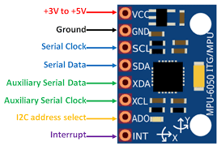
MPU6050
MPU6050 sensor module is an integrated 6-axis Motion tracking device. It has a 3-axis Gyroscope, 3-axis Accelerometer, Digital Motion Processor and a Temperature sensor, all in a single IC
It communicates with the microcontroller via the I2C interface
The I2C interface has two signals – SCL and SDA

Slide 10
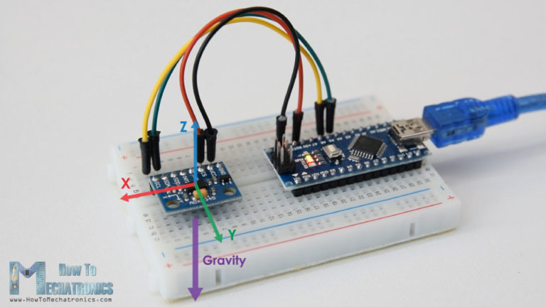
MPU6050 data
Sensitivity : +/- 2g
Output : 16 bit
+/-2g corresponds to +/-32767
1g corresponds to 32767/2 = 16384
Dividing the accelerometer value by 16384 will give the value in g

Slide 11
#include “I2Cdev.h”
#include “MPU6050.h”
#include “Wire.h”
MPU6050 mpu;
void setup(){
Wire.begin();
Serial.begin(115200);
mpu.initialize();}
void loop(){
float ax,ay,az;
mpu_read(&ax,&ay,&az);
Serial.print(ax);
Serial.print(“\t”);
Serial.print(ay);
Serial.print(“\t”);
Serial.println(az);
delay(10);}
void mpu_read(float *ax,float *ay,float *az){
int16_t _ax,_ay,_az,_gx,_gy,_gz;
mpu.getmotion(&_ax,&_ay,&az,&_gx,&_gy,&_gz);
*ax = _ax/16384.0;
*ay=_ay/16384.0;
*az=_az/16384.0;
}
Use the Serial Plotter in the ArduinoIDE to visualize the acceleration in the three axes

Slide 12
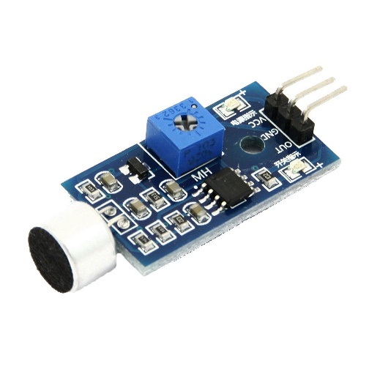
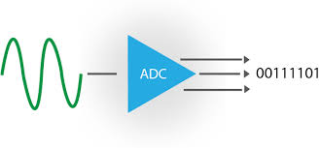
Sound sensor
A sound sensor is a module that detects sound waves through its intensity and converting it to electrical signals
A sound sensor consists of an in-built capacitive microphone, peak detector and an amplifier (LM386, LM393, etc.) that’s highly sensitive to sound

Slide 13
ADC values
ADC resolution :12bits
Range of output values : 0 – 4095
Conversion to +/- values: ADC value – 2048
After conversion:
0- 4095 will map to -2048 to +2048
Scaling down to -128 to +128 by right shifting value by 4(dividing by 16)
Example calculations:
ADC value = 3000
(3000-2048)/16 = 952/16=60
ADC value = 0
(0-2048)/16=-2048/16=-128
ADC value = 4095
(4095-2048)/16=2048/16=128

Slide 14
Raw audio stream

Slide 15
Sound sensor reading
#define MIC 34
void setup(){
Serial.begin(115200);
pinMode(34,INPUT);
}
void loop(){
Serial.println(readMIC());
delay(10);
}
int16_t readMIC()
{
return(analogRead(MIC)-2048) >> 4;
}
Use the Serial Plotter in the ArduinoIDE to visualize the audio signal when you speak

Slide 16
Agenda
1
IOT, IOT & AI, Edge Computing
5
ML using these datasets
2
Using the G-Edge board
6
ML and DL on G-Edge
3
Google Colab + Python Basics
4
Generating datasets with G-Edge

Slide 17
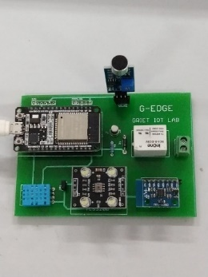



Step #1:
Generate datasets using on-board sensors on G-Edge as CSV files
G-Edge
Datasets
Step #2:
Use the datasets to train the model
Model
Step #3:
Place the model on G-Edge and use it for inference
+
Inference

Slide 18
Temperature datasets
The temperature dataset will be in the form of a CSV(comma separated value) file
Each line in the file will have 5 temperature values separated by commas
The file as a whole will contain 20 such records
The file will be used as a dataset for training a model using Machine Learning algorithms

Slide 19
Read Temperature
Print temperature followed by comma
Increment count
No
Count=5
Yes
Print CR

Slide 20
Temperature dataset
void loop(){
for(int i=0;i<5;i++){
delay(2000);
float t = dht.getTemperature();
Serial.print(t);
if(i<4)
Serial.print(“,”);
Else
Serial.println();
}
#include “DHTesp.h”
#include DHTpin 23
DHTesp dht;
void setup(){
Serial.begin(115200);
dht.setup(DHTpin,DHTesp::DHT11);
}
Output: Comma separated temperature values 5 per row
After 20 such records are accumulated, copy the Serial Monitor screen to a temperature.csv file

Slide 21
Color sensor datasets
The color sensor datasets will be CSV files named after the color objects using which data is collected
For example : red.csv, blue.csv, orange.csv
Each CSV file will have R,G,B values comma separated on each line making up one record
20 such records will be there in each file
The CSV files will serve as data for training a machine learning model

Slide 22
Color sensor datasets
Read R
Post to features[0]
Read G
Post to features[1]
Read B
Post to features[2]
Print features array separated by commas

Slide 23
Color sensor datasets
#define S2 16
#define S3 17
#define sensorOutput 18
float features[3];
void setup(){
pinMode(S2,OUTPUT);
pinMode(S3,OUTPUT);
pinMode(sensorOutput,INPUT);
Serial.begin(115200);
}
Declare S2,S3 pins as output and sensorOutput pin as input
Declare a float array called features to hold 3 values – the R,G and B values for a single record

Slide 24
void loop(){
readRGB();
printFeatures();
delay(1000);
}
void readComponent(bool S2_lvl, bool S3_lvl){
digitalWrite(S2,S2_lvl);
digitalWrite(S3,S3_lvl);
return pulseIn(sensorOutput,LOW);
}
void readRGB(){
features[0]=readComponent(LOW,LOW);
features[1]=readComponent(HIGH,HIGH);
features[2]=readComponent(LOW,HIGH);
}

Slide 25
void printFeatures(){
const uint16_t numFeatures = sizeof(features)/sizeof(float);
for(int i =0;I < numFeatures;i++){
Serial.print(features[i]);
Serial.print(i == numFeatures-1?’\n’:’,’);
}

Slide 26
MPU6050 datasets
Initialize MPU6050
Calibrate
X,Y,Z values - stationary
Read X,Y,Z
No
Motion detected?
Yes
Print X,Y,Z as csv
i==30

Slide 27
Acceleration values after calibration

Slide 28
#include “IC2dev.h”
#include “MPU6050.h”
#include “Wire.h”
MPU6050 mpu;
#define NUM_SAMPLES 30
float baseline[3];
float features[NUM_SAMPLES*3];
float motion_threshold = 0.5;
void setup(){
Wire.setup();
Serial.begin(115200);
mpu.initialize();
calibrate();
}
void loop(){
float ax,ay,az;
mpuread(&ax,&ay,&az);
ax=ax-baseline[0];
ay=ay-baseline[1];
az=az-baseline[2];
If(!motion_detected(ax,ay,az)){
delay(10);
return;
}
mpu_record();
mpu_print_features();
delay(2000);
}

Slide 29
bool motion_detected(float ax,float ay,float az){
return(abs(ax)+abs(ay)+abs(az) > moton_threshold);
}
void mpu_record(){
float ax,ay,az;
for(int i=0;i<NUM_SAMPLES;i++){
mpu_read(&ax,&ay,&az);
ax=ax-baseline[0];
ay=ay-baseline[1];
az=az-baseline[2];
features[i*3 + 0]=ax;
features[i*3 + 1]=ay;
features[i*3 + 2]=az;
}
void print_features(){
const uint_16t num_features=sizeof(features)/sizeof(float);
Serial.print(features);
Serial.print(i==numfeatures-1?’\n’:’,’);
}
void mpu_read(float *ax,float *ay,float *az){
int16_t _ax,_ay,_az,_gx,_gy,_gz;
mpu.getMotion6(&_ax,&_ay,&_az,&_gx,&_gy,&_gz);
*ax=_ax/16384.0;
*ay=_ay/16384.0;
*az=_az/16384.0
}
void calibrate(){
float ax,ay,az;
for(int i=0;i<10;i++){
mpu_read(&ax,&ay,&az);
delay(100);
}
baseline[0]=ax;
baseline[1]=ax;
baseline[2]=ax;
}

Slide 30
Sound
Background sound
calculation
Read sound sensor
No
Sound >
Threshold?
Yes
Collect 64 sound samples
FFT of samples
Store as CSV

Slide 31
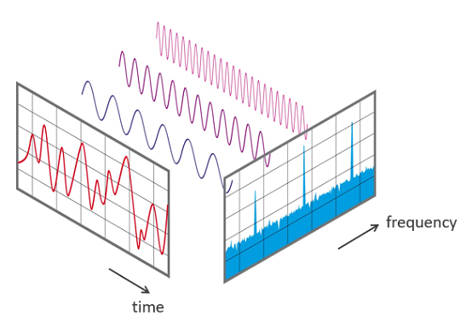
FFT Basics
64 point in-place FFT
Start collecting audio samples after a defined threshold is crossed
Threshold is defined as background + delta
Instead of using he raw audio signal values as features,
The FFT components are used as features for training

