Slide 1
AI on the Edge
Using the G-Edge board

Slide 2
Agenda
1
IOT, IOT & AI, Edge Computing
5
ML using these datasets
2
Using the G-Edge board
6
ML and DL on G-Edge
3
Google Colab + Python Basics
4
Generating datasets with G-Edge

Slide 3
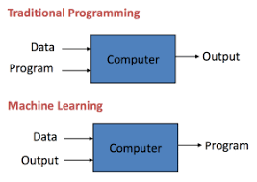
ML vs Traditional programming

Slide 4
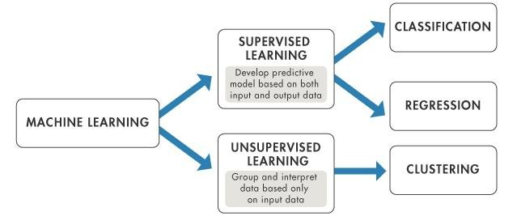
Machine Learning
Color classification
Gestures classification
Word classification
Temperature prediction

Slide 5
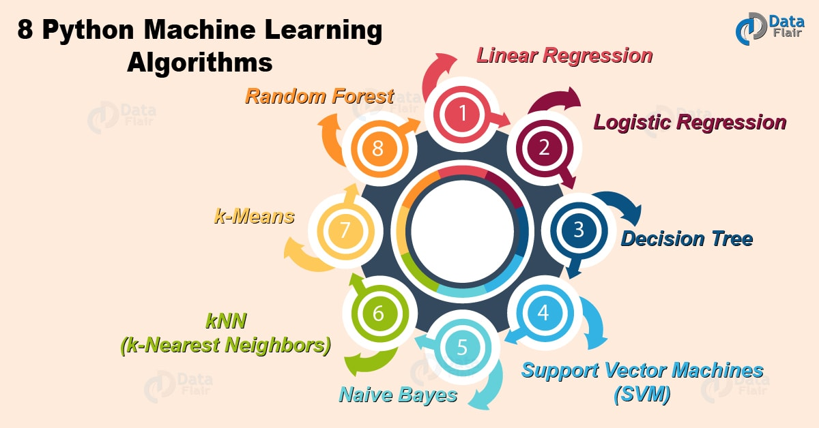
Terminologies in ML
Model
A model is a specific representation learned from data by applying some Machine Learning algorithm

Slide 6
Training
The idea is to give a set of inputs(features) and it’s expected outputs(labels), so after training, we will have a model that will then map new data to one of the categories trained on
Prediction/Inference
Once our model is ready, it can be fed a set of inputs to which it will provide a predicted output(label).

Slide 7
Feature
A feature is an individual measurable property of the data. A set of numeric features can be conveniently described by a feature vector
Application | Features
Color identification | R,G,B values
Gesture identification | Acceleration in X,Y,Z directions
Word identification | FFT components of raw audio signal
Temperature prediction | Previous temperature value

Slide 8
Target(Label)
A target variable or label is the value to be predicted by our model
Application | Target(label)
Color identification | Red/Blue/ Orange/ No color
Gesture identification | Left, Punch, Up
Word identification | Word spoken
Temperature prediction | Temperature

Slide 9
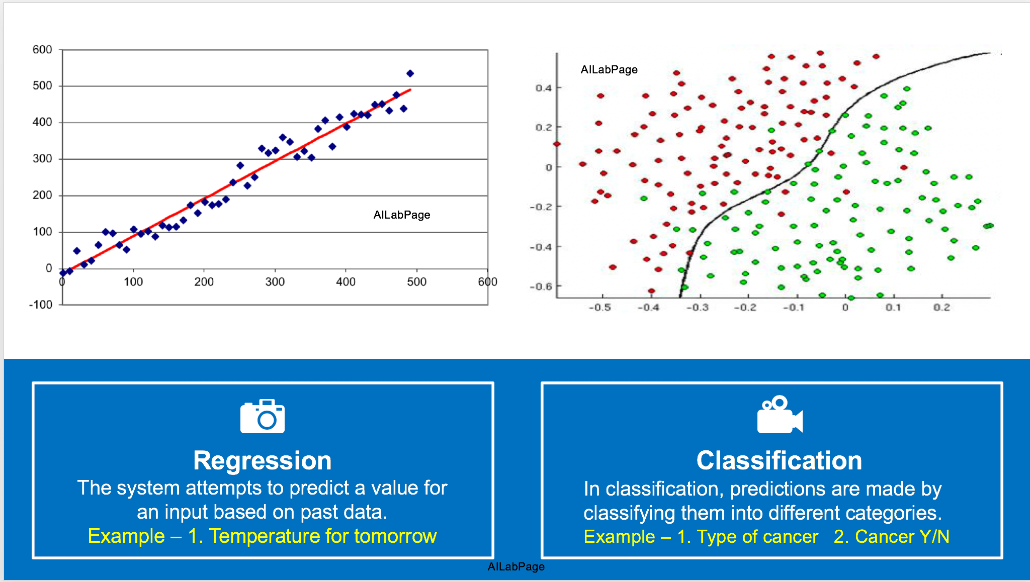
Classification & Regression

Slide 10
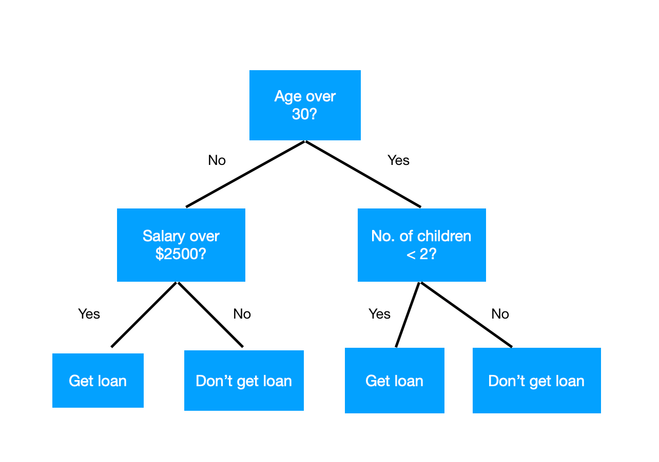
Decision Tree

Slide 11

Random Forest
Random Forest is just many Decision Trees joined together in a voting scheme. The core idea is that of "the wisdom of the crowd", such that if many trees vote for a given class (having being trained on different subsets of the training set), that class is probably the true class
Parameters:
n_estimators: The number of decision trees in the forest
max_depth: The maximum depth of the tree

Slide 12
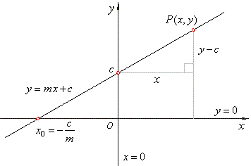
Linear Regression
In statistics, linear regression is a linear approach to modelling the relationship between a dependent variable and one or more independent variables.
The challenge is to find the m and c that gives minimum error for the given dataset. The Least Squares method is used for doing this

Slide 13
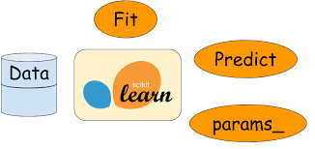
Fit and predict functions for estimators
parameters
Decision Tree:
max_depth
Random Forest:
no.of trees
max_depth
SVM:
kernel(‘rbf’)
Gamma(0.001)
Naïve Bayes:
clf.fit(X,y)
X – Features array
y – Labels
clf.predict(x)
x – New data

Slide 14
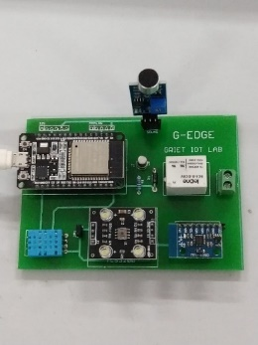



Step #1:
Generate datasets using on-board sensors on G-Edge as CSV files
G-Edge
Datasets
Step #2:
Use the datasets to train the model
Model
Step #3:
Place the model on G-Edge and use it for inference
+
Inference

Slide 15


Using G-Edge datasets in Python
csv files generated using G-Edge sensors stored locally
Google Colab – sample_data/datasets folder
1. Create a folder named datasets inside sample_data folder in Google Colab
2. Transfer csv files from your laptop to Google Colab – sample_data/datasets

Slide 16

sample_data/datasets folder
Label
column
Classmap dictionary
{0:’red’,1:’blue’,2:’no_color’}
100
200
200
0
100
200
200
0
red.csv
red.csv data
100
200
200
0
100
200
200
0
blue.csv
100
200
200
1
blue.csv data
100
200
200
1
100
200
200
1
no_color.csv
100
200
200
1
100
200
200
2
no_color.csv data
100
200
200
2
100
200
200
2
100
200
200
2
np array

Slide 17
Create a single dataset and classmap
Example: Color identification
csv files: red.csv, orange.csv,blue.csv,no_color,csv in a folder /datasets
Use a for loop to iterate down the csv files in the datasets folder
Name of each csv file should be read and the color extracted from the name by leaving out the last 4 characters from the filename
Create a dictionary with the index and color label
Create an np array from the csv file
Stack the color label id to the right of the sample data
Repeat till all the csv files in the folder are covered
The dataset with features and labels and the classmap with id vs color will be ready

Slide 18
import numpy as np
from glob import glob
from os.path import basename
def load_features(folder):
classmap = {}
for class_idx, filename in enumerate(glob(‘%s/*.csv’%folder)
class_name=basename(filename)[:-4]
classmap[class_idx]=class_name
samples=np.loadtxt(filename,dtype=float,delimiter=‘,’)
labels=np.ones((len(samples),1))*class_idx
samples=np.hstack((samples,labels))
dataset=samples if dataset is None else np.vstack((dataset,samples))
return dataset,classmap

Slide 19

micromlgen pkg
Micromlgen
C code
……….
…………
…………
,,,,,,,,,,,
,,,,,,,,,,,,
Classifier
port
Features array( X)
Labels (y)
model

Slide 20
!pip install micromlgen
import numpy as np
from sklearn.ensemble import RandomForestClassifier
from micromlgen import port
features,classmap = load_features(‘sample_data/datasets’)
X,y = features[:,:-1],features[:,-1]
classifier = RandomForestClassifier(n_estimators=30,max_depth=10).fit(X,y)
print(port(classifier,classmap=classmap))

Slide 21
ML code for RandomForestClassifier
from sklearn.ensemble import RandomForestClassifier
from micromlgen import port
features,classmap = load_features(‘sample_data/datasets’)
X,y = features[:,:-1],features[:,-1]
classifier = RandomForestClassifier(n_estimators=30,max_depth=10).fit(X,y)
print(port(classifier,classmap=classmap)

Slide 22
Inference on G-Edge
C code
……….
…………
…………
,,,,,,,,,,,
,,,,,,,,,,,,
Model saved as a model.h file
model.h stored in the folder containing the inference .ino file

Slide 23
Temperature prediction – G-Edge
Instantiate an object belonging to the classifier class
EloquentArduino::ML::Port::LinearRegression LR;
setup()
Initialize the DHT11 sensor
Fill temperature buffer with values
Predict temperature values using buffer values
LR.predict(temp_buffer)
loop()
Read temperature
Update temperature buffer
Print predicted and actual temps

Slide 24
Temperature prediction – G-Edge
void loop(){
float predictedTemp = lr.predict(temperature) ;
float sensorTemp = dht.getTemperature();
for(i=0;i<3;i++){
temperature[i] = temperature[i+1];
}
temperature[3]=sensorTemp;
Serial.print(predicetdTemp);
Serial.print(‘\t’);
Serial.print(sensorTemp);
delay(2000);
#include “model.h”
#include “DHTesp.h”
#define DHTpin 23
Eloquent::ML::Port::Linear Regression lr;
float temperature[4];
Int I;
void setup(){
Serial.begin(115200);
dht.setup(DHTpin,DHTesp::DHT11);
for( i=0;i<4;i++){
temperature[i]=dht.getTemperature();
delay(2000);
}

Slide 25
Color identification using G-Edge
Instantiate an object belonging to the classifier class
EloquentArduino::ML::Port::RandomForestClassifier myClassifier;
setup()
Initialize IOs required for S1,S2 and O/P of TCS3200
Initialize color features array
Read R,G,B values and post to features array
loop()
Pass the features array to the classifier and predict color
myClassifier.predictLabel(features);
Delay before next reading
IOT Lab, ECE Department

Slide 26
Gesture identification using G-Edge
Instantiate an object belonging to the classifier class
EloquentArduino::ML::Port::RandomForestClassifier myClassifier;
setup()
Instantiate an object belonging to MPU6050 class
MPU6050 mpu;
Calibrate the sensor by taking baseline values of X,Y,Z accelerometer values
Read X,Y,Z accelerometer values
If X+Y=Z > Threshold take readings
loop()
Pass X,Y,Z readings to classifier for prediction of gesture
myClassifier.predictLabel(features);

