Slide 1
AI on the Edge
Using the G-Edge board

Slide 2
Agenda
1
IOT, IOT & AI, Edge Computing
5
ML using these datasets
2
Using the G-Edge board
6
ML and DL on G-Edge
3
Google Colab + Python Basics
4
Generating datasets with G-Edge

Slide 3
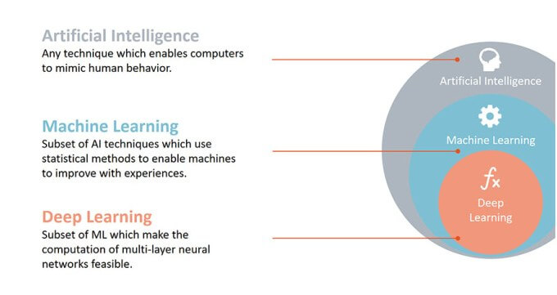
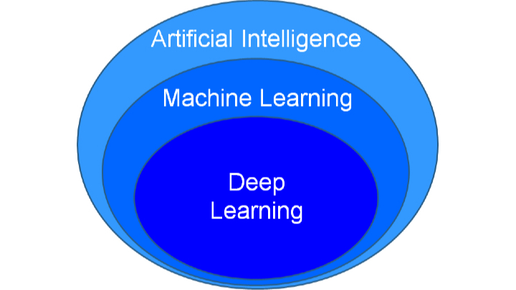
AI-ML-DL

Slide 4
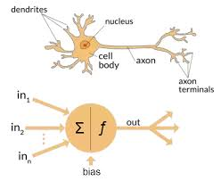
Basics of neural networks
Neuron forms a basic element of a neural network. It receives inputs, processes them and produces an output

Slide 5
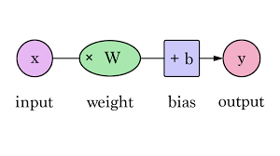
Basics of neural networks
Weights Inputs are multiplied by weights. Weights are randomly initialized. As the network gets trained weights get adjusted
Bias is added to the weighted multiplication of the input
x*W + b. Bias is basically added to change the range of the weighted input

Slide 6
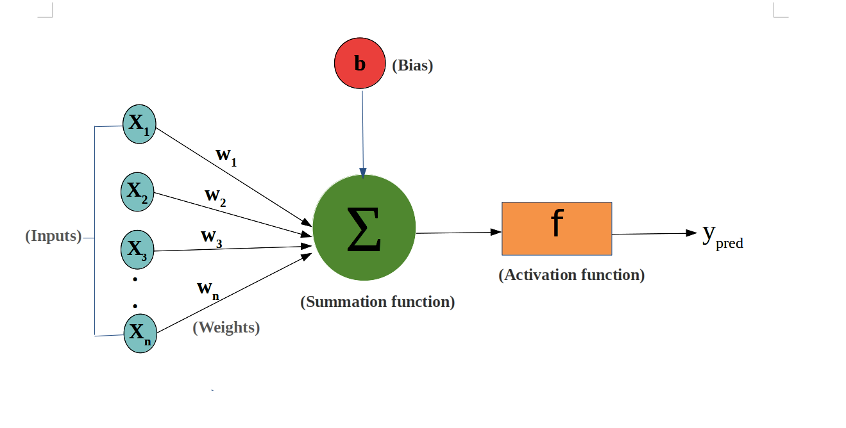
Basics of neural networks
Activation function translates the inputs to outputs non-linearly
f(X1*W1+b) where f() is the activation function
For multiple inputs u = ∑X*w+b
Final output y = f(u)

Slide 7
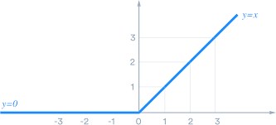
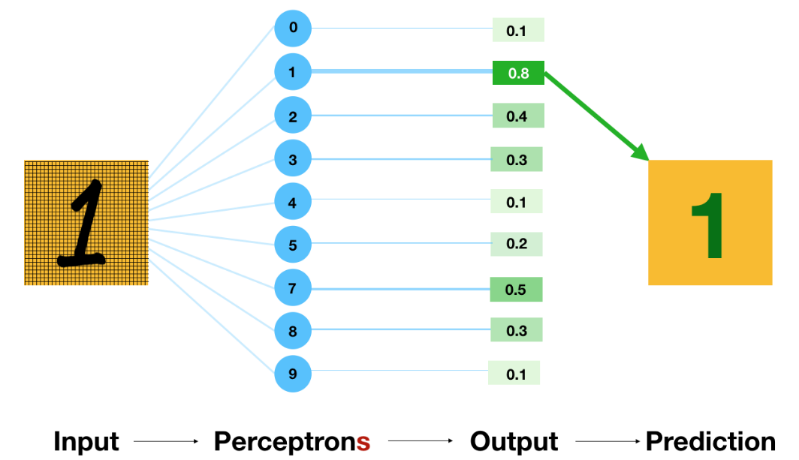
Common activation functions
ReLU
Rectified Linear Unit activation function
f(z) = z if z >= 0
= 0 if z < 0
Softmax
The Softmax function takes an N-dimensional vector of arbitrary real values and produces another N-dimensional vector with real values in the range (0, 1). Softmax activation function is mostly used for multi class classification

Slide 8
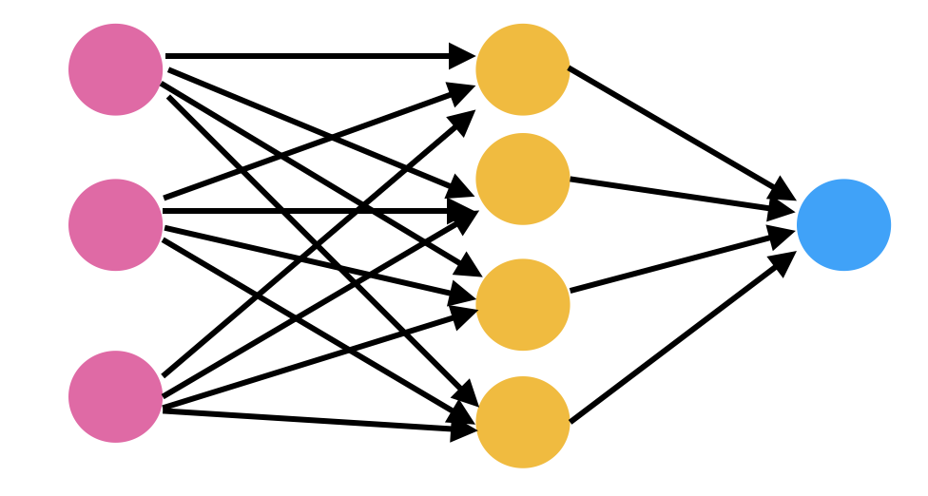
Structure of a neural network
Input layer
Hidden layer
Output layer

Slide 9
Workflow
Training
Validation
Testing
Training data
Dataset
Validation data
Testing data

Slide 10
Compile() function
Optimizers are used for improving speed and performance of a specific model
Loss function: The purpose of the loss function is to compute the quantity that a model should seek to minimize during training
Metrics: A metric is a function that is used to judge the performance of your model
model.compile(optimizer=‘rmsprop’,loss=‘mse’,metrics=[‘mae’])

Slide 11
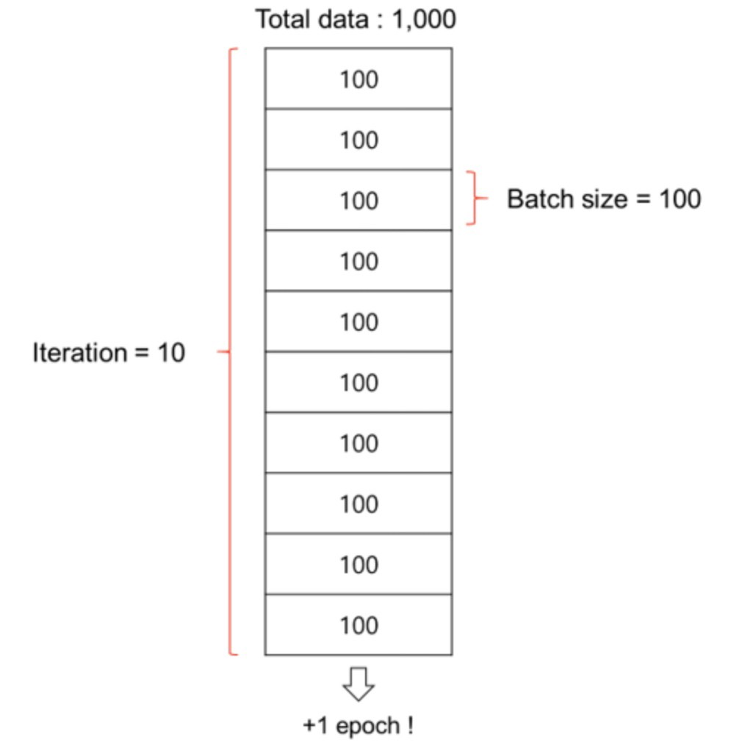
Fit() function
The fit function is used for training the model by
Slicing the data into ‘batches’ of batch_size and
Repeatedly iterating over the entire dataset for a given number of epochs

Slide 12
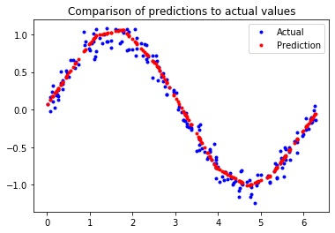
“Hello World” of ANN
Building a neural network capable of predicting the sine value of a given number in the range 0 to pi(3.14)
Take random samples between 0 and 2*pi
Calculate the sin(x) value each sample and add a little bit of random Gaussian noise
Split the data into training, validation and test data sets
Create a model and train it

Slide 13
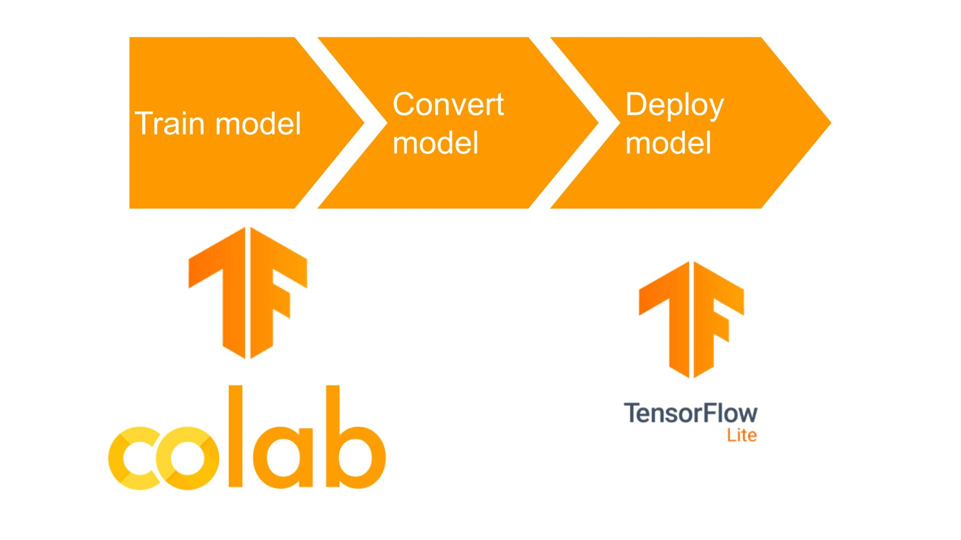
Edge Computing - ANN

Slide 14
Sine wave
def get_model:
SAMPLES=1000
np.random.seed(1337)
x_values=np.random.uniform(low=0,high=2*math.pi,sixe=SAMPLES)
# Shuffle and add noise
np.random.shuffle(x_values)
y_values=np.sin(x_values)
y_values += 0.1*np.random.randn(*y_values.shape)
#Split into train,validation and test
TRAIN_SPLIT = int(0.6 * SAMPLES)
TEST_SPLIT = int(0.2 * SAMPLES + TRAIN_SPLIT)
x_train,x_test,x_validate =np.split(x_values,(TRAIN_SPLIT,TEST_SPLIT))
y_train,y_test,y_validate =np.split(y_values,(TRAIN_SPLIT,TEST_SPLIT))
import math
import numpy as np
import tensorflow as tf
from tensorflow.keras import layers

Slide 15
# Create a neural net with 3 layers and 16 neurons
model = tf.keras.Sequential()
model.add(layers.Dense(16, activation = ‘relu’, input_shape=(1,)))
model.add(layers.Dense(16,activation=‘relu’)
model.add(layers.Dense(1))
model.compile(optimizer = ‘rmsprop’,
loss = ‘mse’,
metrics = [‘mae’])
model.fit(x_train,y_train,epochs=100,batch_size=16,
validation_data=(x_validate,y_validate))
return model
!pip install tinymlgen
from tinymlgen import port
model = get_model
c_code = port(model,pretty_print=True)
print(c_code)

Slide 16
Deploying on G-Edge
void loop(){
float x = 3.14 * random(100)/100;
float y = sin(x);
float input[1] = { x};
float predicted = ml.predict(input);
Serial.print(y);
Serial.print(“ “);
Serial.print(predicted);
delay(1000);;
}
#include “EloquentTinyML.h”
#include “sine_model.h”
#define TENSOR_ARENA_SIZE 2*1024
Eloquent::TinyML::TfLite<NUMBER_OF_INPUTS,NUMBER_OF_OUTPUTS,TENSOR_ARENA_SIZE> ml(sine_model);
void setup(){
Serial.begin(115200);
}

Slide 17
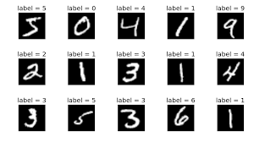
MNIST dataset
Hand-written digits from 0 to 9
Each datapoint is a 8x8 image of a digit
Classes :10
Samples per class : ~180
Samples total:1797
Dimensionality:64
Can be imported from the scikit-learn Python package
datasets using the load_digits method
MNIST – Modified National Institute of Standards & Technology

Slide 18
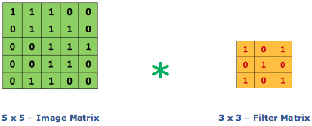
CNN – Convolution layer
CNN stands for Convolutional Neural Network which is a specialized neural network for processing data that has an input shape like a 2D matrix like images. CNN's are typically used for image detection and classification
Convolutional layer is core building block of CNN, it helps with feature detection

Slide 19
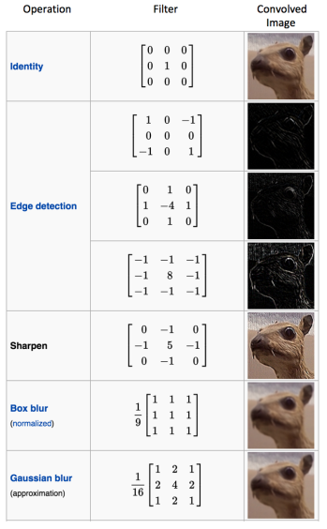
CNN

Slide 20
CNN
All convolutional layers contain filters (or kernels) that slide over the input image, detect features, create a feature map, and pass the results to the next layer. Then the operation repeats. Filters in the first few layers handle the simplest features (like edges or curves), while the next layers combine these results and use them to detect more detailed ones (like textures or entire body parts).
When all the feature maps are ready, they are merged to get the final output that represents predictions about the object that the machine sees

Slide 21
Typical layers in a CNN model
Convolution layers : Feature extraction- feature maps
Activation functions: Typical activation function used is ReLU
Pooling layers: “Downsamples” an image – Typical max pooling
Flattening layer
Fully connected layer - ANN

Slide 22
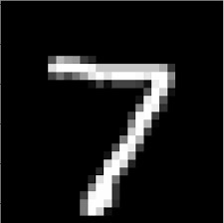
Simple CNN for MNIST data
3x3
Input image from MNIST dataset
Convolution Layer
8 filters
3x3 filter size
reLU activation function
Output Layer
Flattening Layer

Slide 23
Simple CNN forMNIST
Compile function parameters
Fit function parameters:
Parameter | Value
Optimizer | Adam
Loss | SparseCategoricalCrossEntropy
Metics | Accuracy
Parameter | Value
Batch_size | 16
Epochs | 50

Slide 24
CNN for MNIST
Step 1: Import the libraries
import numpy as np
from sklearn.datasets import load_digits
import tensorflow as tf
from tensorflow.keras import layers
from tinymlgen import port

Slide 25
CNN for MNIST
Step 2: Generate train, validate and test data
def get_data():
np.random.seed(1337)
x_values,y_values = load_digits(return_X_y=True)
x_values /= x_values.max()
x_values = x_values.reshape((len(x_values),8,8,1))
TRAIN_SPLIT = int(0.6 * len(x_values)
TEST_SPLIT = int(0.2 * len(x_values) + TRAIN_SPLIT)
x_train,x_test,x_validate=np.split(x_values,(TRAIN_SPLIT,TEST_SPLIT))
y_train,y_test,y_validate=np.split(y_values,(TRAIN_SPLIT,TEST_SPLIT))
return x_train,x_test,x_validate,y_train,y_test,y_validate

Slide 26
CNN for MNIST
Step 3: Create and train the model
def get_model:
model = tf.keras.Sequential()
model.add(layers.Conv2D(8,(3,3),activation=‘relu’,input_shape=(8,8,1)))
model.add(layers.Flatten())
model.add(layers.Dense(len(np.unique(y_train))))
model.compile(optimizer=‘adam’,loss=SparseCategoricalCrossEntropy,metrics=[‘accuracy’])
model.fit(x_train,y_train,epochs=50,batch_size=16,validation_data=(x_validate,y_validate)
return model,x_test,y_test

Slide 27
CNN for MNIST
Step 4: Testing the model accuracy
def test_model(model,x_test,y_test):
x_test=(x_test/x_test.max()).reshape(len(x_test),8,8,1))
y_pred=model.predict(x_test).argmax(axis=1)
print(‘ACCURACY’,(y_pred==y_test).sum()/len(y_test))
Step 5:Exporting the model
Model,x_test,y_test = get_model()
test_model(model,x_test,y_test)
c_code = port(model)
print(c_code)

Slide 28

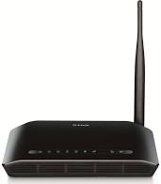

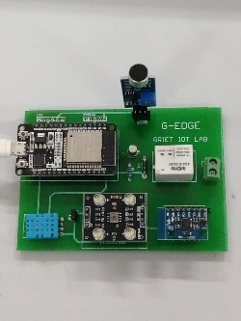
Connecting G-Edge to a cloud database
Firebase
WiFi connectivity
Router
Libraries:
FirebaseESP32.h
HTTPClientESP32Ex
G-Edge

Slide 29
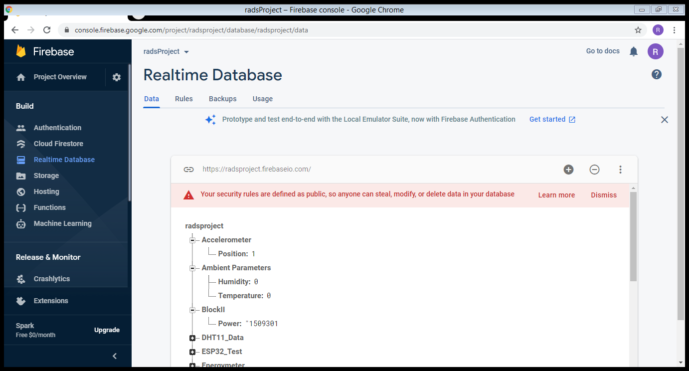
Host name

Slide 30
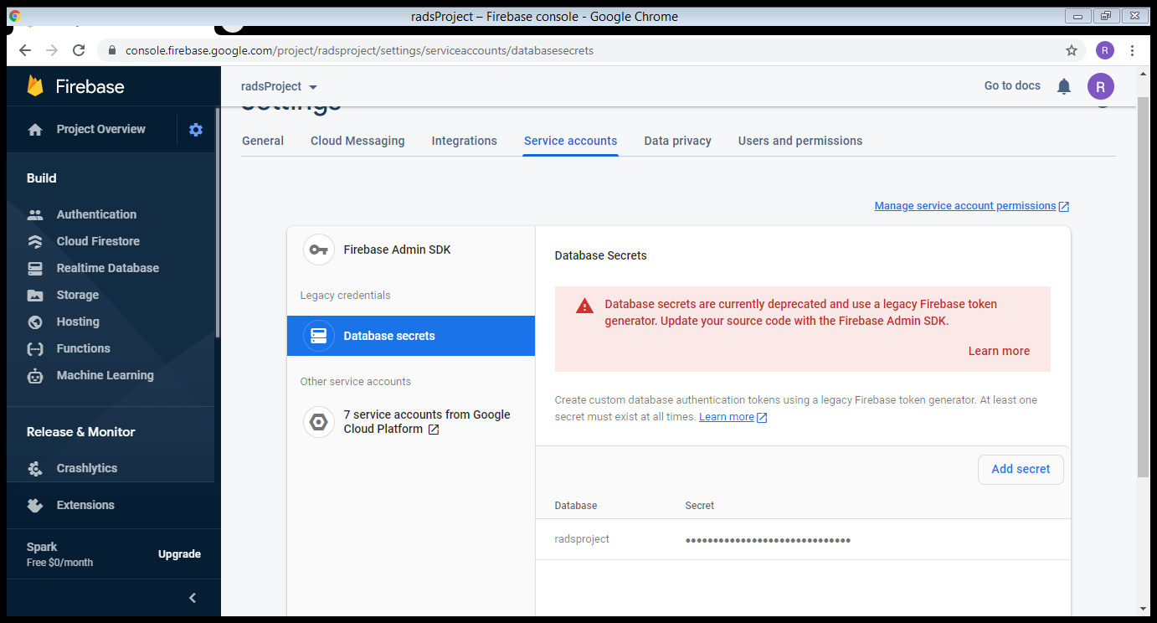
Authorization key

Slide 31
Transferring DHT11 data to Firebase
Connect to WiFi router
giving WiFi credentials
WiFi credentials
WiFi network name
Password
setup
Initialize DHT 11
Firebase credentials
Firebase host name
Firebase authorization key
Initialize Firebase
Giving Firebase credentials
Read temperature, humidity from DHT11
loop
Transfer to Firebase with key values
Delay(2000)

Slide 32
#include <WiFi.h>
#include “FirebaseESP32.h”
#include “DHTesp.h”
#define DHTpin 23
#define FIREBASE_HOST “xxxxxxx.firebaseio.com”
#define FIREBASE_AUTH “xxxxxxxxxxxxxxxxxxxxxx”
#define WIFI_SSID “xxxxxxxx”
#define WIFI_PASSWORD “xxxxxxxxxxxxxxxx”
FirebaseData firebaseData;
float temperature;
float humidity;

Slide 33
void setup(){
Serial.begin(115200);
WiFi.begin(WIFI_SSID,WIFI_PASSWORD);
//Connecting to WiFi network
while(WiFi.status() != WL_CONNECTED){
Serial.print(“.”);
delay(300);
}
//Firebase initialization
Firebase.begin(FIREBASE_HOST,FIREBASE_AUTH);
Firebase.reconnectWiFi(true);
//DHT11 initialization
dht.setup(DHTpin,DHTesp::DHT11);
}

Slide 34
void loop(){
// Read temperature and humidity
temperature = dht.getTemperature();
humidity = dht.getHumidity();
//Print the values locally
Serial.print(temperature);
Serial.print(‘\t’);
Serial.print(humidity);
//Post values to Firebase
Firebase.setFloat(firebaseData,”DHT11_Data/temperature”,temperature);
Firebase.setFloat(firebaseData,”DHT11_Data/humidity”,humidity);
delay(2000);
}

Slide 35
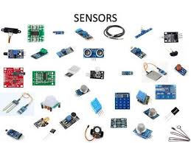

What next?
Signal conditioning
Find new application areas, identify sensors and interface to G-Edge

Slide 36
Comparing different classifiers
Classifier | Training Time | Accuracy | RAM needed | Flash needed
Decision Tree
Random Forest
XGBoost
SVM
Naïve Bayes

Slide 37
Edge Computing Lab?
ECE can help setup an Edge Computing Lab in your department
Resources that can be supplied:
G-Edge boards
Lab Manual with full set of experiments
Training
Platform for Mini Projects
Mechanical Dept
Digitization of an existing lab
Sensors Lab?
IOT
Edge Computing

Slide 38
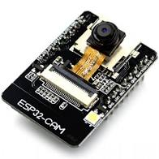
Coming up next: G-Edge II based on ESP32 CAM?
Application to real world projects
Detection and deterrence of simian menace in urban terrace gardens
Door bell with face recognition
CO PO automation
Pros:
Inexpensive
Small size
Arduino IDE support
Cons:
No USB
Programming requires external USB-serial conveter

