Slide 1
G-CAM
G-CAM board programming

Slide 2
introduction
G-CAM is a microcontroller based camera board
Basic board – ESP32-CAM
Can be programmed with the Arduino IDE
Projects
Motion detection
Event based picture capture and remote transfer
Video streaming web server
Object identification
Object classification

Slide 3
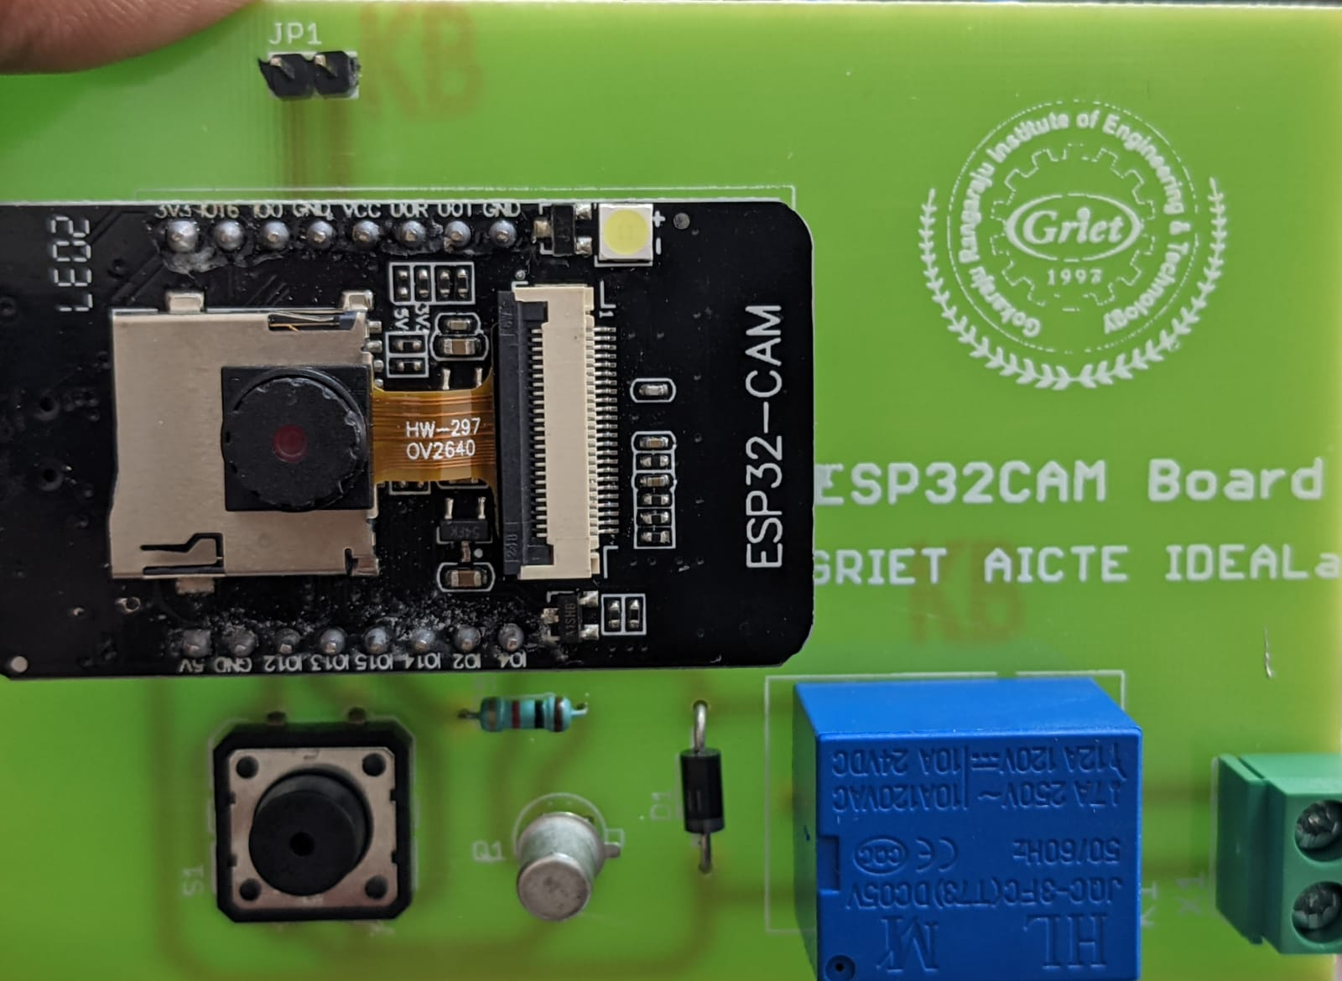
Resources
Jumper – Flash/Run
ESP32-CAM Module
Relay
Switch
Jumper for Flash/Run mode switching
ESP32-CAM
Switch
Relay

Slide 4
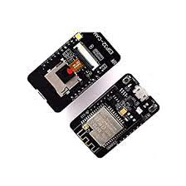
ESP32-CAM
Onboard ESP32-S module, supports WiFi + Bluetooth
Onboard SD card slot for data storage
Supports WiFi video monitoring and WiFi image upload
Comes with Micro USB port for programming

Slide 5
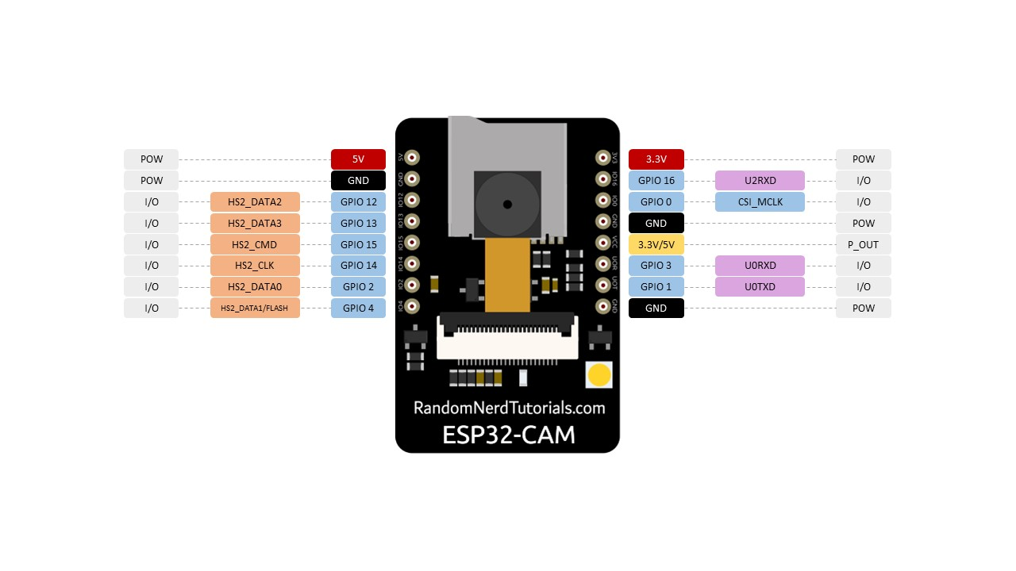
ESP-CAM pinout

Slide 6
ESP32-cam modes
Flash Mode : GPIO 0 is connected to ground. Programming can be done only when ESP322 is in Flash mode
Run Mode: GPIO 0 is free. The program in ESP32-CAM will start running on powerup

Slide 7
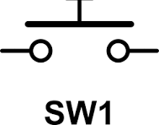

G-CAM board
Trigger switch
ESP32-CAM
5V Relay
Transistor drive ckt.
Flash/Run jumper

Slide 8
G-cam board pinout
Component | ESP32-CAM pin | Remarks
5V Relay | GPIO 13 | HIGH to swith on, LOW to switch off
Trigger switch | GPIO 12 | GPIO 12 grounded when switch is pressed
Flash/Run jumper | GPIO 0 | GPIO 0 grounded when jumper is put
Red LED on ESP32-CAM | GPIO 33 | Can be used by user for indicating any state
Flash LED | GPIO 4 | Can be used as flash light when taking snap shot

Slide 9
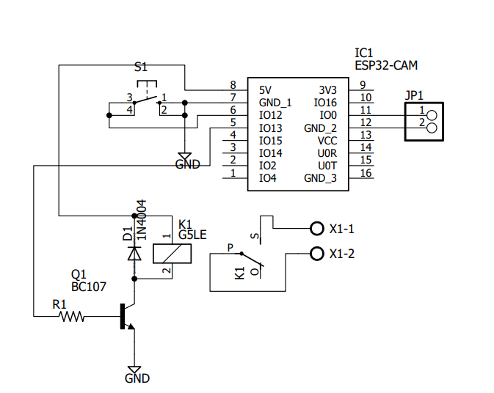
Gcam schematic

Slide 10
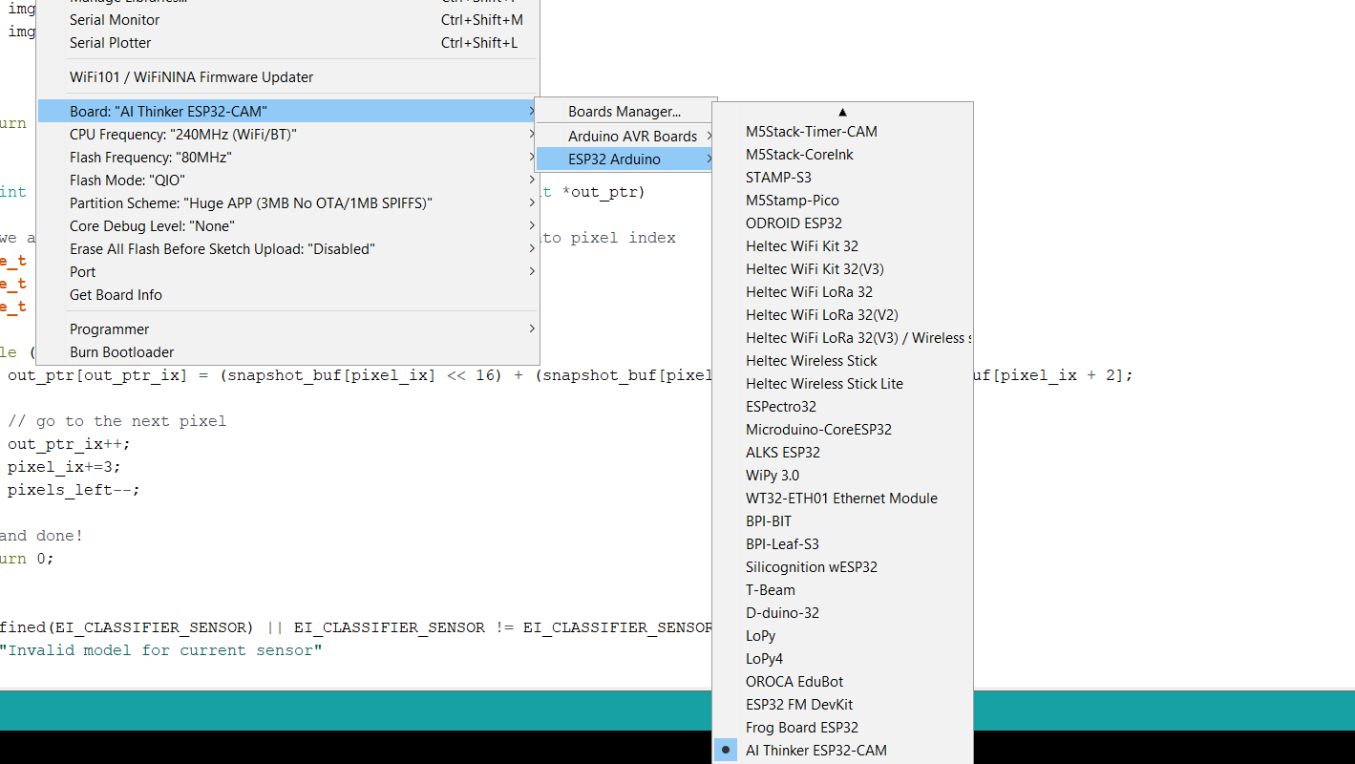
arduino
In ESP32 Boards group
select
AI Thinker ESP32 CAM board

Slide 11
Red LED
void setup()
{
pinMode(33,OUTPUT);
}
void loop()
{
digitalWrite(33,HIGH);
delay(1000);
digitalWrite(33,LOW);
delay(1000);
}

Slide 12
flash LED
void setup()
{
pinMode(4,OUTPUT);
}
void loop()
{
digitalWrite(4,HIGH);
delay(1000);
digitalWrite(4,LOW);
delay(1000);
}

Slide 13
switch
void setup(){
pinMode(12,INPUT_PULLUP);
Serial.begin(115200);
}
void loop(){
int status;
If(status == HIGH)
Serial.println(“Swith pressed”);
Else
Serial.println(“Switch not pressed”);
}
ESP32-CAM
12
GND

Slide 14
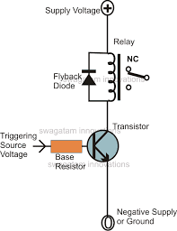
relay
void setup(){
pinMode(13,OUTPUT);
}
void loop(){
digitalWrite(13,HIGH);
delay(1000);
digitalWrite(13,LOW);
delay(1000);
}
ESP32-CAM
13

Slide 15
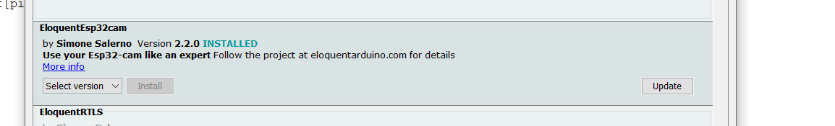
library
Install the latest version of EloquentEsp32cam by Simone Salerno using the Library Manager in the Arduino IDE

Slide 16
github
Github URL : github.com/grietiotlab
Repository : G-CAM

Slide 17
Motion detection
threshold(n): if the value of the pixels at each corner changed from the previous frame by more than this value, that point is marked as a moving point.
4.ratio(percent): ratio of moving points / total points above which motion is triggered.
rate limiter(n): how many seconds should elapse from one trigger to the next.
Parameters for the detector algorithm:
skip(n): Skip the first few frames to allow time for the camera to settle down
stride(n): the image is divided into a grid where each cell size equals the stride. The motion is analyzed only at the corners of each cell. The larger the stride, the faster the execution time, but the coarser the detection. Keep in mind that motion detection already happens on a 1/8th version of the original image!

Slide 18
github
Github URL : github.com/grietiotlab
Repository : G-CAM
File : ESP32_CAM_MotionDetection.ino

Slide 19
Code flow
Set camera parameters: make, resolution, quality
Set motion detection parameters: stride, threshold, ratio, rate limiter
Start camera image capture
Start motion detection
If motion detected, give alert on Serial Monitor
Libraries used:
eloquent_esp32cam.h
eloquent_esp32cam/motion/detection.h

Slide 20
#include <eloquent_esp32cam.h>
#include <eloquent_esp32cam/motion/detection.h>
using eloq::camera;
using eloq::motion::detection;
void setup() {
delay(3000);
Serial.begin(115200);
camera.pinout.aithinker();
camera.brownout.disable();
camera.resolution.vga();
camera.quality.high();
detection.stride(1);
detection.threshold(5);
detection.ratio(0.2);
detection.rate.atMostOnceEvery(5).seconds();
// init camera
while (!camera.begin().isOk())
Serial.println(camera.exception.toString());
Serial.println("Camera OK");
}
void loop() {
// capture picture
if (!camera.capture().isOk()) {
Serial.println(camera.exception.toString());
return;
}
// run motion detection
if (!detection.run().isOk()) {
Serial.println(detection.exception.toString());
return;
}
// on motion, perform action
if (detection.triggered())
Serial.println("Motion detected!");
}

Slide 21

Web server
The sketch will create a web server with an IP address. It needs to join a WiFi network. The network credentials should be provided in the program
Calling the IP address of the web server from any browser in the same WiFi network will display streaming video from the camera
Applications
Camera fitted on a moving robot vehicle
Surveillance applications

Slide 22
github
Github URL : github.com/grietiotlab
Repository : G-CAM
File : ESP32_CAM_VideoStream.ino

Slide 23
Code flow
Initialize camera parameters – make, resolution, quality
Connect to WiFi network using the credentials provided
Start video MJPEG stream from camera
Print MJPEG server address
Access raw MJPEG stream from a browser in the same network using the server address
Get a still picture by using the /jpeg switch
Libraries used:
eloquent_esp32cam.h
eloquent_esp32cam/viz/mjpeg.h

Slide 24

Telegram
What is Telegram?
Telegram is an online messaging app that, at its core, works like the popular messaging apps WhatsApp or Facebook Messenger.
This means that you can use Telegram to send messages to your contacts when connected to Wi-Fi or mobile internet access. Telegram is cloud-based and prioritises security and speed.

Slide 25
Telegram bot
What does the Telegram Bot do?
A Telegram Bot is a programme that behaves like a normal chat partner with additional functions. It performs predefined tasks independently and without the user’s involvement. The term bot is derived from the term for robot.
What does the messenger send?
A Telegram bot can basically do everything a human chat partner does. Automatically or on request, it can send you the following information:
Text messages, Images, Videos, Files of any kind
What makes it special?
An important function of a Telegram bot is the possibility to execute commands in a Telegram chat, which then directly trigger actions or request information. For example, it is possible to send the bot the command “/help” or “/help”, which then outputs the commands possible for this bot in the chat as text feedback.

Slide 26
github
Github URL : github.com/grietiotlab
Repository : G-CAM
File : ESP32_CAM_DoorBell_Telegram.ino

Slide 27
Telegram bot
Can I create a Telegram Bot myself?
How can i create an account?
To create a Telegram Bot yourself, all you have to do is install the Telegram app on a device and log in there to create your personal account.
How can I create the bot?
The actual creation of your own bot is generally very simple. You are supported by the virtual user “Botfather”, which is the central development tool for Telegram bots. So you first have to search for this user on Telegram and start a chat with him.
What is the Botfather?
The Botfather is basically a Telegram Bot and responds to commands. It helps with the creation of one’s own bot, organises unique bot names, for example, and assigns access authorisations for programming.
How do I set up my bot?
Start by entering the command “/newbot” as a text message in the chat with the botfather. Now you have to give your bot a name such as “My first bot for testing”. The user name of the bot is then requested. This must end in “bot”. Now the botfather should congratulate you on setting up the new bot and tell you the address and the personal “token”. This is, so to speak, the password for complete control of the bot. The basic setup of the Telegram bot is now complete. Now the bot only needs to be filled with functionality or programmed.

Slide 28
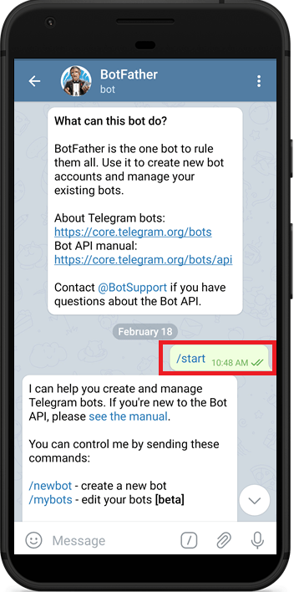
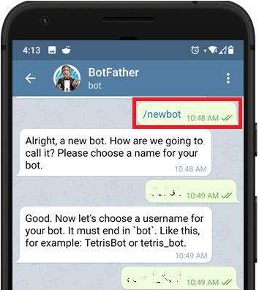
Open Telegram and follow the next steps to create a Telegram Bot. First, search for “botfather” and click the BotFather
The following window should open and you’ll be prompted to click the start button.
Type /newbot and follow the instructions to create your bot. Give it a name and username
Username should end with bot
If your bot is successfully created, you’ll receive a message with a link to access the bot and the bot token. Save the bot token because you’ll need it so that the ESP32 can interact with the bot.
In your Telegram account, search for “IDBot” or open this link t.me/myidbot in your smartphone.
Start a conversation with that bot and type /getid. You will get a reply back with your user ID. Save that user ID,

Slide 29
Telegram basic
Sending a text message from ESP32 to Telegram Bot
Telegram credentials required:
Bot token
Telegram account ID
WiFi credentials required:
SSID
Password

Slide 30
Code flow
Connect to WiFi network using credentials provided
Open Serial Monitor and enter text to be sent
Send message to telegram bot using bot token and Telegram chat ID details
Check whether message is received in Telegram app on mobile
Libraries:
eloquent_esp32cam.h
eloquent_esp32cam/extra/esp32/telegram.h

Slide 31
Smart Door bell
G-CAM
WiFi Router
Action:
Visitor presses switch on G-CAM
Response:
Flash LED switched on
Snap shot of visitor taken
Snap shot recd by Telegram bot
Snap shot sent to Telegram bot
Command recd from Telegram bot to unlock
Command sent from Telegram bot
Mobile with Telegram app and bot
Unlock door

Slide 32
Code flow
Connect to WiFi network using WiFi credentials
Read Door Bell input
If door bell pressed, switch on flash and take snap shot of visitor
Transfer snap shot to Telegram bot of remote user
Remote user checks snap shot and issues unlock command
Unlock command received by G-CAM and unlock action performed
Libraries:
#include <UniversalTelegramBot.h>
#include <ArduinoJson.h>

Slide 33
github
Github URL : github.com/grietiotlab
Repository : G-CAM
File : ESP32_CAM_Doorbell_Telegram.ino

Slide 34
Motion trigger
Github URL : github.com/grietiotlab
Repository : G-CAM
File : ESP32_CAM_Motion_Telegram.ino

