Slide 1
G-RoVe2
GRIET Robot Vehicle Version 2

Slide 2
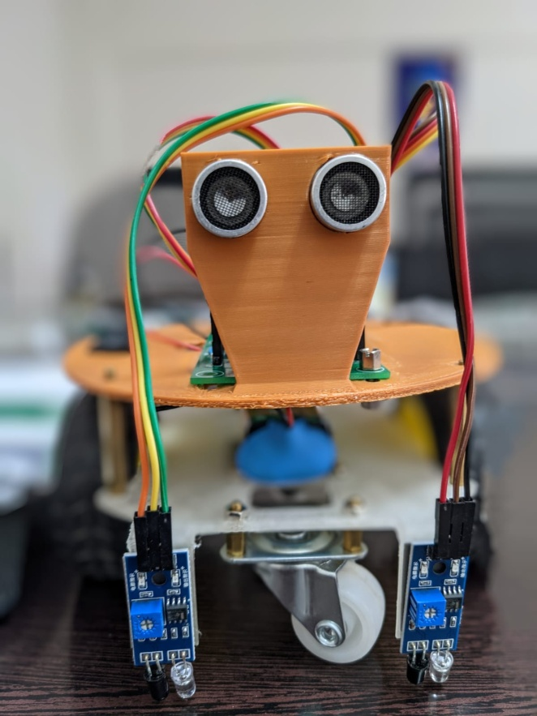
G-RoVe2
2 Wheel Robot Vehicle
32 bit ESP32 based control card
L298 Motor Control driver
9V battery
Ultrasonic sensor
IR sensors

Slide 3


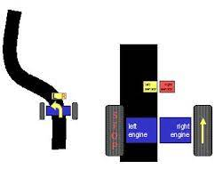

Projects
Remote Control using Bluetooth
Remote Control using Wi-Fi
Obstacle Avoidance
Line Following

Slide 4
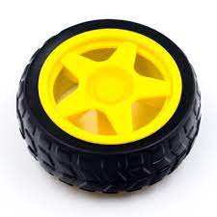
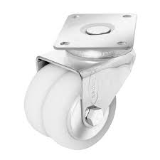
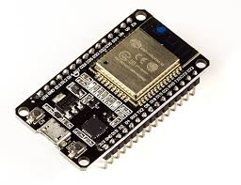
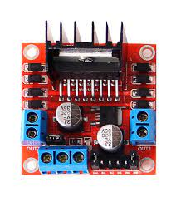
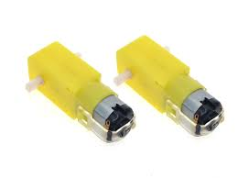
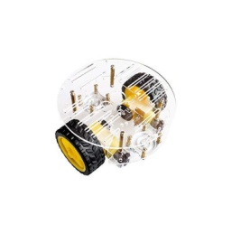
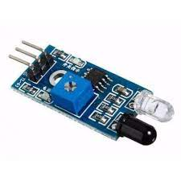
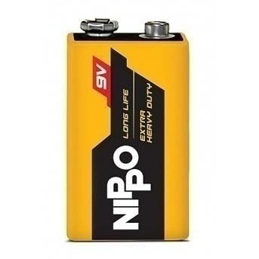
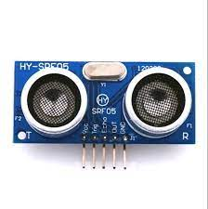
Bill of MATERIALS
65mm Robot Wheels
Caster Wheels
Control Card with ESP32
Geared DC Motors
3D printed top and bottom plates
Motor Driver
IR Sensors
9V Battery
Ultrasonic Sensor

Slide 5
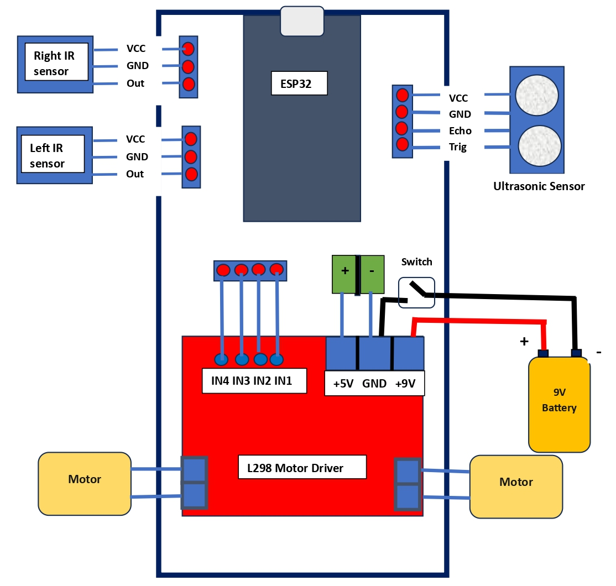
Wiring diagram

Slide 6
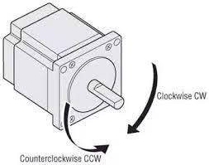
Single Motor action
 | Motor Pins
Action | INP1 | INP2
Stop | LOW | LOW
Clockwise | HIGH | LOW
Counterclockwise | LOW | HIGH
Stop | HIGH | HIGH
Vehicle motion
 | Left Motor |  | Right Motor
Action | INP1 | INP2 | INP3 | INP4
Forward | HIGH | LOW | HIGH | LOW
Backward | LOW | HIGH | LOW | HIGH
Right side | HIGH | LOW | LOW | LOW
Left side | LOW | LOW | HIGH | LOW
ESP32 pin | L298 pin
GPIO14 | IN1
GPIO27 | IN2
GPIO28 | IN3
GPIO25 | IN4

Slide 7
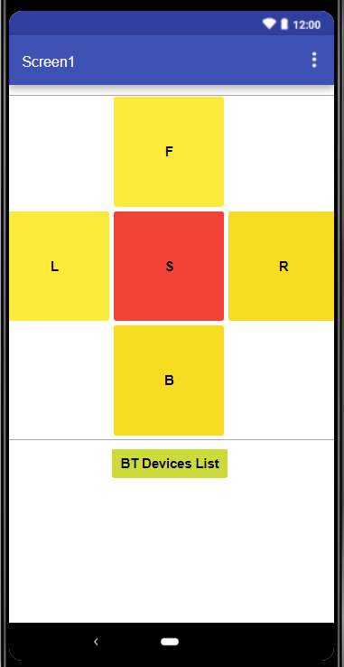

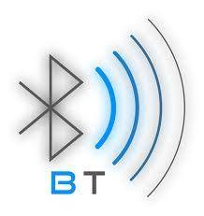
Bluetooth Control using mobile app
Uses Bluetooth of ESP32 on Control Card
G-RoVe2
Mobile app
Bluetooth control

Slide 8
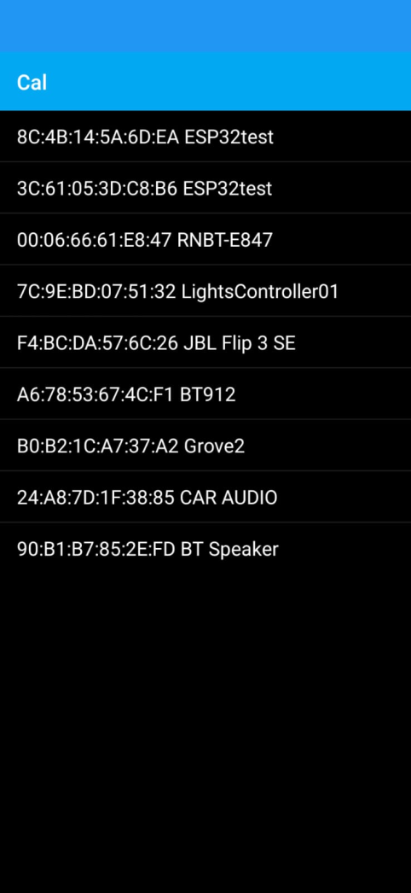
Offline pairing of ESP32 with mobile phone
Click on the BT Devices List button in the mobile app
From the devices list obtained select the G-Rove item
A “Connected” message will appear on the screen
Use L,F,R,W,S buttons to transfer commands
G-RoVe will receive the commands and move accordingly
Bluetooth control

Slide 9
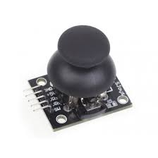

ESP32 based remote with joystick
ESP-NOW control
G-RoVe

Slide 10
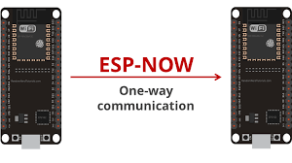
ESP-NOW is a wireless communication protocol defined by Espressif, which enables the direct, quick and low-power control of smart devices, without the need of a router
ESP-NOW can be used for wireless communication between two ESP family devices
ESP32 based Remote and ESP32 based G-RoVe will communicate with one another using ESP-NOW protocol
The Remote will be transmitting and G-RoVe will be receiving
ESP-NOW
Remote
G-RoVe

Slide 11
A device participating in an ESP-NOW network can be operated in one of two modes.
Initiator – This device initiates the transmission. It will require the MAC address of the receiving device.
Responder – This device receives the transmission.
In unidirectional (half-duplex) mode, the transmitting device is the Initiator and the receiving device is the Responder.
ESP-NOW

Slide 12
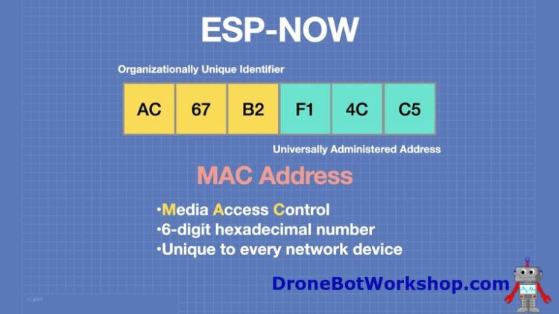
When Initiators communicate with Responders, they need to know the Responder’s MAC Address.
A MAC, or Media Access Control, Address is a unique 6-digit hexadecimal number assigned to every device on a network. It is generally burned into the device by the manufacturer
#include "WiFi.h"
void setup(){
Serial.begin(115200);
WiFi.mode(WIFI_MODE_STA);
Serial.println(WiFi.macAddress());
}
void loop(){
}
ESP-NOW

Slide 13
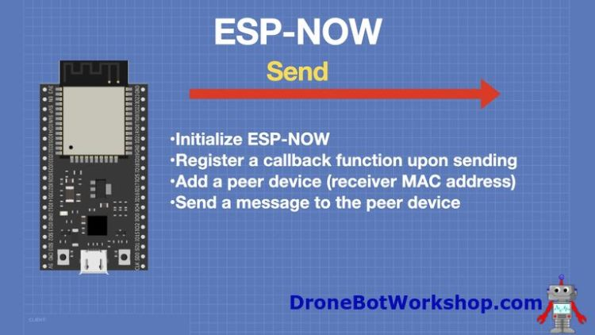
// Init ESP-NOW
if (esp_now_init() != ESP_OK) {
Serial.println("Error initializing ESP-NOW");
return;
}
esp_now_register_send_cb(OnDataSent);
// Register peer
memcpy(peerInfo.peer_addr, broadcastAddress, 6);
peerInfo.channel = 0;
peerInfo.encrypt = false;
// Add peer
if (esp_now_add_peer(&peerInfo) != ESP_OK){
Serial.println("Failed to add peer");
return;
}
ESP-NOW

Slide 14
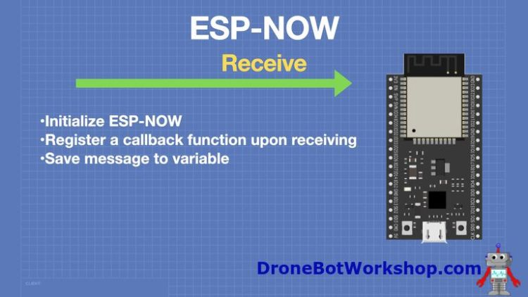
ESP-NOW

Slide 15
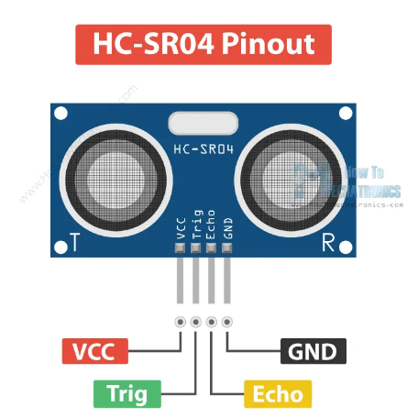
Object detection using Ultrasonic sensor (HC-SR04)
The sensor has 4 pins. VCC and GND go to 5V and GND pins on the Arduino.
Trig and Echo go to any digital Arduino pin.
Using the Trig pin we send the ultrasound wave from the transmitter, and with the Echo pin we listen for the reflected signal.
A short ultrasonic sound wave being transmitted towards the target. The target reflects back the wave which confirms the presence of the object.
ESP32 pin | Ultrasonic
VIN | VCC
GPIO12 | Trig
GPIO13 | Echo
GND | GND
OBSTACLE detection – Ultrasonic sensor

Slide 16
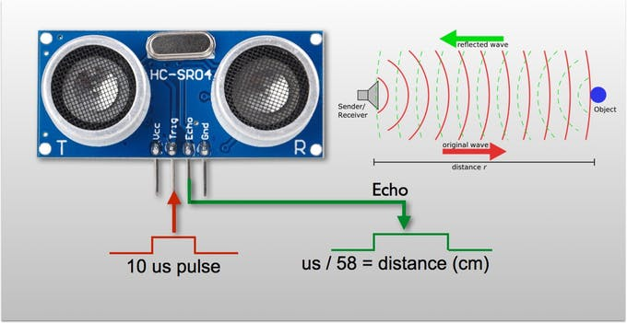
To use this sensor to measure distance, the robot's brain must measure the amount of time it takes for the ultrasonic sound to travel.
Sound travels at approximately 340 meters per second (0.034 mm per microsecond).
To measure the distance the sound has travelled we use the formula:
Distance = (Time x Speed Of Sound) / 2.
= (time * 0.034) / 2
The "2" is in the formula because the sound has to travel back and forth.
OBSTACLE detection – Ultrasonic sensor

Slide 17
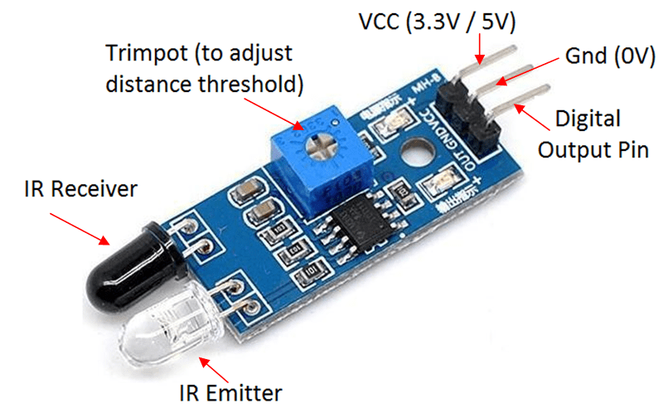
Line following using IR sensors.
The white LED is an IR LED which continuously emits the IR light and black LED is a photodiode that works as the receiver in the IR sensor.
If the light gets reflected back by hitting any object in front it, the IR receiver receives this light. This way the object is detected in the case of the IR sensor.
Using potentiometer (Trimpot) we can control the range
i.e. from how far you want to detect the object by
changing the value of the potentiometer.
Line following – IR sensor

Slide 18
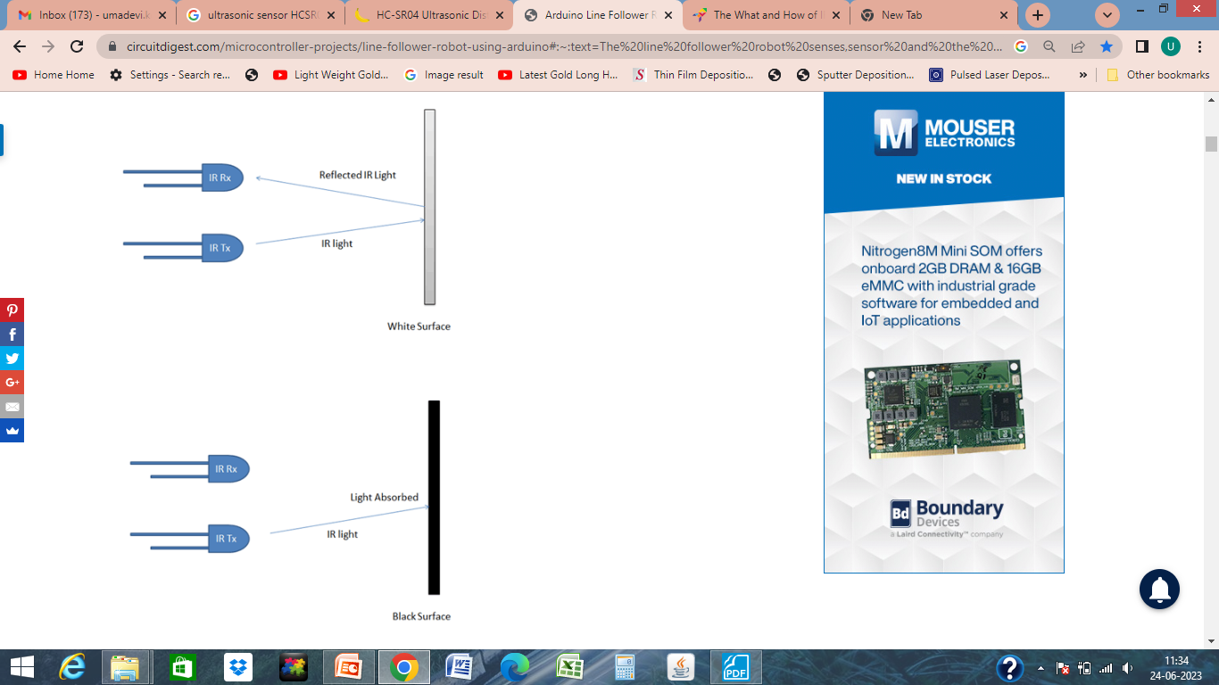
Line Follower
The concept of working of line follower is related to light. We use here the behavior of light at the black and white surfaces. When light falls on a white surface it is almost fully reflected and in the case of a black surface light is completely absorbed. This behavior of light is used in building a line follower robot.
IR Sensor Status
When IR Sensor on white surface, then its status is LOW.
When IR Sensor on Black surface, then its status is HIGH.

Slide 19

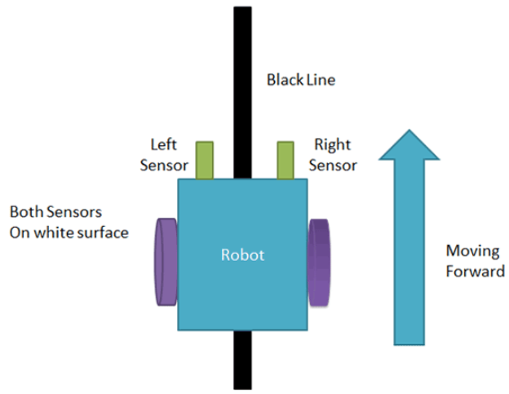
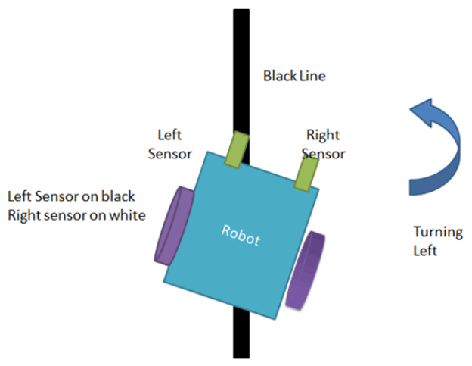
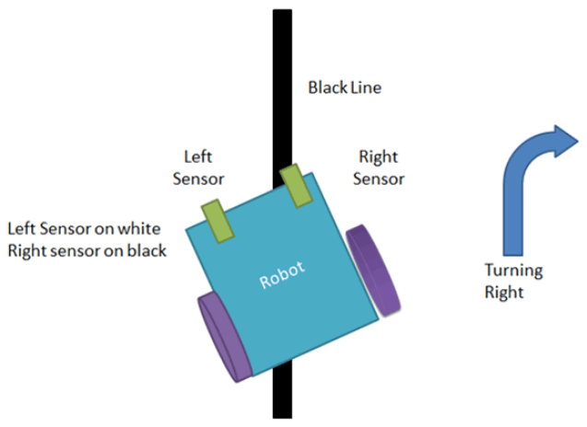
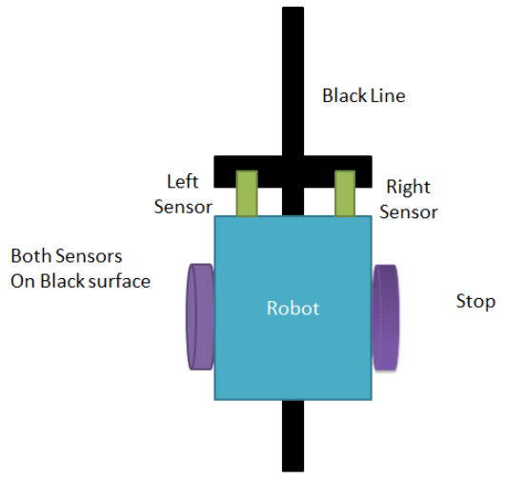
we are using two IR sensor modules namely the left sensor and the right sensor.
When both left and right sensor senses white then the robot moves forward.
2. If the left sensor comes on a black line then the robot turn the left side.
3. If the right sensor sense black line then robot turn right side until both sensors comes at the white surface. When the white surface comes robot starts moving on forward again.
4. If both sensors come on the black line, the robot stops.
1
2
3
4
Line following – IR sensor

Slide 20
Vehicle motion
Action | IR Sensor 1 (Right) | IR Sensor 2 (Left)
Forward | LOW | LOW
Left side | HIGH | LOW
Right side | LOW | HIGH
Stop | HIGH | HIGH
Line following – IR sensor

