Slide 1
Getting Started

Slide 2
Github
All the Arduino programs required for the workshop are on:
https://github.com/GRIETIOTLAB
- Go to GISMO-V repository
Go to GettingStarted folder
GISMO5_OnboardLED.ino

Slide 3
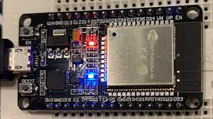
Hello World
Onboard LED
Blinking an LED
Onboard LED connected to pin 2
Create a new project in Arduino
Copy raw content of GISMO5_OnBoardLED.ino into the file
Compile and name file as LED
Upload onto GISMO-V board via USB port

Slide 4
Hello World
#define onBoardLED 2
void setup()
{
pinMode(onBoardLED , OUTPUT);
}
void loop()
{
digitalWrite(onBoardLED , HIGH);
delay(1000);
digitalWrite(onBoardLED, LOW);
delay(1000);
}

Slide 5
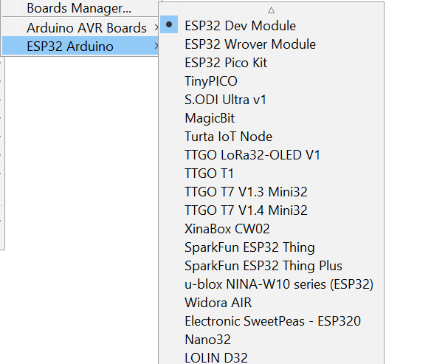
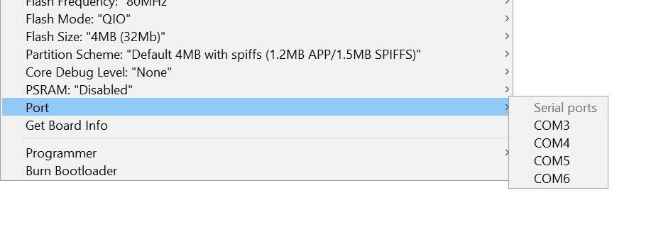
Hello World
Select the COM port to which your bard is mapped
Select ESP32 Arduino -> ESP32 Dev Module as the Board

Slide 6
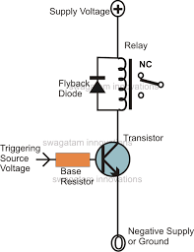
Relay module
ESP32
13

Slide 7
Relay module
#define relayPin 13
void setup(){
pinMode(relayPin,OUTPUT);
}
void loop(){
digitalWrite(relayPin,HIGH);
delay(2000);
digitalWrite(relayPin,LOW);
delay(2000);
}
Path:
github.com/GRIETIOTLAB/GISMO_V/GettingStarted/GISMO5_relay.ino

Slide 8

Relay module
Normally open (NO) contacts are brought out onto terminal blocks
On relay switching on, the NO contacts will close and the Line circuit will be complete and the bulb will glow
GISMO-V
Line
Neutral

Slide 9
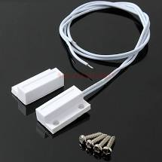
Magnetic switch
ESP32
Internal pullup
GPIO16
Mag sw
GND

Slide 10
Magnetic switch
#define magSW 16
void setup() {
pinMode(magSW,INPUT_PULLUP);
Serial.begin(115200);
}
void loop() {
int sw_status;
sw_status = digitalRead(magSW);
if (sw_status)
Serial.println("Switch open");
else
Serial.println("Switch closed");
delay(1000);
}

Slide 11

OLED display
I2C
OLED display pin | ESP32 pin
GND | GND
VCC | 3.3V
SCL | GPIO22
SDA | GPIO21
OLED: Organic Light Emitting Diode

Slide 12
OLED display
Feature | Value
Screen size | 0.96 inches
Internal controller | SSD1306
Color displayed | Blue
Resolution | 64 x 128
VCC | 3.3V
Protocol | I2C

Slide 13
OLED Display
#include <Wire.h>
#include “SSD1306.h”
SSD1306 display(0x3C,21,22);
SDA,SCL
I2C address

Slide 14
OLED Display
c
display.init();
display.setFont(ArialMT_Plain_24);
display.clear();
display.drawstring(0,0,”Hello World”);
display.display();
c

Slide 15
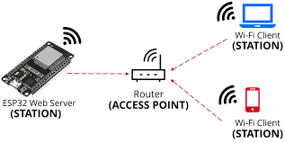
WiFi
ESP32 acts as a station and gets connected to a WiFi router

Slide 16
WiFi
#include <WiFi.h>
#define WIFI_SSID “xxxxxxxxxxxxxxxxxx”
#define WIFI_PASSWORD “xxxxxxxxxxxxxxxxxxxxxx”
The SSID (Service Set Identifier) is the name of your wireless network, also known as Network ID. This is viewable to anyone with a wireless device within reachable distance of your network. ... The SSID is the name of your wireless network. This is what you will look for when connecting wireless computers and devices.

Slide 17
WiFi
WiFi.begin(WIFI_SSID,WIFI_PASSWORD);
Serial.print(“Connecting to WiFi”);
while(WiFi.status() != WL_CONNECTED)
{
Serial.print(“.”);
delay(300);
}
Serial.print(“Connected with IP:”);
Serial.print(WiFi.localIP());

Slide 18


Firebase
#include <FirebaseESP32.h>
#define FIREBASE_HOST “xxxxxxxxxxxxxxxxxxxxxxx”
#define FIREBASE_AUTH “xxxxxxxxxxxxxxxxxxxxxxx”
FirebaseData firebaseData; // Firebase data object

Slide 19
Firebase
c
Firebase.begin(FIREBASE_HOST,FIREBASE_AUTH);
Firebase.reconnectWiFi(true);
Firebase.setFloat(FirebaseData, “IOTLAB/My_App/Sensor_Value”,value);
delay(2000);
Pushing sensor data to Firesbase file : GISMO5R_Firebase.ino
c

Slide 20
Firebase
c
Firebase.begin(FIREBASE_HOST,FIREBASE_AUTH);
Firebase.reconnectWiFi(true);
String ledCmdFull;
String ledCmd;
Firebase.getString(FirebaseData, “IOTLAB/My_App/Motor_Cmd”,ledCmdFull);
ledCmd = ledCmdFull.substring(2,ledCmdFull.length()-2);
finalCmd = ledCmd.toInt();
delay(2000);
Pulling command data from Firesbase file : GISMO5R_Firebase_CR.ino
c

