Slide 1
IEEE Skill Connect - IoT Level 2 – Train the Trainers
Using the IEEE Starter Kit

Slide 2
Agenda
1
Introduction to IoT, IEEE Starter Kit;
Sensor Interfaces
5
Environment Monitoring, RTC based Control, Fall Detection
2
Cloud database creation , Interface to Starter Kit
Smart Garden, Home Safety & Security
6
3
Mobile App Development Framework
6
Intro to AWS
4
Ambient parameter Monitoring, Smart Lock, Range Meter

Slide 3

Internet of Things - IOT
Information
Control
A system of internet-connected ‘things’ that can collect and transfer data over a wireless network without human intervention

Slide 4
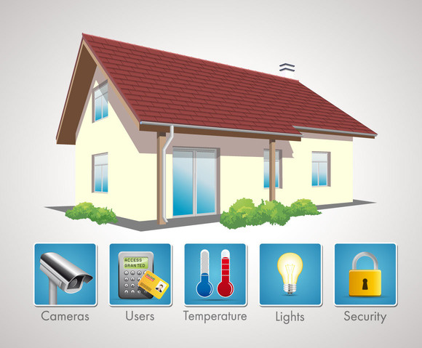

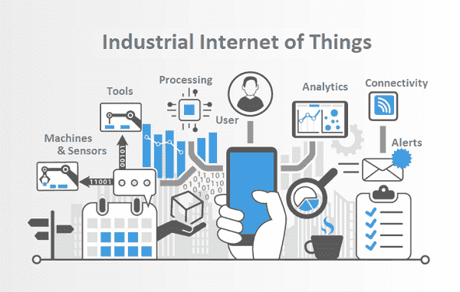
IOT Applications
Intrusion detection
Door/Window open
LPG Gas Leak detection
Appliance Control
Soil moisture
Temperature, humidity, leaf wetness sensing
Watering schedules
Industrial IOT
Manufacturing plants
Process plants

Slide 5



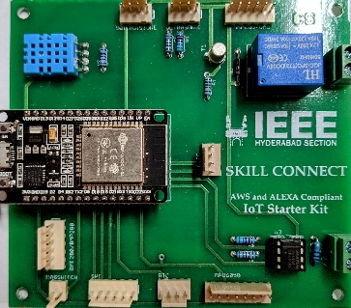



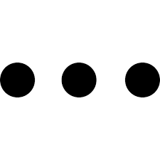
IOT @ IEEE Skill Connect
Cloud
IOT eco-system
Sensors
Data acquisition board
Internet connectivity
Web services
UI using mobile app
Mobile
IEEE Starter Kit

Slide 6
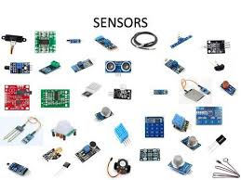
Project Building Blocks
Mobile App
Cloud database interface
Internet connectivity
Sensor data processing
Ambient parameter monitor
Environment monitor
Range meter
Audio meter
Sensor/ Actuator interface
Motor control
Biometric lock control
Smart garden

Slide 7
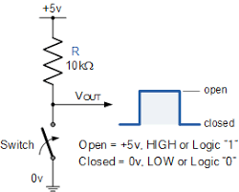
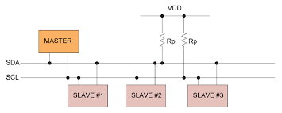
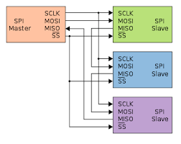
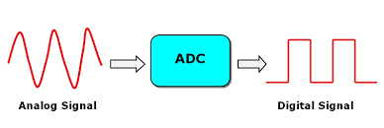
Project Building Blocks
Sensor Interface
Serial
Parallel
Analog
Digital
I2C
SPI

Slide 8
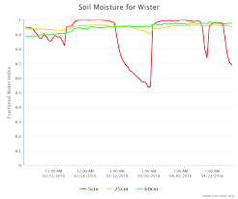
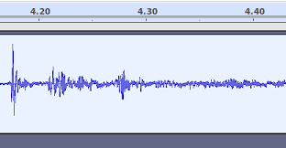
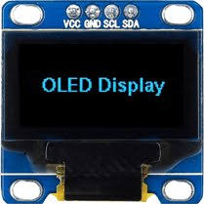
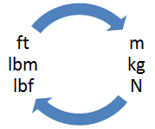
Project Building Blocks
Data Processing
Limit checking
Engg. unit conversion
Peak-to-peak computation
Local display

Slide 9
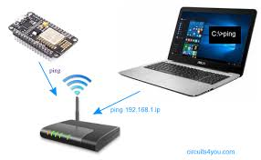
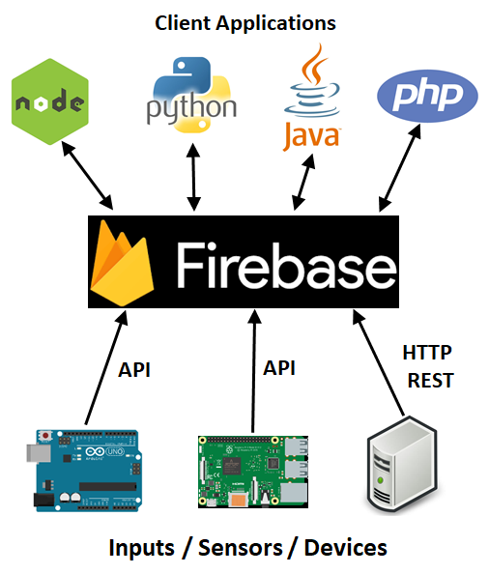
Project Building Blocks
Internet connectivity & Cloud database
Joining WiFi network
Connection status to Internet
Data access from cloud database

Slide 10

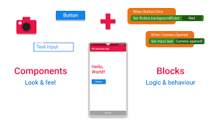
Project Building Blocks
Mobile App Development
UI Design
Cloud database interface
Periodic update

Slide 11

IEEE Starter Kit
Resources
ESP32 DevKitC
DHT11 :Temperature and humidity sensor
Relay
Polarized connectors for:
OLED graphic display
BME280 Environment sensor
MPU6050 3-axes accelerometer & gyro
Soil moisture sensor
RTC DS3231 module
HC-SR04 Ultrasonic sensor
MQ6 LPG Gas leak sensor
Magnetic sensor

Slide 12
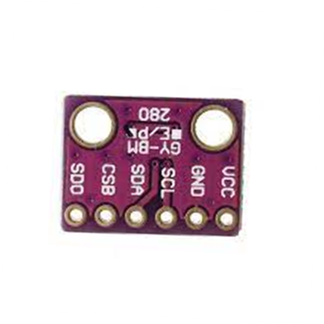
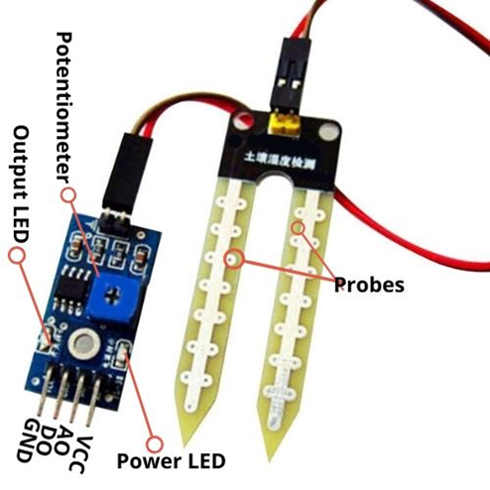
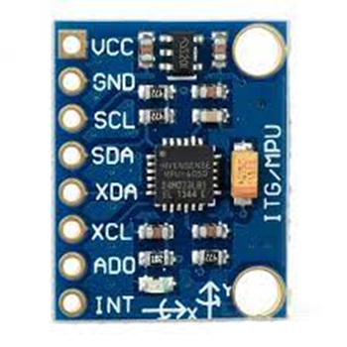
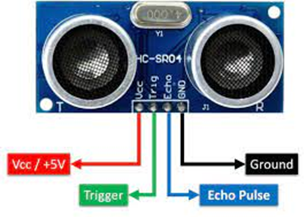
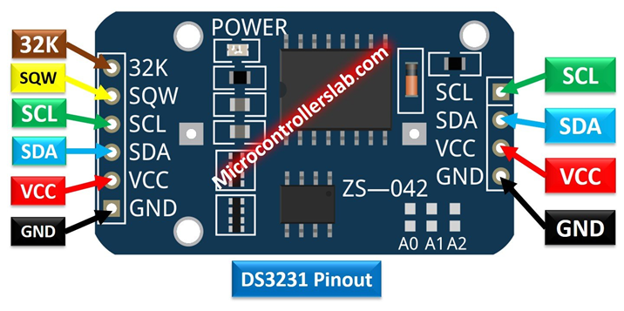
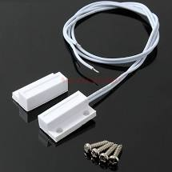
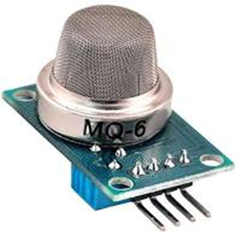
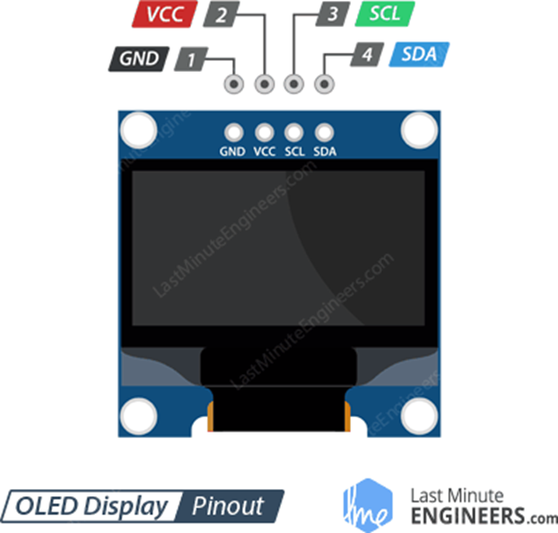
Sensor Pack
BPM280 Environment sensor
Soil moisture sensor
MPU6050 3-axes accelerometer & gyro
HC-SR04 Ultrasonic sensor
DS3231 Real Time Clock
Magnetic switch
MQ6 Gas leak sensor
OLED graphic display

Slide 13
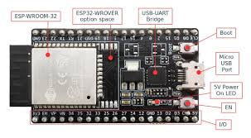
ESP32 Dev Kit
ESP-WROOM-32: 32-bit microprocessor
I/O pins: These pins are capable of Digital Read/Write, Analog Read/Write, PWM, IIC, SPI, DAC and much more.
Micro-USB jack: The micro USB jack is used to connect the ESP32 to our computer through a USB cable. It is used to program the ESP module as well as can be used for serial debugging as it supports serial communication
EN Button: The EN button is the reset button of the ESP module.
Boot Button: Press and upload program from Arduino IDE
Red LED: The Red LED on the board is used to indicate the power supply.
Blue LED: The Blue LED on the board is connected to the GPIO pin2.

Slide 14
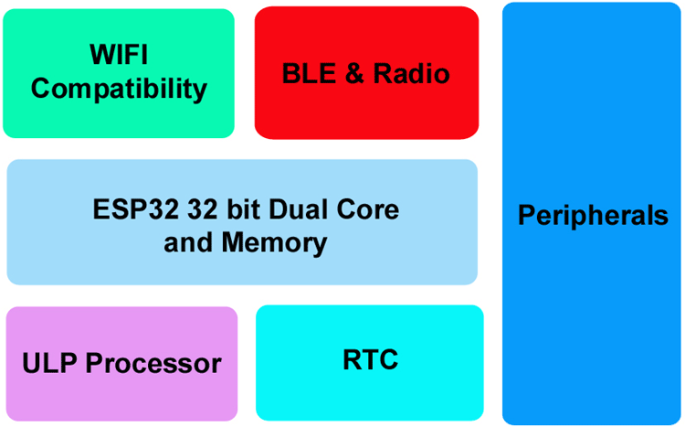
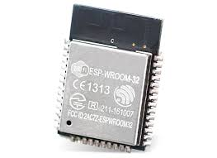
Inside the ESP32

Slide 15
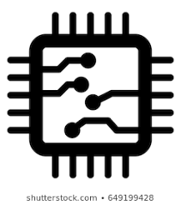


ESP32 features
ESP32 has Xtensa® Dual-Core 32-bit LX6 microprocessors. The ESP32 will run on breakout boards and modules from 160Mhz upto 240MHz
Internal Memory : 448 KB ROM for booting and core functions & 520 KB SRAM for data and instructions
External Flash : 4MB external Flash extendable to16MB
WiFi: ESP32 implements TCP/IP, full 802.11 b/g/n/e/i WLAN MAC protocol
Bluetooth : ESP32 supports the latest BLE Bluetooth 4.2, as well as classic Bluetooth

Slide 16

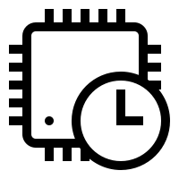
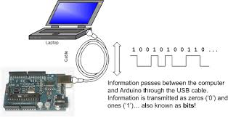
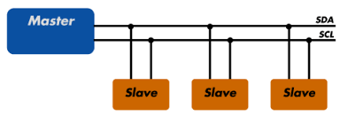
ESP32 peripherals
GPIO
Timers and Watchdog
Real Time Clock
ADC and built-in Sensors
Digital to Analog Convertor (DAC)
Touch Sensor
Ultra Low Power(ULP) Co-processor
Ethernet MAC Interface
Universal Asynchronous Receiver Transmitter (UART)
I2C Interface
I2S Interface
SPI Interface
Pulse Width Modulation (PWM)

Slide 17
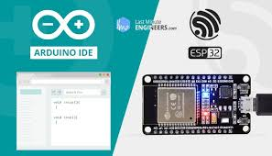
ESP32 – powering & programming

Slide 18
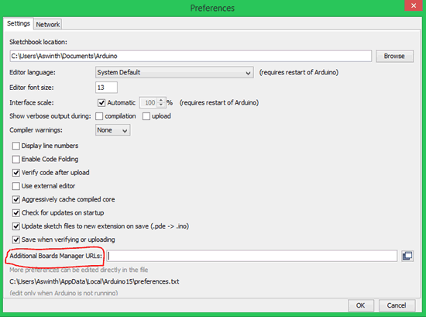
Preparing Arduino IDE for ESP32
STEP 1: Now, let’s get started. The first step would be to download and install the Arduino IDE.. If you already have one make sure it is of the latest version.
STEP 2: Once installed, open the Arduino IDE and go to Files -> Preferences to open the preferences window and locate the “Additional Boards Manager URLs:” as shown

Slide 19
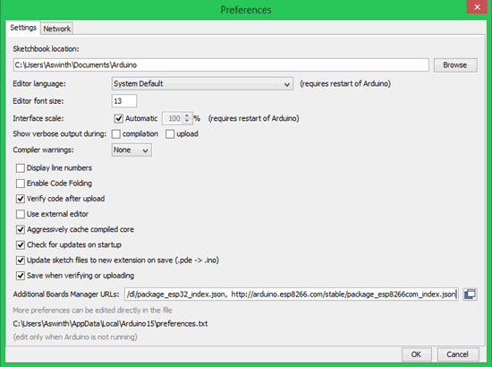
Preparing Arduino IDE for ESP32
STEP 3: This text box might be empty or might also contain some other URL if you have used it previously for ESP8266. If it is empty simply paste the below URL into the text box
https://dl.espressif.com/dl/package_esp32_index.json

Slide 20
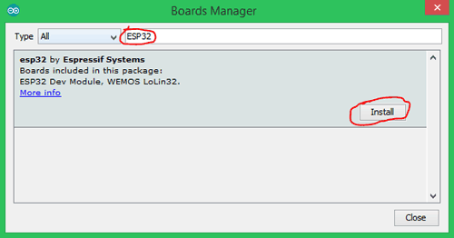
Preparing Arduino IDE for ESP32
STEP 4: Now go to Tools -> Boards -> Board Managers to open the Board manager window and search for ESP32.
If the URL was pasted correctly your window should find the below screen with Install button, just click on the Install button and your board should get installed.

Slide 21
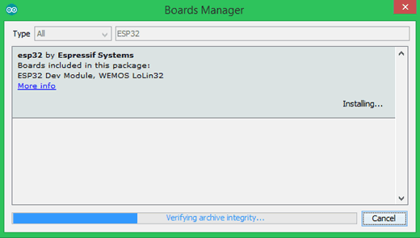
Preparing Arduino IDE for ESP32
STEP 5: Make sure you have an active internet connection and wait while the installation gets complete. It may take few minutes based on the speed of your internet connection.

Slide 22
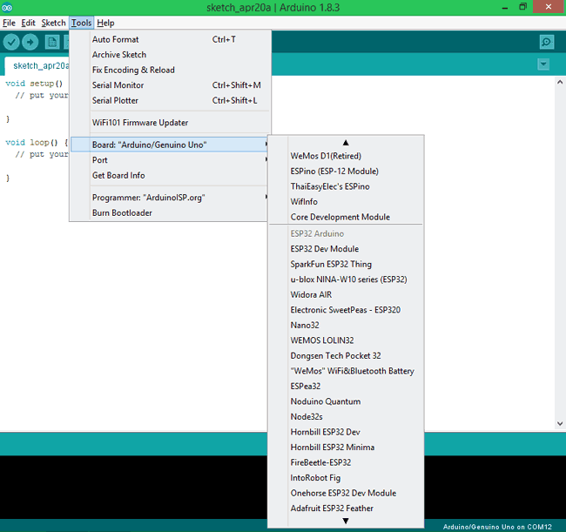
Programming ESP32 with Arduino
STEP 1: Connect your ESP32 board to your computer through the micro-USB cable. Make sure the red LED goes high on the module to ensure power supply.
STEP 2: Start the Arduino IDE and navigate to Tools -> Boards and select ESP32 Dev board as shown

Slide 23
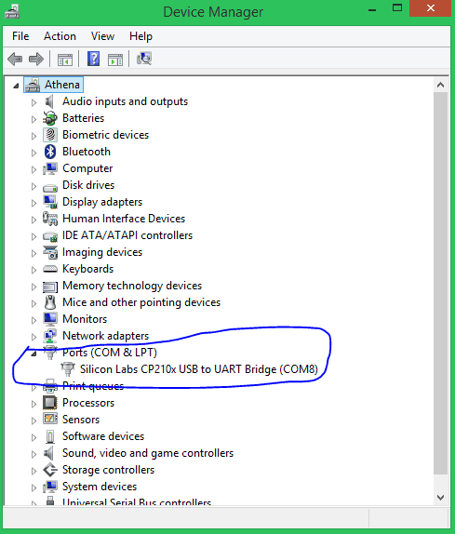
STEP 3: Open device manager and check to which com port your ESP32 is connected to. Mine is connected to COM 8 as shown

Slide 24
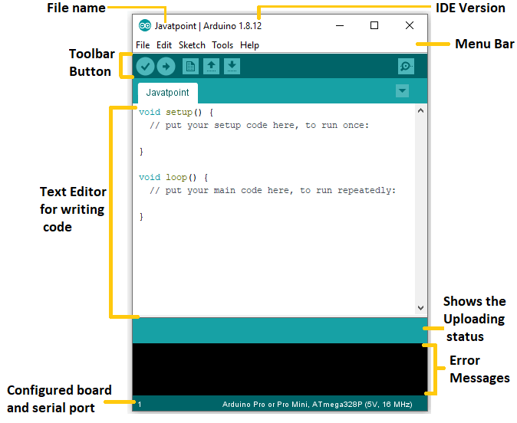
ESP32 – Arduino IDE
In the Tools tab, go to
Board -> ESP32 Arduino -> ESP32 Dev Module
In the Tools tab, go to
Port-> COMX

Slide 25
Arduino IDE
pinMode(2,OUTPUT);
pinMode(3,INPUT);
pinMode(4,INPUT_PULLUP);
2
4

Slide 26
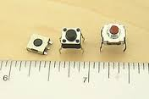
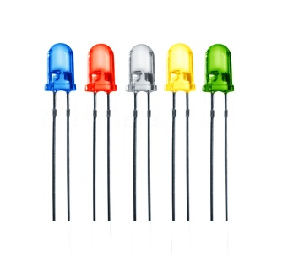
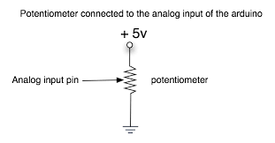
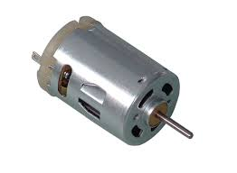
The Arduino IDE
Input
Output
digitalRead ()
digitalWrite ()
Digital
analogRead ()
analogWrite()
Analog

Slide 27
Your first program
void setup(){
pinMode(2,OUTPUT);
}
void loop(){
digitalWrite(2,HIGH);
delay(1000);
digitalWrite(2,LOW);
delay(1000);
}
Press the Boot button and upload

Slide 28
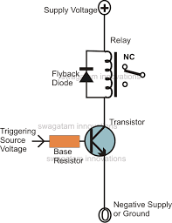
Relay operation
ESP32
void setup(){
pinMode(19,OUTPUT);
}
void loop(){
digitalWrite(19,HIGH);
delay(2000);
digitalWrite(19,LOW);
delay(2000);
}
19

Slide 29
Ambient Parameter Monitoring using IoT
Parameter | Range | Accuracy
Ambient Temperature | 0 – 50 degrees C | +/- 2 degrees
Relative Humidity | 20-90 % | +/- 5%
Update Rate : 2 seconds

Slide 30
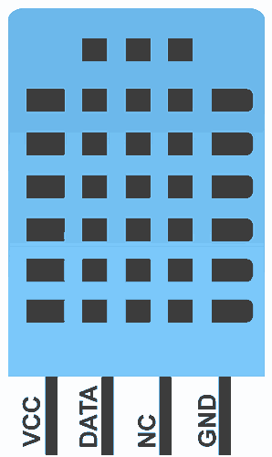
DHT11
GISMO-V connections
DHT11 | ESP32
VCC | 3.3V
DATA | GPIO27
NC | NC
GND | GND
Ckt. Details:
DATA pin pulled up to VCC with a 5.6K resistor

Slide 31
DHT11
The DHT11 is a basic, low cost digital temperature and humidity sensor.
DHT11 is a single wire digital humidity and temperature sensor, which provides humidity and temperature values serially with one-wire protocol.
DHT11 sensor provides relative humidity value in percentage (20 to 90% RH) and temperature values in degree Celsius (0 to 50 °C).
DHT11 sensor uses resistive humidity measurement component, and NTC temperature measurement component.

Slide 32
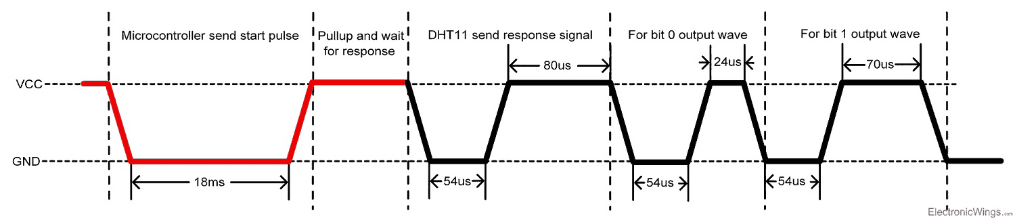
Sensor interface
DHT11 uses only one wire for communication. The voltage levels with certain time value defines the logic one or logic zero on this pin.
The communication process is divided in three steps, first is to send request to DHT11 sensor then sensor will send response pulse and then it starts sending data of total 40 bits to the microcontroller.

Slide 33
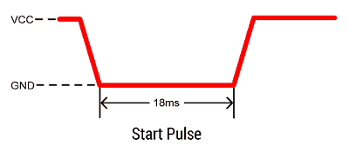
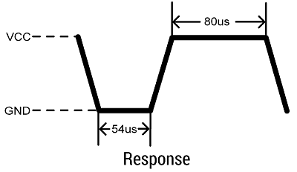
Communication with microcontroller
Start pulse ( Request)
To start communication with DHT11, first we should send the start pulse to the DHT11 sensor.
To provide start pulse, pull down (low) the data pin minimum 18ms and then pull up, as shown in diag.
Response
After getting start pulse from, DHT11 sensor sends the response pulse which indicates that DHT11 received start pulse.
The response pulse is low for 54us and then goes high for 80us.

Slide 34
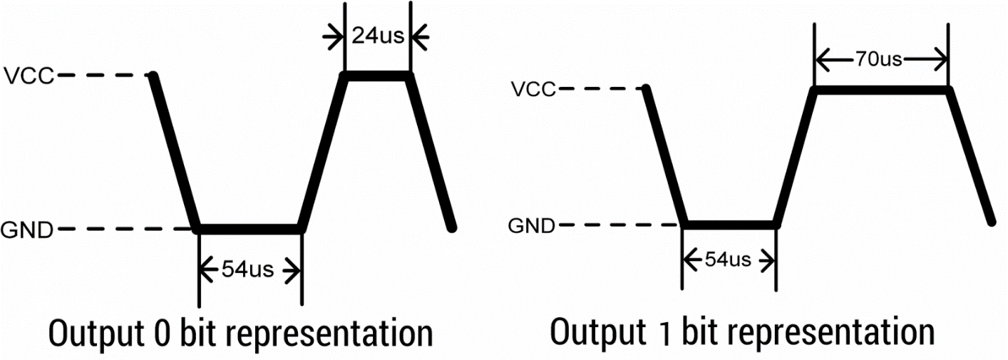
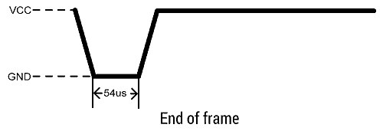
Output
After sending the response pulse, DHT11 sensor sends 40(5 bytes) bit data output
First 2 bytes: Humidity in %
Next 2 bytes: Temperature in C
Last byte: Checksum
End of frame

Slide 35
Code from basics
void request(){
pinMode(27,OUTPUT);
digitalWrite(27,LOW);
delay(20);
digitalWrite(27,HIGH);
}
Start pulse ( Request)
void response(){
pinMode(27,INPUT_PULLUP);
while(digitalRead(27) == HIGH);
while(digitalRead(27) == LOW);
while(digitalRead(27) == HIGH);
}

Slide 36
byte receive_data(){
byte c = 0;
for(int i =0;i < 8;i++){
while (digitalRead(27) == LOW);
delayMicroseconds(30);
if(digitalRead(27) == HIGH){
c = (c<<1) |(0x01);
}
else
c = (c<<1);
while(digitalRead(27) == HIGH);
}

Slide 37
Sensor Interface with library

