Slide 1
IoT Projects
Using IEEE Starter kit

Slide 2
Ambient Parameter Monitoring
Parameter | Range | Accuracy
Ambient Temperature | 0 – 50 degrees C | +/- 2 degrees
Relative Humidity | 20-90 % | +/- 5%
Update Rate : 2 seconds

Slide 3

DHT11
GISMO-V connections
DHT11 | ESP32
VCC | 3.3V
DATA | GPIO27
NC | NC
GND | GND
Ckt. Details:
DATA pin pulled up to VCC with a 10K resistor

Slide 4
DHT11
The DHT11 is a basic, low cost digital temperature and humidity sensor.
DHT11 is a single wire digital humidity and temperature sensor, which provides humidity and temperature values serially with one-wire protocol.
DHT11 sensor provides relative humidity value in percentage (20 to 90% RH) and temperature values in degree Celsius (0 to 50 °C).
DHT11 sensor uses resistive humidity measurement component, and NTC temperature measurement component.

Slide 5
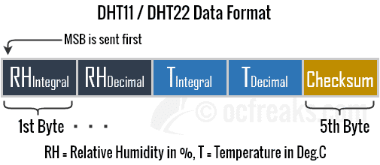
Data frame

Slide 6
Applications
This sensor is used in various applications such as measuring humidity and temperature values in heating, ventilation and air conditioning systems.
Weather stations also use these sensors to predict weather conditions.
The humidity sensor is used as a preventive measure in homes where people are affected by humidity.
Offices, cars, museums, greenhouses and industries use this sensor for measuring humidity values and as a safety measure.

Slide 7
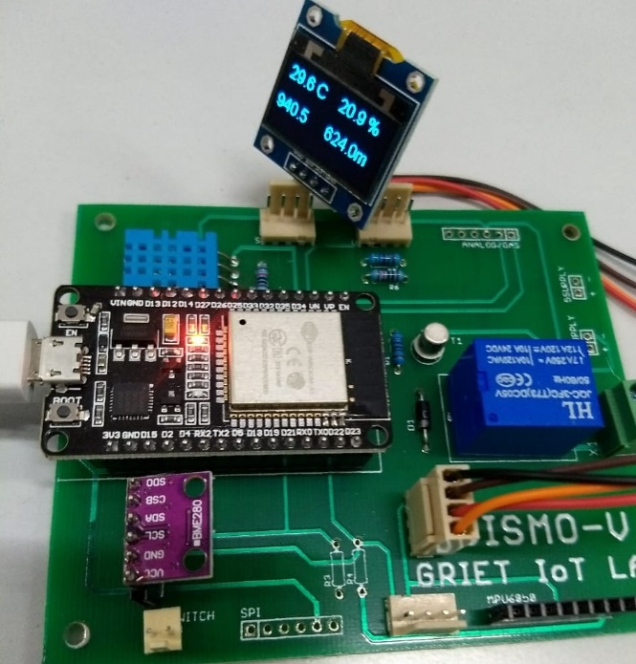
Location on the board
DHT11 is available on-board the GISMO-V module

Slide 8
DHT11
Data pin DHT11
#include "DHTesp.h"
#define DHTpin 27
DHTesp dht; dht.setup(DHTpin,DHTesp::DHT11); dht.getTemperature();
dht.getHumidity();

Slide 9
OLED display
I2C address
SDA, SCL
# include <Wire.h>
#include “SSD1306.h”
SSD1306 display(0x3c, 21, 22);
display.init();
display.setFont(ArialMT_Plain_24);
display.clear();
display.drawString(0,0,strHumidity);
display.drawstring(0,30,strTemperature);
display.display();
128x64 OLED display

Slide 10
WiFi
#define WIFI_SSID "xxxxxxxxxxxxxx"
#define WIFI_PASSWORD "xxxxxxxxxxxxxxxxxxxxxx"
WiFi.begin(SSID,PASSWORD);
while(WiFi.status() != WL_CONNECTED
{
Serial.print(“.”);
delay(300);
}
Serial.println(WiFi.localIP());

Slide 11
Firebase
#define FIREBASE_HOST "xxxxxxxxxxxxxx"
#define FIREBASE_AUTH "xxxxxxxxxxxxxxxxxxxxxx"
FirebaseData firebaseData;
Firebase.begin(FIREBASE_HOST,FIREBASE_AUTH);
Firebase.setFloat(firebaseData,”IOTLAB/Ambient_Parameters/Humidity”,h);
Firebase.setFloat(firebaseData,”IOTLAB/Ambient_Parameters/Temperature”,t);

Slide 12
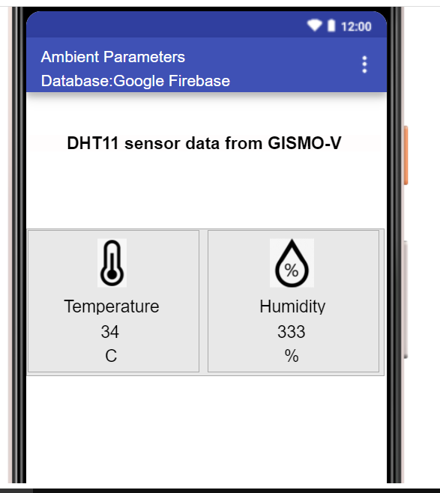
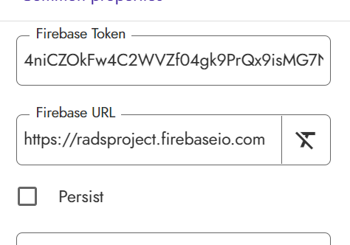
Mobile App
FirebaseData firebaseData;
Fill the Firebase Token and Firebase URL properties of the Firebase)Database component with your Firebase credentials

Slide 13
Environment Monitoring
Parameter | Range | Accuracy
Ambient Temperature | 0 – 65 degrees C | +/- 1 degrees
Atmospheric Pressure | 300hPa-1100hPa | +/- 1hPa
Altitude
IOT Lab, ECE Department

Slide 14
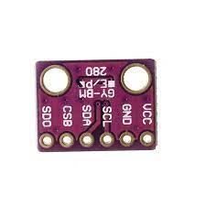
BMP280
BMP280 | ESP32
VCC | 3.3V
GND | GND
SCL | GPIO22
SDA | GPIO21
Interface to ESP32 is via I2C
IOT Lab, ECE Department

Slide 15
BMP280
This sensor can measure barometric pressure and temperature with very good accuracy. Because pressure changes with altitude we can also use it as an altimeter with ±1 meter accuracy
Accuracy for barometric pressure is ±1 hPa and ±1.0°C for temperature.
Its small dimensions and its low power consumption allow for the implementation in battery-powered devices such as mobile phones, GPS modules or watches.
Interface with microcontroller is via I2C or SPI
IOT Lab, ECE Department

Slide 16
BMP280
#include <Adafruit_Sensor.h>
#include <Adafruit_BMP280.h>
#define SEALAVELPRESSURE_HPA (1013.25)
Adafruit_BMP280 bmp;
Class
IOT Lab, ECE Department

Slide 17
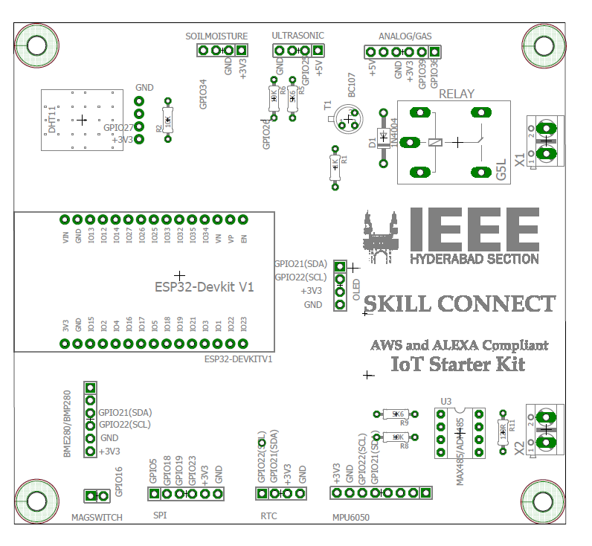
BMP280 – Location on the board
Sensor module connected to board via a 4-pin polarised connector cable
ESP32
Relay
IOT Lab, ECE Department

Slide 18
BMP280
bmp.begin(BMP280_ADDRESS_ALT,BMP280_CHIPID);
bmp.setSampling(Adafruit_BMP280::MODE_NORMAL,
Adafruit_BMP280::SAMPLING_X2,
Adafruit_BMP280::SAMPLING_X16,
Adafruit_BMP280::MODE_NORMAL)
bmp.readTemperature();
bmp.readPressure();
bmp.readAlititude(1013.25);
IOT Lab, ECE Department

Slide 19
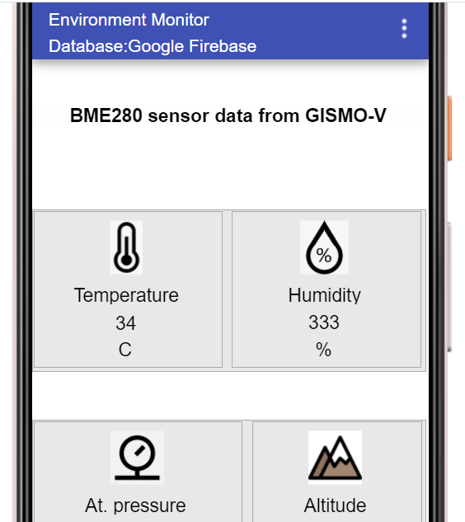
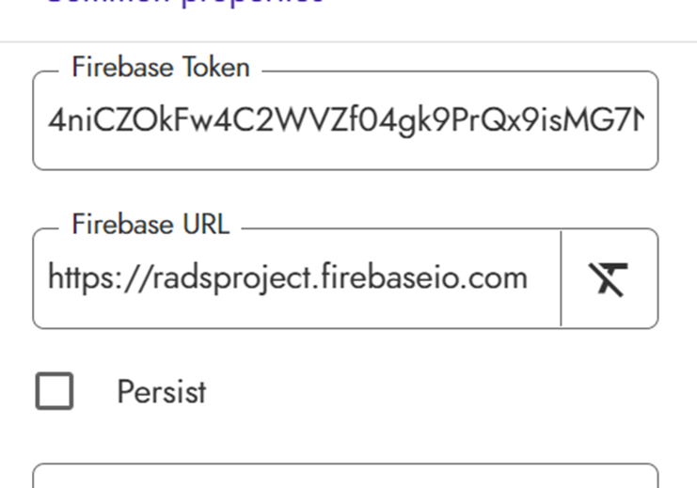
BMP280 Mobile App
IOT Lab, ECE Department

