Slide 1
IoT Projects
Using GISMO-V board

Slide 2
Smart garden
Monitor soil moisture
Get threshold from Firebase
Compare with threshold
Switch on motor if dry else switch off
Transfer soil moisture and pump status to
OLED display
Firebase database

Slide 3
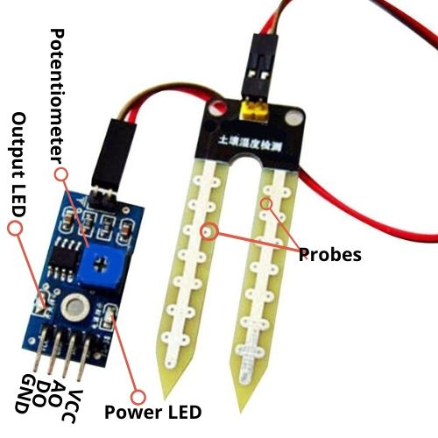
Smart Garden
Soil Moisture sensor | ESP32 pin
VCC | 3.3V
A0 | GPIO34
D0 | NC
GND | GND
The soil moisture sensor provides a digital as well as a analog output. We will be using the analog output

Slide 4
ADC in ESP32
ESP32 has 2 12-bit ADCs – ADC1 and ADC2
ADC1 – 8 channels – GPIOs 32 – 39 (GPIO34 is used)
ADC2 – 10 channels – GPIOs 0,2,4,12-15, 25-27
12 bit ADC:
I/P analog voltage | ADC value
0V | 0
3.3V | 4095

Slide 5
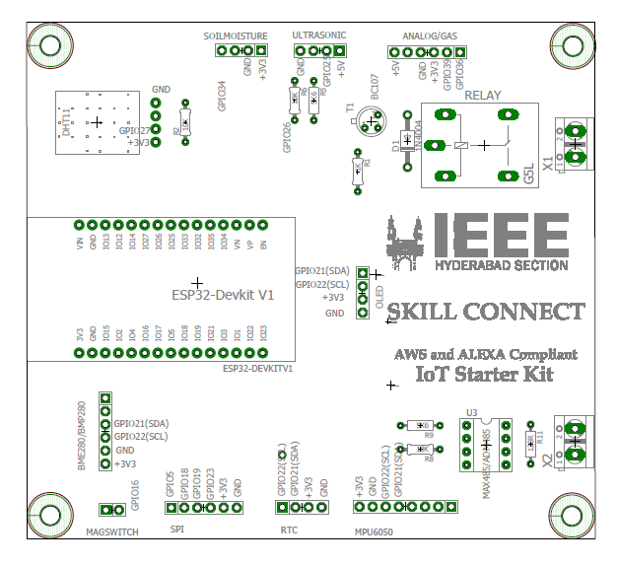
Location on board
Soil moisture sensor is connected via a polarised 4-pin connector cable to the board

Slide 6
Basic read
#define smPin 34
#define relayPin 13
pinMode(13,OUTPUT);
Serial.begin(115200);
int val = 4095 – analogRead(smPin);
if( val < threshold) digitalWrite(relayPin,HIGH);
else digitalWrite(relayPin,LOW);
Note: Check sensor reading with water and without water and fix threshold

Slide 7
WiFi
#define WIFI_SSID "xxxxxxxxxxxxxx"
#define WIFI_PASSWORD "xxxxxxxxxxxxxxxxxxxxxx"
WiFi.begin(SSID,PASSWORD);
while(WiFi.status() != WL_CONNECTED
{
Serial.print(“.”);
delay(300);
}
Serial.println(WiFi.localIP());

Slide 8
Firebase
#define FIREBASE_HOST "xxxxxxxxxxxxxx"
#define FIREBASE_AUTH "xxxxxxxxxxxxxxxxxxxxxx"
FirebaseData firebaseData;
Firebase.begin(FIREBASE_HOST,FIREBASE_AUTH);
Firebase.getString(firebaseData,”IOTLAB/Smart_Garden/SM_Threshold”,s);
s1 = s.substring(2,s.length()-2);
threshold = s1.toInt();
Firebase.setInt(firebaseData,”IOTLAB/Smart_Garden/Soil_Moisture”,sm);
Firebase.setString(firebaseData,”IOTLAB/Smart_Garden/Motor_Status”,”ON”

Slide 9
OLED display
I2C address
SDA, SCL
# include <Wire.h>
#include “SSD1306.h”
SSD1306 display(0x3c, 21, 22);
display.init();
display.setFont(ArialMT_Plain_16);
display.clear();
display.drawString(0,0,soilMoisture);
display.drawstring(0,30,motorStatus);
IOT Lab, ECE Department

Slide 10
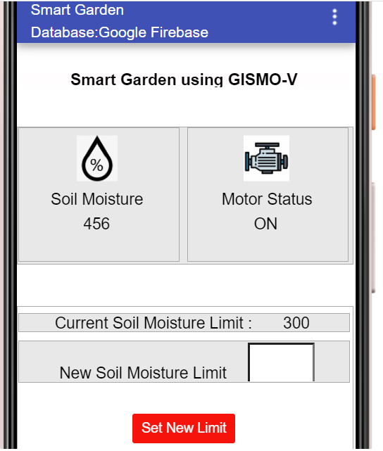
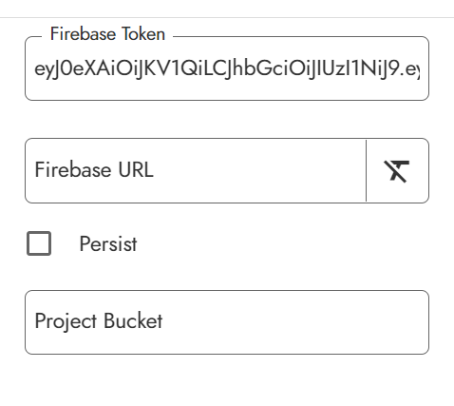
Mobile App

Slide 11
Fall Detector
Detect position of object:
Upright
Fallen Left
Fallen Right
Fallen Forward
Fallen Backward
Transfer object position to:
OLED display
Firebase database

Slide 12
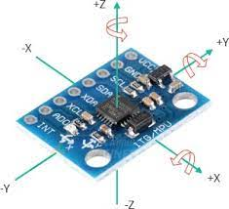
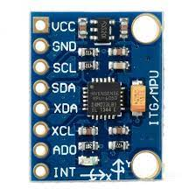
MPU6050
MEMS 3-aixs accelerometer and 3-axis gyroscope values combined.
Power Supply: 3-5V.
Communication : I2C protocol.
Built-in 16-bit ADC provides high accuracy.
Micro-electromechanical systems (MEMS) is a process technology used to create tiny integrated devices or systems that combine mechanical and electrical components.

Slide 13

MPU6050
MPU6050 pin | ESP32 pin
VCC | 3.3V
GND | GND
SCL | GPIO22
SDA | GPIO21
I2C

Slide 14
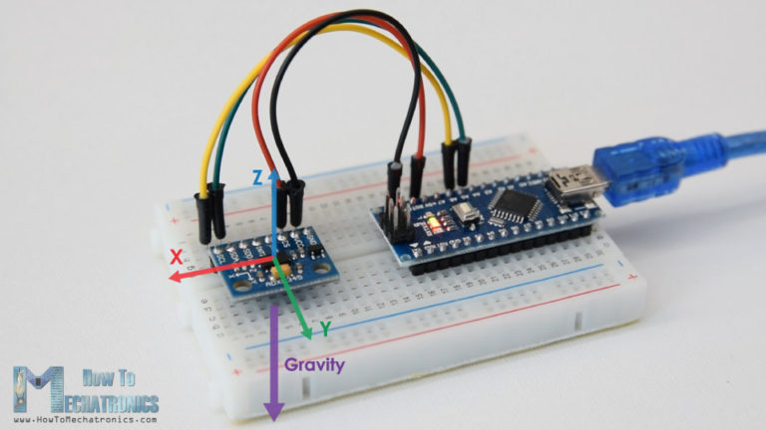
MPU6050 data
Sensitivity : +/- 2g
Output : 16 bit
+/-2g corresponds to +/-32767
1g corresponds to 32767/2 = 16384
Dividing the accelerometer value by 16384 will give the value in g

Slide 15
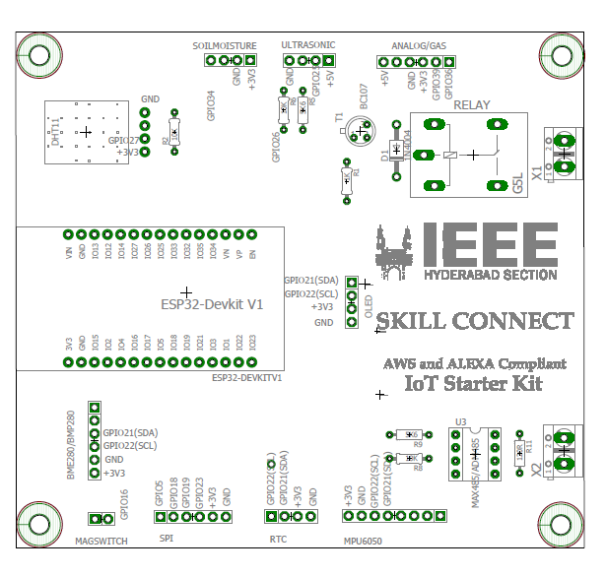
Location on board

Slide 16
#include “I2Cdev.h”
#include “MPU6050.h”
#include “Wire.h”
MPU6050 mpu;
mpu.initialize();
mpu.read();
void mpu_read(float *ax,float *ay,float *az){
int16_t _ax,_ay,_az,_gx,_gy,_gz;
mpu.getmotion(&_ax,&_ay,&az,&_gx,&_gy,&_gz);
*ax = _ax/16384.0;
*ay=_ay/16384.0;
*az=_az/16384.0;
}
Use the Serial Plotter in the ArduinoIDE to visualize the acceleration in the three axes
IOT Lab, ECE Department

Slide 17
Calibration
There is a calibrate function which is called in setup(). In this function 10 acceleration values in the X,Y and Z directions are taken and averaged and the average value is taken as the baseline value. This baseline value is subtracted from the actual read value
void calibrate()
{
float ax,ay,az;
for(int i=0;i < 10;i++)
{ mpu_read(&ax,&ay,&az);
delay(100);
}
baseline[0]=ax;
baseline[1]=ay;
baseline[2]=az; }

Slide 18
WiFi
#define WIFI_SSID "xxxxxxxxxxxxxx"
#define WIFI_PASSWORD "xxxxxxxxxxxxxxxxxxxxxx"
WiFi.begin(SSID,PASSWORD);
while(WiFi.status() != WL_CONNECTED
{
Serial.print(“.”);
delay(300);
}
Serial.println(WiFi.localIP());

Slide 19
Firebase
#define FIREBASE_HOST "xxxxxxxxxxxxxx"
#define FIREBASE_AUTH "xxxxxxxxxxxxxxxxxxxxxx"
FirebaseData firebaseData;
Firebase.begin(FIREBASE_HOST,FIREBASE_AUTH);
Firebase.getString(firebaseData,”IOTLAB/Fall_Detector/Limit”,s);
s1 = s.substring(2,s.length()-2);
limit = s1.toFloat();
Firebase.setInt(firebaseData,”IOTLAB/Fall_Detector/Position”,position)

Slide 20
OLED display
I2C address
SDA, SCL
# include <Wire.h>
#include “SSD1306.h”
SSD1306 display(0x3c, 21, 22);
display.init();
display.setFont(ArialMT_Plain_16);
display.clear();
display.drawString(30,0,”Position:”);
display.drawstring(30,30,position);
IOT Lab, ECE Department

Slide 21
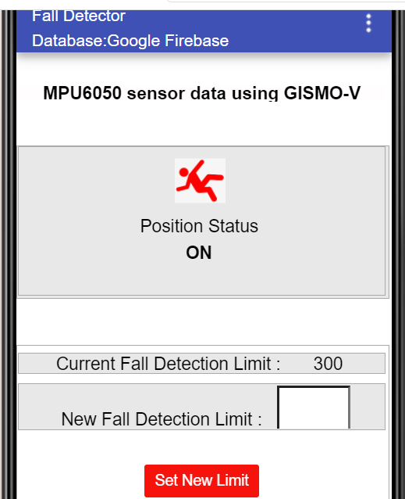
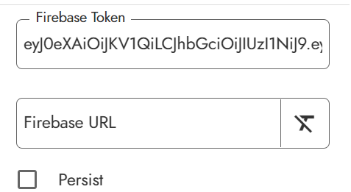
Mobile App

Slide 22
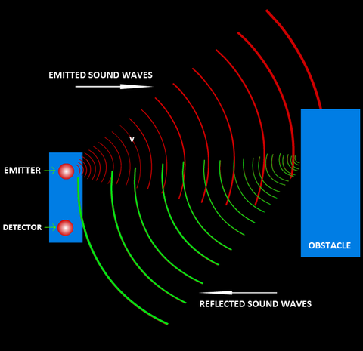
Range Finder
Use an ultrasonic sensor to find out the range of an object
Transfer the range value to:
Local OLED display
Firebase database in the cloud
Develop mobile app in Kodular
Display of range value in app – text as well as graphical

Slide 23
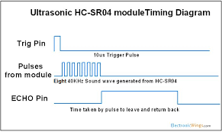
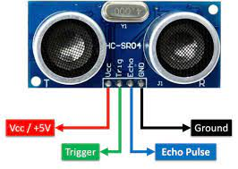
Ultrasonic sensor

Slide 24
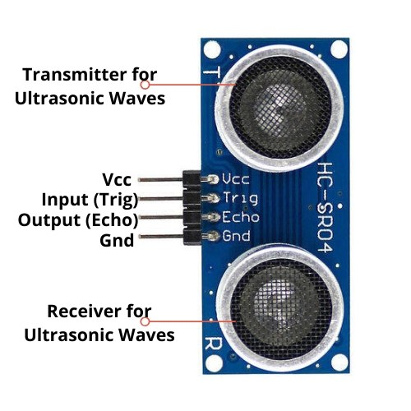
Ultrasonic sensor
5V operation
ESP32
3.3V operation
Potential divider

Slide 25
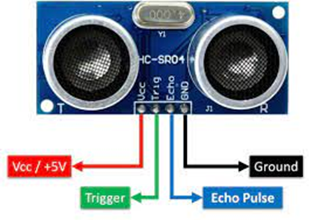
Ultrasonic sensor
Ultrasonic sensor | ESP32 pin
VCC | 5V
Trigger | GPIO25
Echo | GPIO26
GND | GND

Slide 26
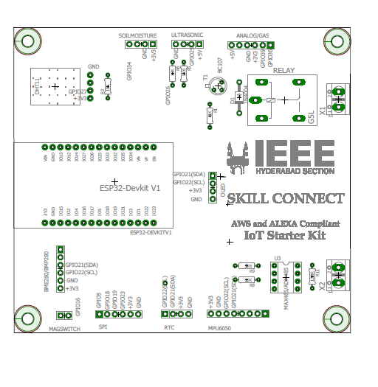
Location on board

Slide 27
Ultrasonic sensor – basic read
t is in microcseconds
t in seconds = duration/1000000
Distance travelled in 1 second = 340 x 100 cm
Distance travelled in time t = t x 340 x100/1000000
= t x 0.034
This is the distance to and from the object
Range = t x 0.034/2
pinMode(trigPin,OUTPUT);
pinMode(echoPin, INPUT);
digitalWrite(trigPin,HIGH);
delayMicroseconds(10);
digitalWrite(trigPin,LOW);
t = pulseIn(echoPin,HIGH);
distance = t x 0,034/2;
delay(1000);

Slide 28
WiFi
#define WIFI_SSID "xxxxxxxxxxxxxx"
#define WIFI_PASSWORD "xxxxxxxxxxxxxxxxxxxxxx"
WiFi.begin(SSID,PASSWORD);
while(WiFi.status() != WL_CONNECTED
{
Serial.print(“.”);
delay(300);
}
Serial.println(WiFi.localIP());

Slide 29
Firebase
#define FIREBASE_HOST "xxxxxxxxxxxxxx"
#define FIREBASE_AUTH "xxxxxxxxxxxxxxxxxxxxxx"
FirebaseData firebaseData;
Firebase.begin(FIREBASE_HOST,FIREBASE_AUTH);
Firebase.setInt(firebaseData,”IOTLAB/Range_Meter/Range”,range);

Slide 30
OLED display
I2C address
SDA, SCL
# include <Wire.h>
#include “SSD1306.h”
SSD1306 display(0x3c, 21, 22);
display.init();
display.setFont(ArialMT_Plain_16);
display.clear();
display.drawString(0,0,range);
display.display();
IOT Lab, ECE Department

Slide 31
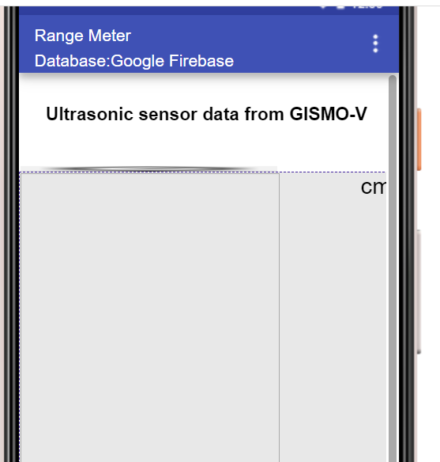
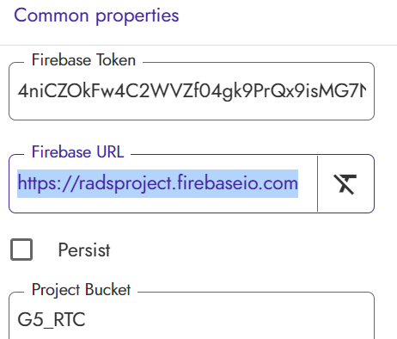
Mobile App

