Slide 1
IoT Projects
Using GISMO-V Board

Slide 2

Motor Control
Mobile app with Start and Stop buttons
Transfer Start and Stop commands to Firebase
From GISMO-V read the motor commands
Take action as per commands
Firebase
GISMO-V
Mobile App

Slide 3
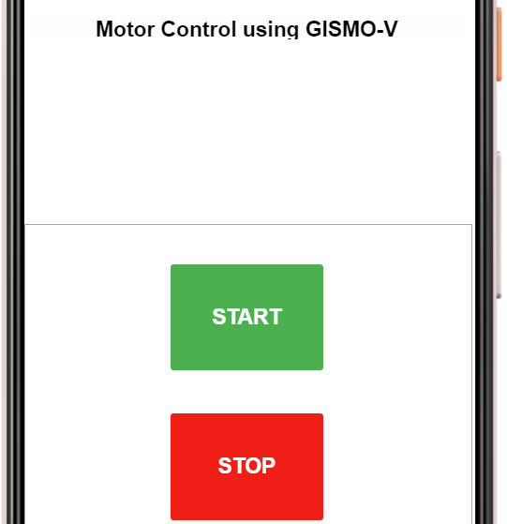
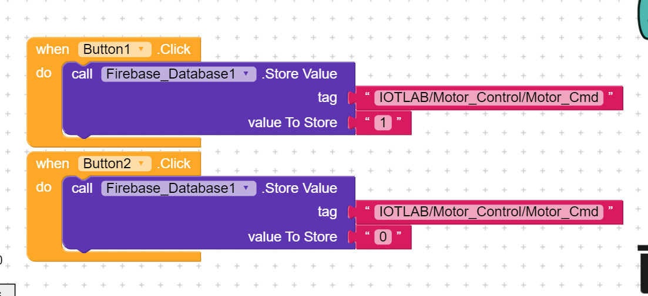
Motor Control

Slide 4
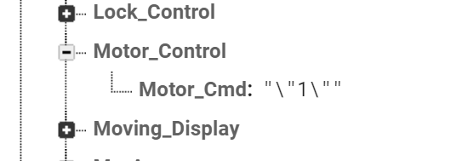
Motor Control
Tag value in Firebase: IOTLAB/Motor_Control/Motor_Cmd

Slide 5
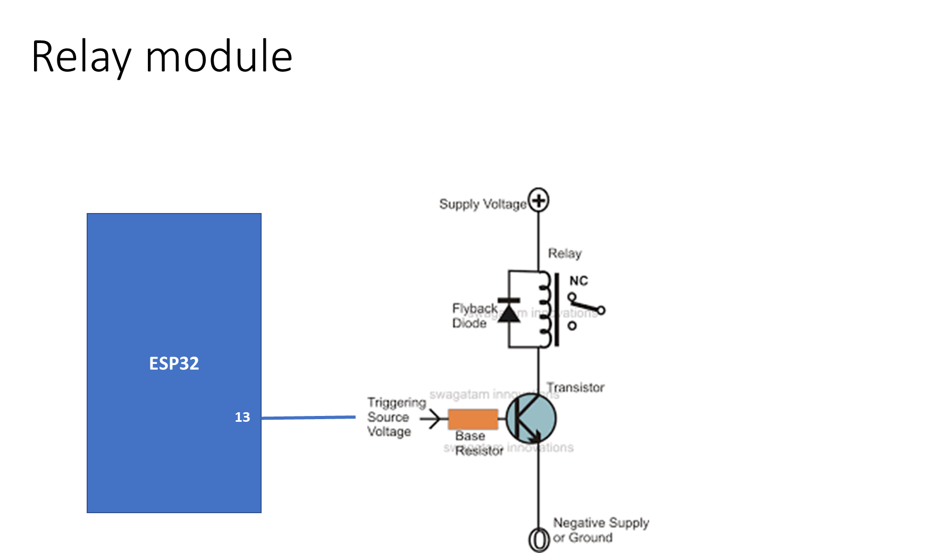

Slide 6
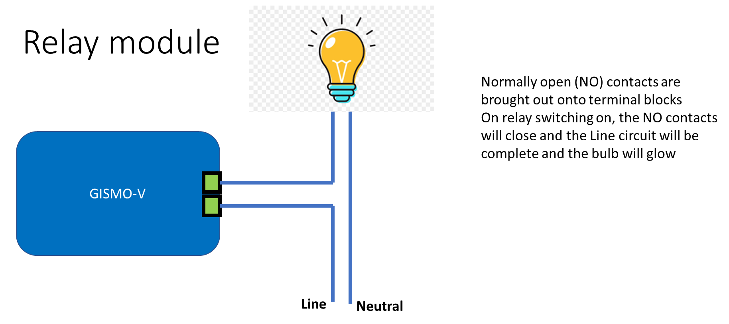

Slide 7

Motor Control
GISMO-V
Contactor
Motor
Line
Neutral

Slide 8
WiFi
#define WIFI_SSID "xxxxxxxxxxxxxx"
#define WIFI_PASSWORD "xxxxxxxxxxxxxxxxxxxxxx"
WiFi.begin(SSID,PASSWORD);
while(WiFi.status() != WL_CONNECTED
{
Serial.print(“.”);
delay(300);
}
Serial.println(WiFi.localIP());

Slide 9
Firebase
#define FIREBASE_HOST "xxxxxxxxxxxxxx"
#define FIREBASE_AUTH "xxxxxxxxxxxxxxxxxxxxxx"
FirebaseData firebaseData;
Firebase.begin(FIREBASE_HOST,FIREBASE_AUTH);
Firebase.getString(firebaseData,”IOTLAB/Motor_Control/Motor_Cmd”,s);
s1 = s.substring(2,s.length()-2);
mc = s1.toInt();

Slide 10
OLED display
I2C address
SDA, SCL
# include <Wire.h>
#include “SSD1306.h”
SSD1306 display(0x3c, 21, 22);
display.init();
display.setFont(ArialMT_Plain_16);
display.clear();
display.drawString(20,0,”MOTOR ON”);
display.display();
IOT Lab, ECE Department

Slide 11
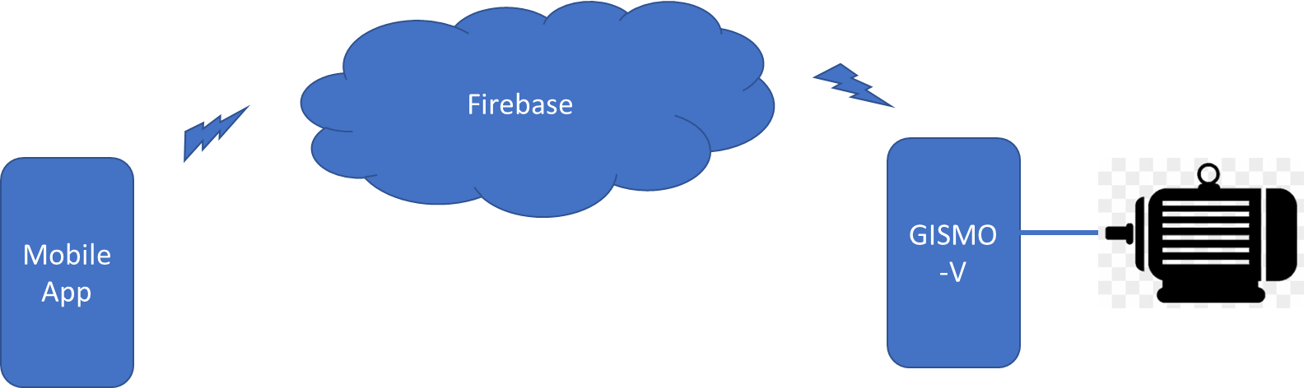
Appliance Control using RTC
RTC – real Time Clock
Turn on an appliance – heater, motor etc- only during a scheduled slot time
The scheduled slot time is settable via a mobile app
Slot time will be stored in the cloud database
RTC with battery backup will be used to get the current time

Slide 12
DS3231 RTC
Maintains seconds, minutes, hours, days, weeks, months, years information
12 hour/ 24 hour format available for time
Battery back-up so that the clock remains updated even if there is no power
Operating voltage – 2.3V – 5.5V
I2C interface with microcontroller

Slide 13
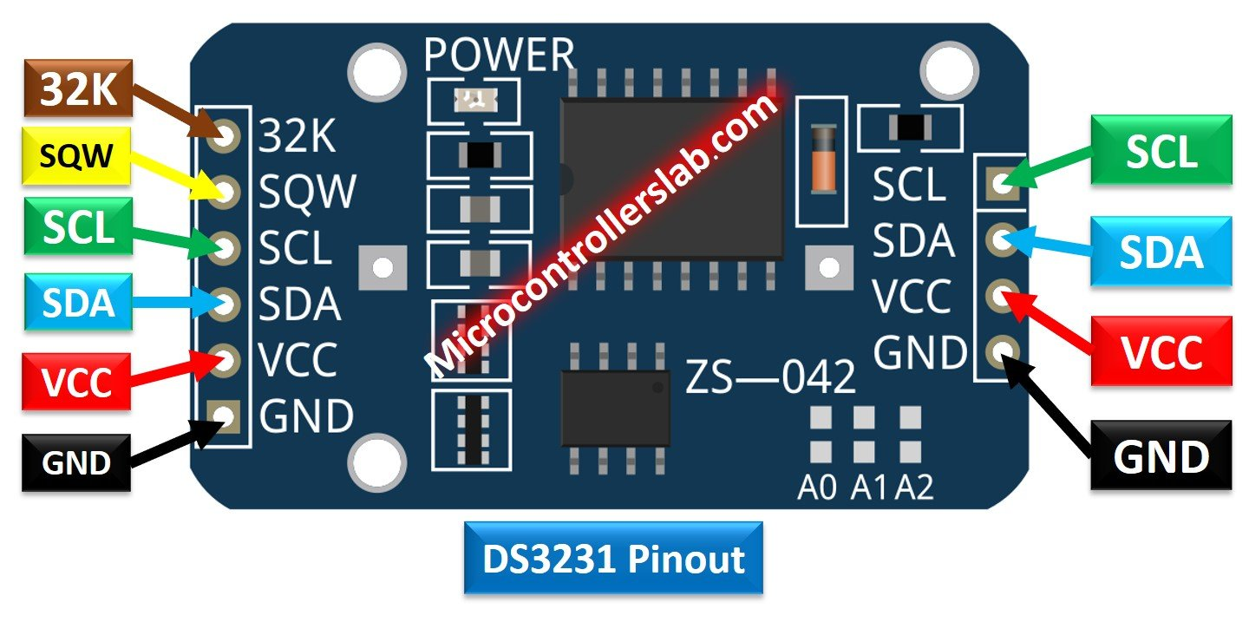
DS3231
DS3231 pin | ESP32 pin
SCL | GPIO22
SDA | GPIO21
VCC | 3.3V
GND | GND

Slide 14
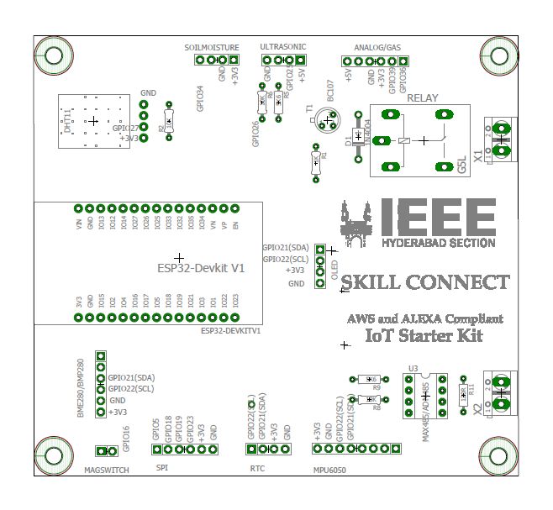
Location on board

Slide 15
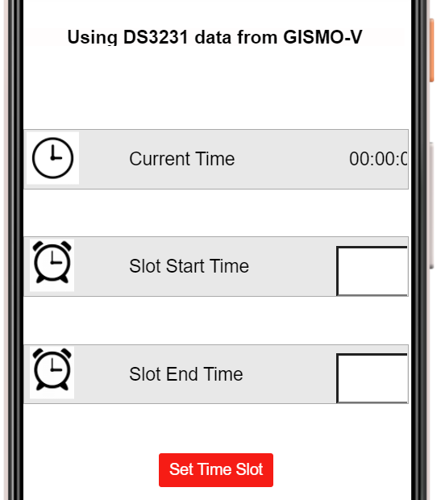
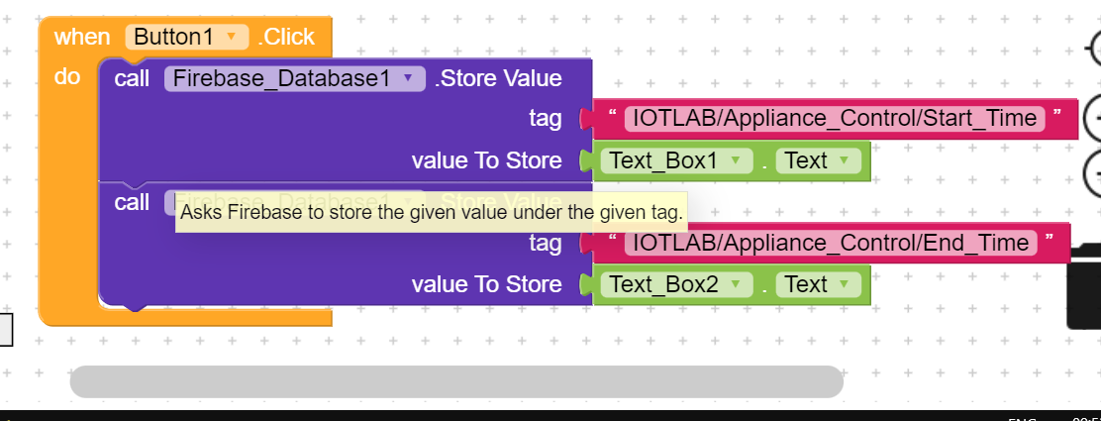
Mobile App

Slide 16
Basic read
#include <Wire.h>
# include <RTClib.h>
RTC_3231 rtc;
rtc.begin();
rtc.adjust(DateTime(F(_DATE_),F(_TIME)));
DateTime now = rtc.now();
now.hour(), now.minute(),now.second()

Slide 17
WiFi
#define WIFI_SSID "xxxxxxxxxxxxxx"
#define WIFI_PASSWORD "xxxxxxxxxxxxxxxxxxxxxx"
WiFi.begin(SSID,PASSWORD);
while(WiFi.status() != WL_CONNECTED
{
Serial.print(“.”);
delay(300);
}
Serial.println(WiFi.localIP());

Slide 18
Firebase
#define FIREBASE_HOST "xxxxxxxxxxxxxx"
#define FIREBASE_AUTH "xxxxxxxxxxxxxxxxxxxxxx"
FirebaseData firebaseData;
Firebase.begin(FIREBASE_HOST,FIREBASE_AUTH);
Firebase.setString(firebaseData,”IOTLAB/Appliance_Control/Current_Time”,s);
Firebase.getString(firebaseData,”IOTLAB/Appliance_Control/Start_Time”,s);
Firebase.getString(firebaseData,”IOTLAB/Appliance_Control/Stop_Time”,s);

Slide 19
OLED display
I2C address
SDA, SCL
# include <Wire.h>
#include “SSD1306.h”
SSD1306 display(0x3c, 21, 22);
display.init();
display.setFont(ArialMT_Plain_16);
display.clear();
display.drawString(0,0,currentTime);
display.drawstring(0,30,startTime);
display.drawstring(80,30,stopTime);
display.drawCircle(60,36,8);
display.display();
IOT Lab, ECE Department

Slide 20
Biometric based access control
Mobile app with finger print authentication
Authentication status stored in Firebase
GISMO-V reads authentication status and unlocks/locks a solenoid based lock

Slide 21
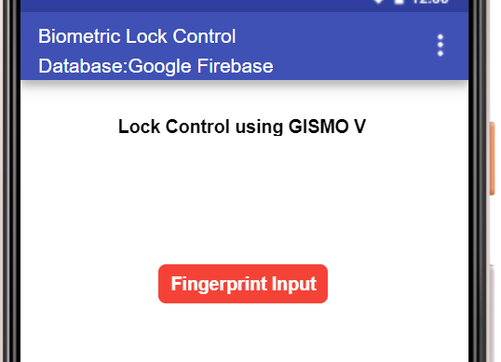
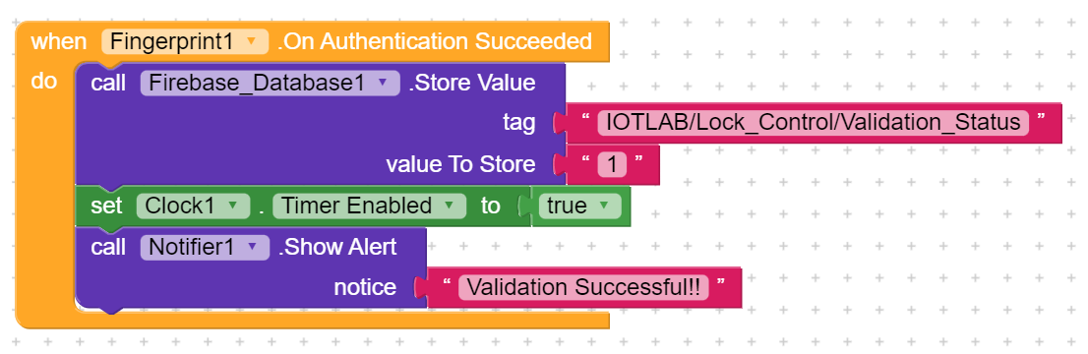
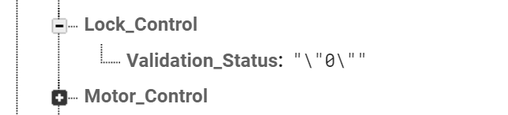
Mobile App
Firebase tag : IOTLAB/Lock_Control/Validation_Status

Slide 22
Home Safety & Security
LPG gas leak sensor MQ6
Magnetic switch to detect door/window open status
The status of the two alerts are transferred to Firebase
Mobile app will display the status of the two alerts

Slide 23
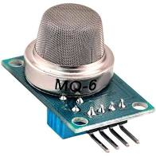
MQ6 gas leak sensor
FEATURES
* High sensitivity to LPG, iso-butane, propane
* Small sensitivity to alcohol, smoke.
* Fast response .
* Simple drive circuit
APPLICATION They are used in gas leakage detecting equipments in home and industry, are suitable for detecting of LPG, iso-butane and propane

Slide 24
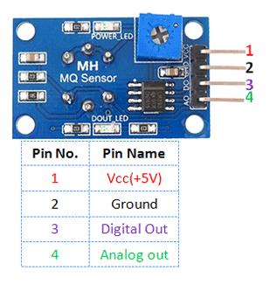
MQ6
MQ6 pin | ESP32 pin
VCC | 5V
Ground | GND
Digital out | NC
Analog out | GPIO36
Note: There is heater on board which heats the sensor. Stable readings will be got only after about 3 minutes of stabilization after cold start

Slide 25
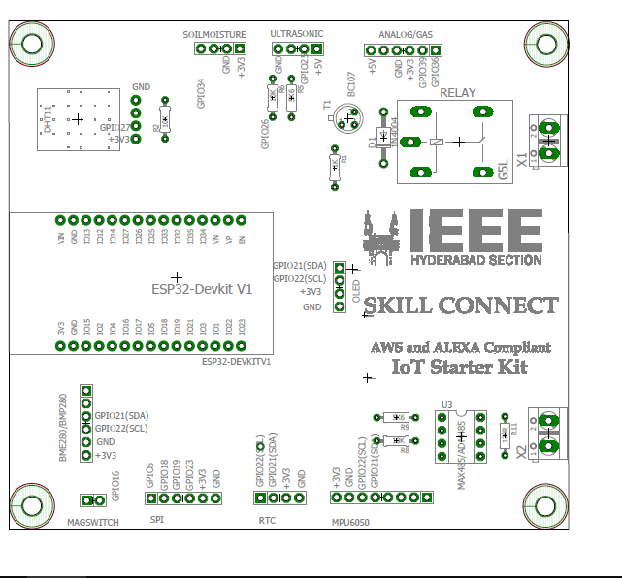
Location on board

Slide 26
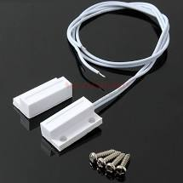
Magnetic switch
ESP32
Internal pullup
GPIO16
Mag sw
GND

Slide 27
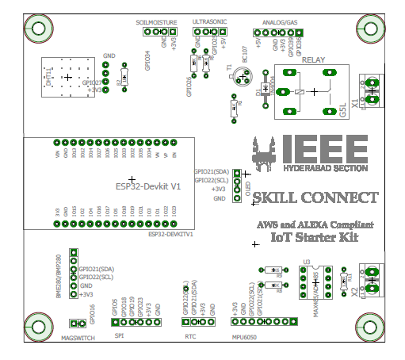
Location on board

Slide 28
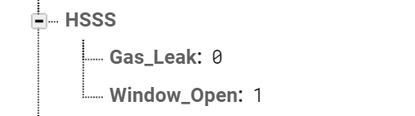
Firebase tags
IOTLAB/HSSS/Gas_Leak
IOTLAB/HSSS/Window_Open

Slide 29
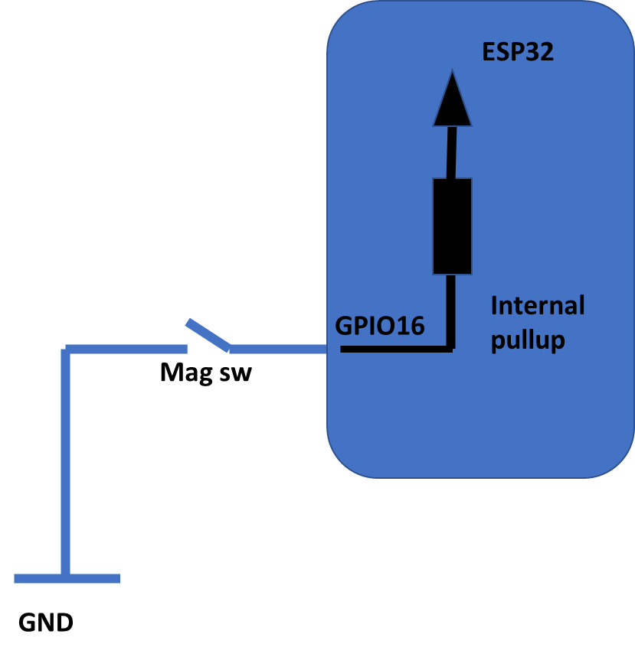
Test Project
Connect a switch to GPIO16
Read switch status
If switch is closed switch on onboard LED else off
Display switch status on OLED

