Slide 1
Getting Started

Slide 2
Github
All the Arduino programs required for the workshop are on:
https://github.com/GRIETIOTLAB
- Go to GISMO-VI repository
Go to GettingStarted folder

Slide 3
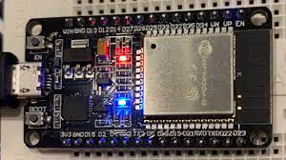
Hello World
Onboard LED
Blinking an LED
Onboard LED connected to pin 2
Create a new project in Arduino
Copy raw content of GISMO6_LED.ino into the file
Compile and name file as LED
Upload onto GISMO-VI board via USB port

Slide 4
LED Blink
void setup()
{
pinMode(2 , OUTPUT);
}
void loop()
{
digitalWrite(2 , HIGH);
delay(1000);
digitalWrite(2, LOW);
delay(1000);
}
Digital output

Slide 5
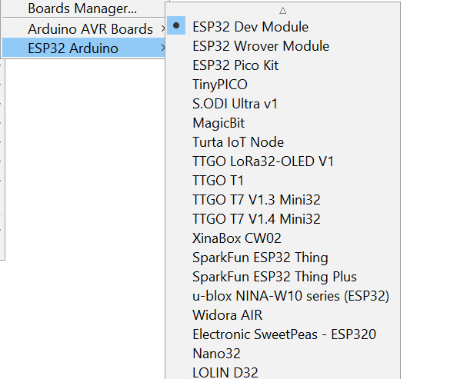
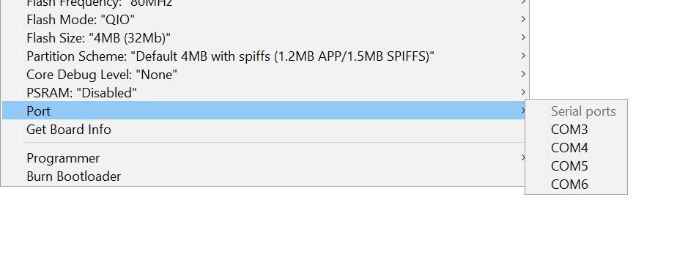
Hello World
Select the COM port to which your bard is mapped
Select ESP32 Arduino -> ESP32 Dev Module as the Board

Slide 6
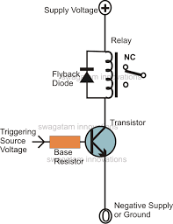
Relay module
ESP32
13

Slide 7
Relay module
void setup(){
pinMode(13,OUTPUT);
}
void loop(){
digitalWrite(13,HIGH);
delay(2000);
digitalWrite(13,LOW);
delay(2000);
}
Digital output

Slide 8

Relay module
Normally open (NO) contacts are brought out onto terminal blocks
On relay switching on, the NO contacts will close and the Line circuit will be complete and the bulb will glow
GISMO-V
Line
Neutral

Slide 9
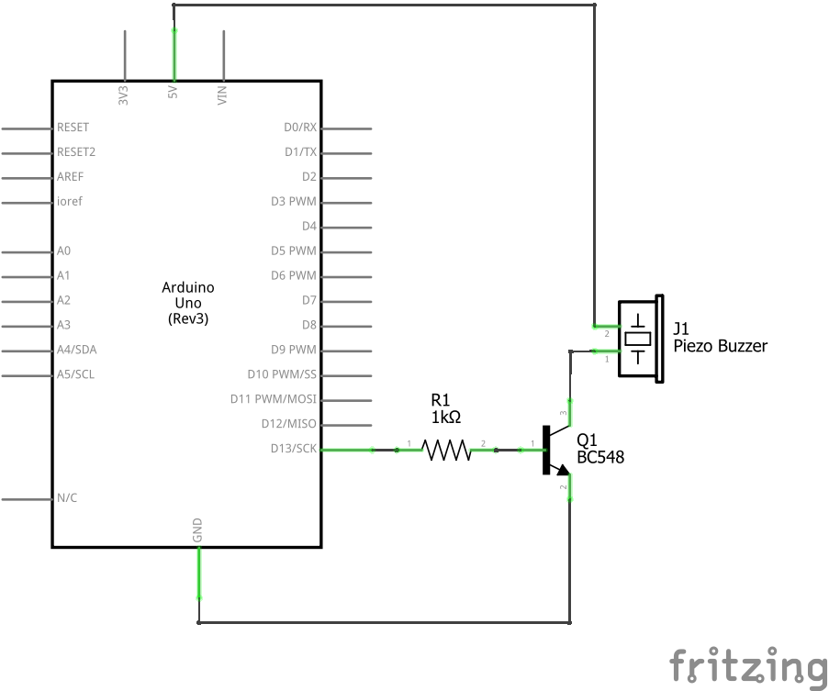
Buzzer
void setup(){
pinMode(32,OUTPUT);
}
void loop(){
digitalWrite(32,HIGH);
delay(2000);
digitalWrite(32,LOW);
delay(2000);
}

Slide 10
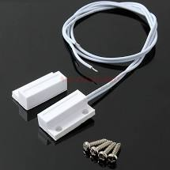
Magnetic switch
ESP32
Internal pullup
GPIO16
Mag sw
GND

Slide 11
Magnetic switch
Digital input
#define magSW 16
void setup() {
pinMode(magSW,INPUT_PULLUP);
Serial.begin(115200);
}
void loop() {
int sw_status;
sw_status = digitalRead(magSW);
if (sw_status)
Serial.println("Switch open");
else
Serial.println("Switch closed");
delay(1000);
}

Slide 12

Serial Communication
Program upload
Debugging
GISMO-VI

Slide 13
Serial Communication
int count;
void setup() {
Serial.begin(115200);
}
void loop() {
Serial.println(count);
count++;
if(count == 10) count = 0;
delay(1000);
}

Slide 14
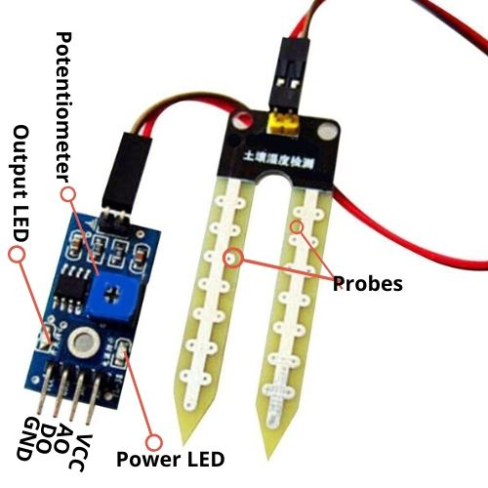
Soil Moisture sensor
Soil Moisture sensor | ESP32 pin
VCC | 3.3V
A0 | GPIO34
D0 | NC
GND | GND
The soil moisture sensor provides a digital as well as a analog output. We will be using the analog output

Slide 15
Soil Moisture sensor
void setup(){
Serial.begin(115200);
}
void loop(){
int soilmoisture;
soilmoisture = 4095 – analogRead(34);
Serial.println(soilmoisture);
delay(1000);
}
Analog input

Slide 16
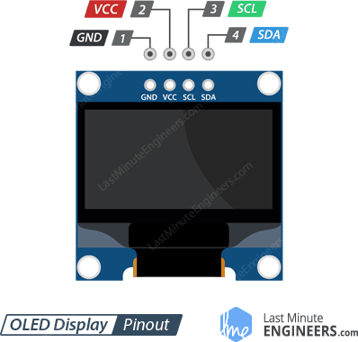
OLED display
I2C
OLED display pin | ESP32 pin
GND | GND
VCC | 3.3V
SCL | GPIO22
SDA | GPIO21
OLED: Organic Light Emitting Diode

Slide 17
OLED display
Feature | Value
Screen size | 0.96 inches
Internal controller | SSD1306
Color displayed | Blue
Resolution | 64 x 128
VCC | 3.3V
Protocol | I2C

Slide 18
OLED Display
#include <Wire.h>
#include “SSD1306.h”
SSD1306 display(0x3C,21,22);
SDA,SCL
I2C address

Slide 19
OLED Display
void OLEDInit(){
display.init();
display.setFont(ArialMT_Plain_24);
}

Slide 20
OLED Display
void OLEDUpdate(){
display.clear();
display.drawstring(0,0,”Hello World”);
display.display();
}

Slide 21
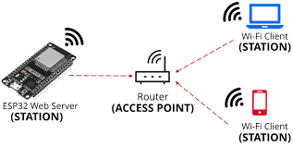
WiFi
ESP32 acts as a station and gets connected to a WiFi router

Slide 22
WiFi
#include <WiFi.h>
#define WIFI_SSID “xxxxxxxxxxxxxxxxxx”
#define WIFI_PASSWORD “xxxxxxxxxxxxxxxxxxxxxx”
The SSID (Service Set Identifier) is the name of your wireless network, also known as Network ID. This is viewable to anyone with a wireless device within reachable distance of your network. ... The SSID is the name of your wireless network. This is what you will look for when connecting wireless computers and devices.

Slide 23
WiFi
WiFiInit(){
pinMode(2,OUTPUT);
WiFi.begin(WIFI_SSID,WIFI_PASSWORD);
Serial.print(“Connecting to WiFi”);
while(WiFi.status() != WL_CONNECTED)
{
Serial.print(“.”);
digitalWrite(2,!digitalRead(2);
delay(300);
}
Serial.print(“Connected with IP:”);
Serial.print(WiFi.localIP());
}

Slide 24


Firebase
#include <FirebaseESP32.h>
#define FIREBASE_HOST “xxxxxxxxxxxxxxxxxxxxxxx”
#define FIREBASE_AUTH “xxxxxxxxxxxxxxxxxxxxxxx”
FirebaseData firebaseData; // Firebase data object

Slide 25
Firebase
FirebaseInit(){
Firebase.begin(FIREBASE_HOST,FIREBASE_AUTH);
Firebase.reconnectWiFi(true);
}
FirebaseWrite(){
Firebase.setFloat(FirebaseData, tag,value);
}

Slide 26
Credentials.h
#define FIREBASE_HOST "xxxxxxxxx"
#define FIREBASE_AUTH "xxxxxxxxx"
#define WIFI_SSID "xxxxxxxxx"
#define WIFI_PASSWORD "xxxxxxx"
#include <Wire.h>
#include "SSD1306.h"
#include "FirebaseESP32.h"
FirebaseData firebaseData;
SSD1306 display(0x3c, 21, 22);

