Slide 1


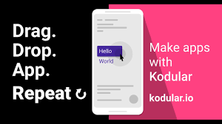
Mobile App Development - Kodular
Getting started with Kodular
Hello World in Kodular
Sample app in Kodular

Slide 2
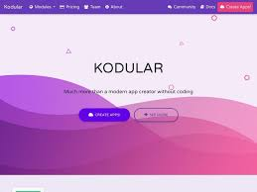
What is Kodular?
Kodular is a free online suite for mobile apps development. It mainly provides an online drag-and-drop Android app creator, on which everyone can create any kind of app without programming a single line of code.

Slide 3
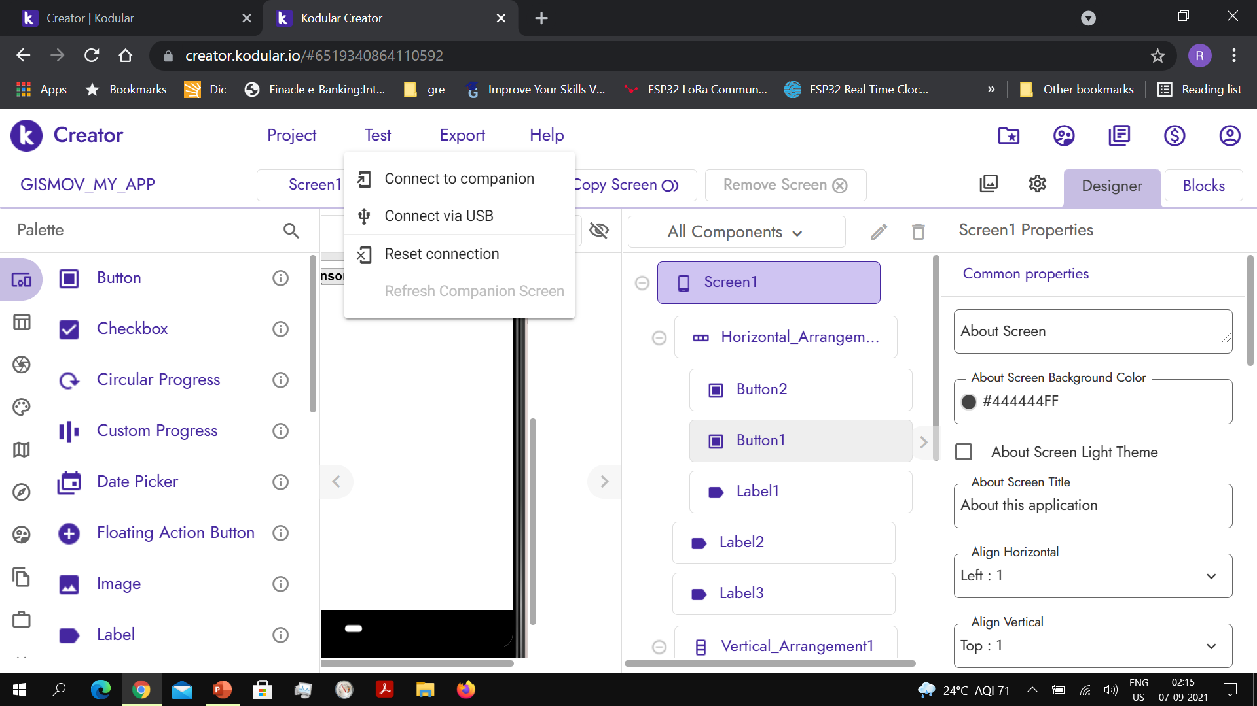

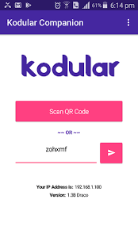
Kodular Companion
Kodular Companion is an Android app that will help developers using Kodular to live test their apps without exporting and compiling them
Kodular Creator in the Test tab has a Connect to Companion item that will open a 2D QR code that can be scanned by Kodular Companion

Slide 4
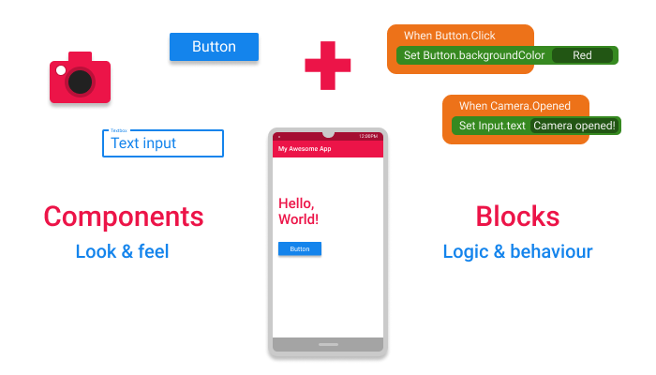
Understanding Kodular
The apps in Kodular are built as a combination of various Components , with each individual Component being used for a specific purpose.
The Component's behaviour is configured using Blocks

Slide 5
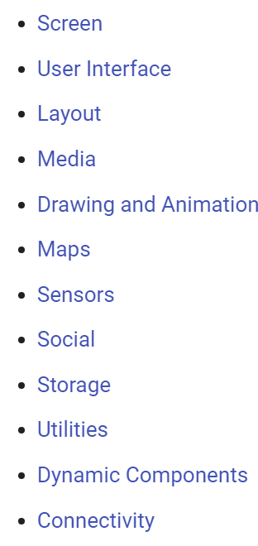
Components
Components are the basic building elements of any app in Kodular. Everything in the app is done with the help of one component or the other.
Different components are used for different purposes. One component may be used to design the User Interface(UI) of the app, for example a Button component, while others may be used for performing actions like communicating to a database, saving an image to the Android device's folder etc. for example the FirebaseDB component

Slide 6
Blocks
Blocks are ones which are used describe how to do a task. The way in which the Components respond to various actions and events in the app is designed using the Blocks.
For example, how the app should respond when a Button is clicked, what data is to be communicated to the database using FirebaseDB component etc. are all configured using the Blocks.
Thus, by using the various Components and by configuring its behaviour and response to actions from the user with the help of Blocks, an app is "koded" in Kodular.

Slide 7
Types of Components
Visible Components: The components that can be viewed in the Viewer panel of the Designer page are known as Visible Component. They are visible to the user in the app and the user can interact with it directly and help in building the User Interface of the app.
Non-Visible Components: The components that are not viewed in the Viewer panel of the Designer page are known as Non-Visible Component. They are the components that usually do other things like saving a file to the device's storage, getting data from various sensors of the device etc.

Slide 8
Types of Blocks of Components
Each Component has its own set of blocks, divided into three types:
Property blocks
Method blocks
Event blocks

Slide 9

Property Blocks
Each component comes with its own set of Properties, which describe its characteristics. For example, the Button component has properties like Background Color, Text Color, Text Font Size etc. which are characteristics that describe the features of that particular button.
Some these Properties can either be set from Designer page, or through Blocks, while some can be set only through Blocks and some only from the Designer.
The property blocks are Green in color

Slide 10

Method Blocks
Methods are certain functions that a component can do. For example, the Sound component should be able to play the music when required. This is done by using a Method called Play, which instructs the components to carry out the task of playing the music.
So, Methods are nothing but an instruction to carry out a particular task, like playing the music.
Some methods require some additional data, which will also be used in carrying out that task. For example, Firebase DB component stores the data using a method called Store Value. But how will the component know what data to store and under what name ? This is where Parameters or simply Params are used.

Slide 11
Event Blocks
Kodular apps are "koded" in an event-driven approach. That is, the blocks or behaviour of the app is executed based on the various events that occur. There is a wide range of events that occur thorughout the time for which the app is running, and the response of the app to these events can be configured.
For example, the user clicking a Button, the app starting are all events. The response of the app to such events are configured by grouping the desired behaviour under the Event block. The methods and property blocks grouped under each event are executed whenever that particular event occurs.

Slide 12

Event Blocks example
Let us take an example. If you want to change the Button text when the user clicks it, you have to group the logic to change the text under the Button.Clicked event. This is shown below.

Slide 13
Hello World
The first steps:
Navigate to Kodular Creator. You will be presented with a Login screen
After logging in you will be taken to a Projects screen
Name the project as HelloKodular and click Next
Project will be created and you will be taken to the Designer page of your project

Slide 14
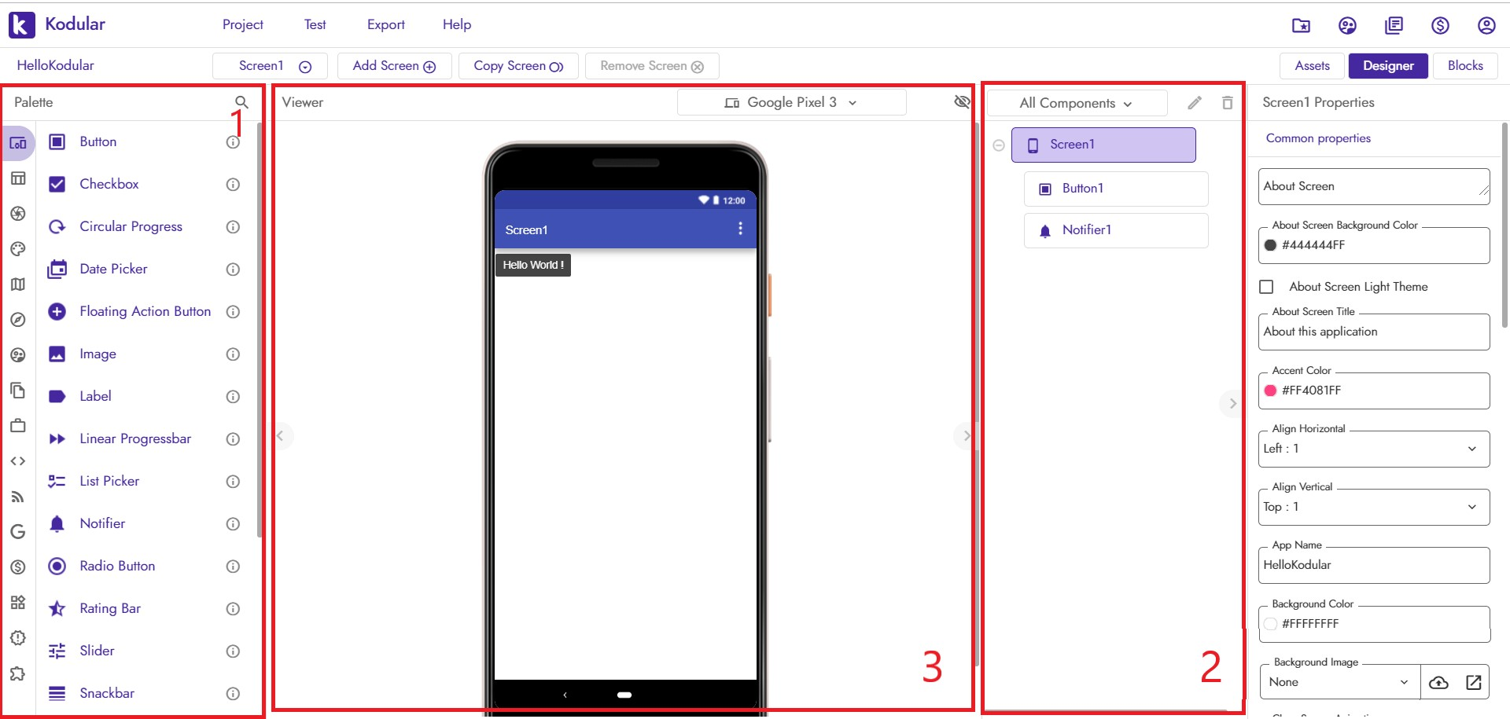
User Interface of Kodular

Slide 15
Designer
Palette – Various Components grouped under various categories
Viewer – Mocked-up view of the app as will be seen on a real device
Components Hierarchy - shows the visible components added to the present project
Designer Properties Panel - will be visible on clicking on a Component and will display the properties of that Component

Slide 16
Designer
Palette – Various Components grouped under various categories
Viewer – Mocked-up view of the app as will be seen on a real device
Components Hierarchy - shows the visible components added to the present project
Designer Properties Panel - will be visible on clicking on a Component and will display the properties of that Component

Slide 17
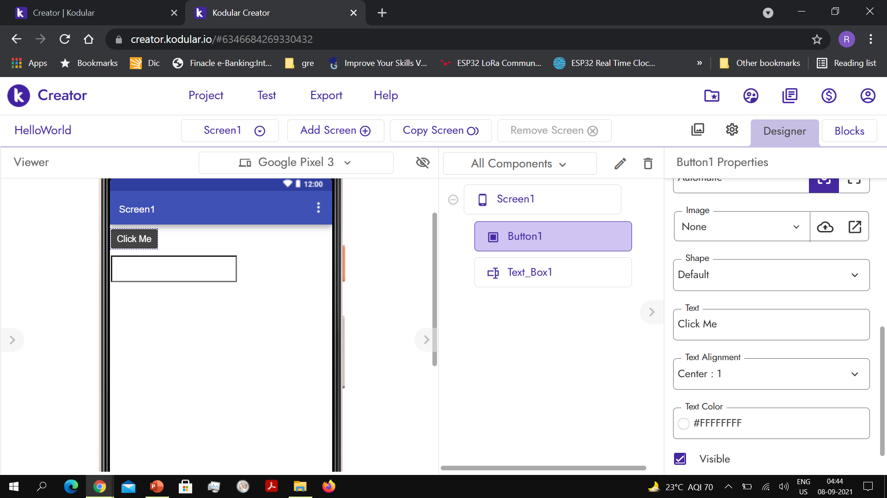
Designer
Step 1 Find the Button component from the Palette under the User Interface category and drag it into the Viewer. Next find the Text Box component and drag it into the Viewer
Step 2: Click on the Button1 component. The Button1 properties open up on the right side. Go to Button1 Text property and change it to Click Me

Slide 18
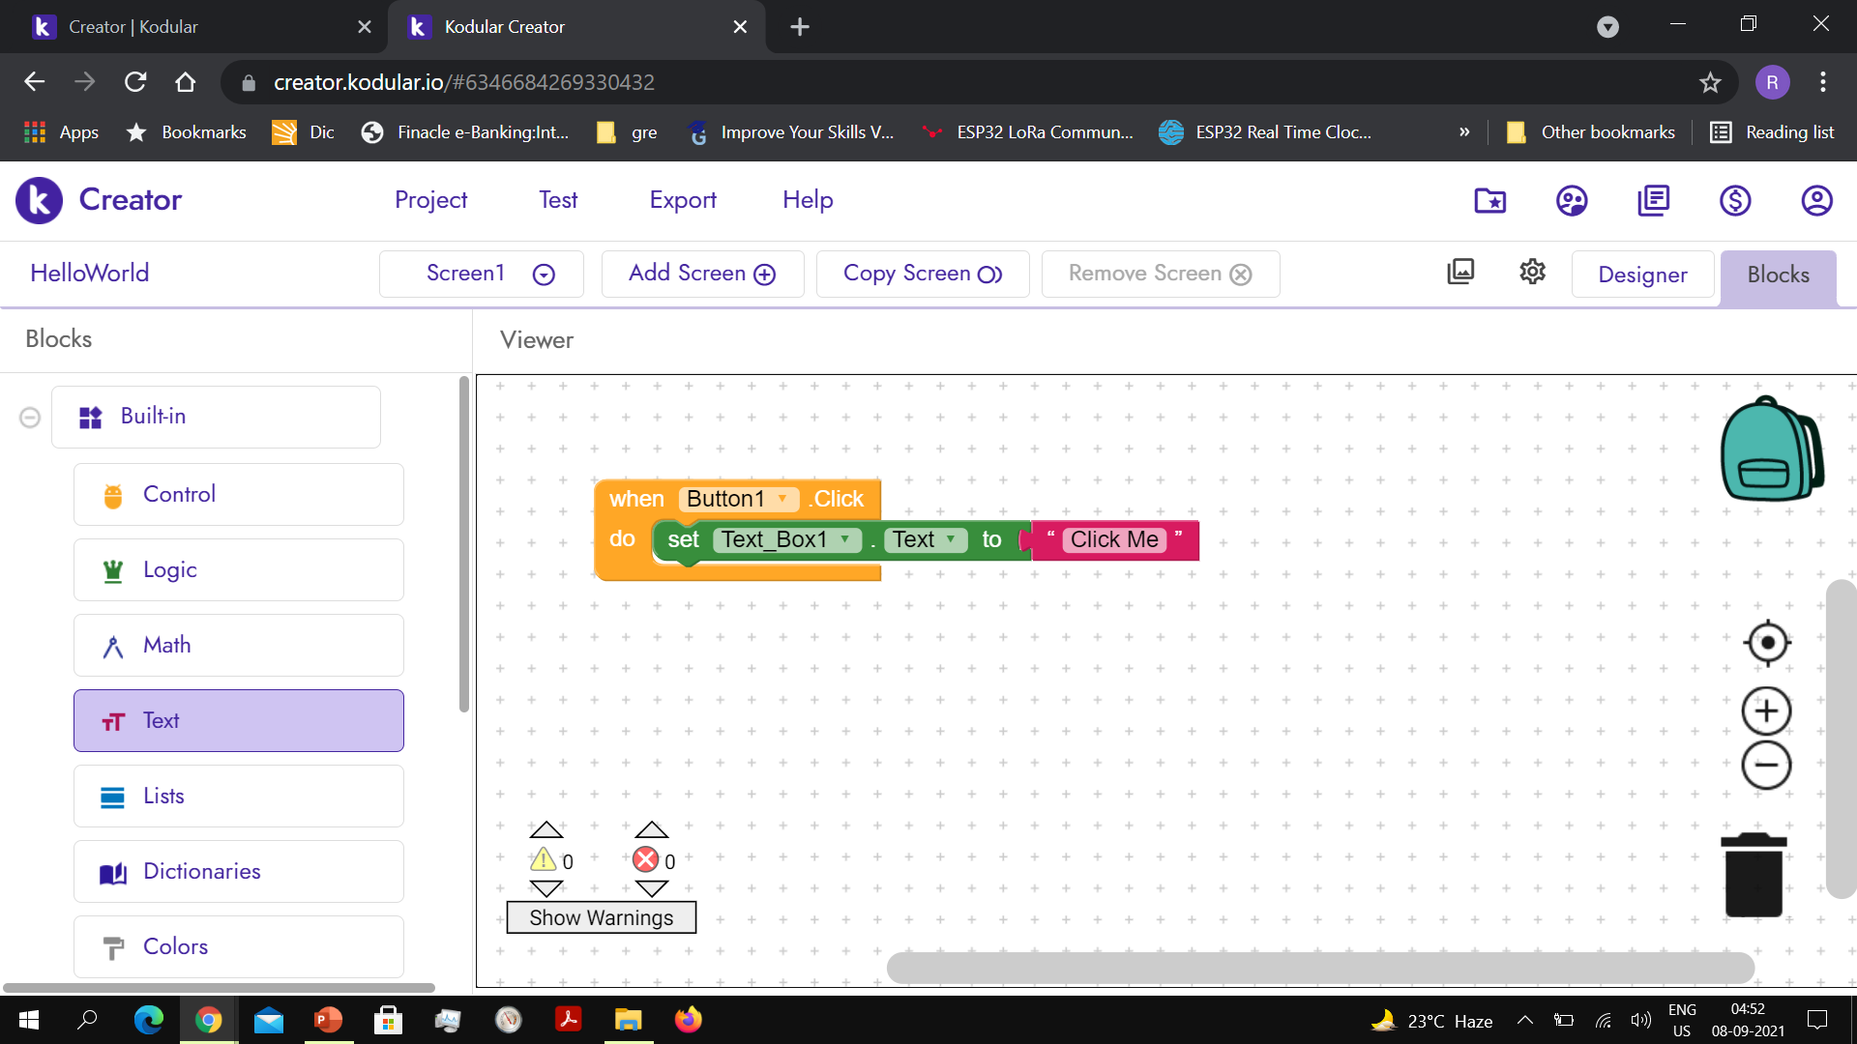
Blocks
Step 1 Go to Blocks
Step 2: Click on the Button1 component. The Button1 functions open up on the Viewer
Step 3: Drag and drop the When Button1.Click block onto the Viewer
Step 4: Click on the Text_Box1 component. Drag and drop the Set Text_Box1. Text block onto the Viewer
Step 5:Go to the Text Blocks group. Drag and drop an empty Text and write “Click Me” in the block

Slide 19
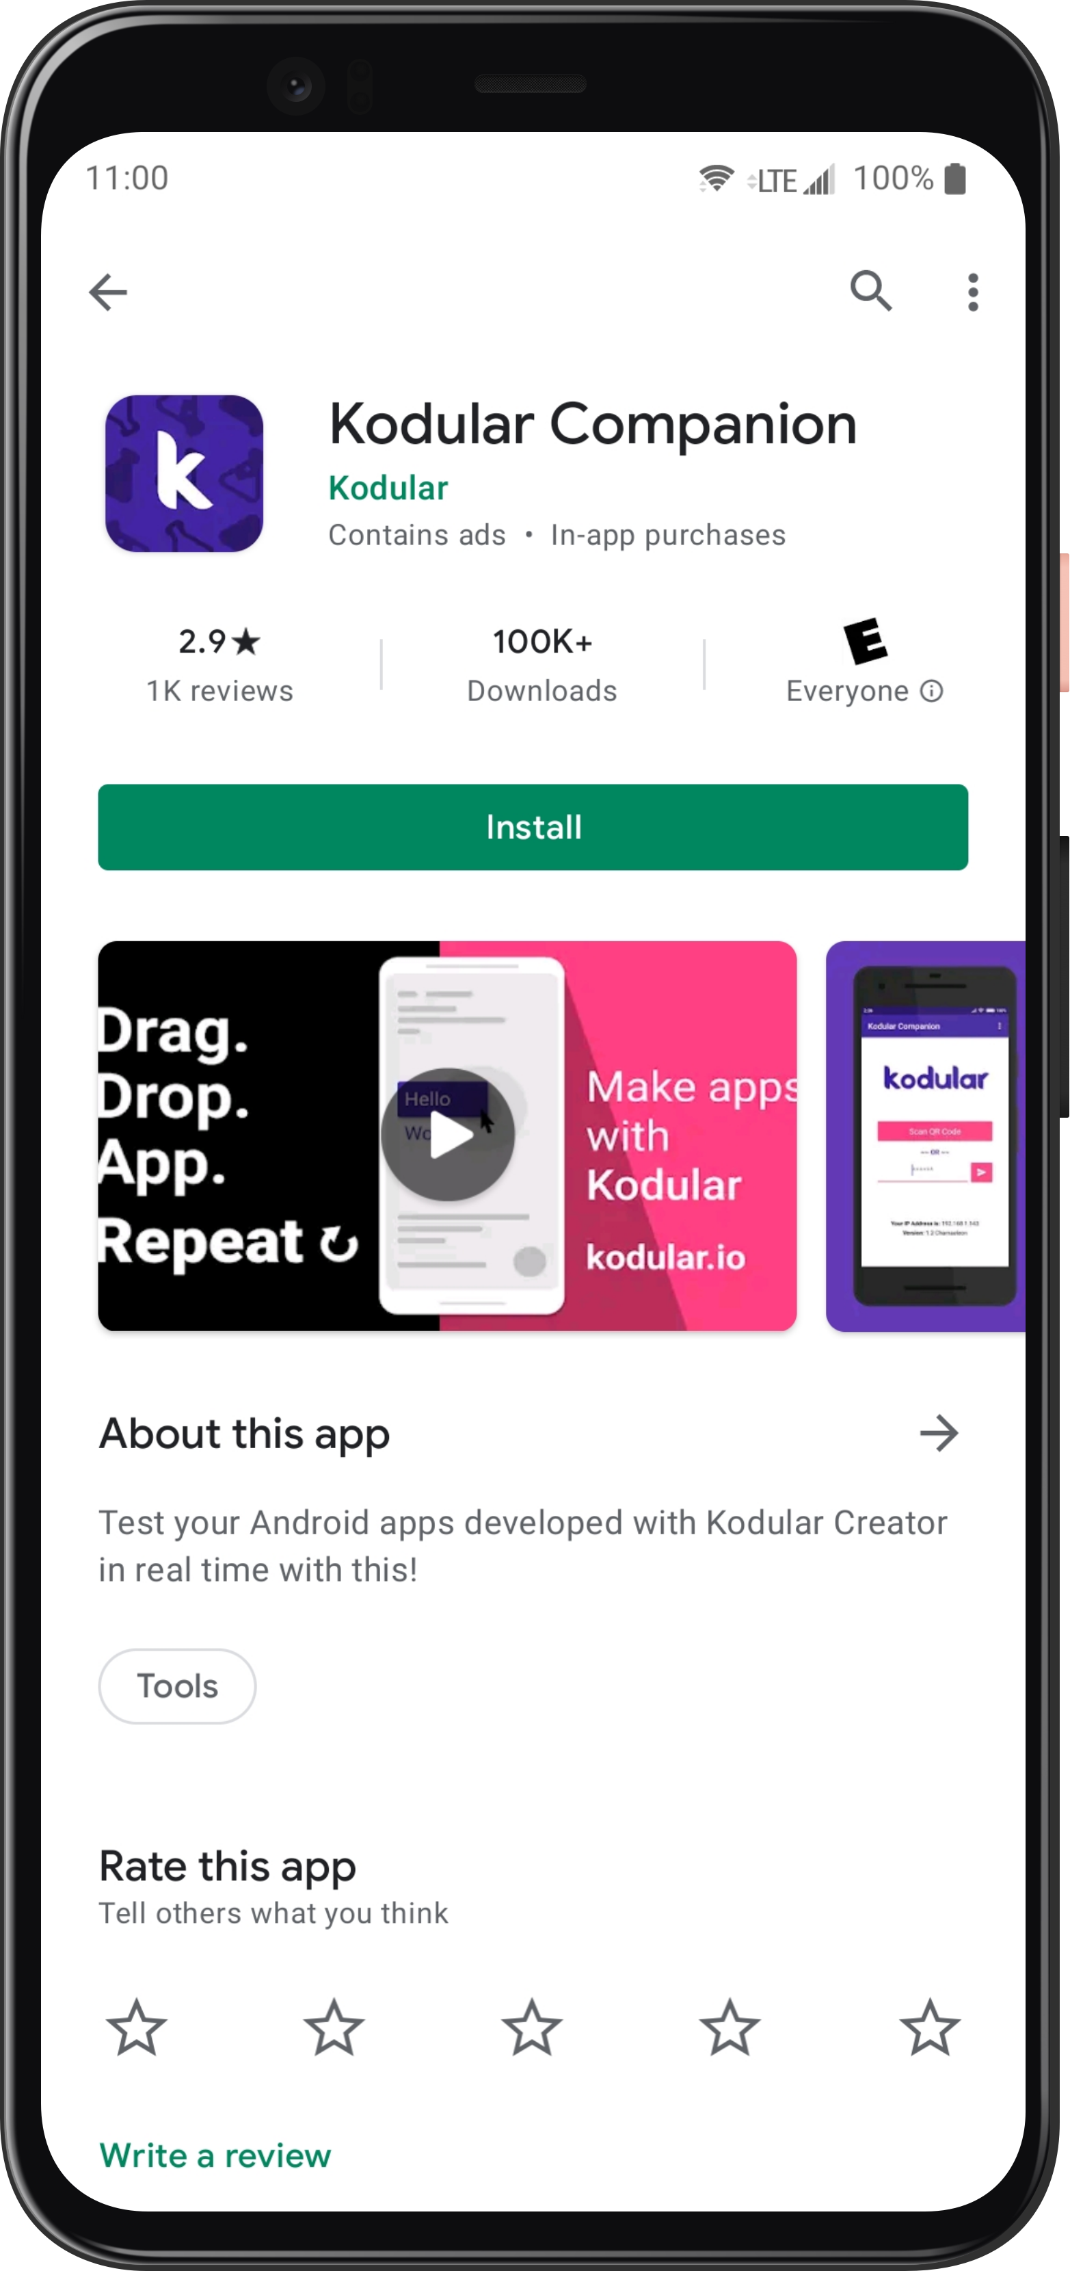
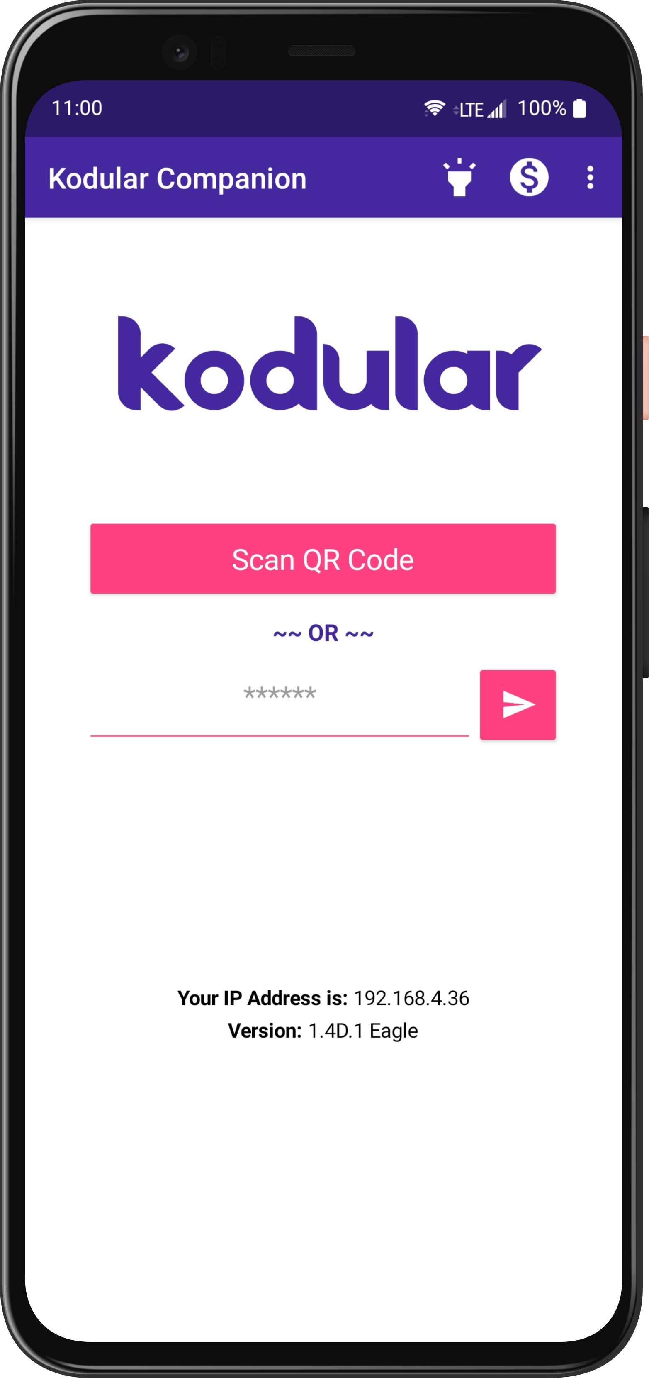
Live Development
Step 2: Open the app
Note:
Your laptop and mobile phone should be on the same WiFi network
Step 1: Download the Kodular Companion app from Google Play Store

Slide 20
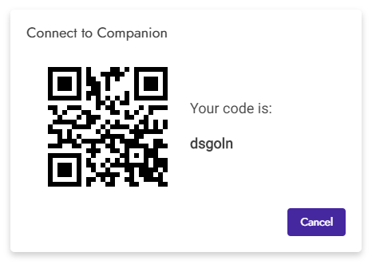
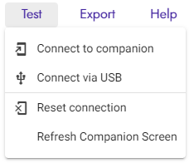
Live Development
Step 1: From the App bar choose Test
Step 3:
Scan the QR code using the Companion app
Step 2: Choose Connect to companion in the drop down

Slide 21
Calculator
Operand1
Operand2
Button
+
TextBox
-
x
/
Result

Slide 22
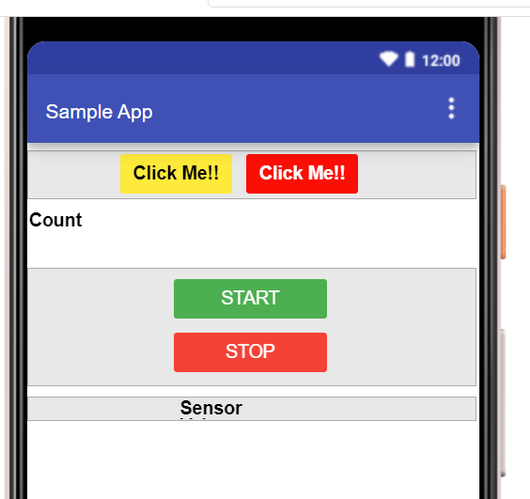
Sample app – GISMO5_MY_APP

