Slide 1
Mini Projects
Using GISMO VI

Slide 2
Environment Monitoring
Parameter | Range | Accuracy
Ambient Temperature | 0 – 65 degrees C | +/- 1 degrees
Atmospheric Pressure | 300hPa-1100hPa | +/- 1hPa
Altitude
IOT Lab, ECE Department

Slide 3
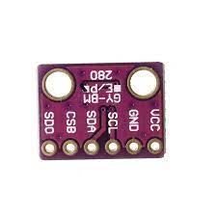
BMP280
BMP280 | ESP32
VCC | 3.3V
GND | GND
SCL | GPIO22
SDA | GPIO21
Interface to ESP32 is via I2C
IOT Lab, ECE Department

Slide 4
BMP280
This sensor can measure barometric pressure and temperature with very good accuracy. Because pressure changes with altitude we can also use it as an altimeter with ±1 meter accuracy
Accuracy for barometric pressure is ±1 hPa and ±1.0°C for temperature.
Its small dimensions and its low power consumption allow for the implementation in battery-powered devices such as mobile phones, GPS modules or watches.
Interface with microcontroller is via I2C or SPI
IOT Lab, ECE Department

Slide 5
BMP280
#include <Adafruit_Sensor.h>
#include <Adafruit_BMP280.h>
#define SEALAVELPRESSURE_HPA (1013.25)
Adafruit_BMP280 bmp;
Class
IOT Lab, ECE Department

Slide 6
BMP280
bmp.begin(BMP280_ADDRESS_ALT,BMP280_CHIPID);
bmp.setSampling(Adafruit_BMP280::MODE_NORMAL,
Adafruit_BMP280::SAMPLING_X2,
Adafruit_BMP280::SAMPLING_X16,
Adafruit_BMP280::MODE_NORMAL)
bmp.readTemperature();
bmp.readPressure();
bmp.readAlititude(1013.25);
IOT Lab, ECE Department

Slide 7
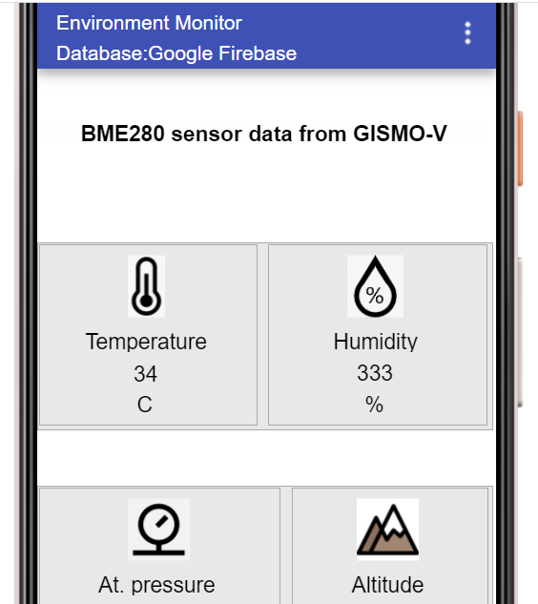
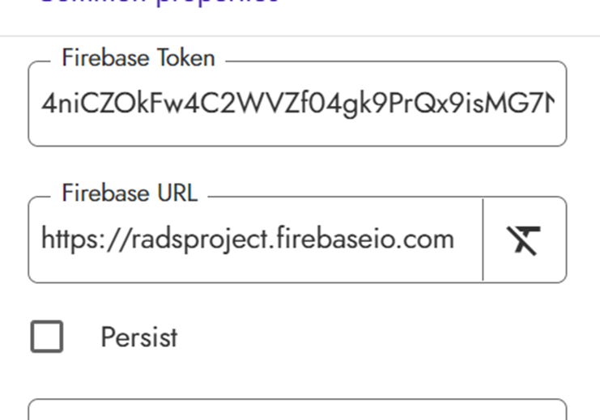
BMP280 Mobile App
IOT Lab, ECE Department

Slide 8
Credentials.h
#define FIREBASE_HOST “xxx”
#define FIREBASE_AUTH “xxx”
#define WIFI_SSID “xxx"
#define WIFI_PASSWORD “xxx“
#include <Wire.h> // For I2C communication
#include "SSD1306.h" // For OLED Display
#include "FirebaseESP32.h“// For Firebase
FirebaseData firebaseData;
SSD1306 display(0x3c, 21, 22);

Slide 9
OLED
Font and Font size
void OLEDInit(){
display.init();
display.setFont(ArialMT_Plain_16);
}

Slide 10
OLED
myString = "";
dtostrf(atPressure,5,1,buffer);
myString.concat(buffer);
display.drawString(0,30,myString);
myString = "";
dtostrf(altitude,5,1,buffer);
myString.concat(buffer);
myString.concat("m");
display.drawString(64,30,myString);
display.display(); }
void displayValues(){
display.clear();
humidity = 0.0;
myString = "";
dtostrf(humidity,5,1,buffer);
myString.concat(buffer);
myString.concat(" %");
display.drawString(64,0,myString);

Slide 11
WiFi connectivity
void WiFiInit(){
pinMode(2,OUTPUT);
WiFi.begin(WIFI_SSID, WIFI_PASSWORD);
Serial.print("Connecting to Wi-Fi");
while (WiFi.status() != WL_CONNECTED)
{ Serial.print(".");
digitalWrite(2,!digitalRead(2));
delay(300); }
Serial.println(WiFi.localIP());
}

Slide 12
Firebase
void FirebaseInit(){
Firebase.begin(FIREBASE_HOST, FIREBASE_AUTH);
Firebase.reconnectWiFi(true);
}

Slide 13
Firebase
void printValues(){
tempC = bmp.readTemperature();
Firebase.setFloat(firebaseData,"IOTLAB/Environment_Monitor/Temperature",tempC);
atPressure=bmp.readPressure()/100.0F;
Firebase.setFloat(firebaseData,"IOTLAB/Environment_Monitor/Pressure",atPressure);
altitude=bmp.readAltitude(SEALEVELPRESSURE_HPA);
Firebase.setFloat(firebaseData,"IOTLAB/Environment_Monitor/Altitude",altitude);
}

