Slide 1
IoT Projects
Using GISMO-VI Board

Slide 2

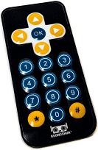
IR based Remote Control
Firebase
GISMO-VI
Mobile App
Control Modes
Local
Cloud

Slide 3
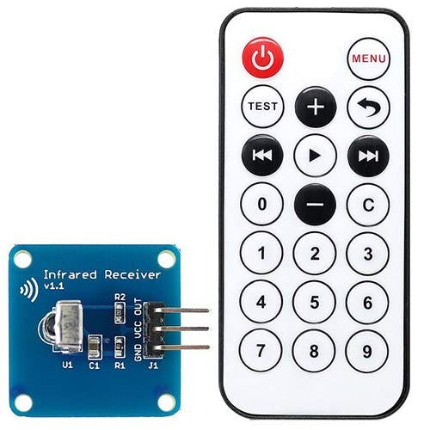
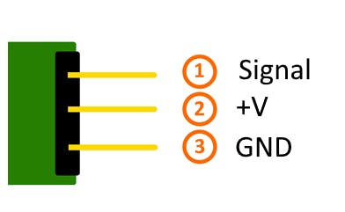
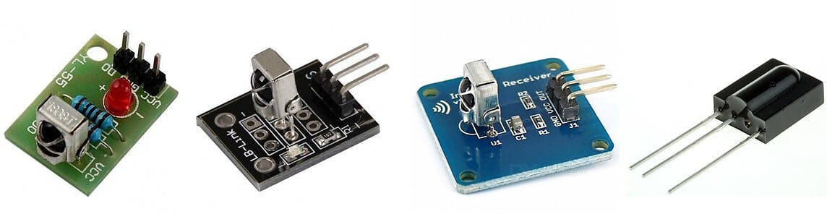
IR Remote Control
The Remote unit sends a modulated 38KHz IR signal which is demodulated and interpreted by the IR Receiver module. Each key on the Remote has a unique code which will help identify the key
IR Receiver Modules

Slide 4
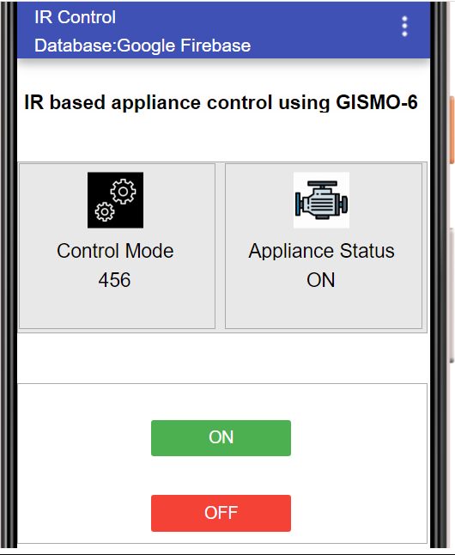
IR Remote Control
ON button
OFF Button
Local
Remote

Slide 5
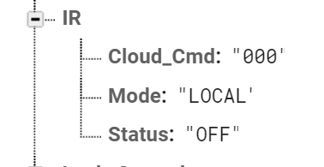
IR Remote Control

Slide 6
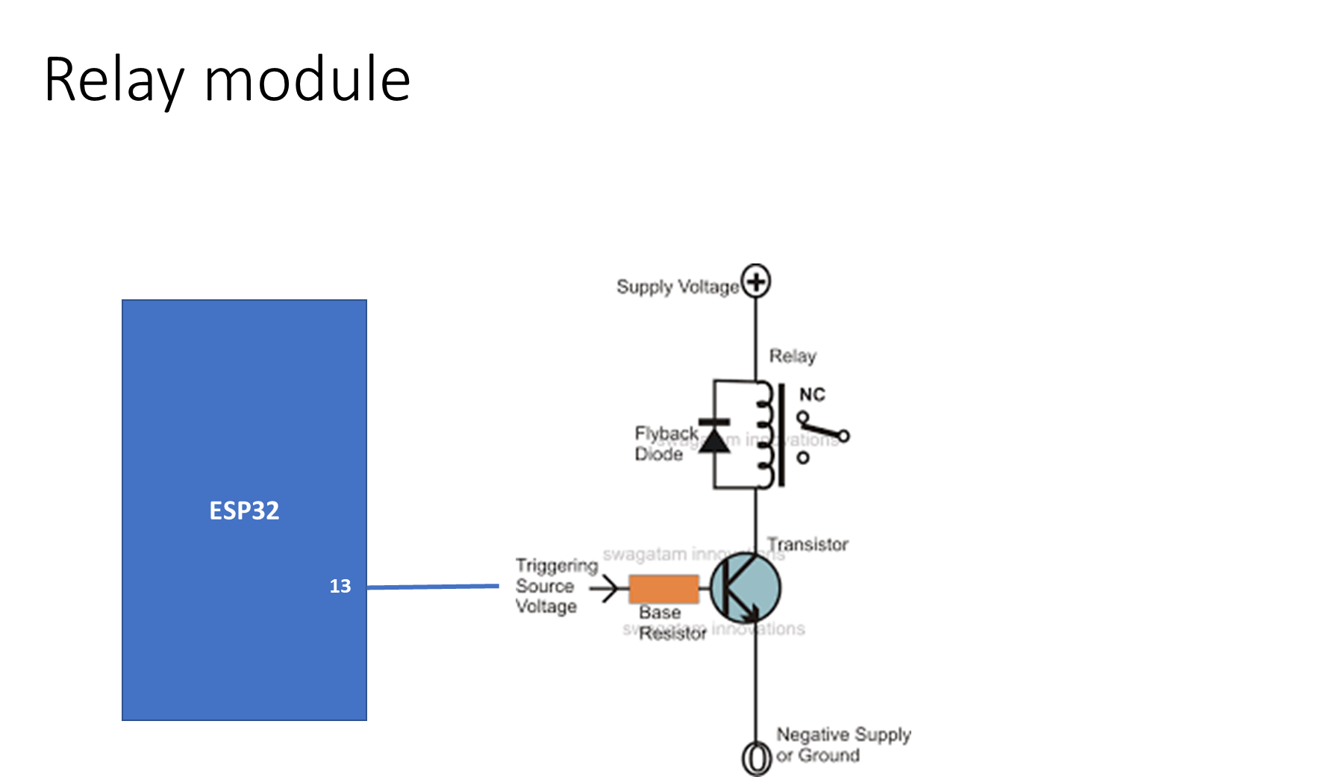

Slide 7
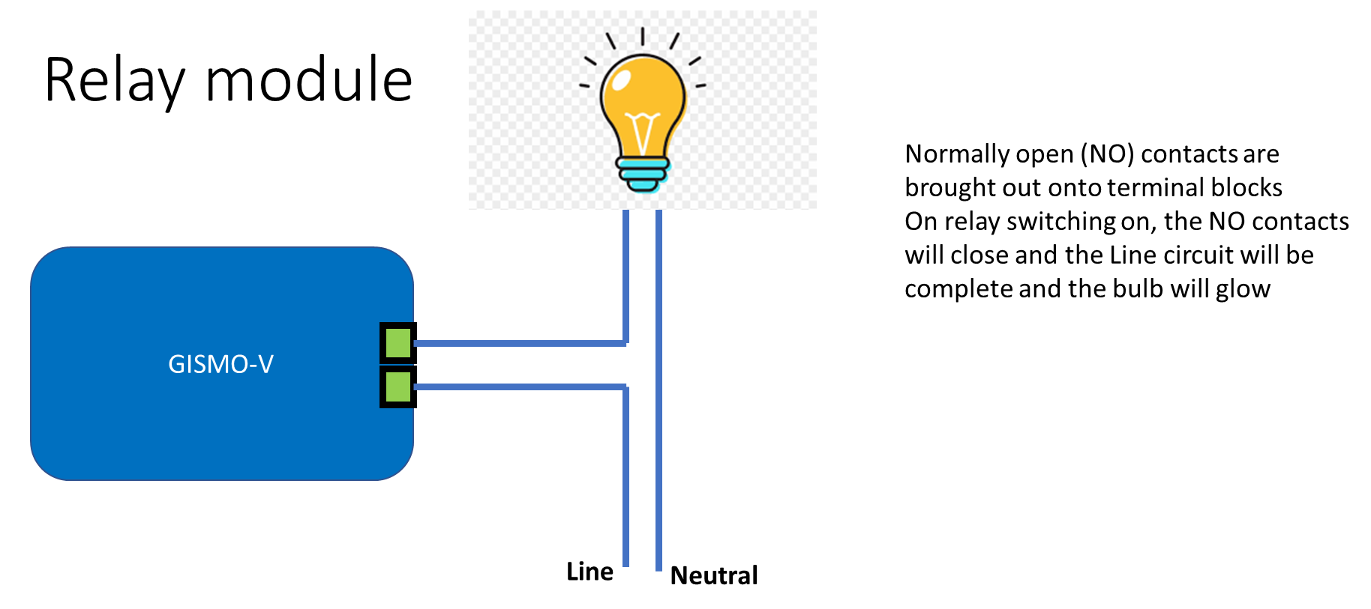

Slide 8
Basic read
#include <IRremoteESP8266.h>
#include <IRrecv.h>
#include <IRutils.h>
const uint16_t kRecvPin = 4;
IRrecv irrecv(kRecvPin);
decode_results results;
irrecv.enableIRIn();
if (irrecv.decode(&results)) {
long btnValue = results.value;
switch(btnValue){
case 16718055:

Slide 9
WiFi
#define WIFI_SSID "xxxxxxxxxxxxxx"
#define WIFI_PASSWORD "xxxxxxxxxxxxxxxxxxxxxx"
WiFi.begin(SSID,PASSWORD);
while(WiFi.status() != WL_CONNECTED
{
Serial.print(“.”);
delay(300);
}
Serial.println(WiFi.localIP());

Slide 10
Firebase
#define FIREBASE_HOST "xxxxxxxxxxxxxx"
#define FIREBASE_AUTH "xxxxxxxxxxxxxxxxxxxxxx"
FirebaseData firebaseData;
Firebase.begin(FIREBASE_HOST,FIREBASE_AUTH);
Firebase.getString(firebaseData,”IOTLAB/Motor_Control/Motor_Cmd”,s);
s1 = s.substring(2,s.length()-2);
mc = s1.toInt();

Slide 11
OLED display
I2C address
SDA, SCL
# include <Wire.h>
#include “SSD1306.h”
SSD1306 display(0x3c, 21, 22);
display.init();
display.setFont(ArialMT_Plain_16);
display.clear();
display.drawString(20,0,”MOTOR ON”);
display.display();
IOT Lab, ECE Department

Slide 12
Real Time Appliance Control
Based on real time start and stop times set via a mobile app and stored in the cloud database, an appliance (such as a heater) will be started and stopped during the slot time
Instead of using hardware for RTC, cloud based NTP (Network Time Protocol) servers are used to get real time
Real time is fetched from the cloud and if it is within the slot time, the appliance is switched on

Slide 13
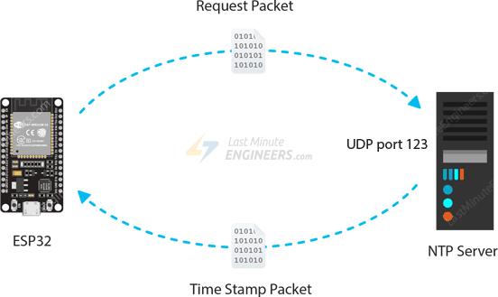
Real Time Appliance Control
The Network Time Protocol (NTP) is used by hundreds of millions of computers and devices to synchronize their clocks over the Internet.
The protocol can be used to synchronize all networked devices to Coordinated Universal Time (UTC)
Coordinated Universal Time (UTC) is a world-wide time standard, closely related to GMT (Greenwich Mean Time)
NTP server : pool.ntp.org
UTC+05:30 is an identifier for a time offset from UTC of +05:30. This time is used in India^{[1]} and Sri Lanka.
^{3]} It is five and a half hours ahead of Coordinated Universal Time.

Slide 14
NTP server
#include <WiFi.h>
#include "time.h"
#include "Credentials.h"
const char* ntpServer = "pool.ntp.org";
const long gmtOffset_sec = 19800;
// 5 hrs 30 minutes offset converted into seconds
//(5x60 + 30) x 60 = 19800

Slide 15
Fetching time from NTP server
configTime(gmtOffset_sec, daylightOffset_sec, ntpServer);
struct tm timeinfo;
if(!getLocalTime(&timeinfo)){
Serial.println("Failed to obtain time");
return 0; }
hrs = timeinfo.tm_hour;
mins = timeinfo.tm_min;

Slide 16
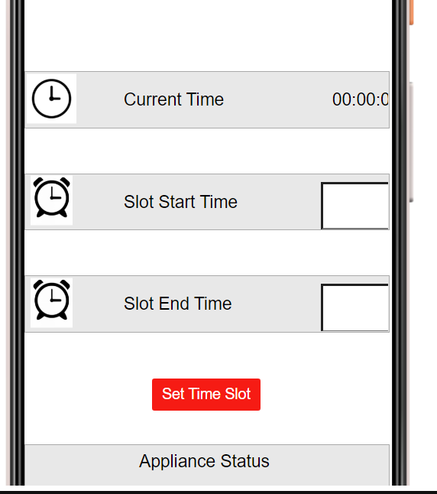
Mobile app
Slot start and end time setting in HH:MM format
Real time display. Real time is fetched from cloud and transferred to cloud database
Appliance status: On/Off

Slide 17
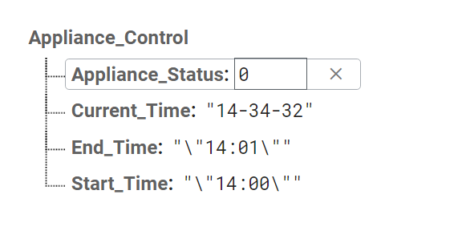
Cloud database

Slide 18
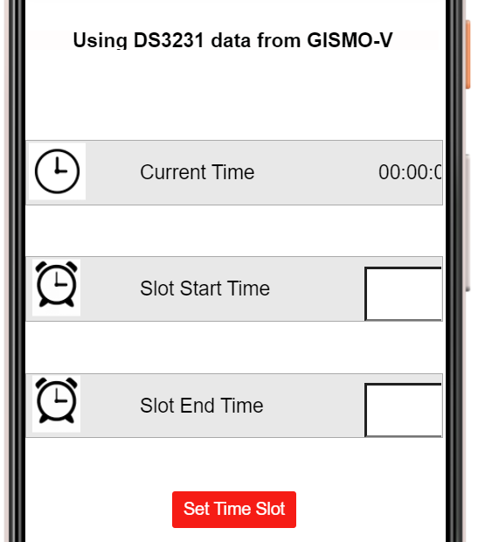
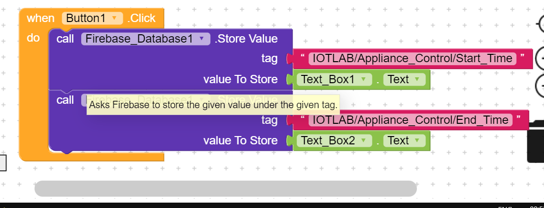
Mobile App

Slide 19
WiFi
#define WIFI_SSID "xxxxxxxxxxxxxx"
#define WIFI_PASSWORD "xxxxxxxxxxxxxxxxxxxxxx"
WiFi.begin(SSID,PASSWORD);
while(WiFi.status() != WL_CONNECTED
{
Serial.print(“.”);
delay(300);
}
Serial.println(WiFi.localIP());

Slide 20
Firebase
#define FIREBASE_HOST "xxxxxxxxxxxxxx"
#define FIREBASE_AUTH "xxxxxxxxxxxxxxxxxxxxxx"
FirebaseData firebaseData;
Firebase.begin(FIREBASE_HOST,FIREBASE_AUTH);
Firebase.setString(firebaseData,”IOTLAB/Appliance_Control/Current_Time”,s);
Firebase.getString(firebaseData,”IOTLAB/Appliance_Control/Start_Time”,s);
Firebase.getString(firebaseData,”IOTLAB/Appliance_Control/Stop_Time”,s);

Slide 21
OLED display
I2C address
SDA, SCL
# include <Wire.h>
#include “SSD1306.h”
SSD1306 display(0x3c, 21, 22);
display.init();
display.setFont(ArialMT_Plain_16);
display.clear();
display.drawString(0,0,currentTime);
display.drawstring(0,30,startTime);
display.drawstring(80,30,stopTime);
display.drawCircle(60,36,8);
display.display();
IOT Lab, ECE Department

Slide 22
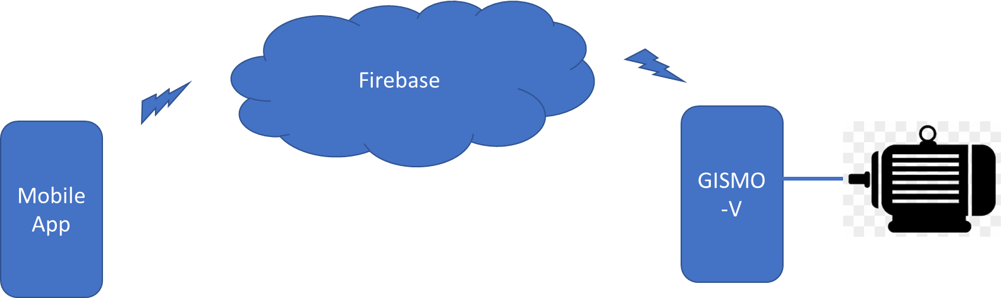
Biometric based access control
Mobile app with finger print authentication
Authentication status stored in Firebase
GISMO-V reads authentication status and unlocks/locks a solenoid based lock

Slide 23
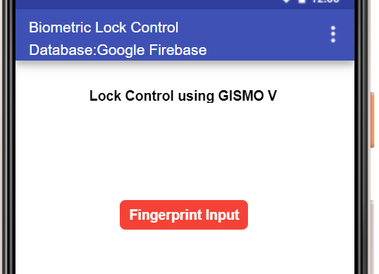
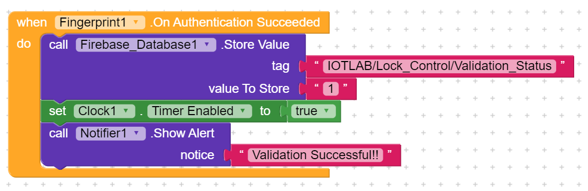
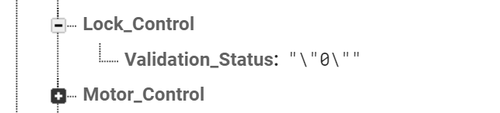
Mobile App
Firebase tag : IOTLAB/Lock_Control/Validation_Status

Slide 24
Home Safety
PIR sensor for intrusion detection
Magnetic switch to detect door/window open status
The status of the two alerts are transferred to Firebase
Mobile app will display the status of the two alerts

Slide 25
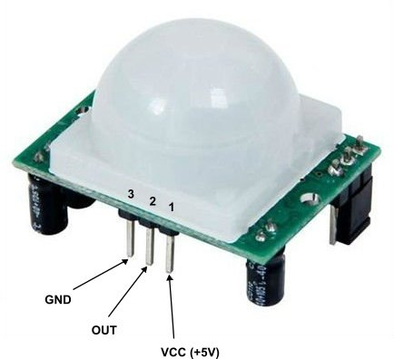
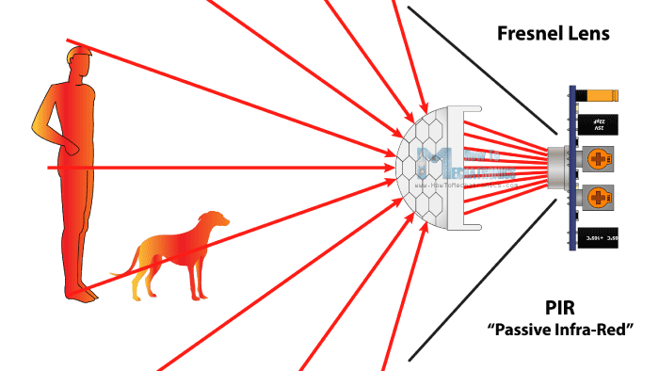
PIR sensor
A passive infrared sensor is an electronic sensor that measures infrared light radiating from objects. PIR sensors mostly used in PIR-based motion detectors. Also, it used in security alarms and automatic lighting applications.
Generally, PIR sensor can detect animal/human movement in a requirement range. PIR is made of a pyroelectric sensor, which is able to detect different levels of infrared radiation. The detector itself does not emit any energy but passively receives it.

Slide 26
PIR sensor interface
#define PIR 33
pinMode(PIR,INPUT);
int pir_status = digitalRead(PIR);
if (pir_status == HIGH) {
Serial.println("Motion detected!");
loopDelay=3000;}
else {
Serial.println("No Motion detected!");
loopDelay = 1000;}
delay(loopDelay);
PIR sensor signal | ESP32 pin
GND | GND
OUT | GPIO33
VCC | 5V

Slide 27
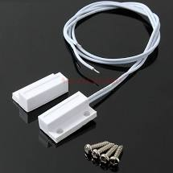
Magnetic switch
ESP32
#define magSW 16
pinMode(magSW,INPUT_PULLUP)
int status = digitalRead(magSW);
If(status == HIGH)
Serial.println(“ Window open”);
else
Serial.println(“Window closed”);
Internal pullup
GPIO16
Mag sw
GND

Slide 28
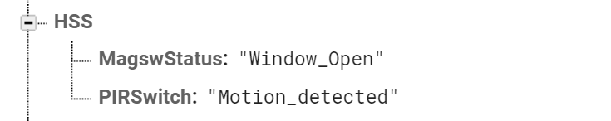
Firebase tags
IOTLAB/HSS/MagswStatus
IOTLAB/HSSS/PIRSwitch

Slide 29
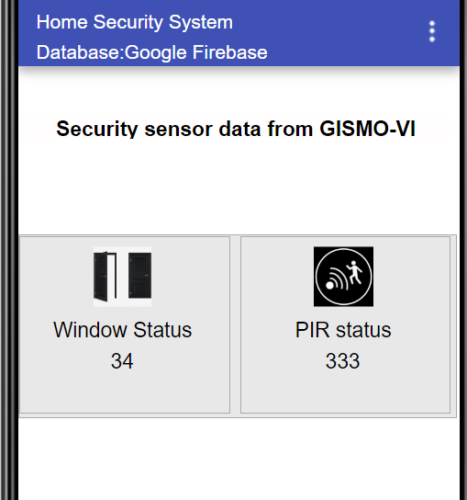
Mobile App

Slide 30
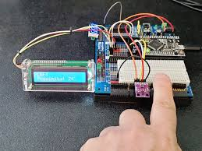
Gesture Recognition
Following gestures will be recognized:
Up to Down
Down to Up
Left to Right
Right to Left
Far to Near
Near to Far

Slide 31
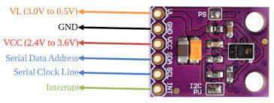
APDS9960
APDS9960 pin | ESP32 pin
VL | NC
GND | GND
VCC | 3.3V
Serial Data | SDA
Serial Clock | SCL
Interrupt | GPIO23
The APDS-9960 is a multipurpose sensor that can be used for Ambient Light, RGB Sensing, Proximity Sensing, and Gesture Detection.

Slide 32
APDS9960
Gesture detection utilizes four directional photodiodes to sense reflected IR energy (sourced by the integrated LED) to convert physical motion information (i.e. velocity, direction and distance) to a digital information.
The gesture engine accommodates a wide range of mobile device gesturing requirements: simple UP-DOWN-RIGHT-LEFT gestures or more complex gestures can be accurately sensed.

Slide 33
APDS9960
#include <Wire.h>
#include <SparkFun_APDS9960.h>
#define APDS9960_INT 23 // Needs to be an interrupt pin
SparkFun_APDS9960 apds = SparkFun_APDS9960();
pinMode(APDS9960_INT, INPUT);
attachInterrupt(APDS9960_INT, interruptRoutine, FALLING);
apds.init();
apds.enableGestureSensor(true);

Slide 34
APDS9960
void handleGesture() {
if ( apds.isGestureAvailable() ) {
switch ( apds.readGesture() ) {
case DIR_UP:
Serial.println("UP");
break;
………………..
default:
Serial.println("NONE");
}
}

Slide 35
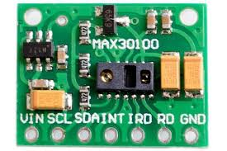
Heart Beat Detection
The module features the MAX30102 – a modern, integrated pulse oximeter and heart rate sensor IC, from Analog Devices.
It combines two LEDs, a photodetector, optimized optics, and low-noise analog signal processing to detect pulse oximetry (SpO2) and heart rate (HR) signals.

Slide 36
Heart Beat Detection
MAX30102 signal | ESP32 pin
VIN | 3.3V
SCL | GPIO22(SCL)
SDA | GPIO21(SDA)
INT | NC
IRD | NC
RD | NC
GND | GND

Slide 37
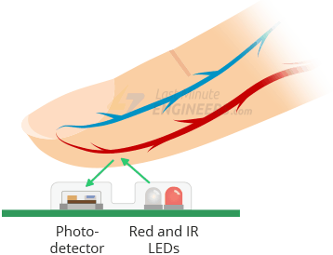
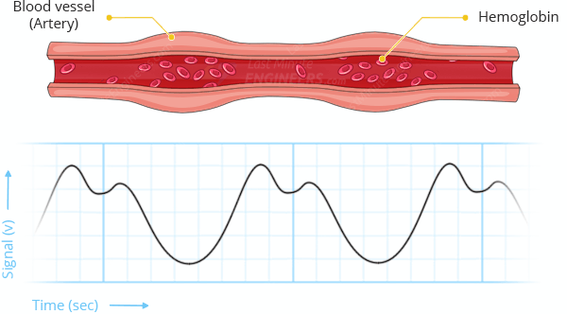
Heart Beat Detection
The MAX30102 works by shining both lights onto the finger and measuring the amount of reflected light using a photodetector.
The oxygenated hemoglobin (HbO2) in the arterial blood has the characteristic of absorbing IR light.
The redder the blood (the higher the hemoglobin), the more IR light is absorbed.
As the blood is pumped through the finger with each heartbeat, the amount of reflected light changes, creating a changing waveform at the output of the photodetector.
As you continue to shine light and take photodetector readings, you quickly start to get a heart-beat (HR) pulse reading.

Slide 38
MAX30105 particleSensor;
particleSensor.begin(Wire, I2C_SPEED_FAST)) //Use default I2C port, 400kHz speed
long irValue = particleSensor.getIR();
if (checkForBeat(irValue) == true)
{
long delta = millis() - lastBeat;
lastBeat = millis();
beatsPerMinute = 60 / (delta / 1000.0);
if (beatsPerMinute < 255 && beatsPerMinute > 20)
{
rates[rateSpot++] = (byte)beatsPerMinute; //Store this reading in the array
rateSpot %= RATE_SIZE; //Wrap variable
beatAvg = 0;
for (byte x = 0 ; x < RATE_SIZE ; x++)
beatAvg += rates[x];
beatAvg /= RATE_SIZE;
}
}

Slide 39
Alarm bell detection and notification
Detection of a specific alarm bell sound
Capture of audio using a MEMS digital microphone INMP441
Performing an FFT on raw audio signal to detect frequency components
Check for presence of specific frequency component corresponding to alarm bell
Post alarm bell detection status(Bell detected/No bell) to cloud
Pull from cloud and display alarm bell detection status on mobile app

Slide 40
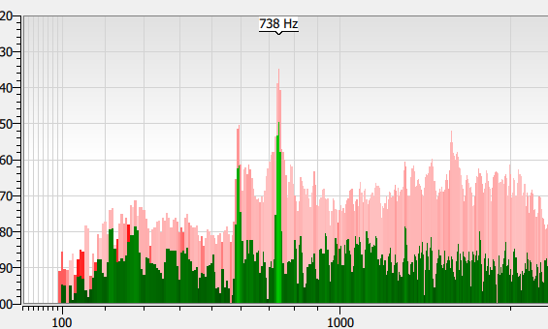

Alarm bell detection and notification
Offline FFT analysis of alarm bell sound in laptop using Friture, a free real-time audio analyzer tool for Windows to get the frequency of the alarm bell sound
Audio capture using the GISMO6 board with a INMP digital microphone
FFT on the captured audio signal and check for the specific alarm bell frequency

Slide 41
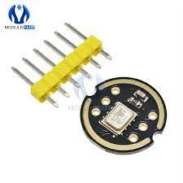
INMP441
The INMP441 is a high performance, low power, digital output, omnidirectional MEMS(microelectromechanical)microphone
The I2S interface allows the INMP441 to be directly connected to digital processors such as ESP32 without the need for an audio codec for use in the system.
The INMP441 has a flat wideband frequency response that results in high definition of natural sound.

Slide 42
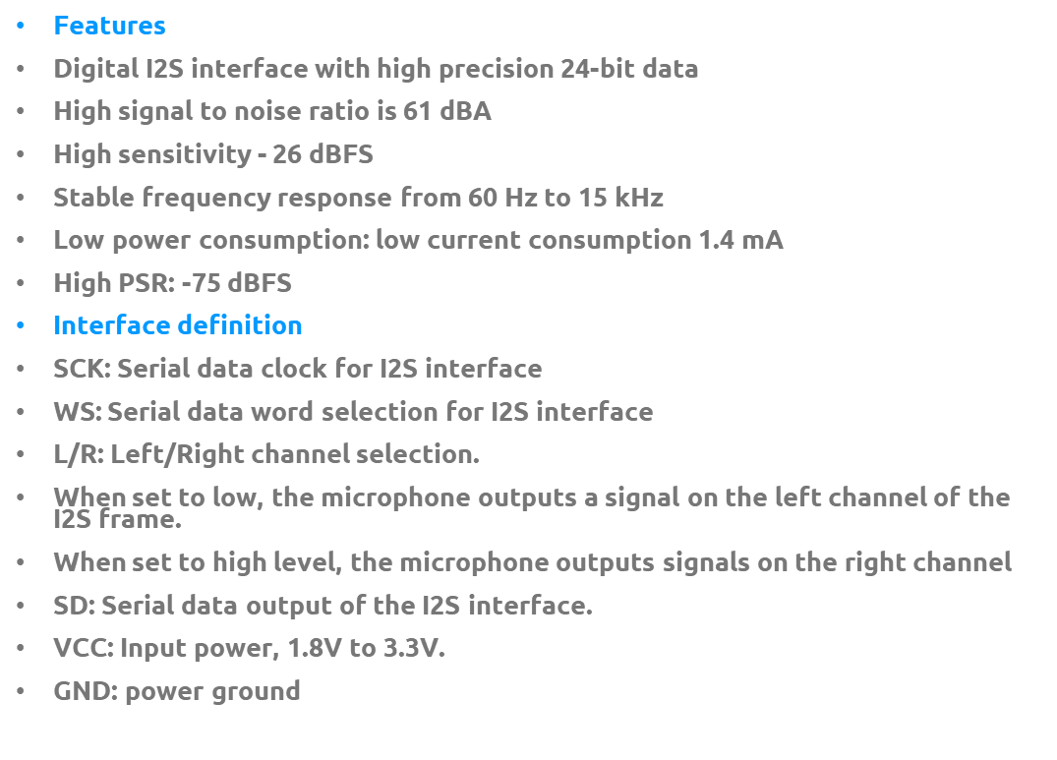
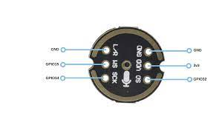
INMP441

Slide 43
INMP441 - ESP32 interface
INMP441 signal | ESP32 pin
L/R | GND
WS | GPIO27
SCK | GPIO14
GND | GND
VDD | 3.3V
SD | GPIO12

Slide 44
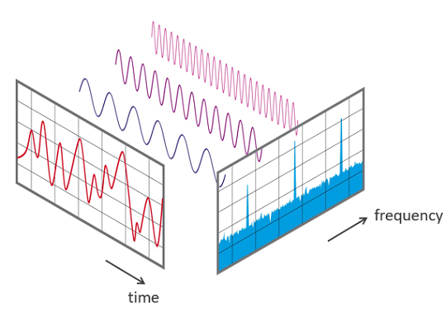
FFT basics
A Fourier transform converts a signal from a time domain into the frequency domain.
In the frequency domain the signal is represented by a weighted sum of sine and cosine waves.
A fast Fourier transform, or FFT, is a clever way of computing a discrete Fourier transform in Nlog(N) time instead of N² time, where N is the number of samples
This method can save a huge amount of processing time, especially with real-world signals that can have many thousands or even millions of samples.

Slide 45
FFT basics
The signal is scanned and the following parameters are important:
The sampling frequency fs of the measuring system (e.g. 48 kHz). This is the average number of samples obtained in one second (samples per second).
The selected number of samples; the blocklength BL. This is always an integer power to the base 2 in the FFT (e.g., 2^10 = 1024 samples)

Slide 46
FFT Basics
Bandwidth fn This value indicates the theoretical maximum frequency that can be determined by the FFT.
fn = fs / 2
For example at a sampling rate of 48 kHz, frequency components up to 24 kHz can be theoretically determined.
Measurement duration D. The measurement duration is given by the sampling rate fs and the blocklength BL. D = BL / fs. At fs = 48 kHz and BL = 1024, this yields 1024/48000 Hz = 21.33 ms
Frequency resolution df. The frequency resolution indicates the frequency spacing between two measurement results. df = fs / BL
At fs = 48 kHz and BL = 1024, this gives a df of 48000 Hz / 1024 = 46.88 Hz.

Slide 47
FFT bins
Frequency bins are intervals between samples in frequency domain
For the project, the sampling rate is 22627Hz and the number of samples is 1024
Divide the 22627Hz range into 1024 intervals – 0-22,22-44,44-66 and so on
The door bell frequency used is 738Hz so it will be ( 738/22 = 33.54 ) in 33rd or 34th bin

Slide 48
I2S protocol
Inter-IC Sound (I2S) bus – a serial link, is developed especially for digital audio. The bus handles only audio data through a simple, 3-line serial bus consisting of:
Serial Clock (SCL)
Word Select (WS)
WS = 0 (Left Channel)
WS = 1 (Right Channel)
Serial Data (SDA)
Transmitter INMP441
SCL
Receiver ESP32
WS
SDA
Receiver = Master

Slide 49
INMP441 – ESP32 interface
Sensor signal | ESP32 pin
L/R | GND
WS | GPIO27
SCK | GPIO14
GND | GND
VDD | 3.3V
SD | GPIO12

