Slide 1
Sensors,Actuators, Boards

Slide 2
Agenda
1
Sensors & Actuators: Intro
2
Sensors & Actuators: Types
3
Sensor interfaces
4
Microcontroller boards

Slide 3


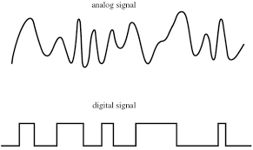


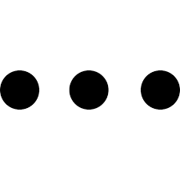
Sensors
A sensor, is a device whose task is to detect events or changes in its immediate environment and convert these physical phenomena (like temperature, light, air humidity, movement, presence of chemical substances and many others) into electrical impulses which then can be meaningfully interpreted.
Electrical impulses
Physical phenomena
Sensor
‘Detector’

Slide 4

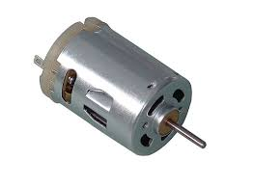
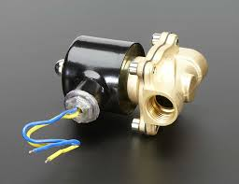
Actuators
An actuator, on the other hand, can be seen as a tool which functions inversely to the sensor. By interpreting the electrical impulses sent from the control system and converting them into mechanical motion, it actually introduces changes to its physical surroundings by means of a variety of simple actions, including but not limited to opening and closing valves, changing other devices’ position or angle, activating them or emitting sounds or light. In simpler terms, the actuator is referred to as a ‘mover’.
Actuator
‘Mover’

Slide 5

Thermistor: a type of resistor, whose resistance (resistance) depends significantly on the temperature. Thermistors are widely used as sensors in electronics, e.g. as temperature sensors in electronic thermometers or in systems preventing excessive current increase.
Resistance temperature detectors: instruments for measuring temperature based on a change in resistance that is associated with temperature changes.
Thermocouples: elements of an electric circuit consisting of two different conductors. By using the fact that the electromotive force that arises between the connectors of a thermocouple is proportional to the temperature difference, thermocouples can be used as temperature sensors or sometimes even as a power source with very low voltage and relatively high current.

Slide 6
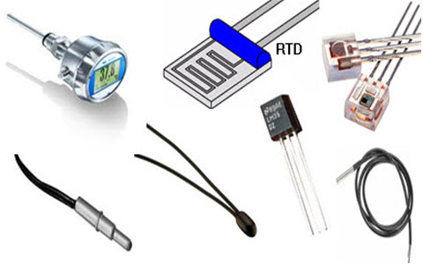

Slide 7

Humidity sensors
Types of humidity sensors:
- Capacitive
A capacitive humidity sensor measures relative humidity by placing a thin strip of metal oxide between two electrodes. The metal oxide’s electrical capacity changes with the atmosphere’s relative humidity. Weather, commercial and industries are the major application areas.
- Resistive
Resistive humidity sensors utilize ions in salts to measure the electrical impedance of atoms. As humidity changes, so do the resistance of the electrodes on either side of the salt medium.
- Homes. A humidity sensor is also found as part of home heating, ventilating and air conditioning systems (HVAC systems).
These are also used in offices, cars, humidors, museums, industrial spaces and greenhouses and are also used in meteorology stations to report and predict the weather.

Slide 8

Photoresistor: it’s a photosensitive element, whose resistance changes through radiation. It can easily be connected to for example Arduino as an analog light sensor. Thanks to this it is possible to build e.g. lamps that turn on automatically after dark
Photodiode: a diode which works based on photoelectric effect. When photons reach the junction of a photodiode they are absorbed, which results in the electron being transferred to the conductivity band to create an electron-hole pair. Photodiodes are widely used in industrial automation (signaling and control systems), telecommunications (optocouplers, optoelectronic links) and many more industries.
Depending on ambient light intensity, smart TVs, mobile phones or computer screens are able to adjust their brightness thanks to light sensors, yet sensors for detecting ambient light are not only commonplace in consumer electronics, but also smart city applications.

Slide 9
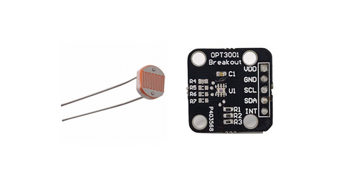

Slide 10

Active, ultrasonic motion sensor: sending and receiving ultrasonic passive waves
Passive, infrared motion sensor: detecting changes in infrared radiation
Active, radar sensor: emitting and receiving electromagnetic waves
A smart building system is probably the most banale IoT application for the motion sensor to imagine. While this obviousness holds largely true, apart from helping to monitor private or public spaces from intrusion and burglary, the use of motion sensors is extending to energy management solutions, smart cameras, automated devices and many others.

Slide 11
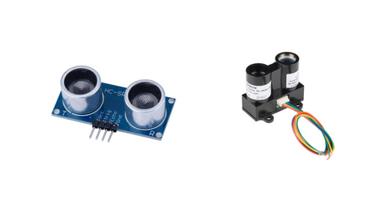

Slide 12
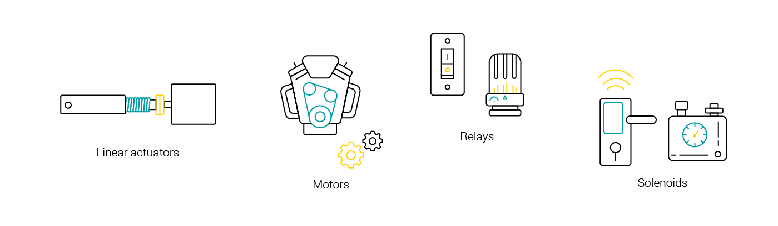
IoT Actuator types

Slide 13
IoT Actuator types
Linear actuators – these are used to enable motion of objects or elements in a straight line.
Motors – they enable precise rotational movements of device components or whole objects.
Relays – this category includes electromagnet-based actuators to operate power switches in lamps, heaters or even smart vehicles.
Solenoids – most widely used in home appliances as part of locking or triggering mechanisms, they also act as controllers in IoT-based gas and water leak monitoring systems.

Slide 14
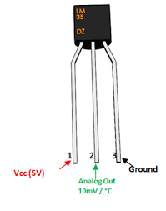
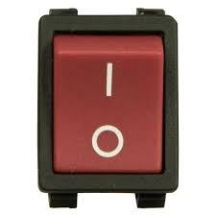
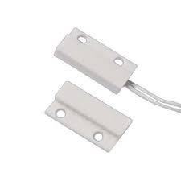
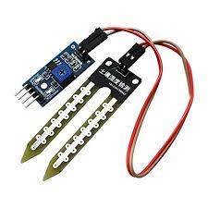
Sensor interfaces
Direct Analog
Direct Digital
LM35 temperature sensor
Switch
Soil moisture sensor
MagneticSwitch

Slide 15
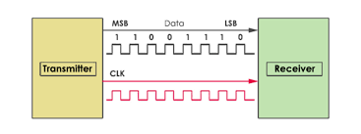
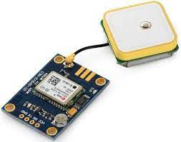
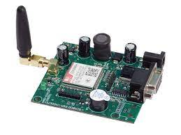
Sensor interfaces
Protocol based communication
GPS module
Serial communication
Signals
TX
RX
GSM module

Slide 16
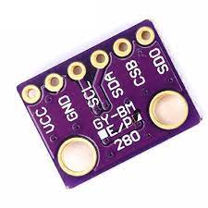
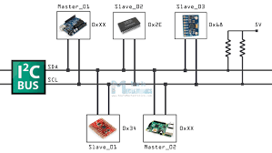
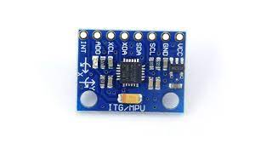
Sensor interfaces
BMP280 module
Environment sensor module
MPU6050
Multi-axes acceleration & gyro
Signals
SDA
SCK
I2C (Inter IC)communication

Slide 17
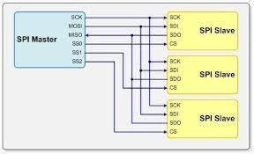
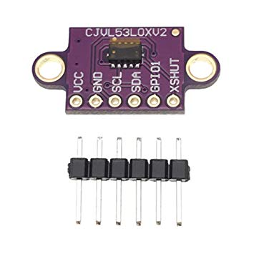
Sensor interfaces
BMP280 Environment sensor module
VL53L0X Time of Flight module
Signals
SCK
MOSI
MISO
SS
SPI(Serial Peripheral Interface)

Slide 18
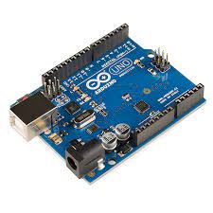
Arduino UNO
Microcontroller : ATmega328
Operating voltage : 5V
Digital I/O pins : 14
Analog input pins : 6
Flash memory : 32 KB
SRAM : 2KB
Clock speed : 16 MHz

Slide 19
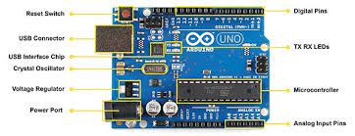
Arduino UNO

Slide 20
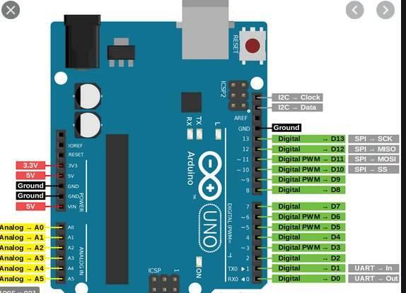
Arduino UNO

Slide 21
Arduino UNO
What can the ATmega328 do?
- Write digital outputs : LEDs, switching on relays
- Read digital inputs: Switches, Magnetic switches
- Read analog inputs : LM35 temperature sensor, Soil moisture sensor
- Serial communication: GPS/ GSM module
- I2C communication : BMP280, MPU6050

Slide 22
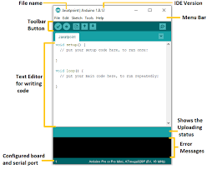
Arduino IDE

Slide 23
Arduino IDE
pinMode(2,OUTPUT);
pinMode(3,INPUT);
pinMode(4,INPUT_PULLUP);
2
4

Slide 24
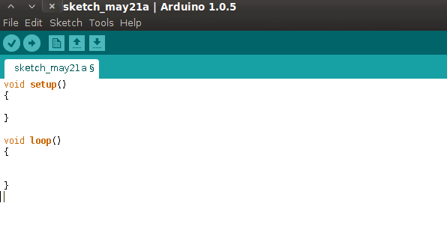
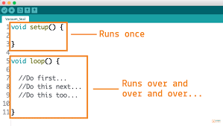
Arduino IDE

Slide 25
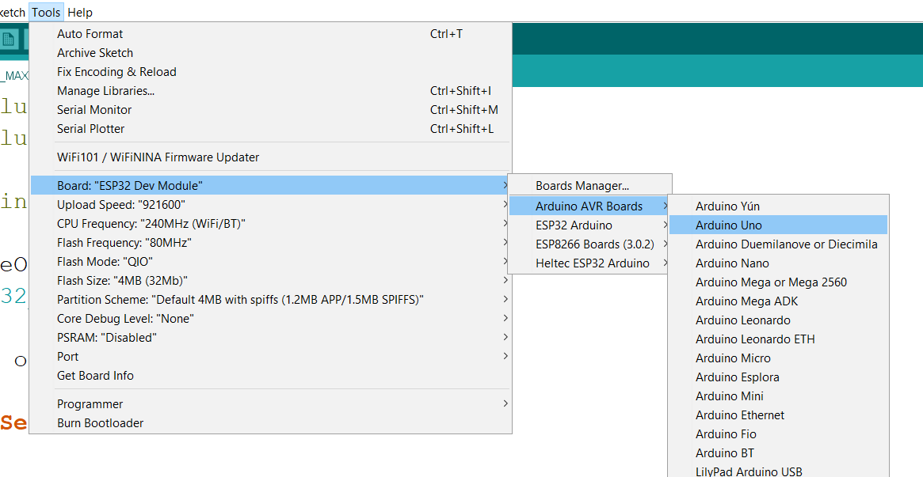
Arduino IDE

Slide 26
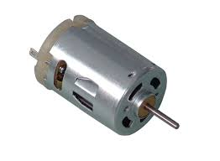
Arduino IDE
Input
Output
digitalRead ()
digitalWrite ()
Digital
analogRead ()
analogWrite()
Analog

Slide 27
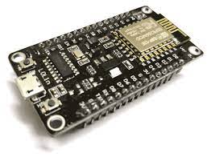
ESP8266 NodeMCU
ESP8266-12E
Tensilica Xtensa® 32-bit LX106
80 to 160 MHz Clock Freq.
128kB internal RAM
4MB external Flash
802.11 b/g/n WiFi transceiver
-Operating Voltage 3.3V8 transceiver

Slide 28
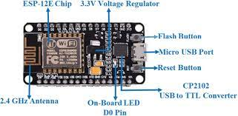
ESP8266 NodeMCU
17 GPIOs
1 Analog input
2 UARTs
I2C
SPI

Slide 29
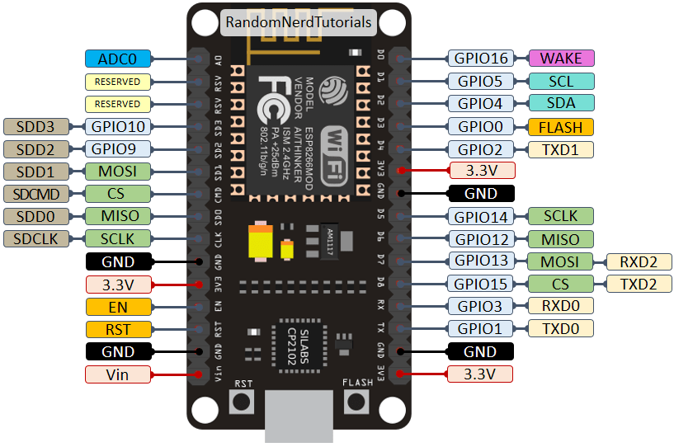
ESP8266 NodeMCU

Slide 30
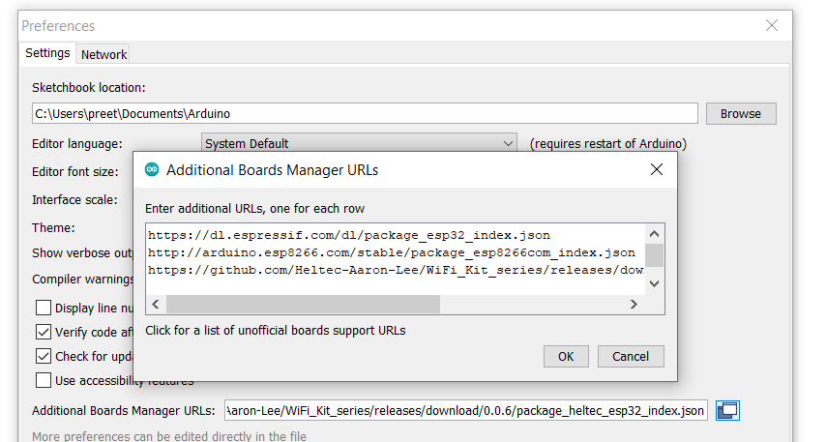
ESP8266NodeMCU & Arduino
The Arduino IDE does not have native support for ESP8266NodeMCU
The board support package for the ESP8266 group of boards has to be downloaded separately

Slide 31
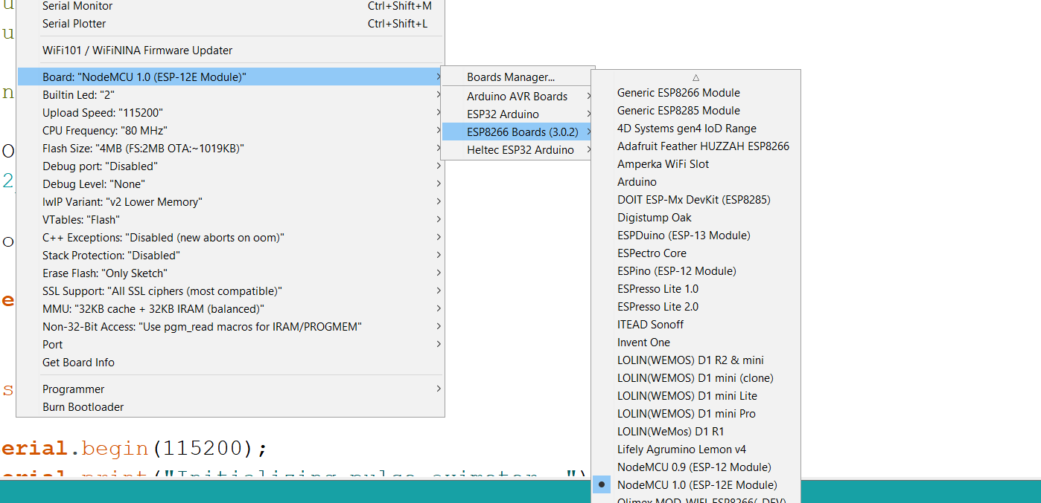
ESP8266 NodeMCU

Slide 32
Arduino UNO vs ESP8266NodeMCU
 | Arduino UNO | ESP8266 NodeMCU
CPU | 8-bit | 32-bit
Operating voltage | 5V | 3.3V
Clock frequency | 16MHz | 80-160MHz
RAM | 2KB | 128KB
Flash | 32KB | 4MB (external flash)
WiFi | No WiFi | WiFi on-chip
Digital I/O Analog inputs | 14 6 | 11 1

Slide 33
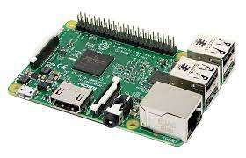
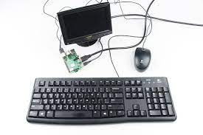
Raspberry Pi 3
Raspberry Pi is a low-cost, credit card-sized computer that connects to a computer monitor or TV using HDMI, and uses a standard keyboard and mouse. It can run a host of operating systems, such as Raspbian (Debian Linux), Android, Windows 10, IoT Core, etc.

Slide 34
Raspberry Pi 3
Features
Processor: 64-bit ARMv8 CPU
Operating frequency: 1.2GHz
WiFi: 802.11n Wireless LAN
Bluetooth: 4.1 Low Energy (BLE)
4 USB ports
Ethernet port
40-pin GPIO connector for connecting external sensors

Slide 35
Raspberry Pi3
Once the Raspbian OS is installed, you can proceed to log into it and see a full windowed system (see Figure 5). The default username is pi and the password is raspberry.
One of the most popular OSs used for the Raspberry Pi is the Raspbian Operating system. The Raspbian OS is based on the Debian OS, optimized for the Raspberry Pi hardware
The Raspbian OS boots off a micro-SD card and the entire operating system runs off the cardinstalled, you can proceed to
Once the Rasbian OS is installed, you can log into it and see a full windowed system.
Username: pi
Password: raspberry

Slide 36
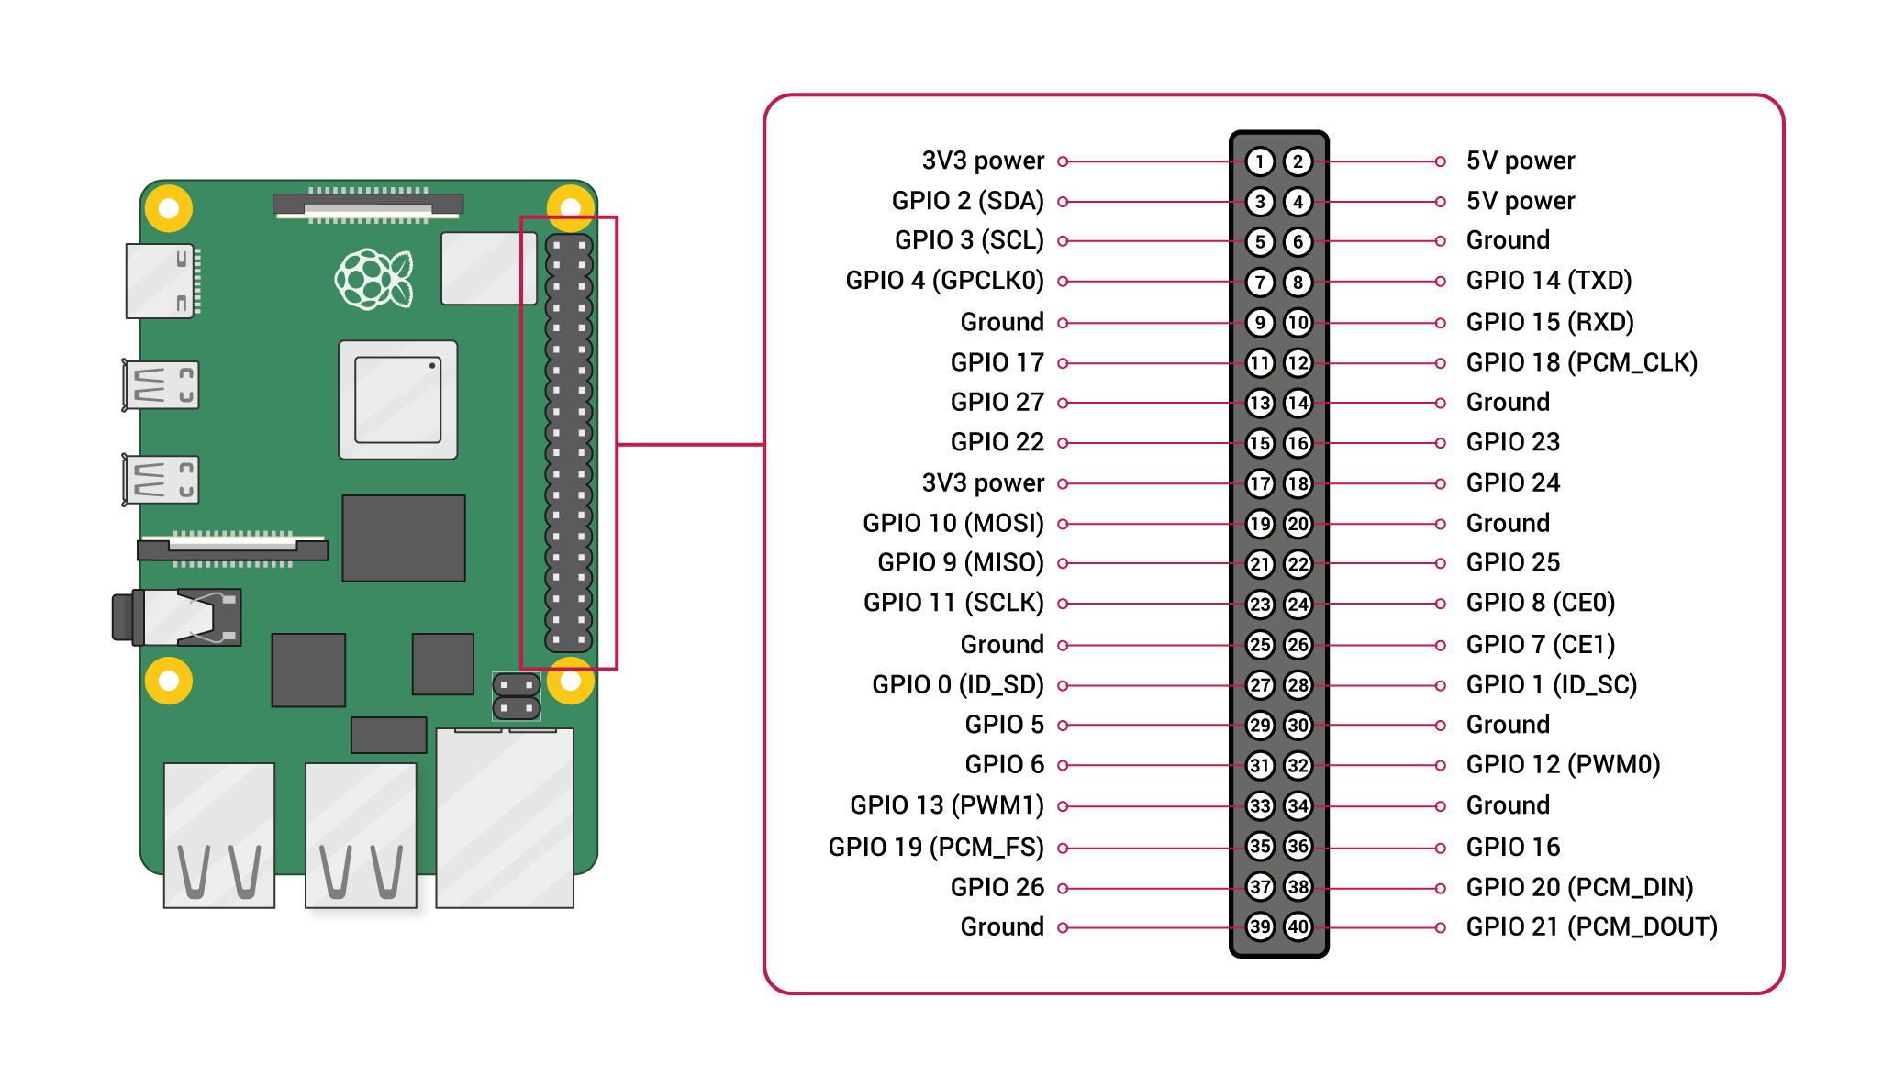
Raspberry Pi

Slide 37
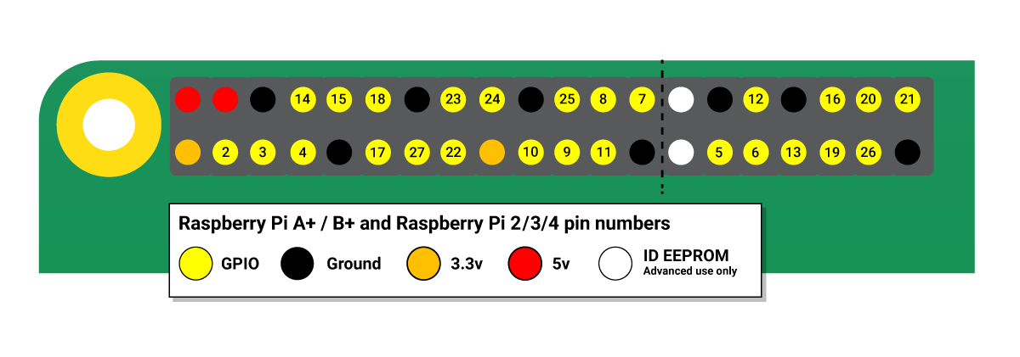
Raspberry Pi
Voltages
Two 5V pins and two 3.3V pins are present on the board, as well as a number of ground pins (0V), which are unconfigurable. The remaining pins are all general purpose 3.3V pins, meaning outputs are set to 3.3V and inputs are 3.3V-tolerant.
Outputs
A GPIO pin designated as an output pin can be set to high (3.3V) or low (0V).
Inputs
A GPIO pin designated as an input pin can be read as high (3.3V) or low (0V). This is made easier with the use of internal pull-up or pull-down resistors.

Slide 38
Raspberry Pi
PWM (pulse-width modulation)
Software PWM available on all pins
Hardware PWM available on GPIO12, GPIO13, GPIO18, GPIO19
SPI
SPI0: MOSI (GPIO10); MISO (GPIO9); SCLK (GPIO11); CE0 (GPIO8), CE1 (GPIO7)
SPI1: MOSI (GPIO20); MISO (GPIO19); SCLK (GPIO21); CE0 (GPIO18); CE1 (GPIO17); CE2 (GPIO16)
I2C
Data: (GPIO2); Clock (GPIO3)
EEPROM Data: (GPIO0); EEPROM Clock (GPIO1)
Serial
TX (GPIO14); RX (GPIO15)

