Slide 1
IoT and AI on the Edge
Using the GISMO-VI board

Slide 2
Agenda
1
Introduction to IoT, Edge Computing, GISMO-VI; Programming environment
Mobile App Development: Kodular
Simple UI, Firebase interface
5
2
Getting started: LED, Relay, Buzzer
Magnetic switch, Soil Moisture sensor, OLED display
6
End to End Projects: Smart Garden, Home Security, Environment Monitoring, Remote Ranger
3
Google Firebase creation, WiFi
GISMO6 – Firebase interface
PIR,IR,Ultrasonic
7
ML introduction: Dataset, Model, Inference
4
Sensors: BMP280, MPU6050, INMP441
8
ML projects: Classification and Regression

Slide 3

Internet of Things - IOT
Information
Control
A system of internet-connected ‘things’ that can collect and transfer data over a wireless network without human intervention

Slide 4
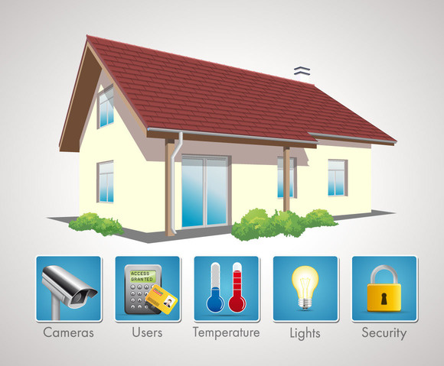


IOT Applications
Intrusion detection
Door/Window open
LPG Gas Leak detection
Appliance Control
Soil moisture
Temperature, humidity, leaf wetness sensing
Watering schedules
Industrial IOT
Manufacturing plants
Process plants

Slide 5





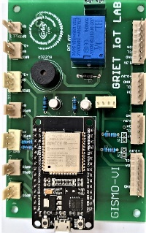



IoT Projects
Cloud
IOT eco-system
Sensors
Microcontroller Board
Sensor Interfaces
WiFi
Internet Connectivity
Cloud Database
UI using mobile app
Mobile
GISMO-VI

Slide 6
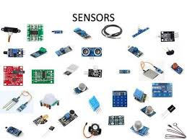
Project Building Blocks
Mobile App
Cloud database interface
Internet connectivity
Sensor data processing
Environment monitor
Range meter
Sound detector
Gesture recognition
Fall detector
Sensor/ Actuator interface
Smart garden
IR based appliance control
Real time based appliance control

Slide 7
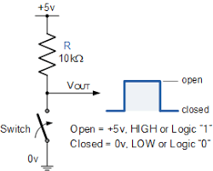
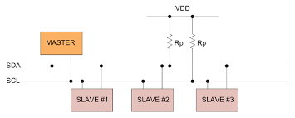
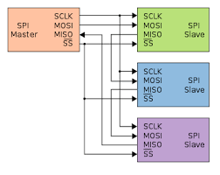
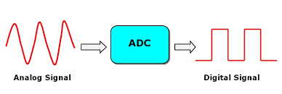
Project Building Blocks
Sensor Interface
Serial
Parallel
Analog
Digital
I2C
SPI

Slide 8
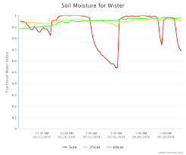
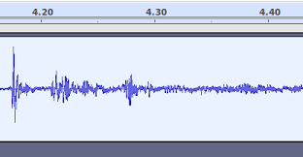
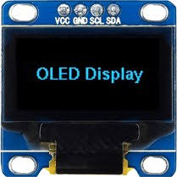
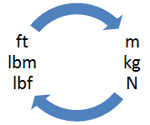
Project Building Blocks
Data Processing
Limit checking
Engg. unit conversion
FFT computation
Local display

Slide 9
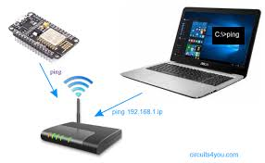
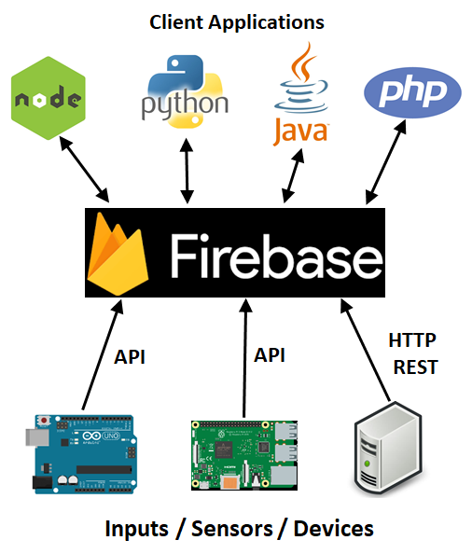
Project Building Blocks
Internet connectivity & Cloud database
Joining WiFi network
Connection status to Internet
Data access from cloud database

Slide 10

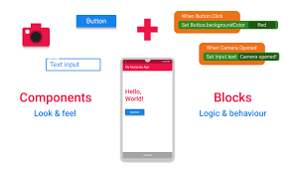
Project Building Blocks
Mobile App Development
UI Design
Cloud database interface
Periodic update

Slide 11

GISMO VI
Resources
ESP32 DevKitC
Relay
Buzzer
Polarized connectors for:
OLED graphic display
BMP280 Environment sensor
MPU6050 3-axes accelerometer & gyro
Soil moisture sensor
APDS 9960 Gesture and Color sensor
HC-SR04 Ultrasonic sensor
PIR sensor
Magnetic switch
MAX30100 Heart rate and SPO2 sensor
INMP441 MEMS microphone

Slide 12
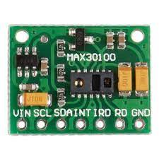
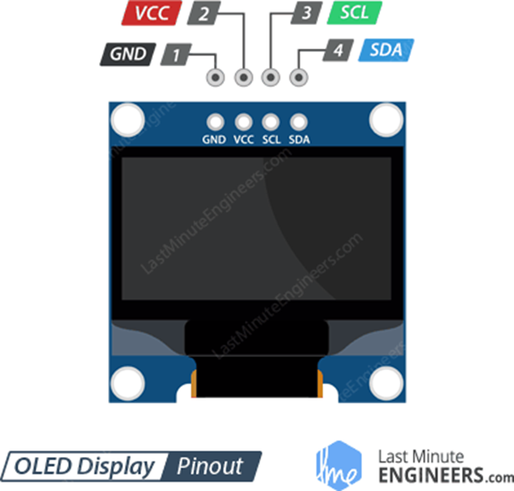
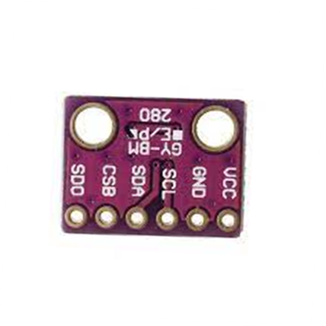
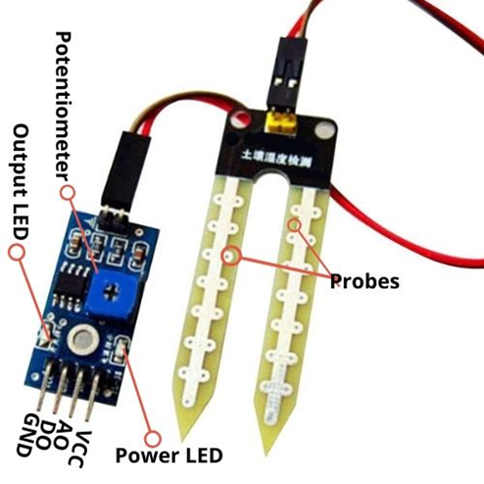
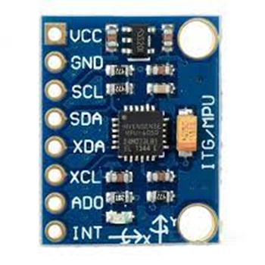
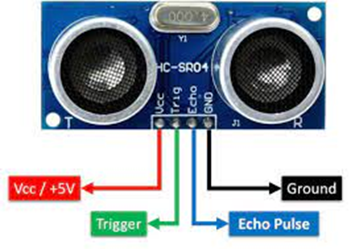
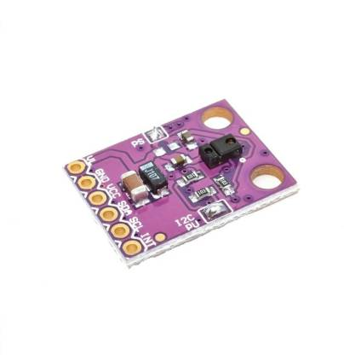
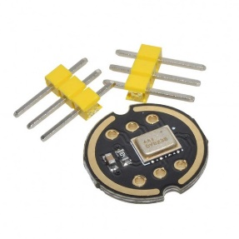
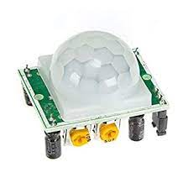
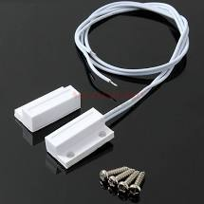
Sensor Pack
Heart rate & Pulse Oximeter
OLED graphic display
BPM280 Environment sensor
MPU6050 3-axes accelerometer & gyro
HC-SR04 Ultrasonic sensor
Soil moisture sensor
APDS 9960 Gesture & Color sensor
Magnetic switch
INMP441 MEMS microphone
PIR sensor

Slide 13
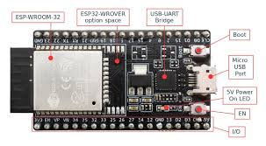
ESP32 Dev Kit
ESP-WROOM-32: 32-bit microprocessor
I/O pins: These pins are capable of Digital Read/Write, Analog Read/Write, PWM, IIC, SPI, DAC and much more.
Micro-USB jack: The micro USB jack is used to connect the ESP32 to our computer through a USB cable. It is used to program the ESP module as well as can be used for serial debugging as it supports serial communication
EN Button: The EN button is the reset button of the ESP module.
Boot Button: Press and upload program from Arduino IDE
Red LED: The Red LED on the board is used to indicate the power supply.
Blue LED: The Blue LED on the board is connected to the GPIO pin2.

Slide 14
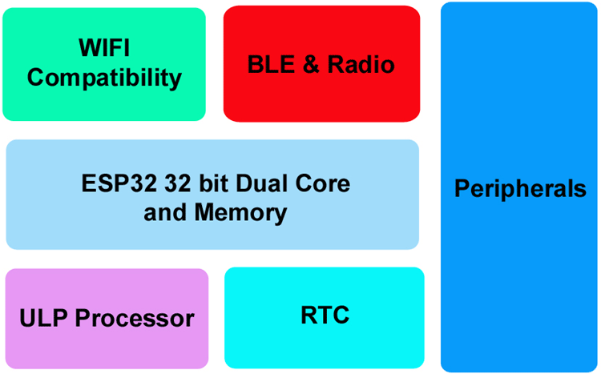
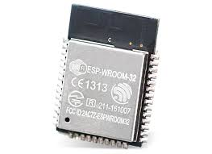
Inside the ESP32

Slide 15
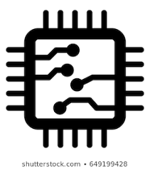


ESP32 features
ESP32 has Xtensa® Dual-Core 32-bit LX6 microprocessors. The ESP32 will run on breakout boards and modules from 160Mhz upto 240MHz
Internal Memory : 448 KB ROM for booting and core functions & 520 KB SRAM for data and instructions
External Flash : 4MB external Flash extendable to16MB
WiFi: ESP32 implements TCP/IP, full 802.11 b/g/n/e/i WLAN MAC protocol
Bluetooth : ESP32 supports the latest BLE Bluetooth 4.2, as well as classic Bluetooth

Slide 16

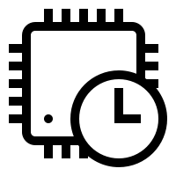
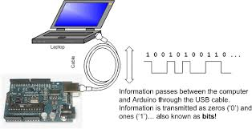
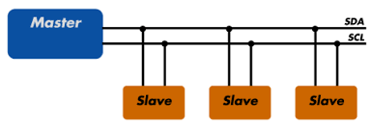
ESP32 peripherals
GPIO
Timers and Watchdog
Real Time Clock
ADC and built-in Sensors
Digital to Analog Convertor (DAC)
Touch Sensor
Ultra Low Power(ULP) Co-processor
Ethernet MAC Interface
Universal Asynchronous Receiver Transmitter (UART)
I2C Interface
I2S Interface
SPI Interface
Pulse Width Modulation (PWM)

Slide 17
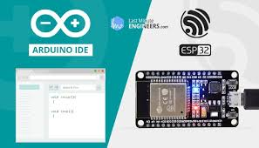
ESP32 – powering & programming

Slide 18
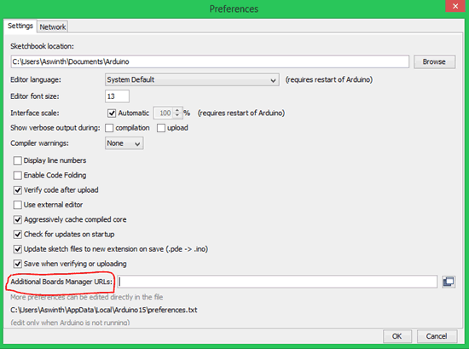
Preparing Arduino IDE for ESP32
STEP 1: Now, let’s get started. The first step would be to download and install the Arduino IDE.. If you already have one make sure it is of the latest version.
STEP 2: Once installed, open the Arduino IDE and go to Files -> Preferences to open the preferences window and locate the “Additional Boards Manager URLs:” as shown

Slide 19
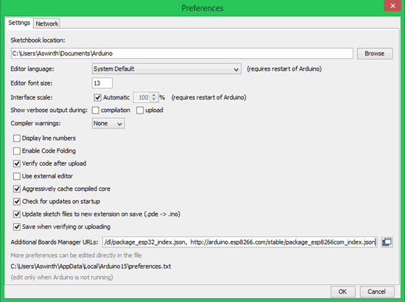
Preparing Arduino IDE for ESP32
STEP 3: This text box might be empty or might also contain some other URL if you have used it previously for ESP8266. If it is empty simply paste the below URL into the text box
https://dl.espressif.com/dl/package_esp32_index.json

Slide 20
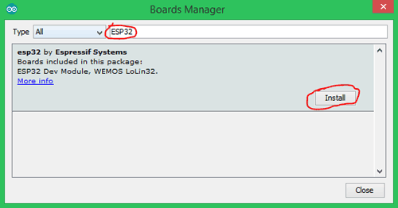
Preparing Arduino IDE for ESP32
STEP 4: Now go to Tools -> Boards -> Board Managers to open the Board manager window and search for ESP32.
If the URL was pasted correctly your window should find the below screen with Install button, just click on the Install button and your board should get installed.

Slide 21
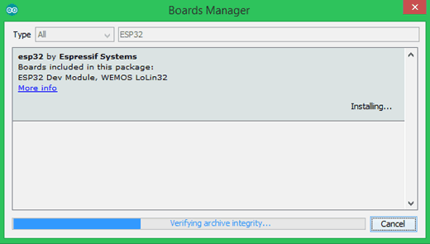
Preparing Arduino IDE for ESP32
STEP 5: Make sure you have an active internet connection and wait while the installation gets complete. It may take few minutes based on the speed of your internet connection.

Slide 22
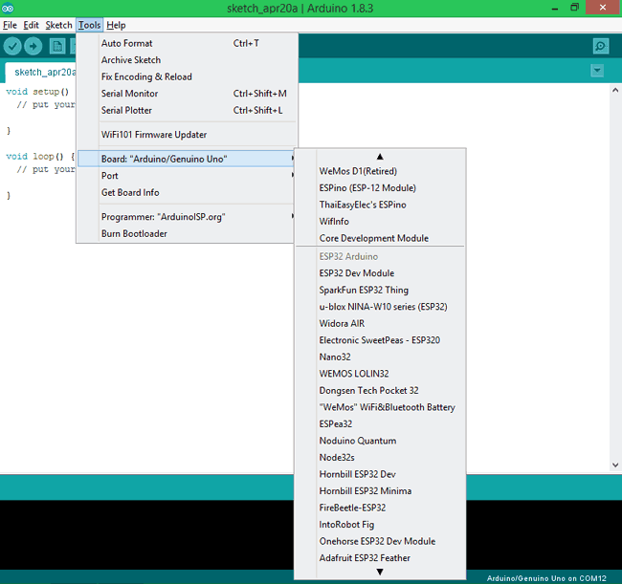
Programming ESP32 with Arduino
STEP 1: Connect your ESP32 board to your computer through the micro-USB cable. Make sure the red LED goes high on the module to ensure power supply.
STEP 2: Start the Arduino IDE and navigate to Tools -> Boards and select ESP32 Dev Module as shown

Slide 23
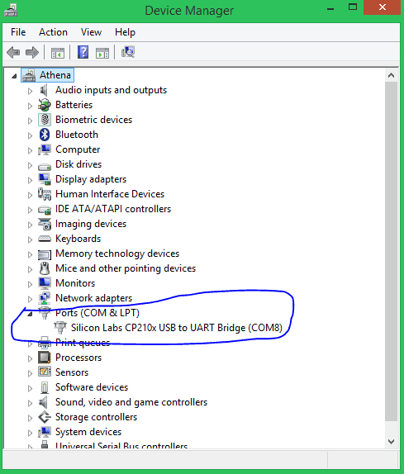
STEP 3: Open device manager and check to which com port your ESP32 is connected to. Mine is connected to COM 8 as shown

Slide 24
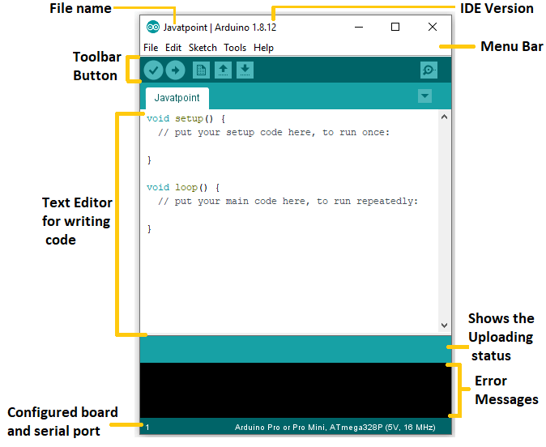
ESP32 – Arduino IDE
In the Tools tab, go to
Board -> ESP32 Arduino -> ESP32 Dev Module
In the Tools tab, go to
Port-> COMX

Slide 25
Arduino IDE
pinMode(2,OUTPUT);
pinMode(3,INPUT);
pinMode(4,INPUT_PULLUP);
2
4

Slide 26
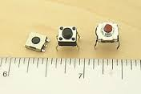
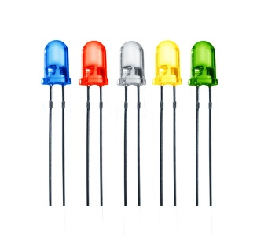
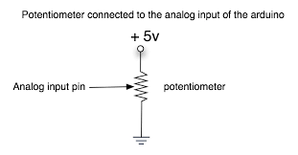
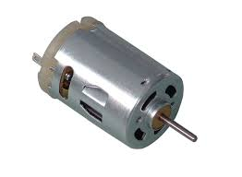
The Arduino IDE
Input
Output
digitalRead ()
digitalWrite ()
Digital
analogRead ()
analogWrite()
Analog

Slide 27
Arduino Libraries
S.No | Sensor | Library
01 | OLED Display | ESP8266 and ESP32 OLED driver for SSD1306 displays By Thingpulse
02 | BMP280 | Adafruit BMP280 library By Adafruit
02A | BMP280 | Adafruit BusIO By Adafruit
02B | BMP280 | Adafruit_Sensor_Master zip file
03 | MPU6050 | MPU6050 By Electronic Cats MPU6050 Arduino Library
04 | Firebase | Firebase ESP32 Client By Mobizt
05 | APDS9960 | SparkFun APDS9960 RGB and Gesture Sensor By SparkFun Electronics
06 | IR Remote | IRRemoteESP8266 By David Conran et al
07 | MAX30102 | SparkFun MAX3010x Pulse and Proximity Sensor Library By SparkFun Electronics
Display
Environment sensor
Accelerometer
Cloud database
Gesture sensor
Infrared Remote
Heartbeat sensor

Slide 28
GitHub repository
URL: github.com/grietiotlab
Repository: GISMO-VI
Important docs:
Arduino libraries list GISMO-VI/GISMO6_Docs/Arduino Libraries.docx
GISMO-VI pin assignments GISMO-VI/GISMO6_Docs/GISMO-VI Pin Assignments.docx
Sensor Locations GISMO-VI/GISMO-VI_SensorLocations.jpg
Hardware schematic GISMO-VI/Hardware/gismoviv1.pdf

