Slide 1
ESP8266NodeMCU

Slide 2
What is NodeMCU?
The NodeMCU (Node MicroController Unit) is an open-source software and hardware development environment built around an inexpensive System-on-a-Chip (SoC) called the ESP8266.
The ESP8266, designed and manufactured by Espressif Systems, contains the crucial elements of a computer: CPU, RAM, networking (WiFi).That makes it an excellent choice for Internet of Things (IoT) projects of all kinds.
However, as a chip, the ESP8266 is also hard to access and use. You must solder wires, with the appropriate analog voltage, to its pins for the simplest tasks such as powering it on or doing serial communication. You also have to program it in low-level machine instructions that can be interpreted by the chip hardware. Itis a huge burden for hobbyists, hackers, or students who want to experiment with it in their own IoT projects

Slide 3
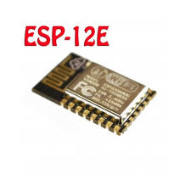
ESP8266-12E
ESP8266-12E
Tensilica Xtensa® 32-bit LX106
80 to 160 MHz Clock Freq.
128kB internal RAM
4MB external Flash
802.11 b/g/n WiFi transceiver
-Operating Voltage 3.3V8 transceiver

Slide 4
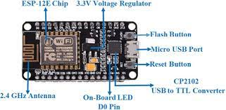
ESP8266 NodeMCU
17 GPIOs
1 Analog input
2 UARTs
I2C
SPI

Slide 5
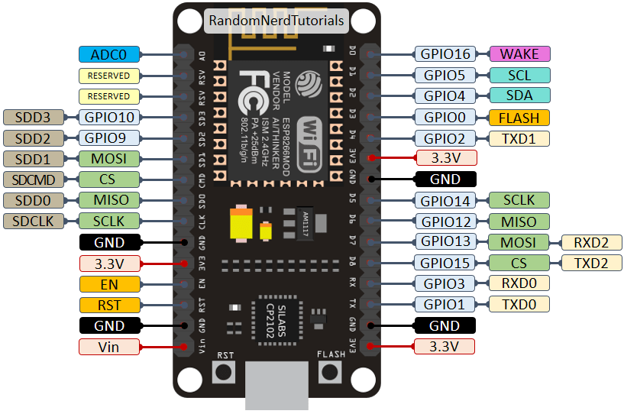
ESP8266 NodeMCU

Slide 6
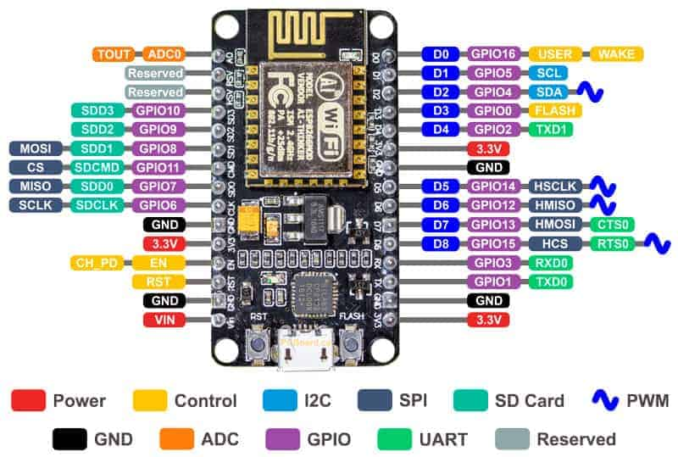

Slide 7
Pin functions
Power:There are four power pins. VIN pin and three 3.3V pins.
VIN can be used to directly supply the NodeMCU/ESP8266 and its peripherals.
3.3V pins are the output of the onboard voltage regulator and can be used to supply power to external components.
GND: are the ground pins of NodeMCU/ESP8266
I2C Pins are used to connect I2C sensors and peripherals. Both I2C Master and I2C Slave are supported.
GPIO Pins NodeMCU/ESP8266 has 17 GPIO pins which can be assigned to functions such as I2C, I2 UART, PWM programmatically. Each digital enabled GPIO can be configured to internal pull-up or pull-down, or set to high impedance. When configured as an input, it can also be set to edge-trigger or level-trigger to generate CPU interrupts.

Slide 8
Pin functions
ADC Channel The NodeMCU is embedded with a 10-bit precision SADC. The two functions can be implemented using ADC. T
UART Pins NodeMCU/ESP8266 has 2 UART interfaces (UART0 and UART1) which provide asynchronous serial communication (RS232 and RS485), and can communicate at up to 4.5 Mbps.
SPI Pins NodeMCU/ESP8266 features two SPIs (SPI and HSPI) in slave and master modes.
PWM Pins The board has 4 channels of Pulse Width Modulation (PWM). The PWM output can be implemented programmatically and used for driving digital motors and LEDs.
EN: The ESP8266 chip is enabled when EN pin is pulled HIGH. When pulled LOW the chip works at minimum power.
RST: RST pin is used to reset the ESP8266 chip.

Slide 9
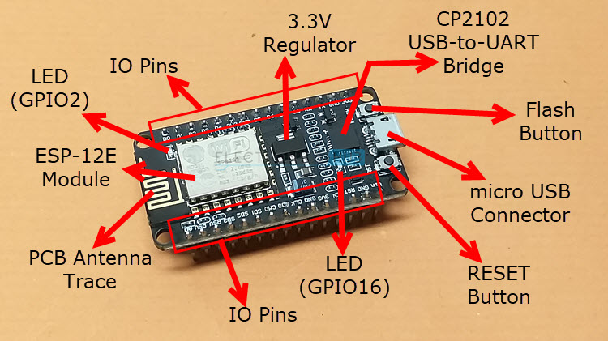
Layout
ESP-12E(ESP8266) (Processor)
3.3V regulator (Power supply)
USB-UART bridge ( Serial communication)
Reset button
Flash button
2 LEDs

Slide 10
Programming NodeMCU
Development platforms for NodeMCU_ESP8266:
ESPlorer
LuaIDE
Arduino IDE
Programming languages for NodeMCU_ESP8266:
MicroPython
Circuit python
Lua scripting
Arduino(C/C++)

Slide 11
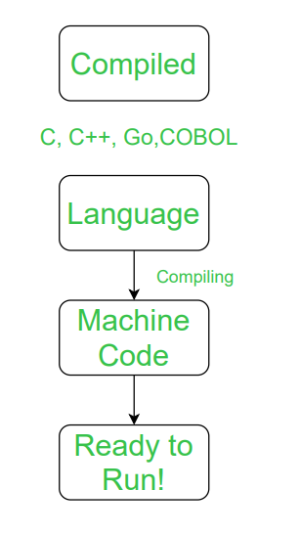
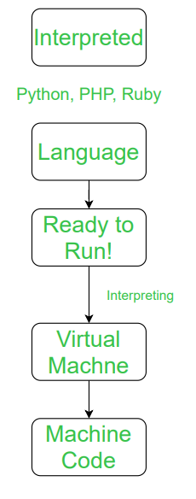
Compiled vs Interpreted

Slide 12
Key differences
C is a structural programming language, while Python is an object-oriented programming language.
Python is a general-purpose programming language, while C is mainly used for hardware-related applications and low-level code.
C is a compiled language, and Python is an interpreted language.
Code execution is faster in C than in Python.
Python doesn't support pointer functionality, but pointers are available in C.
C has a limited library of built-in functions while Python's is more extensive.
In C, it's mandatory to declare variable types, but this is not necessary in Python.
C allows line assignment, while it gives errors in Python.
The syntax of Python is easier to understand than C's.

Slide 13
KM to Mile conversion
#include <stdio.h>
int main(void) {
float kilometers;
printf("Please enter Kilometers:");
scanf("%f", &kilometers);
float miles = kilometers * 0.621371;
printf("%f miles", miles);
}
# Taking kilometers as input from the user
kilometers = float(input("Enter value in kilometers: "))
# conversion factor
conv_fac = 0.621371
# calculate miles
miles = kilometers * conv_fac
print('%0.2f kilometers is equal to %0.2f miles' %(kilometers,miles))

Slide 14
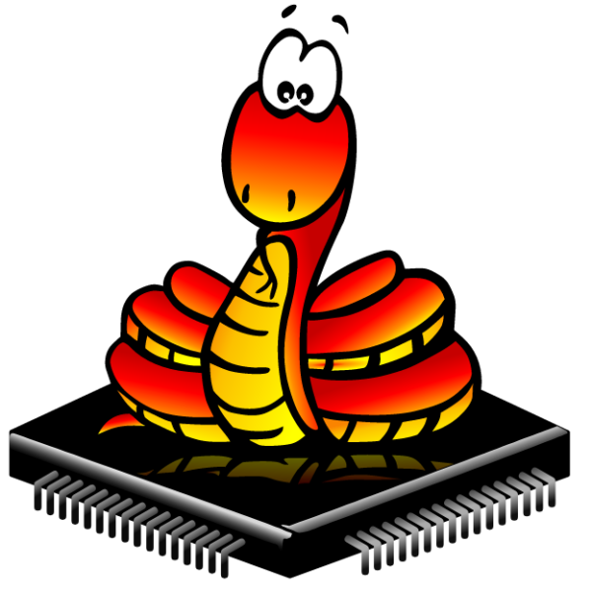
MicroPython
MicroPython is a tiny open source Python programming language interpreter that runs on small embedded development boards such as ESP8266NodeMCU
With MicroPython you can write clean and simple Python code to control hardware instead of having to use complex low-level languages like C or C++ (what Arduino uses for programming).
The simplicity of the Python programming language makes MicroPython an excellent choice for beginners who are new to programming and hardware.
However MicroPython is also quite full-featured and supports most of Python's syntax so even seasoned Python veterans will find MicroPython familiar and fun to use

Slide 15
MicroPython
Interactive REPL, or read-evaluate-print loop. This allows you to connect to a board and have it execute code without any need for compiling or uploading--perfect for quickly learning and experimenting with hardware!
Extensive software library. Like the normal Python programming langauge MicroPython is 'batteries included' and has libraries built in to support many tasks. For example, parsing JSON data from a web service, searching text with a regular expression, or even doing network socket programming is easy with built-in libraries for MicroPython.
Extensibility. For advanced users MicroPython is extensible with low-level C/C++ functions so you can mix expressive high-level MicroPython code with faster low-level code when you need it

Slide 16
MicroPython
Just like an Arduino board MicroPython can control hardware and connected devices.
You can control GPIO pins to blink lights, read switches, and more. You can drive PWM outputs for servos, LEDs, etc. or read analog sensors with an ADC.
Talking to I2C or SPI devices is easy too, and you'll even find network & WiFi support on some boards.
MicroPython even has libraries for controlling other hardware like NeoPixels and LED strips, tiny OLED displays, and more

Slide 17
MicroPython vs Arduino
Arduino is an entire 'ecosystem' with the Arduino IDE, the Arduino programming language (based on C/C++), and Arduino hardware like the Arduino Uno R3 board.
MicroPython is only a programming language interpreter and does not include an editor
MicroPython language is interpreted instead of being compiled into code the CPU can run directly like with the Arduino programming language.
A major advantage of interpreted code is that it can be much cleaner and simpler compared to languages that compile directly to CPU instructions. You can even write and run interpreted code like MicroPython directly on a board without any compiling or uploading--something that's impossible with Arduino

Slide 18
pyboard
This is the first MicroPython board and has very complete support for the language and hardware peripherals. This board comes to you with MicroPython running on it so you can get started using it immediately without any setup.
ESP8266:
MicroPython support for the popular ESP8266 WiFi microcontroller is excellent. With MicroPython on ESP8266 you can access peripherals like GPIO, ADC, PWM, and I2C/SPI devices. In addition WiFi & internet access is available and well supported.
WiPy
The WiPy is another MicroPython board with WiFi and great support. Pycom is the company behind the WiPy board and they provide a nice integrated development environment to load and run MicroPython code on their boards.
BBC micro:bit
The BBC micro:bit has great support for MicroPython and a very nice set of tools to write and upload code.
Teensy 3.x
The Teensy 3.x series of microcontrollers have an early port of MicroPython available.

Slide 19
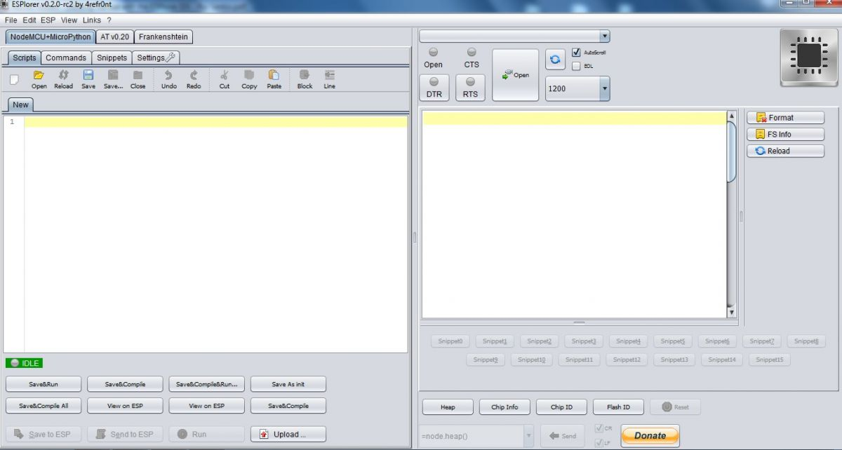
ESPlorer
The ESPlorer is an IDE for ESP development.
It’s multiplatform, means that it runs on Windows, Mac OS X or Linux (it was created in JAVA).

Slide 20
Requirements
1. You need to have JAVA installed in your computer. If you are not having already, go to this website: http://java.com/download, download and install the latest version. It requires JAVA (SE version 7 and above) installed.
2. You need to flash your ESP8266 with NodeMCU firmware

Slide 21
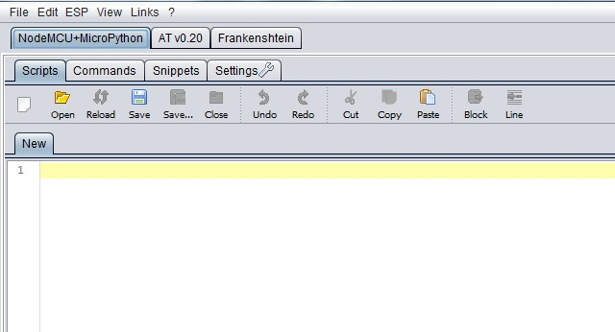
ESPlorer overview
In the top left corner you can see all the regular options that you find in any software.
Create a New file, Open a new file, Save file, Save file as, Undo, Redo, etc.

Slide 22
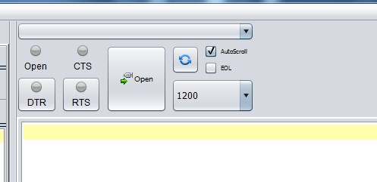
Serial communication
In the top right corner you have all the options you need to establish a serial communication

Slide 23

Code window
This next screenshot shows your Code Window, that’s where you write your scripts (your scripts are highlighted with your code syntax).

Slide 24
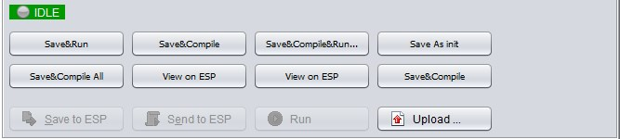
ESPlorer ESP8266 interaction
Below the Code Window, you have 12 buttons that offer you all the functions you could possibly need to interact with your ESP8266. Here’s the ones you’ll use most: “Save to ESP” and “Send to ESP”.

Slide 25
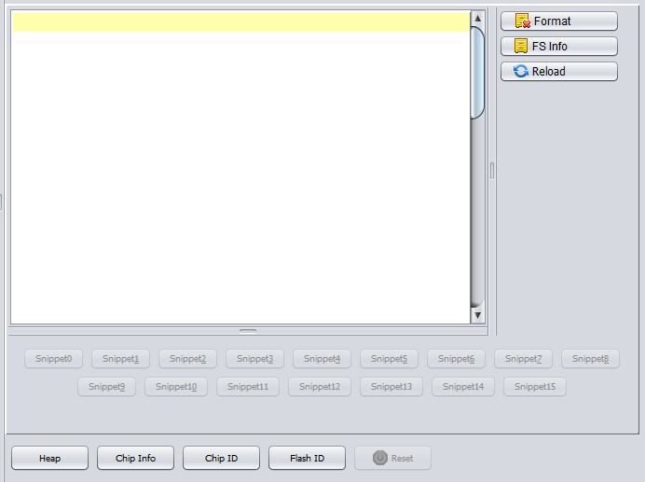
Output window
This screenshot shows the Output Window which tells you exactly what’s going on in your ESP8266. You can see errors and use prints in your code to debug your projects.

Slide 26
Flashing ESP8266 with MicroPython
Getting the firmware
The first thing you need to do is download the most recent MicroPython firmware .bin file to load onto your ESP8266 device. You can download it from the MicroPython downloads page.
Deploying the firmware
Once you have the MicroPython firmware (compiled code), you need to load it onto your ESP8266 device. There are two main steps to do this: first you need to put your device in boot-loader mode, and second you need to copy across the firmware.
If you have a board that has a USB connector, a USB-serial convertor, then deploying the firmware should be easy as all steps can be done automatically. Boards that have such features include the Adafruit Feather HUZZAH and NodeMCU boards

Slide 27
Blinking LED
from machine import Pin
import time
led = Pin(2,Pin.OUT)
While True:
led.high()
time.sleep(1)
led.low()
time.sleep(1)
The first line “imports” the “Pin” function from the “machine” module. In Python, to use any libraries, you first have to import them. The “machine” module contains most of the hardware-specific functions in Micropython.
Once we have the “Pin” function imported, we use it to create a pin object, with the first parameter telling it to use gpio2, and the second parameter telling it to switch it into output mode. Once created, the pin is assigned to the variable we called “led”.

Slide 28
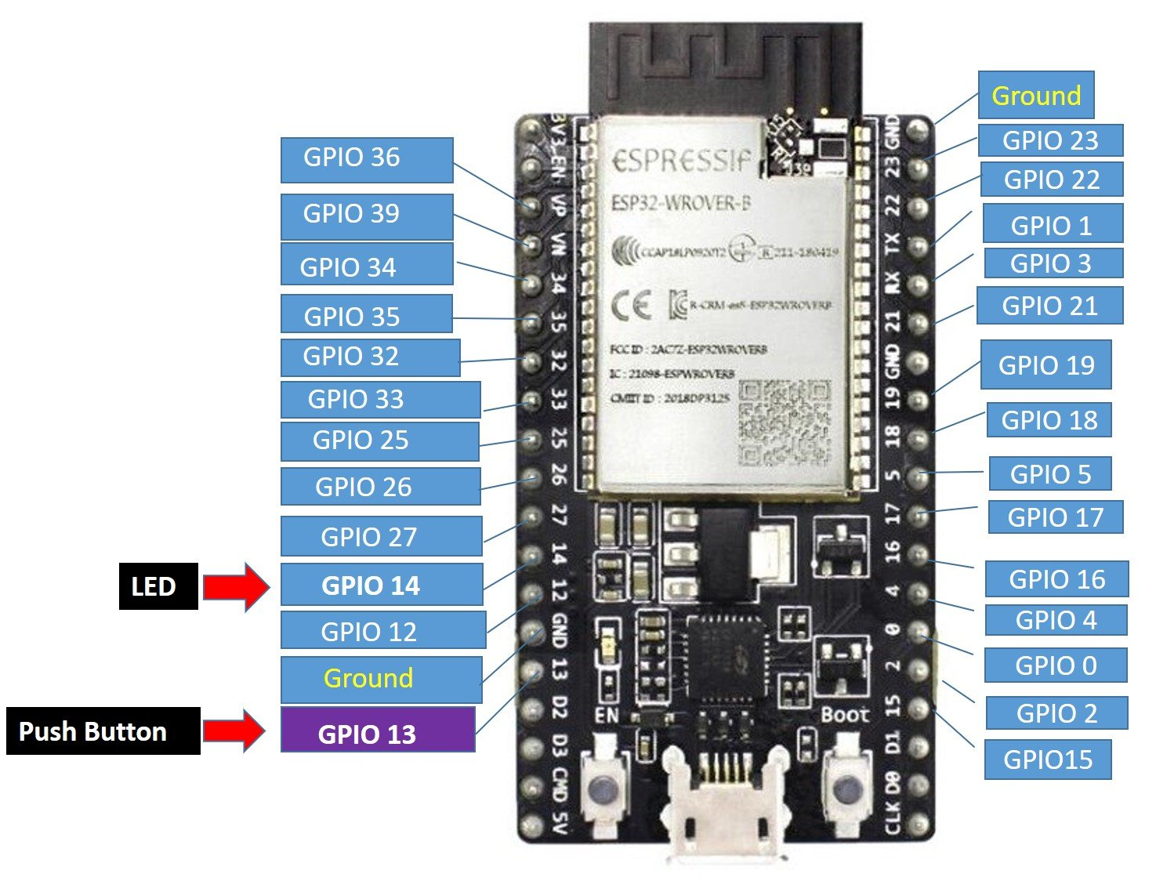
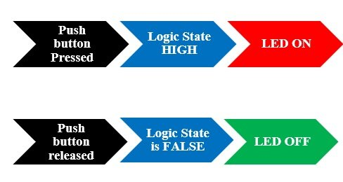
LED Push Button

Slide 29
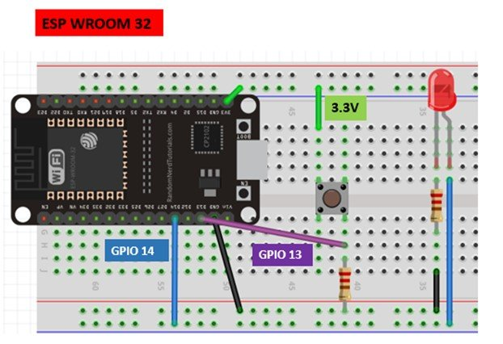
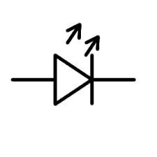

LED Push Button
3.3V
14
13
ESP8266 NodeMCU
GND
GND

Slide 30
class Pin
A pin object is used to control I/O pins (also known as GPIO - general-purpose input/output).
Pin objects are commonly associated with a physical pin that can drive an output voltage and read input voltages.
The pin class has methods to set the mode of the pin (IN, OUT, etc) and methods to get and set the digital logic level.
from machine import Pin
# create an output pin on pin #0
p0 = Pin(0, Pin.OUT)
# set the value low then high
p0.value(0)
p0.value(1)
# create an input pin on pin #2, with a pull up resistor
p2 = Pin(2, Pin.IN)
# read and print the pin value
print(p2.value())

Slide 31
LED Push Button
from machine import Pin
from time import sleep
led = Pin(14, Pin.OUT)
push_button = Pin(13, Pin.IN)
while True:
logic_state = push_button.value()
if logic_state == True:
led.value(1)
else:
led.value(0)

Slide 32
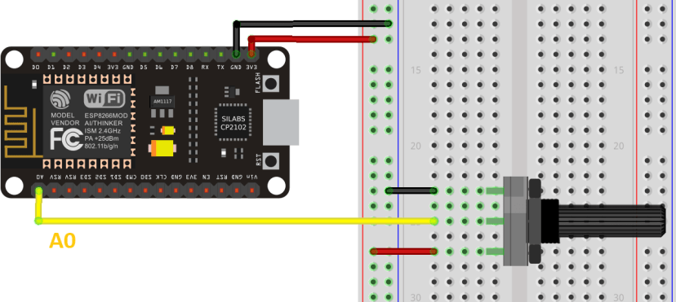
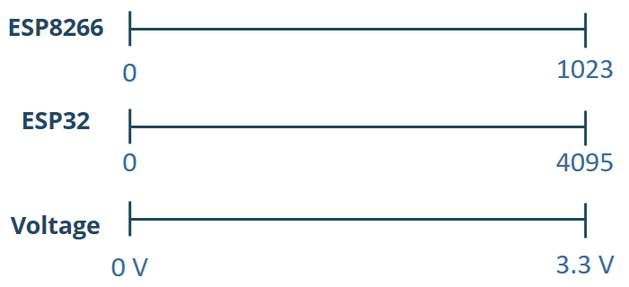
Reading analog values

Slide 33
Reading analog values
from machine import Pin, ADC
from time import sleep
pot = ADC(0)
while True:
pot_value = pot.read()
print(pot_value)
sleep(0.1)

Slide 34
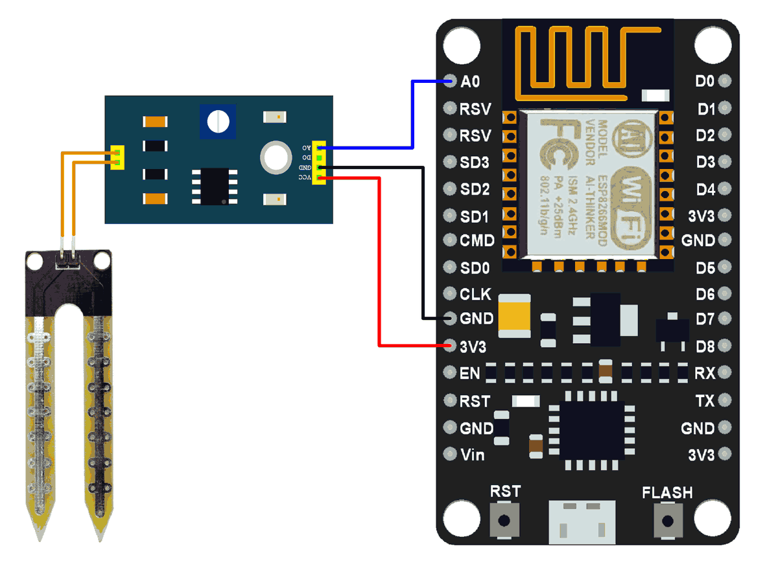
Soil Moisture sensor
Pins of soil moisture sensor
VCC : Supply
AO : Analog output
GND : Ground

Slide 35
Code
from machine import Pin, ADC
from time import sleep
soil_sensor = ADC(0)
while True:
sensor_value = soil_sensor.read()
print(sensor_value)
sleep(1)

Slide 36
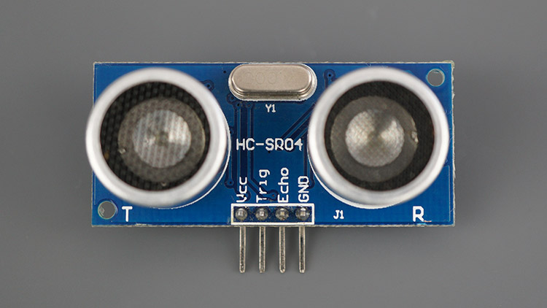
Ultrasonic sensor
VCC | Powers the sensor (5V)
Trig | Trigger Input Pin
Echo | Echo Output Pin
GND | Common GND

Slide 37
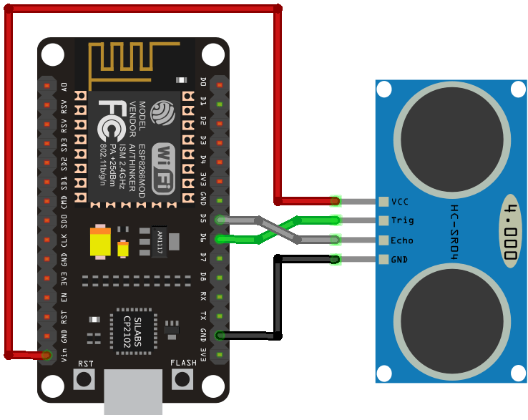
Ultrasonic sensor
Wire the HC-SR04 ultrasonic sensor to the ESP8266 as shown in the following schematic diagram. We’re connecting the Trig pin to GPIO 12 and the Echo pin to GPIO 14, but you can use any other suitable pins.

Slide 38
import machine, time
from machine import Pin
class HCSR04:
def __init__(self, trigger_pin, echo_pin, echo_timeout_us=500*2*30):
self.echo_timeout_us = echo_timeout_us
self.trigger = Pin(trigger_pin, mode=Pin.OUT, pull=None)
self.echo = Pin(echo_pin, mode=Pin.IN, pull=None)
def _send_pulse_and_wait(self):
self.trigger.value(1)
time.sleep_us(10)
self.trigger.value(0)
try:
pulse_time = machine.time_pulse_us(self.echo, 1, self.echo_timeout_us)
return pulse_time
except OSError as ex:
if ex.args[0] == 110:
raise OSError('Out of range')

Slide 39
Code
def distance_mm(self):
pulse_time = self._send_pulse_and_wait()
# To calculate the distance we get the pulse_time and divide it by 2
# (the pulse walk the distance twice) and by 29.1 becasue
# the sound speed on air (343.2 m/s), that It's equivalent to
# 0.34320 mm/us that is 1mm each 2.91us
# pulse_time // 2 // 2.91 -> pulse_time // 5.82 -> pulse_time * 100 // 582
mm = pulse_time * 100 // 582
return mm

Slide 40
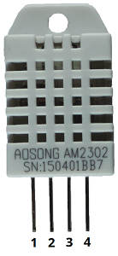
DHT11
DHT pin | Connect to
1 | 3.3V
2 | Any digital GPIO pin
3 | Do not connect
4 | GND

Slide 41
DHT11
Parameter | Value
Temperature range | 0 to 50 deg C +/- 2 deg C
Humidity range | 20 – 90 % +/- 5%
Resolution | Temperature: 1 deg C Humidity: 1%
Operating voltage | 3 – 5.5V
Sampling period | 1 second

Slide 42
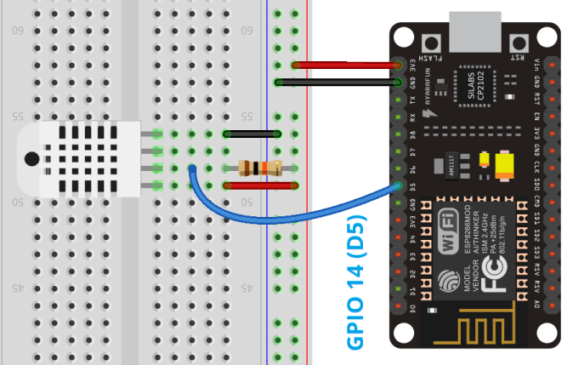
Schematic

Slide 43
Code
from machine import Pin
from time import sleep
import dht
sensor = dht.DHT11(Pin(14))
while True:
try:
sleep(1)
sensor.measure()
temp = sensor.temperature()
hum = sensor.humidity()
print('Temperature: %3.1f C' %temp)
print('Humidity: %3.1f %%' %hum)
except OSError as e:
print(‘Failed to read sensor’)
Note: try and except allows us to continue the execution of the program when an exception happens.
For example, when an error occurs, the try block code execution is stopped and transferred to the except block. In our example, the exception is especially useful to prevent the ESP8266 from crashing when we are not able to read from the sensor.

Slide 44
Network module
MicroPython’s network module is written to configure WiFi connections. The module provides two WiFi interfaces: station and access point. The access-point interface is active by default.
In the access-point interface, the ESP8266/ESP32 or any other MicroPython port acts as a WiFi access point for other devices to connect with an internet connection.
In the station interface, the ESP8266/ESP32 or any other MicroPython port connects to the router for internet access.
The network module can be imported into a MicroPython script with this statement: import network

Slide 45
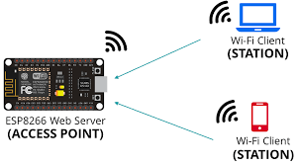
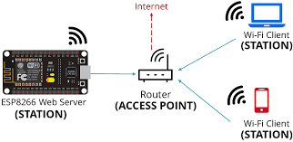
Network module

Slide 46
Network module
import network
>>>sta_if = network.WLAN(network.STA_IF)
>>>ap_if = network.WLAN(network.AP_IF)
>>>sta_if.active()
False
>>>ap_if.active()
True
>>>ap_if.ifconfig()
('192.168.4.1', '255.255.255.0', '192.168.4.1', '8.8.8.8’)
The returned values are: IP address, netmask, gateway, DNS.

Slide 47
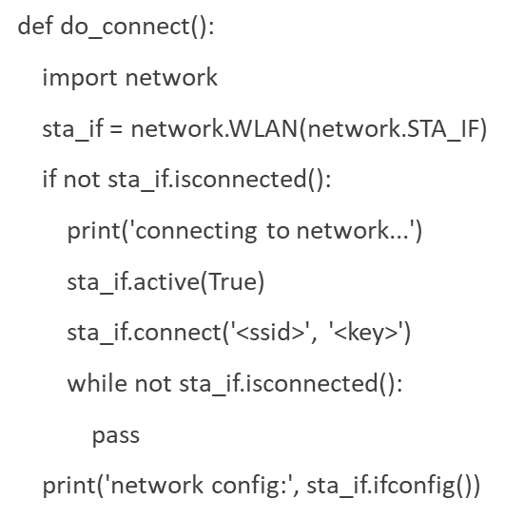
Network module
>>>sta_if.connect('<your SSID>', '<your key>’)
>>>sta_if.isconnected()
WiFi network credentials:
SSID
Password

